Slide 1
Atmospheric Mercury Modeling 101
Mark Cohen
Air Resources Laboratory
ARL 101
June 19, 2012
Notes:
People involved in ARL’s Mercury Research program include:
Winston Luke, Steve Brooks*, Paul Kelley, Jake Walker#, Xinrong Ren, Tilden Meyers, Roland Draxler, Fantine Ngan, and Richard Artz
* Oak Ridge Associated Universities, on assignment to NOAA ARL
# Grand Bay National Estuarine Research Reserve, Moss Point, MS

Slide 2

In many waterbodies – including the Great Lakes and Gulf of Mexico -- levels of mercury in some fish are too high for safe consumption by humans and wildlife

Slide 3
Mercury Concentrations in Gulf of Mexico Seafood Species
approximate concentration
in light tuna –
can have 12 oz per week

Slide 4
In many waterbodies – including the Great Lakes and Gulf of Mexico -- levels of mercury in some fish are too high for safe consumption by humans and wildlife
For many waterbodies, atmospheric deposition is the largest loading pathway for mercury
For a given waterbody, where does the mercury come from that is deposited?

Slide 5
Atmospheric mercury emitted from other regional and more distant sources
wet deposition: pollutants brought down to the earth’s surface in rain and snow
dry deposition: pollutants brought down to the earth’s surface in the absence of rain or snow
Gaseous pollutants can be absorbed by the surface
Particles with pollutants on them can “fall” to the surface

Slide 6
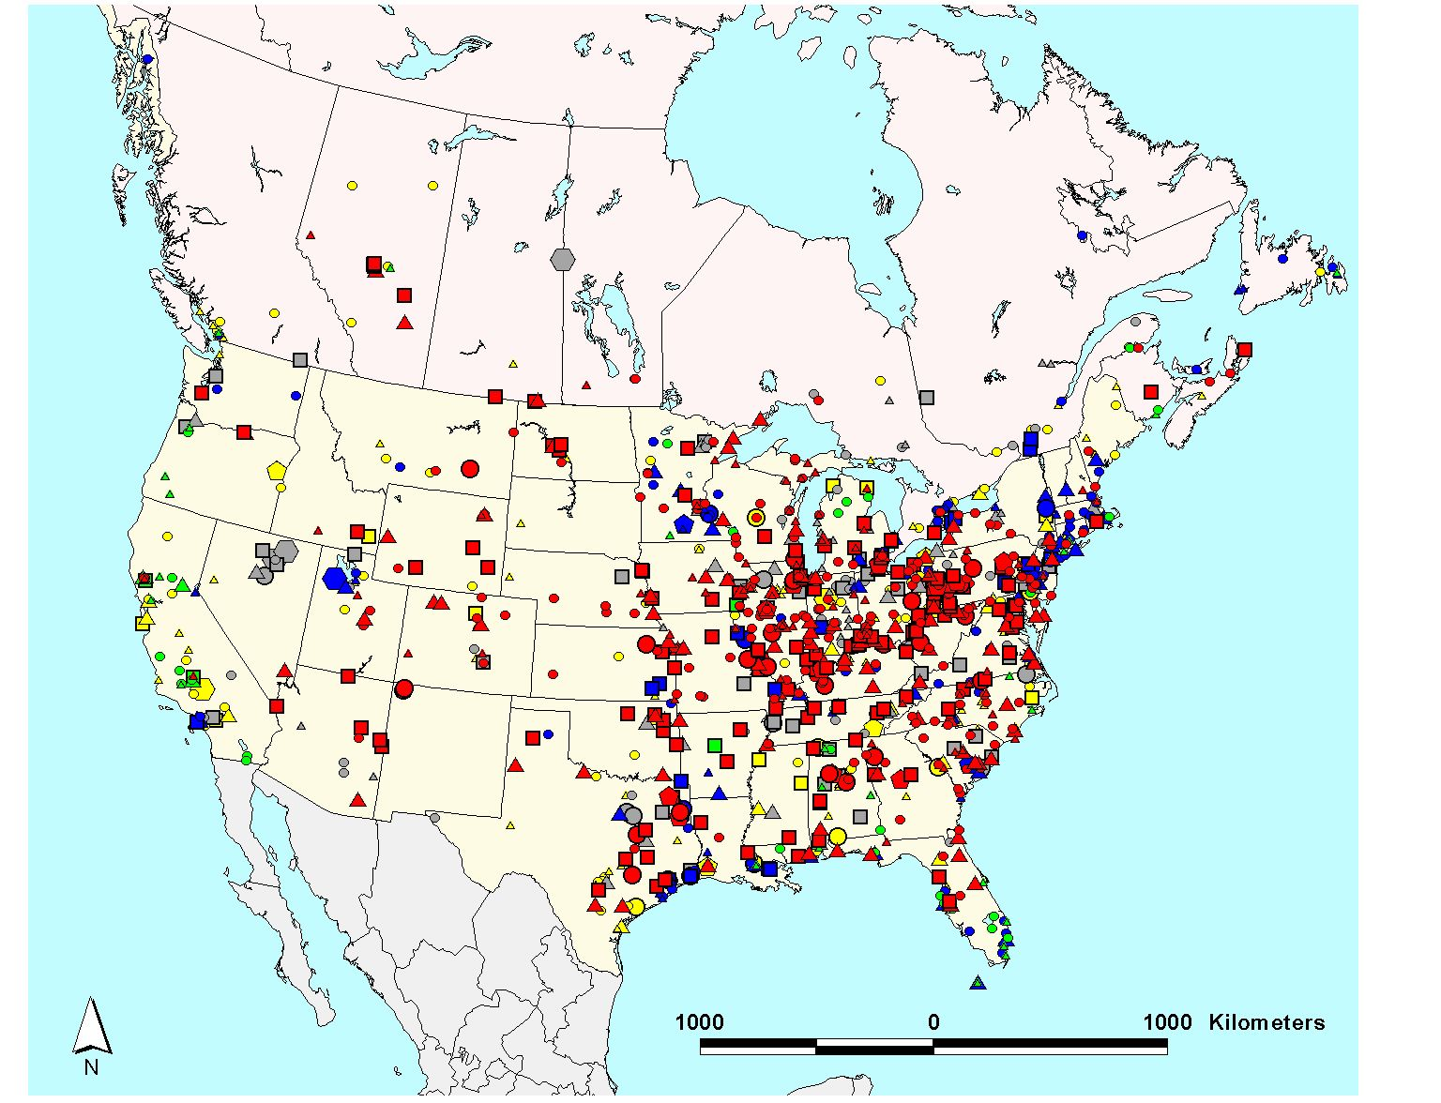
2002 U.S. and Canadian Emissions of Total Mercury [Hg(0) + Hg(p) + RGM]
There are a lot of sources!
Large Point Sources of Mercury Emissions Based on the 2002 EPA NEI and
2002 Envr Canada NPRI*
size/shape of symbol denotes amount of mercury emitted (kg/yr)
5 - 10
10 - 50
50 - 100
100 – 300
300 - 500
500 - 1000
1000 - 3000
color of symbol denotes type of mercury source
coal-fired power plants
other fuel combustion
waste incineration
metallurgical
manufacturing & other
* Note – some large Canadian point sources may not be included due to secrecy agreements between industry and the Canadian government.

Slide 7
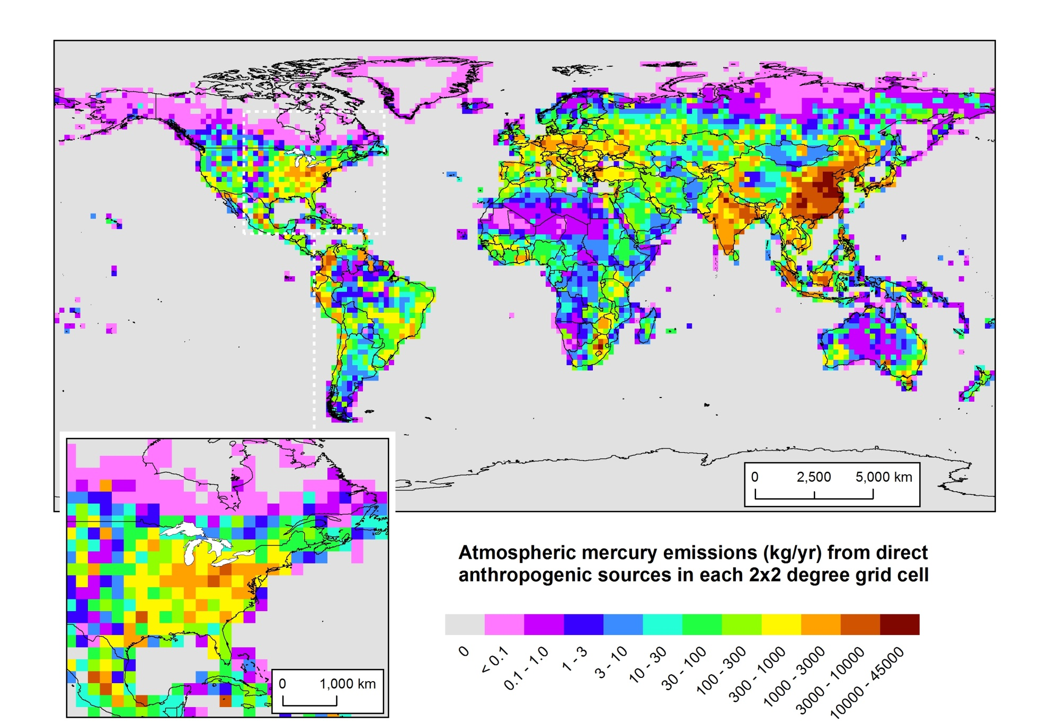
Anthropogenic Mercury Emissions (ca. 2005)

Slide 8
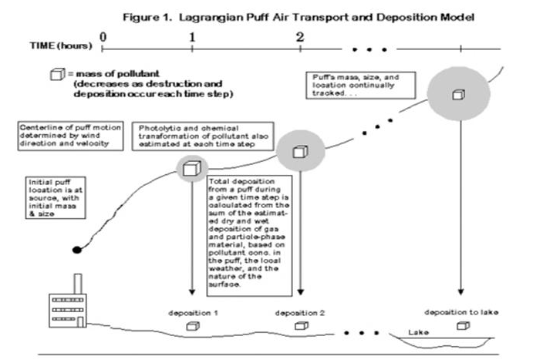
NOAA
HYSPLIT
MODEL
Lagrangian Puff Atmospheric Fate and Transport Model
0
1
2
TIME (hours)
= mass of pollutant
(changes due to chemical transformations and deposition that occur at each time step)
The puff’s mass, size, and location are continuously tracked…
Phase partitioning and chemical transformations of pollutants within the puff are estimated at each time step
Initial puff location is at source, with mass depending on emissions rate
Centerline of puff motion determined by wind direction and velocity
Dry and wet deposition of the pollutants in the puff are estimated at each time step.
deposition 1
deposition 2
deposition to receptor
lake
Notes:
8

Slide 9
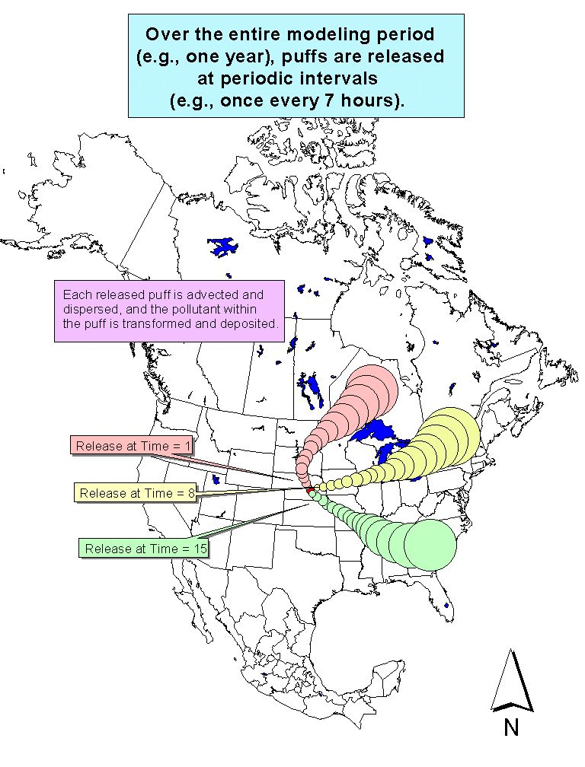
Notes:
9
This is way we typically run the HYSPLIT model. We do a run for one particular source location, and we release puffs periodically throughout the year (e.g., once every 7 hours). We follow each puff and keep track of the dispersion and the fate processes (deposition, transformation, etc.). The model uses the physical-chemical properties of the pollutant we are modeling, of course. By the end of the year, we have a good idea of the average impact that a source in this location would have on the receptors of interest (e.g., the Great Lakes).

Slide 10
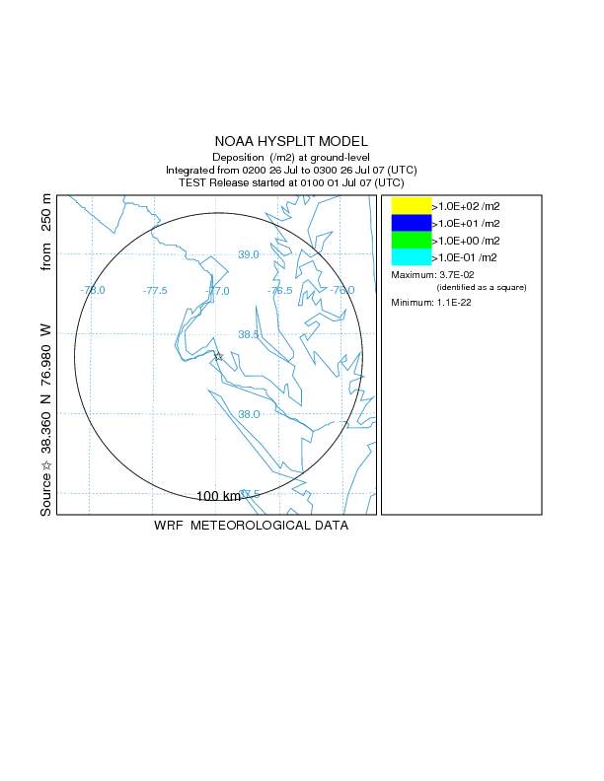
deposition
(ug/m2)*
Beltsville monitoring site
100 - 1000
10 – 100
1 - 10
0.1 – 1
Washington D.C.
NOAA Silver Spring
Model-predicted hourly mercury deposition (wet + dry) in the vicinity of one example Hg source for a 3-day period in July 2007
one Hg emissions
source
* hourly deposition converted
to annual equivalent

Slide 11
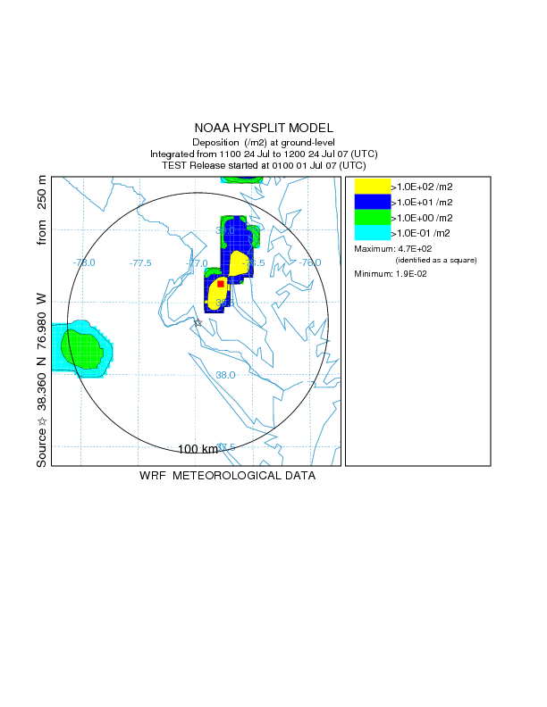
deposition
(ug/m2)*
Beltsville monitoring site
100 - 1000
10 – 100
1 - 10
0.1 – 1
Washington D.C.
NOAA Silver Spring
Model-predicted hourly mercury deposition (wet + dry) in the vicinity of one example Hg source for a 3-day period in July 2007
one Hg emissions
source
* hourly deposition converted
to annual equivalent

Slide 12
Large, time-varying spatial gradients in deposition & source-receptor relationships
deposition
(ug/m2)*
Beltsville monitoring site
100 - 1000
10 – 100
1 - 10
0.1 – 1
Washington D.C.
NOAA Silver Spring
Model-predicted hourly mercury deposition (wet + dry) in the vicinity of one example Hg source for a 3-day period in July 2007
one Hg emissions
source
* hourly deposition converted
to annual equivalent

Slide 13
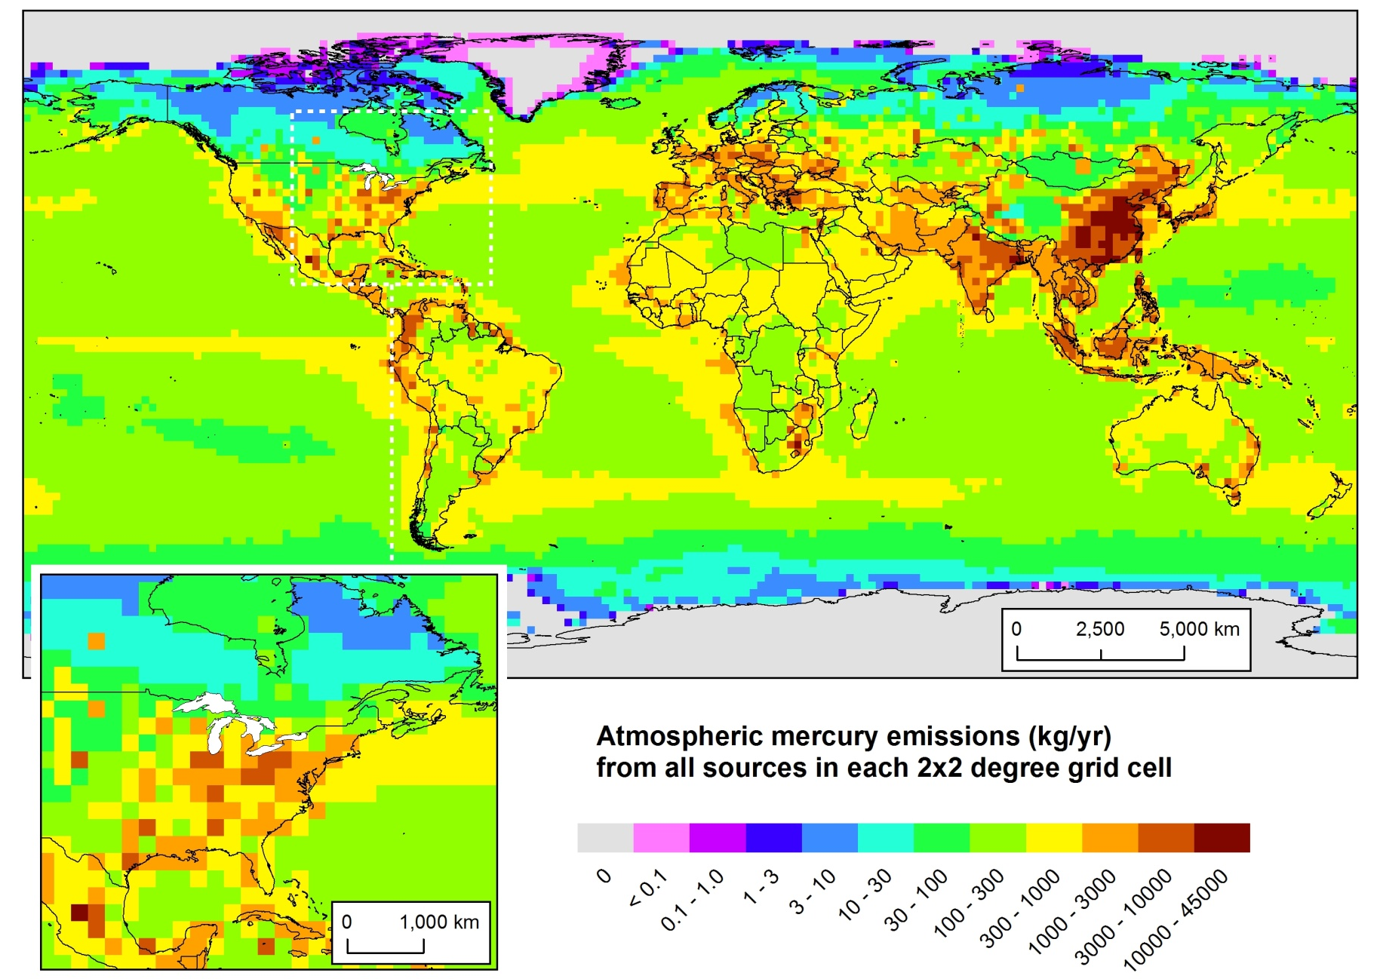
Here’s where the mercury is emitted from...
But what is the relative importance of different source regions to atmospheric deposition of mercury to the Great Lakes?
Does most of it come from China?
Policy-Relevant
Scenario Analysis
Geographical Distribution of 2005 Atmospheric Mercury Emissions
(Natural + Re-emit + Direct Anthropogenic)
NOAA Air Resources Laboratory
13
Presentation to IJC-IAQAB, Apr 25, 2012
Notes:
Data for 2005, from USEPA, Environment Canada, NILU (Norway), and others. Assembled for the GLRI FY2010 modeling project.
Looking at this emissions map, its easy to think that the dominant contributor to Great Lakes mercury might be emissions from China.

Slide 14
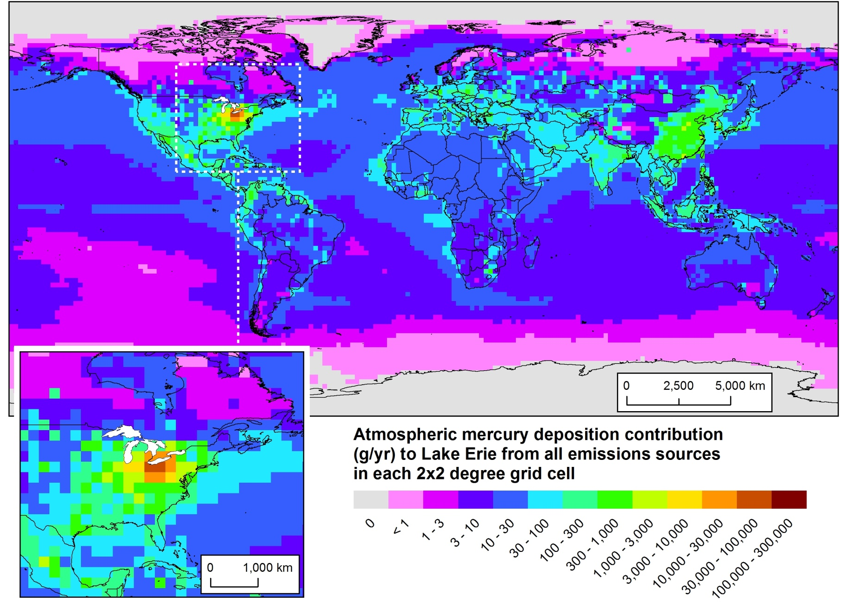
Here’s where the mercury came from that was deposited to Lake Erie (~2005)
Policy-Relevant
Scenario Analysis
Geographical Distribution of 2005 Atmospheric Mercury Deposition Contributions to Lake Erie
NOAA Air Resources Laboratory
14
Presentation to IJC-IAQAB, Apr 25, 2012

Slide 15
A tiny fraction of 2005 global mercury emissions within 500 km of Lake Erie
Modeling results show that these “regional” emissions are responsible for a large fraction of the modeled 2005 atmospheric deposition
Important policy implications!
NOAA Air Resources Laboratory
15
Presentation to IJC-IAQAB, Apr 25, 2012
Notes:
Results obtained by modeling the atmospheric fate and transport of mercury emitted to the air with the HYSPLIT-Hg model, in the FY2010 GLRI mercury-modeling project. These results are for 2005, the latest year for which mercury emissions inventory information was available, at the time the project was carried out. Atmospheric deposition of mercury to the Great Lakes is an important – and probably the largest – current loading pathway.
In the upper left graph, the total mercury emissions as a function of distance away from the center of Lake Erie are plotted. You can see that a very small fraction of the total global mercury emissions are emitted within 500 km of the Lake center, or even with 1000km of the Lake center. The bulk of the global emissions are much further away from the Lake.
In the bottom right graph, the total modeled atmospheric mercury deposition to Lake Erie arising from emissions at the same distance ranges are shown. So, this graph shows that about 200 kg were modeled to have been deposited into Lake Erie from sources within 500 km of the Lake center, about 40% of the total modeled deposition.

Slide 16
Model-estimated 2005 deposition to the Great Lakes Basin from countries with the highest modeled contribution from direct and re-emitted anthropogenic sources
NOAA Air Resources Laboratory
16
Presentation to IJC-IAQAB, Apr 25, 2012

Slide 17
To get the answers we need, we need to use both monitoring and modeling -- together
Modeling needed to help interpret and extend measurements and to estimate source-receptor relationships
Monitoring needed to ground-truth models and provide solid deposition estimates at specific locations

Slide 18
Extra Slides

Slide 19
Herring
Salmon
Halibut
Swordfish
Oysters
Tuna
(fresh or
frozen)
Shark
Tilefish
Flounder or Sole
Pollock
Shrimp
Crabs
Lobster
King Mackerel
Tuna*
Red Snapper
Clams
Catfish
Scallops
Mahi
Mahi
Grouper
Cod
Orange Roughy
* canned, light
Graph based on data presented by the American Heart Association -- http://www.americanheart.org

Slide 20
Mercury Levels in Commercial Fish and Shellfish
“error bars” show range
of mercury concentrations in data for a given species
Number of Samples
300 - 700
100 - 300
50 - 100
10 - 50
x
1 - 10
Fish concentration data from NOAA and FDA. Downloaded Sept 2008 from the EPA-FDA fish-mercury website:
http://www.cfsan.fda.gov/~frf/sea-mehg.html

Slide 21
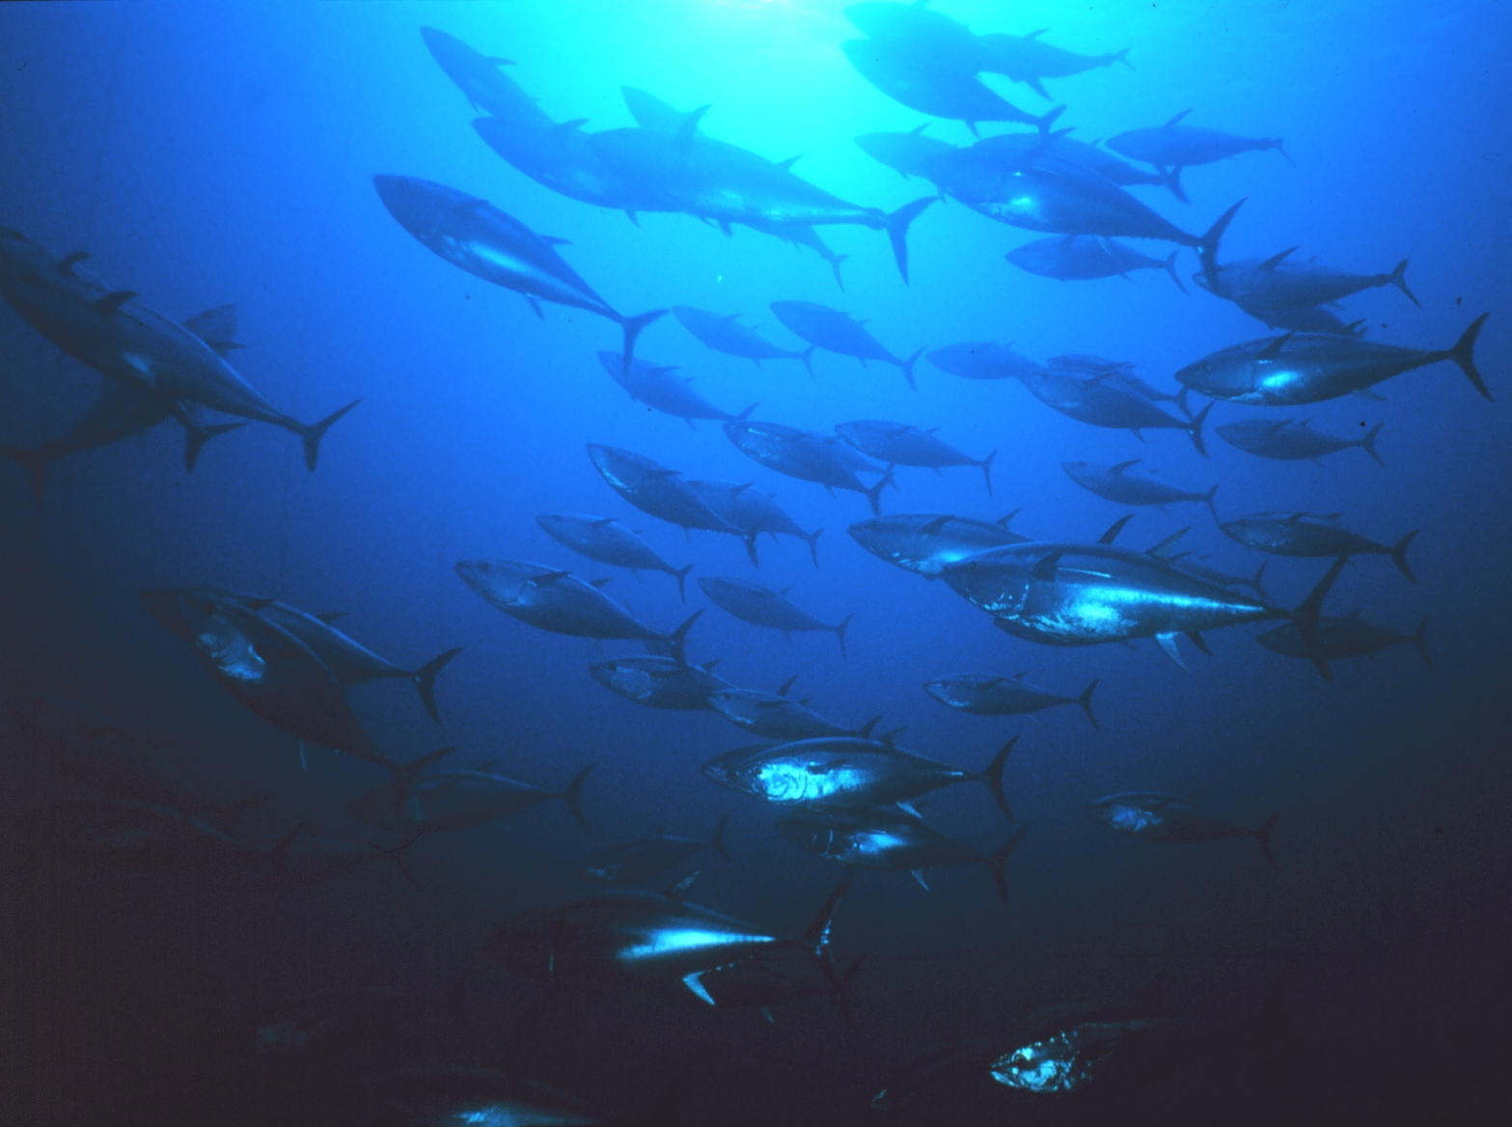
What Influences Hg Levels in Fish?
Current / past atmospheric and other Hg inputs to the fish’s ecosystem
Biogeochemical factors influencing the degree of mercury methylation in the ecosystem (sulfate, dissolved organic carbon, pH, etc)
Food web structure of the waterbody and trophic level of species
Age (size) of fish – as fish age, they accumulate more and more mercury
History of that particular fish
Note – Hg in fish muscle tissue, so can’t easily avoid it
  (PCB’s, Dioxins and other hydrophobic contaminants concentrated in fat)
Knowledge gaps for Hg levels and reasons for levels:
  freshwater (inland) fish -- LARGE
  estuarine & marine fish -- VERY LARGE

Slide 22
Mean Methylmercury Concentrations for "Top 24" Types of Fish Consumed in U.S. Commercial Seafood Market
Source of data: Carrington and Bolger, 2002
Based on slide from: Elsie Sunderland, USEPA

Slide 23
Percent Contribution to per capita Methylmercury Intake by Fish Type for "Top 24" Types of Fish in U.S. Commercial Seafood Market
Source of data: Carrington and Bolger, 2002
Based on slide from: Elsie Sunderland, USEPA

Slide 24
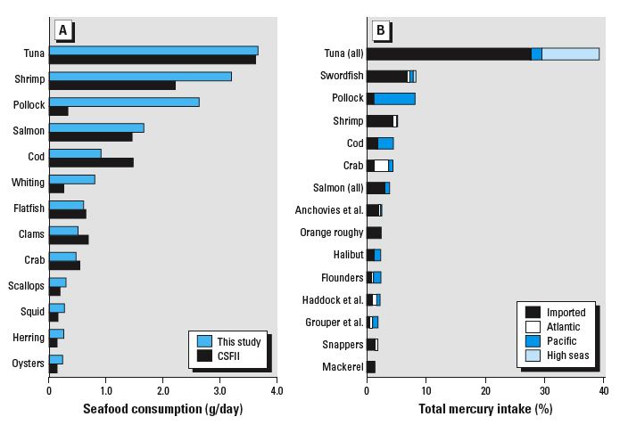
U.S. Population-Wide Consumption & Hg Exposure for Marine and Estuarine Fish
Percentage of total Hg intake (product of seafood supply and Hg concentrations) for the top 15 seafood categories; intake is allocated by the source region for each of the fisheries products [Atlantic, Pacific, imported (foreign sources), and high seas landings].
Seafood consumption estimated in this study from NMFS fisheries supply data compared with available data for marine and estuarine fish consumption from CSFII dietary survey data [uncooked weights
(U.S. EPA 2002].
Sunderland, E. (2007). Mercury exposure from domestic and imported estuarine and marine fish in the U.S. seafood market. Environ Health Perspect 115(2):235-42.
Notes:
24
Figure 1. Seafood consumption and total Hg intake from estuarine and marine fish and shellfish in the commercial market. (A) Seafood consumption estimated in this study from NMFS fisheries supply data compared with available data for marine and estuarine fish consumption from CSFII dietary survey data [uncooked weights (U.S. EPA 2002]. (B) Percentage of total Hg intake (product of seafood supply and Hg concentrations) for the top 15 seafood categories; intake is allocated by the source region for each of the fisheries products [Atlantic, Pacific, imported (foreign sources), and high seas landings]. “Salmon” includes both canned and fresh and frozen products; “Anchovies et al.” includes anchovies, herring, shad, and sardines; “Flounders” includes flounder, plaice, and sole; “Haddock et al.” includes haddock, hake, whiting, and monkfish; and “Grouper et al.” includes grouper and seabass (Table 1).
Sunderland, E. (2007). Mercury exposure from domestic and imported estuarine and marine fish in the U.S. seafood market. Environ Health Perspect 115(2):235-42.
CSFII - U.S. Department of Agriculture's Continuing Survey of Food Intake by Individuals (CSFII)

Slide 25
Source: Gary Ginsberg, Connecticut Dept of Public Health (2007).
“Risk-Benefit Synthesis for Fish Consumption Advisories,”
presented at National Forum on Fish Contaminants, Portland, ME. http://www.epa.gov/waterscience/fish/forum/2007/pdf/section2f.pdf

Slide 26
Model-estimated per capita 2005 deposition to the Great Lakes Basin from countries with the highest modeled contribution from direct & re-emitted anthropogenic sources
NOAA Air Resources Laboratory
26
Presentation to IJC-IAQAB, Apr 25, 2012

Slide 27
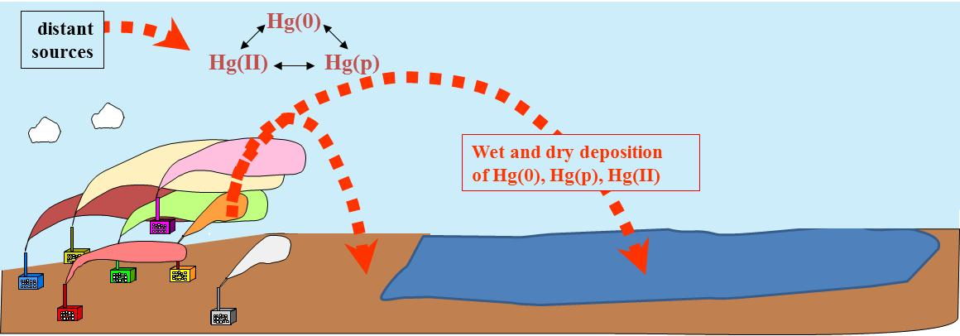
Modeling – Approaches
Back-trajectory analyses with HYSPLIT
Fate and transport modeling with HYSPLIT-Hg
…focus on source-receptor relationships
Notes:
Hg(II) is Reactive Gaseous Mercury
Hg(0) is Elemental Mercury
Hg(p) is Particulate Mercury

Slide 28
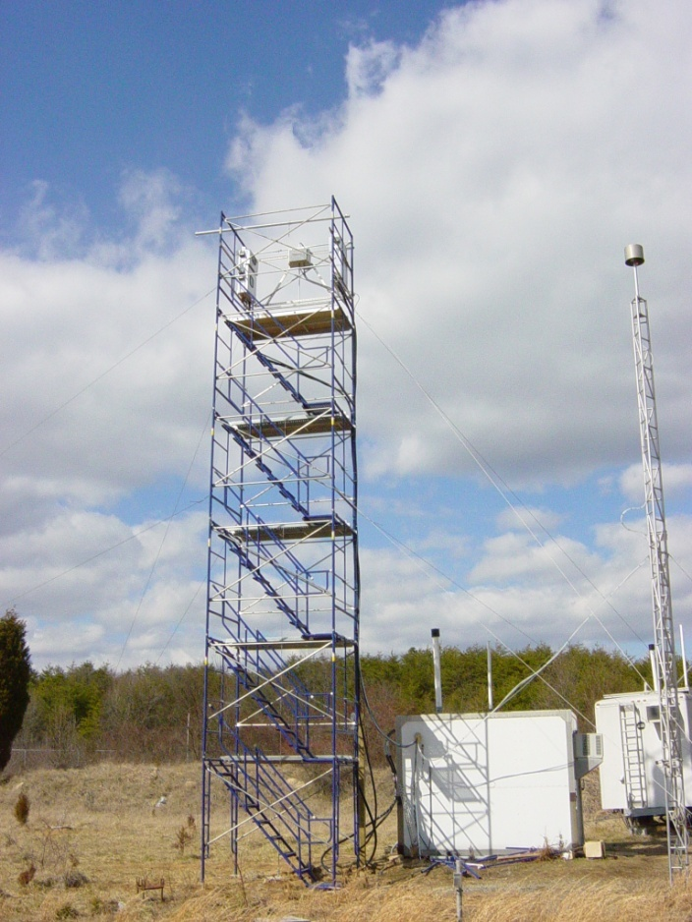
Back Trajectory Analysis – Episodes
Beltsville, Maryland
mercury site
Reactive Gaseous Mercury episode
Notes:
Sometimes we see high peaks of RGM and/or other mercury compounds.
Can we explain what is happening during these episodes? Why was the concentration so high?
Ultimately we want and need to be able to explain the continuous record of measurements at the site, but sometimes it is useful to focus on episodes.

Slide 29
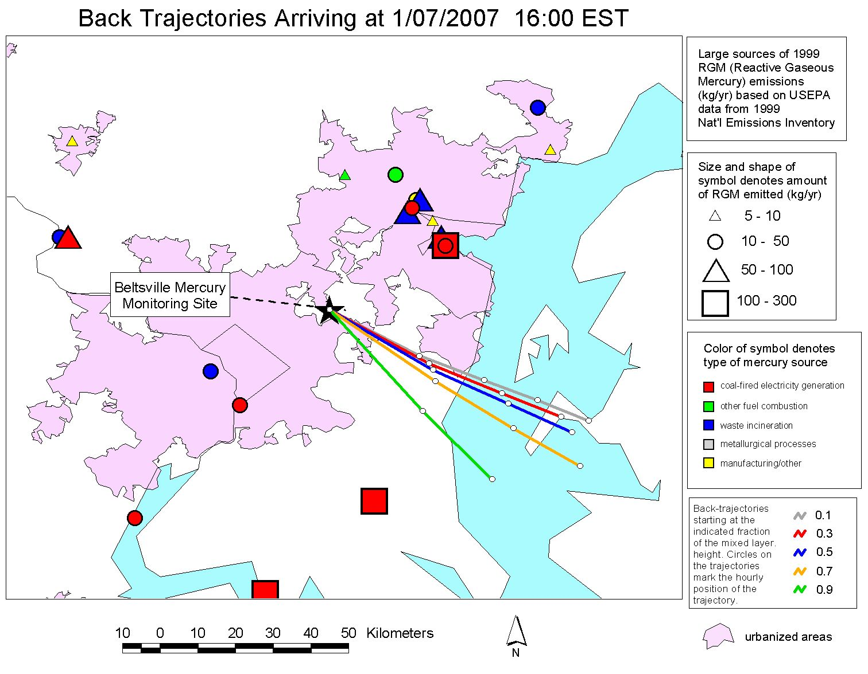
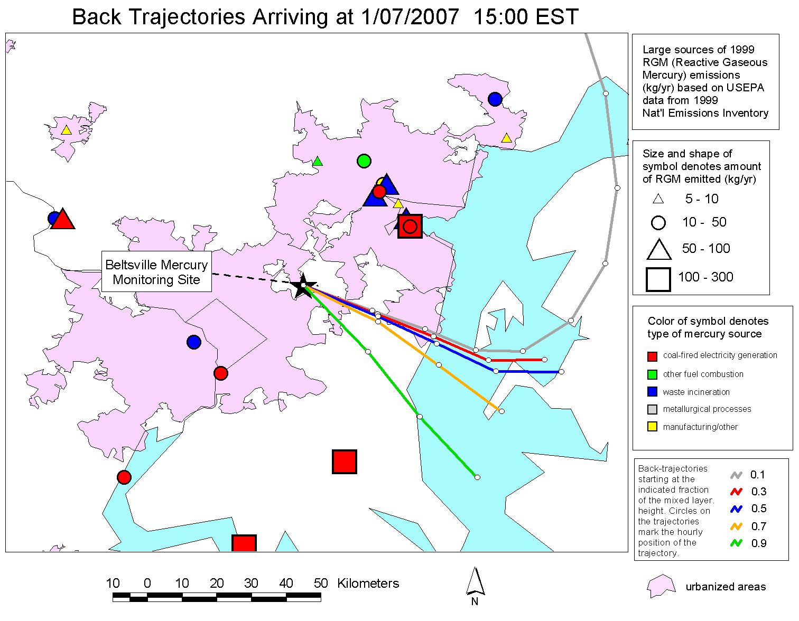
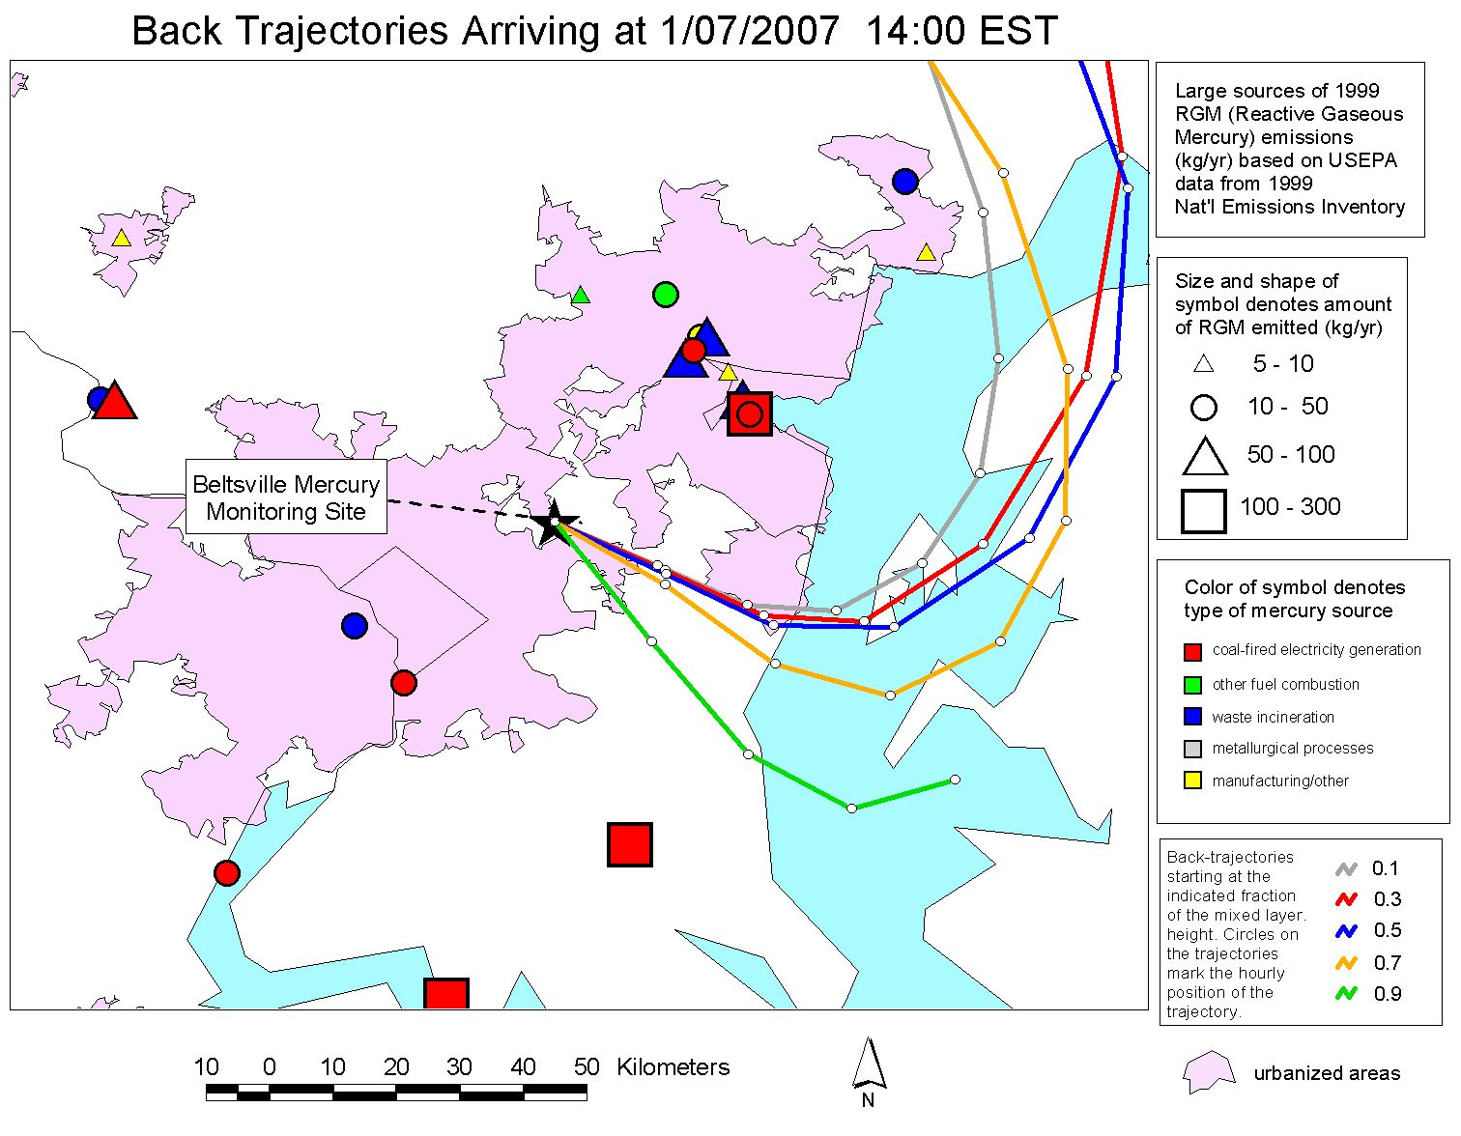
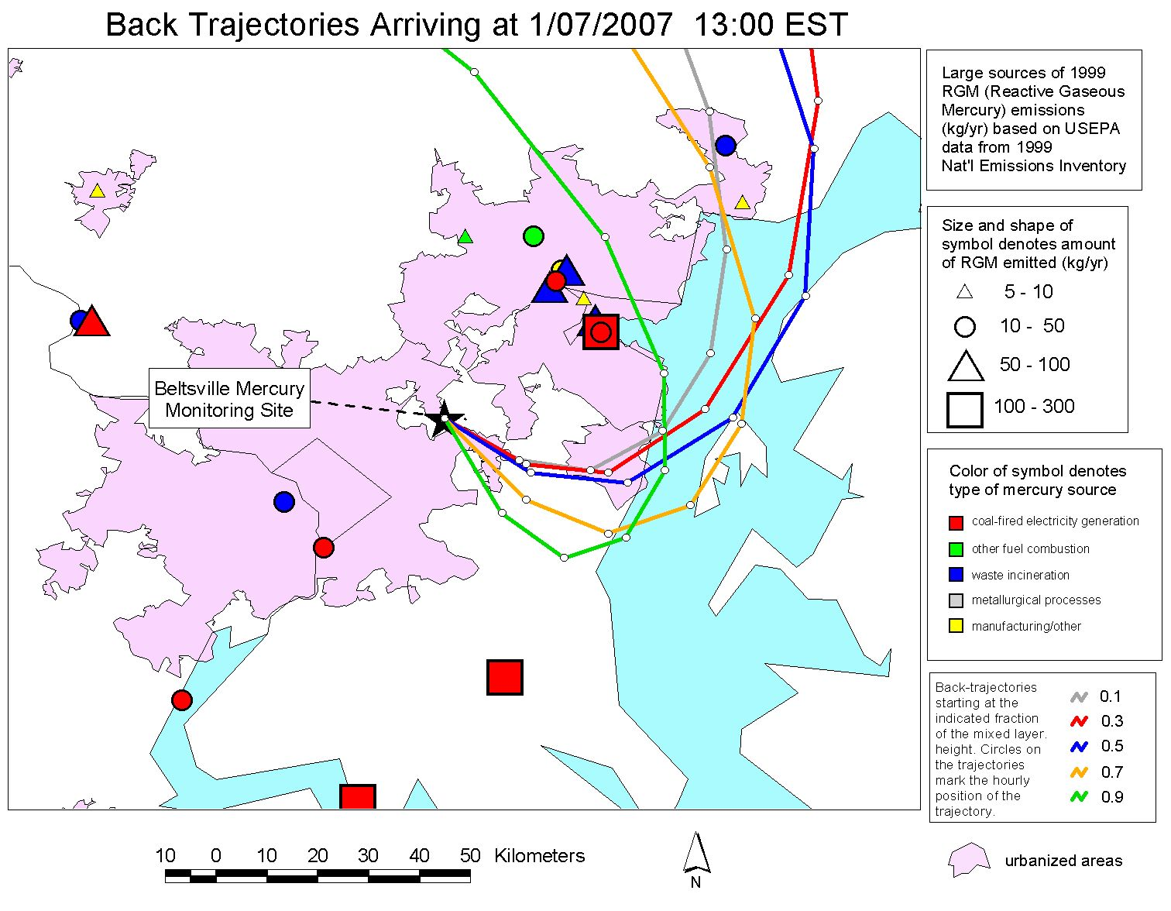
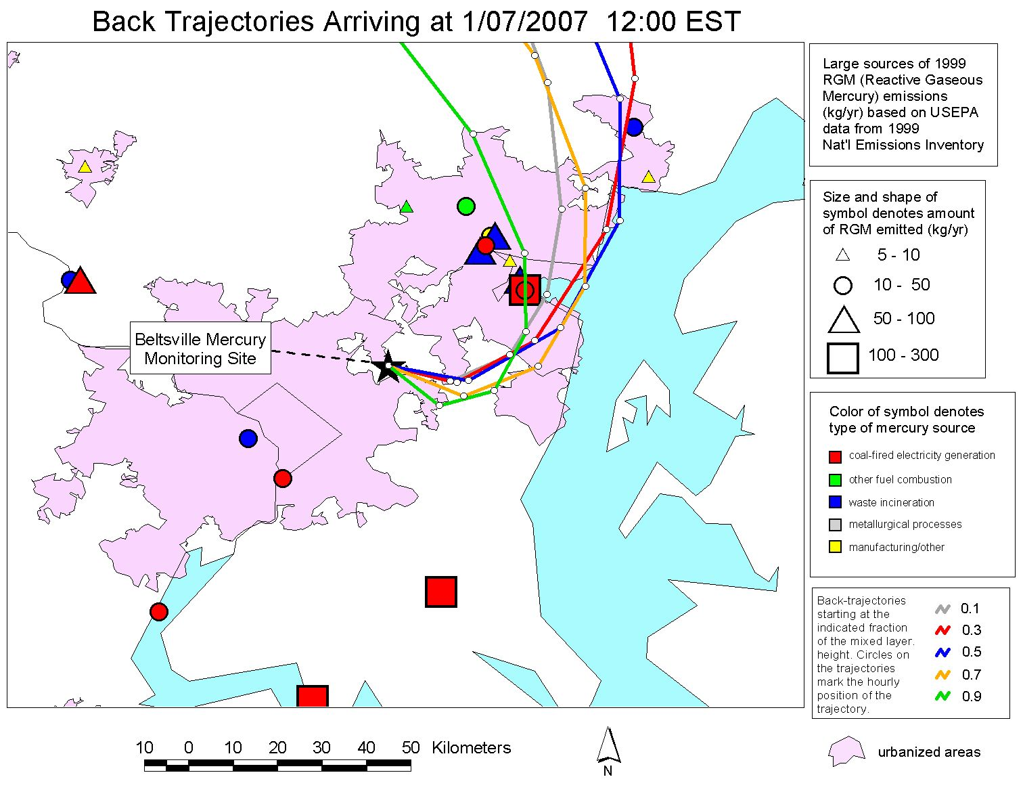
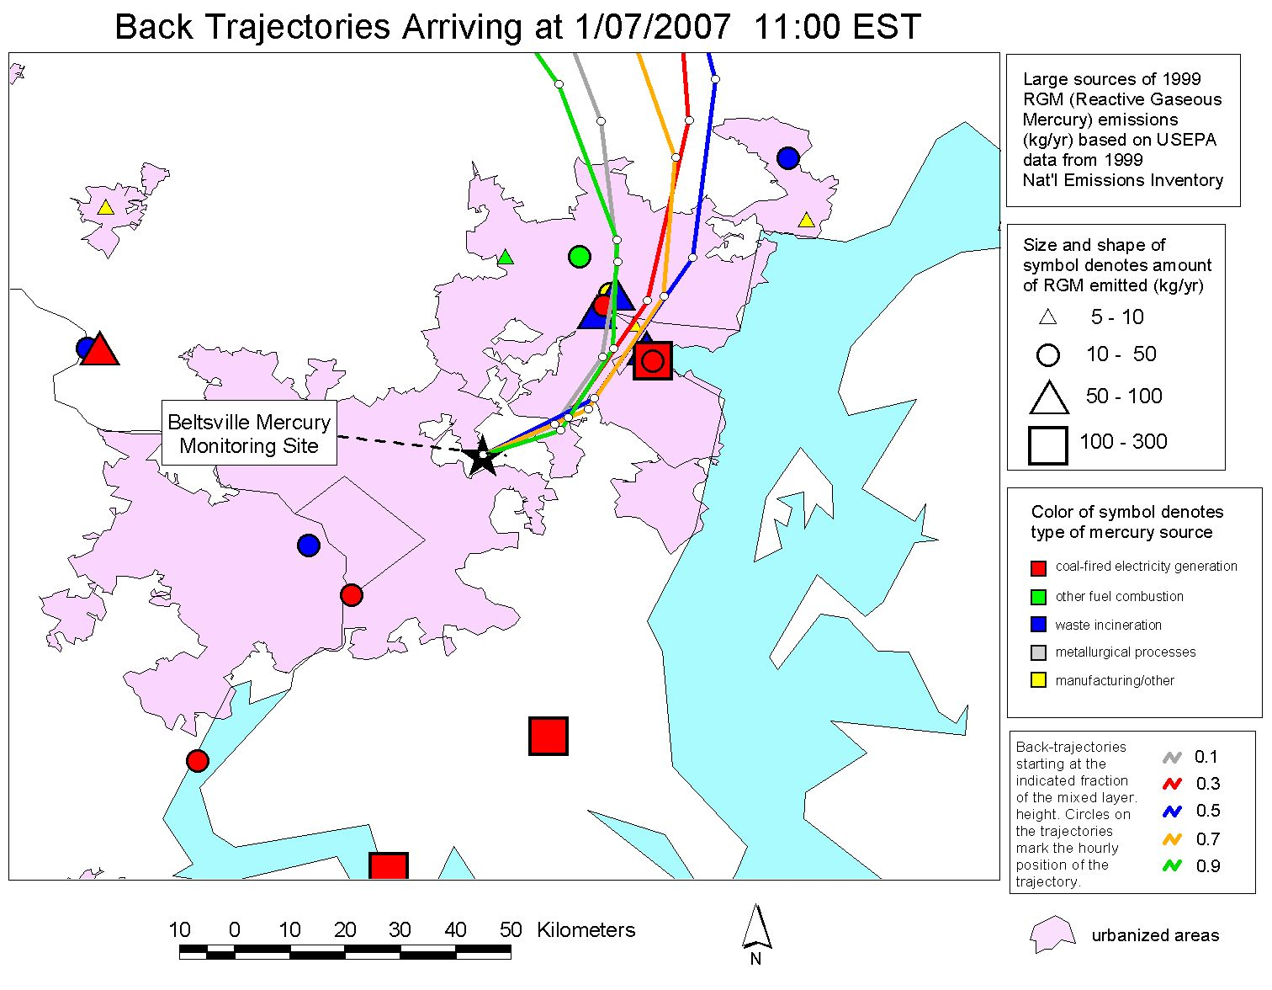

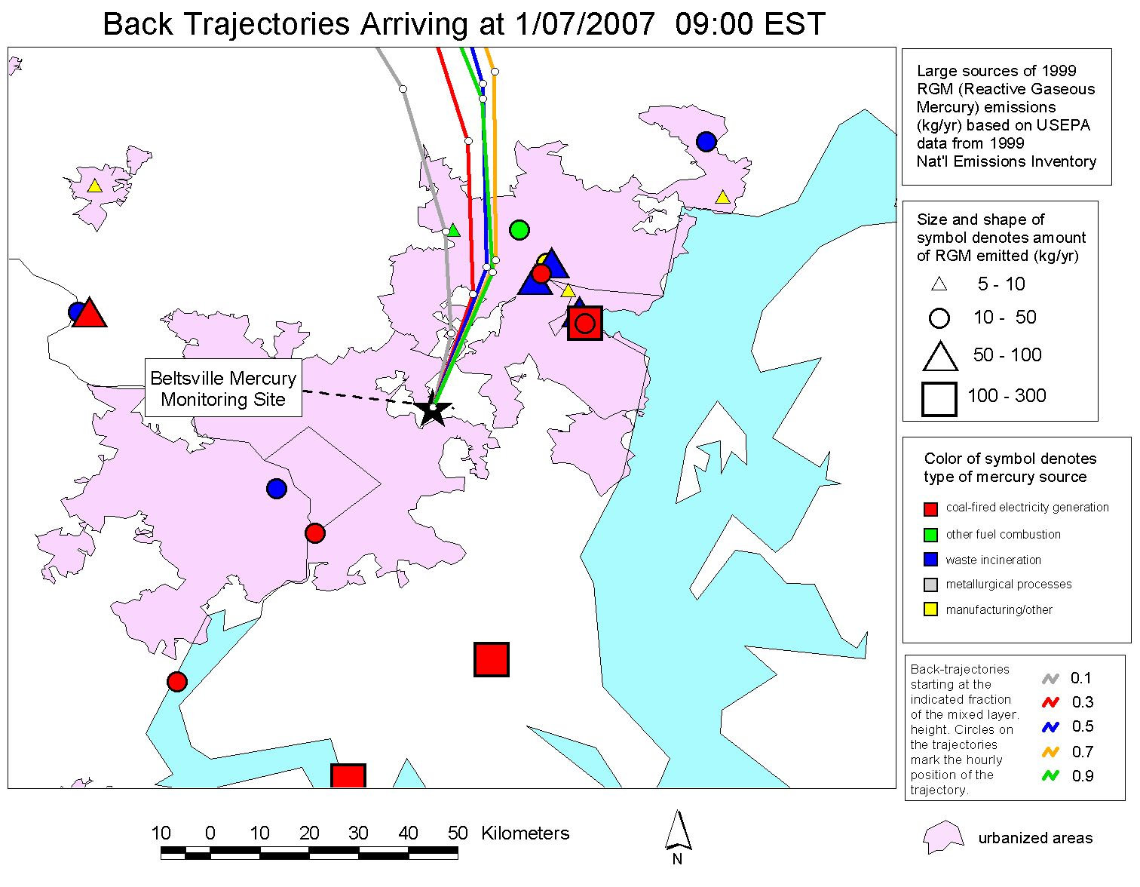
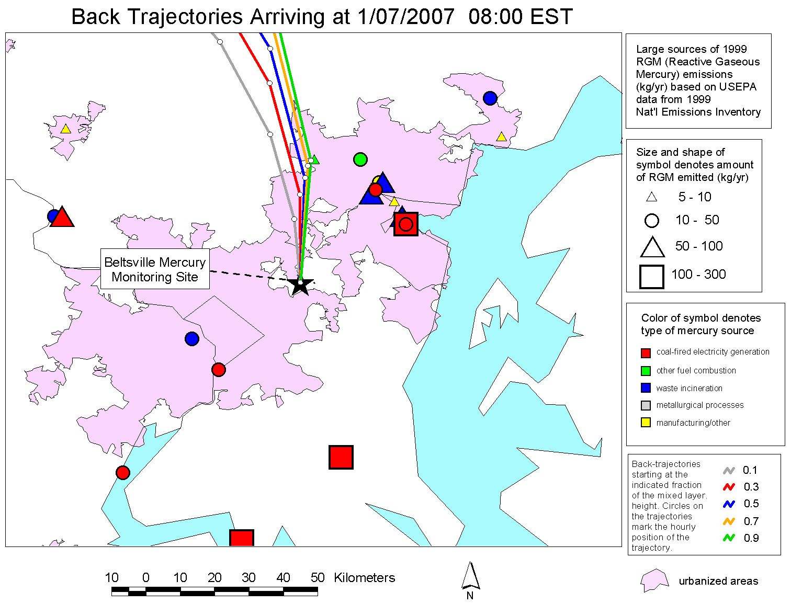
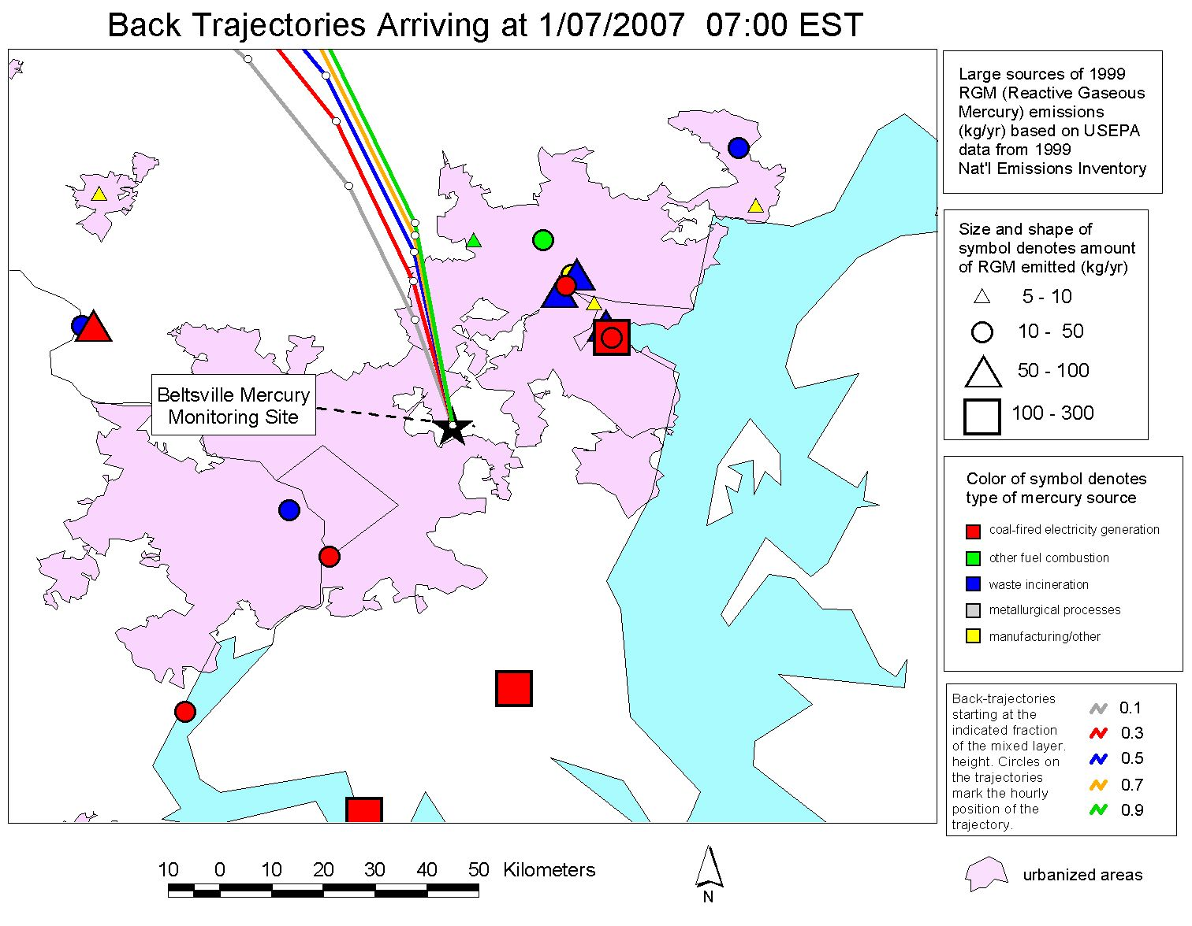
Baltimore
Chesapeake Bay
Washington D.C.
Notes:
When the concentration was high, the air masses appeared to be from a group of significant sources in the Baltimore region northeast of the site.
We have MANY examples of this kind of analysis.
This kind of analysis does not prove that the sources impacted the site and caused the episode, but it is suggestive.
Coupled with other information, this can contribute to a weight-of-evidence approach.

Slide 30
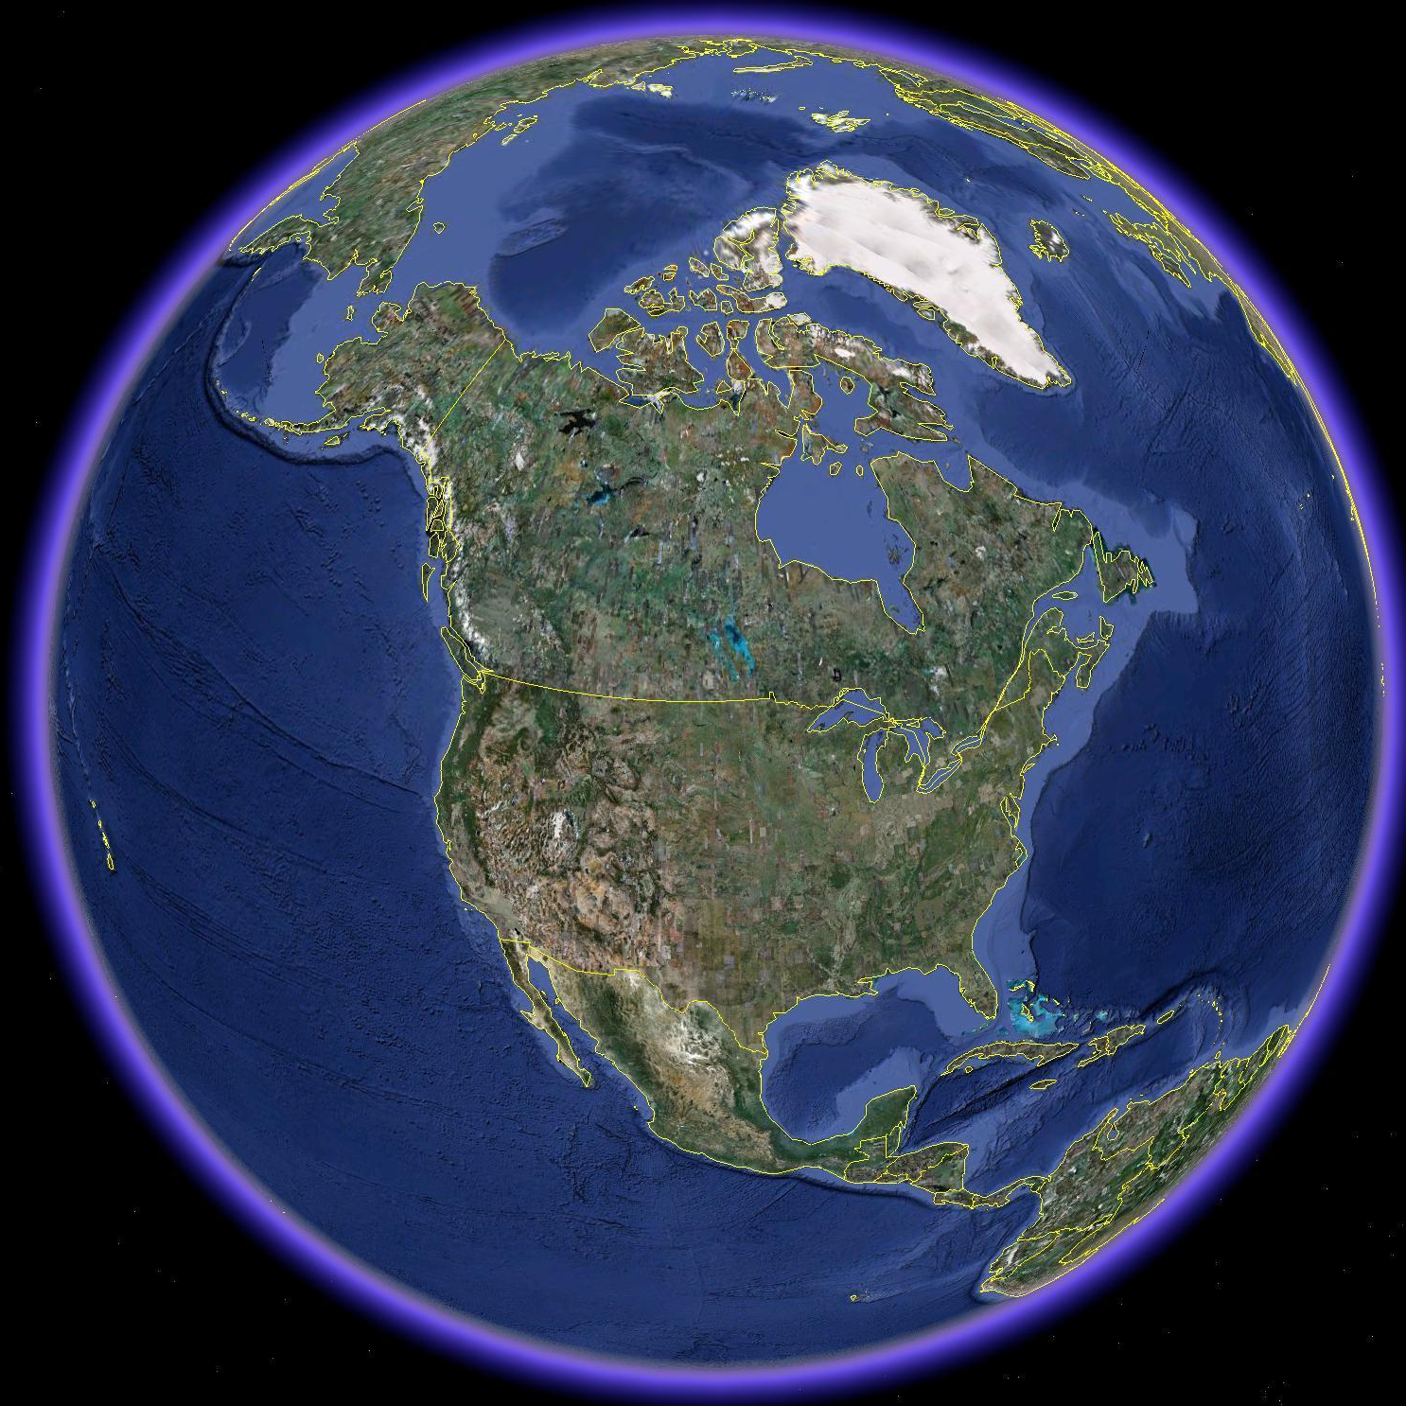


Polar-specific air-chemistry can lead to enhanced mercury deposition under some conditions
mercury
from global atmospheric pool entering
North America
mercury
that doesn’t deposit continues
its global circulation
regional and
and global sources contribute to atmospheric mercury deposition
North
American
mercury
sources
*
Atmospheric mercury deposition varies spatially and temporally, and is always a complex combination of impacts from local, regional, national, and global emissions sources.
Thousands of fish-advisories throughout North America due to mercury contamination
Notes:
Key point: atmospheric mercury impacts occur at local, regional, national, continental, and global scales…
The relative importance of the deposition contributions of local/regional sources vs. global sources to deposition is highly variable across North America and depends, e.g., on the proximity of local/regional sources

Slide 31

Different “forms” of mercury in the atmosphere
Elemental Mercury -- Hg(0)
  most of total Hg in atmosphere
  doesn’t easily dry or wet deposit
  globally distributed
Elemental Mercury -- Hg(0)
  most of total Hg in atmosphere
  doesn’t easily dry or wet deposit
  globally distributed
?
Reactive Gaseous Mercury -- RGM
  a few % of total atmos. Hg
  oxidized Hg (HgCl₂, others)
  very water soluble and “sticky”
  bioavailable
Reactive Gaseous Mercury -- RGM
  a few % of total atmos. Hg
  oxidized Hg (HgCl₂, others)
  very water soluble and “sticky”
  bioavailable
Particulate Mercury -- Hg(p)
  a few % of total atmos. Hg
  Hg in/on atmos. particles
  atmos. lifetime 1~ 2 weeks
  bioavailability?
Particulate Mercury -- Hg(p)
  a few % of total atmos. Hg
  Hg in/on atmos. particles
  atmos. lifetime 1~ 2 weeks
  bioavailability?
?
Notes:
There are three kinds of mercury in the atmosphere. They behave very differently and have different ecological and public health impacts. The forms can inter-covert… Measuring and modeling each of these forms is challenging, but is critical to understand the atmospheric behavior and impacts of mercury. There are many uncertainties in the scientific knowledge regarding atmospheric mercury, e.g., what is RGM? Have we identified all of the significant chemical reactions? Are the currently used reaction rates accurate? The importance of atmospheric methly-mercury as well as its fate and transport is uncertain.
Elemental Mercury -- Hg(0)
most of total Hg in atmosphere
not very water soluble
doesn’t easily dry or wet deposit
upward evasion vs. deposition
atmos. lifetime approx ~ 0.5-1 yr
globally distributed
Reactive Gaseous Mercury -- RGM
a few percent of total atmos Hg
oxidized Hg (HgCl2, others)
operationally defined
very water soluble and “sticky”
atmos. lifetime <= 1 week
local and regional effects
bioavailable
Particulate Mercury -- Hg(p)
a few percent of total atmos Hg
not pure particles of mercury
Hg compounds in/on atmos particles
species largely unknown (HgO?)
atmos. lifetime approx 1~ 2 weeks
local and regional effects
bioavailability?

Slide 32

Modeling – Comprehensive Fate and Transport Simulations
Start with an emissions inventory
Use gridded meteorological data
Simulate the dispersion, chemical transformation, and wet and dry deposition of mercury emitted to the air
Source-attribution information needed at the end, so optimize modeling system and approach to allow source-receptor information to be captured
HYSPLIT-Hg developed over the last ~10 years with specialized algorithms for simulation of atmospheric mercury
Notes:
We use emissions inventories from the U.S. EPA, Environment Canada, the Commission for Environmental Cooperation, the Mexican government, the United Nations Environmental Program (UNEP), and many other sources. We also do “spot checks” on inventory records that seem suspect, by attempting to verify the location and emissions information listed in the inventory by independent means.
HYSPLIT is run using gridded meteorological data, from the output of meteorological models. The primary source of gridded met data for ARL is NOAA NCEP. The data is converted to HYSPLIT format and archived at ARL for modeling use. In some cases, we generate our “own” meteorological modeling output, for special cases, with higher resolution than would otherwise be available. We also use data from other sources (e.g., ECMWF, NCAR…).

Slide 33

Context
Mercury exposure via fish consumption is an important public health concern
NOAA has a primary stewardship responsibility for the nation’s fisheries
Atmospheric emissions and subsequent deposition is a significant pathway through which mercury contamination enters sensitive aquatic ecosystems
Goals
Provide sound scientific information on the emission, dispersion, transformation, and air-surface exchange of atmospheric mercury compounds
Measure and understand spatial and temporal trends in air concentrations and air-surface exchange
Provide robust source-attribution information for atmospheric mercury deposition to sensitive ecosystems, to inform policies to reduce loadings
Notes:
For approximately the last 10 years, ARL has had an active research program involving mercury.
Context:
Mercury exposure via fish consumption is an important public health concern.
NOAA has a primary stewardship responsibility for the nation’s fisheries
Atmospheric emissions and subsequent deposition is a significant pathway through which mercury contamination enters sensitive aquatic ecosystems
Goals:
Provide sound scientific information on the emission, dispersion, transformation, and air-surface exchange of atmospheric mercury compounds
Measure and understand spatial and temporal trends in air concentrations and air-surface exchange
(b) Provide robust and policy-relevant source-attribution information for atmospheric mercury deposition to sensitive ecosystems

Slide 34
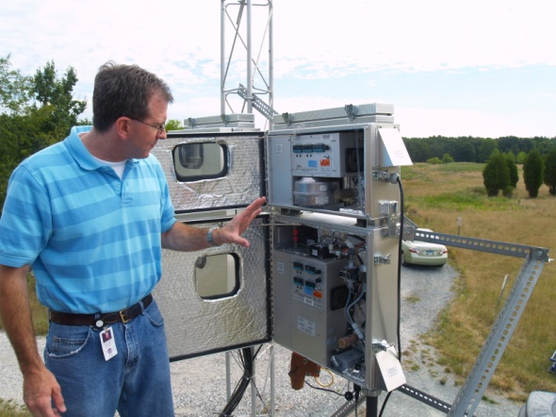

Mercury: Measurements and Modeling
MEASUREMENTS
speciated atmospheric mercury
Modeling used to aid in data interpretation and measurement planning
other air pollutants, e.g., SO₂, O₃, CO
wet deposition
air-surface exchange
MODELING
back trajectories
Measurements used for model evaluation and improvement
comprehensive fate and transport
source-attribution for deposition
Notes:
We have two basic approaches in our mercury research program at ARL – measurements and modeling. They are independent and also integrated. One key objective is to produce policy-relevant results, and to work towards reducing the uncertainties in these results. Another key objective is determining and understanding spatial and temporal trends.
The picture shows Winston Luke and the Tekran speciated mercury samplers (reactive gaseous mercury and fine particulate mercury) and the tower at Beltsville, MD, a comprehensive monitoring site representing a long-term collaboration between EPA and NOAA
One example of how the measurements are being used to aid in modeling is an ongoing model evaluation program in which the HYSPLIT-Hg model is being run for specific episodes at our Grand Bay and Beltsville sites, and the model predictions are being compared against the measurements. High resolution met data (e.g., 4 km) is being generated at ARL to support and enhance this analysis.
One example of how the modeling helps the measurements is the forecasting work done to aid in scientific mission planning. This is illustrated by the daily HYSPLIT-Hg model forecasts of anthropogenic mercury plumes to inform daily decisions about flight planning in the Grand Bay Mercury Intensive (1st phase was carried out summer 2010 and 2nd phase is going on right now (April 15-May 15).

Slide 35
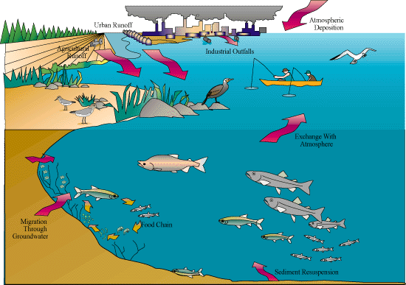
atmospheric deposition to the watershed
atmospheric deposition
to the water surface
Humans and wildlife affected primarily by
eating fish
containing mercury
Best documented impacts are on the developing fetus: impaired motor and cognitive skills
Mercury transformed by bacteria into methylmercury in sediments, soils & water, then bioaccumulates in fish
adapted from slides prepared by USEPA and NOAA

Slide 36
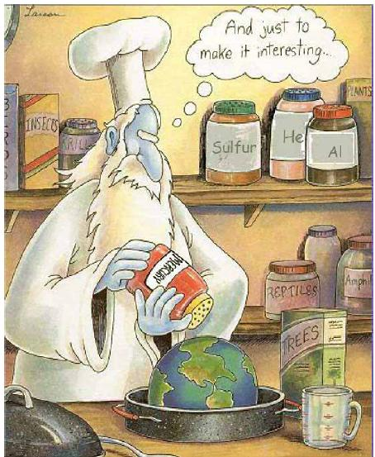
Environmental Mercury Cycling -- Natural vs. Anthropogenic
Mercury (Hg) is an element... there is the same amount of mercury on Earth today as there always has been
“natural” Hg cycle:
  transported throughout the environment
  chemical transformations interconvert different mercury species
This has always been going on, ... always has been Hg in fish

Slide 37
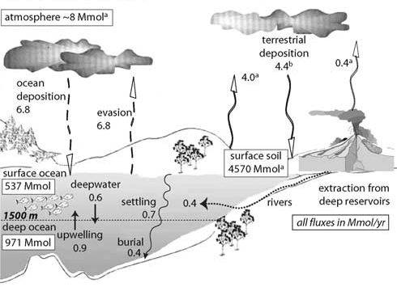
Pre-Industrial Global Mercury Cycling
Sunderland and Mason (2007). Global Biogeochemical Cycles 21, 4022
Notes:
Elsie M. Sunderland and Robert P. Mason (2007). Human impacts on open ocean mercury concentrations. GLOBAL BIOGEOCHEMICAL CYCLES, VOL. 21, GB4022.
Note – Mark Cohen removed “foot notes” from the figure to aid in presentation clarity
Figure 4. Global budgets for current and preindustrial mercury cycling in oceans. For the present-day ocean, 90% confidence intervals are shown in brackets. Note that for the present-day budget, river fluxes shown refer to the amounts of mercury deposited in each region (estuaries, shelf, open ocean), not the total flux (sum >14 Mmol). (a) From Mason and Sheu [2002]. (b) Calculated by assuming preindustrial atmosphere is at steady state. (c) Estimated from sediment core data showing contemporary atmospheric deposition to terrestrial systems is approximately 3 times greater than preindustrial deposition [Fitzgerald et al., 1998]. (d) Lower end of range is year 2000 global anthropogenic emissions from Pacyna et al. [2006]. Upper limit of anthropogenic emissions were used in GEOS-Chem simulations and include additional sources described by Selin et al. [2007b]. (e) Estimate derived by Selin et al. [2007b].

Slide 38
GLOBAL MERCURY CYCLING
(note -10⁶ moles ~ 200 metric tons)
natural extraction from deep reservoirs, e.g., volcanoes
natural
evasion
from
ocean
natural
evasion from
land
10⁶
moles
per
year
pre-industrial: total mercury in atmosphere ~ 8.0 x 10⁶ moles
natural dep to land
natural
dep to ocean
Based on data presented in Sunderland and Mason (2007) Global Biogeochemical Cycles 21: GB4022
Notes:
million moles is about 200 metric tons...
large uncertainties in most of these numbers
D:\_mark\talks_and_meetings\2008\09_SRC_Mayorga\global_mass_balance.123

Slide 39
Environmental Mercury Cycling -- Natural vs. Anthropogenic
Mercury (Hg) is an element... there is the same amount of mercury on Earth today as there always has been
“natural” Hg cycle – Hg is transported throughout the environment, and chemical transformations interconvert different mercury species
This has always been going on, and there has always been Hg in fish
But, we make some Hg unexpectedly “bioavailable”
Most anthropogenic Hg is “released” as atmospheric emissions:
  Hg in coal is released to the air when coal is burned
  Hg in other fuels is released to the air when they are processed and burned
  Hg in ores is released to the air during metallurgical processes
  Hg in products is released to the air when burned or landfilled after being discarded (e.g., batteries, switches)
Average, current atmospheric Hg deposition is ~3x pre-industrial levels
Evidence suggests that newly deposited Hg is more bioavailable

Slide 40
GLOBAL MERCURY CYCLING
(note -10⁶ moles ~ 200 metric tons)
natural extraction from deep reservoirs, e.g., volcanoes
natural
evasion
from
ocean
natural
evasion from
land
10⁶
moles
per
year
pre-industrial: total mercury in atmosphere ~ 8.0 x 10⁶ moles
natural dep to land
natural
dep to ocean
Based on data presented in Sunderland and Mason (2007) Global Biogeochemical Cycles 21: GB4022
anthrop
direct
emit
anthrop
re-emit
from
land
anthrop
re-emit
from
ocean
10⁶
moles
per
year
contemporary: total mercury in atmosphere ~ 28.0 x 10⁶ moles
anthrop
dep to land
anthrop
dep to ocean
Notes:
million moles is about 200 metric tons...
large uncertainties in most of these numbers
D:\_mark\talks_and_meetings\2008\09_SRC_Mayorga\global_mass_balance.123

Slide 41
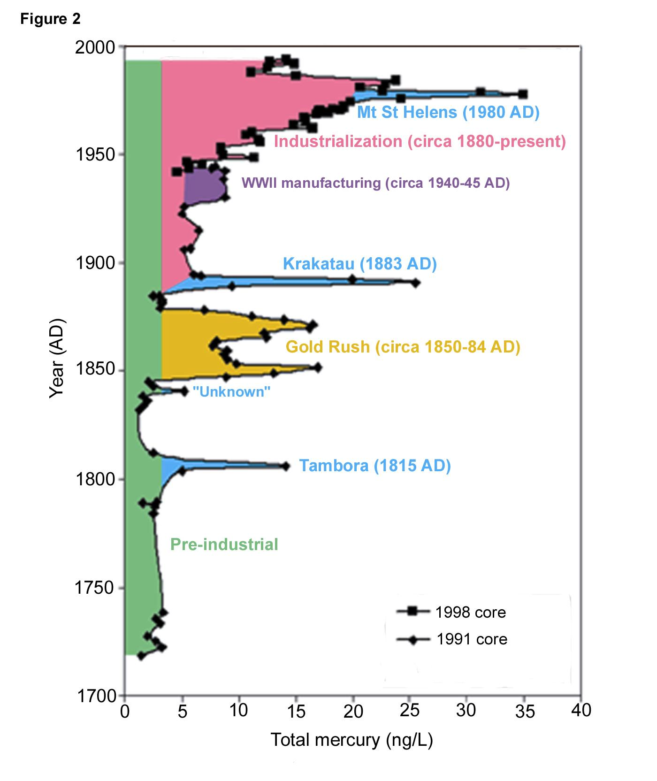
Natural vs.
anthropogenic
mercury?
Studies show that anthropogenic activities have
typically increased bioavailable Hg concentrations in ecosystems by a
factor of 2 – 10
Freemont Glacier, Wyoming
source: USGS, Shuster et al., 2002

Slide 42

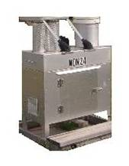
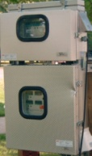
Hg from
other sources: local, regional & more distant
Measurement of wet deposition
Measurement of ambient air concentrations

