Slide 1
Modeling the Atmospheric Transport and Deposition of Mercury to the Great Lakes
Dr. Mark Cohen, Roland Draxler, Richard Artz
NOAA Air Resources Laboratory (ARL)
College Park, MD, USA
International Conference on Mercury as a Global Pollutant
July 28 – Aug 2, 2013, Edinburgh, Scotland

Slide 2
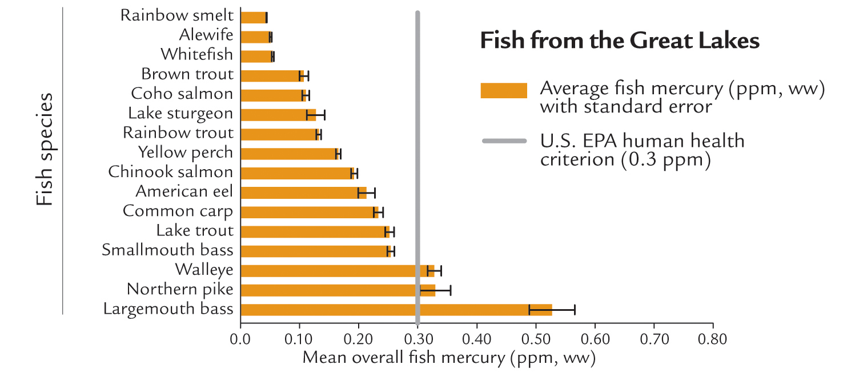
0.05 ppm level recommended by the Great Lakes Fish Advisory Workgroup (2007)
Mercury in Great Lakes Fish
Evers, D.C., et al. (2011). Great Lakes Mercury Connections: The Extent and Effects of Mercury Pollution in the Great Lakes Region. Biodiversity Research Institute. Gorham, Maine. Report BRI 2011-18. 44 pages.
Notes:
Biodiversity Research Institute (2011): http://www.briloon.org/uploads/hgconnections/glmc/GLMC_FinalReport.pdf
The Great Lakes Fish Advisory Workgroup currently recommends a methylmercury reference dose of 0.05 parts per million, six times lower than the 2001 level.
Great Lakes Fish Advisory Workgroup. 2007. A protocol for mercurybased fish consumption advice: an addendum to the 1993 protocol
for a uniform Great Lakes sport fish consumption advisory. Wisconsin Department of Health Services, Madison, WI, 30 pp.
Available at http://www.dhs.wisconsin.gov/eh/fish/FishFS/2007Hg_Add_Final_05_07.pdf.

Slide 3
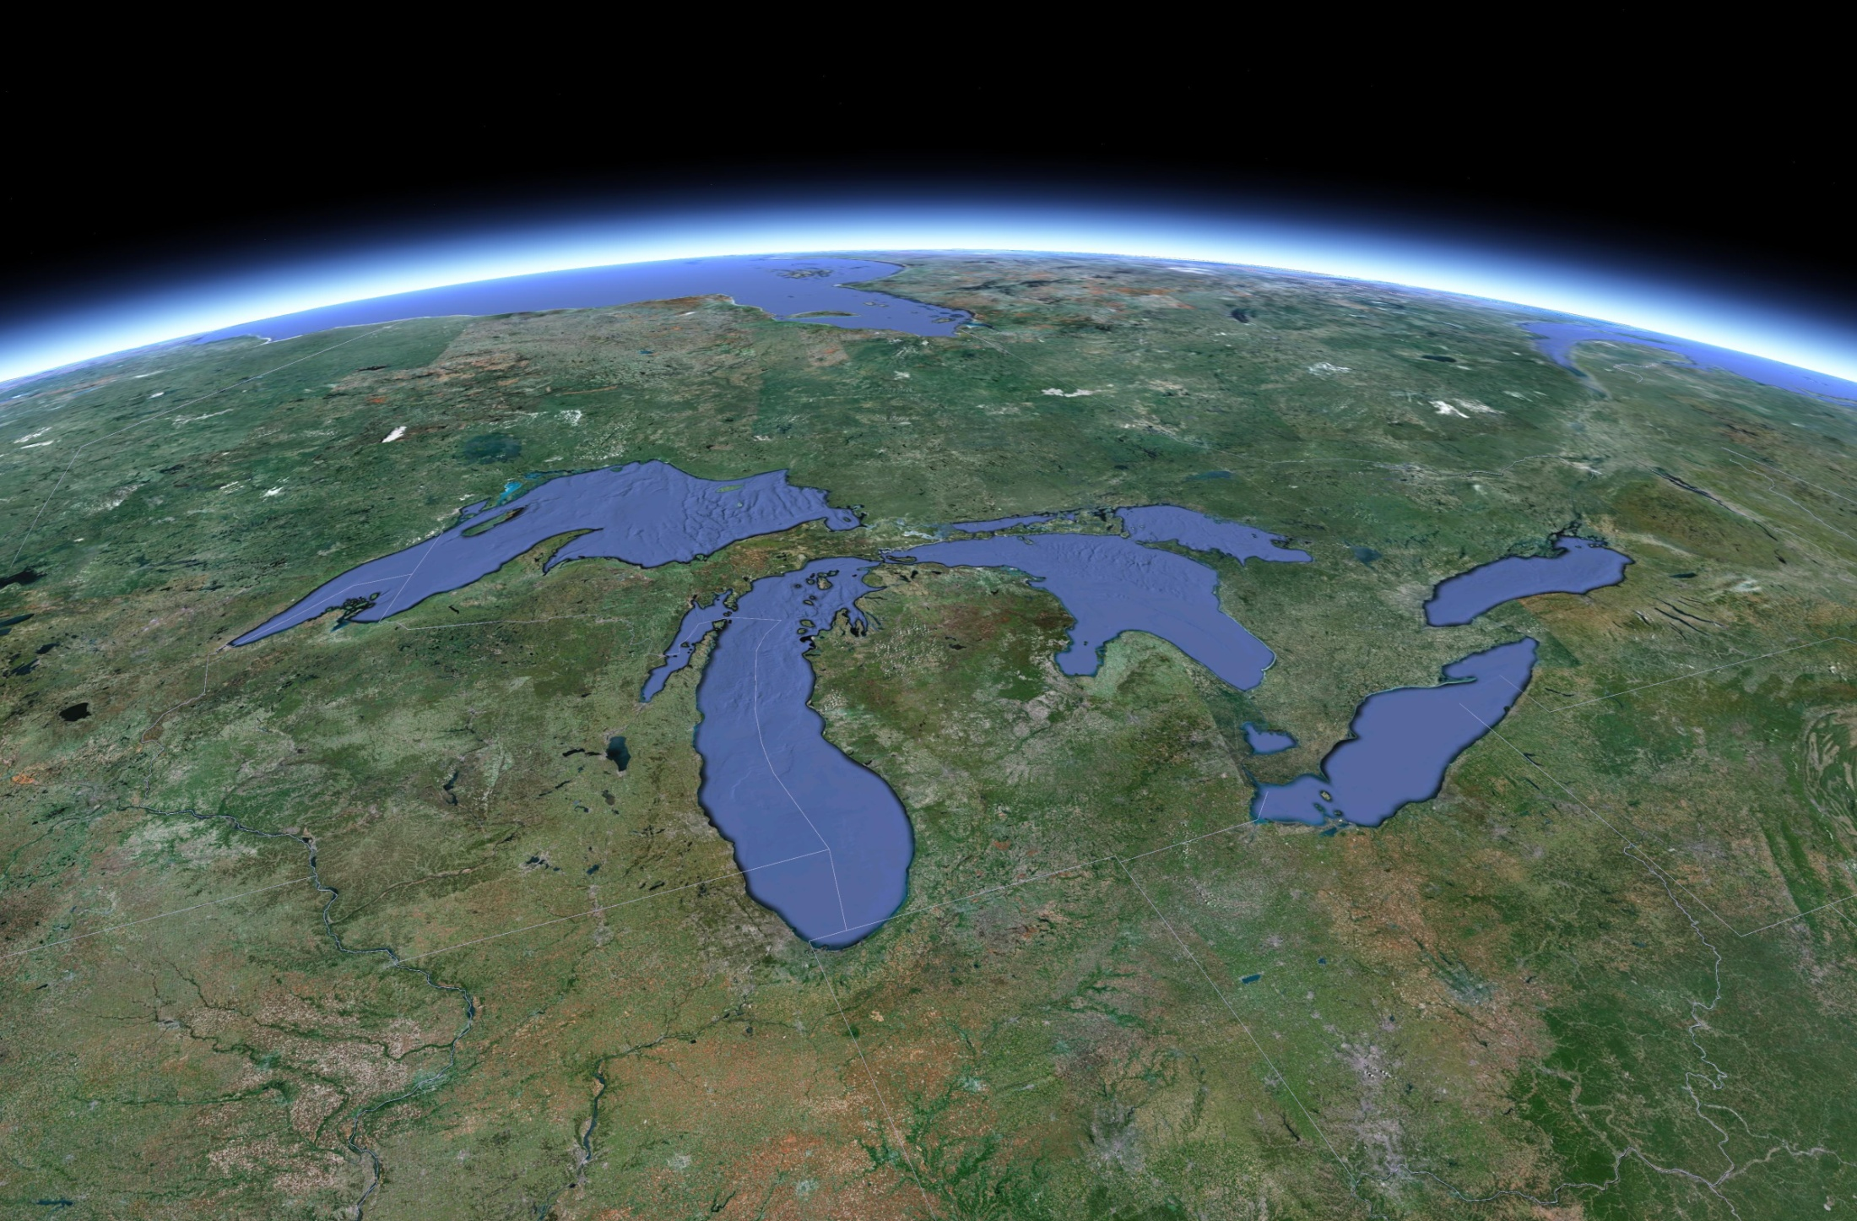
Atmospheric deposition is believed to be the largest
current mercury loading pathway to the Great Lakes…
How much is deposited and where does it come from?
(…this information can only be obtained via modeling...)

Slide 4
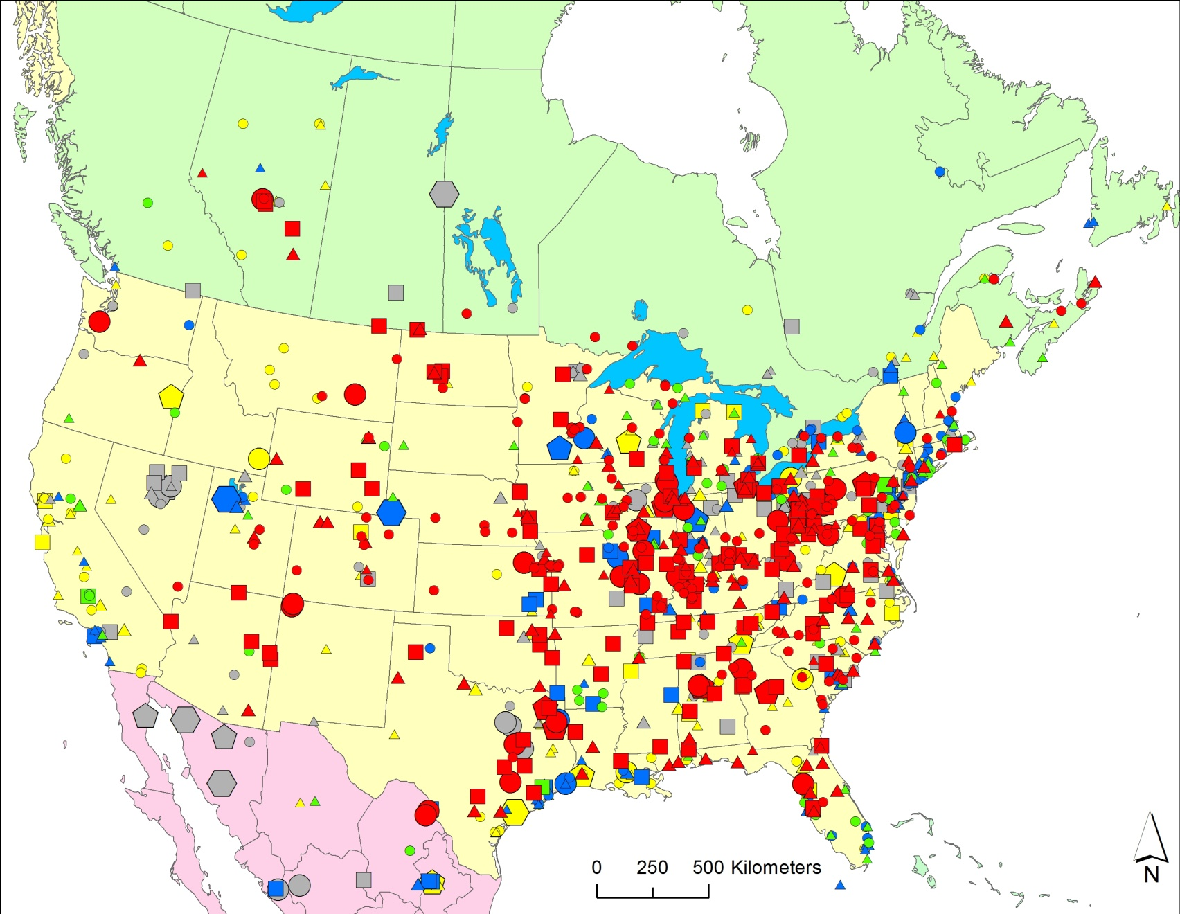
Starting point: where is mercury emitted to the air?
2005 Atmospheric Mercury Emissions from Large Point Sources
Emissions
(kg/yr)
5-10
10-50
50-100
100–300
300–500
500–1000
1000–3000
Type of Emissions Source
coal-fired power plants
other fuel combustion
waste incineration
metallurgical
manufacturing & other

Slide 5
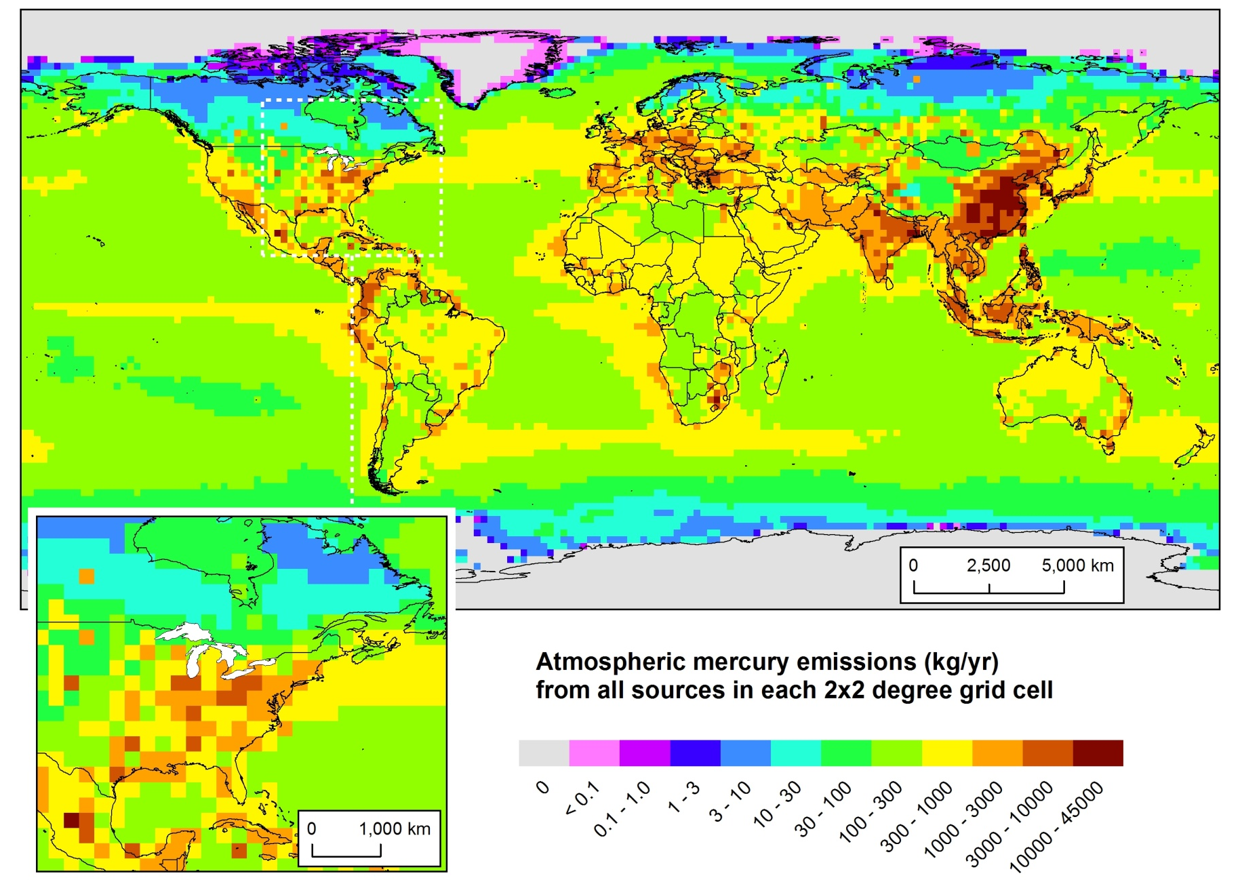
2005 Atmospheric Mercury Emissions
(Direct Anthropogenic + Re-emit + Natural)
Policy-Relevant
Scenario Analysis
Notes:
Here’s where the mercury is emitted from... But what is the relative importance of different source regions to atmospheric deposition of mercury to sensitive U.S. ecosystems, e.g., the Great Lakes? Does most of it come from China?
Data for 2005, from USEPA, Environment Canada, NILU (Norway), and others. Assembled for the GLRI FY2010 modeling project.
Looking at this emissions map, its easy to think that the dominant contributor to Great Lakes mercury might be emissions from China.

Slide 6

When puffs grow to sizes large relative to the meteorological data grid, they split, horizontally and/or vertically
To simulate the global transport of mercury, puffs are transferred to Eulerian grid after a specified time downwind (~3 weeks), and the mercury is simulated on that grid from then on…
This is how we model the local & regional impacts.
But for global modeling,
puff splitting overwhelms
computational resources
Puffs of pollutant are emitted and dispersed downwind
Atmospheric chemistry and deposition simulated for each puff
Notes:
Incorporation of the mercury modeling algorithms into the new GEM-HYSPLIT code was a large scientific programming task.

Slide 7
Computational Challenge
350,000 “sources” in global emissions inventory
Would like to keep track of each source individually
typical one-year simulation takes ~96 processor hours
~3800 processor years, if ran explicit simulation for each source
~240 years on 16-processor workstation

Slide 8
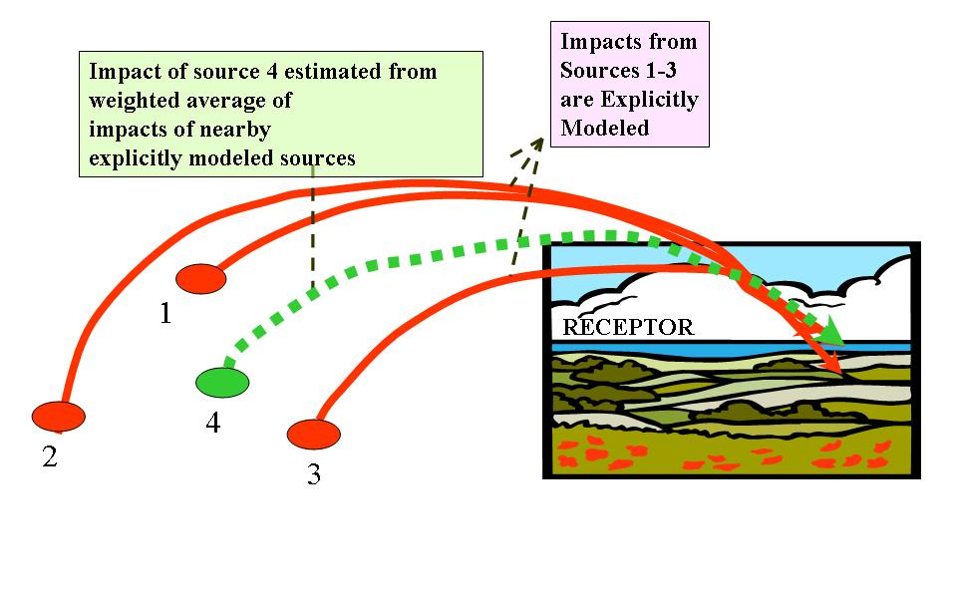
Spatial Interpolation

Slide 9
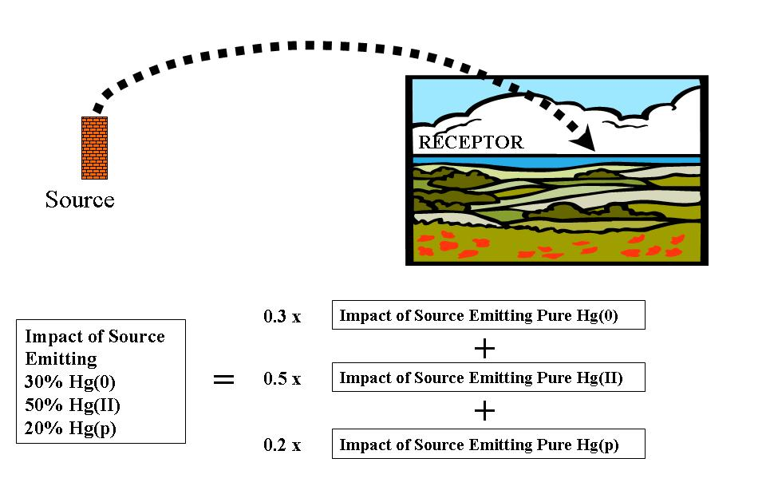
Chemical Interpolation

Slide 10
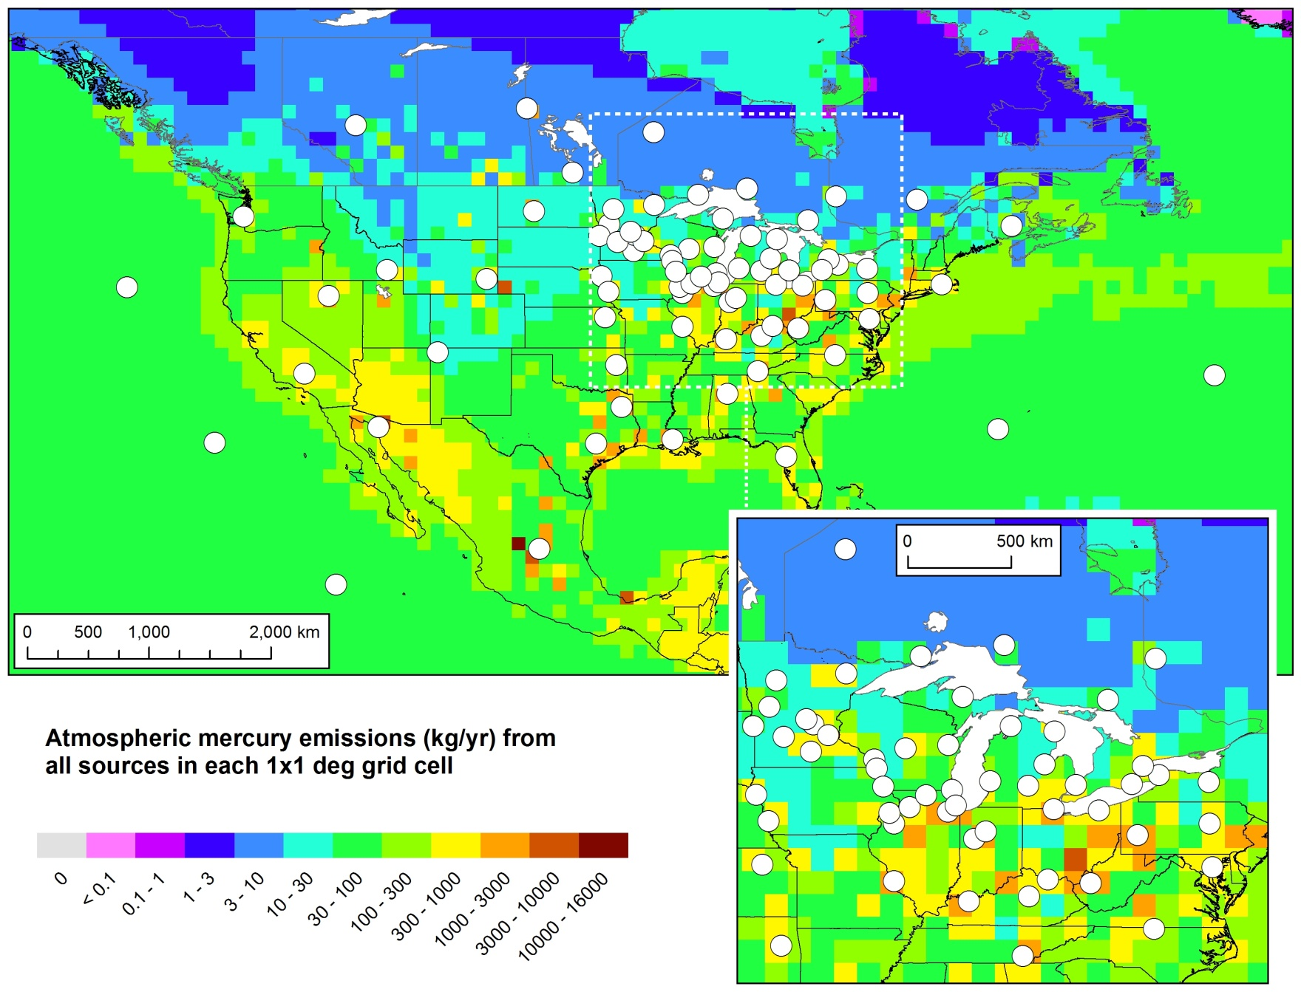
Standard Points in North America
For each standard source location, we do three
unit-emissions simulations:
pure Hg(0),
pure HgII (RGM)
pure Hg(p)
10
Notes:
A total of 136 Std Source Locations used in this analysis

Slide 11
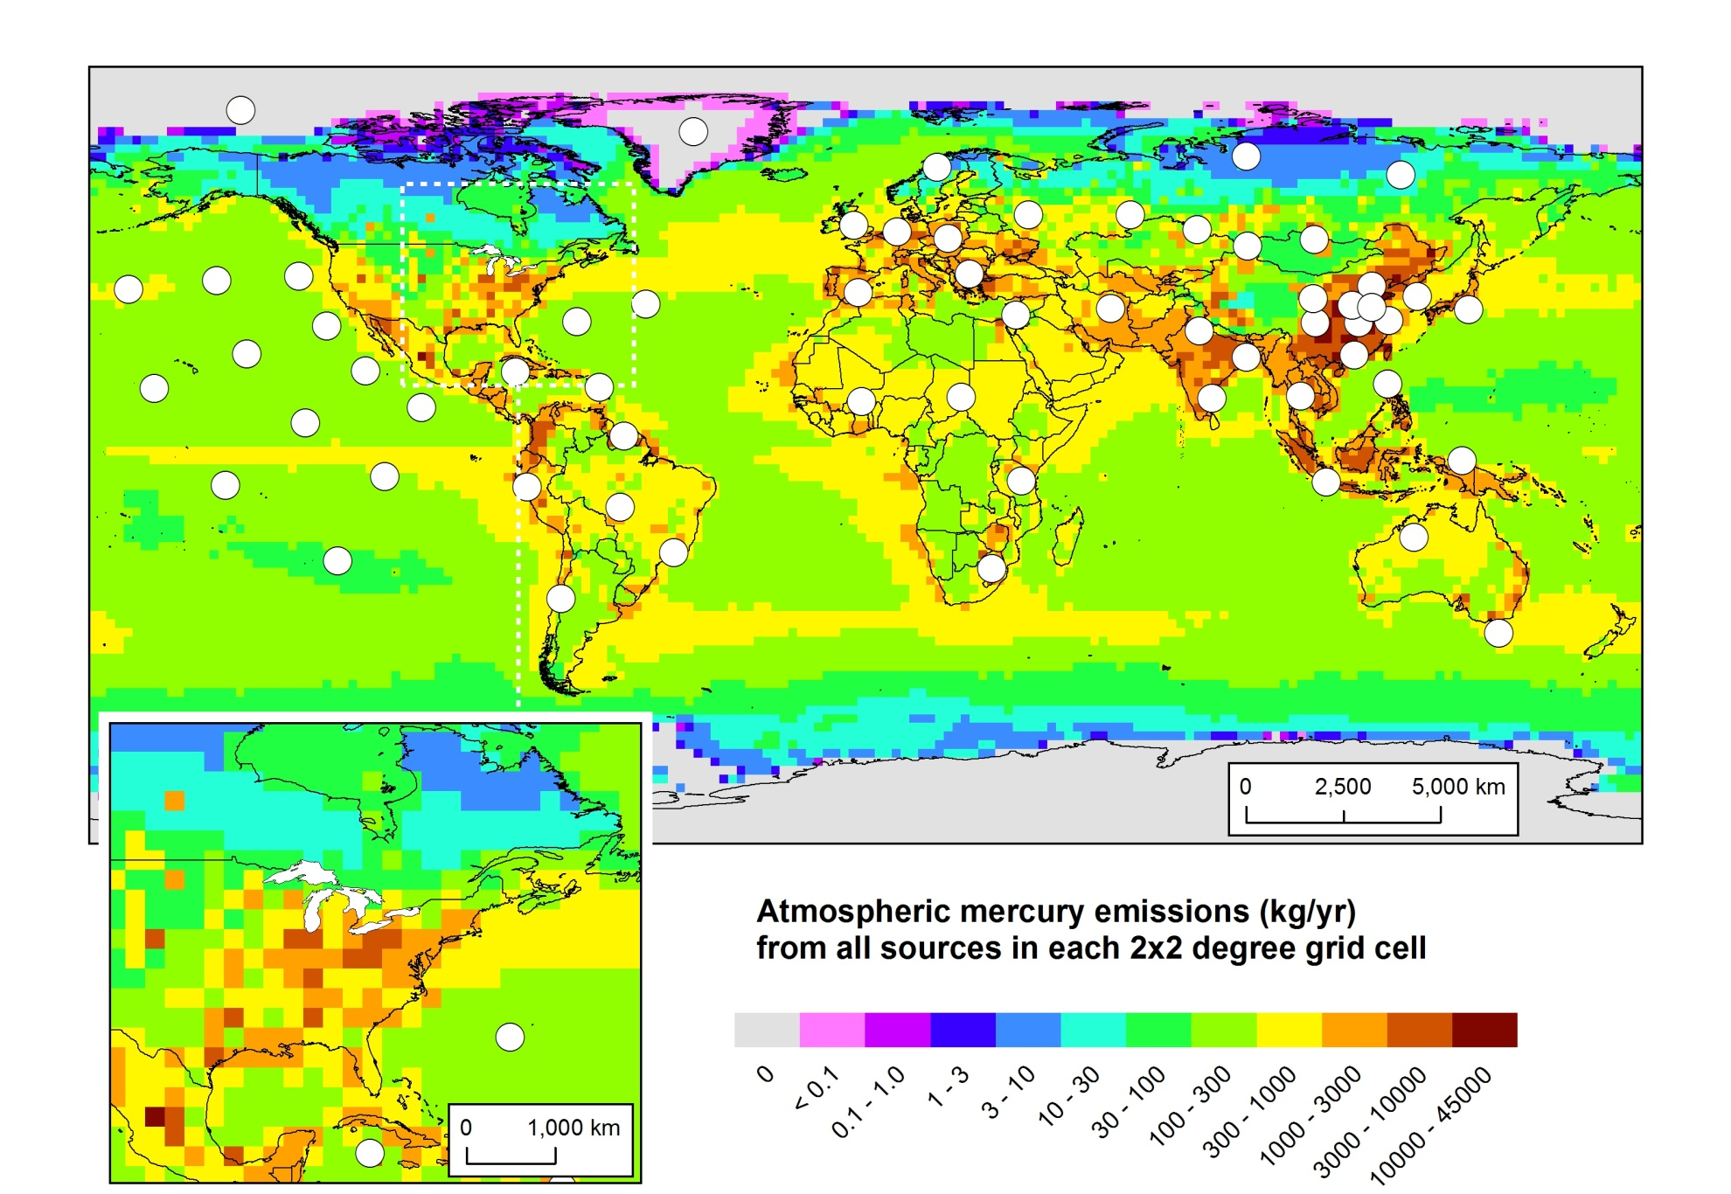
Standard Points Outside of North America
…three unit-emissions simulations for each location
11

Slide 12
Computational Solution
This analysis done with 136 standard source locations
3 unit emissions simulations from each location (Hg(0), RGM, and Hg(p)
~4.5 processor years
~3.5 months on 16-processor workstation
instead of 240 years … almost 1000x less!

Slide 13
After all the standard source simulations have been run, and the impacts of each of the ~350,000 sources worldwide are estimated using spatial and chemical interpolation, is the model giving reasonable results?
Modeled vs. Measured Wet Deposition of
Mercury at Sites in the Great Lakes Region
Notes:
All the data, but MDN sites “downwind” of the Great Lakes (“eastern GL region”) are open squares…

Slide 14
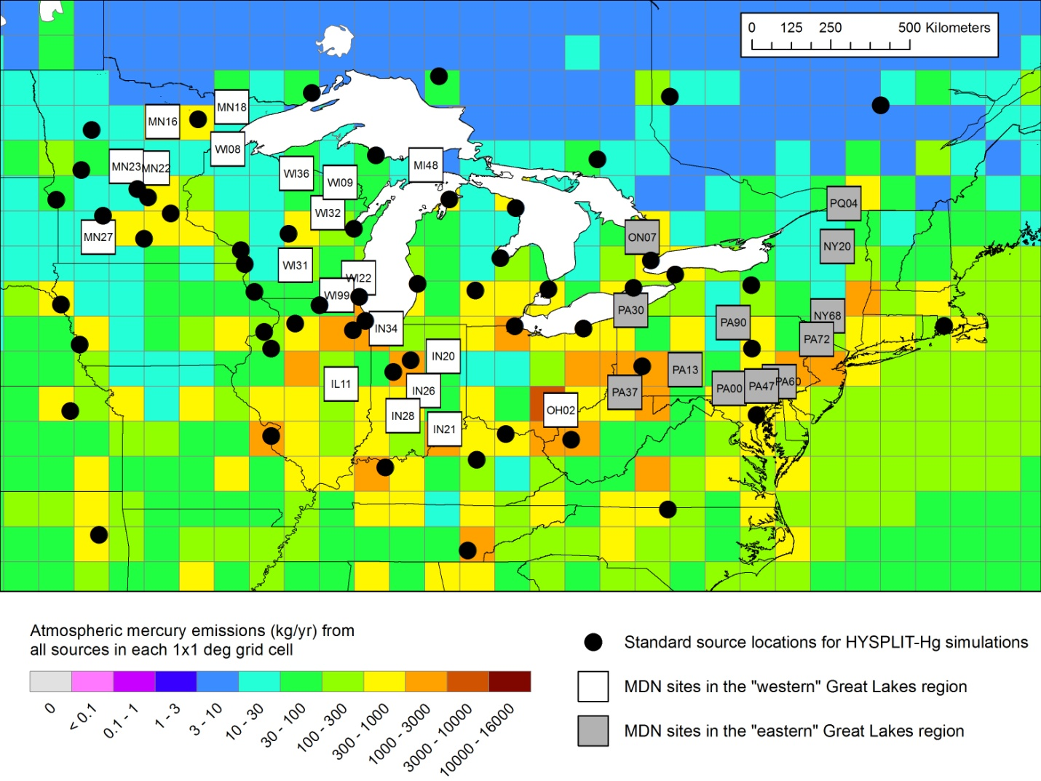
Standard source locations, MDN sites, and mercury emissions in the Great Lakes region
Overestimates for wet deposition found for these sites
14
Notes:
It is seen in Figure 61 that the density of standard source locations is generally lower in the region of the eastern-most MDN sites. The reason why more standard source locations were not utilized at the outset was computational resource constraints. As discussed above in Section 2.4, the consequence of this sparseness is a higher likelihood that interpolation errors will affect the results. In particular, the general situation regarding the difference in estimating deposition at point monitoring sites vs. large area receptors – discussed above in Section 2.4.3, page 43 – seems to be particularly relevant here. That is, the density of standard source locations required to estimate deposition to the Great Lakes is much less than that required for estimating deposition at a set of monitoring sites throughout the Great Lakes region. Or put another way, for the same set of standard source locations – or the same expenditure of computational resources -- the expected accuracy of deposition estimates for large area receptors – e.g., in this case, the Great Lakes and their watersheds – is much higher than the expected accuracy for deposition estimates at a set of monitoring sites throughout the region.
With additional standard source locations in the regions surrounding each of these eastern-most Great Lakes region MDN sites, the agreement between modeled and measured wet deposition will likely improve. At the same time, the addition of these new standard source locations will likely not change the results for the Great Lakes very much. We will test these hypotheses in the next phase of the work.

Slide 15
2005 Atmospheric Mercury Emissions
(Direct Anthropogenic + Re-emit + Natural)
Policy-Relevant
Scenario Analysis
Notes:
Here’s where the mercury is emitted from... But what is the relative importance of different source regions to atmospheric deposition of mercury to sensitive U.S. ecosystems, e.g., the Great Lakes? Does most of it come from China?
Data for 2005, from USEPA, Environment Canada, NILU (Norway), and others. Assembled for the GLRI FY2010 modeling project.
Looking at this emissions map, its easy to think that the dominant contributor to Great Lakes mercury might be emissions from China.

Slide 16
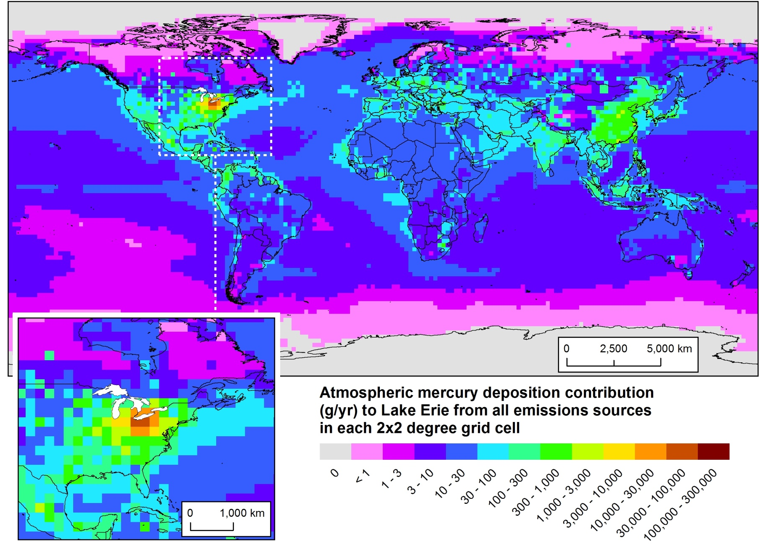
Keep track of the contributions from each source, and add them up
Policy-Relevant
Scenario Analysis
Geographical Distribution of 2005 Atmospheric Mercury Deposition Contributions to Lake Erie

Slide 17
Results can be shown in many ways…
A tiny fraction of 2005 global mercury emissions within 500 km of Lake Erie
Modeling results show that these “regional” emissions are responsible for a large fraction of the modeled 2005 atmospheric deposition
Important policy implications!
Notes:
Results obtained by modeling the atmospheric fate and transport of mercury emitted to the air with the HYSPLIT-Hg model, in the FY2010 GLRI mercury-modeling project. These results are for 2005, the latest year for which mercury emissions inventory information was available, at the time the project was carried out. Atmospheric deposition of mercury to the Great Lakes is an important – and probably the largest – current loading pathway.
In the upper left graph, the total mercury emissions as a function of distance away from the center of Lake Erie are plotted. You can see that a very small fraction of the total global mercury emissions are emitted within 500 km of the Lake center, or even with 1000km of the Lake center. The bulk of the global emissions are much further away from the Lake.
In the bottom right graph, the total modeled atmospheric mercury deposition to Lake Erie arising from emissions at the same distance ranges are shown. So, this graph shows that about 200 kg were modeled to have been deposited into Lake Erie from sources within 500 km of the Lake center, about 40% of the total modeled deposition.

Slide 20
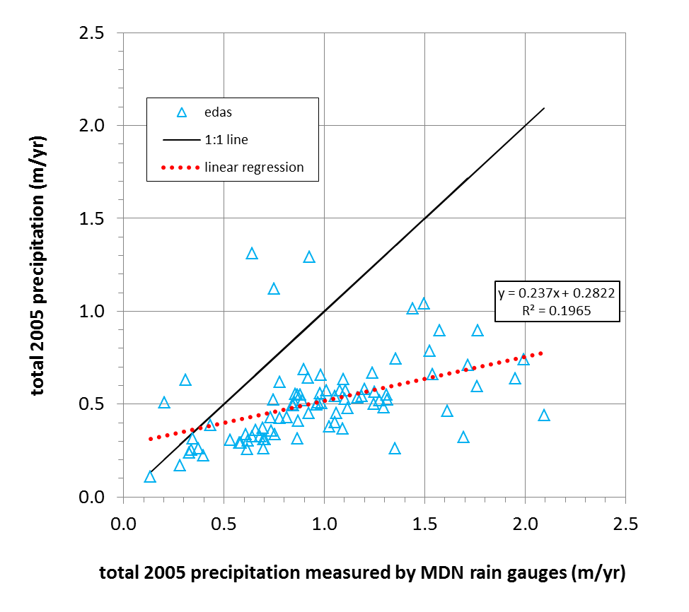
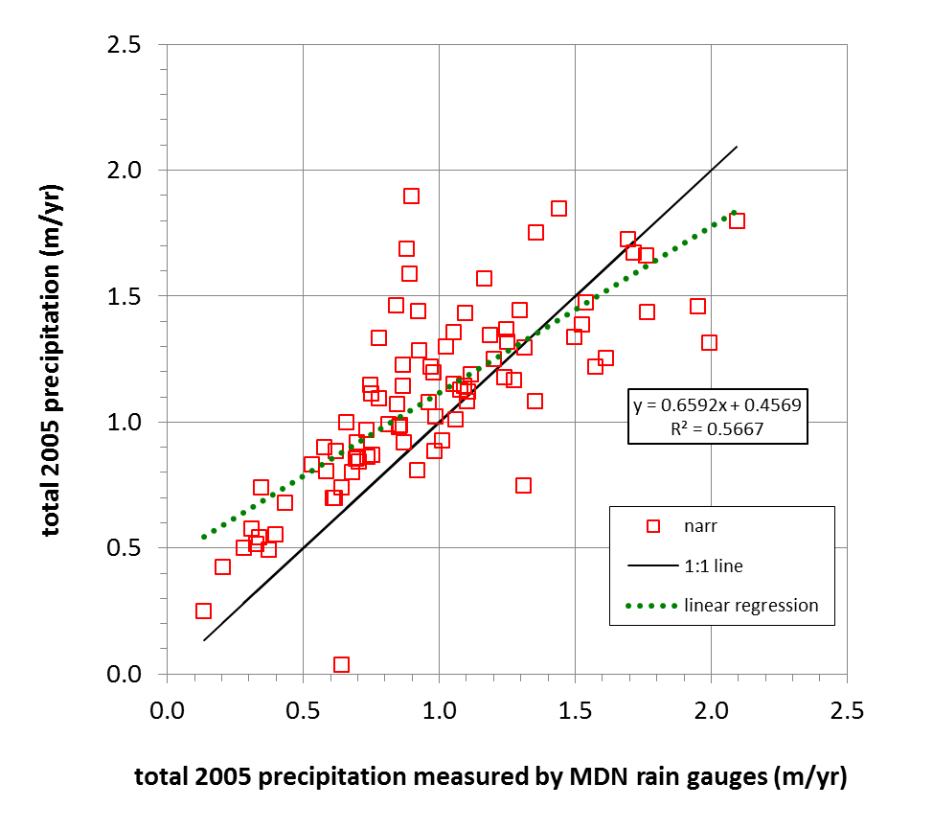
Comparison of precipitation measured by rain gauges at Mercury Deposition Network sites with that in the EDAS and NARR meteorological datasets used to drive the HYSPLIT-Hg model
EDAS
used in Phase 1 baseline analysis
NARR
used in Phase 2 sensitivity analysis
Notes:
EDAS = Eta Data Assimilation System, NOAA NCEP
NARR = North American Regional Reanalysis, NCEP/NCAR
Problems with precipitation in EDAS have been corrected in recent years
But for this 2005-based analysis, the NARR dataset appears to be a better choice to drive the HYSPLIT-Hg model for the Great Lakes analysis

Slide 21
Overall source attribution results not changed dramatically for Lake Erie (top) or the Great Lakes Basin (bottom) for largest variations in modeling methodology; 2005 baseline (left); variations (center & right)
Notes:
In default simulations, total global ocean re-emissions of anthropogenic mercury were 1250 metric tons/year
In default simulations, total global terrestrial re-emissions of anthropogenic mercury were 750 metric tons/year
-------------------------
Total Re-emissions = 2000 metric tons/year
================================================
In “high range re-emissions” simulations, total global ocean re-emissions of anthropogenic mercury were 2000 metric tons/year
In “high range re-emissions” simulations, total global terrestrial re-emissions of anthropogenic mercury were 2000 metric tons/year
-------------------------
Total Re-emissions = 4000 metric tons/year
================================================
In context, total global direct anthropogenic emissions ~2000 metric tons/year

Slide 22
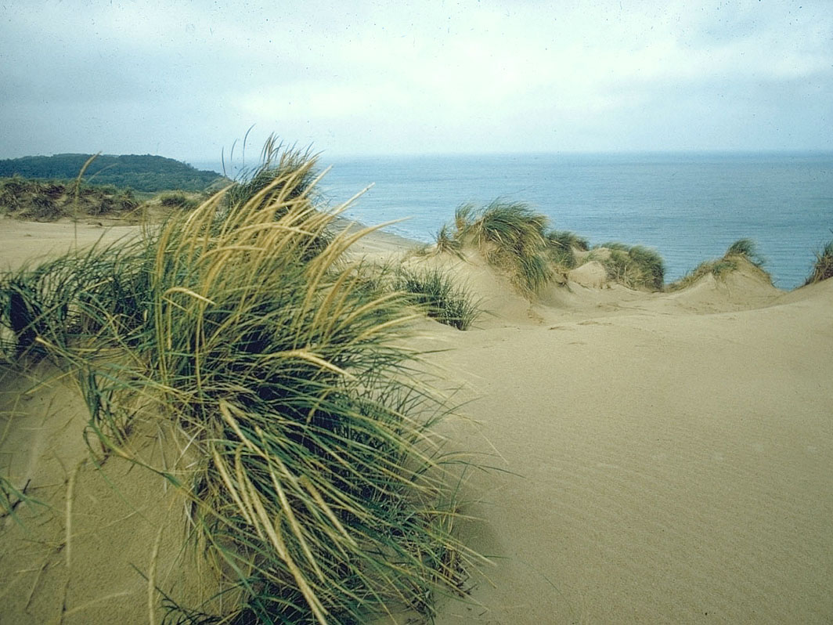

Thanks!
This work was partially funded through the Great Lakes Restoration Initiative

Slide 23
EXTRA SLIDES

Slide 24
Atmospheric Mercury Deposition to the Great Lakes
A Multi-Year Study Supported by the Great Lakes Restoration Initiative
Phase 1: Baseline analysis for 2005
  Used “EDAS” meteorological data
  One set of model parameters and emissions data
  Summary: http://www.arl.noaa.gov/documents/reports/GLRI_Atmos_Mercury_Summary.pdf
  Final Report: http://www.arl.noaa.gov/documents/reports/GLRI_FY2010_Atmospheric_Mercury_Final_Report_2011_Dec_16.pdf
  Recent Presentation: http://www.arl.noaa.gov/documents/reports/Cohen_ARL_Seminar_Feb_7_2013.pptx
Phase 2: Sensitivity analysis
  Used “NARR” meteorological data
  Numerous variations of model parameters and emissions data
  Overall results – even for largest variations found – not changed dramatically (see pie charts below)
  Conclusion: results are robust
  Final Report being prepared
Phase 3: Analysis of alternative future emissions scenarios
  Work is beginning on this policy-relevant analysis
Phase 4: Updates to more recent years
  To start when FY13 GLRI funding received
NOAA Air Resources Laboratory
24

Slide 25
Acknowledgements
Other members of HYSPLIT Model Development
Team at ARL:
Glenn Rolph
Barbara Stunder
Ariel Stein
Fantine Ngan
+ numerous collaborations with external partners involving:
emissions inventory data for model input, and
atmospheric measurement data for model evaluation
Winston Luke
Paul Kelley
Steve Brooks
Xinrong Ren
Other members of Mercury Research
Team at ARL:
IT Team
at ARL:
Rick Jiang
Yan Huang
Great Lakes Restoration Initiative,
via Interagency Agreement with USEPA
Funding:

Slide 26
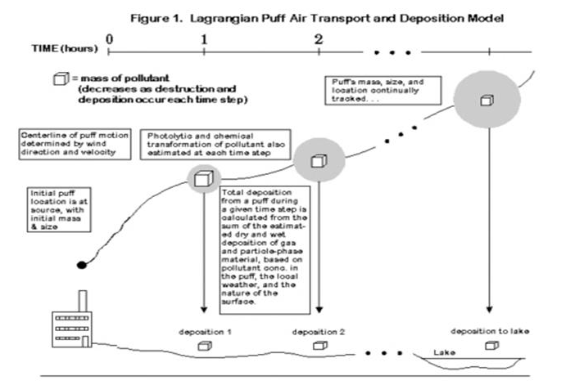
Next step: What happens to the mercury after it is emitted?
HYSPLIT-Hg Lagrangian Puff Atmospheric Fate and Transport Model
0
1
2
TIME (hours)
= mass of pollutant
(changes due to chemical transformations and deposition that occur at each time step)
The puff’s mass, size, and location are continuously tracked…
Phase partitioning and chemical transformations of pollutants within the puff are estimated at each time step
Initial puff location is at source, with mass depending on emissions rate
Centerline of puff motion determined by wind direction and velocity
Dry and wet deposition of the pollutants in the puff are estimated at each time step.
deposition 1
deposition 2
deposition to receptor
lake
Notes:
26

Slide 27
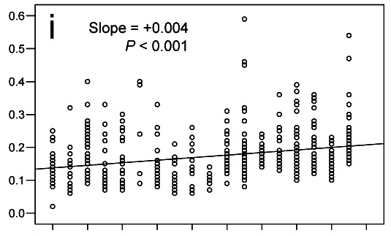
Temporal trends of mercury in Lake Erie
45−55 cm walleye collected between 1990−2007
{Bhavsar et al. (2010), Environ. Sci. Technol. 44, 3273-3279}
1990
1992
1994
1996
1998
2000
2002
2004
2006
2008
Notes:
FROM: Satyendra P. Bhavsar; Sarah B. Gewurtz; Daryl J. McGoldrick; Michael J. Keir; Sean M. Backus; Environ. Sci. Technol. 2010, 44, 3273-3279.
DOI: 10.1021/es903874x
Time Trends of Mercury Concentrations in GL Fish
Temporal trends of mercury in OMOE skinless fillets of 45−55 cm walleye collected between 1990−2007.
Linear regression on regular concentrations.
P-value is for statistical significance.
Sen’s estimate line is shown only for statistically significant (P < 0.05) upward/downward trend.

Slide 28
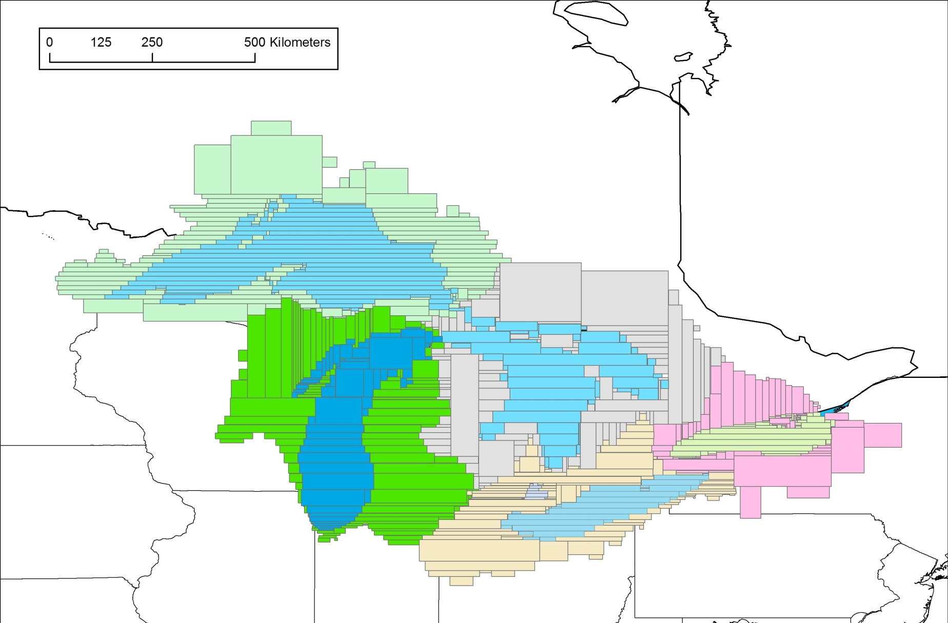
Deposition explicitly modeled to actual lake/watershed areas
As opposed to the usual practice of ascribing portions of gridded deposition to these areas in a post-processing step
Notes:
This shows the “polygons” that represent each Great Lake and each of their watersheds.
At each time step, the overlap of each pollutant “puff” (and Eulerian grid square) is estimated for each polygon, and the deposition from the puff or grid square is attributed to the polygon based on the degree of overlap… (this is a little more simple than it actually is, as differences in land-type are factored in as well…)

Slide 29
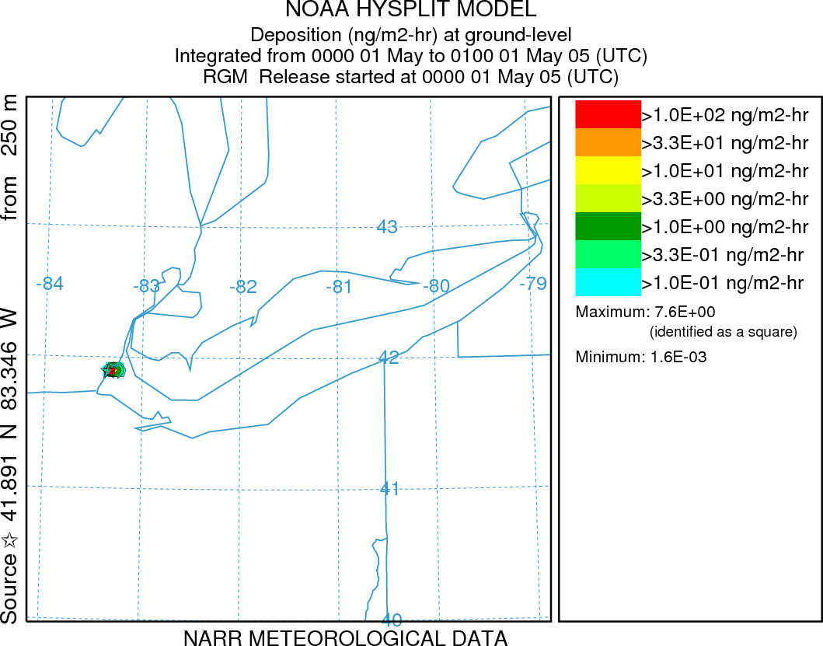
Illustrative simulation of reactive gaseous mercury (RGM)
emissions from one power plant on the shore of Lake Erie:
hourly deposition estimates for the first two weeks in May 2005
Lake Erie
Results scaled to actual RGM emissions of 43.6 g/hr
1 ng/m2-hr = 8.8 ug/m2-yr
(if it persisted the entire year)
Total deposition to Lk Erie is ~20 ug/m2-yr
Notes:
RGM emissions from Monroe plant are 43.61 g/hr according to the 2005 NEI
Elem emissions are 16.44 g/hr, Hgpt emissions are 3.9 g/hr, and total emissions are 64.04 g/hr
Monroe 2005 NEI:
Elem 144.00 kg/yr
RGM 382.00 kg/yr
Hgpt 34.20 kg/yr
Total Hg 561.00 kg/yr

Slide 30
an example for one source… the Monroe coal-fired power plant on the shore of Lake Erie
Emissions
(kg/yr)
5-10
10-50
50-100
100–300
300–500
500–1000
1000–3000
Type of Emissions Source
coal-fired power plants
other fuel combustion
waste incineration
metallurgical
manufacturing & other
2005 Atmospheric Mercury Emissions from Large Point Sources

Slide 31
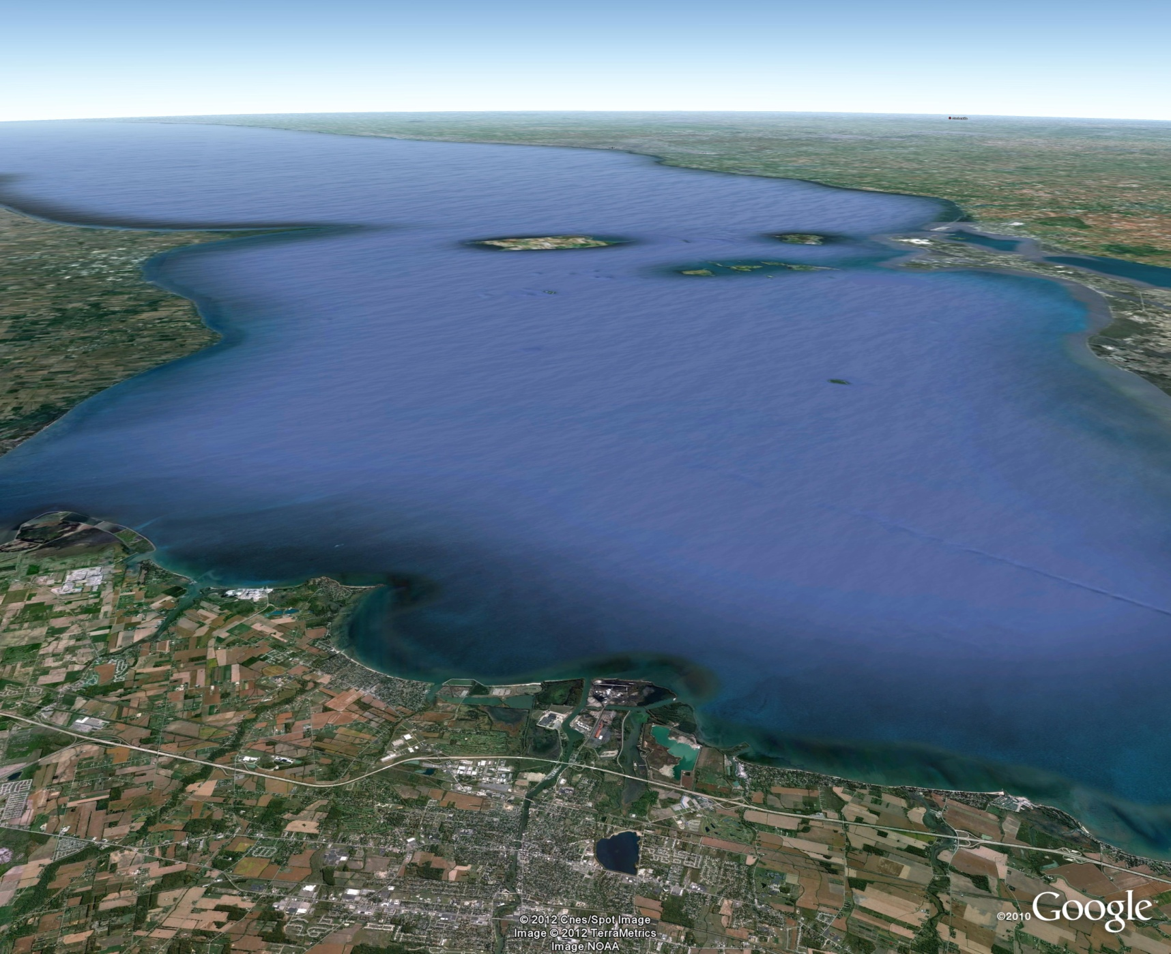
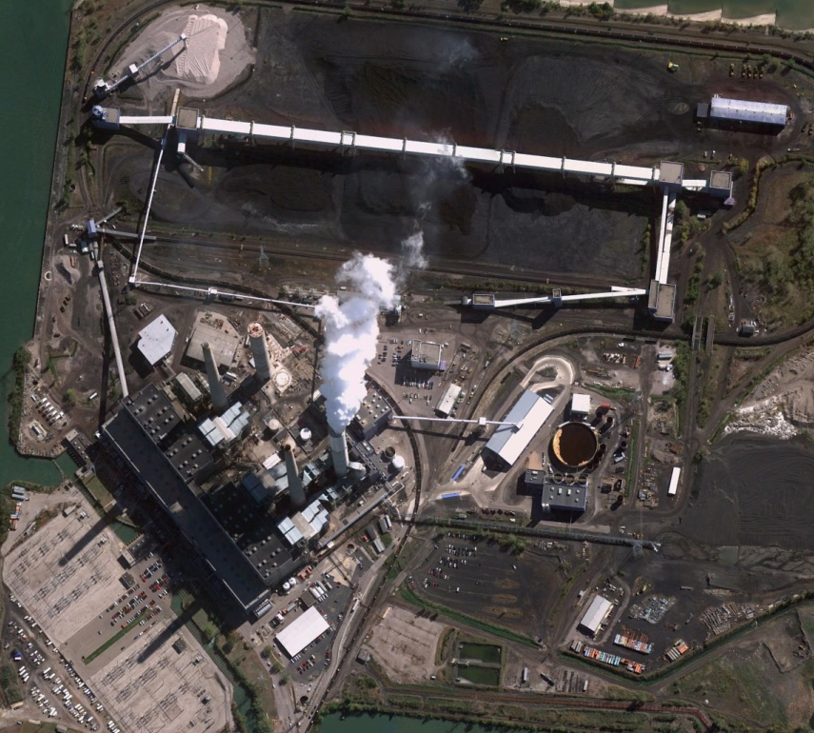
Monroe emitted 561 kg of mercury in 2005 (EPA’s National Emissions Inventory)
How much of this mercury was deposited into Lake Erie and its watershed?
Lake Erie
Detroit Edison Monroe coal fired power plant on the shore of Lake Erie

Slide 32
Monroe emitted 561 kg of mercury in 2005 (EPA’s National Emissions Inventory)
Modeling results for this specific source:
  24 kg (~4%) of this emitted mercury was deposited directly into Lake Erie
  107 kg (~19%) of this emitted mercury was deposited in the Lake Erie Watershed
We make this same type of estimate for every source in the national and global emissions inventories used as model input… using spatial and chemical interpolation
Lake Erie
Detroit Edison Monroe coal fired power plant on the shore of Lake Erie

Slide 33
Outline of Modeling Analysis
HYSPLIT
HYSPLIT-Hg (with mercury-specific chemistry, …)
Unit Emissions Simulations of Hg(0), Hg(II) and Hg(p) from an array of standard source locations
Emissions Inventory – emissions of Hg(0), Hg(II), and Hg(p) from sources at specified latitudes and longitudes
“Multiplication” of emissions inventory by array of unit emissions simulations using spatial and chemical interpolation
Evaluate overall model results: compare against ambient measurements
Source-attribution results for deposition to selected receptors
33

Slide 34
Outline of Modeling Analysis
HYSPLIT
HYSPLIT-Hg (with mercury-specific chemistry, …)
Unit Emissions Simulations of Hg(0), Hg(II) and Hg(p) from an array of standard source locations
Emissions Inventory – emissions of Hg(0), Hg(II), and Hg(p) from sources at specified latitudes and longitudes
“Multiplication” of emissions inventory by array of unit emissions simulations using spatial and chemical interpolation
Evaluate overall model results: compare against ambient measurements
Source-attribution results for deposition to selected receptors
34

Slide 35
…350,000

Slide 38
A multi-phase project
ARL’s GLRI Atmospheric Mercury Modeling Project
Jan 1, 2009
Initial Inter- and Intra-Agency Planning for FY10 GLRI Funds
Jan 1, 2010
FY10 $ Baseline Analysis
for 2005
Jan 1, 2011
Jan 1, 2012
FY11 $ Sensitivity Analysis + Extended Model Evaluation
Jan 1, 2013
FY12 $ Scenario Analysis
Jan 1, 2014
FY13 $ (proposed)
Update Analysis (~2008)
Jan 1, 2015
FY14 $ (proposed)
Update Analysis (~2011)
Jan 1, 2016

Slide 39
Phase 1: Baseline Analysis for 2005
(Final Report Completed December 2011)
2005 was chosen as the analysis year, because 2005 was the latest year for which comprehensive mercury emissions inventory data were available at the start of this project
Using 2005 meteorological data and emissions, the deposition and source-attribution for this deposition to each Great Lake and its watershed was estimated
The model results were ground-truthed against 2005 Mercury Deposition Network data from sites in the Great Lakes region

Slide 40
Modeling Atmospheric Mercury Deposition to the Great Lakes. Final Report for work conducted with FY2010 funding from the
Great Lakes Restoration Initiative. December 16, 2011.
Mark Cohen, Roland Draxler, Richard Artz. NOAA Air Resources Laboratory, Silver Spring, MD, USA. 160 pages.
http://www.arl.noaa.gov/documents/reports/GLRI_FY2010_Atmospheric_Mercury_Final_Report_2011_Dec_16.pdf
http://www.arl.noaa.gov/documents/reports/Figures_Tables_GLRI_NOAA_Atmos_Mercury_Report_Dec_16_2011.pptx
One-page summary: http://www.arl.noaa.gov/documents/reports/GLRI_Atmos_Mercury_Summary.pdf

Slide 41
Some Key Features of this Analysis
Deposition explicitly modeled to actual lake/watershed areas
As opposed to the usual practice of ascribing portions of gridded deposition to these areas in a post-processing step
Combination of Lagrangian & Eulerian modeling
allows accurate and computationally efficient estimates of the fate and transport of atmospheric mercury over all relevant length scales – from “local” to global.
Uniquely detailed source-attribution information is created
deposition contribution to each Great Lakes and watersheds from each source in the emissions inventories used is estimated individually
The level of source discrimination is only limited by the detail in the emissions inventories
Source-type breakdowns not possible in this 1st phase for global sources, because the global emissions inventory available did not have source-type breakdowns for each grid square

Slide 42
Some Key Findings of this Analysis
“Single Source” results illustrate source-receptor relationships
For example, a “typical” coal-fired power plant near Lake Erie may contribute on the order of 1000x the mercury – for the same emissions – as a comparable facility in China.
Regional, national, & global mercury emissions are all important contributors to mercury deposition in the Great Lakes Basin
For Lakes Erie and Ontario, the U.S. contribution is at its most significant
For Lakes Huron and Superior, the U.S. contribution is less significant.
Local & regional sources have a much greater atmospheric deposition contributions than their emissions, as a fraction of total global mercury emissions, would suggest.

Slide 43
Some Key Findings of this Analysis (…continued)
Reasonable agreement with measurements
Despite numerous uncertainties in model input data and other modeling aspects
Comparison at sites where significant computational resources were expended – corresponding to regions that were the most important for estimating deposition to the Great Lakes and their watersheds – showed good consistency between model predictions and measured quantities.
For a smaller subset of sites generally downwind of the Great Lakes (in regions not expected to contribute most significantly to Great Lakes atmospheric deposition), less computational resources were expended, and the comparison showed moderate, but understandable, discrepancies.

Slide 44
Phase 2: Sensitivity Analysis + Extended Model Evaluation
(current work, with GLRI FY11 funding)
Examining the influence of uncertainties on the modeling results, by varying critical model parameters, algorithms, and inputs, and analyzing the resulting differences in results
Ground-truthing the model against additional ambient monitoring data, e.g., ambient mercury air concentration measurements and wet deposition data not included in the Mercury Deposition Network (MDN)

Slide 45
Release height
50 m vs 250 m
Met data
(EDAS vs. NARR)
Fortran compilation
Number of puffs
Chemistry and Partitioning
Deposition modeling
Time step
Puff lifetime

Slide 46
Chemistry and Partitioning
Number of puffs
Compilation
Deposition modeling
Emit height

Slide 47
Phase 3: Scenarios
(next year’s work, with GLRI FY12 funding)
A modeling analyses such as this is the only way to quantitatively examine the potential consequences of alternative future emissions scenarios
We will work with EPA and other Great Lakes Stakeholders to identify and specify the most policy relevant scenarios to examine
For each scenario, we will estimate the amount of atmospheric deposition to each of the Great Lakes and their watersheds, along with the detailed source-attribution for this deposition

Slide 49
Atmospheric Mercury Fate Processes
Elemental Mercury [Hg(0)]
Hg(II), ionic mercury, RGM
Upper atmospheric
halogen-mediated
oxidation?
Polar sunrise
“mercury depletion events”
Particulate Mercury [Hg(p)]
Br
cloud
CLOUD DROPLET
Hg(II) reduced to Hg(0)
by SO₂ and sunlight
Vapor phase:
Hg(0) oxidized to RGM and Hg(p) by O₃, H₂0₂, Cl₂, OH, HCl
Hg(p)
Adsorption/
desorption
of Hg(II) to
/from soot
Primary
Anthropogenic
Emissions
Hg(0) oxidized to dissolved
Hg(II) species by O₃, OH,
HOCl, OCl⁻
Multi-media interface
Wet deposition
Natural
emissions
Re-emission of previously deposited anthropogenic and natural mercury
Dry deposition
Notes:
Could mention Marine Boundary Layer issues as well... rapid oxidation, deposition, but then some reduction and re-emission, so, potential “churning”

Slide 50
(Evolving) Atmospheric Chemical Reaction Scheme for Mercury
Reaction | Rate |  | Units | Reference
GAS PHASE REACTIONS
Hg⁰ + O₃ → Hg(p) | 3.0E-20 | cm³/molec-sec |  | Hall (1995)
Hg⁰ + HCl → HgCl₂ | 1.0E-19 | cm³/molec-sec |  | Hall and Bloom (1993)
Hg⁰ + H₂O₂ → Hg(p) | 8.5E-19 | cm³/molec-sec |  | Tokos et al. (1998) (upper limit based on experiments)
Hg⁰ + Cl₂ → HgCl₂ | 4.0E-18 | cm³/molec-sec |  | Calhoun and Prestbo (2001)
Hg⁰ +OH → Hg(p) | 8.7E-14 | cm³/molec-sec |  | Sommar et al. (2001)
Hg⁰ + Br → HgBr₂
AQUEOUS PHASE REACTIONS
Hg⁰ + O₃ → Hg⁺² | 4.7E+7 | (molar-sec)⁻¹ |  | Munthe (1992)
Hg⁰ + OH → Hg⁺² | 2.0E+9 | (molar-sec)⁻¹ |  | Lin and Pehkonen(1997)
HgSO₃ → Hg⁰ | T*e^{((31.971*T)-12595.0)/T)} sec⁻¹ [T = temperature (K)] |  |  | Van Loon et al. (2002)
Hg(II) + HO₂ → Hg⁰ | ~ 0 | (molar-sec)⁻¹ |  | Gardfeldt & Jonnson (2003)
Hg⁰ + HOCl → Hg⁺² | 2.1E+6 | (molar-sec)⁻¹ |  | Lin and Pehkonen(1998)
Hg⁰ + OCl⁻¹ → Hg⁺² | 2.0E+6 | (molar-sec)⁻¹ |  | Lin and Pehkonen(1998)
Hg(II) ↔ Hg(II) _{(soot)} | 9.0E+2 | liters/gram; t = 1/hour |  | eqlbrm: Seigneur et al. (1998) rate: Bullock & Brehme (2002).
Hg⁺² + hv → Hg⁰ | 6.0E-7 | (sec)⁻¹ (maximum) |  | Xiao et al. (1994); Bullock and Brehme (2002)
?
?
new
?

Slide 51
What year to model?
Mercury Emissions Inventory
Dataset Available
for 2005
U.S. anthropogenic emissions inventory
Canadian anthropogenic emissions inventory
Mexican anthropogenic emissions inventory
Global anthropogenic emissions inventory
Natural emissions inventory
Re-emissions inventory
Need all of these datasets for the same year
Ambient Data for Model Evaluation
Wet deposition (Mercury Deposition Network)
“Speciated” Air Concentrations
Meteorological Data to drive model
2005 chosen for baseline analysis
NCEP/NCAR Global Reanalysis (2.5 deg)
NCEP EDAS 40km North American Domain
North American Regional Reanalysis (NARR)

Slide 52
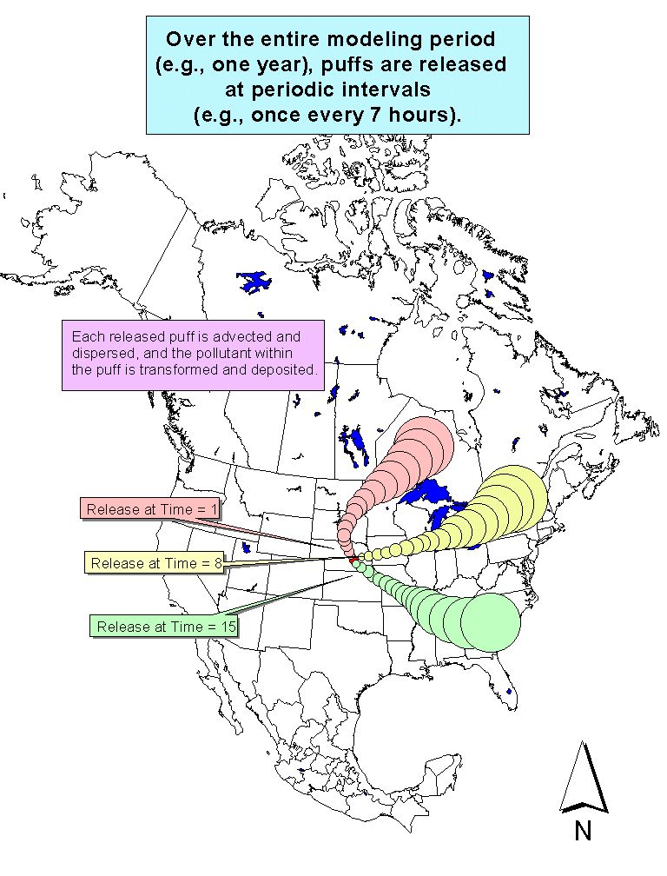
Notes:
52
This is way we typically run the HYSPLIT model. We do a run for one particular source location, and we release puffs periodically throughout the year (e.g., once every 7 hours). We follow each puff and keep track of the dispersion and the fate processes (deposition, transformation, etc.). The model uses the physical-chemical properties of the pollutant we are modeling, of course. By the end of the year, we have a good idea of the average impact that a source in this location would have on the receptors of interest (e.g., the Great Lakes).

Slide 53
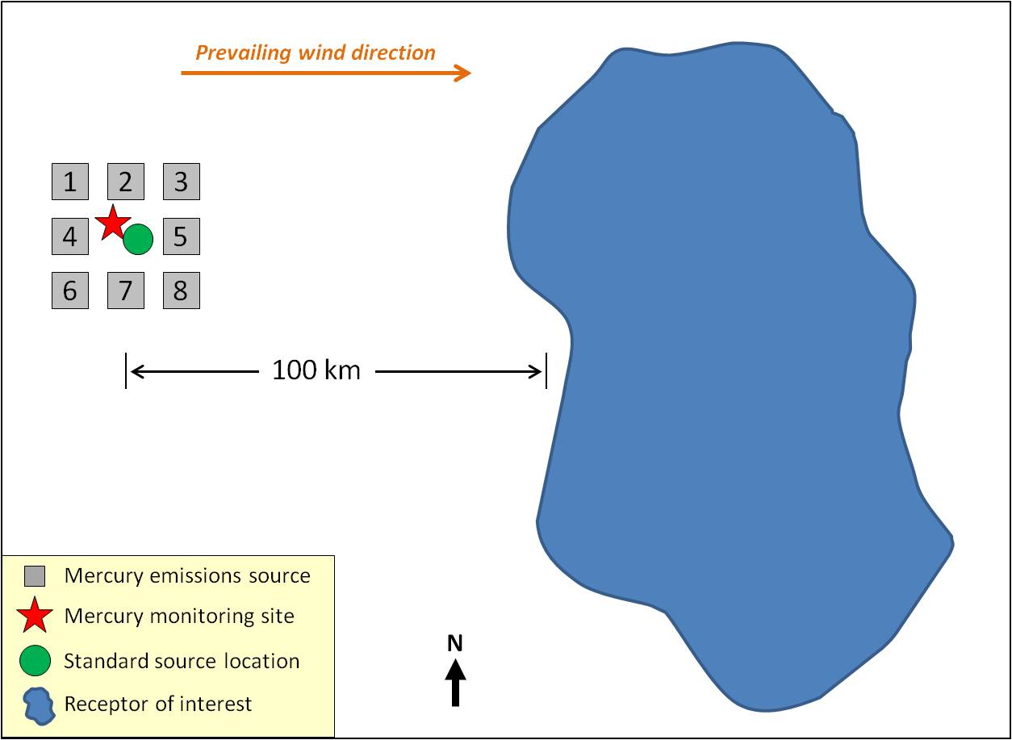
Getting good ground-truthing results harder
than estimating deposition to the Great Lakes
One Standard Source Location (green dot) would do a decent job of estimating deposition to the receptor, for all of the hypothetical, “actual” source locations shown (numbered boxes)
But the same Standard Source Location would be completely inadequate to estimate deposition and concentrations at the monitoring site (red star)
Notes:
Typically, modeling analyses are evaluated by comparing their predictions with measurements at monitoring sites. We will present such an evaluation analysis in Section 5, below. However, the primary goal of this project is to create accurate estimates of the amount and source attribution for mercury deposition to the Great Lakes – not to produce deposition estimates at monitoring sites in the region.
As will be seen shortly, it is generally much more difficult – and computationally intensive – to accurately predict deposition at a single monitoring site (or a set of such sites) than it is to predict deposition for large area receptors such as the Great Lakes.
Consider Figure 24, a conceptual diagram in which we show a hypothetical situation with a receptor of interest, a monitoring site, and several (8) mercury emissions sources in the vicinity of the monitoring site. For reference, a prevailing wind direction, distance scale, and map orientation are also shown. Since the winds do not always blow in the “prevailing” direction, all of the sources will have some impacts on the monitoring site. However, even if each of the sources were identical, they would likely have dramatically different impacts on the monitoring site, given their different spatial orientation to the site. For example, given the prevailing wind direction, source #4 would be expected to have a relatively large impact on the site, but source #5 would be expected to have a relatively small impact on the monitoring site. The consequence is that to estimate the wet deposition of mercury at the monitoring site – arising simply from the sources in the vicinity of the site alone -- standard sources would most likely have to be located at each of the eight sources shown.
However, to accurately estimate the impacts of the 8 sources on the receptor of interest, about 100 km away in this hypothetical example, a single standard source location located near the “center” of the source group would likely suffice. In other words, to estimate the concentration or deposition at the monitoring site in this simple, hypothetical example, 8 standard source locations would be needed – corresponding to 24 different computer simulations, one for each of the three forms of mercury emitted – whereas only 1 location (3 simulations) would be needed to estimate the deposition impact of the sources on the receptor of interest. Because of computational resource constraints, and given the overarching goals of this project, we have prioritized the estimation of deposition to the Great Lakes -- large area receptors – rather than focus on “point” monitoring sites in the region. Substantially more standard source locations than the 136 utilized would have had to have been used to generate the same accuracy for monitoring site estimates as were generated for the Great Lakes in this analysis. Notwithstanding all of the above, as will be shown in Section 5 below, this modeling analysis produced results at monitoring sites in the Great Lakes region that were encouragingly – and perhaps even surprisingly – close to the measurements made at these sites.

Slide 54
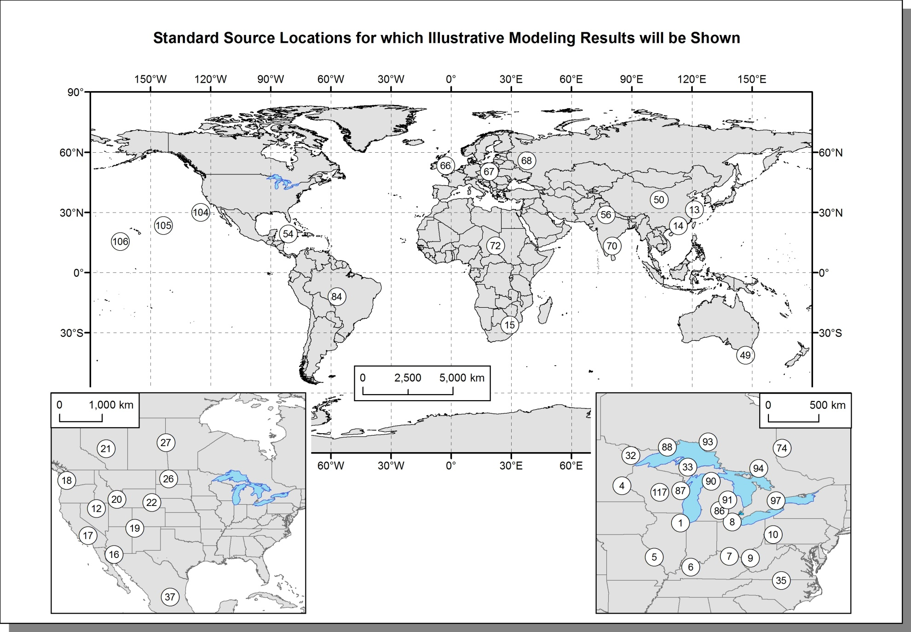
Standard Source Locations for Illustrative Modeling Results

Slide 55
Lake Erie Transfer Flux Coefficients for two kinds
of Generic Coal-Fired Power Plants (logarithmic scale)

Slide 56
Lake Erie Transfer Flux Coefficients for two kinds
of Generic Coal-FIred Power Plants (linear scale)

Slide 57
In order to conveniently compare different model results,
a “transfer flux coefficient” X will be used,
defined as the following:

Slide 59
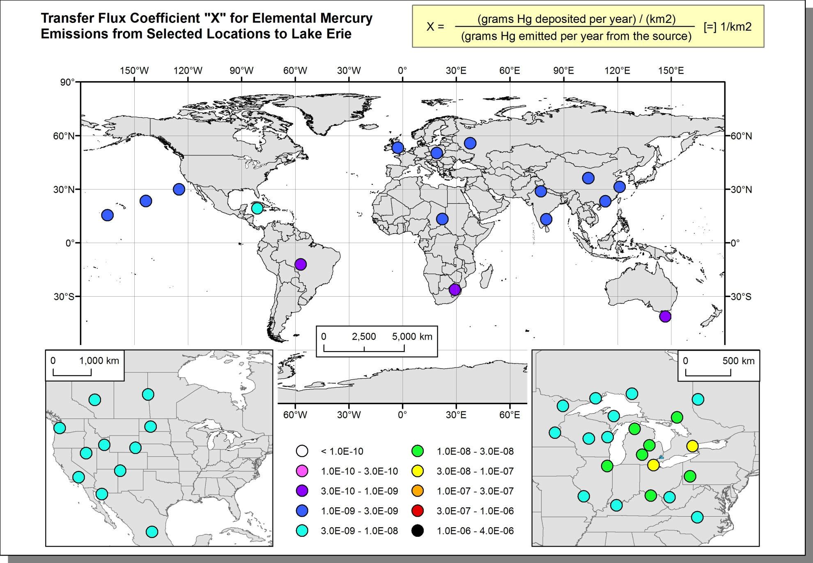
Transfer Flux Coefficients For Pure Elemental Mercury Emissions at an Illustrative Subset of Standard Source Locations, for Deposition Flux Contributions to Lake Erie

Slide 60
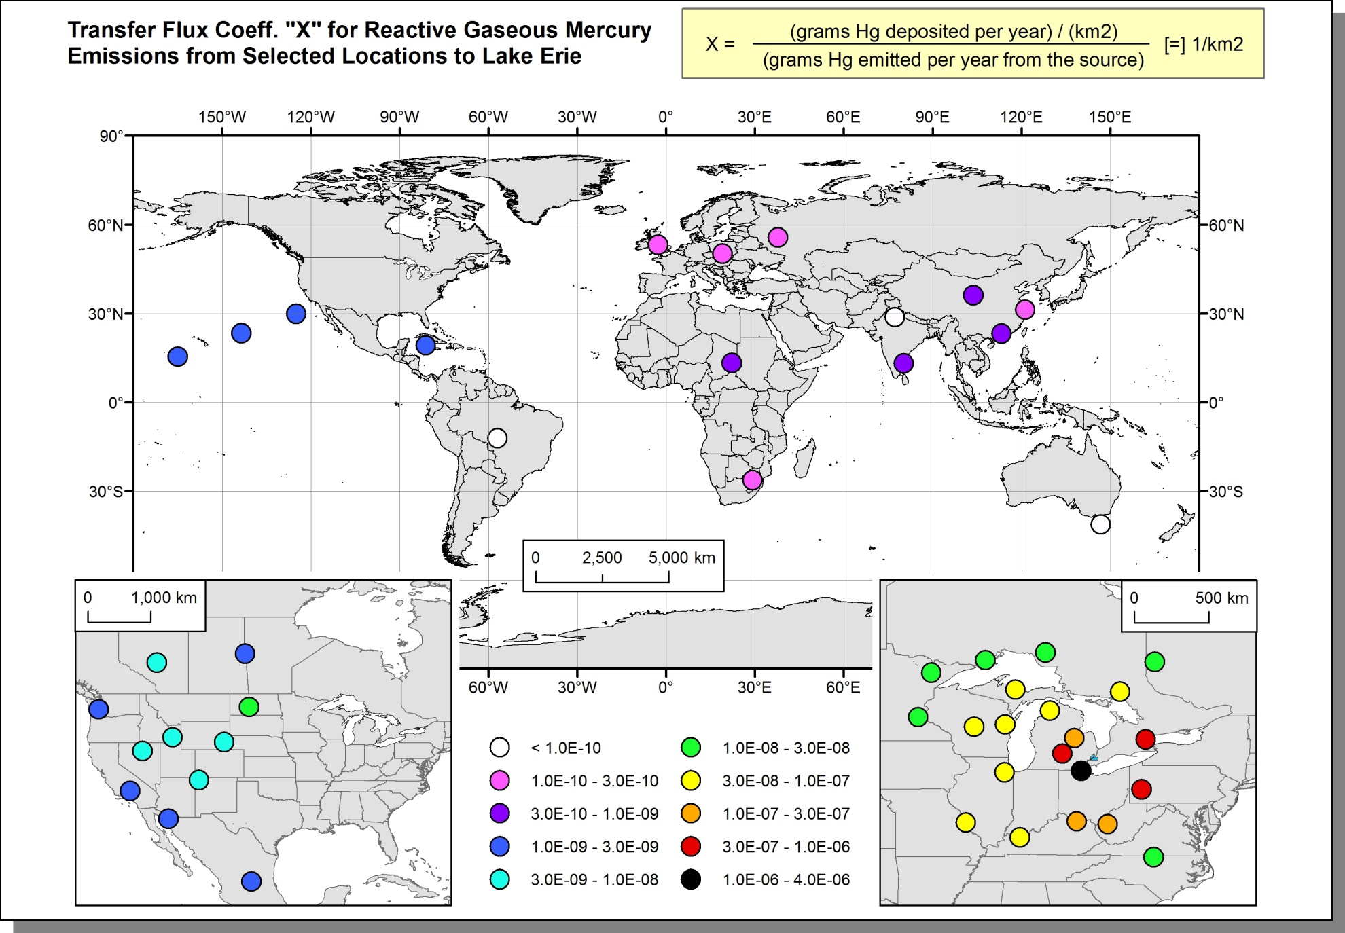
Transfer Flux Coefficients For Pure Reactive Gaseous Mercury Emissions at an Illustrative Subset of Standard Source Locations, for Deposition Flux Contributions to Lake Erie

Slide 61
Transfer Flux Coefficients For Hg(0), Hg(II),
and Hg(p) to Lake Erie (logarithmic scale)

Slide 62
Transfer Flux Coefficients For Hg(0), Hg(II),
and Hg(p) to Lake Erie (linear scale)

Slide 63
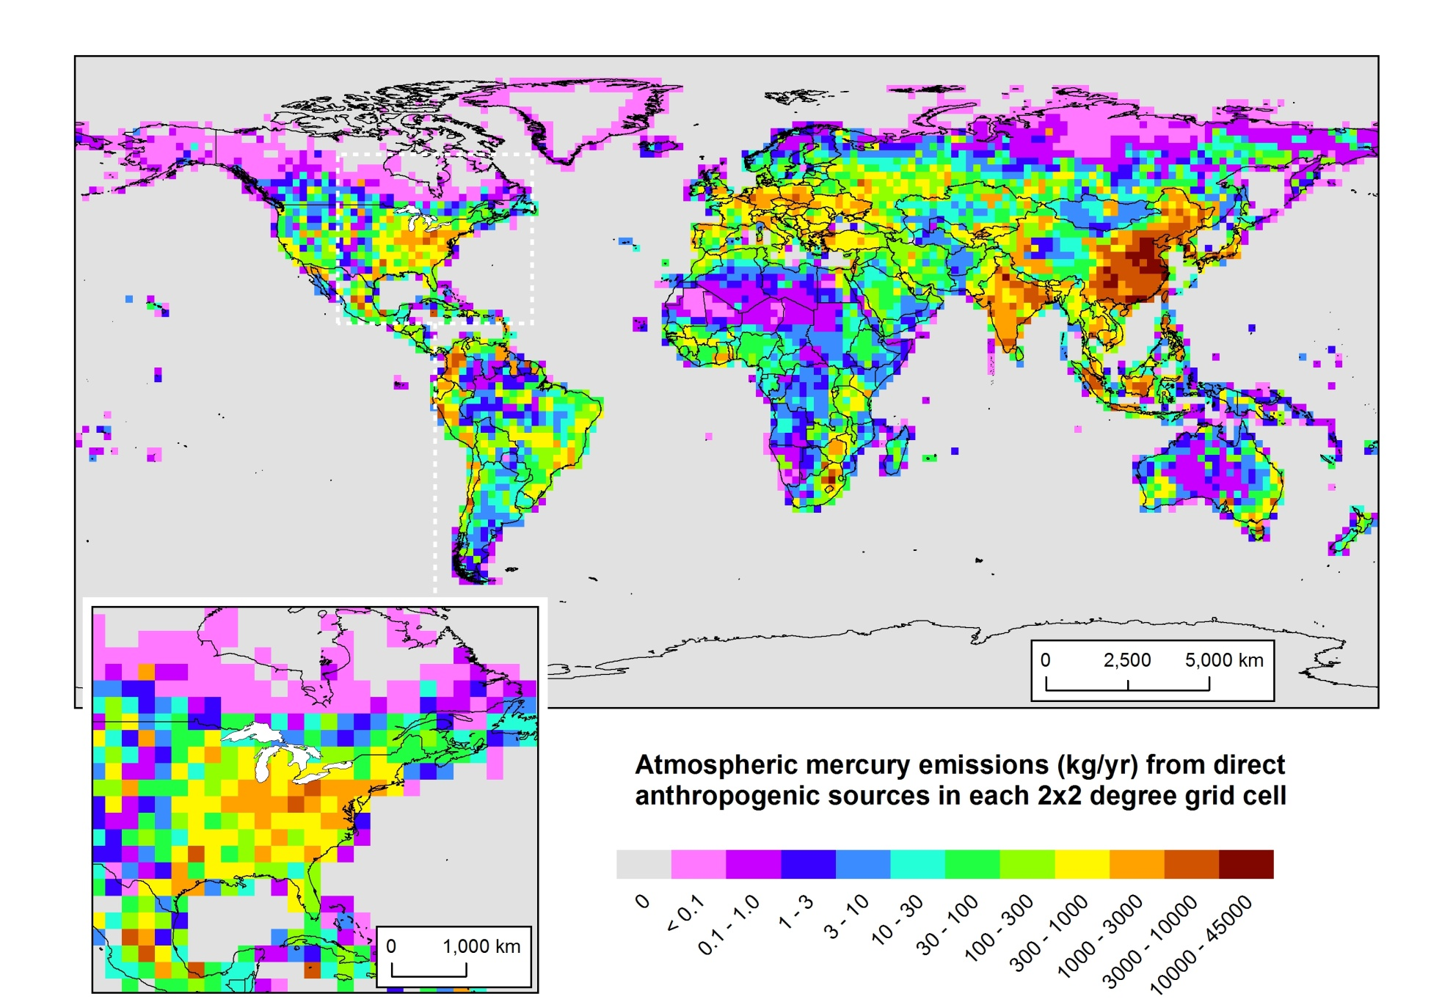
Anthropogenic Mercury Emissions (ca. 2005)

Slide 64
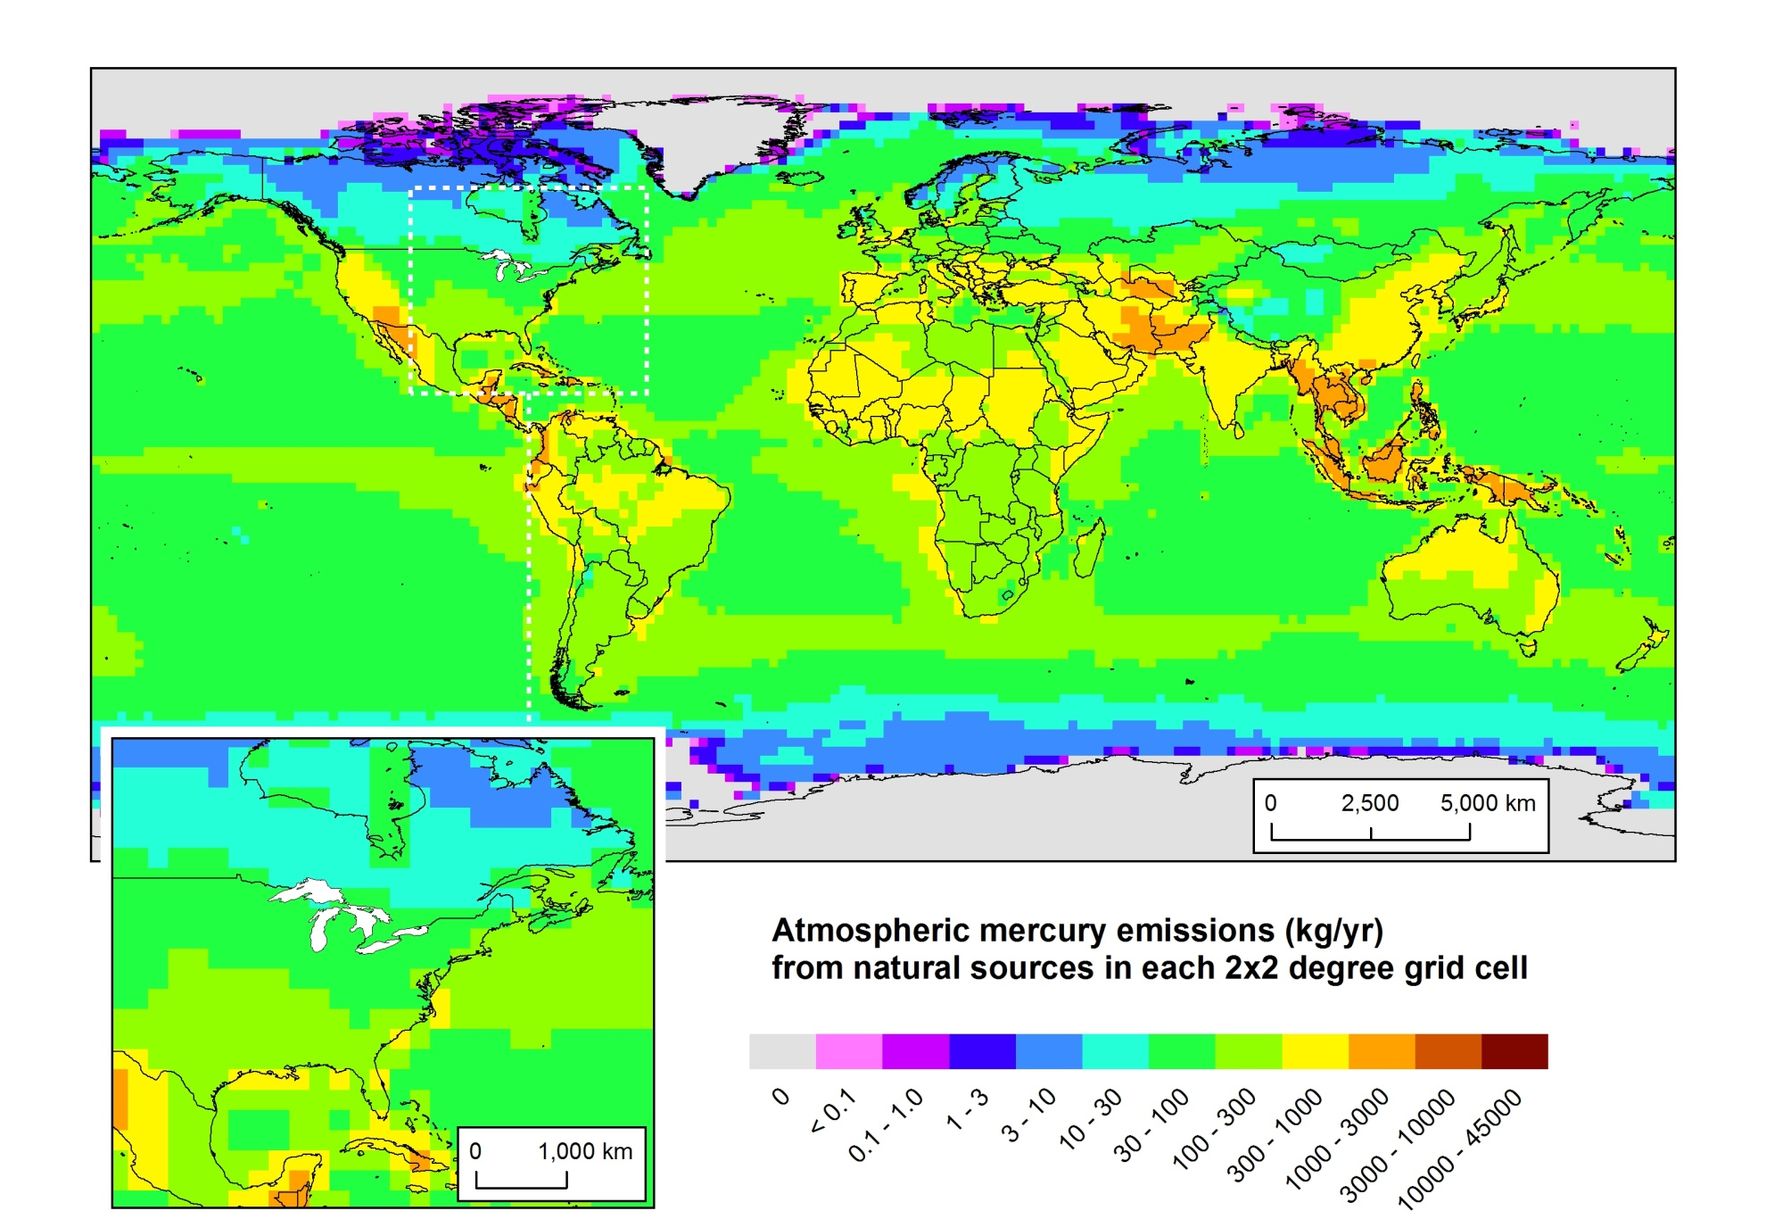
Natural mercury emissions

Slide 65
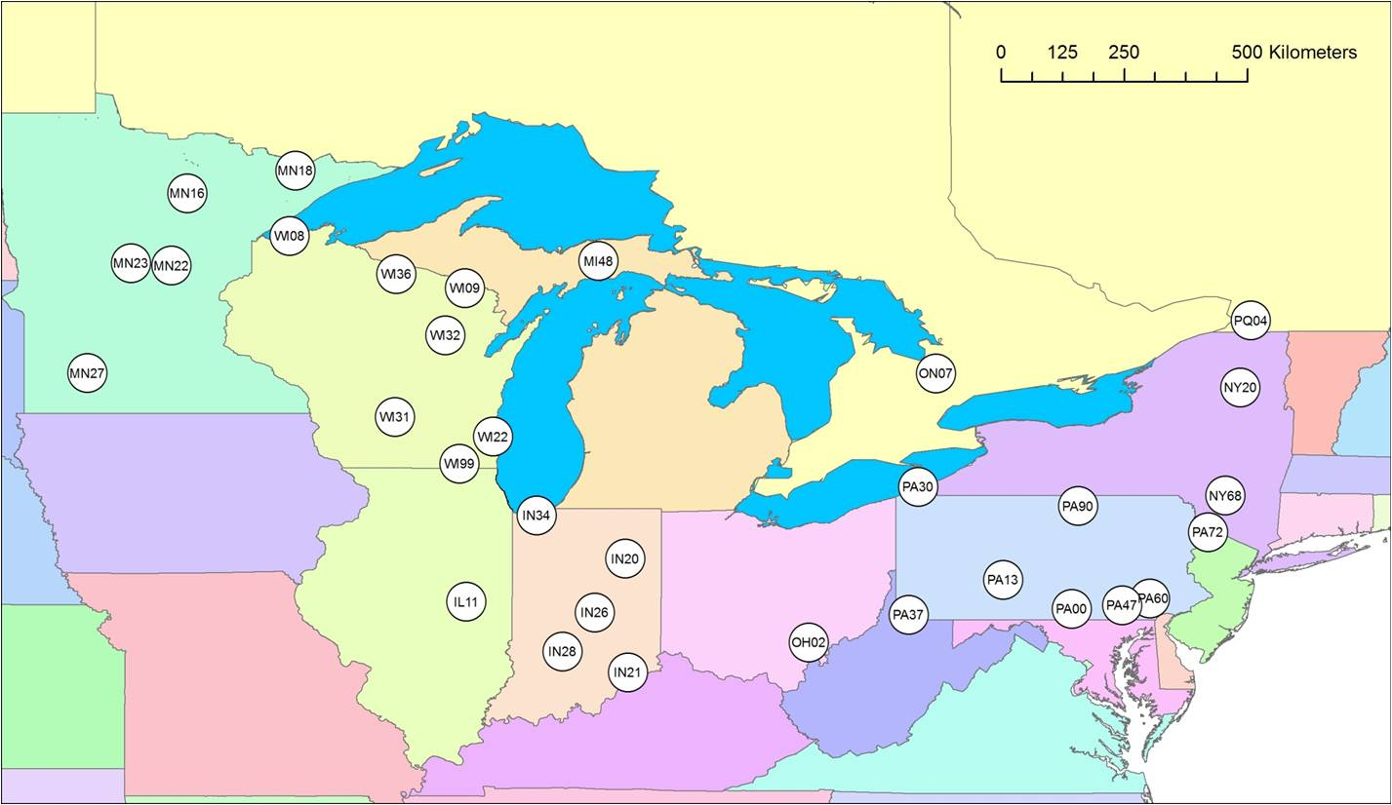
Figure 55. Mercury Deposition Network Sites in the Great Lakes
Region Considered in an Initial Model Evaluation Analysis
NOAA Air Resources Laboratory
65
Discussion July 5, 2012

Slide 66
Figure 56. Comparison of Total 2005 Precipitation Measured at each of the Great-Lakes Region MDN Sites with the Precipitation in the Meteorological Datasets Used as Inputs to this Modeling Study
NOAA Air Resources Laboratory
66
Discussion July 5, 2012
Notes:
EDAS met data (over a central North American domain) used as input to the model underestimated the actual precipitation at the MDN sites…
NCEP/NCAR global met data used as input to the model overestimated the actual precipitation at the MDN sites…

Slide 67
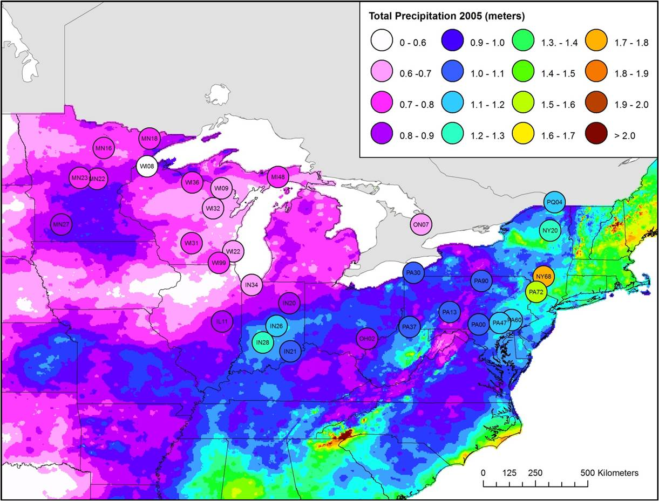
Comparison of 2005 precipitation total as measured at MDN sites in the
Great Lakes region (circles) with precipitation totals assembled
by the PRISM Climate Group, Oregon State University
NOAA Air Resources Laboratory
67
Discussion July 5, 2012
Notes:
2005 MDN measured precip was probably pretty good –
seems to match the general regional picture of precip measurements during 2005

Slide 68
Modeled vs. Measured Wet Deposition of Mercury at Sites in the Great Lakes Region
NOAA Air Resources Laboratory
68
Discussion July 5, 2012
Notes:
All the data

Slide 69
Modeled vs. Measured Wet Deposition of Mercury at Sites in the Great Lakes Region
NOAA Air Resources Laboratory
69
Discussion July 5, 2012

Slide 70
Summary of Mercury Emissions Inventories Used in GLRI Analysis

Slide 71
Model-estimated 2005 deposition to the Great Lakes Basin from countries with the highest modeled contribution from direct and re-emitted anthropogenic sources

Slide 72
Model-estimated per capita 2005 deposition to the Great Lakes Basin from countries with the highest modeled contribution from direct & re-emitted anthropogenic sources

