Slide 1
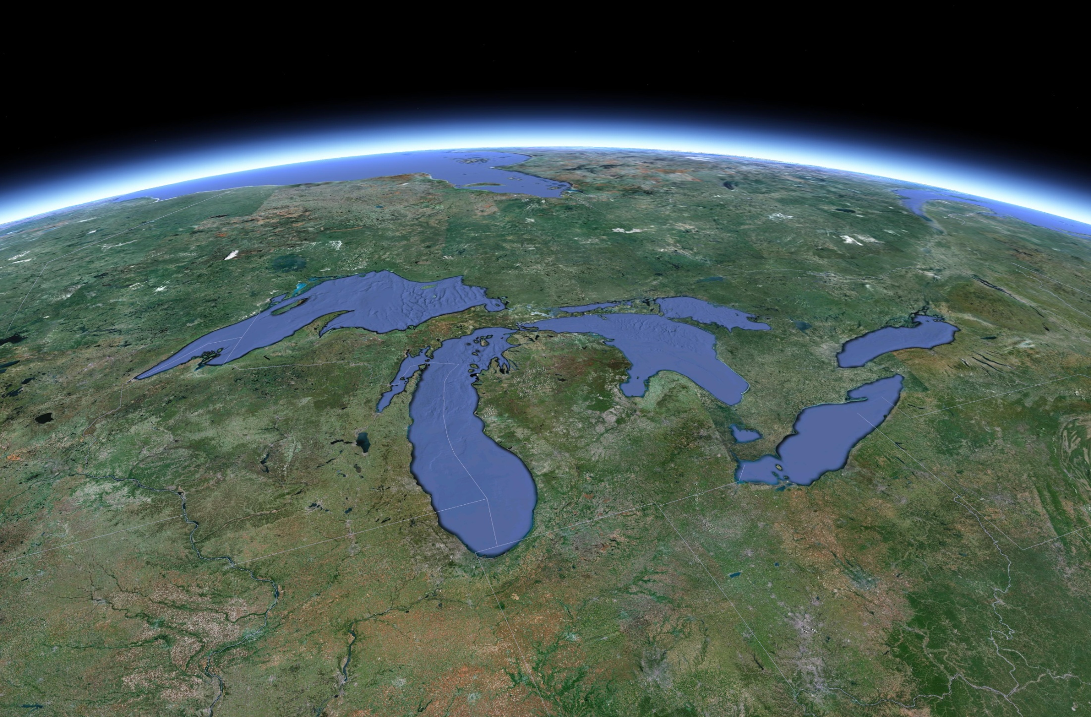
Modeling the Atmospheric Transport and Deposition of Mercury to the Great Lakes
Mark Cohen, Roland Draxler, Hang Lei, Richard Artz
NOAA Air Resources Laboratory (ARL)
College Park, MD, USA
12th International Conference on Mercury as a Global Pollutant (ICMGP), Jeju, Republic of Korea, June 18, 2015

Slide 2
Acknowledgements and Thanks:
USEPA, Environment Canada
Arctic Monitoring and Assessment Program (AMAP)
National Atmospheric Deposition Program (NADP)
Winston Luke, Xinrong Ren, Paul Kelley, NOAA ARL
Eric Miller (Underhill Vermont)
Tom Holsen, Young-Ji Han (New York State sites)
Mae Gustin, Seth Lyman, et al. (Nevada sites)
Dan Jaffe, Seth Lyman, et al. (Mt Bachelor site)
Laurier Poissant and Martin Pilote (St. Anicet)
Frank Froude (Burnt Island, Egbert, and Point Petre)
Rob Tordon (Kejimkujik)
Alexandra Steffen and Cathy Banic (Alert)
Brian Wiens (Bratt’s Lake)
HYSPLIT Modeling Team at NOAA ARL, Rick Jiang
Great Lakes Restoration Initiative
Emissions
Measurement Data for Model Evaluation
Met Data, IT
Funding
Notes:
Rick Jiang, Chief Information Officer at the Air Resources Laboratory, for maintenance, troubleshooting, and development of the Linux-based computational server used to carry out the modeling in this study;
Eric Miller, Ecosystems Research Group, Norwich, Vermont, for providing 2005 ambient mercury monitoring data from the Underhill, Vermont site;
Tom Holsen, Young-Ji Han, and colleagues at Clarkson University, for providing 2005 ambient mercury monitoring data from the Potsdam and Stockton, New York sites;
Seth Lyman, Mae Gustin, and colleagues at the Desert Research Institute (DRI) in Reno, Nevada, for providing 2005 ambient mercury monitoring data for the Paradise, Gibbs Ranch, and Reno sites in Nevada;
Seth Lyman, Dan Jaffe and colleagues at the University of Washington-Bothell, for providing 2005 ambient mercury monitoring data for the Mt. Bachelor, Oregon site;
Environment Canada, for 2005 CAMNet ambient mercury monitoring data downloaded from the Canadian National Atmospheric Chemistry (NAtChem) Toxics Database;
The following CAMNet Principal Investigators and their teams, responsible for contribution of Total Gaseous Mercury data for 2005 used in this analysis to the NAtChem Toxics Database:
Laurier Poissant and Martin Pilote (St. Anicet)
Frank Froude (Burnt Island, Egbert, and Point Petre)
Rob Tordon (Kejimkujik)
Alexandra Steffen and Cathy Banic (Alert)
Brian Wiens (Bratt’s Lake)
National Atmospheric Deposition Program (NADP), Illinois State Water Survey, Champaign, IL, for 2005 mercury wet deposition data at sites in the NADP’s Mercury Deposition Network.
Current affiliation: Kangwon National University, Kangwon Do, South Korea
Current affiliation: Utah State University, Vernal, Utah

Slide 3
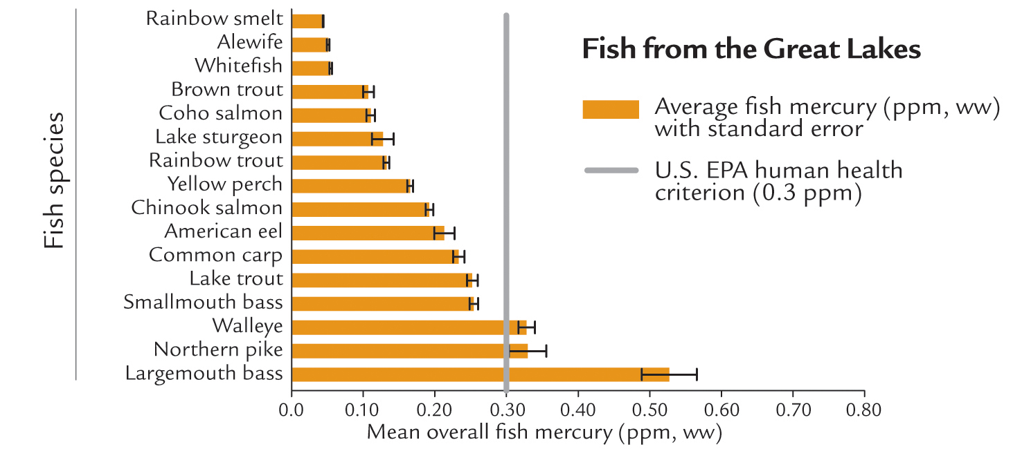
0.05 ppm level recommended by the Great Lakes Fish Advisory Workgroup (2007)
Mercury in Great Lakes Fish
Evers, D.C., et al. (2011). Great Lakes Mercury Connections: The Extent and Effects of Mercury Pollution in the Great Lakes Region. Biodiversity Research Institute. Gorham, Maine. Report BRI 2011-18. 44 pages.
Notes:
Biodiversity Research Institute (2011): http://www.briloon.org/uploads/hgconnections/glmc/GLMC_FinalReport.pdf
The Great Lakes Fish Advisory Workgroup currently recommends a methylmercury reference dose of 0.05 parts per million, six times lower than the 2001 level.
Great Lakes Fish Advisory Workgroup. 2007. A protocol for mercurybased fish consumption advice: an addendum to the 1993 protocol
for a uniform Great Lakes sport fish consumption advisory. Wisconsin Department of Health Services, Madison, WI, 30 pp.
Available at http://www.dhs.wisconsin.gov/eh/fish/FishFS/2007Hg_Add_Final_05_07.pdf.

Slide 4
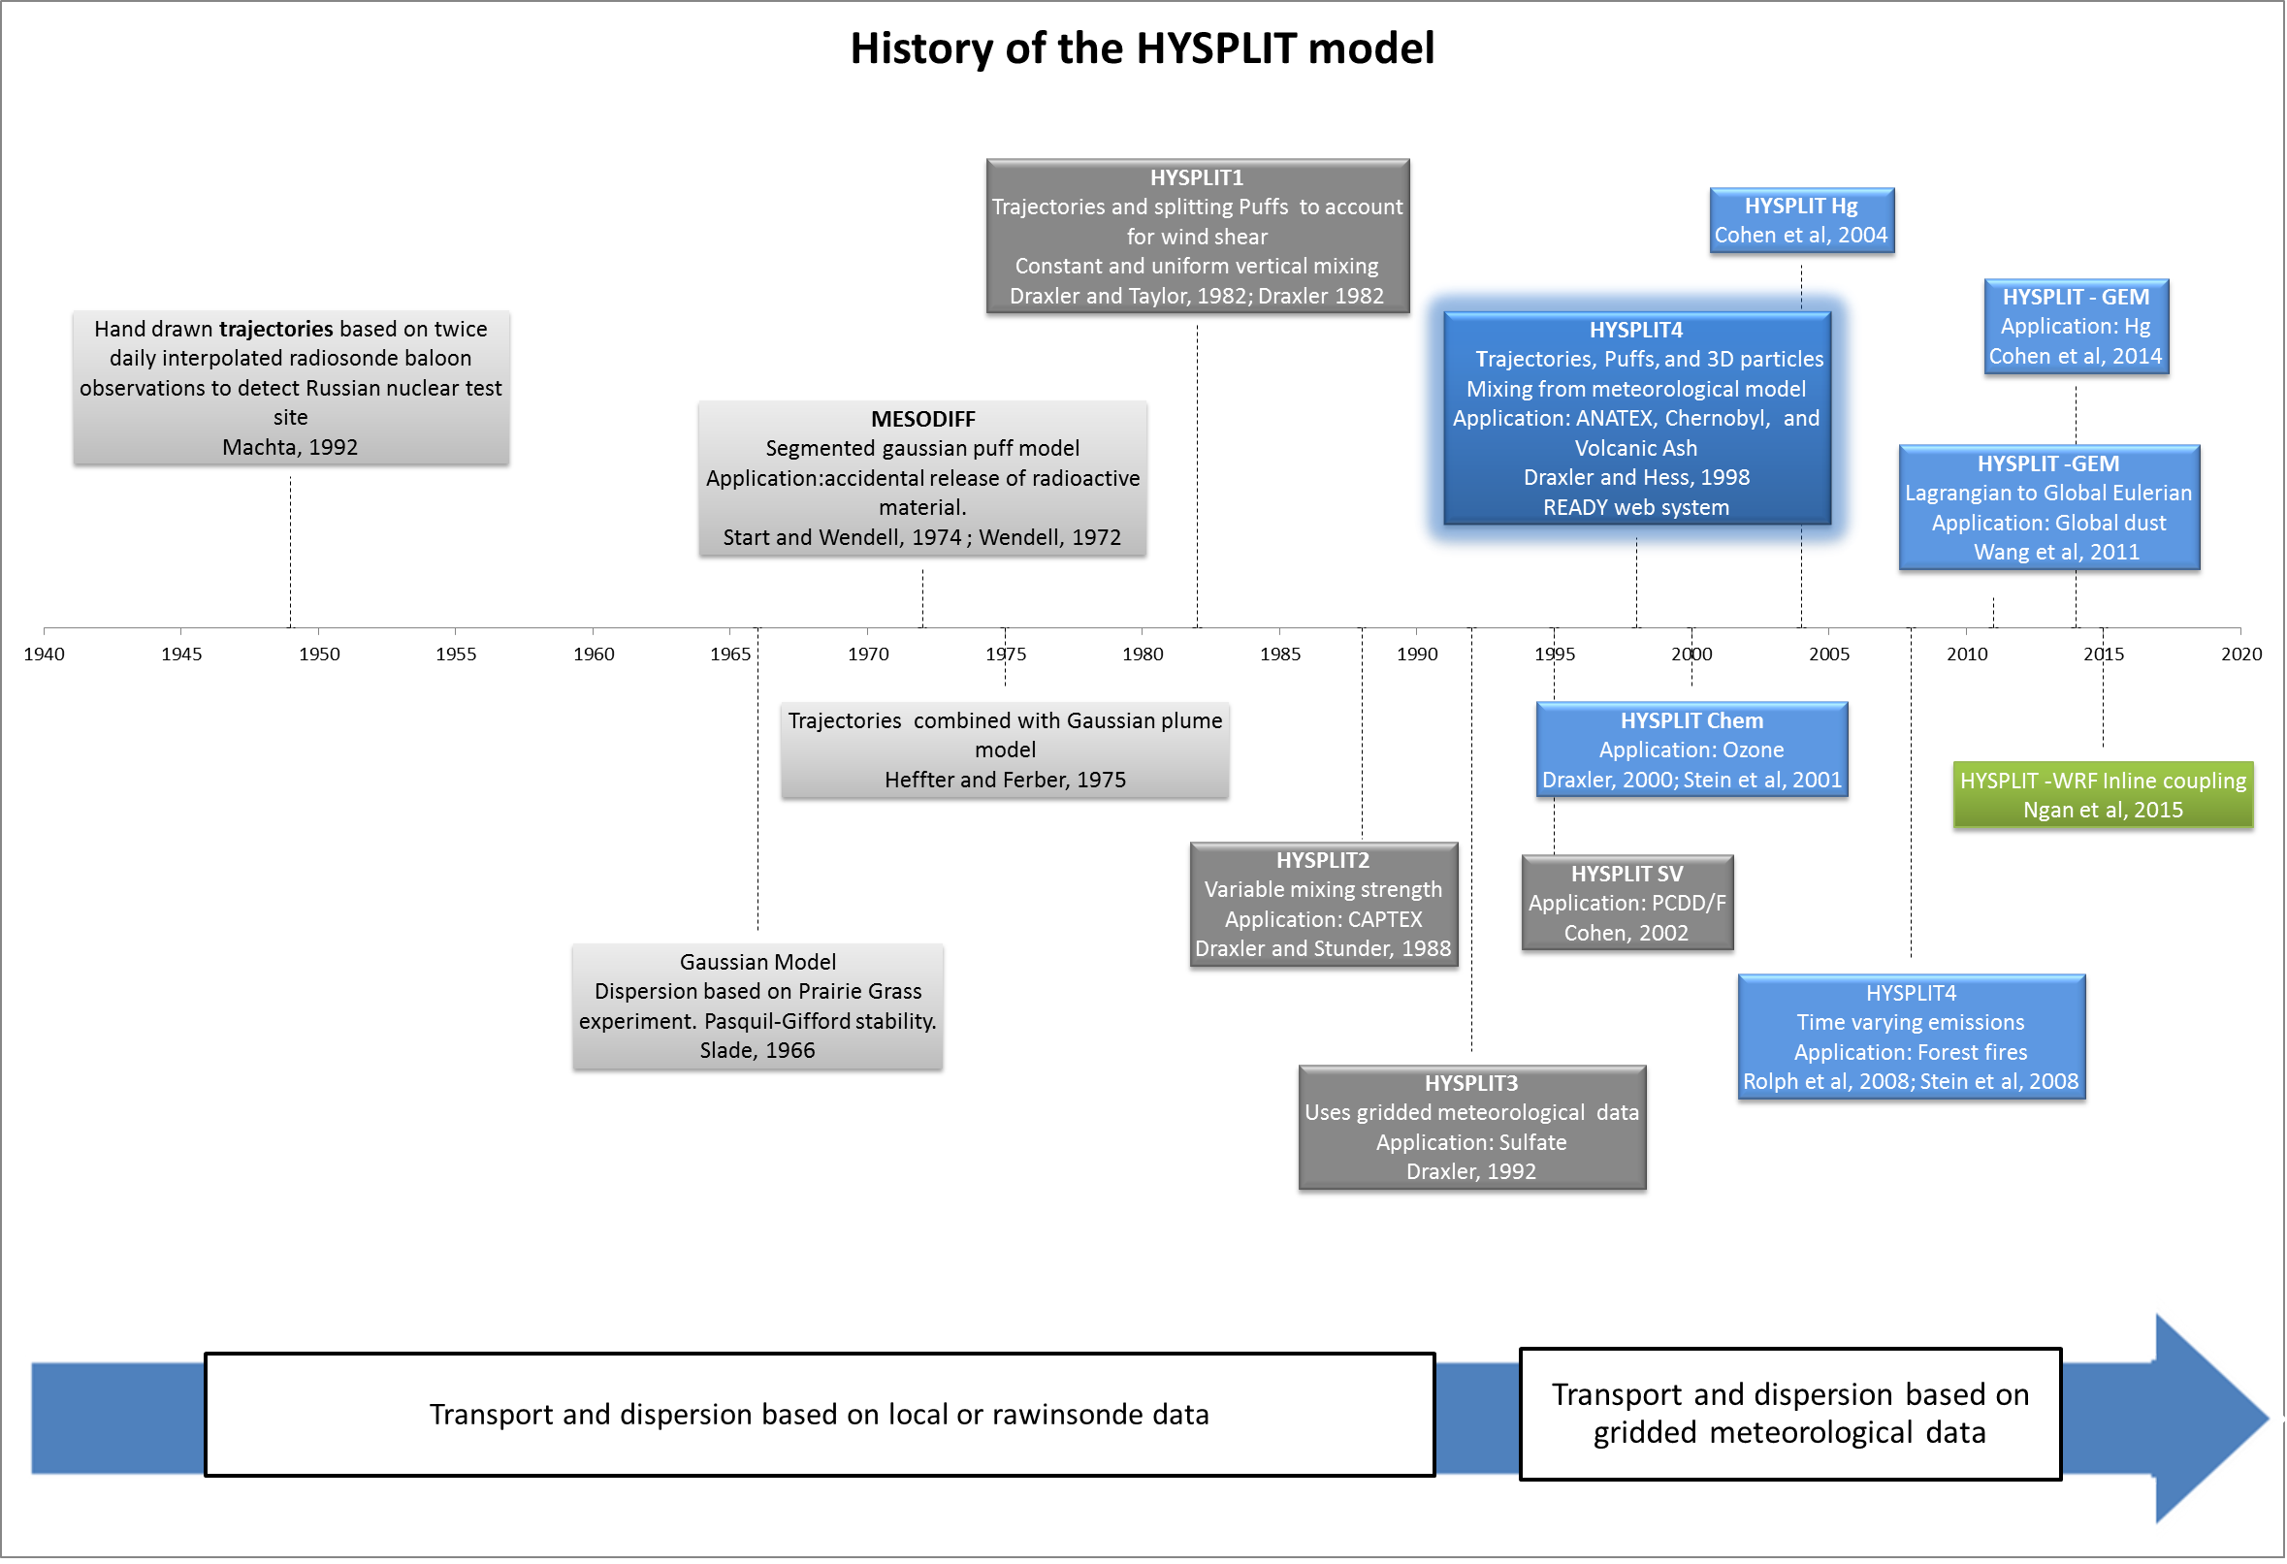
NOAA’s HYSPLIT atmospheric transport and dispersion modeling system
Stein, A.F., Draxler, R.R., Rolph, G.D, Stunder, B.J.B., Cohen, M.D., and Ngan, F.
Bulletin of the American Meteorological Society, 2015, in press.
http://journals.ametsoc.org/doi/abs/10.1175/BAMS-D-14-00110.1
1940
1950
1960
1970
1980
1990
2000
2010
2020
HYSPLIT can do more than just back-trajectories
Notes:
Although similar developments were taking place elsewhere in the world, the U.K. in particular, within NOAA, the early development of computerized numerical methods to compute transport and dispersion in a time-varying wind field (in contrast to steady-state Gaussian plume models) started at ARL’s field division in Idaho that supported the emergency operations center at what was called at the time the National Reactor Testing Station. The MESODIFF model interpolated winds and temperatures from a network of towers over the test site to compute the transport of a series of sequentially released puffs that grow with time to estimate the dispersion. Later this approach was expanded to more regional applications at ARL Headquarters by Heffter and Ferber (1975) by using the data from the weather observing rawindsonde network. This model was then restructured to more realistically simulate the diurnal variations in mixing and the resulting differences in dispersion due to the effects of wind shear especially during stable conditions, modeled by the use of splitting puffs that would each transport with their own wind vector rather than a layer-average wind. This prototype modeling approach became HYSPLIT. Subsequent versions incorporated more sophisticated mixing schemes, gridded meteorological data, and improvements in mixing and turbulence parameterizations. The prime focus in the last ten years has been to apply the model to a variety of different applications.

Slide 5

When puffs grow to sizes large relative to the meteorological data grid, they split, horizontally and/or vertically
To simulate the global transport of mercury, puffs are transferred to Eulerian grid after a specified time downwind (~3 weeks), and the mercury is simulated on that grid from then on…
This is how we model the local & regional impacts.
But for global modeling,
puff splitting overwhelms
computational resources
Puffs of pollutant are emitted and dispersed downwind
Atmospheric chemistry and deposition simulated for each puff
5
Notes:
Incorporation of the mercury modeling algorithms into the new GEM-HYSPLIT code was a large scientific programming task.

Slide 6

Today’s talk will just present Eulerian-only results, for 2005
These Eulerian-only simulations were much faster (a few weeks) than Lagrangian-only and hybrid Lagrangian-Eulerian simulations (3-6 months)
It’s important to fail fast!

Slide 7
1/e Half-Lives for Fate Processes within HYSPLIT-Hg
Starting with Uniform Mixing Ratio Throughout the Atmosphere
Hg(p)
Hg(II)
0.2 year = 2.4 months
0.048 year = 2.5 weeks
Hg(0)
Hg(0) oxidation rate 67% – no reduction
Hg(0) oxidation base case – no reduction
0.84 year = 10 months

Slide 8
Study Year was 2005

Slide 9
Emissions Inventories with Net Ocean and Terrestrial Hg(0) Fluxes
This Work
GEOS-Chem

Slide 10
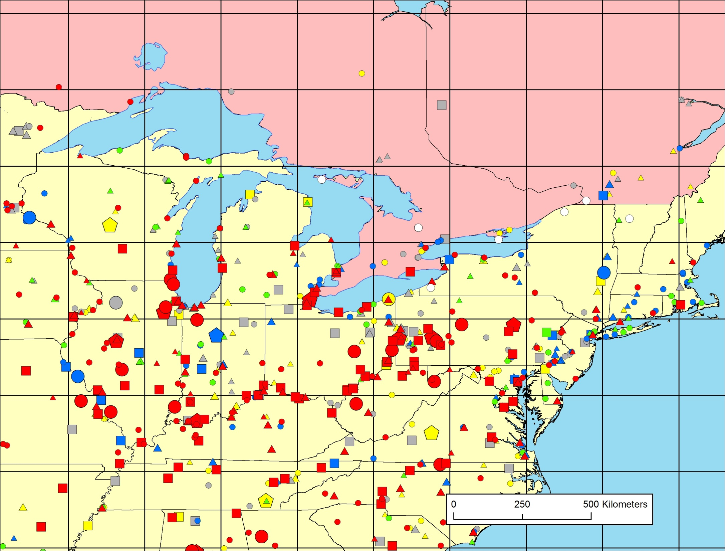
2.5º x 2.5º
grid
Grid is too coarse to expect good agreement with measurements, but…
Type of Emissions Source
coal-fired power plants
other fuel combustion
waste incineration
metallurgical
manufacturing & other
Burnt Island
St. Anicet
Potsdam
Underhill
Egbert
Point Petre
Stockton
Emissions
(kg/yr)
5-10
10-50
50-100
100–300
300–500
500–1000
1000–3000

Slide 11
Hg(0) at Egbert Ontario
Notes:
Base Case (J) -- oxid_33_pf_10_wetr_40K_AE100_Aii100_AP100_B75_L75_O115_R75_V50 (0.70)
All data are 24 hour averages

Slide 12
Hg(0) at Egbert Ontario
Which inventory components show the right seasonal variation?

Slide 13
modeled vs. measured Hg(0) concentrations during 2005, for measurement sites in the Great Lakes region and sites outside the region

Slide 14
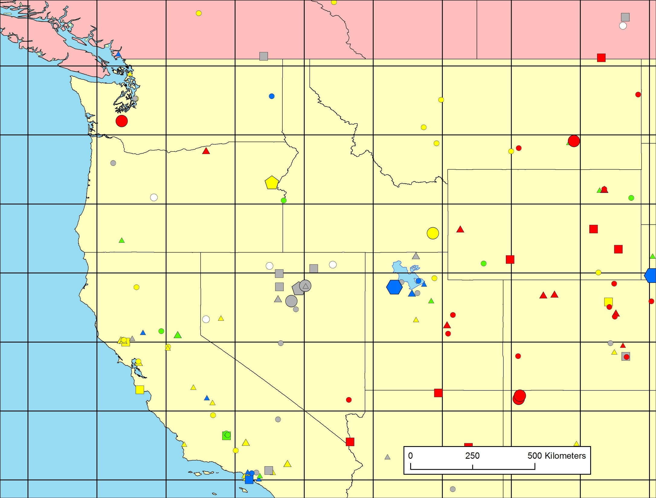
Mt. Bachelor
Paradise
Gibbs
Reno
2.5º x 2.5º
grid

Slide 15
Hg(II) + Hg(p) at Reno (Desert Research Inst.)
Notes:
Model includes Hg2s

Slide 16
modeled vs. measured Hg(II) and Hg(p) concentrations during 2005
Model estimated total for all non-elemental mercury is higher than measurements:
Are the measurements too low or is the model too high?

Slide 17
modeled vs. measured 2005 Hg wet deposition for Mercury Deposition Network (MDN) sites in different regions

Slide 18
Base Case Source Attribution Results

Slide 19
Base-case results compared with recent CMAQ modeling:
Grant, S. L., M. Kim, P. Lin, K. C. Crist, S. Ghosh and V. R. Kotamarthi (2014). A simulation study of atmospheric mercury and its deposition in the Great Lakes. Atmospheric Environment 94: 164-172.
Base Case Source Attribution Results
Notes:
Grant, S. L., M. Kim, P. Lin, K. C. Crist, S. Ghosh and V. R. Kotamarthi (2014). A simulation study of atmospheric mercury and its deposition in the Great Lakes. Atmospheric Environment 94: 164-172.

Slide 20
 | Base Case | Variation 1 4-D-iii | Variation 2 5-O-i | Variation 3 6-V-i
Oxidation Reaction rates | default | 60% less | default | default
Prompt Hg(II) Conversion | 0% | 0% | 50% | 67%
Anthropogenic Emit (Mg/yr) | 1930 | 1930 | 1930 | 1930
Land + Reemissions + Ocean {Net Hg(0) emissions} (Mg/yr) | 4350 | 2300 | 4350 | 4350
Particle Fraction of Hg(0) oxidation | 10% | 25% | 10% | 10%
WETR (wet deposition parameter) | 40,000 | 80,000 | 40,000 | 40,000
Great Lakes Hg(0) bias | 0% | 0% | 0% | 0%
Great Lakes Hg wet dep bias | +2% | -8% | -10% | -14%
Notes:
Base case is J
Variation 1 is 4-D-iii
variation 2 is 5-O-i
Variation 3 is 6-V-i

Slide 22
Base Case
1: 60% oxid; ~50% L+R+O net Hg0
2: Plume HgII convert 50%
3: Plume HgII convert 67%

Slide 23
HYSPLIT-Hg Base Case gives reasonable results for 2005
  Several variations also considered, which can also give reasonable results for 2005
Source Attribution results for the different cases are understandably somewhat different
  However, policy implications of the different modeling results may not be that different
Next steps:
  Modeling for more recent years, including detailed model evaluation at three NOAA/EPA monitoring sites (within AMNet):
    Beltsville MD; Grand Bay MS; and Mauna Loa HI
  + Nested grid + explicit sub-surface terrestrial & ocean layers

Slide 24
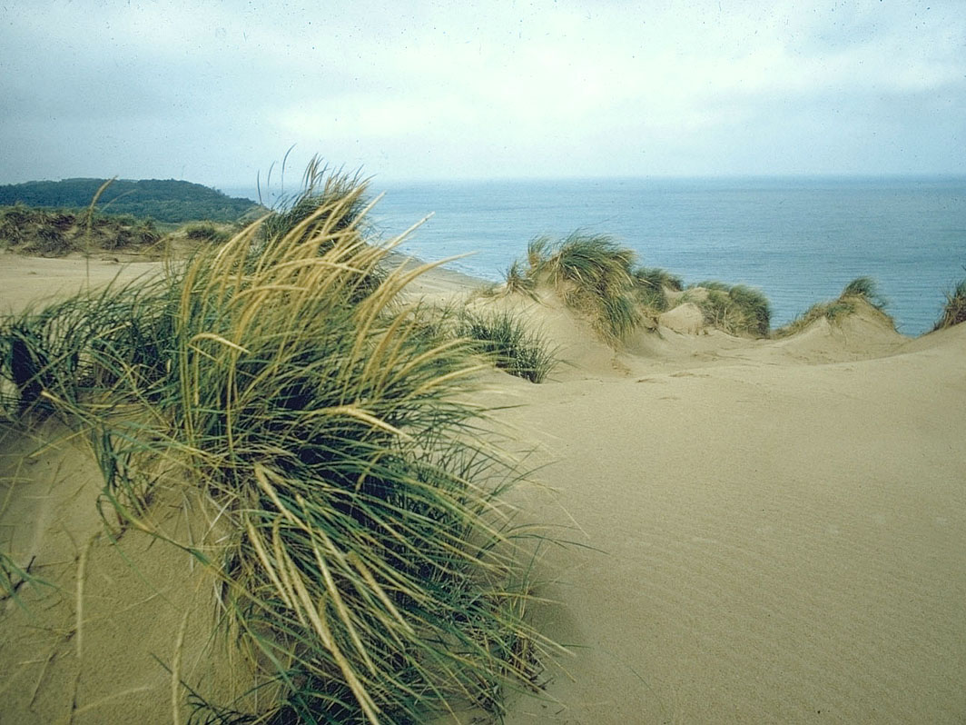

Thanks!
This work was partially funded through the Great Lakes Restoration Initiative

