Slide 1
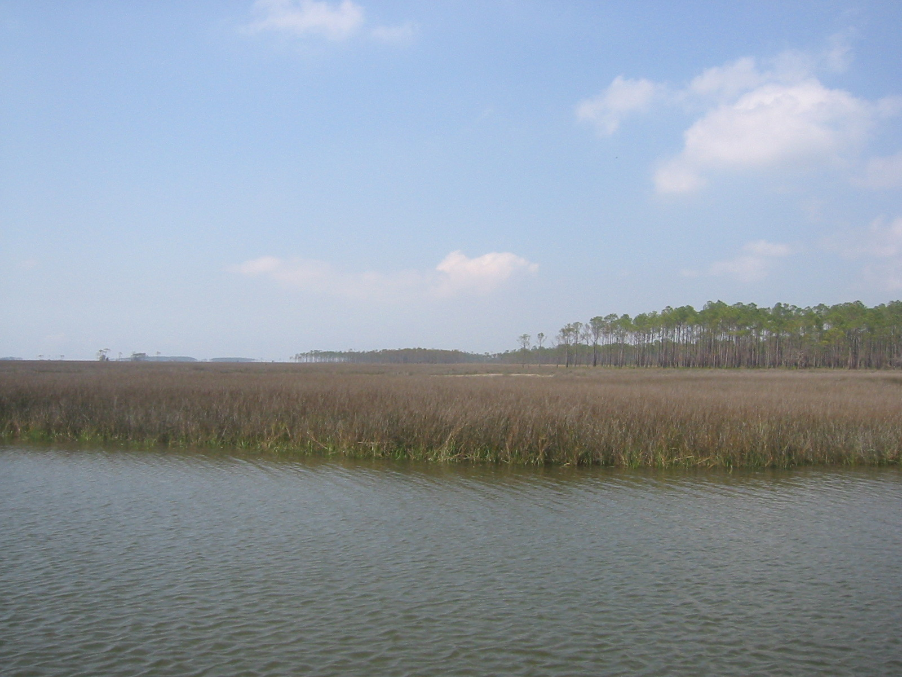
Evaluating the HYSPLIT-Hg Atmospheric
Mercury Model Using Ambient Monitoring Data
Mark Cohen¹, Winston Luke¹, Paul Kelley¹, Fantine Ngan¹,
Richard Artz¹, Steve Brooks², Venkata Bhaskar Rao Dodla³, Roland Draxler¹,
Xinrong Ren¹, David Schmeltz⁴, Timothy Sharac⁴, Jake Walker⁵
NOAA Air Resources Laboratory, Silver Spring MD, USA
Canaan Valley Institute, Davis WV, USA
Jackson State University, Jackson MS, USA
USEPA Clean Air Markets Division, Washington DC, USA
Grand Bay National Estuarine Research Reserve, Moss Point MS, USA
10th International Conference on Mercury as a Global Pollutant
July 23-29, 2011, Halifax, Nova Scotia
Notes:
1
[...background picture is the view from the Atmospheric Mercury Monitoring site at the Grand Bay NERR...]

Slide 2
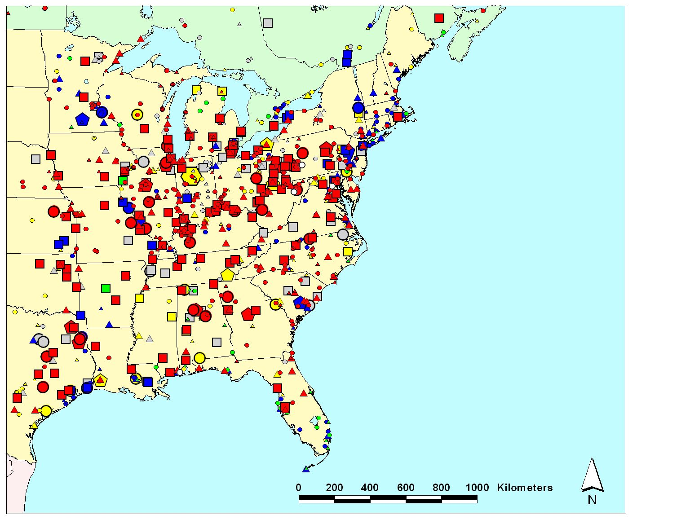
NOAA Air Resources Laboratory: Five Collaborative Speciated Atmospheric Mercury Measurement Sites
Emissions
(kg/yr)
Allegheny
Portage
5-10
10-50
50-100
100–300
300–500
500–1000
1000–3500
Mauna Loa
Beltsville
Canaan Valley
Type of Emissions Source
coal-fired power plants
other fuel combustion
waste incineration
metallurgical
Grand Bay
NERR
manufacturing & other
2002 mercury emissions sources based on
data from USEPA, Envr. Canada and the CEC
Notes:
We have five total long-term measurement sites. Four of these are in the continental U.S., and one is at Mauna Loa in Hawaii.
Measurements have taken place at Grand Bay since 2006. Impetus for this site is the threat of mercury contamination in Gulf of Mexico seafood, and the role that NOAA has in protecting this fisheries resource. Located at the Grand Bay National Estuarine Research Reserve (NERR). Ongoing collaboration with Grand Bay NERR, Mississippi Department of Environmental Quality, EPA, US Fish and Wildlife Service. ARL’s site at Grand Bay was a founding station of the NADP Atmospheric Mercury Initiative, contributing data to the national network (now called the Atmospheric Mercury Monitoring Network – AMNet – see slide #16).
Measurements have taken place at the Canaan Valley Institute since 2005. The Canaan Valley Institute is in the heart of the Mid-Atlantic Highlands which generates and receives some of the highest atmospheric inputs of mercury in the nation, and is the primary source of freshwater to the Chesapeake Bay.
Twenty-two rivers and lakes within West Virginia are on the EPA 303b list of mercury impaired waters. CVI was also a founding station of AMNet. Other network site at CVI include: Climate Reference Network, Ameriflux, Global Energy and Water Cycle Experiment (GEWEX), and AIRMoN.
Measurements have taken place at Beltsville MD, in close collaboration with the USEPA, since 2006. The EPA operates a CASTNet site there, and the State of MD and the Univ of MD operates an NADP-NTN (acid rain) and MDN (mercury in rain) co-located network site.
Measurements have taken place at the Allegheny Portage site in PA since ~March 2009, in collaboration with the State of Pennsylvania, CVI, and the National Park Service. The site is in a region with very large coal-fired plants with very large emissions of mercury.
We have also made measurements at numerous other locations during short-term field-intensive, e.g., Houston, Arctic, Antarctic, Michigan, …

Slide 3

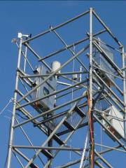
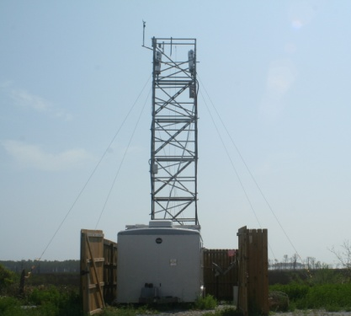
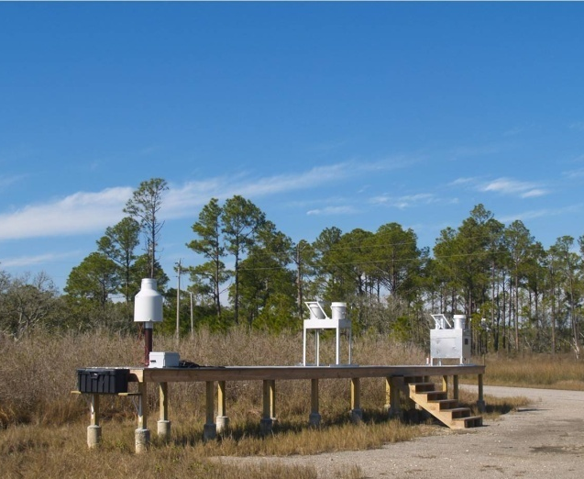
Atmospheric Mercury Monitoring Station at the Grand Bay NERR
precipitation collection
mercury and trace gas
monitoring tower
(10 meters)
Mercury Deposition Network and heavy metals
precipitation amount
major ions
(“acid rain”)

Slide 4
time series of RGM concentrations measured at Grand Bay
May 5-6
2008
episode
Then down for ~2 months due to hurricanes
….
Oct
Nov
Dec
Jan
Feb
Mar
Apr
May
Jun
Jul
Aug
Sep
….
2007
2008
Notes:
4

Slide 5
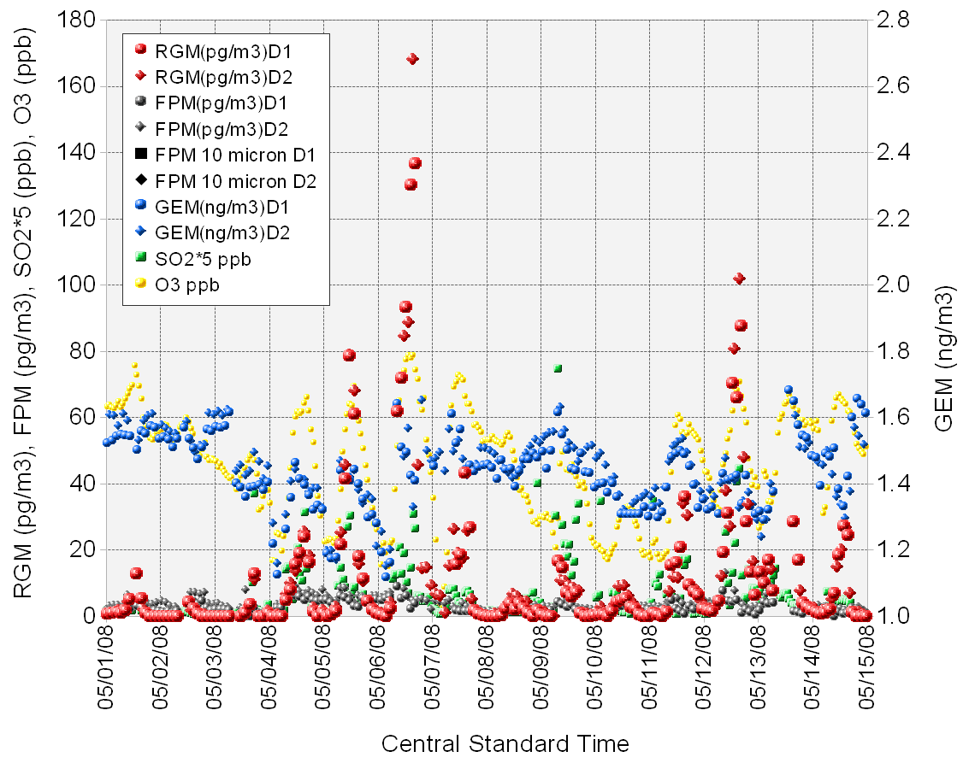
two co-located speciated mercury measurement suites provide continuous “coverage” and allow peaks to be verified
Date

Slide 6
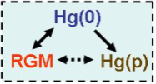



Can we reproduce this episode with an atmospheric mercury model?
Peaks are important to understand
Opportunity for model evaluation
Just one episode of many
Hg from
other sources: local, regional & more distant
emissions of
Hg(0), Hg(II), Hg(p)
Measurement of ambient air concentrations
Measurement of wet deposition

Slide 7
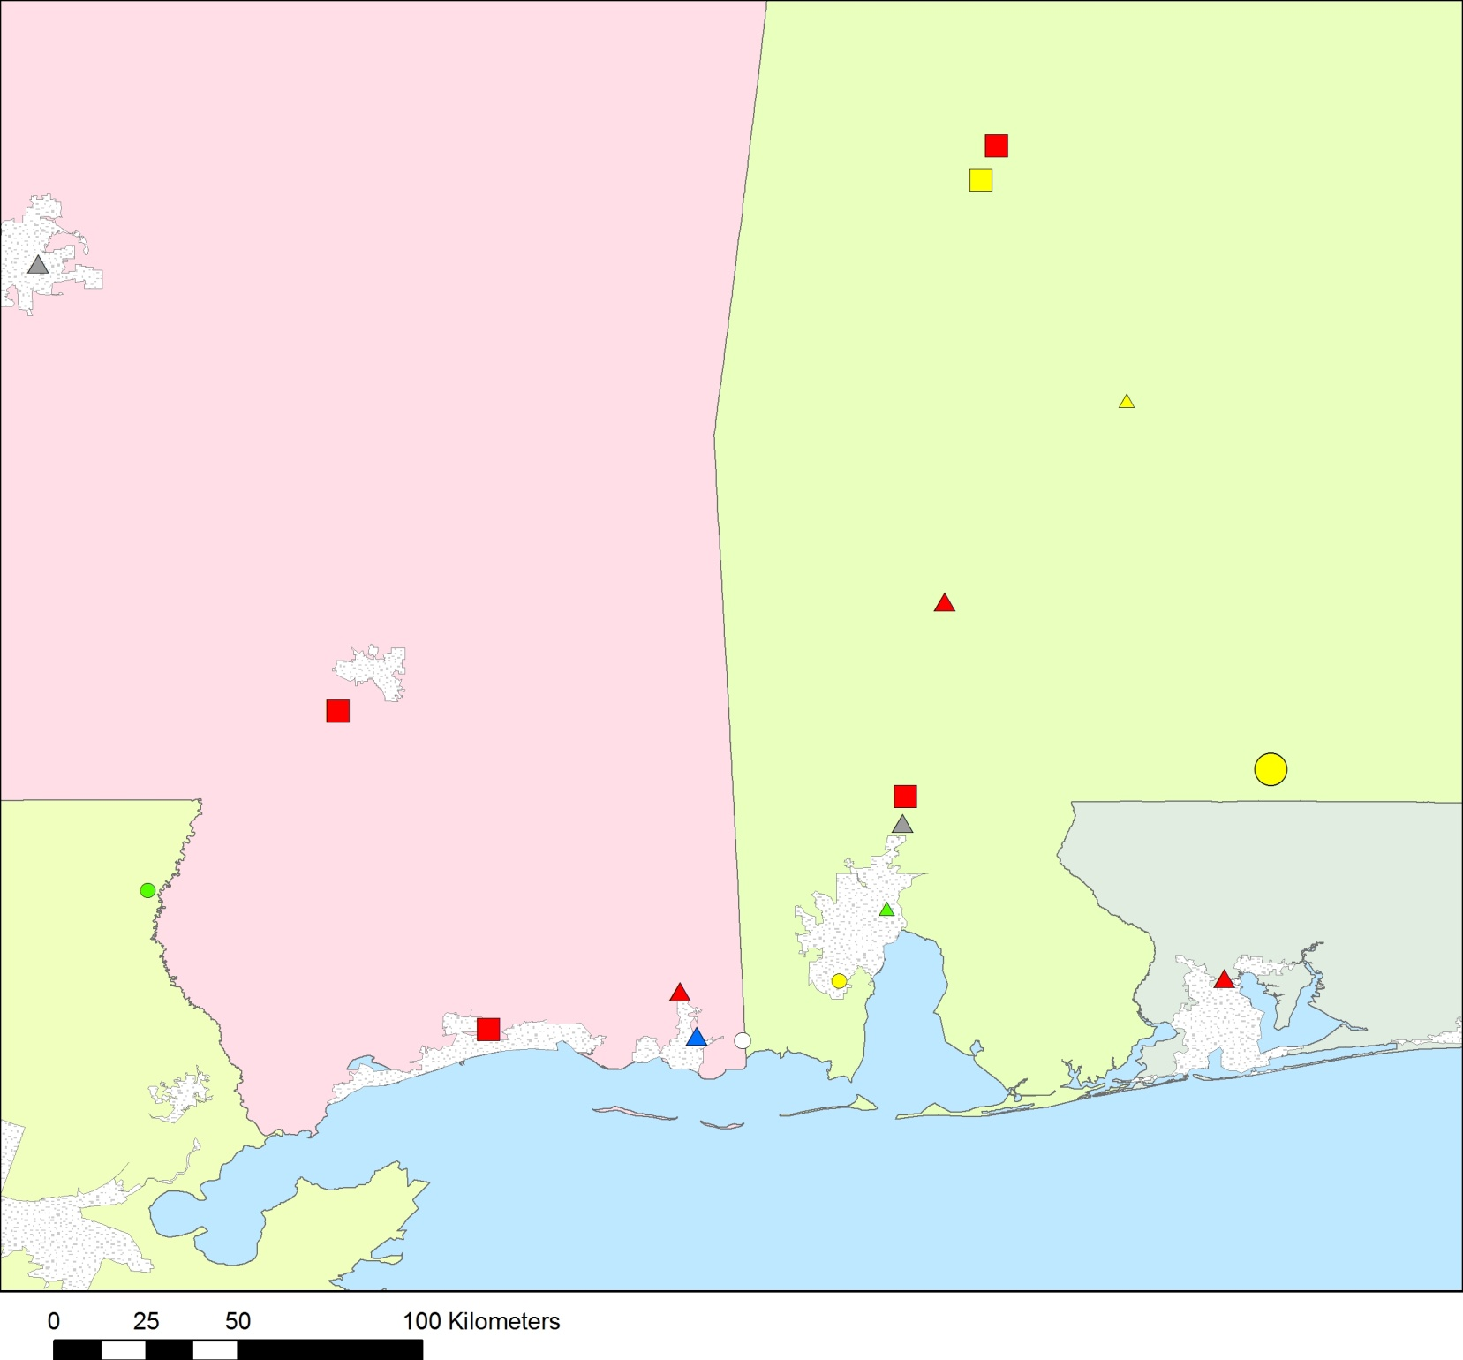
size/shape of symbol denotes amount of Reactive Gaseous Mercury (RGM) emitted during 2002 (kg/yr)
Mississippi
Alabama
Ipsco Steel: significant mercury emissions in 2002 NEI,
but negligible emissions reported in 2008 TRI
Greene
5 - 10
10 - 50
Lowman: big reduction in Hg emissions reported in 2008
50 - 100
Brewton Paper Mill:
no emissions according to 2002-2008 Toxic Release Inventory
100 – 300
color of symbol denotes type of mercury source
coal-fired power plants
Lowman
other fuel combustion
waste incineration
Morrow
metallurgical
manufacturing & other
Barry
urban areas
Mobile*
Florida
Daniel
Crist
Louisiana
Watson
Pascagoula Waste Incinerator:
in 2002 NEI but shut down in 2001
Grand Bay site
* Also called “Kimberly Clark Paper”
Notes:
Mark – make legend better and figure out if mapping total Hg or RGM… and can animate notations if I want…

Slide 8
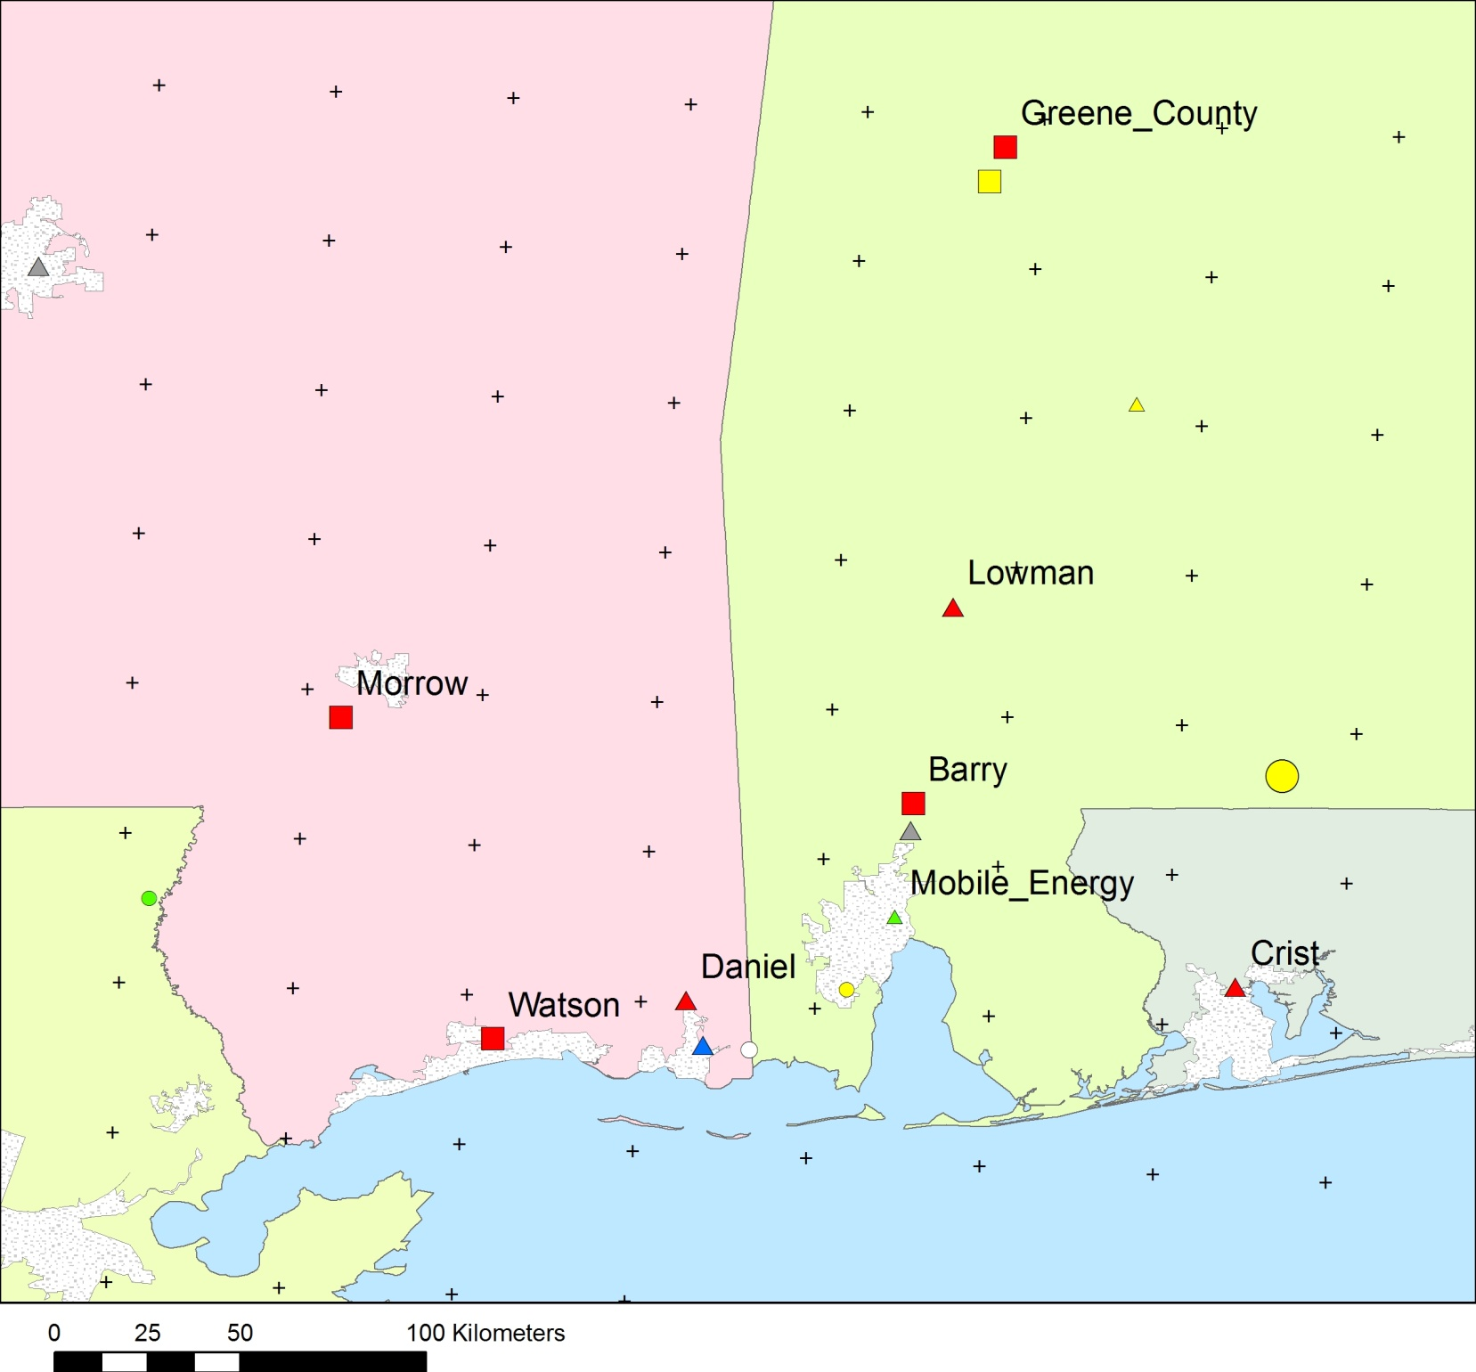
NOAA “EDAS 40km” met data (grid points shown here)
Ok for regional analysis, but too coarse for local analysis
Unlikely to simulate sea-breeze well, and in general, wind speed and wind direction are unlikely to be very accurate on local scales
Grand Bay site

Slide 9
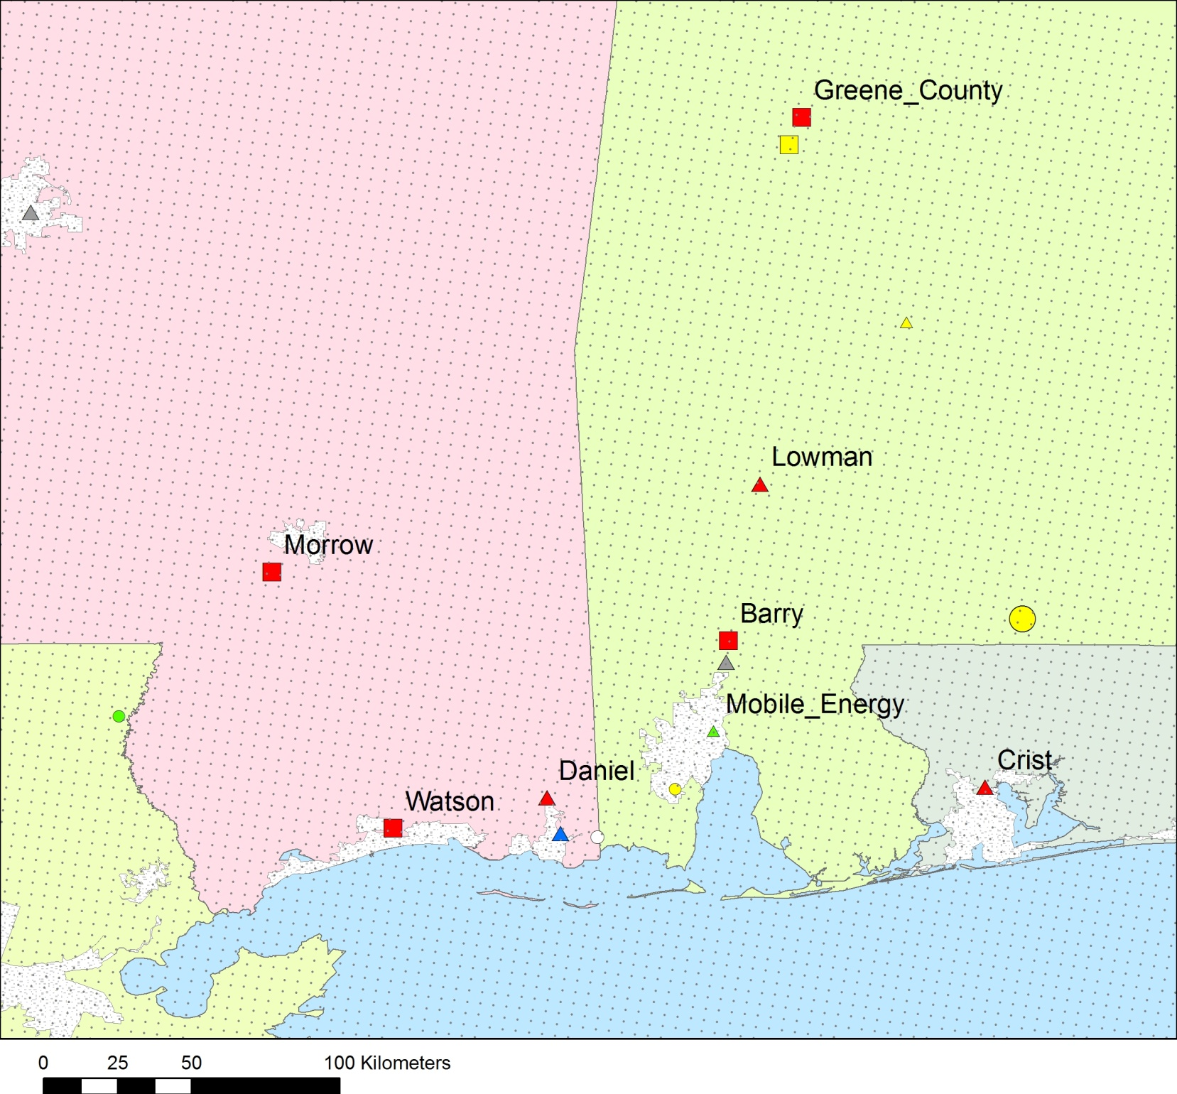
We created a 4km resolution met data set – also with enhanced vertical resolution – using the Weather Research and Forecasting (WRF) model (grid points shown here)

Slide 10
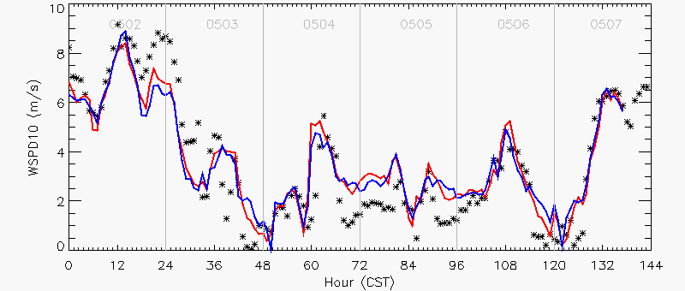
May 3
May 4
May 5
May 6
May 7
Mercury peaks
Model over-predicted
wind speed
*
Measurements at the Grand Bay NERR site
Model: WRF(a) (NOAH Land Surface Model + nudging)
Model: WRF(b) (PX Land Surface Model + nudging)

Slide 11
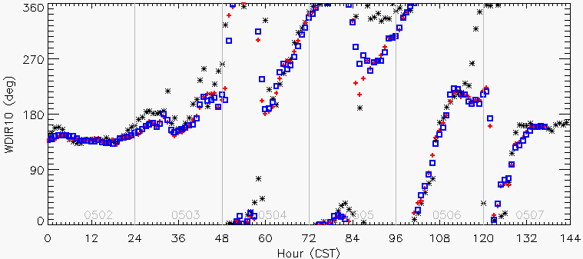
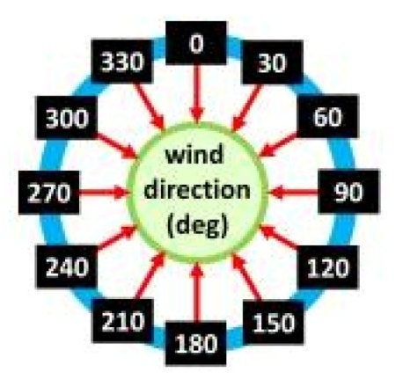
May 3
May 4
May 5
May 6
May 7
Modeled wind did not turn to north
Mercury peaks
*
Measurements at the Grand Bay NERR site
Model: WRF(a)
(NOAH Land Surface Model + nudging)
Model: WRF(b)
(PX Land Surface Model + nudging)

Slide 12
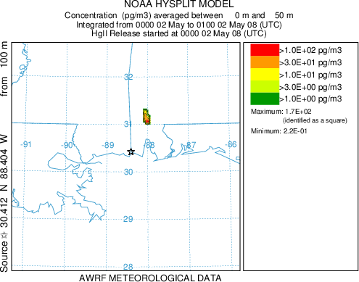
Notes:
This is Barry 101, AMS63, 4km, with plume rise, and deposition

Slide 13
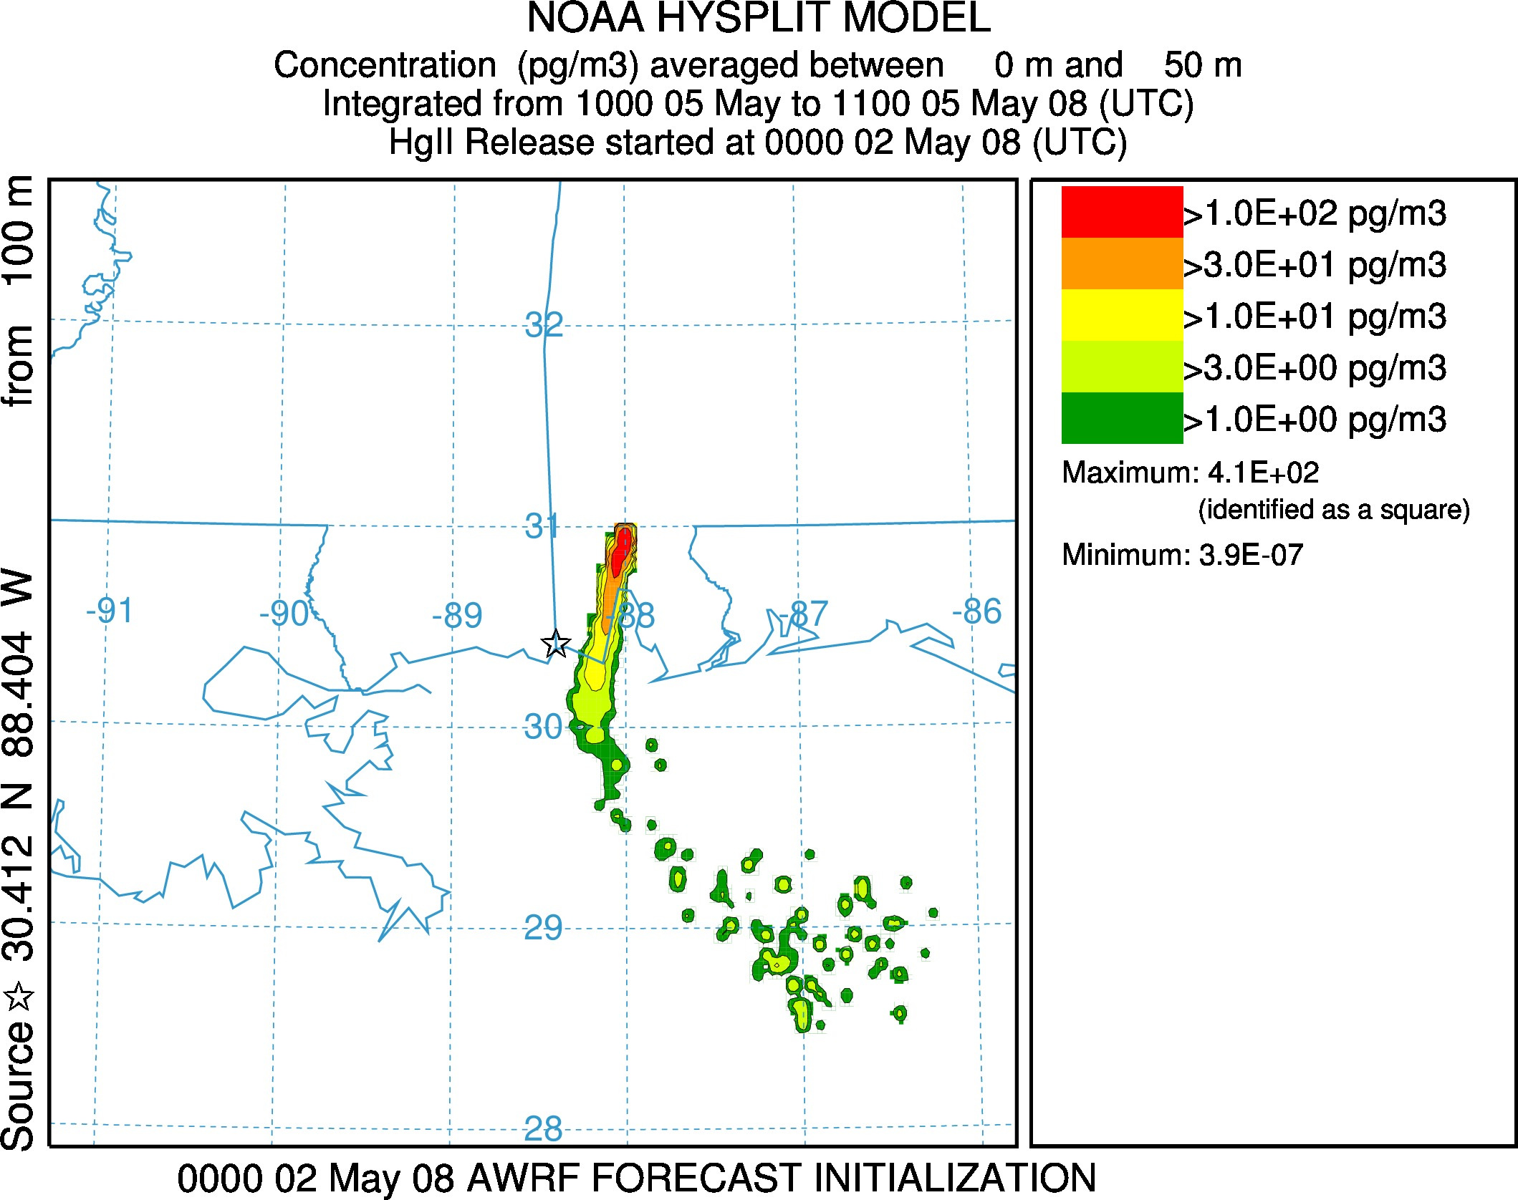

Slide 14
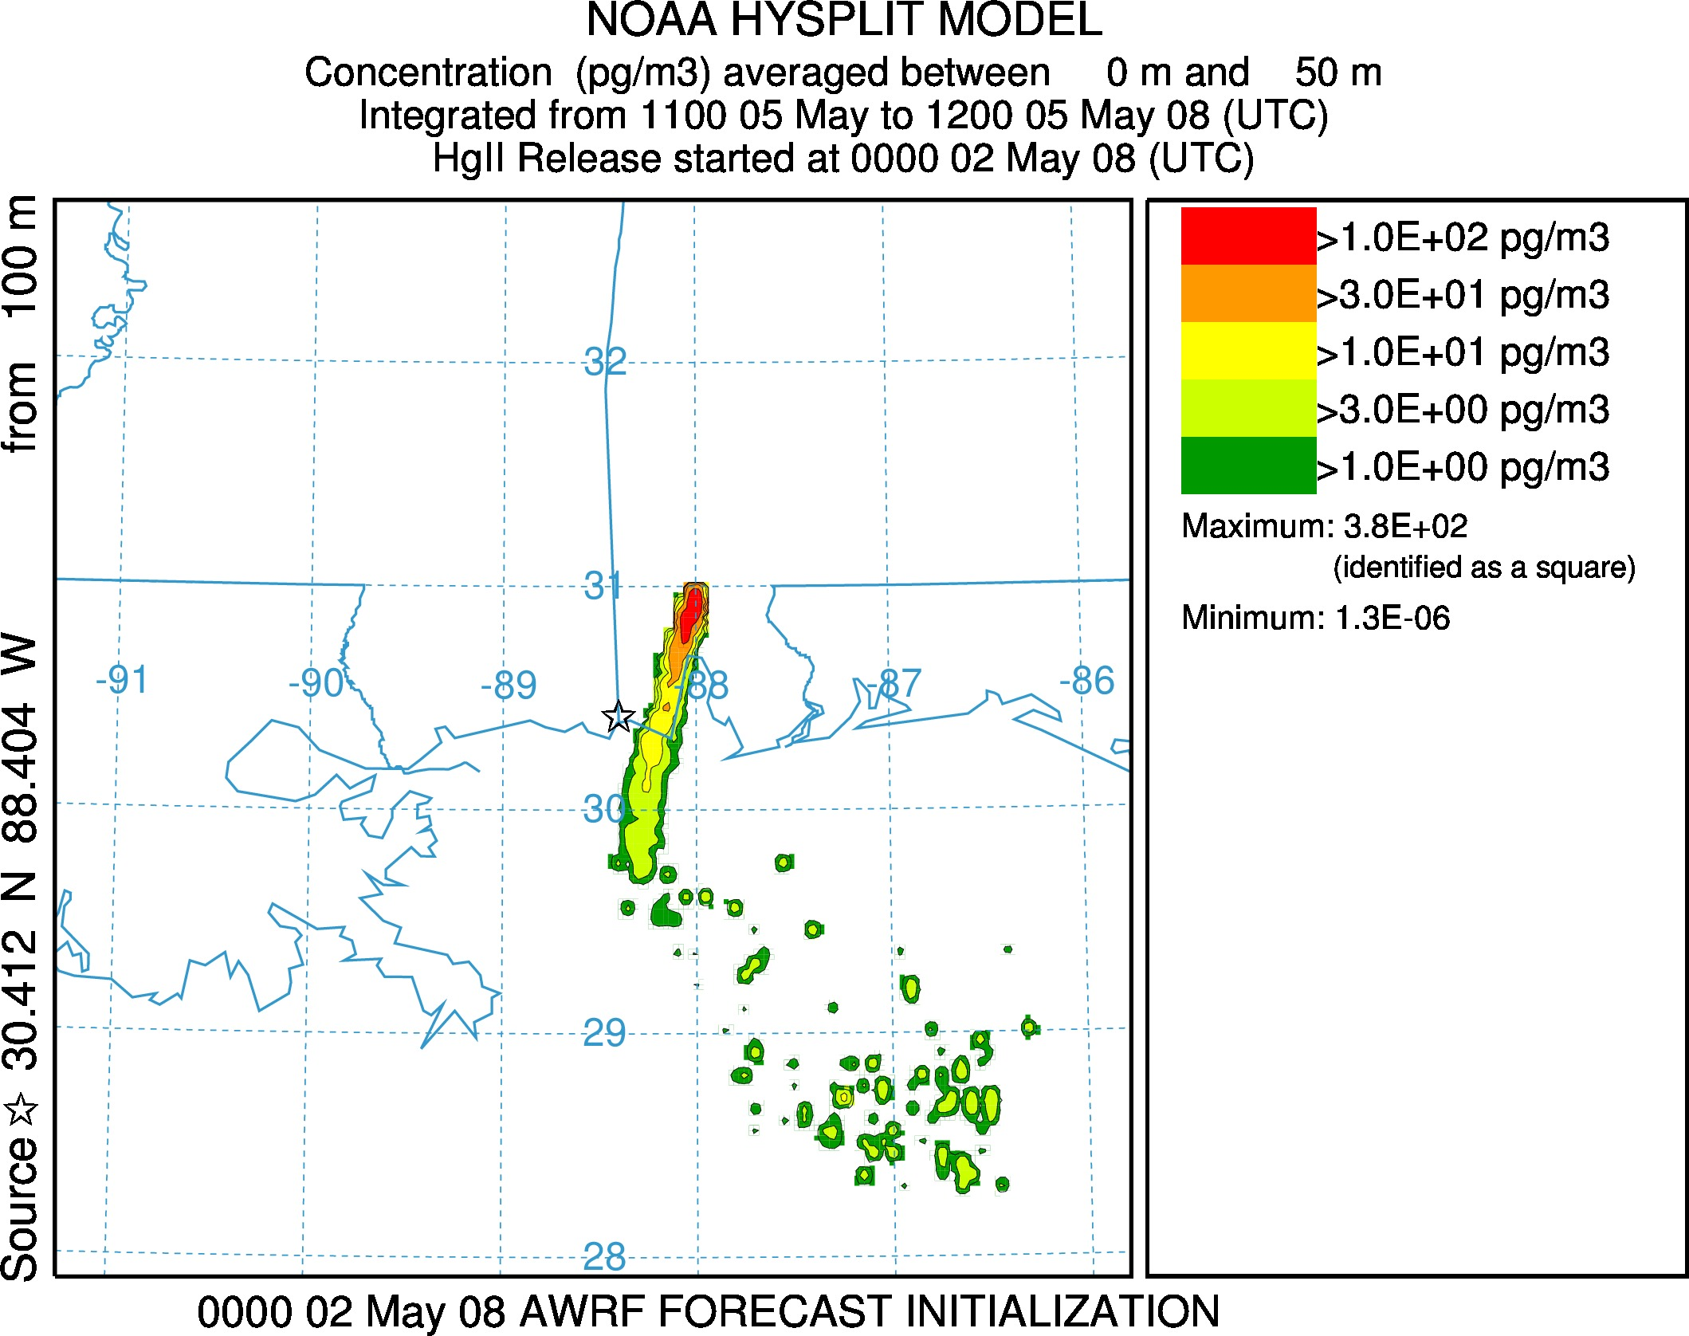

Slide 15
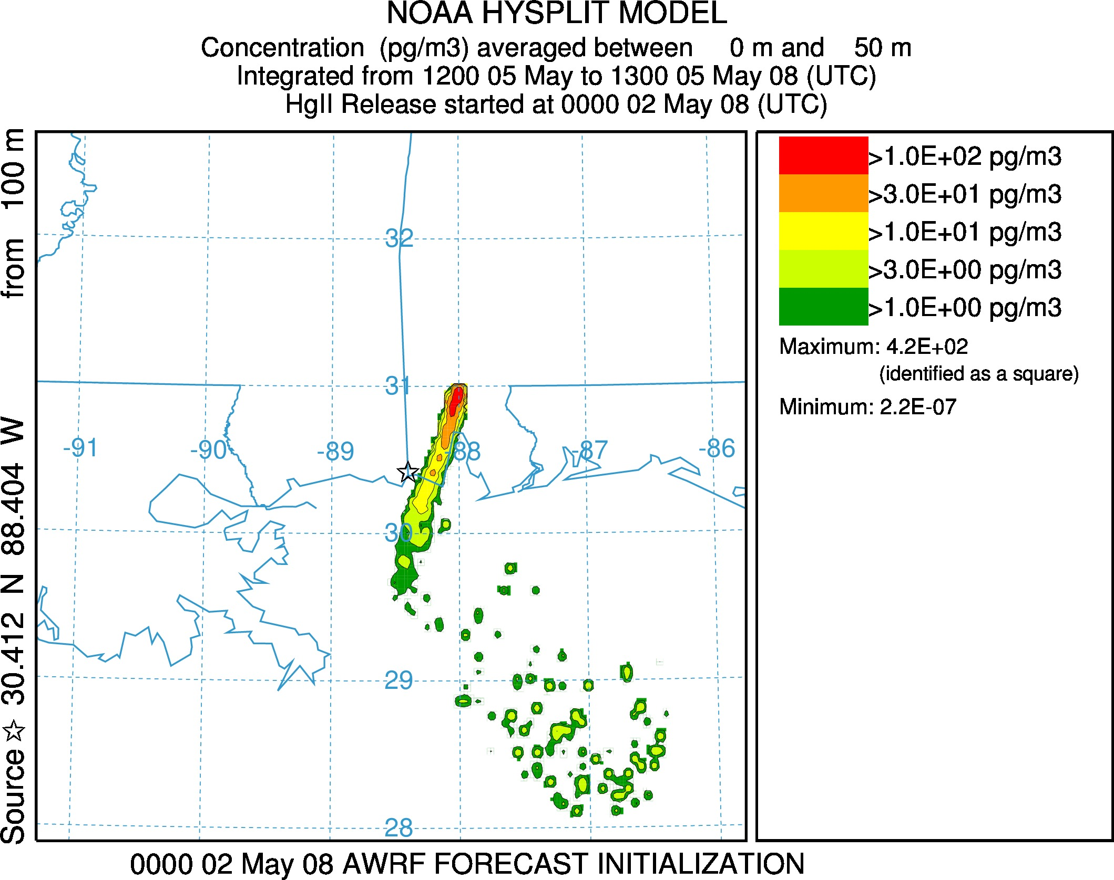

Slide 16
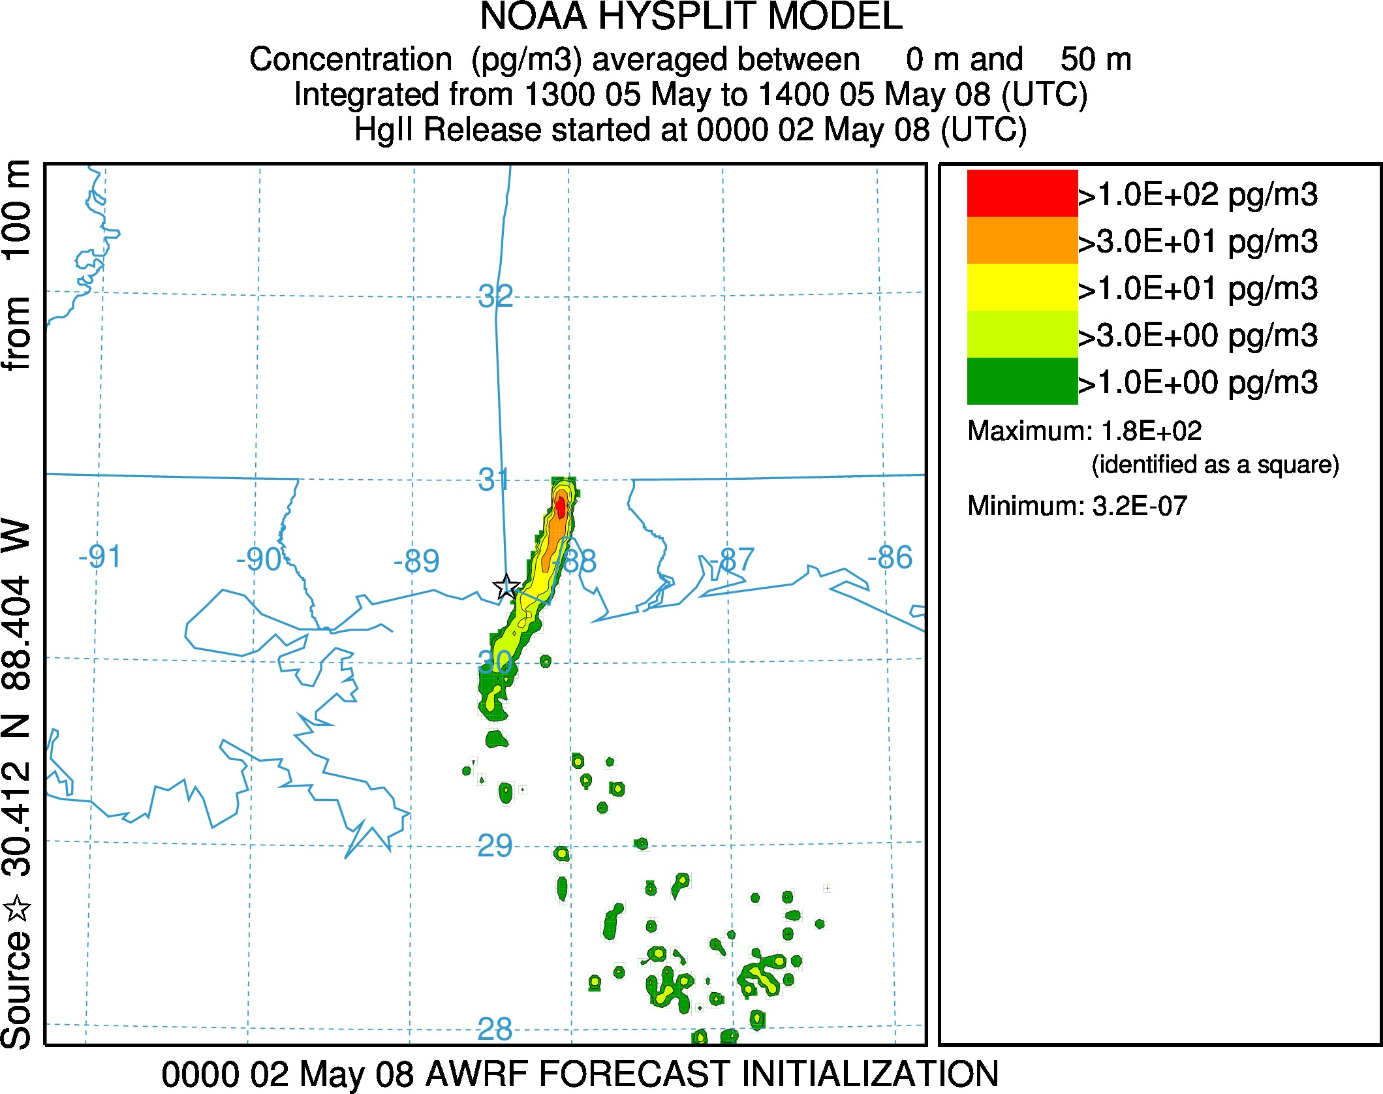

Slide 17
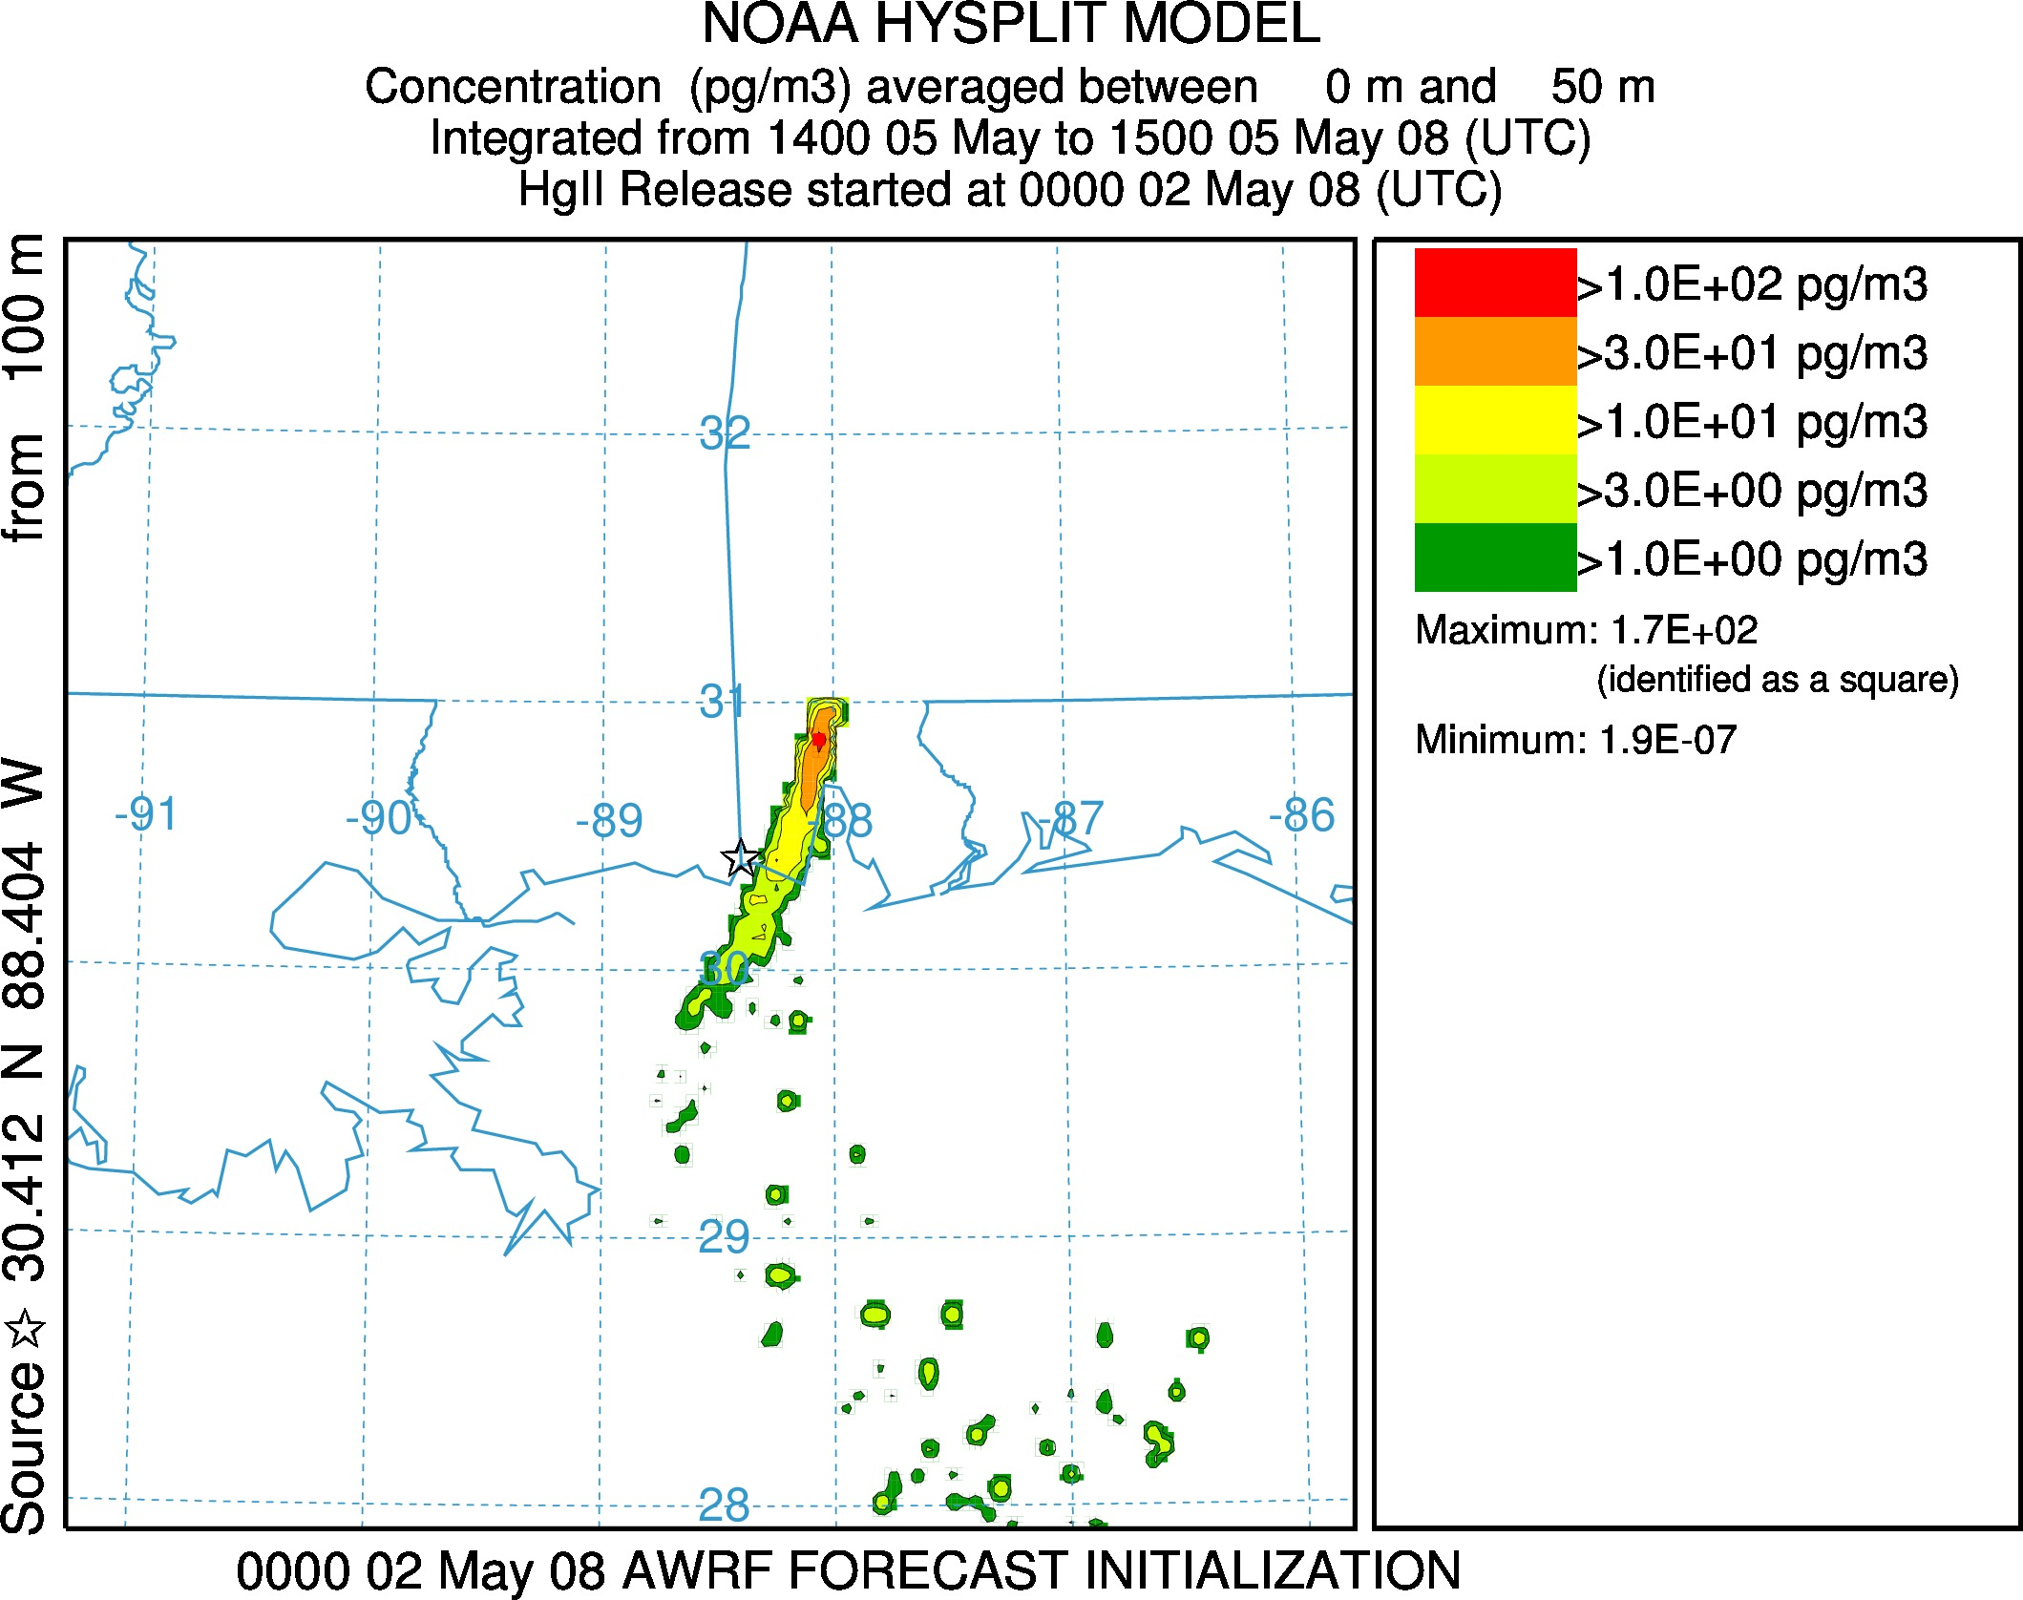

Slide 18


Slide 19
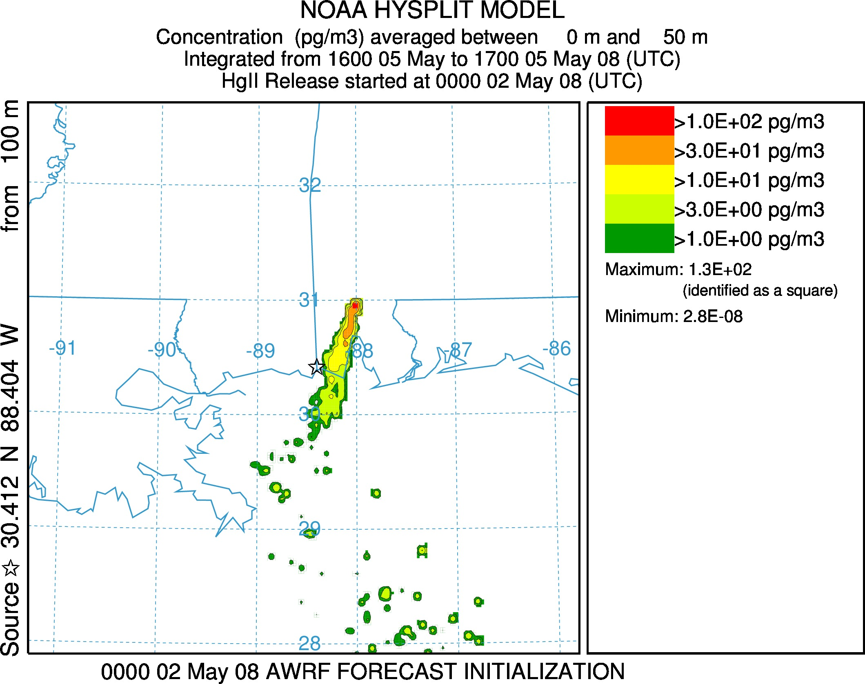

Slide 20
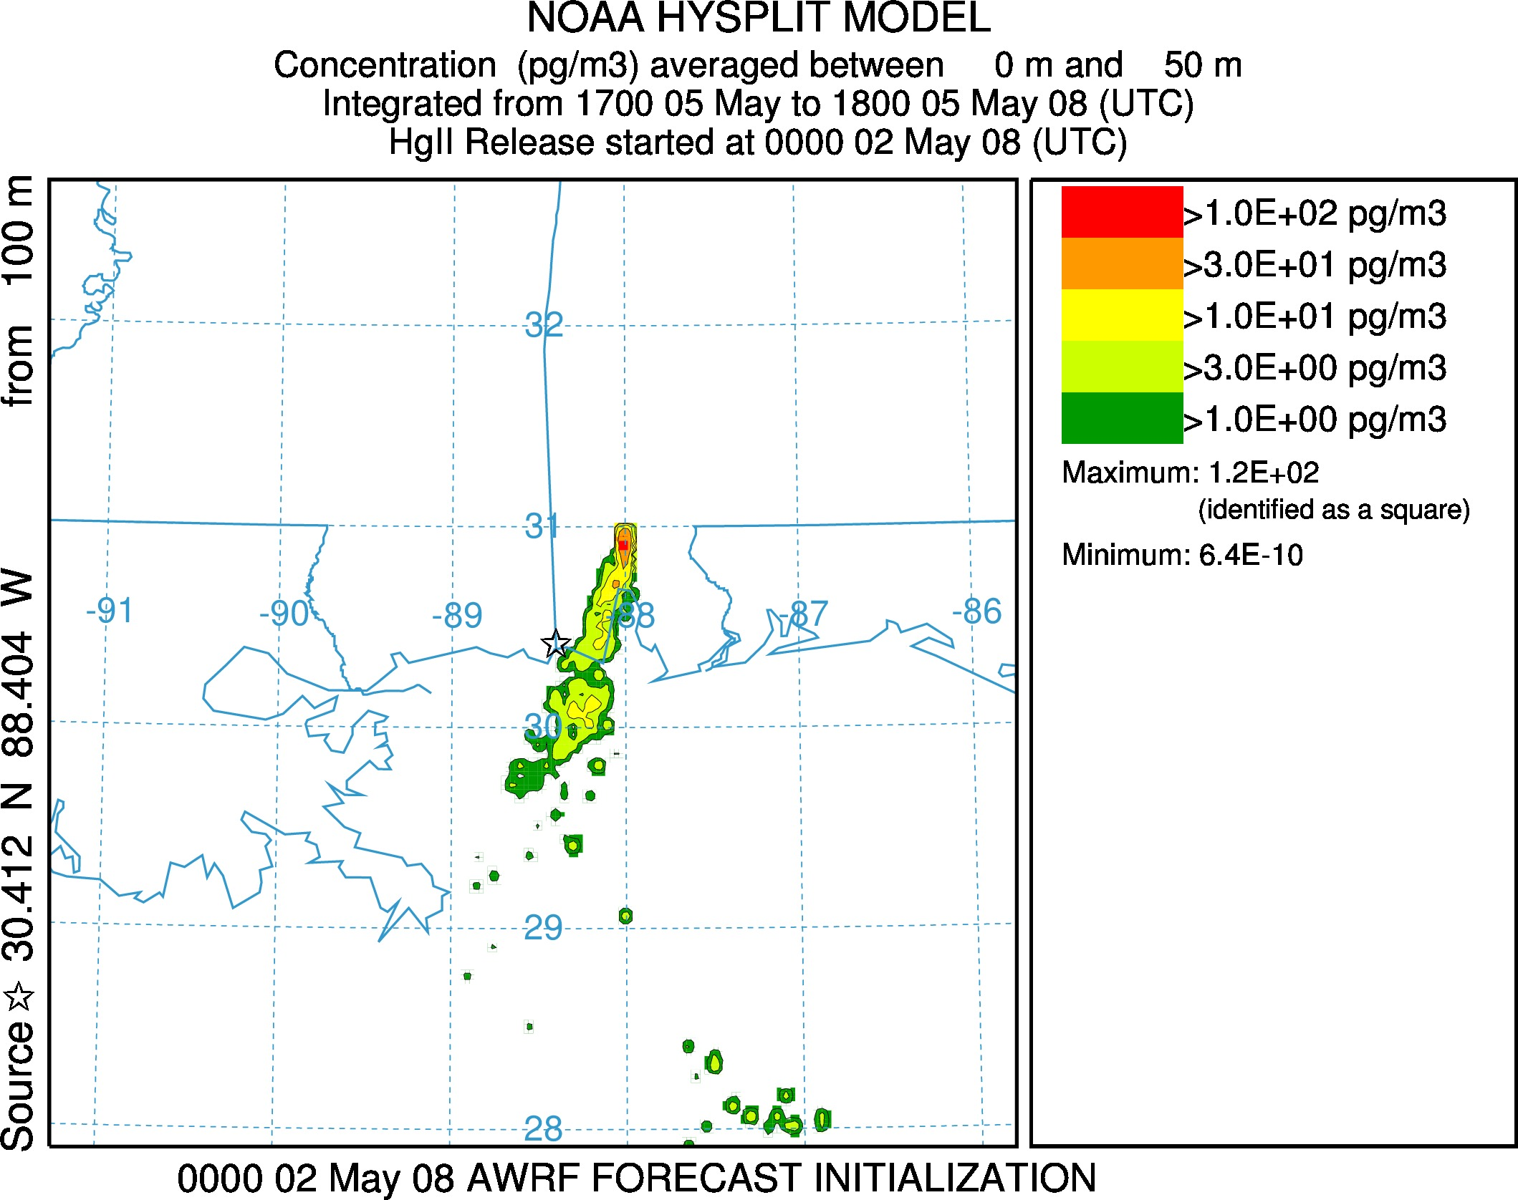

Slide 21
This is the period that you just saw – a measured peak, but not a modeled peak (BARRY - blue line)
RGM
Measurements
#1
#2
One set of model results
BARRY
DANIEL
CRIST
GREENE
LOWMAN
WATSON
MOBILE

Slide 22
We typically assume emissions are constant throughout the year
May 2008: “typical” month for SO2 emissions at the Daniel plant
May 2008
Source of data: USEPA Clean Air Markets Division

Slide 23
But, hourly SO2 emissions at the Daniel plant were not constant… and so Hg emissions were also likely variable
May 4-7, 2008
Source of data: USEPA Clean Air Markets Division

Slide 24
SOME CONCLUDING THOUGHTS (and questions):
In order to “use” the AMNet data, we need
Emissions information with higher temporal resolution (better than annual once every 3 years)
Meteorological data with higher resolution
…no matter what kind of analyses we are doing
Comparing Trends; Trajectories; Dispersion
Justification for the network depends on being able to use the data meaningfully!
How can we improve this situation?

Slide 25
This model evaluation exercise will be more fully characterized for this one episode at this one site
Of course, must look at other episodes, other sites
Variations and uncertainties in meteorology and emissions make local plumes “stochastic”…
Even if a model was “perfect” it would not be generally possible to reproduce a local plume hit at a monitoring site.
What is the best way to evaluate (and improve) models?

Slide 26
Thanks!

Slide 27
EXTRA
SLIDES

Slide 28

Modeling – Comprehensive Fate and Transport Simulations
Start with an emissions inventory
Use gridded meteorological data
Simulate the dispersion, chemical transformation, and wet and dry deposition of mercury emitted to the air
Source-attribution information needed at the end, so optimize modeling system and approach to allow source-receptor information to be captured
HYSPLIT-Hg developed over the last ~10 years with specialized algorithms for simulation of atmospheric mercury
Notes:
We use emissions inventories from the U.S. EPA, Environment Canada, the Commission for Environmental Cooperation, the Mexican government, the United Nations Environmental Program (UNEP), and many other sources. We also do “spot checks” on inventory records that seem suspect, by attempting to verify the location and emissions information listed in the inventory by independent means.
HYSPLIT is run using gridded meteorological data, from the output of meteorological models. The primary source of gridded met data for ARL is NOAA NCEP. The data is converted to HYSPLIT format and archived at ARL for modeling use. In some cases, we generate our “own” meteorological modeling output, for special cases, with higher resolution than would otherwise be available. We also use data from other sources (e.g., ECMWF, NCAR…).

Slide 29
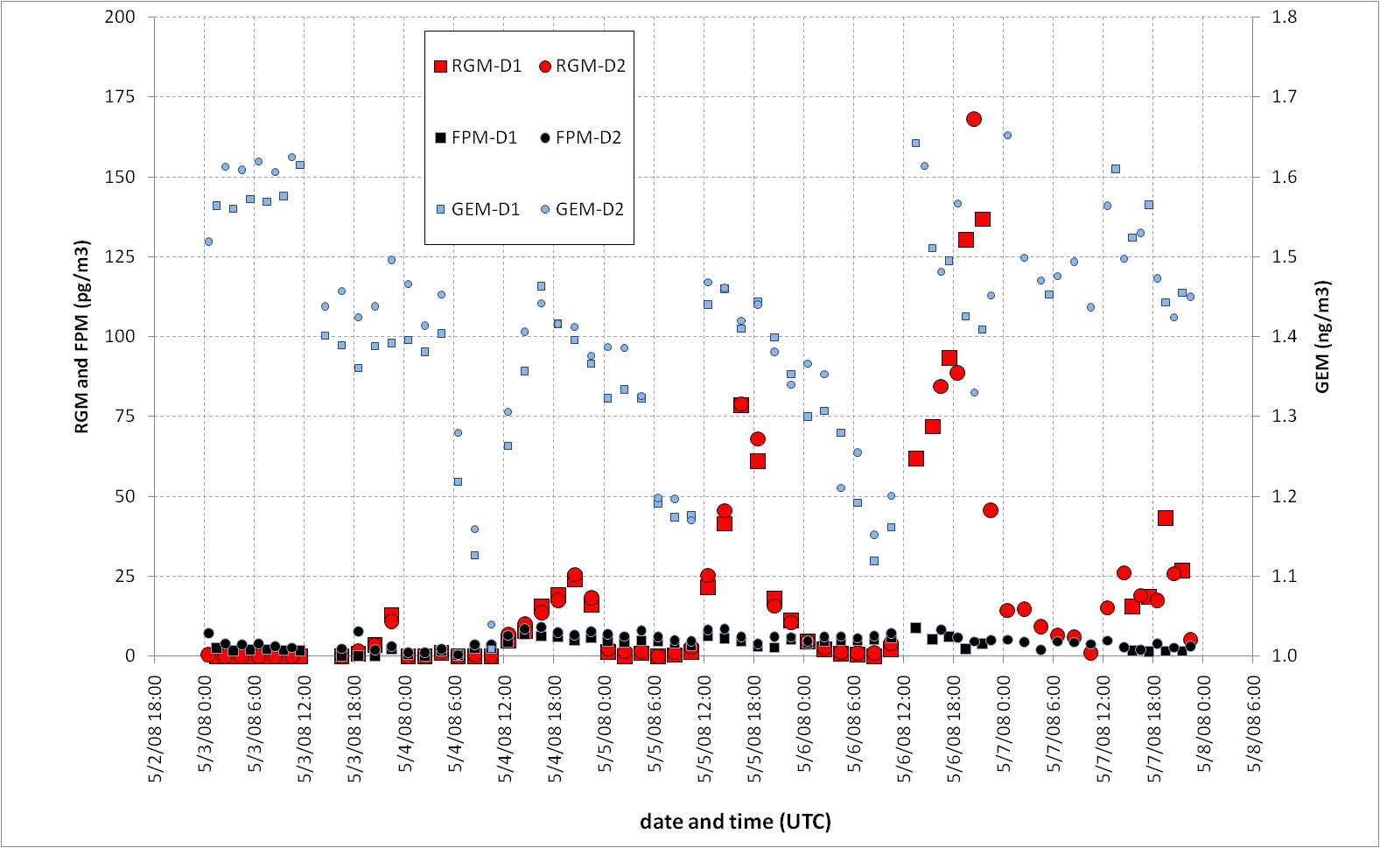
(Proposed Alternative) Figure 3. Time series of Reactive Gaseous Mercury (RGM), Fine Particulate Mercury (FPM) and Gaseous Elemental Mercury (GEM) from two co-located instruments (D1 and D2) (top graph) and of SO2, O3, NO, NOy, and CO (bottom graph) measured at the Grand Bay NERR from May 3-8, 2008

Slide 30
