Slide 1
Modeling the Atmospheric Deposition
of Mercury to the Great Lakes
(work funded through the Great Lakes Restoration Initiative)
Mark Cohen, Roland Draxler, Richard Artz
NOAA Air Resources Laboratory
Silver Spring, MD, USA
Presentation to the
IJC’s International Air Quality Advisory Board
April 25, 2012, Washington D.C.

Slide 2
ARL’s GLRI Mercury Modeling Project Timeline
Jan 1, 2009
Initial Inter- and Intra-Agency Planning for FY10 GLRI Funds
Jan 1, 2010
FY10 $ Baseline Analysis
Jan 1, 2011
Jan 1, 2012
FY11 $ Sensitivity Analysis + Extended Model Evaluation
Jan 1, 2013
FY12 $ (?) Scenario Analysis
Jan 1, 2014
FY13 $ (??) Update Analysis
Jan 1, 2015
FY14 $ (???)
Jan 1, 2016
NOAA Air Resources Laboratory
Presentation to IJC-IAQAB, Apr 25, 2012

Slide 3
Phase 1:
Baseline Analysis
NOAA Air Resources Laboratory
3
Presentation to IJC-IAQAB, Apr 25, 2012

Slide 4
Emissions
NOAA Air Resources Laboratory
4
Presentation to IJC-IAQAB, Apr 25, 2012

Slide 5
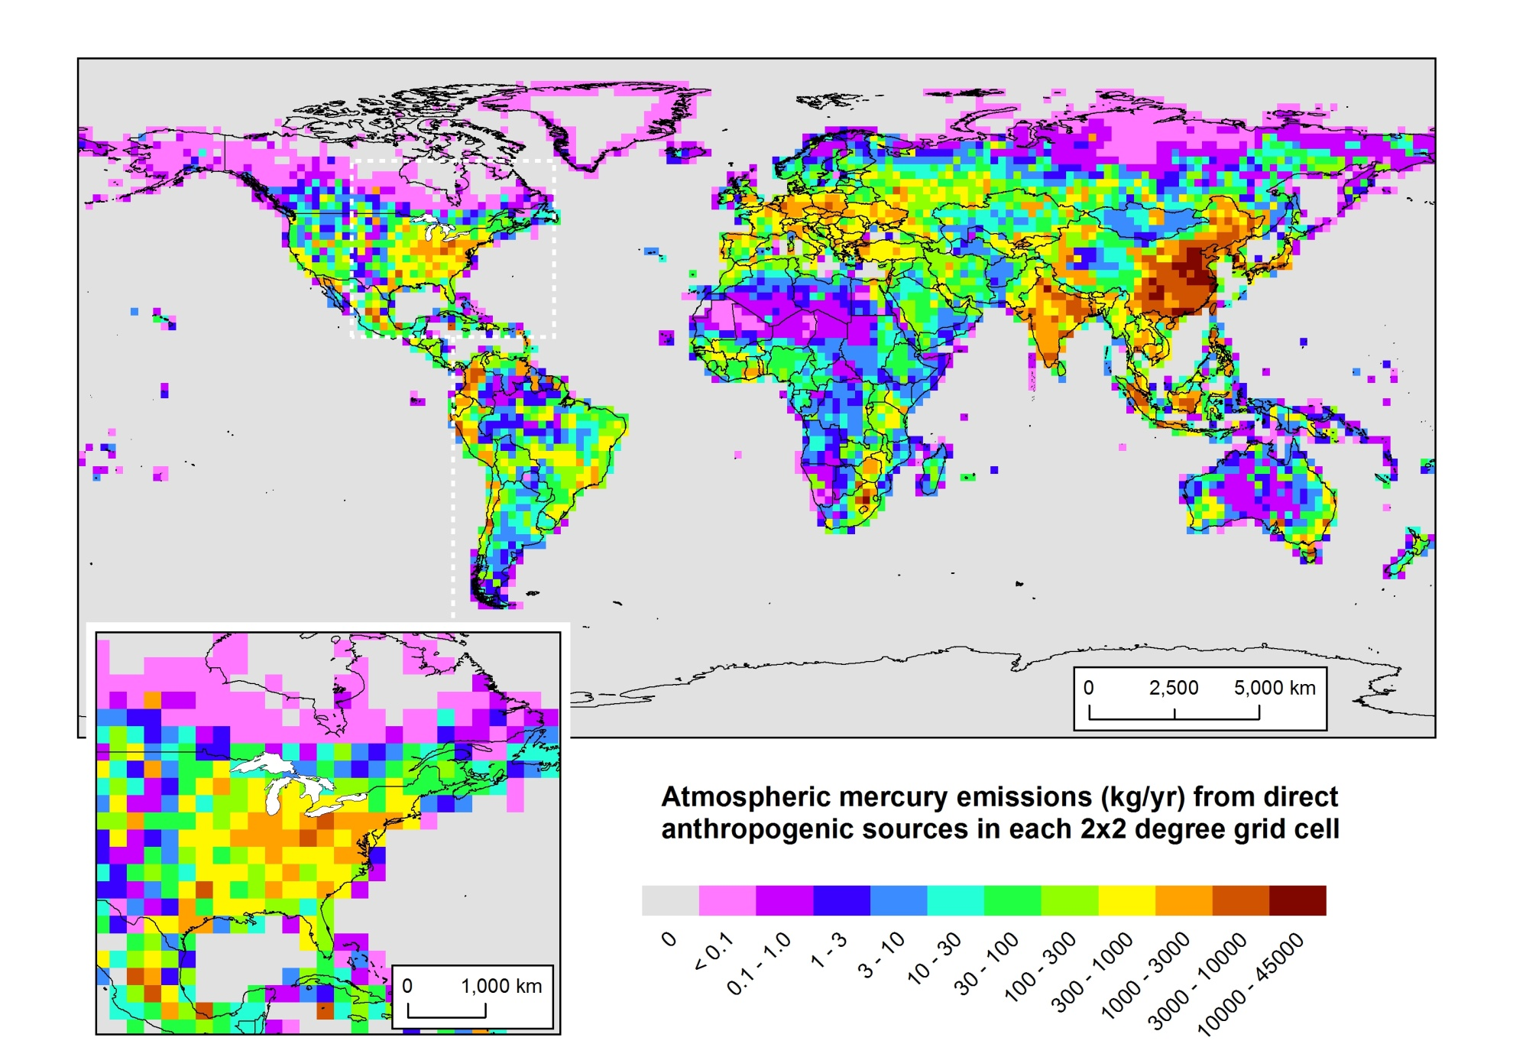
Anthropogenic Mercury Emissions (ca. 2005)
NOAA Air Resources Laboratory
5
Presentation to IJC-IAQAB, Apr 25, 2012

Slide 6
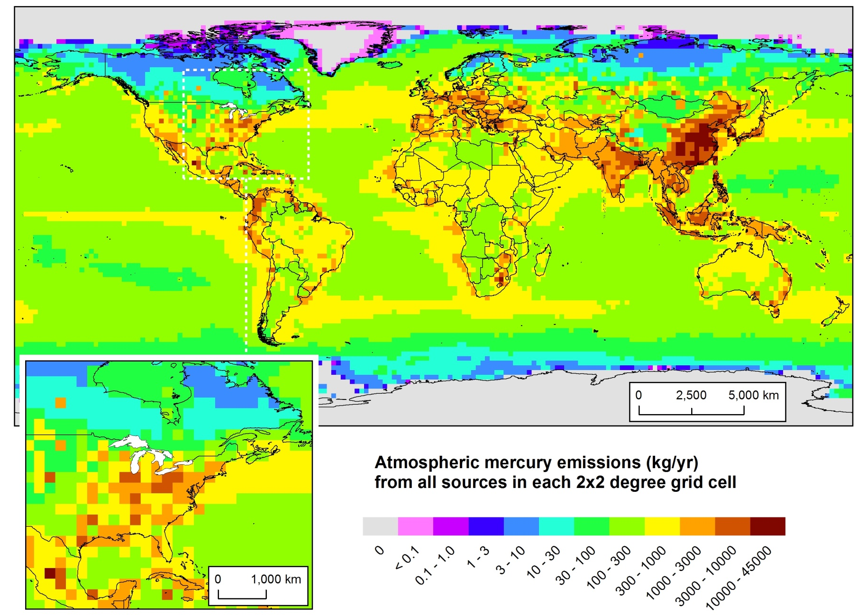
Atmospheric Mercury Emissions
(Direct Anthropogenic + Re-emit + Natural)
Policy-Relevant
Scenario Analysis
NOAA Air Resources Laboratory
6
Presentation to IJC-IAQAB, Apr 25, 2012
Notes:
Here’s where the mercury is emitted from... But what is the relative importance of different source regions to atmospheric deposition of mercury to sensitive U.S. ecosystems, e.g., the Great Lakes? Does most of it come from China?
Data for 2005, from USEPA, Environment Canada, NILU (Norway), and others. Assembled for the GLRI FY2010 modeling project.
Looking at this emissions map, its easy to think that the dominant contributor to Great Lakes mercury might be emissions from China.

Slide 7
Methodology
NOAA Air Resources Laboratory
7
Presentation to IJC-IAQAB, Apr 25, 2012

Slide 8

Can we run HYSPLIT globally?
When puffs grow to sizes large relative to the meteorological data grid, they split, horizontally and/or vertically
In the new version of HYSPLIT (4.9), puffs are “dumped” into an Eulerian grid after a specified time (e.g., 96 hrs), and the mercury is simulated on that grid from then on…
Ok for regional simulations,
but for global modeling,
puff splitting
overwhelms
computational
resources
Notes:
Incorporation of the mercury modeling algorithms into the new GEM-HYSPLIT code was a large scientific programming task.

Slide 9
What year to model?
Mercury Emissions Inventory
Dataset Available
for 2005
U.S. anthropogenic emissions inventory
Canadian anthropogenic emissions inventory
Mexican anthropogenic emissions inventory
Global anthropogenic emissions inventory
Natural emissions inventory
Re-emissions inventory
Need all of these datasets for the same year
Ambient Data for Model Evaluation
Wet deposition (Mercury Deposition Network)
“Speciated” Air Concentrations
Meteorological Data to drive model
2005 chosen for baseline analysis
NCEP/NCAR Global Reanalysis (2.5 deg)
NCEP EDAS 40km North American Domain
North American Regional Reanalysis (NARR)
NOAA Air Resources Laboratory
Presentation to IJC-IAQAB, Apr 25, 2012

Slide 10
Illustrative Results for Single Sources
NOAA Air Resources Laboratory
10
Presentation to IJC-IAQAB, Apr 25, 2012

Slide 11
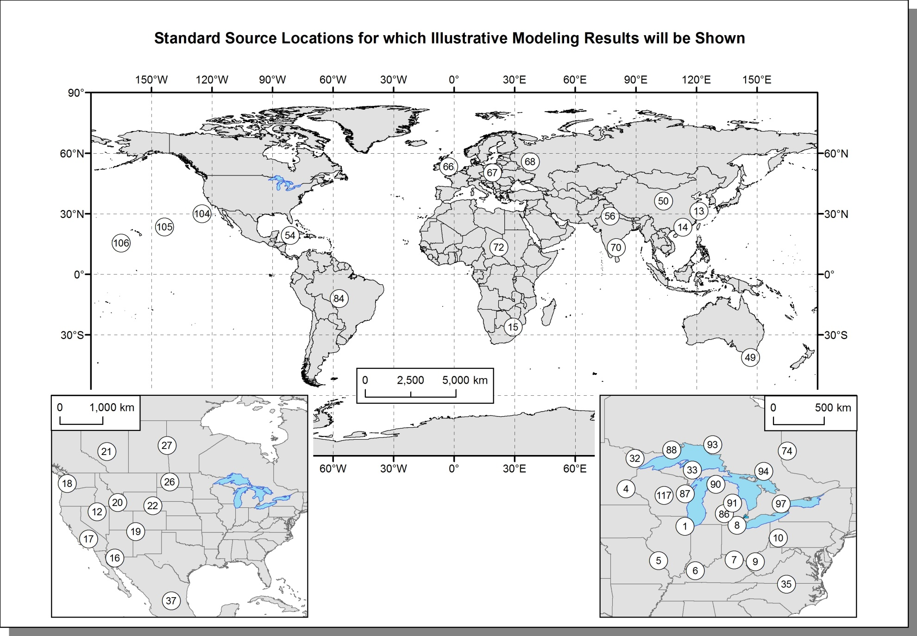
Standard Source Locations for Illustrative Modeling Results
NOAA Air Resources Laboratory
11
Presentation to IJC-IAQAB, Apr 25, 2012

Slide 12
Lake Erie Transfer Flux Coefficients for two kinds
of Generic Coal-Fired Power Plants (logarithmic scale)
NOAA Air Resources Laboratory
12
Presentation to IJC-IAQAB, Apr 25, 2012

Slide 13
Lake Erie Transfer Flux Coefficients for two kinds
of Generic Coal-FIred Power Plants (linear scale)
NOAA Air Resources Laboratory
13
Presentation to IJC-IAQAB, Apr 25, 2012

Slide 14
Model Evaluation
NOAA Air Resources Laboratory
14
Presentation to IJC-IAQAB, Apr 25, 2012

Slide 15
Modeled vs. Measured Wet Deposition of Mercury at Sites in the Great Lakes Region
NOAA Air Resources Laboratory
15
Presentation to IJC-IAQAB, Apr 25, 2012
Notes:
All the data, but MDN sites “downwind” of the Great Lakes (“eastern GL region”) are open squares…

Slide 16
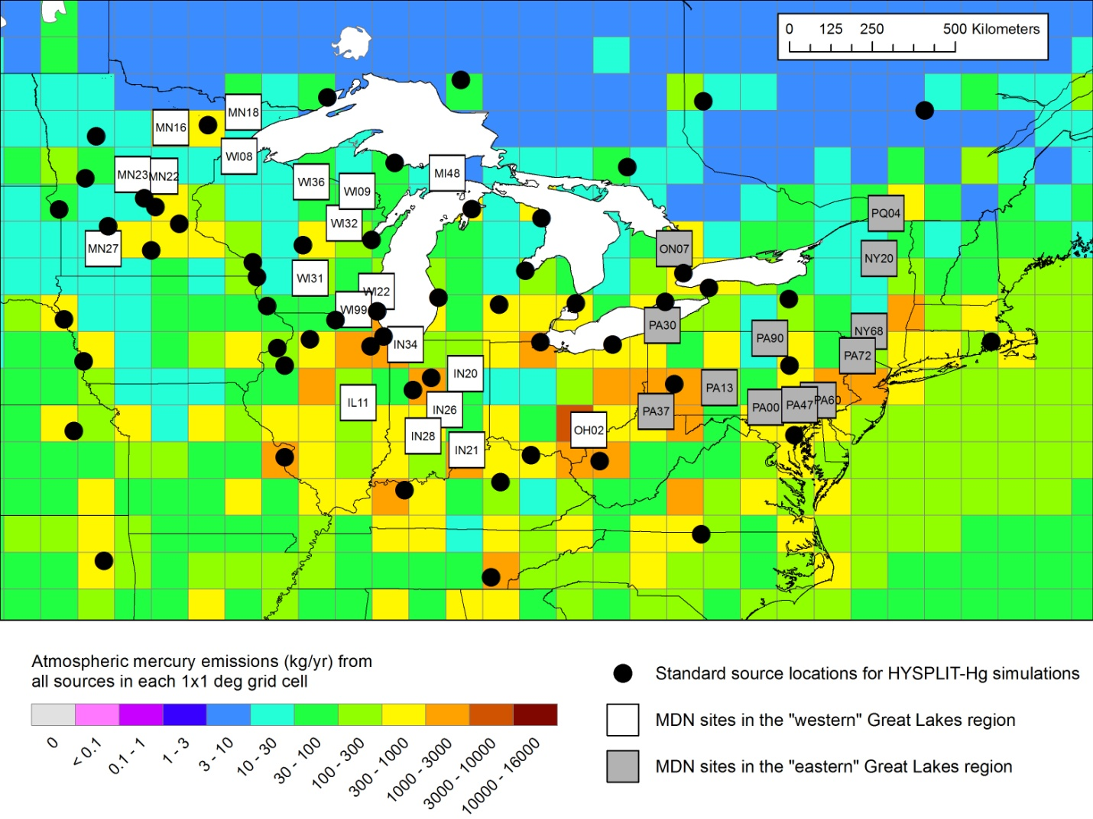
Standard source locations, MDN sites, and mercury emissions in the Great Lakes region
NOAA Air Resources Laboratory
16
Presentation to IJC-IAQAB, Apr 25, 2012
Notes:
It is seen in Figure 61 that the density of standard source locations is generally lower in the region of the eastern-most MDN sites. The reason why more standard source locations were not utilized at the outset was computational resource constraints. As discussed above in Section 2.4, the consequence of this sparseness is a higher likelihood that interpolation errors will affect the results. In particular, the general situation regarding the difference in estimating deposition at point monitoring sites vs. large area receptors – discussed above in Section 2.4.3, page 43 – seems to be particularly relevant here. That is, the density of standard source locations required to estimate deposition to the Great Lakes is much less than that required for estimating deposition at a set of monitoring sites throughout the Great Lakes region. Or put another way, for the same set of standard source locations – or the same expenditure of computational resources -- the expected accuracy of deposition estimates for large area receptors – e.g., in this case, the Great Lakes and their watersheds – is much higher than the expected accuracy for deposition estimates at a set of monitoring sites throughout the region.
With additional standard source locations in the regions surrounding each of these eastern-most Great Lakes region MDN sites, the agreement between modeled and measured wet deposition will likely improve. At the same time, the addition of these new standard source locations will likely not change the results for the Great Lakes very much. We will test these hypotheses in the next phase of the work.

Slide 17
Overall Results for the
Great Lakes
NOAA Air Resources Laboratory
17
Presentation to IJC-IAQAB, Apr 25, 2012

Slide 18
Here’s where the mercury is emitted from... But what is the relative importance of different source regions to atmospheric deposition of mercury to the Great Lakes? Does most of it come from China?
Policy-Relevant
Scenario Analysis
Geographical Distribution of 2005 Atmospheric Mercury Emissions (Natural + Re-emit + Direct Anthropogenic)
NOAA Air Resources Laboratory
18
Presentation to IJC-IAQAB, Apr 25, 2012
Notes:
Data for 2005, from USEPA, Environment Canada, NILU (Norway), and others. Assembled for the GLRI FY2010 modeling project.
Looking at this emissions map, its easy to think that the dominant contributor to Great Lakes mercury might be emissions from China.

Slide 19
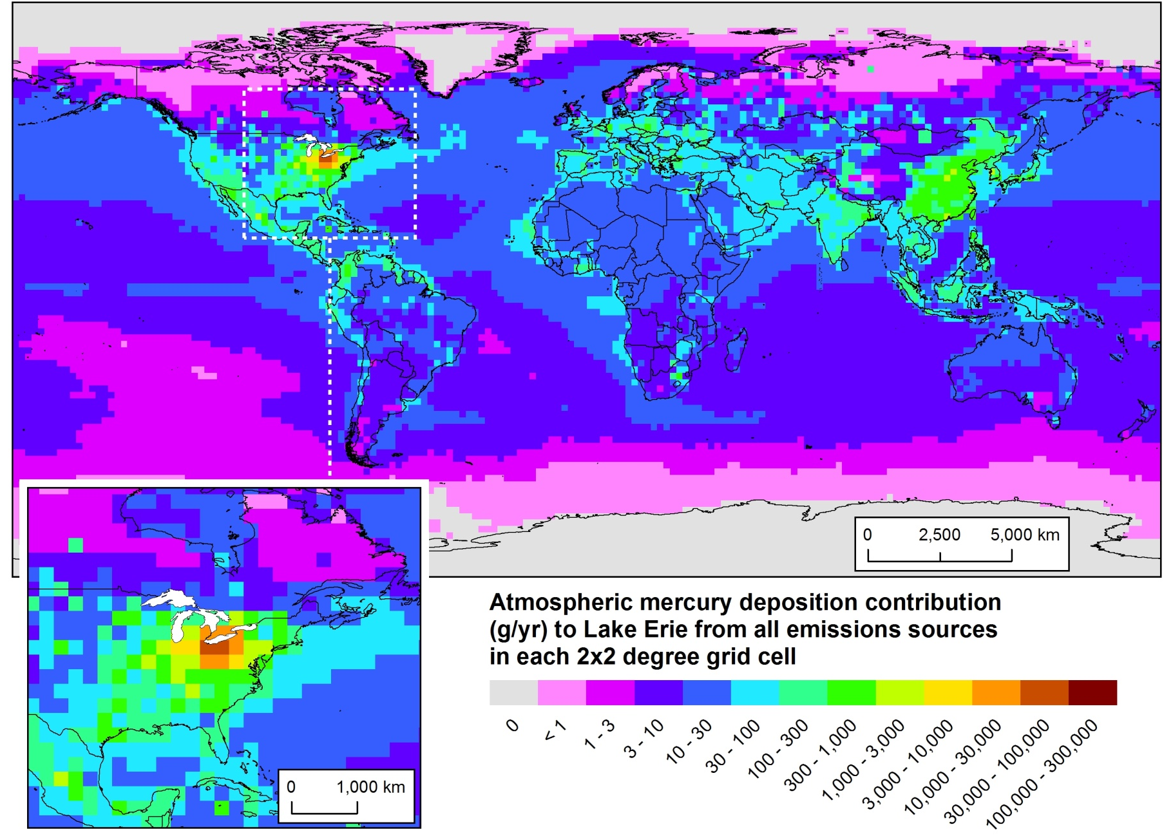
Here’s where the mercury came from that was deposited to Lake Erie (~2005)
Policy-Relevant
Scenario Analysis
Geographical Distribution of 2005 Atmospheric Mercury Deposition Contributions to Lake Erie
NOAA Air Resources Laboratory
19
Presentation to IJC-IAQAB, Apr 25, 2012

Slide 20
A tiny fraction of 2005 global mercury emissions within 500 km of Lake Erie
Modeling results show that these “regional” emissions are responsible for a large fraction of the modeled 2005 atmospheric deposition
Important policy implications!
NOAA Air Resources Laboratory
20
Presentation to IJC-IAQAB, Apr 25, 2012
Notes:
Results obtained by modeling the atmospheric fate and transport of mercury emitted to the air with the HYSPLIT-Hg model, in the FY2010 GLRI mercury-modeling project. These results are for 2005, the latest year for which mercury emissions inventory information was available, at the time the project was carried out. Atmospheric deposition of mercury to the Great Lakes is an important – and probably the largest – current loading pathway.
In the upper left graph, the total mercury emissions as a function of distance away from the center of Lake Erie are plotted. You can see that a very small fraction of the total global mercury emissions are emitted within 500 km of the Lake center, or even with 1000km of the Lake center. The bulk of the global emissions are much further away from the Lake.
In the bottom right graph, the total modeled atmospheric mercury deposition to Lake Erie arising from emissions at the same distance ranges are shown. So, this graph shows that about 200 kg were modeled to have been deposited into Lake Erie from sources within 500 km of the Lake center, about 40% of the total modeled deposition.

Slide 21
Model-estimated 2005 deposition to the Great Lakes Basin from countries with the highest modeled contribution from direct and re-emitted anthropogenic sources
NOAA Air Resources Laboratory
21
Presentation to IJC-IAQAB, Apr 25, 2012

Slide 22
Model-estimated per capita 2005 deposition to the Great Lakes Basin from countries with the highest modeled contribution from direct & re-emitted anthropogenic sources
NOAA Air Resources Laboratory
22
Presentation to IJC-IAQAB, Apr 25, 2012

Slide 23
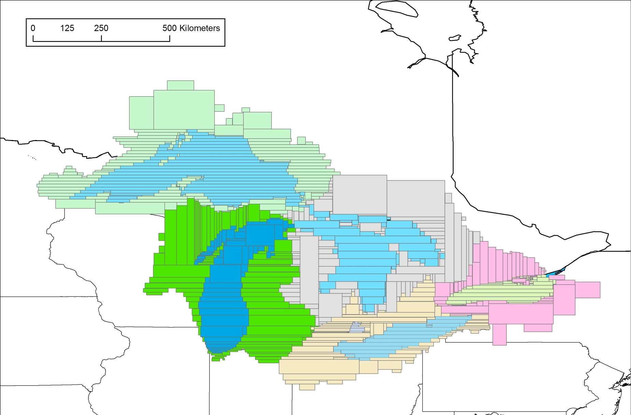
Some Key Features of this Analysis
Deposition explicitly modeled to actual lake/watershed areas
As opposed to the usual practice of ascribing portions of gridded deposition to these areas in a post-processing step
NOAA Air Resources Laboratory
Presentation to IJC-IAQAB, Apr 25, 2012
Notes:
This shows the “polygons” that represent each Great Lake and each of their watersheds.
At each time step, the overlap of each pollutant “puff” (and Eulerian grid square) is estimated for each polygon, and the deposition from the puff or grid square is attributed to the polygon based on the degree of overlap… (this is a little more simple than it actually is, as differences in land-type are factored in as well…)

Slide 24
Some Key Features of this Analysis
Deposition explicitly modeled to actual lake/watershed areas
As opposed to the usual practice of ascribing portions of gridded deposition to these areas in a post-processing step
Combination of Lagrangian & Eulerian modeling
allows accurate and computationally efficient estimates of the fate and transport of atmospheric mercury over all relevant length scales – from “local” to global.
Detailed source-attribution information is created
deposition contribution to each Great Lakes and watersheds from each source in the emissions inventories used is estimated individually
The level of source discrimination is only limited by the detail in the emissions inventories
Source-type breakdowns not possible in this 1st phase for global sources, because the global emissions inventory available did not have source-type breakdowns for each grid square
NOAA Air Resources Laboratory
Presentation to IJC-IAQAB, Apr 25, 2012

Slide 25
Some Key Findings of this Analysis
“Single Source” results illustrate source-receptor relationships
For example, a “typical” coal-fired power plant near Lake Erie may contribute on the order of 100x the mercury – for the same emissions – as a comparable facility in China.
Regional, national, & global mercury emissions are all important contributors to mercury deposition in the Great Lakes Basin
For Lakes Erie and Ontario, the U.S. contribution is at its most significant
For Lakes Huron and Superior, the U.S. contribution is less significant.
Local & regional sources have a much greater atmospheric deposition contributions than their emissions, as a fraction of total global mercury emissions, would suggest.
NOAA Air Resources Laboratory
Presentation to IJC-IAQAB, Apr 25, 2012

Slide 26
Some Key Findings of this Analysis (…continued)
Reasonable agreement with measurements
Despite numerous uncertainties in model input data and other modeling aspects
Comparison at sites where significant computational resources were expended – corresponding to regions that were the most important for estimating deposition to the Great Lakes and their watersheds – showed good consistency between model predictions and measured quantities.
For a smaller subset of sites generally downwind of the Great Lakes (in regions not expected to contribute most significantly to Great Lakes atmospheric deposition), less computational resources were expended, and the comparison showed moderate, but understandable, discrepancies.
NOAA Air Resources Laboratory
Presentation to IJC-IAQAB, Apr 25, 2012

Slide 27
Modeling Atmospheric Mercury Deposition to the Great Lakes. Final Report for work conducted with FY2010 funding from the
Great Lakes Restoration Initiative. December 16, 2011.
Mark Cohen, Roland Draxler, Richard Artz. NOAA Air Resources Laboratory, Silver Spring, MD, USA. 160 pages.
http://www.arl.noaa.gov/documents/reports/GLRI_FY2010_Atmospheric_Mercury_Final_Report_2011_Dec_16.pdf
http://www.arl.noaa.gov/documents/reports/Figures_Tables_GLRI_NOAA_Atmos_Mercury_Report_Dec_16_2011.pptx
NOAA Air Resources Laboratory
27
Presentation to IJC-IAQAB, Apr 25, 2012

Slide 28
Phase 2:
Sensitivity Analysis
And Extended Model Evaluation
NOAA Air Resources Laboratory
28
Presentation to IJC-IAQAB, Apr 25, 2012

Slide 29
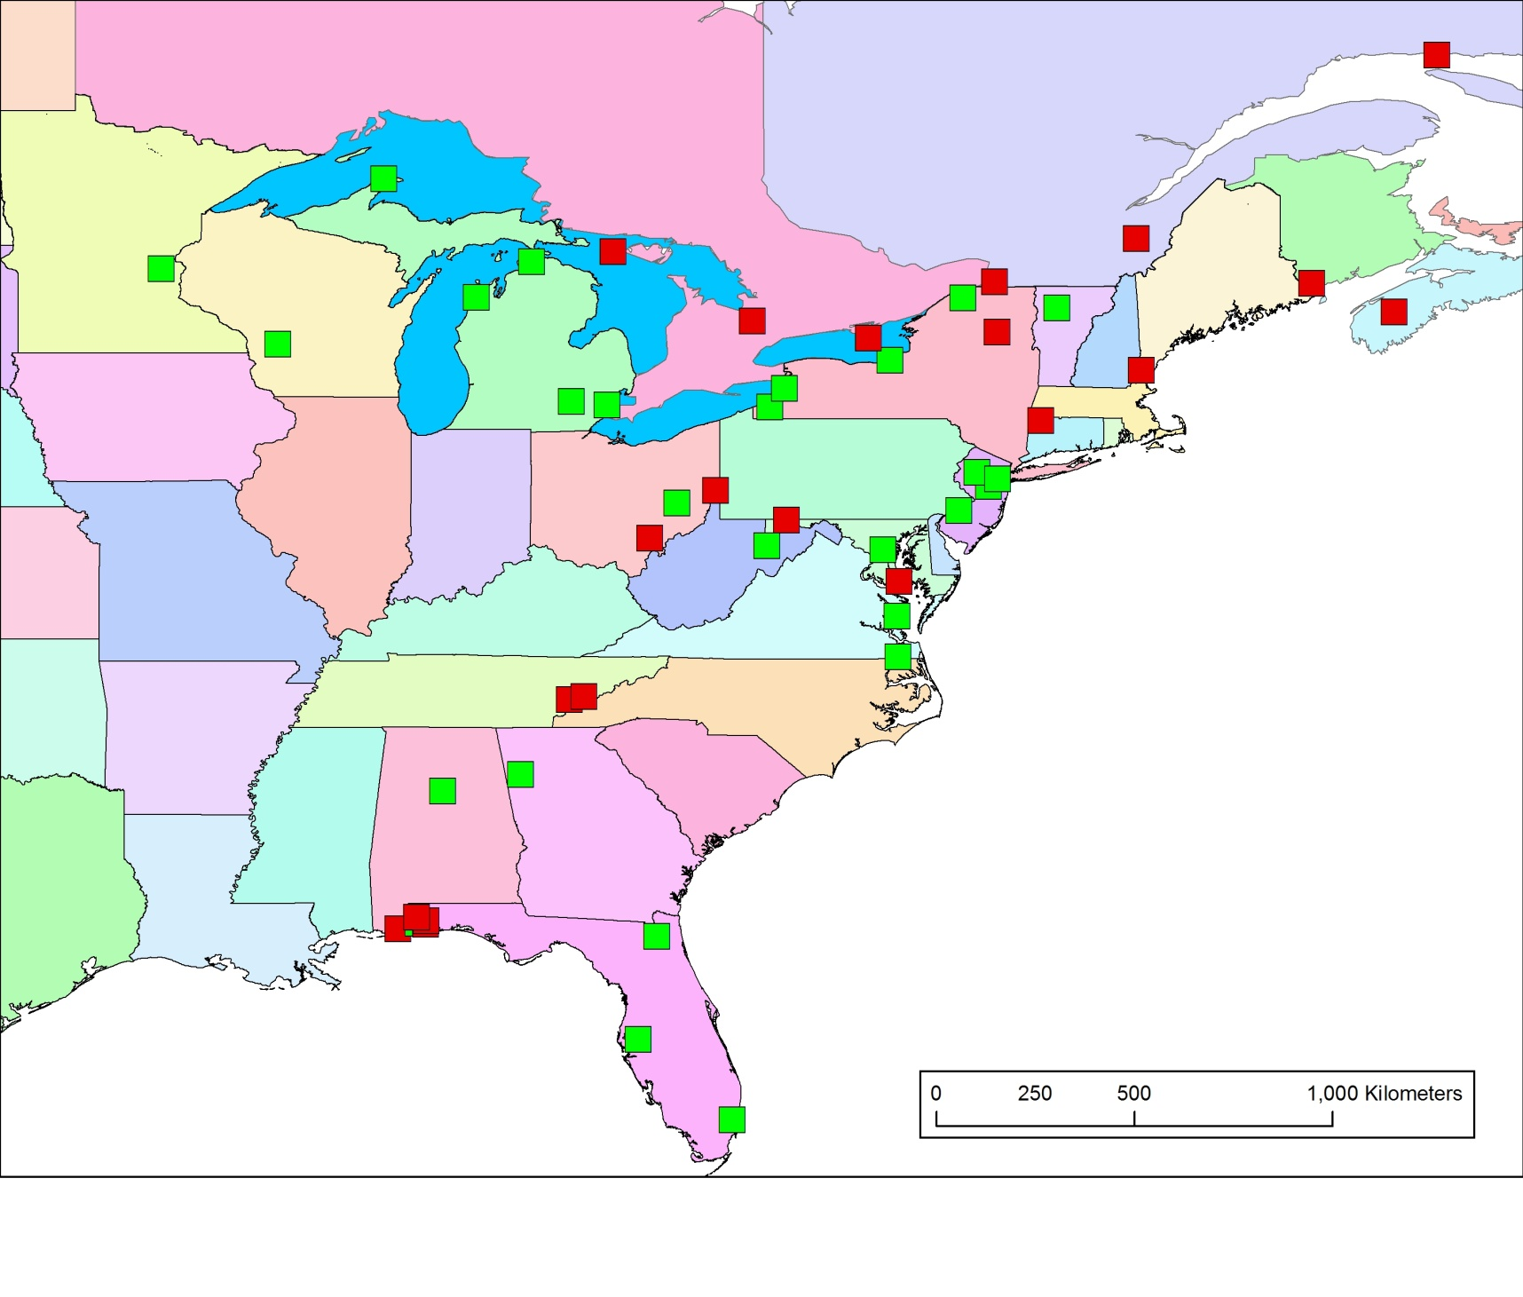
Sites That May Have Ambient Mercury Concentration
Measurement Data for 2005 for Model Evaluation
Positive response from PI
No positive response yet*
* In a few cases, no request yet
NOAA Air Resources Laboratory
29
Presentation to IJC-IAQAB, Apr 25, 2012
Notes:
First year just compared against MDN (wet dep sites) in GL region
Having trouble getting data from Canada…
Can’t reach Laurier Poissant
Pierrette Blanchard has not yet responded to emails…

Slide 30
Sensitivity Analysis (in progress)
Meteorological Data
NARR instead of EDAS40km for North America
Standard Source Locations and Interpolation Methodologies
Adding pts in Eastern Great Lakes region to see if results improve
Numerical experiments with different interpolation methods
Numerical experiments with subsets of std pts – do we need them all?
Model Parameters
Simulation (time step, release elevation …)
Dispersion (number of puffs, freq. of splitting, “conage”, …)
Deposition (wet and dry deposition algorithms, …)
Phase partitioning (gas-droplet, gas-particle, …)
Chemistry (reaction rates, reactant concentrations, …)
NOAA Air Resources Laboratory
Presentation to IJC-IAQAB, Apr 25, 2012
Notes:
Conage is the age in hours of the puffs at which the puff’s pollutant is dumped into the Eulerian grid and simulated on that grid from then on.

Slide 31
Sensitivity Analysis (in progress)
Investigating Impact of Variations on:
model evaluation results?
model-estimated deposition to the GL?
Model-estimated source attribution
Tactical Considerations
Cannot do “Full” Phase-1 analysis for more than a few cases
Screening on a small subset of source locations
“Full Analysis” may be possible on reduced subset of std pts
NOAA Air Resources Laboratory
Presentation to IJC-IAQAB, Apr 25, 2012

Slide 32
Phase 3: Scenarios
NOAA Air Resources Laboratory
32
Presentation to IJC-IAQAB, Apr 25, 2012

Slide 33
What Scenarios Should be Used?
How to generate / solicit scenarios?
Significant role for IAQAB?
NOAA Air Resources Laboratory
Presentation to IJC-IAQAB, Apr 25, 2012

Slide 34
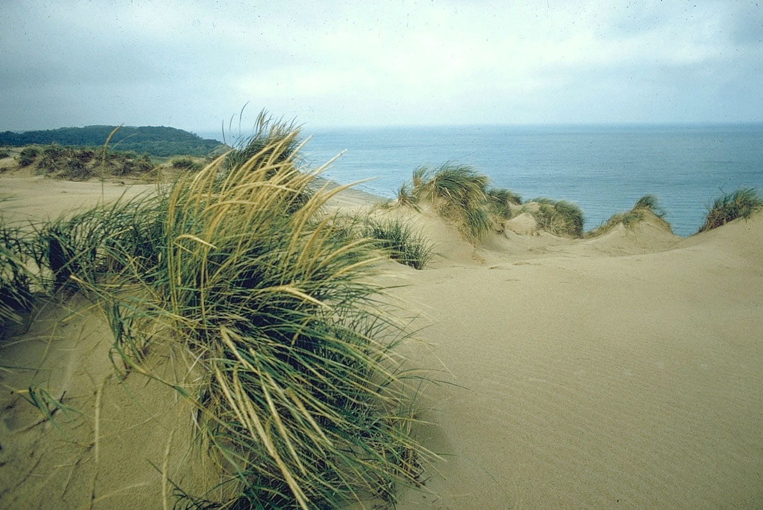
Thanks!
Questions? Suggestions?

Slide 35
Extra Slides
NOAA Air Resources Laboratory
35
Presentation to IJC-IAQAB, Apr 25, 2012

Slide 36
Emissions
NOAA Air Resources Laboratory
36
Presentation to IJC-IAQAB, Apr 25, 2012

Slide 37
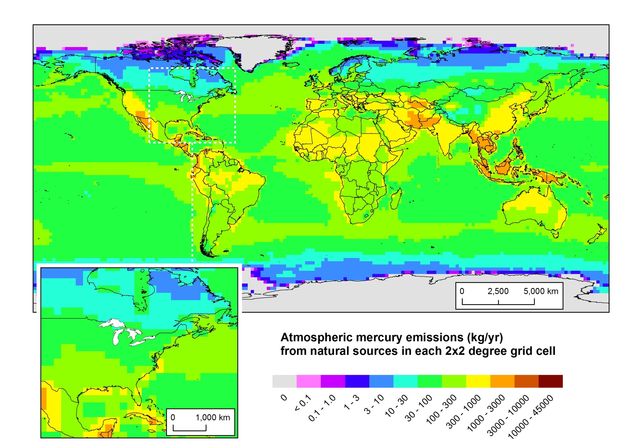
Natural mercury emissions
NOAA Air Resources Laboratory
37
Presentation to IJC-IAQAB, Apr 25, 2012

Slide 38
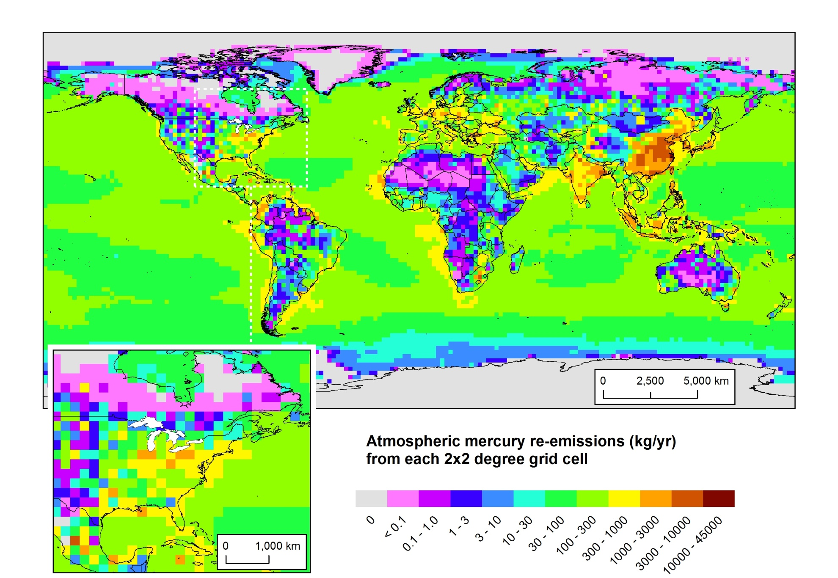
Atmospheric re-emissions of previously deposited
mercury from anthropogenic sources
NOAA Air Resources Laboratory
38
Presentation to IJC-IAQAB, Apr 25, 2012

Slide 39
Methodology
NOAA Air Resources Laboratory
39
Presentation to IJC-IAQAB, Apr 25, 2012

Slide 40
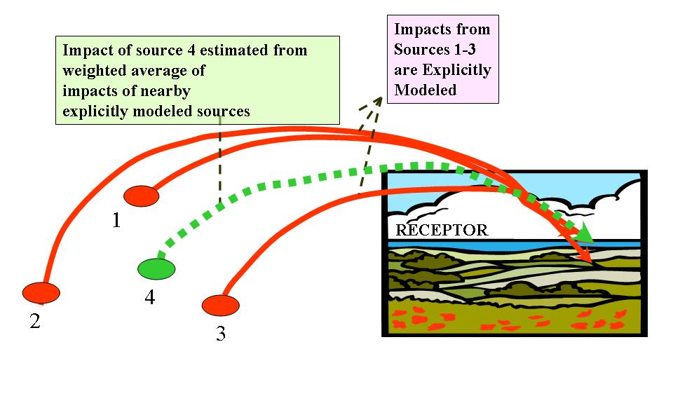
Spatial Interpolation
NOAA Air Resources Laboratory
Presentation to IJC-IAQAB, Apr 25, 2012

Slide 41
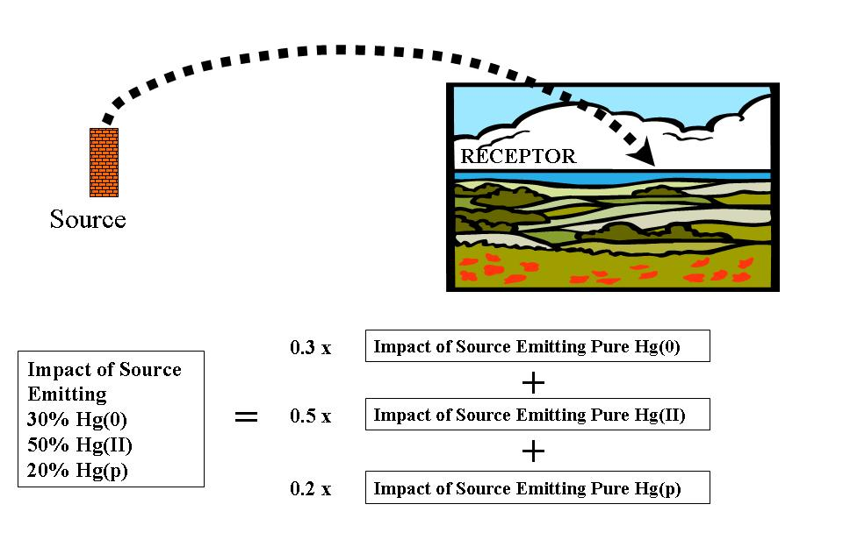
Chemical Interpolation
NOAA Air Resources Laboratory
41
Presentation to IJC-IAQAB, Apr 25, 2012

Slide 42
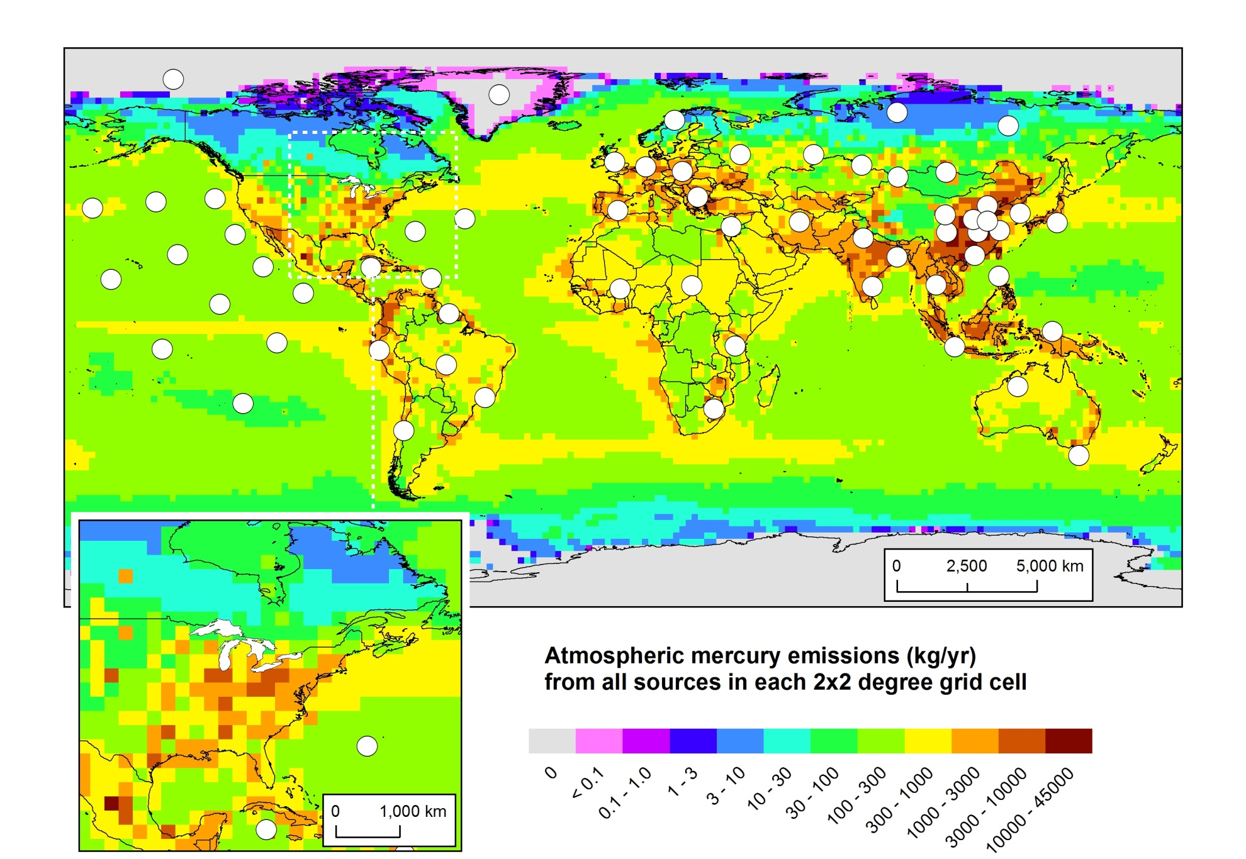
Standard Points Outside of North America
NOAA Air Resources Laboratory
42
Presentation to IJC-IAQAB, Apr 25, 2012

Slide 43
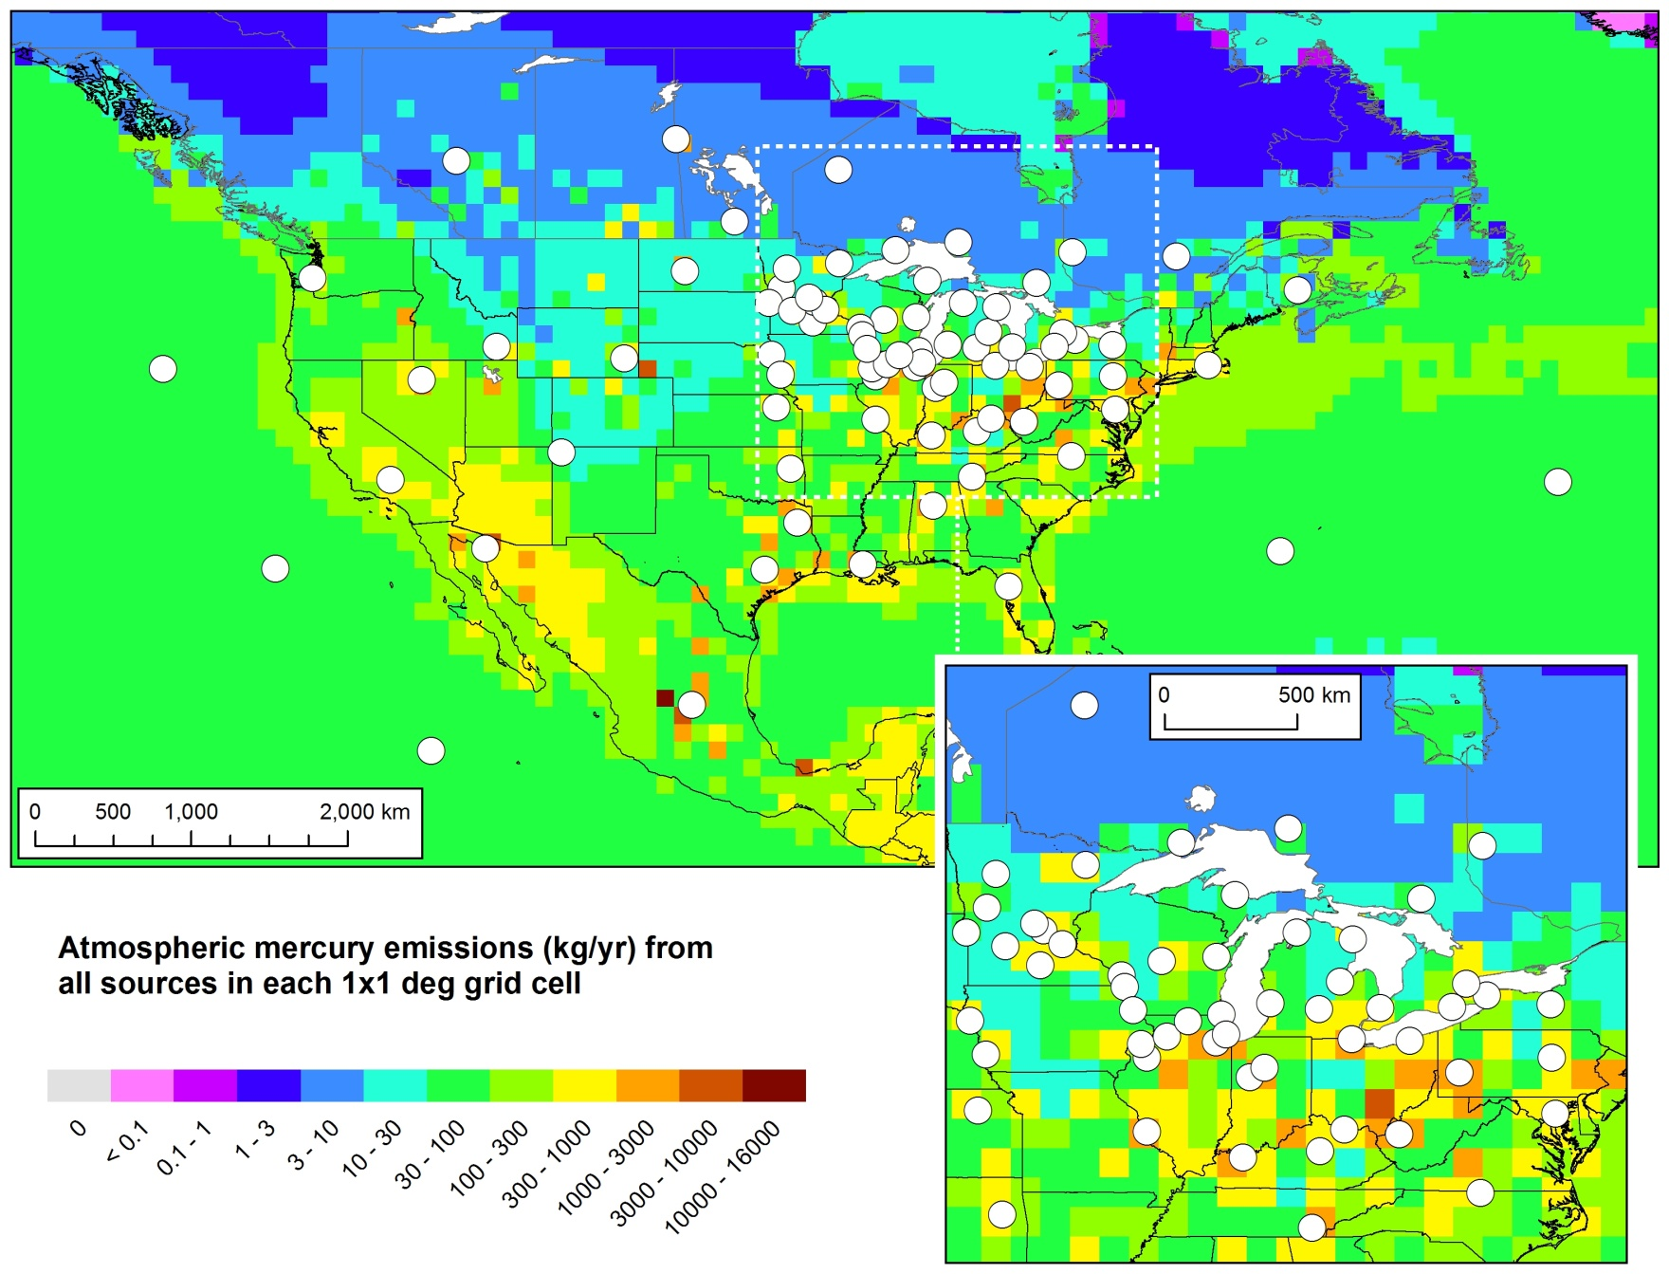
Standard Points in North America
NOAA Air Resources Laboratory
43
Presentation to IJC-IAQAB, Apr 25, 2012
Notes:
A total of 136 Std Source Locations used in this analysis

Slide 44
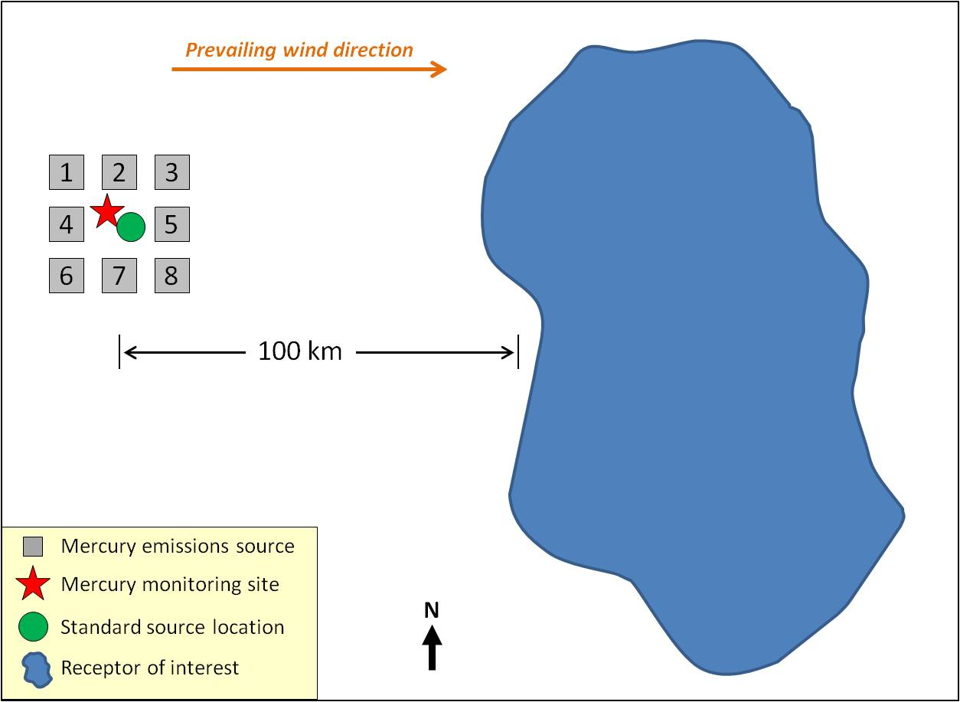
Getting good ground-truthing results harder
than estimating deposition to the Great Lakes
One Standard Source Location (green dot) would do a decent job of estimating deposition to the receptor, for all of the hypothetical, “actual” source locations shown (numbered boxes)
But the same Standard Source Location would be completely inadequate to estimate deposition and concentrations at the monitoring site (red star)
NOAA Air Resources Laboratory
44
Presentation to IJC-IAQAB, Apr 25, 2012
Notes:
Typically, modeling analyses are evaluated by comparing their predictions with measurements at monitoring sites. We will present such an evaluation analysis in Section 5, below. However, the primary goal of this project is to create accurate estimates of the amount and source attribution for mercury deposition to the Great Lakes – not to produce deposition estimates at monitoring sites in the region.
As will be seen shortly, it is generally much more difficult – and computationally intensive – to accurately predict deposition at a single monitoring site (or a set of such sites) than it is to predict deposition for large area receptors such as the Great Lakes.
Consider Figure 24, a conceptual diagram in which we show a hypothetical situation with a receptor of interest, a monitoring site, and several (8) mercury emissions sources in the vicinity of the monitoring site. For reference, a prevailing wind direction, distance scale, and map orientation are also shown. Since the winds do not always blow in the “prevailing” direction, all of the sources will have some impacts on the monitoring site. However, even if each of the sources were identical, they would likely have dramatically different impacts on the monitoring site, given their different spatial orientation to the site. For example, given the prevailing wind direction, source #4 would be expected to have a relatively large impact on the site, but source #5 would be expected to have a relatively small impact on the monitoring site. The consequence is that to estimate the wet deposition of mercury at the monitoring site – arising simply from the sources in the vicinity of the site alone -- standard sources would most likely have to be located at each of the eight sources shown.
However, to accurately estimate the impacts of the 8 sources on the receptor of interest, about 100 km away in this hypothetical example, a single standard source location located near the “center” of the source group would likely suffice. In other words, to estimate the concentration or deposition at the monitoring site in this simple, hypothetical example, 8 standard source locations would be needed – corresponding to 24 different computer simulations, one for each of the three forms of mercury emitted – whereas only 1 location (3 simulations) would be needed to estimate the deposition impact of the sources on the receptor of interest. Because of computational resource constraints, and given the overarching goals of this project, we have prioritized the estimation of deposition to the Great Lakes -- large area receptors – rather than focus on “point” monitoring sites in the region. Substantially more standard source locations than the 136 utilized would have had to have been used to generate the same accuracy for monitoring site estimates as were generated for the Great Lakes in this analysis. Notwithstanding all of the above, as will be shown in Section 5 below, this modeling analysis produced results at monitoring sites in the Great Lakes region that were encouragingly – and perhaps even surprisingly – close to the measurements made at these sites.

Slide 45
Illustrative Results for Single Sources
NOAA Air Resources Laboratory
45
Presentation to IJC-IAQAB, Apr 25, 2012

Slide 46
In order to conveniently compare different model results,
a “transfer flux coefficient” X will be used,
defined as the following:
NOAA Air Resources Laboratory
46
Presentation to IJC-IAQAB, Apr 25, 2012

Slide 47
NOAA Air Resources Laboratory
47
Presentation to IJC-IAQAB, Apr 25, 2012

Slide 48
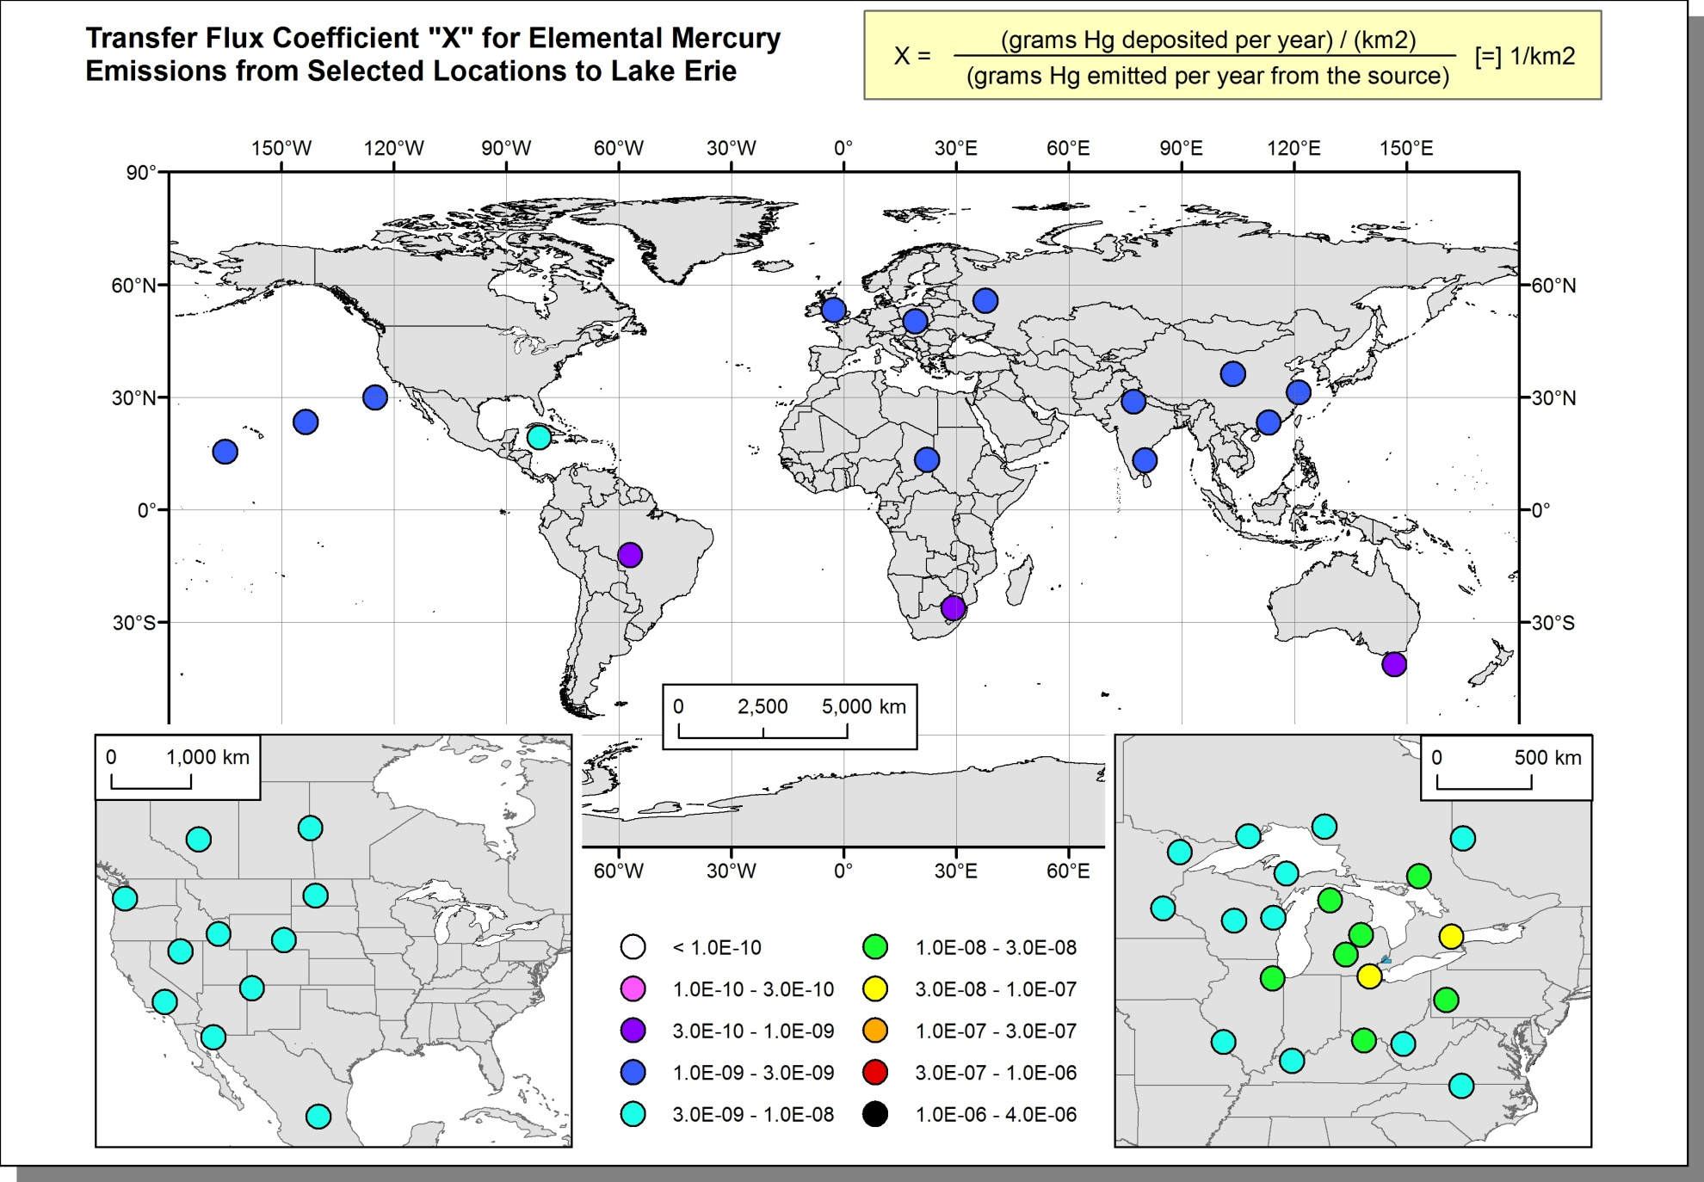
Transfer Flux Coefficients For Pure Elemental Mercury Emissions at an Illustrative Subset of Standard Source Locations, for Deposition Flux Contributions to Lake Erie
NOAA Air Resources Laboratory
48
Presentation to IJC-IAQAB, Apr 25, 2012

Slide 49
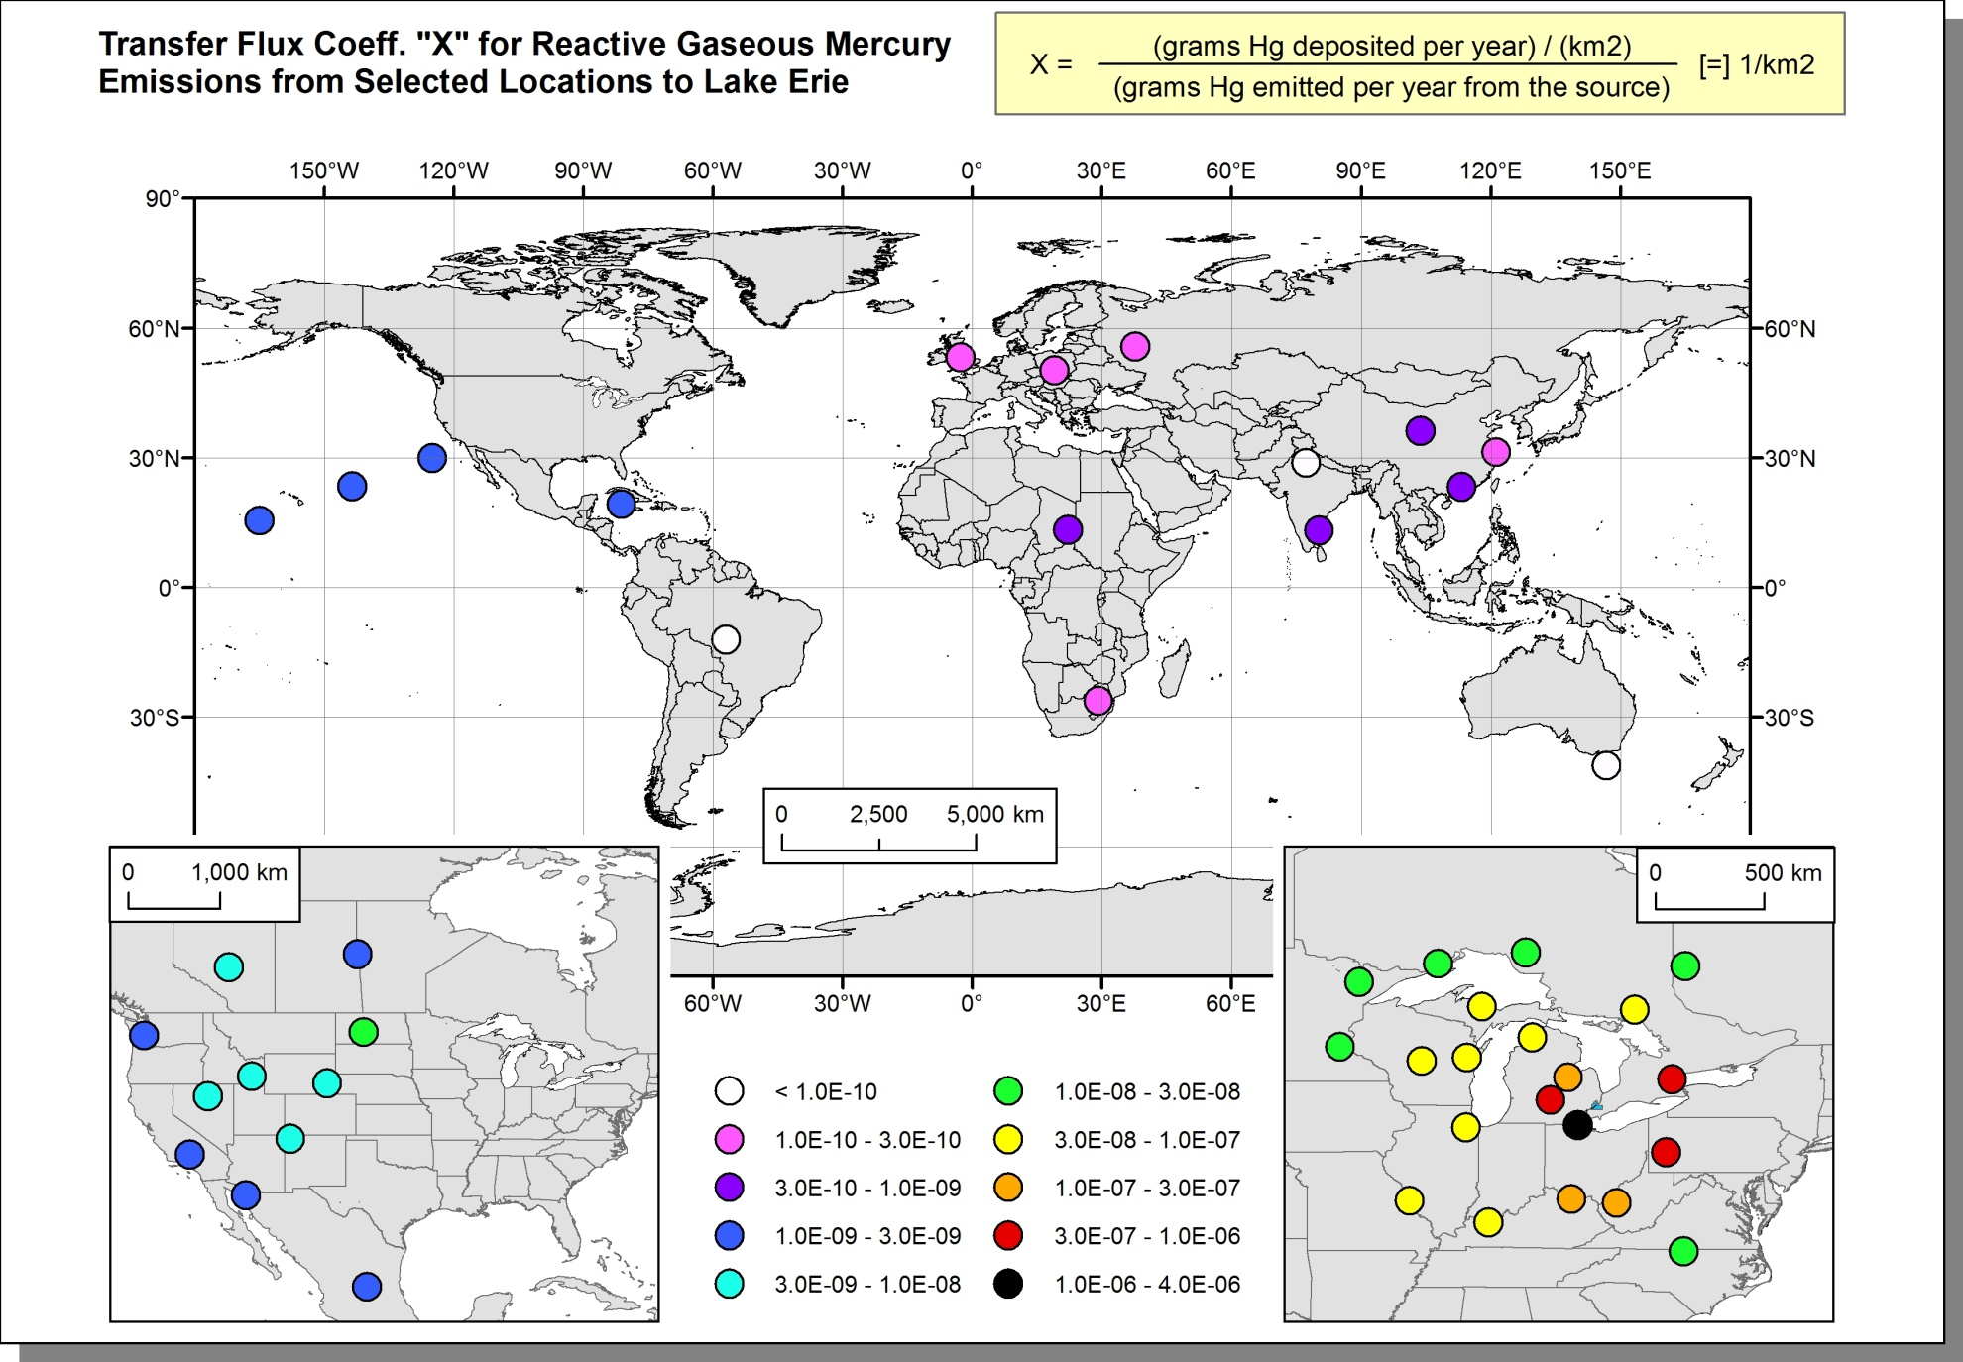
Transfer Flux Coefficients For Pure Reactive Gaseous Mercury Emissions at an Illustrative Subset of Standard Source Locations, for Deposition Flux Contributions to Lake Erie
NOAA Air Resources Laboratory
49
Presentation to IJC-IAQAB, Apr 25, 2012

Slide 50
Transfer Flux Coefficients For Hg(0), Hg(II),
and Hg(p) to Lake Erie (logarithmic scale)
NOAA Air Resources Laboratory
50
Presentation to IJC-IAQAB, Apr 25, 2012

Slide 51
Transfer Flux Coefficients For Hg(0), Hg(II),
and Hg(p) to Lake Erie (linear scale)
NOAA Air Resources Laboratory
51
Presentation to IJC-IAQAB, Apr 25, 2012

Slide 52
Model Evaluation
NOAA Air Resources Laboratory
52
Presentation to IJC-IAQAB, Apr 25, 2012

Slide 53
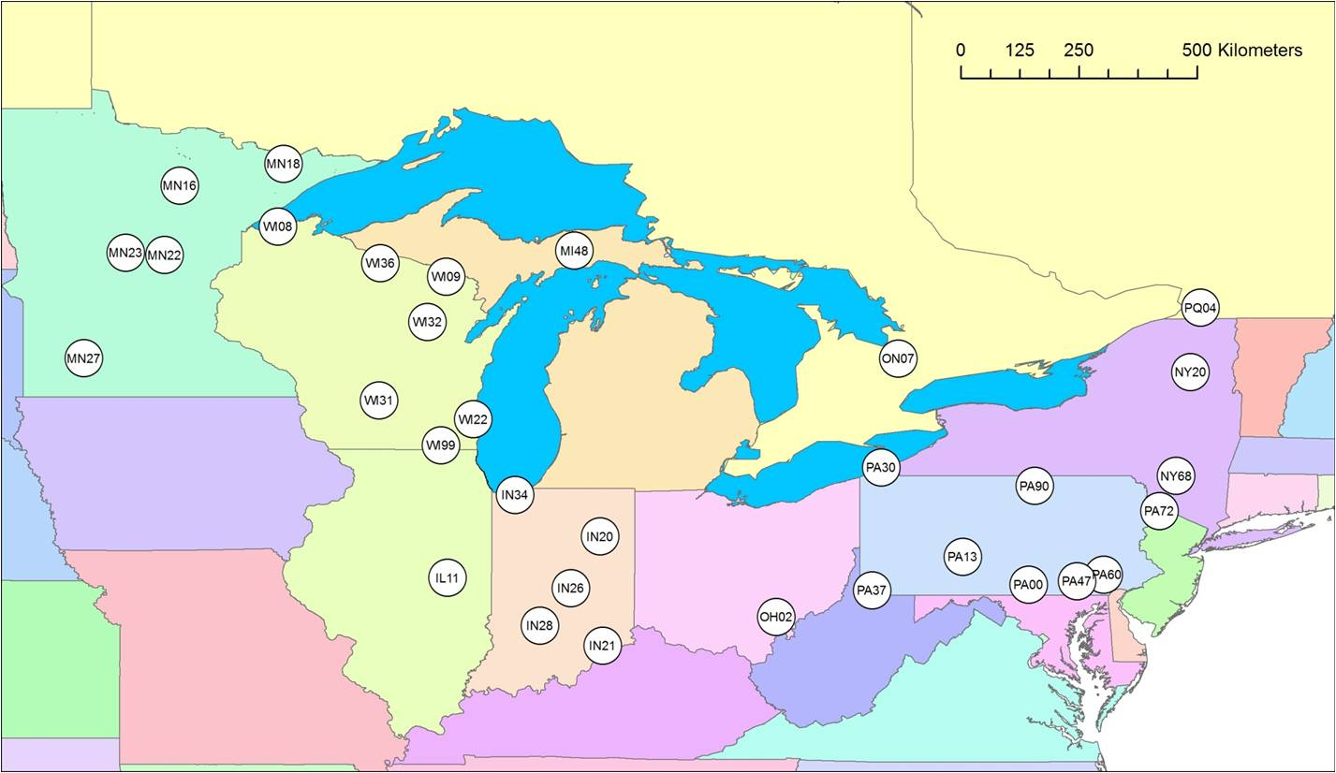
Figure 55. Mercury Deposition Network Sites in the Great Lakes
Region Considered in an Initial Model Evaluation Analysis
NOAA Air Resources Laboratory
53
Presentation to IJC-IAQAB, Apr 25, 2012

Slide 54
Figure 56. Comparison of Total 2005 Precipitation Measured at each of the Great-Lakes Region MDN Sites with the Precipitation in the Meteorological Datasets Used as Inputs to this Modeling Study
NOAA Air Resources Laboratory
54
Presentation to IJC-IAQAB, Apr 25, 2012
Notes:
EDAS met data (over a central North American domain) used as input to the model underestimated the actual precipitation at the MDN sites…
NCEP/NCAR global met data used as input to the model overestimated the actual precipitation at the MDN sites…

Slide 55
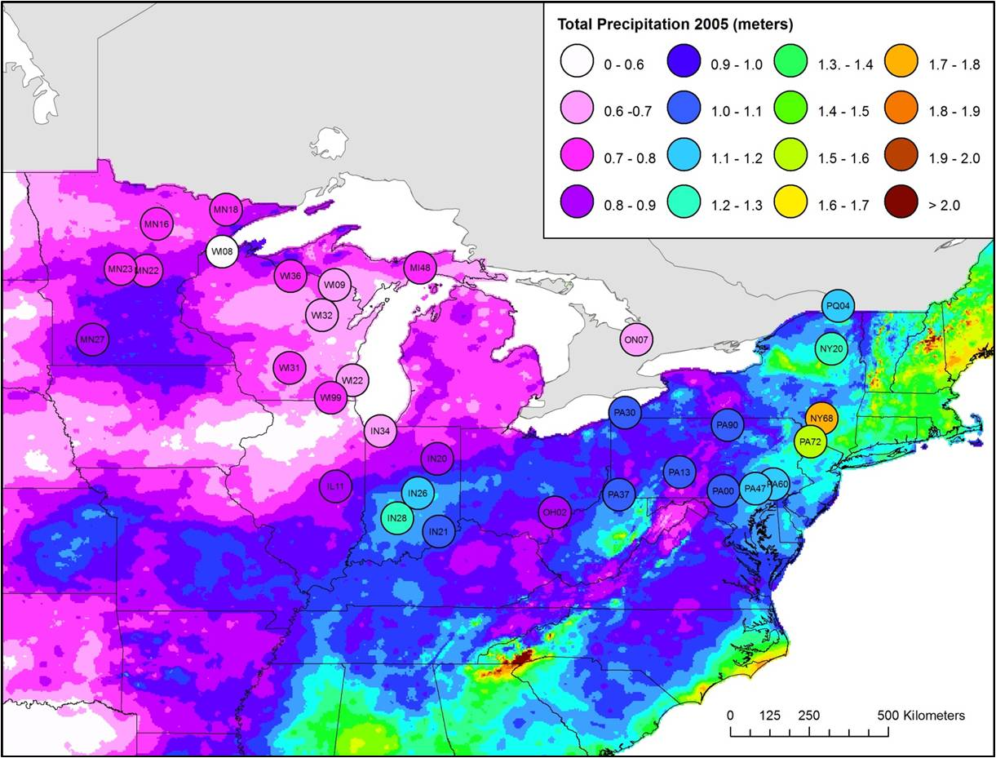
Comparison of 2005 precipitation total as measured at MDN sites in the
Great Lakes region (circles) with precipitation totals assembled
by the PRISM Climate Group, Oregon State University
NOAA Air Resources Laboratory
55
Presentation to IJC-IAQAB, Apr 25, 2012
Notes:
2005 MDN measured precip was probably pretty good –
seems to match the general regional picture of precip measurements during 2005

Slide 56
Modeled vs. Measured Wet Deposition of Mercury at Sites in the Great Lakes Region
NOAA Air Resources Laboratory
56
Presentation to IJC-IAQAB, Apr 25, 2012
Notes:
All the data

Slide 57
Modeled vs. Measured Wet Deposition of Mercury at Sites in the Great Lakes Region
NOAA Air Resources Laboratory
57
Presentation to IJC-IAQAB, Apr 25, 2012

Slide 58
Overall Results for the
Great Lakes
NOAA Air Resources Laboratory
58
Presentation to IJC-IAQAB, Apr 25, 2012

Slide 59
Overall model estimates of mercury
deposition to the Great Lakes Basin
NOAA Air Resources Laboratory
59
Presentation to IJC-IAQAB, Apr 25, 2012

Slide 60
Model-estimated 2005 deposition fluxes (ug/m2-year) to the Great Lakes and Great Lakes Watersheds
NOAA Air Resources Laboratory
60
Presentation to IJC-IAQAB, Apr 25, 2012

Slide 61
Model-estimated 2005 deposition amounts (kg/year)
to the Great Lakes and Great Lakes Watersheds
NOAA Air Resources Laboratory
61
Presentation to IJC-IAQAB, Apr 25, 2012

Slide 62
Time Trends of Mercury Concentrations in GL Fish
Satyendra P. Bhavsar; Sarah B. Gewurtz; Daryl J. McGoldrick; Michael J. Keir; Sean M. Backus; Environ. Sci. Technol. 2010, 44, 3273-3279.
DOI: 10.1021/es903874x
NOAA Air Resources Laboratory
62
Presentation to IJC-IAQAB, Apr 25, 2012

Slide 63
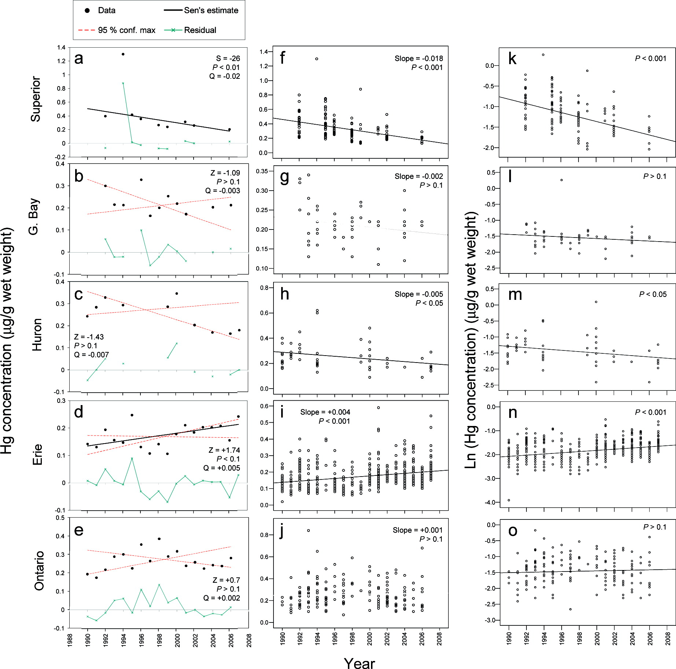
Temporal trends of mercury in OMOE skinless fillets of Lake Erie 45−55 cm walleye collected between 1990−2007 (from Bhavsar et al., 2010)
1990
1992
1994
1996
1998
2000
2002
2004
2006
2008
NOAA Air Resources Laboratory
63
Presentation to IJC-IAQAB, Apr 25, 2012
Notes:
FROM: Satyendra P. Bhavsar; Sarah B. Gewurtz; Daryl J. McGoldrick; Michael J. Keir; Sean M. Backus; Environ. Sci. Technol. 2010, 44, 3273-3279.
DOI: 10.1021/es903874x
Temporal trends of mercury in OMOE skinless fillets of 45−55 cm walleye collected between 1990−2007.
Linear regression on regular concentrations.
P-value is for statistical significance.
Sen’s estimate line is shown only for statistically significant (P < 0.05) upward/downward trend.

Slide 64

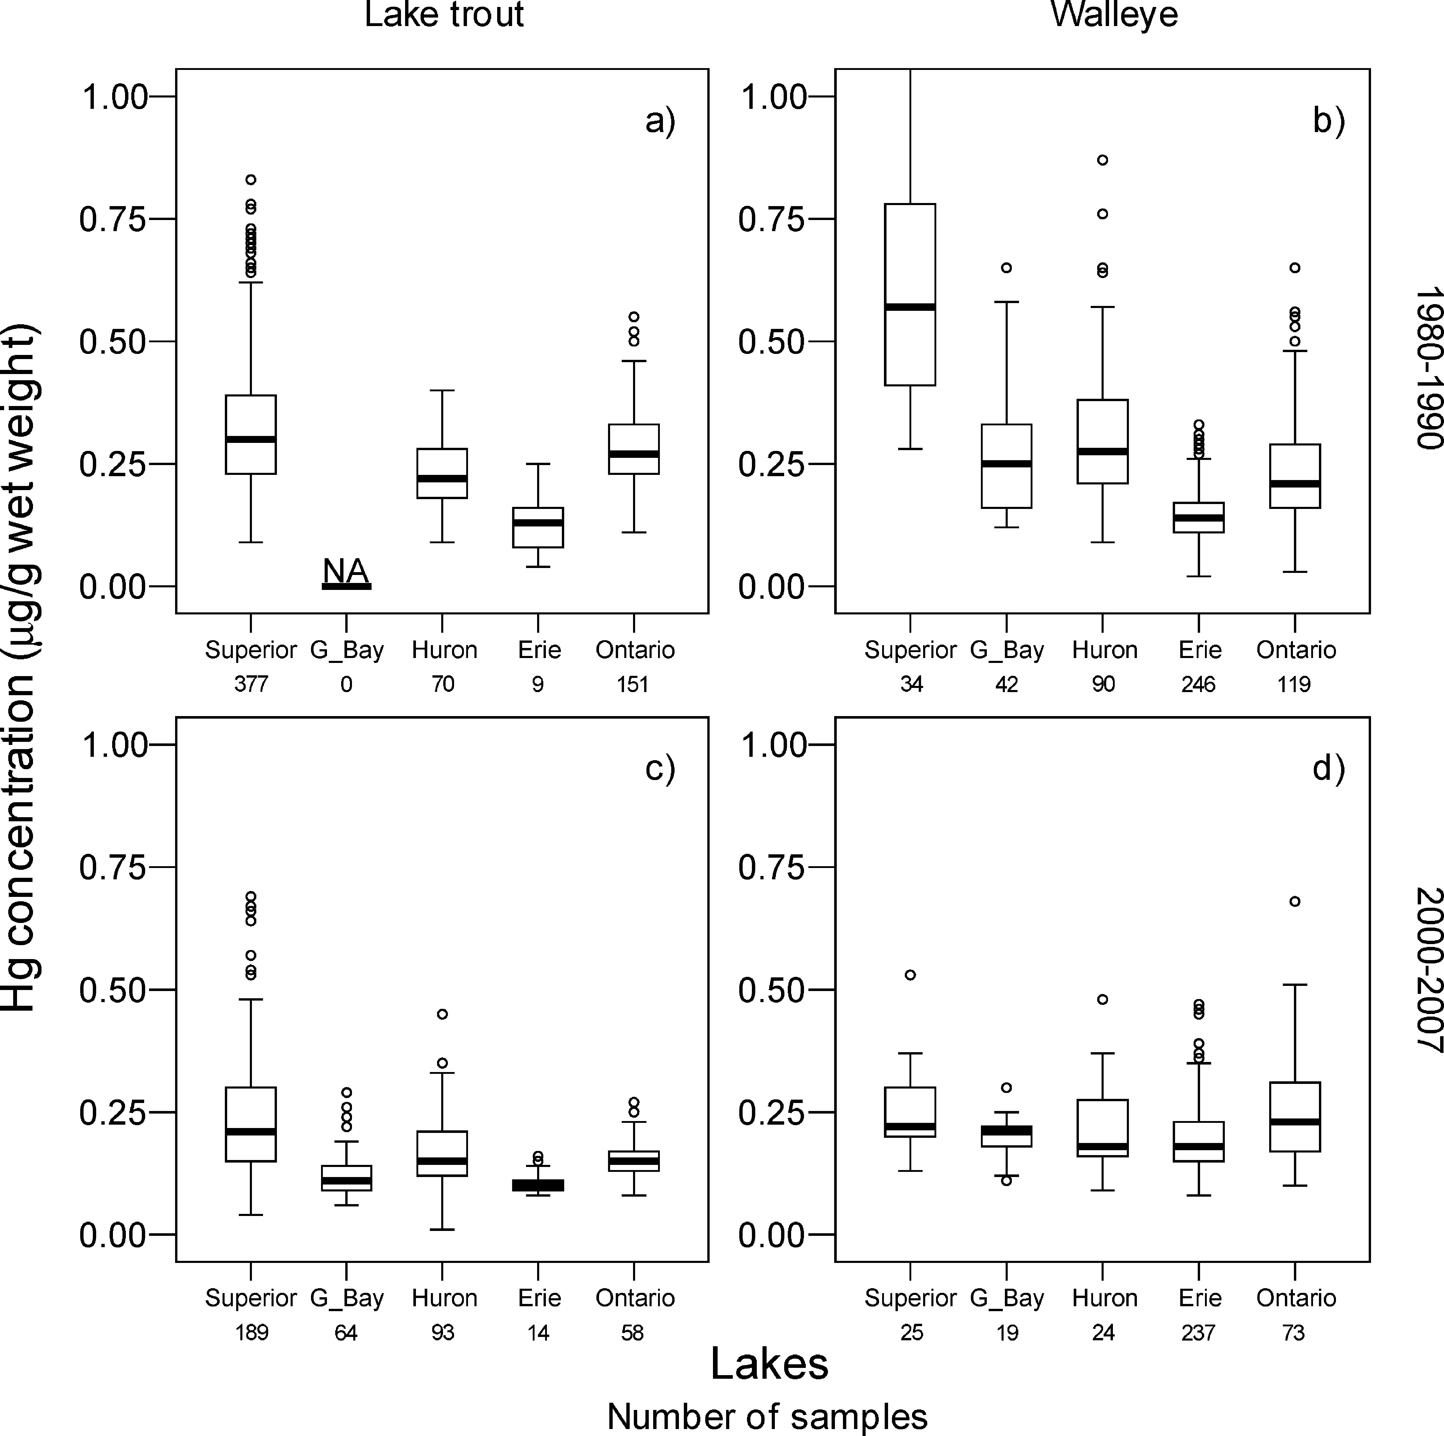
Measured Hg concentrations (μg/g wet weight) in OMOE skinless fillets. (a, c) 55−65 cm lake trout and (b, d) 45−55 cm walleye collected from Lakes Superior, Georgian Bay, Huron, Erie and Ontario during (a, b) 1980−1990 and (c, d) 2000−2007. Box plots: the line within the box indicates median, the box indicates 25th and 75th quartile values, the whiskers indicate the upper and lower values not classified as statistical outliers or extremes. The outliers (open circles) and extremes (not shown) were values more than 1.5 and 3 times 25th−75th interquartile range away from the closest end of the box, respectively. The numbers below lake names are for sample sizes (N). NA indicates not available.
Published in: Satyendra P. Bhavsar; Sarah B. Gewurtz; Daryl J. McGoldrick; Michael J. Keir; Sean M. Backus; Environ. Sci. Technol. 2010, 44, 3273-3279.
DOI: 10.1021/es903874x
Copyright © 2010 American Chemical Society
NOAA Air Resources Laboratory
64
Presentation to IJC-IAQAB, Apr 25, 2012

Slide 65
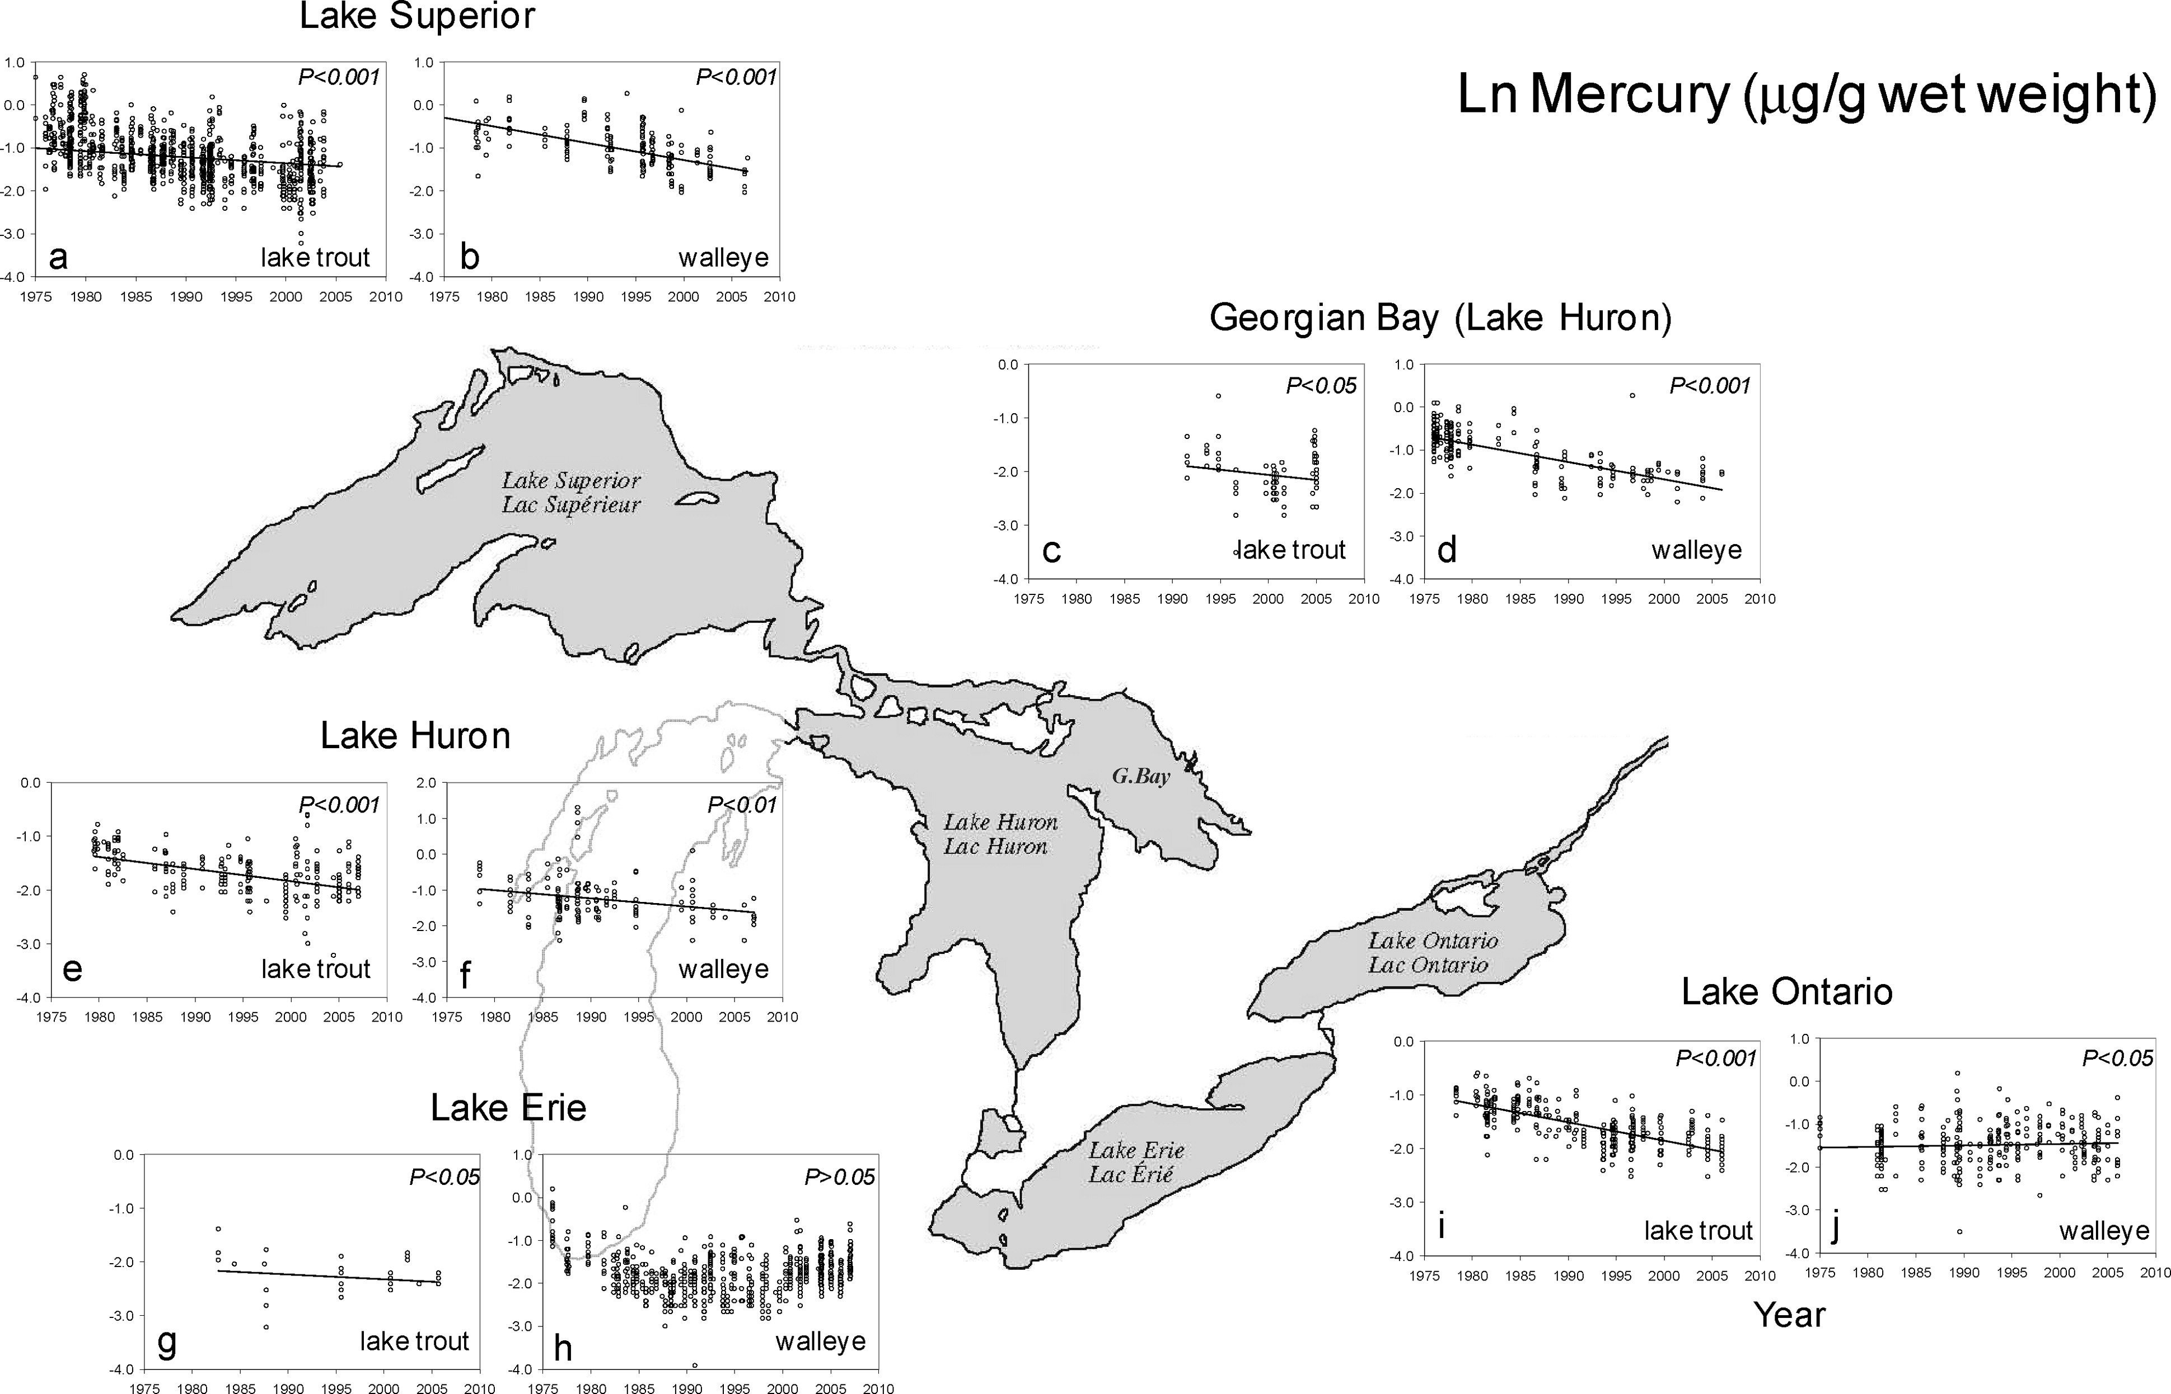
Temporal trends of mercury (natural log-transformed, μg/g ww) in OMOE skinless fillets. (a, c, e, g, i) 55−65 cm lake trout, and (b, d, f, h, j) 45−55 cm walleye collected from Lakes Superior (a-b), Georgian Bay (c,d), Huron (e,f), Erie (g,h), and Ontario (i,j) between 1973 and 2007. P-value is for statistical significance.
Published in: Satyendra P. Bhavsar; Sarah B. Gewurtz; Daryl J. McGoldrick; Michael J. Keir; Sean M. Backus; Environ. Sci. Technol. 2010, 44, 3273-3279.
DOI: 10.1021/es903874x
Copyright © 2010 American Chemical Society
NOAA Air Resources Laboratory
65
Presentation to IJC-IAQAB, Apr 25, 2012

Slide 66
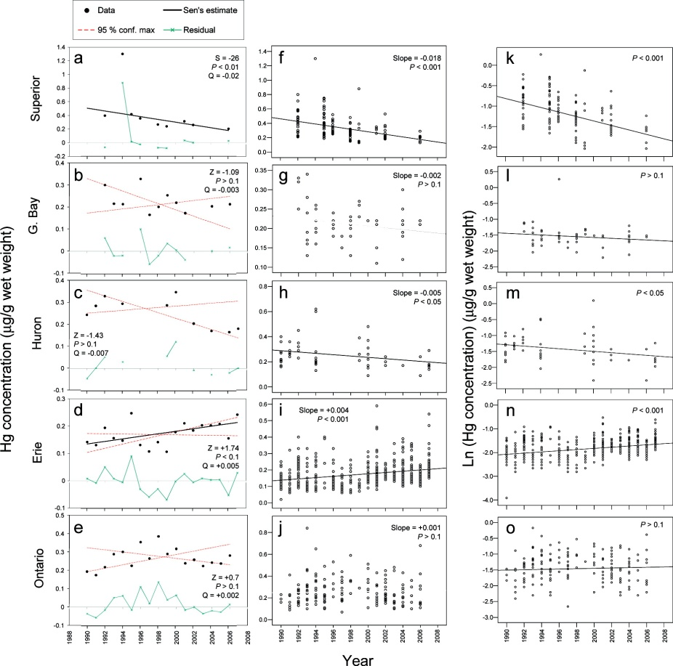
Temporal trends of mercury in OMOE skinless fillets of 45−55 cm walleye collected between 1990−2007. (a−e) Man-Kendall test, (f−j) linear regression on regular concentrations, and (k−o) linear regression on natural log-transformed concentrations. P-value is for statistical significance. Sen’s estimate line is shown only for statistically significant (P < 0.05) upward/downward trend.
Published in: Satyendra P. Bhavsar; Sarah B. Gewurtz; Daryl J. McGoldrick; Michael J. Keir; Sean M. Backus; Environ. Sci. Technol. 2010, 44, 3273-3279.
DOI: 10.1021/es903874x
Copyright © 2010 American Chemical Society
NOAA Air Resources Laboratory
66
Presentation to IJC-IAQAB, Apr 25, 2012

Slide 67
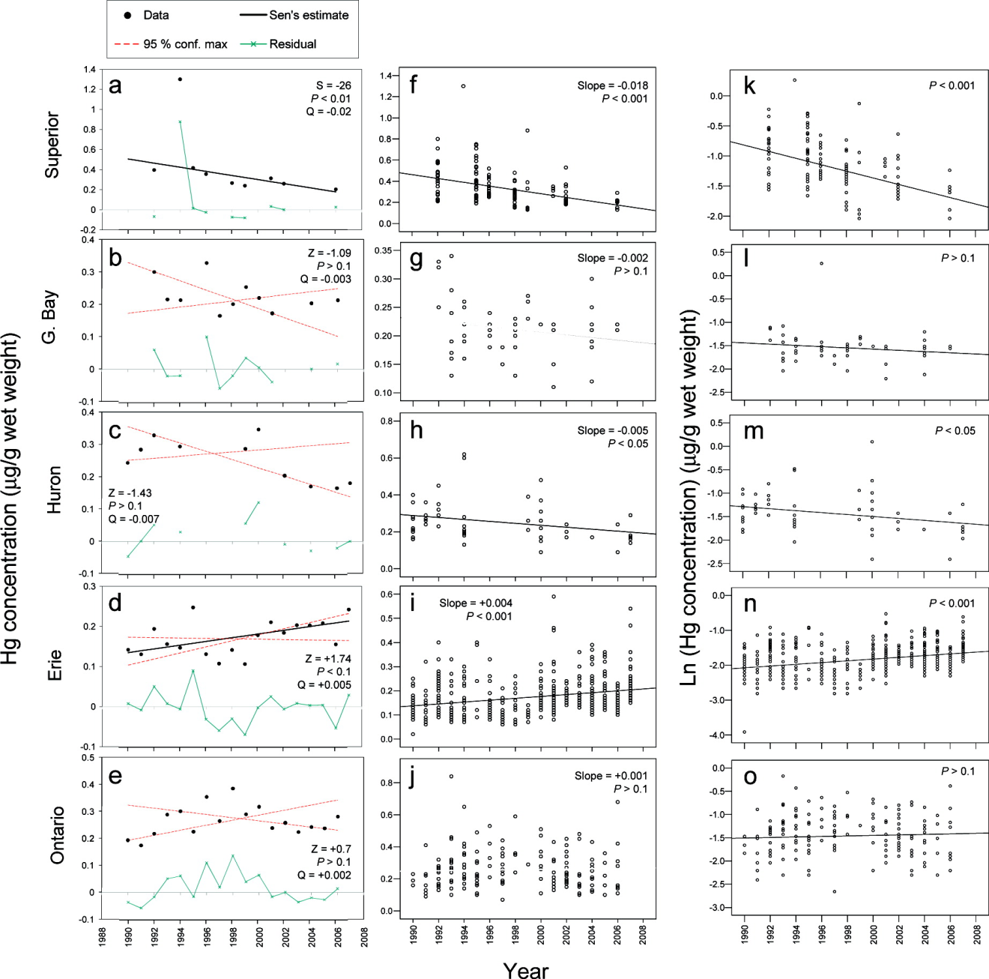
NOAA Air Resources Laboratory
67
Presentation to IJC-IAQAB, Apr 25, 2012

Slide 68
Lake Erie
NOAA Air Resources Laboratory
68
Presentation to IJC-IAQAB, Apr 25, 2012

Slide 69
Areas of Concern
NOAA Air Resources Laboratory
69
Presentation to IJC-IAQAB, Apr 25, 2012

Slide 70
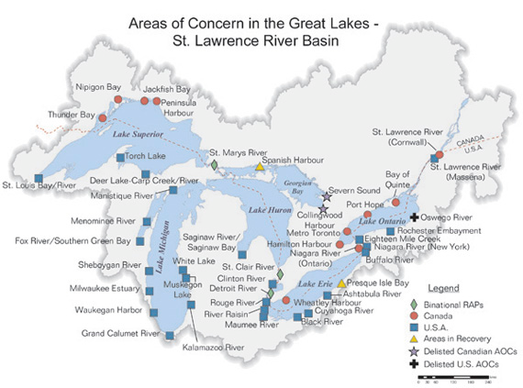

Slide 71
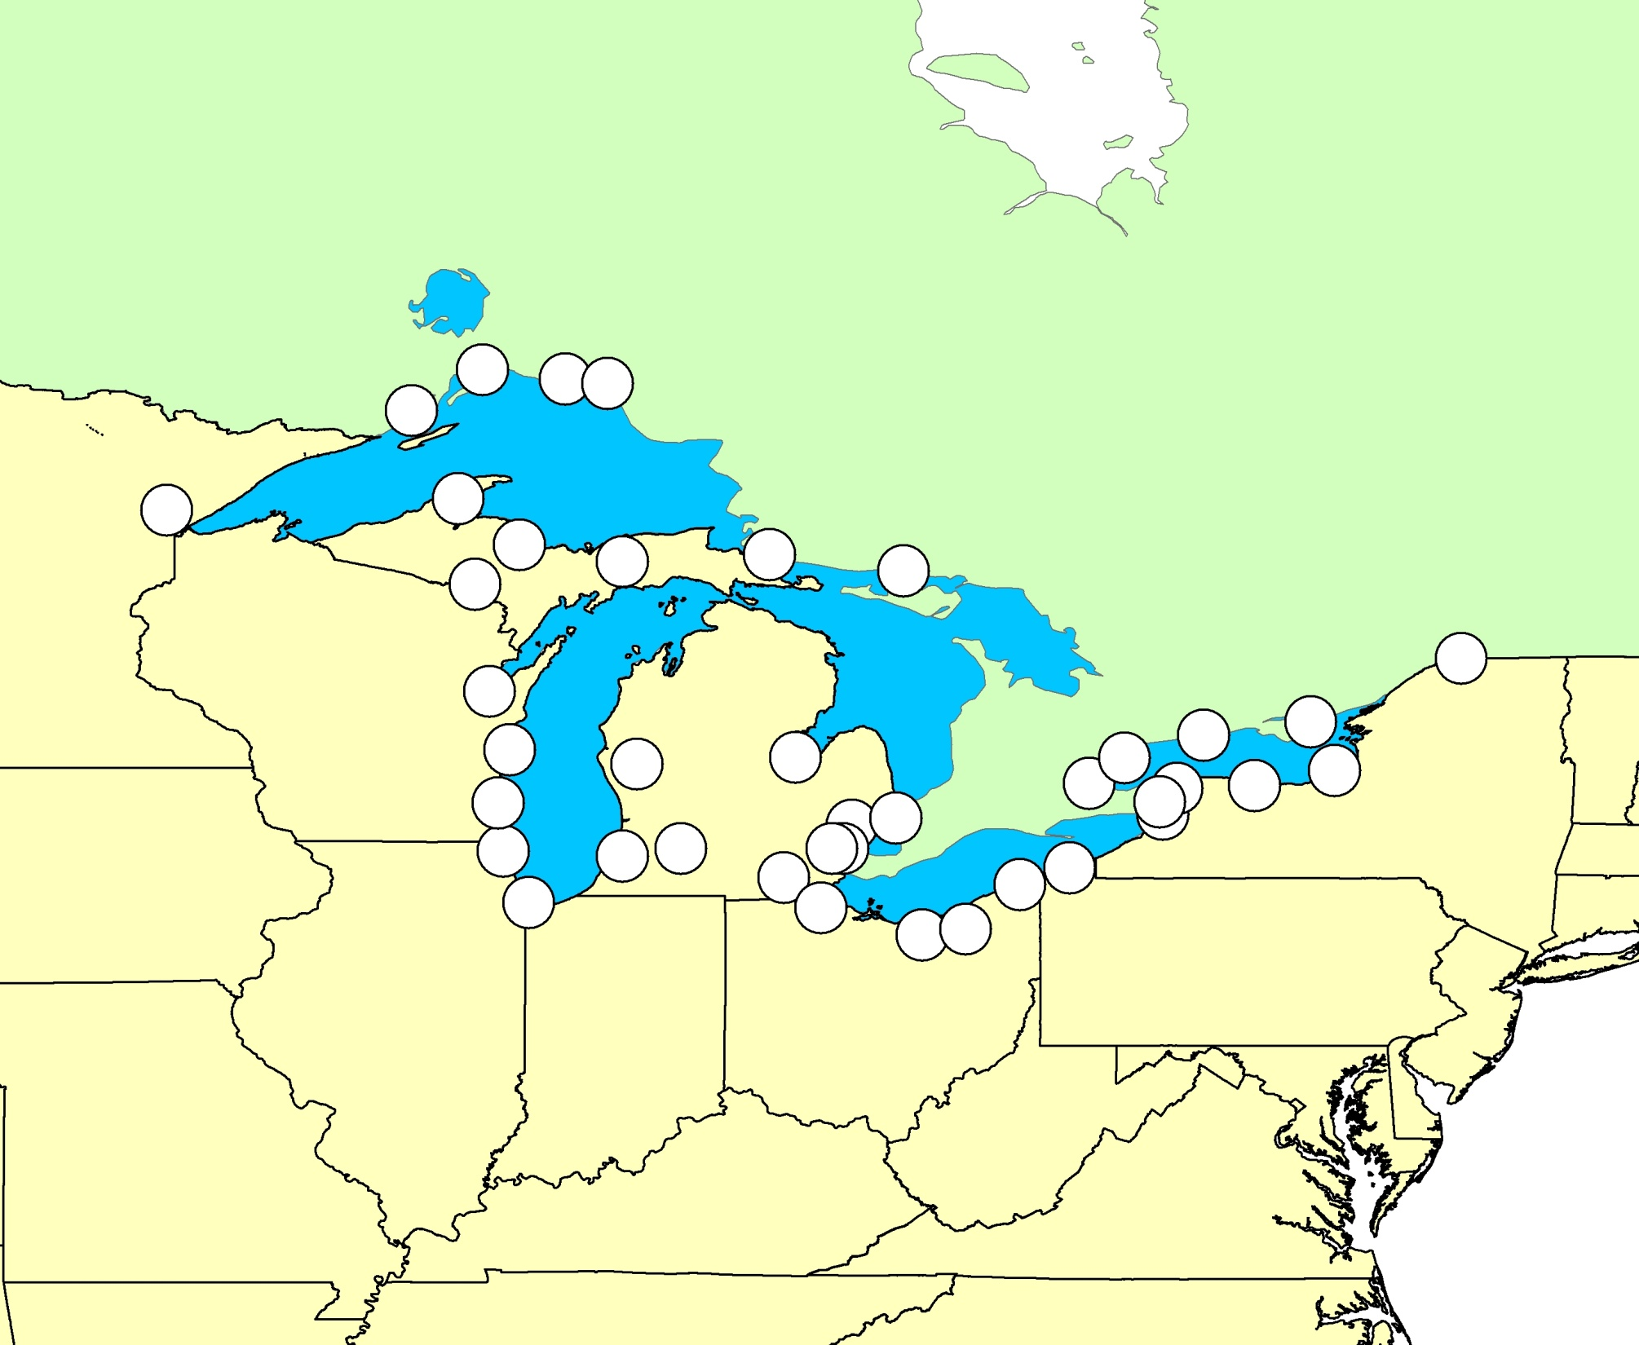
Great Lakes Areas of Concern

Slide 72
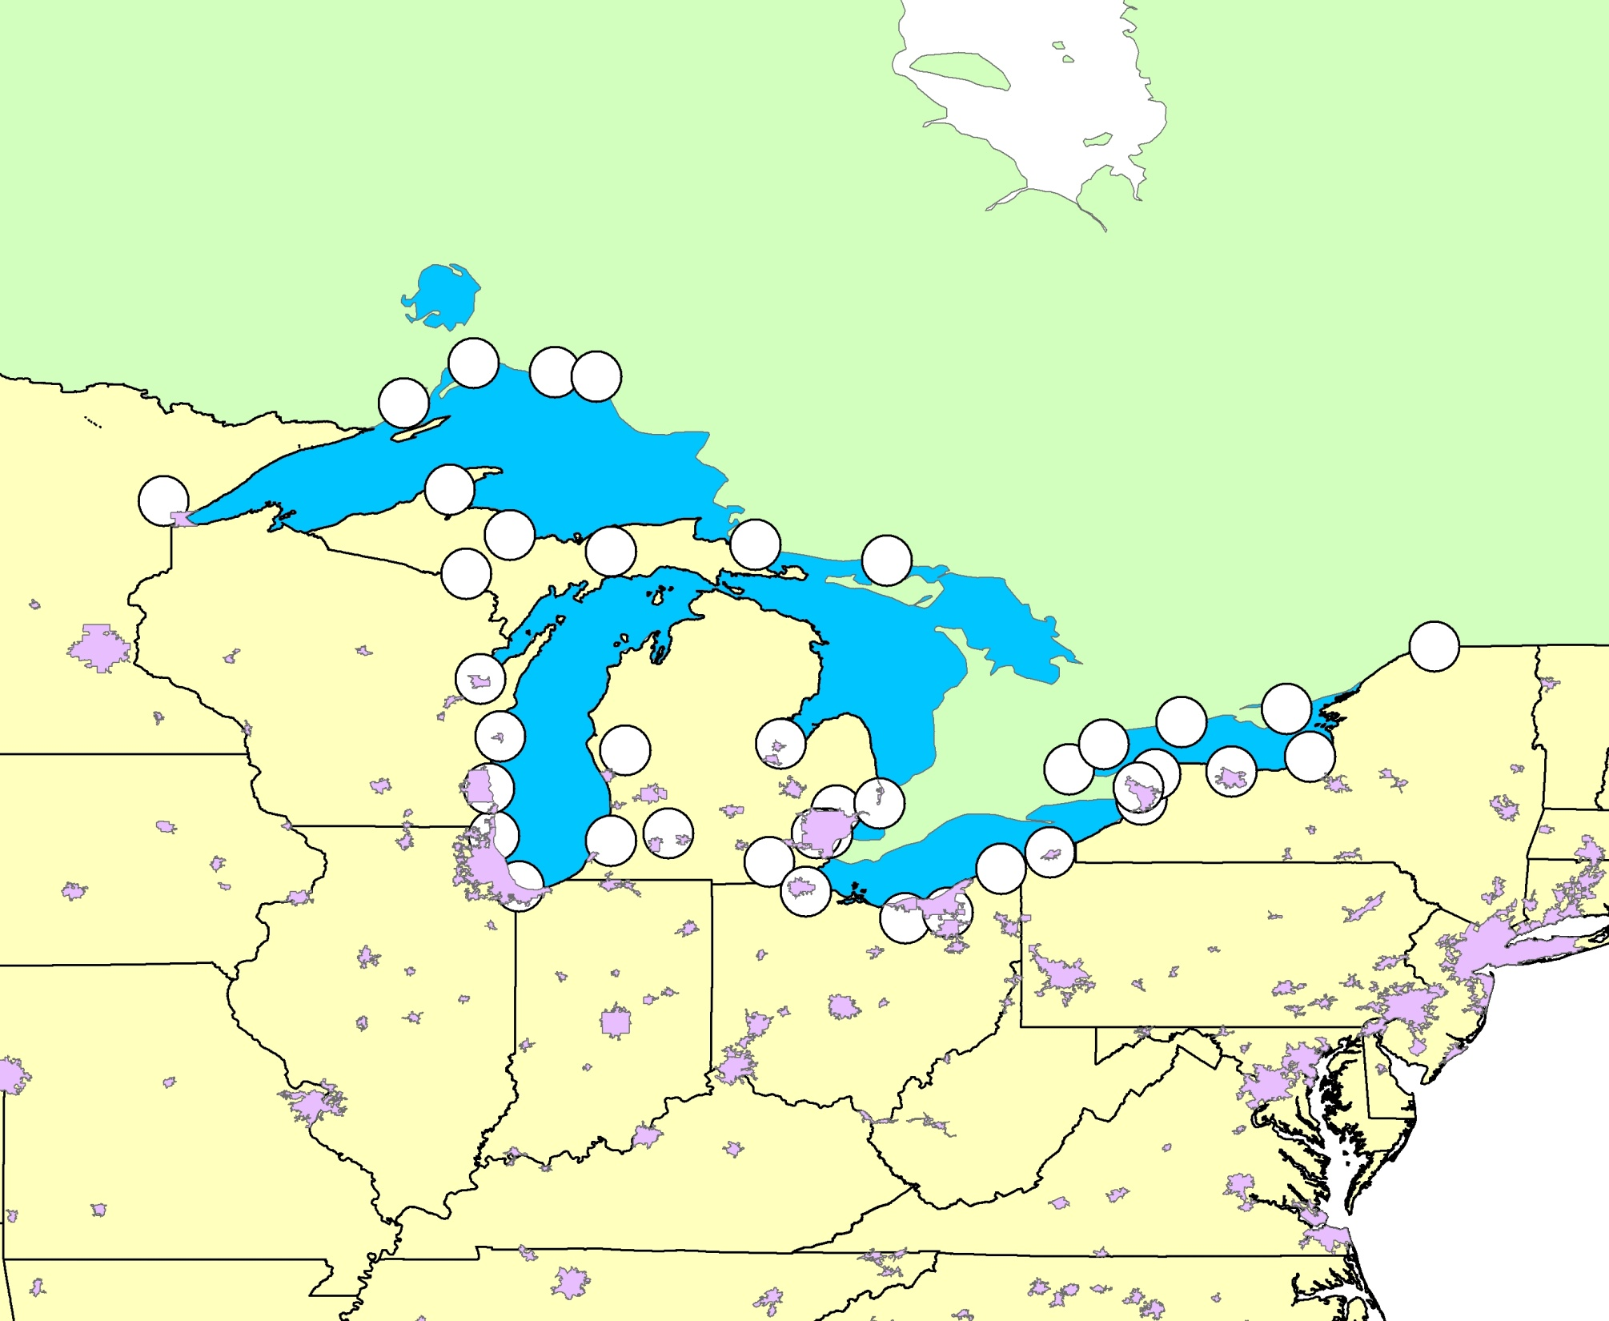
Great Lakes Areas of Concern
U.S. urban areas (pink shading)
Notes:
With urban areas

Slide 73
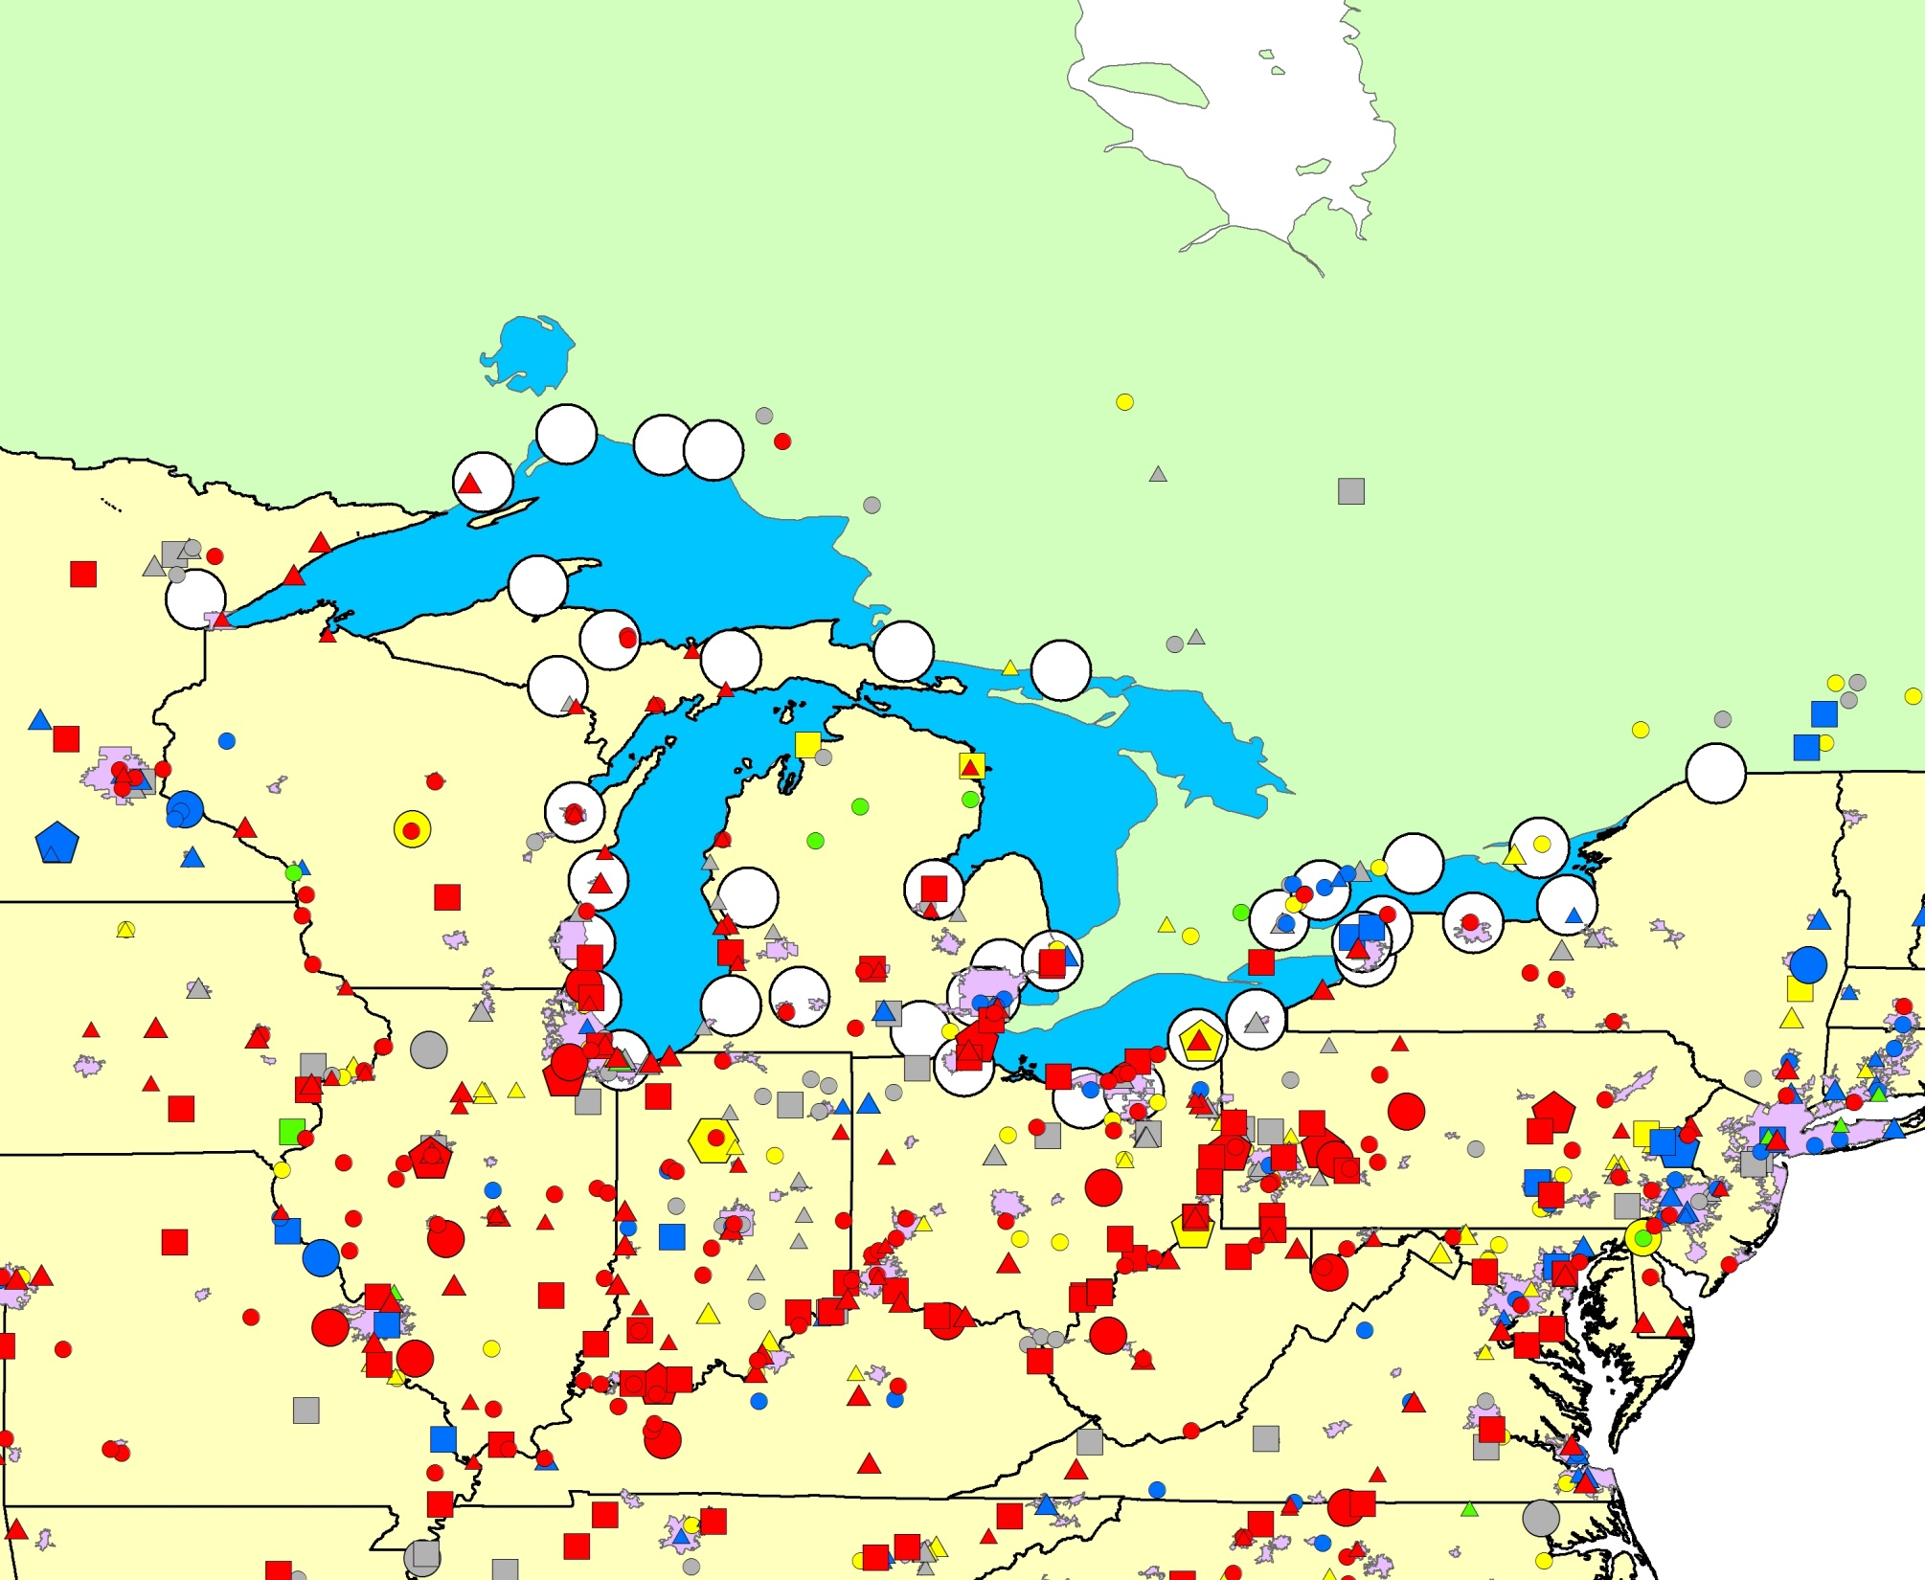
Great Lakes Areas of Concern
U.S. urban areas (pink shading)
Large U.S./Canadian 2002 point sources of mercury
Type of Emissions Source
Emissions of Mercury
(kg/yr)
coal-fired power plants
other fuel combustion
5-10
waste incineration
10-50
metallurgical
50-100
manufacturing & other
100–300
300–500
500–1000
1000–3500
Notes:
2002 emit

Slide 74
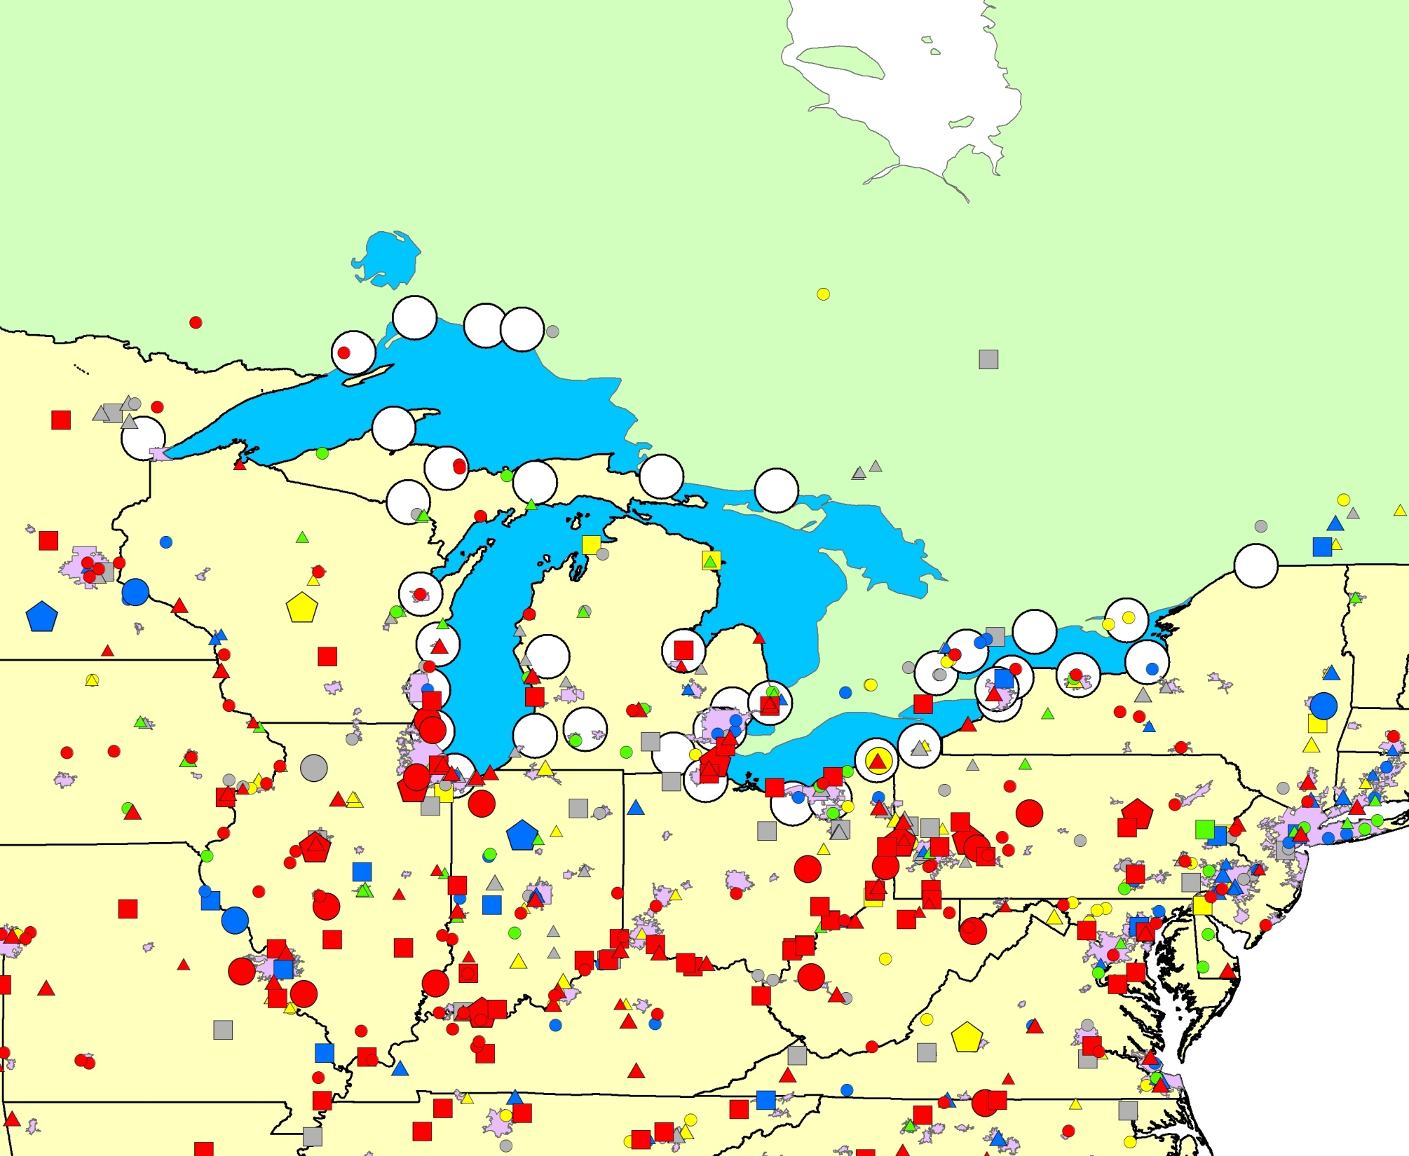
Great Lakes Areas of Concern
U.S. urban areas (pink shading)
Large U.S./Canadian 2005 point sources of mercury
Type of Emissions Source
Emissions of Mercury
(kg/yr)
coal-fired power plants
other fuel combustion
5-10
waste incineration
10-50
metallurgical
50-100
manufacturing & other
100–300
300–500
500–1000
1000–3500
Notes:
2005 emit

