Slide 1
Mercury Overview +
Modeling the Atmospheric Transport and Deposition of Mercury to the Great Lakes
Dr. Mark Cohen, Roland Draxler, Richard Artz
NOAA Air Resources Laboratory (ARL)
College Park, MD, USA
CENRS Air Quality Research Subcommittee
Oct 16, 2014, Washington, DC

Slide 2
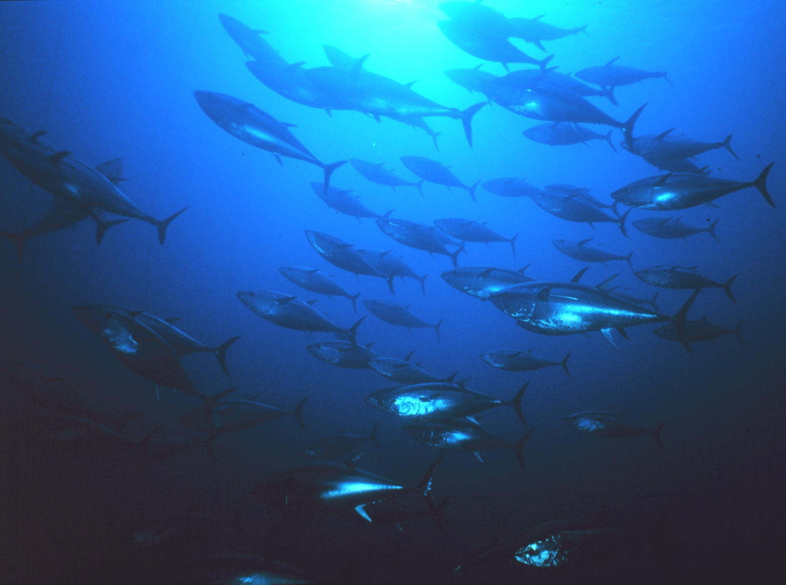
Public Health Context
Methyl-mercury is a developmental neurotoxin -- risks to fetuses/infants
Cardiovascular toxicity might be even more significant (CRS, 2005)
Uncertainties, but mercury toxicity relatively well understood
  well-documented tragedies: (a) Minimata (Japan) ~1930 to ~1970; (b) Basra (Iraq), 1971
  epidemiological studies, e.g., (a) Seychelles; (b) Faroe Islands; (c) New Zealand
Critical exposure pathway: methylmercury from fish consumption
Toxicity believed to be occurring at current exposures
Widespread fish consumption advisories
+ Wildlife
Health Issues
e.g., fish-eating birds
Methylmercury vs. Omega-III Fatty Acids
Selenium – protective role?

Slide 3
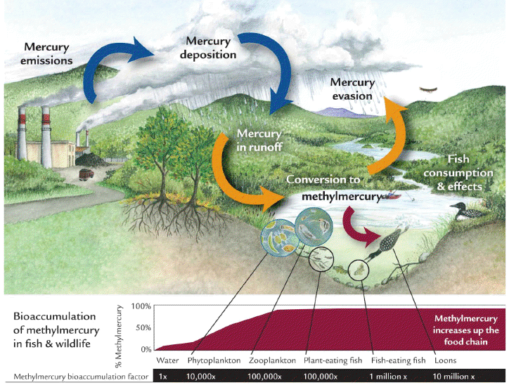
Mercury in the Environment
Biodiversity Research Institute (2011): http://www.briloon.org/uploads/hgconnections/glmc/GLMC_FinalReport.pdf
Notes:
Biodiversity Research Institute, The Extent and Effects of Mercury Pollution in the Great Lakes Region, A publication of the Biodiversity Research Institute in partnership with the Great Lakes Commission and the University of Wisconsin-La Crosse,
The Great Lakes Commission sponsored a binational scientific synthesis effort through its U.S. Environmental
Protection Agency-funded Great Lakes Air Deposition program. The purpose of the synthesis project was to foster
binational collaboration among mercury researchers and resource managers from government, academic, and nonprofit institutions to compile a wide variety of mercury data for the Great Lakes region, and to address key questions concerning mercury contamination, the bioaccumulation of methylmercury in food webs, and the resulting
exposures and risks.
The synthesis effort began in November of 2008 and has involved more than 170 scientists and managers working
to compile and evaluate more than 300,000 mercury measurements and to conduct new modeling and analyses.
This synthesis provides a comprehensive overview of the sources, cycling, and impacts of mercury in the Great Lakes
region. The primary results of this initiative have been published in a series of more than 35 scientific papers in the
journals Ecotoxicology and Environmental Pollution and are distilled here for use by decision makers and the public.
Suggested citation for this report: Evers, D.C., Wiener, J.G., Driscoll, C.T., Gay, D.A., Basu, N., Monson, B.A., Lambert,
K.F., Morrison, H.A., Morgan, J.T., Williams, K.A., Soehl, A.G. 2011. Great Lakes Mercury Connections: The Extent
and Effects of Mercury Pollution in the Great Lakes Region. Biodiversity Research Institute. Gorham, Maine.
Report BRI 2011-18. 44 pages.

Slide 4
Environmental Mercury Cycling -- Natural vs. Anthropogenic
Mercury (Hg) is an element... there is the same amount of mercury on Earth today as there always has been
“natural” Hg cycle – Hg is transported throughout the environment, and chemical transformations interconvert different mercury species
This has always been going on, and there has always been Hg in fish
But, we make some Hg unexpectedly “bioavailable”
Most anthropogenic Hg is “released” as atmospheric emissions:
  Hg in coal is released to the air when coal is burned
  Hg in other fuels is released to the air when they are processed and burned
  Hg in ores is released to the air during metallurgical processes
  Hg in products is released to the air when burned or landfilled after being discarded (e.g., batteries, switches)
Average, current atmospheric Hg deposition is ~3x pre-industrial levels
Evidence suggests that newly deposited Hg may be more bioavailable

Slide 5
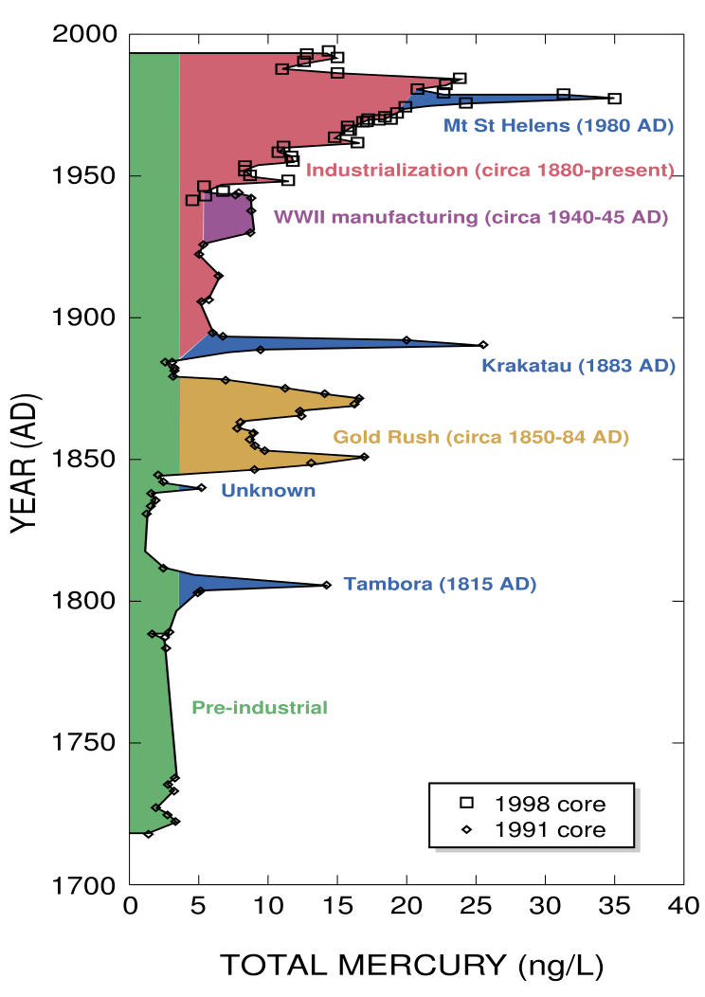
Mercury in
Ice Cores
from the
Upper
Fremont Glacier
Natural vs.
anthropogenic
mercury?
Studies show that anthropogenic activities have
typically increased bioavailable Hg concentrations in ecosystems by a factor of 2–10
U.S. Geological Survey: http://toxics.usgs.gov/pubs/FS-051-02/pdf/fs-051-02.pdf
Notes:
Atmospheric mercury deposition corresponds to volcanic and anthropogenic events over the past 270 years. Preindustrial deposition rates can be conservatively extrapolated to present time (4 ng/L; in green) to illustrate the increase during the past 100 years (in red) and significant decreases in the past 15-20 years.

Slide 6
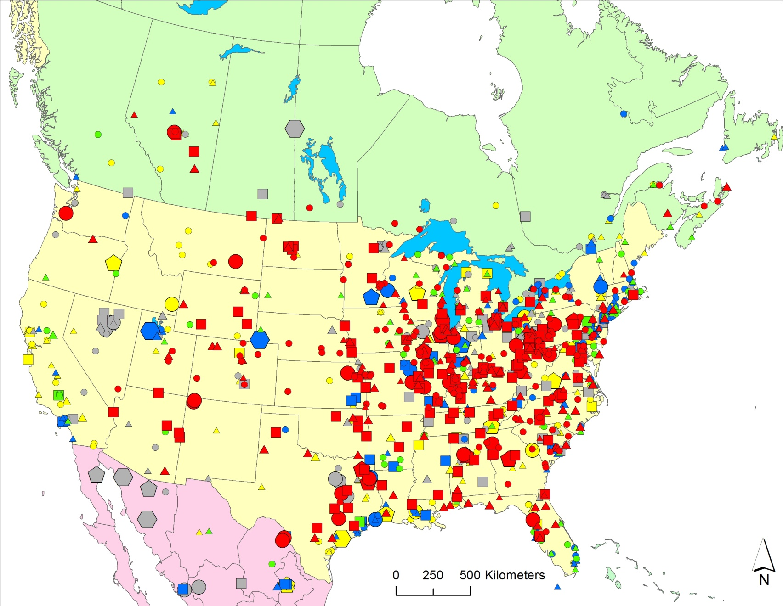
2005 Atmospheric Mercury Emissions from Large Point Sources
Emissions
(kg/yr)
5-10
10-50
50-100
100–300
300–500
500–1000
1000–3000
Type of Emissions Source
coal-fired power plants
other fuel combustion
waste incineration
metallurgical
manufacturing & other

Slide 7
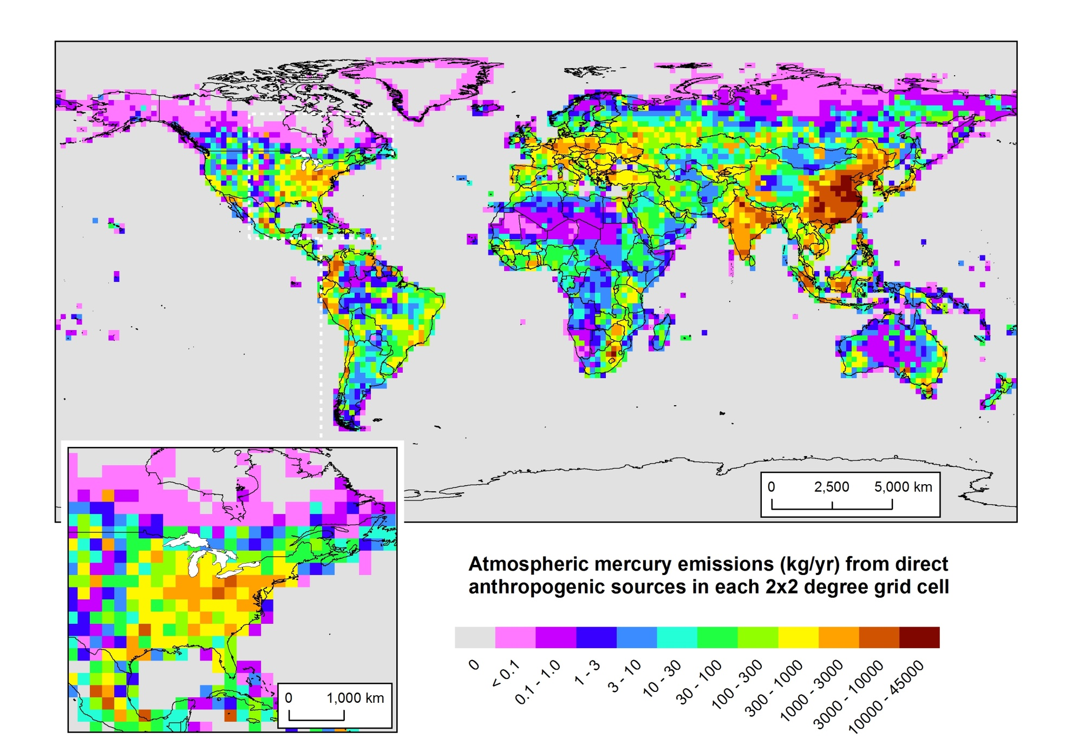
Anthropogenic Mercury Emissions (ca. 2005)

Slide 8
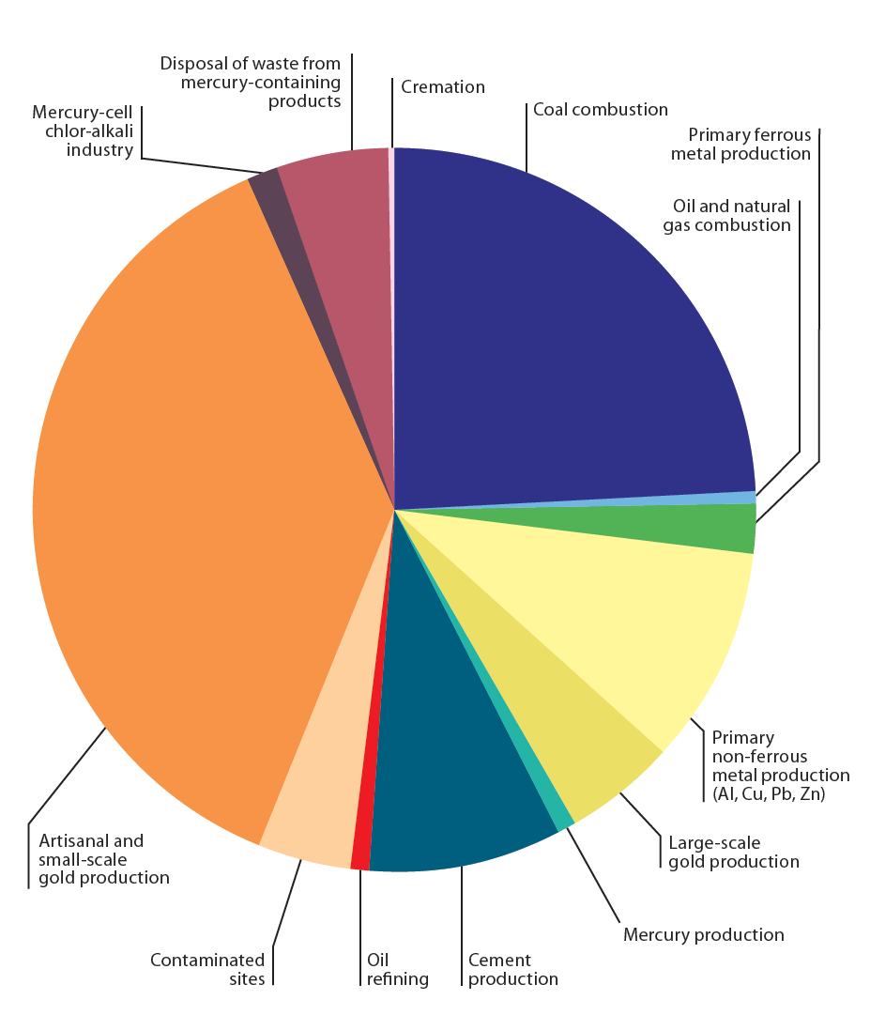
Proportions of
global anthropogenic mercury emissions to air in 2010 from different sectors
AMAP/UNEP, 2013. Technical Background Report for the Global Mercury Assessment 2013. Arctic Monitoring and Assessment Programme, Oslo, Norway/UNEP Chemicals Branch, Geneva, Switzerland. vi + 263 pp.
Available at: http://www.amap.no/documents/doc/technical-background-report-for-the-global-mercury-assessment-2013/848

Slide 9
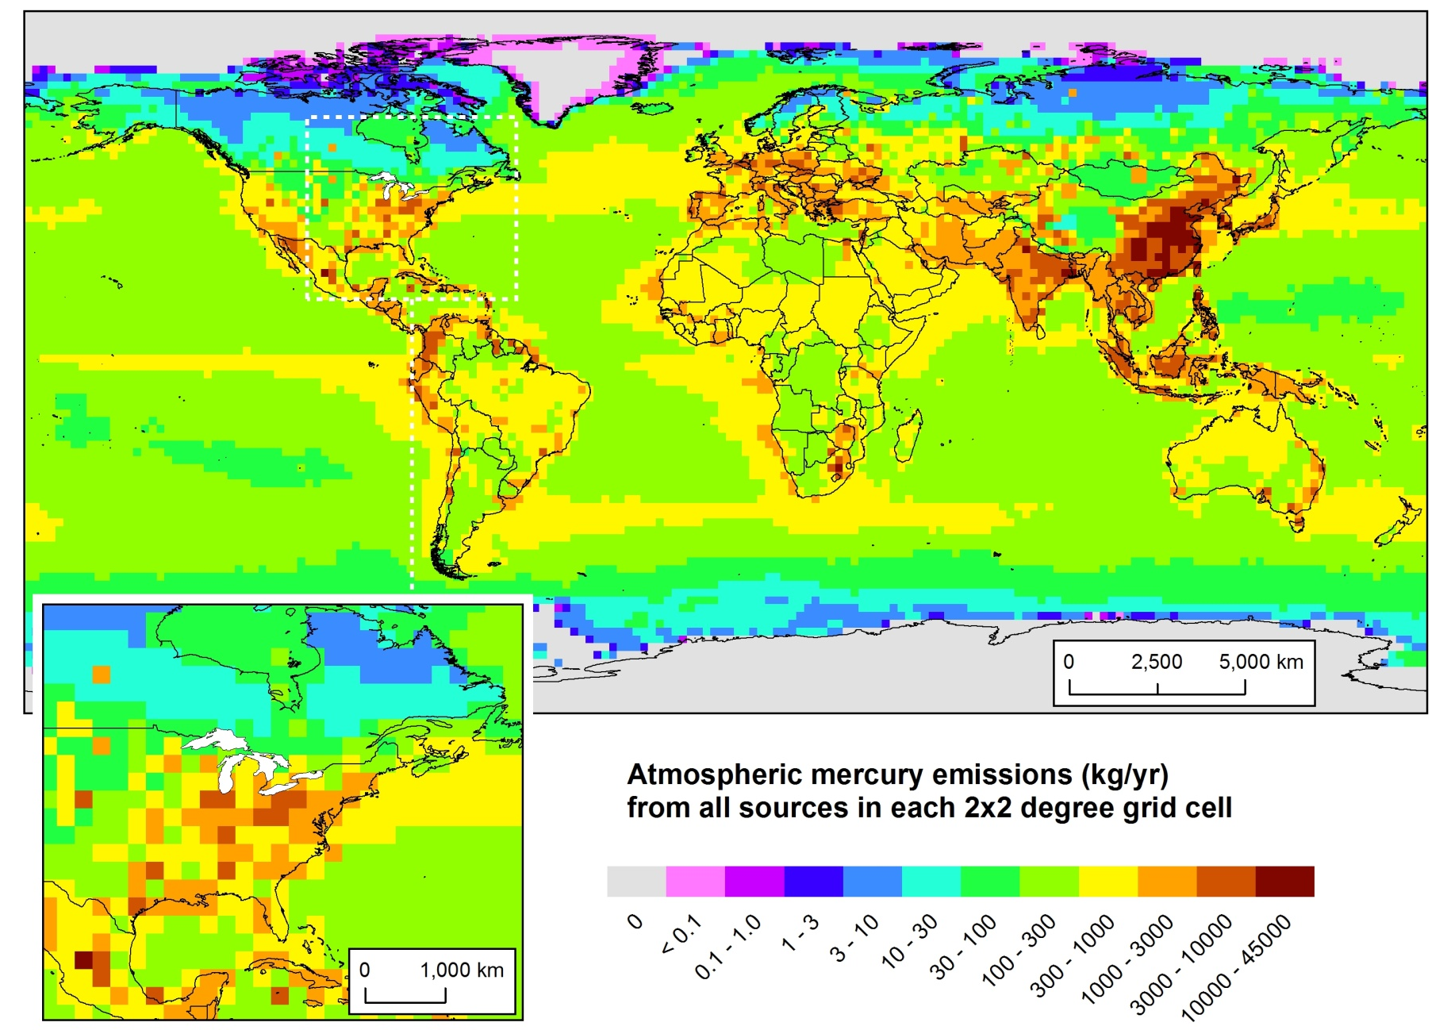
2005 Atmospheric Mercury Emissions
(Direct Anthropogenic + Re-emit + Natural)
Policy-Relevant
Scenario Analysis
Notes:
Here’s where the mercury is emitted from... But what is the relative importance of different source regions to atmospheric deposition of mercury to sensitive U.S. ecosystems, e.g., the Great Lakes? Does most of it come from China?
Data for 2005, from USEPA, Environment Canada, NILU (Norway), and others. Assembled for the GLRI FY2010 modeling project.
Looking at this emissions map, its easy to think that the dominant contributor to Great Lakes mercury might be emissions from China.

Slide 10
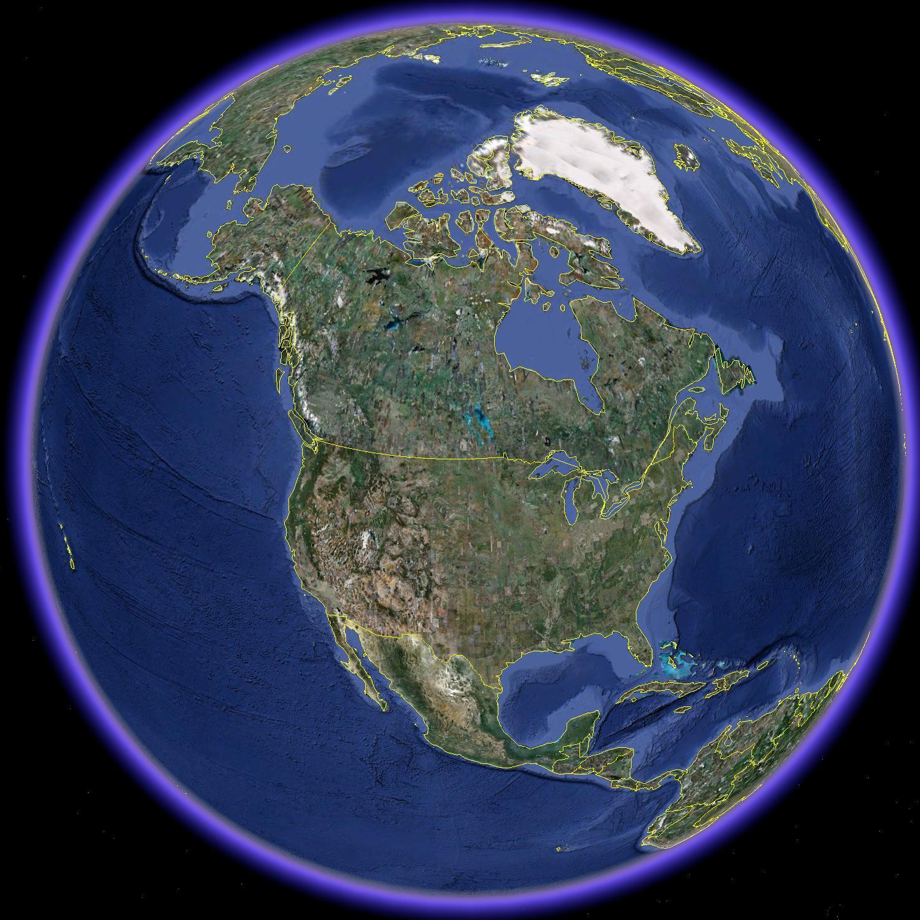


Polar-specific air-chemistry can lead to enhanced mercury deposition under some conditions
mercury
from global atmospheric pool entering
North America
mercury
that doesn’t deposit continues
its global circulation
regional and
and global sources contribute to atmospheric mercury deposition
North
American
mercury
sources
*
Atmospheric mercury deposition varies spatially and temporally, and is always a complex combination of impacts from local, regional, national, and global emissions sources.
Thousands of fish-advisories throughout North America due to mercury contamination
Notes:
Key point: atmospheric mercury impacts occur at local, regional, national, continental, and global scales…
The relative importance of the deposition contributions of local/regional sources vs. global sources to deposition is highly variable across North America and depends, e.g., on the proximity of local/regional sources

Slide 11
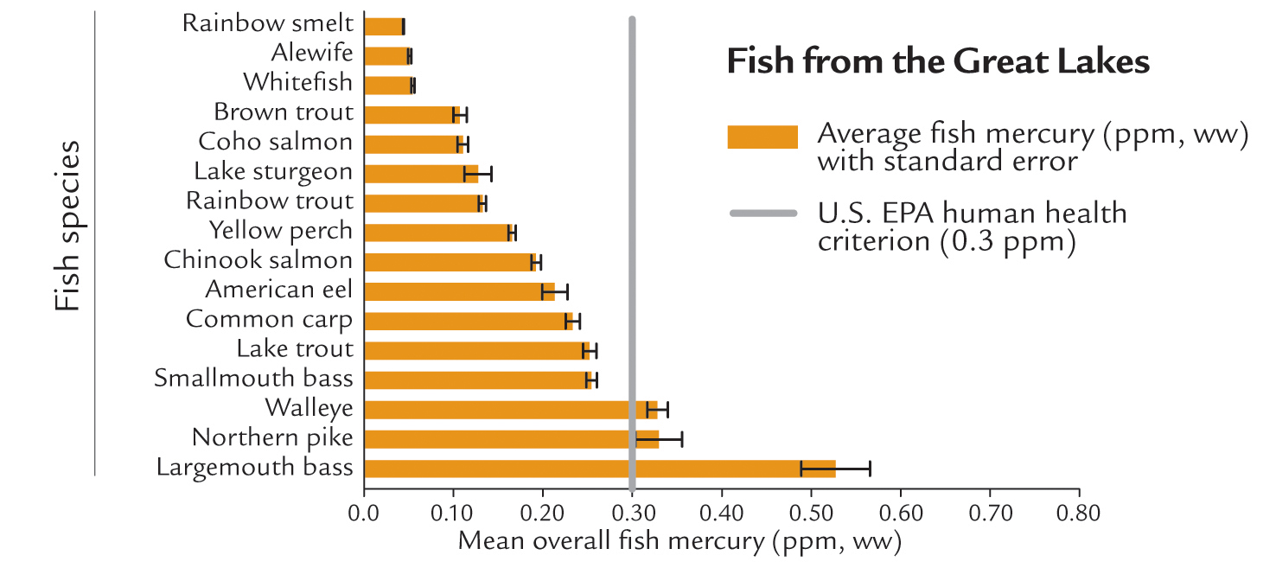
0.05 ppm level recommended by the Great Lakes Fish Advisory Workgroup (2007)
Mercury in Great Lakes Fish
Evers, D.C., et al. (2011). Great Lakes Mercury Connections: The Extent and Effects of Mercury Pollution in the Great Lakes Region. Biodiversity Research Institute. Gorham, Maine. Report BRI 2011-18. 44 pages.
Notes:
Biodiversity Research Institute (2011): http://www.briloon.org/uploads/hgconnections/glmc/GLMC_FinalReport.pdf
The Great Lakes Fish Advisory Workgroup currently recommends a methylmercury reference dose of 0.05 parts per million, six times lower than the 2001 level.
Great Lakes Fish Advisory Workgroup. 2007. A protocol for mercurybased fish consumption advice: an addendum to the 1993 protocol
for a uniform Great Lakes sport fish consumption advisory. Wisconsin Department of Health Services, Madison, WI, 30 pp.
Available at http://www.dhs.wisconsin.gov/eh/fish/FishFS/2007Hg_Add_Final_05_07.pdf.

Slide 12
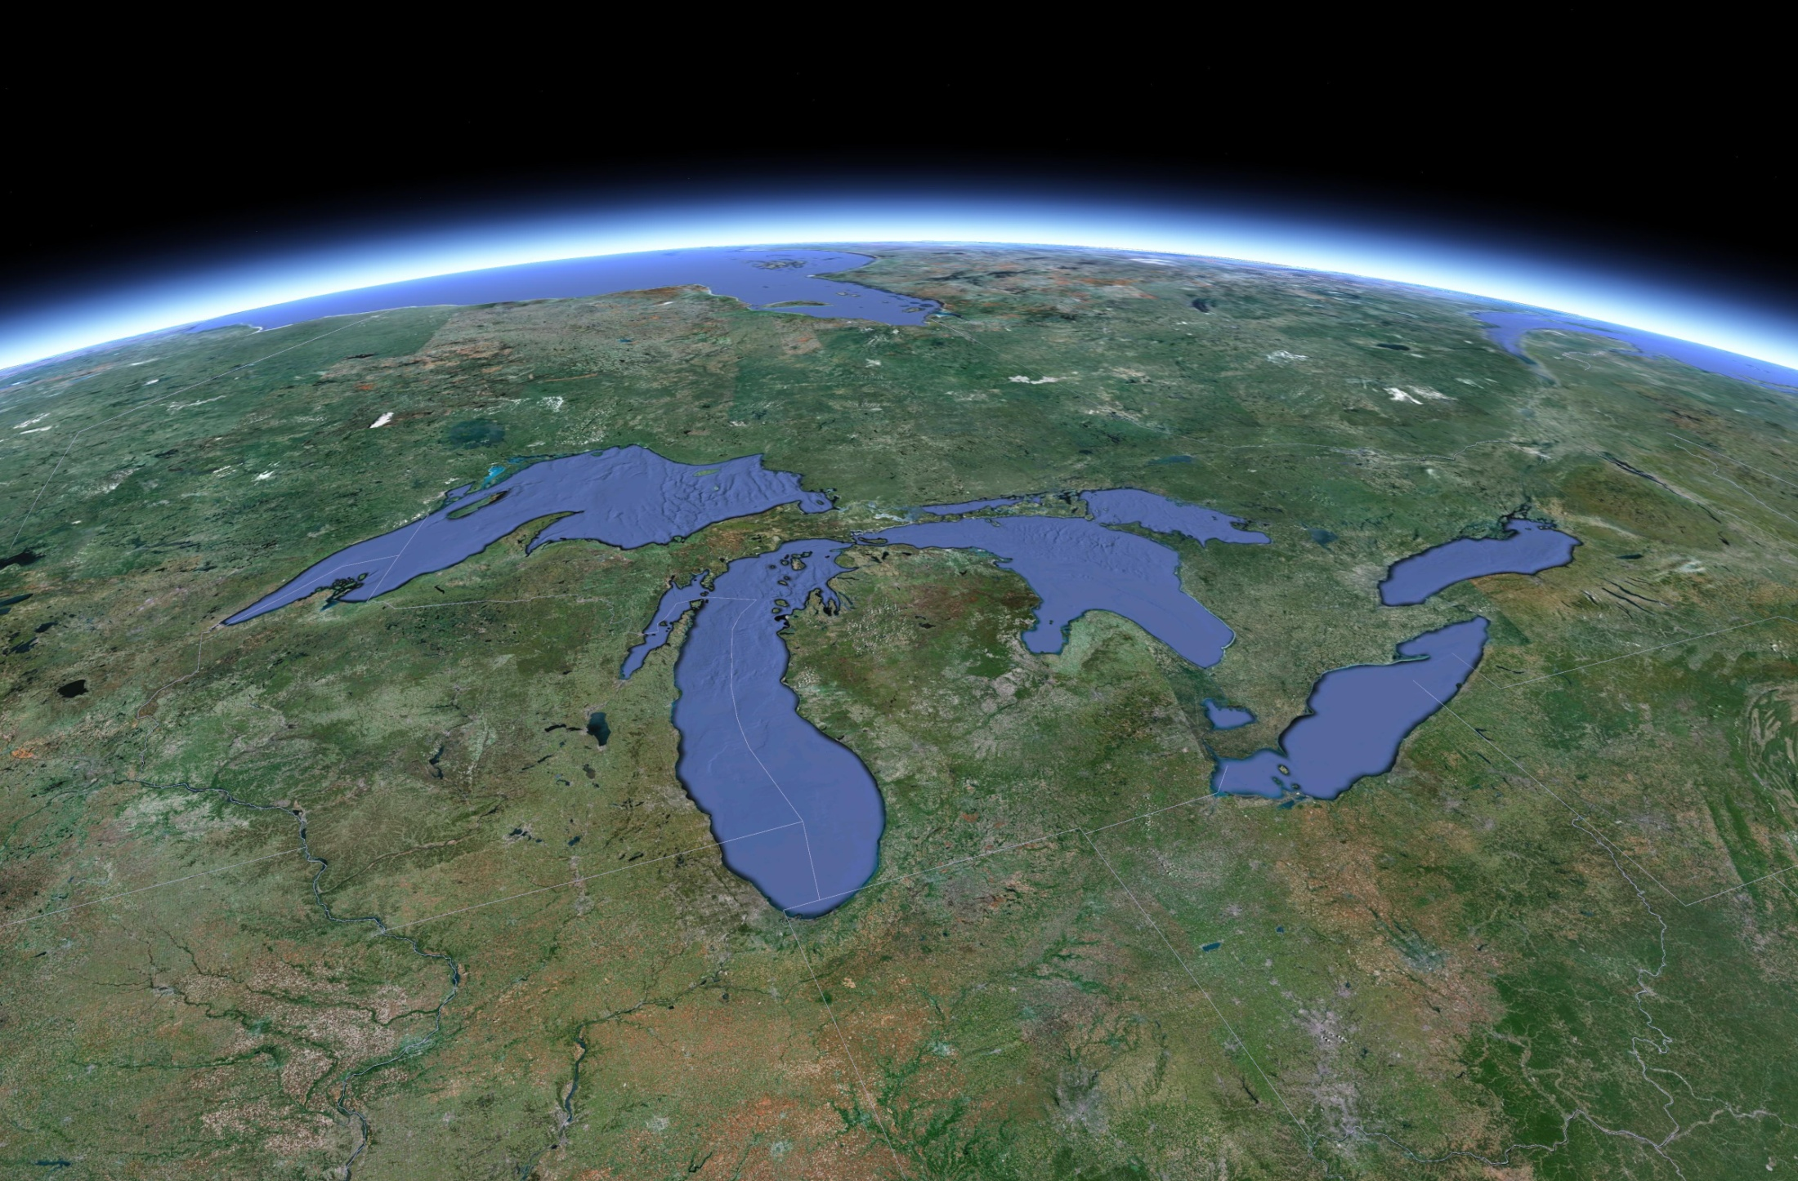
Atmospheric deposition is believed to be the largest
current mercury loading pathway to the Great Lakes…
How much is deposited and where does it come from?
(…this information can only be obtained via modeling...?)

Slide 13

Different “forms” of mercury in the atmosphere
Elemental Mercury -- Hg(0)
  most of total Hg in atmosphere
  doesn’t easily dry or wet deposit
  globally distributed
Elemental Mercury -- Hg(0)
  most of total Hg in atmosphere
  doesn’t easily dry or wet deposit
  globally distributed
?
Reactive Gaseous Mercury -- RGM
  a few % of total atmos. Hg
  oxidized Hg (HgCl₂, others)
  very water soluble and “sticky”
  bioavailable
Reactive Gaseous Mercury -- RGM
  a few % of total atmos. Hg
  oxidized Hg (HgCl₂, others)
  very water soluble and “sticky”
  bioavailable
Particulate Mercury -- Hg(p)
  a few % of total atmos. Hg
  Hg in/on atmos. particles
  atmos. lifetime 1~ 2 weeks
  bioavailability?
Particulate Mercury -- Hg(p)
  a few % of total atmos. Hg
  Hg in/on atmos. particles
  atmos. lifetime 1~ 2 weeks
  bioavailability?
?
Notes:
There are three kinds of mercury in the atmosphere. They behave very differently and have different ecological and public health impacts. The forms can inter-covert… Measuring and modeling each of these forms is challenging, but is critical to understand the atmospheric behavior and impacts of mercury. There are many uncertainties in the scientific knowledge regarding atmospheric mercury, e.g., what is RGM? Have we identified all of the significant chemical reactions? Are the currently used reaction rates accurate? The importance of atmospheric methly-mercury as well as its fate and transport is uncertain.
Elemental Mercury -- Hg(0)
most of total Hg in atmosphere
not very water soluble
doesn’t easily dry or wet deposit
upward evasion vs. deposition
atmos. lifetime approx ~ 0.5-1 yr
globally distributed
Reactive Gaseous Mercury -- RGM
a few percent of total atmos Hg
oxidized Hg (HgCl2, others)
operationally defined
very water soluble and “sticky”
atmos. lifetime <= 1 week
local and regional effects
bioavailable
Particulate Mercury -- Hg(p)
a few percent of total atmos Hg
not pure particles of mercury
Hg compounds in/on atmos particles
species largely unknown (HgO?)
atmos. lifetime approx 1~ 2 weeks
local and regional effects
bioavailability?

Slide 14
Atmospheric Mercury Fate Processes
Elemental Mercury [Hg(0)]
Hg(II), ionic mercury, RGM, “GOM”
cloud
Particulate Mercury [Hg(p)]
CLOUD DROPLET
Vapor phase:
Hg(0) oxidized to RGM [and maybe Hg(p)?] by
O₃, H₂0₂, Cl₂, OH, HCl, Br
Hg(II) reduced to Hg(0)
by SO₂ and sunlight
? Hg(p)
Adsorption/
desorption
of Hg(II) to
/from soot
In-plume reduction
of Hg(II) to Hg(0)?
Hg(0) oxidized to dissolved
Hg(II) species by O₃, OH,
HOCl, OCl⁻
Wet deposition
Anthropogenic Emissions
Natural
emissions
Re-emission of previously deposited anthropogenic and natural mercury
Dry deposition
Notes:
Could mention Marine Boundary Layer issues as well... rapid oxidation, deposition, but then some reduction and re-emission, so, potential “churning”

Slide 15
Why are emissions speciation data - and potential plume transformations -- critical?
NOTE: plume modeling distance results averaged over all directions –
Some directions will have higher fluxes, some will have lower
Oct 16, 2014
NOAA Air Resources Laboratory
15

Slide 16

When puffs grow to sizes large relative to the meteorological data grid, they split, horizontally and/or vertically
To simulate the global transport of mercury, puffs are transferred to Eulerian grid after a specified time downwind (~3 weeks), and the mercury is simulated on that grid from then on…
This is how we model the local & regional impacts.
But for global modeling,
puff splitting overwhelms
computational resources
Puffs of pollutant are emitted and dispersed downwind
Atmospheric chemistry and deposition simulated for each puff
16
Notes:
Incorporation of the mercury modeling algorithms into the new GEM-HYSPLIT code was a large scientific programming task.

Slide 17
Report has just been completed…
Modeling Atmospheric Mercury
Deposition to the Great Lakes:
Projected Consequences of
Alternative Future Emissions Scenarios
Final Report for work conducted
with FY2012 funding from the
Great Lakes Restoration Initiative,
Oct 9, 2014, 194 pages.
Mark Cohen, Roland Draxler, Richard Artz
NOAA Air Resources Laboratory,
College Park, MD, USA
…this work was carried out just with the Eulerian grid approach
Oct 16, 2014
NOAA Air Resources Laboratory
17

Slide 22
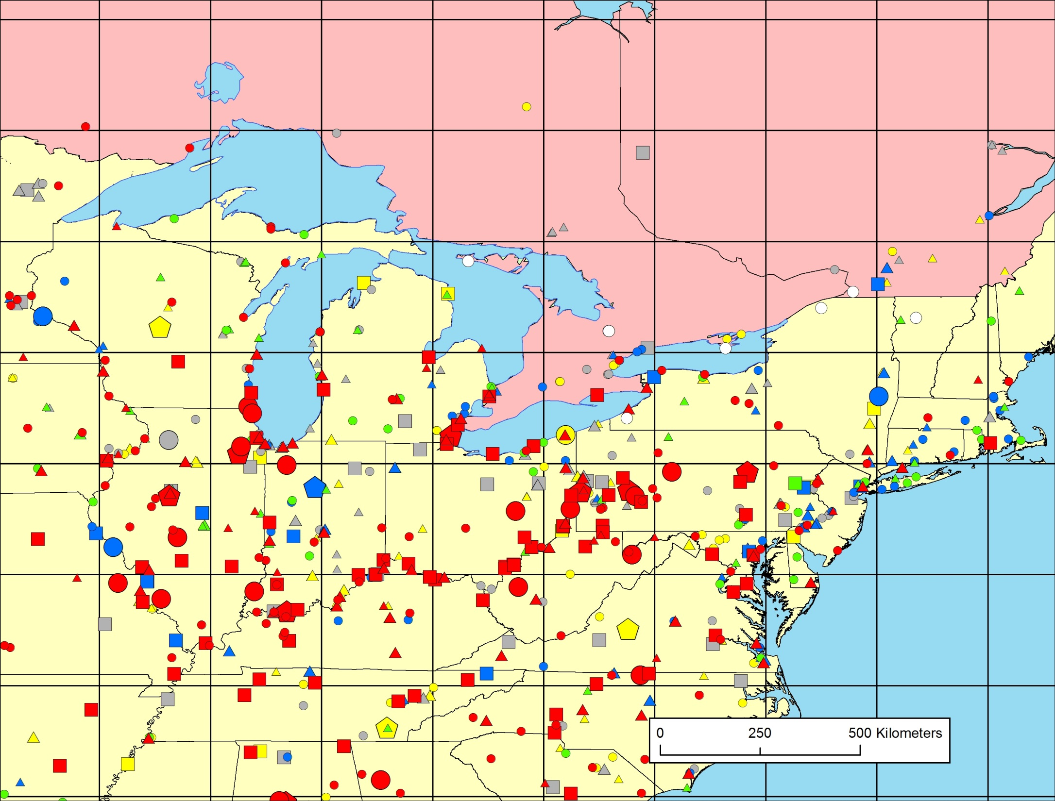
2.5º x 2.5º
grid
Type of Emissions Source
coal-fired power plants
other fuel combustion
waste incineration
metallurgical
manufacturing & other
Burnt Island
St. Anicet
Potsdam
Underhill
Egbert
Point Petre
Stockton
Emissions
(kg/yr)
5-10
10-50
50-100
100–300
300–500
500–1000
1000–3000

Slide 25
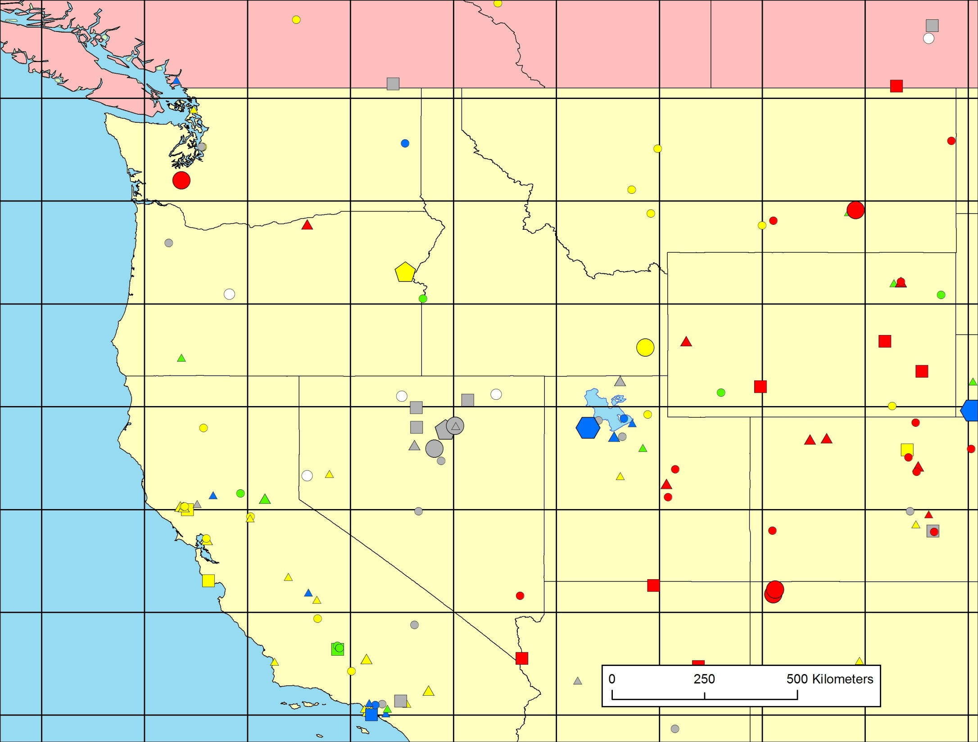
Mt. Bachelor
Paradise
Gibbs
Reno
2.5º x 2.5º
grid

Slide 26
Grant et al., Atmospheric Environment 94: 164 (2014)
Notes:
Grant, S. L., M. Kim, P. Lin, K. C. Crist, S. Ghosh and V. R. Kotamarthi (2014). A simulation study of atmospheric mercury and its deposition in the Great Lakes. Atmospheric Environment 94: 164-172.

Slide 31
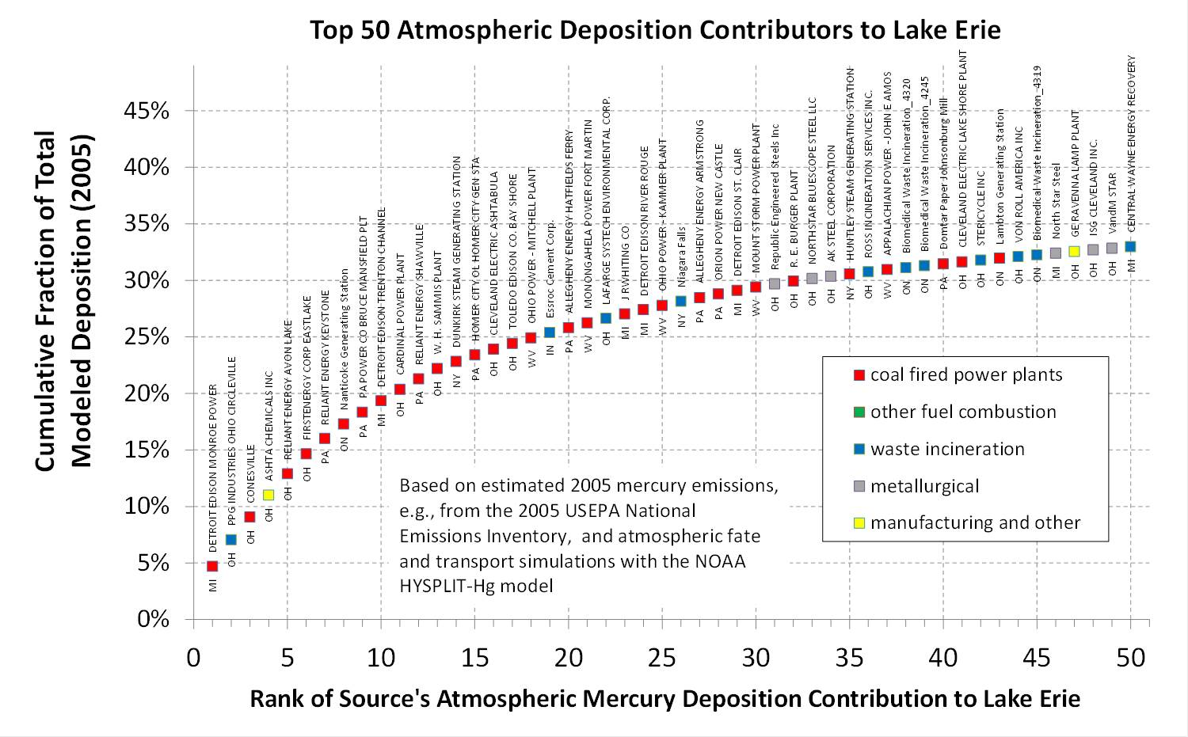
From earlier Lagrangian + Eulerian work… very detailed source-receptor results

Slide 32
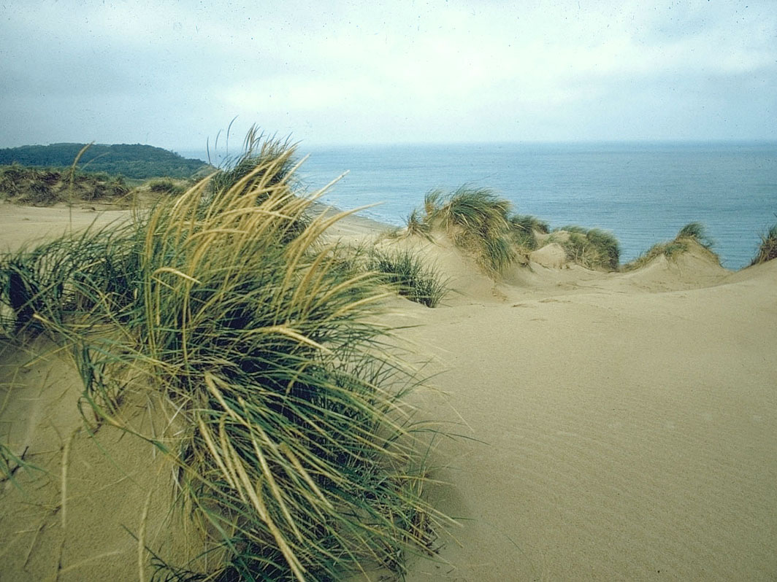

Thanks!
This work was partially funded through the Great Lakes Restoration Initiative

