Slide 1
Smoke and Dust Research and Development
Ariel Stein
Earth Resources & Technology (ERT), Inc. on assignment to Air Resources Laboratory
ARL Laboratory Review
May 3-5, 2011

Slide 2
Scientific goal: Improve modeling capabilities to simulate smoke and dust
Integrate conceptual understanding of atmospheric processes using models and ambient measurements
Gain insight on the emission, transport, dispersion and deposition processes involved in the simulation of smoke and dust
Develop, implement and test algorithms
Improve model performance
Better National Air Quality Forecast Capability
(NAQFC)

Slide 3
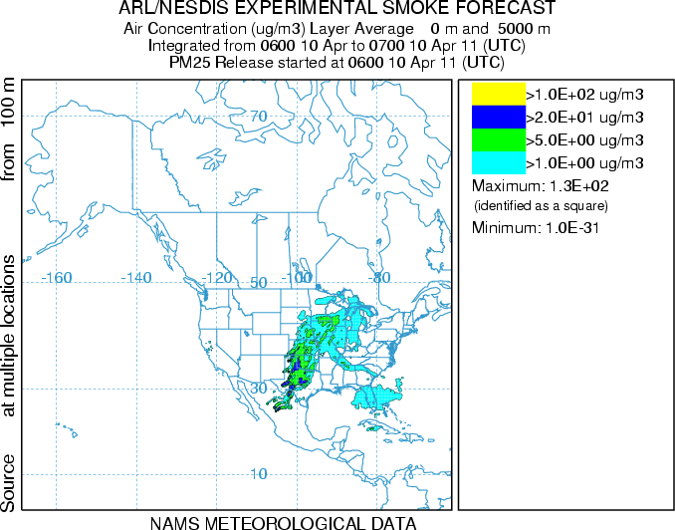
Smoke Forecast System
Experimental testing phase began March 28, 2006
Run daily at NCEP as part of the Air Quality Forecast Guidance to produce a 24-hr analysis and a 48-hr forecast
  Daily Procedure
Satellite detection of fire location and heat released
Calculation of emissions
HYSPLIT run
Statistics calculation
Web distribution
Rolph et al., 2007
Notes:
National Oceanic and Atmospheric Administration’s (NOAA) current operational Smoke Forecasting System (SFS) is introduced. This system is intended as guidance to air quality forecasters and the public for fine particulate matter (≤ 2.5 μm) emitted from large wildfires and agricultural burning which can elevate particulate concentrations to unhealthful levels. The SFS uses National Environmental Satellite, Data, and Information Service’s (NESDIS) Hazard Mapping System (HMS), which is based on satellite imagery, to establish the location and extent of the fires. The particulate matter emission rate is computed using the emission processing portion of the U.S. Forest Service’s BlueSky. Smoke estimations are produced by the HYSPLIT dispersion model. Advection and diffusion calculations are made in a Lagrangian framework following the transport, while concentrations are calculated on a fixed grid. Model outputs are compared against satellite measurements to test the simulation performance.

Slide 4
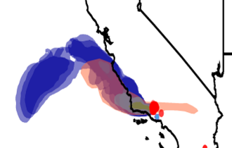
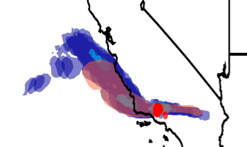
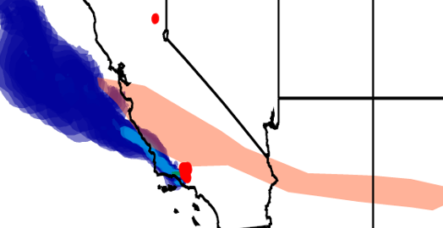
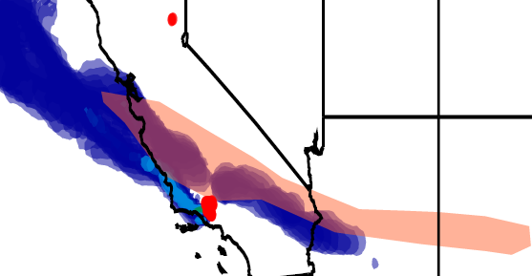
Approach:
Forest fires and release height
2215 to 0000 UTC on 23-24 September 2006
Injection:
Below PBL
Injection:
Above PBL
1100 to 1630 UTC 24 September 2006
Smoke column from the HYSPLIT model (blue) and satellite based Hazardous Mapping System (orange)
Notes:
A detailed evaluation of NOAA’s Smoke Forecasting System (SFS) is a fundamental part of its development and further refinement. In this work, particulate matter with a diameter less than or equal to 2.5 microns (PM_{2.5}) concentration levels, simulated by the SFS, have been evaluated against satellite measurements. Four multi-day forest fire case studies, one covering the continental US, two in California (one of them is shown in the figure) , and one near the Georgia/Florida border, have been analyzed. The column integrated PM_{2.5} concentrations for these cases compared to the satellite measurements showed a similar or better statistical performance than the mean performance of the SFS for the period covering 1 September 2006 to 1 November 2007. However near the surface, the model shows a tendency to over-predict the measured PM_{2.5} concentrations in the western US and under-predict concentrations for the Georgia/Florida case. Furthermore, a sensitivity analysis of the model response to changes in the smoke release height shows that the simulated surface and column integrated PM_{2.5} concentrations are very sensitive to variations in this parameter. Indeed, the model capability to represent the measured values is highly dependent on the accuracy of the determination of the actual injection height and in particular to whether the smoke injection actually occurred below or above the planetary boundary layer.

Slide 5
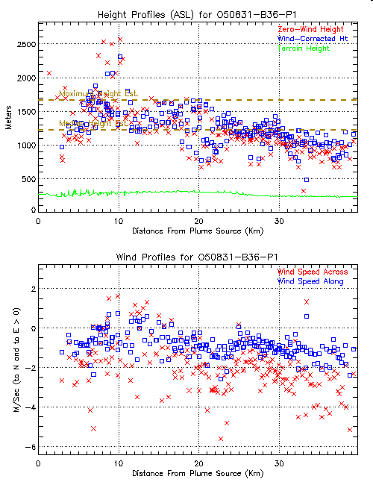
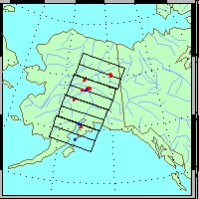
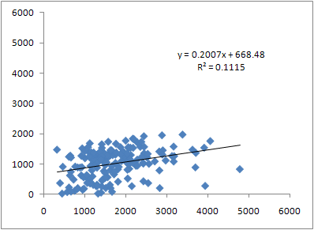
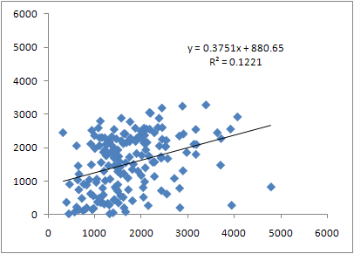
Approach:
HYSPLIT vs. MISR observed plume rise
Fire locations
Base case
1.25 *PBL
HYSPLIT height [m]
MISR height [m]
MISR height [m]
Notes:
Additional studies of the accuracy of the algorithm used to calculate smoke plume height have been carried out by comparing the model calculated injection height with the Multi-angle Imaging Spectro Radiometer (MISR) satellite derived heights. The geographical extension used for this study covered the Alaska region during the months of June, July and August of 2009. Approximately 180 fires have been analyzed. The model injection heights have been estimated using the Briggs equation implemented with 12 km North American Model (NAM) meteorological data for AK. The base case corresponds to a limit release height to 0.75 xPBL height for Neutral/Unstable conditions. Several test release height limits have been used: 1x, 1.25x, 2 x PBL, and 3 km. Results from this comparison show that the best performing limit corresponds to 1.25*PBL height.

Slide 6
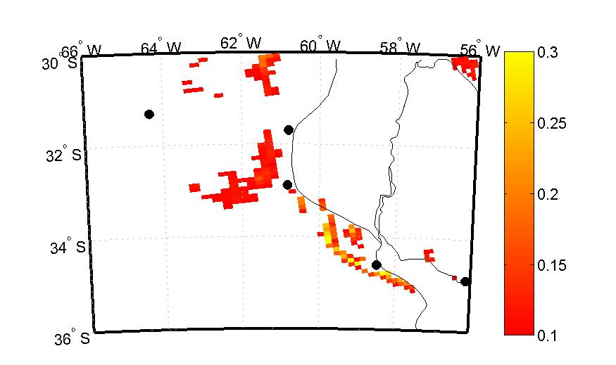
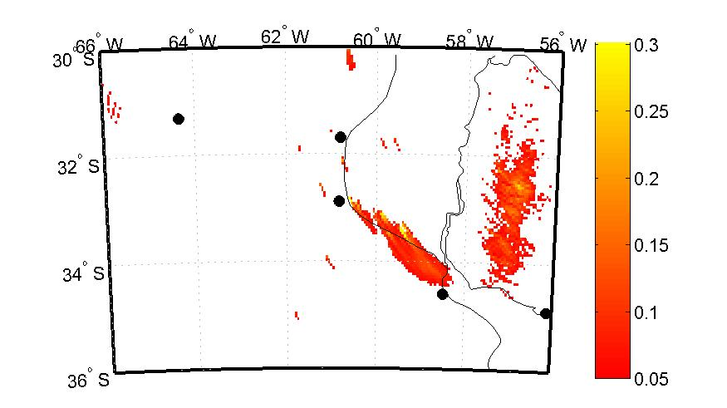
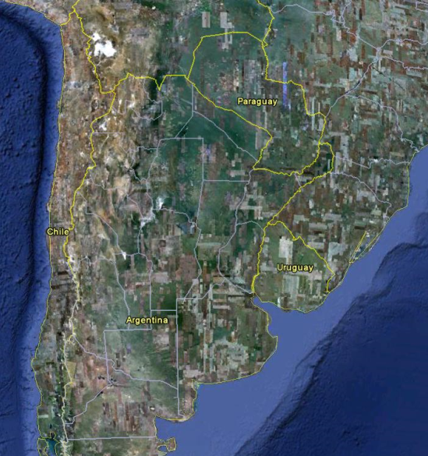
Argentina’s NWS uses HYSPLIT to predict smoke
Model derived aerosol optical depth (AOD)
MODIS AOD
As part of a Memorandum of Understanding between ARL and the Argentinean National Weather Service
Notes:
- Quantitative tool for estimating the particulate matter levels originated from fires.
- The geographic location of the fire sources is determined using images from the MODIS detector on board of the Terra and Aqua satellites.
- The particulate matter emissions are estimated using the Fire Emission Production Simulator (FEPS) model.
- The HYSPLIT model is used to calculate the transport and dispersion of air masses containing smoke.
- The model outputs are compared against the column integrated particulate matter estimated with MODIS.
- This product is part of the emergency response system of the Argentinean National Weather Service (Servicio Meteorologico Nacional Argentino), set in collaboration by ARL scientists as part of a Memorandum of Agreement.

Slide 7
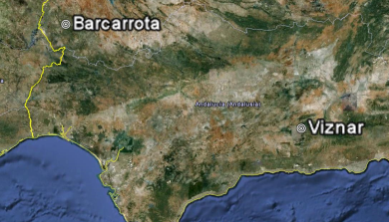
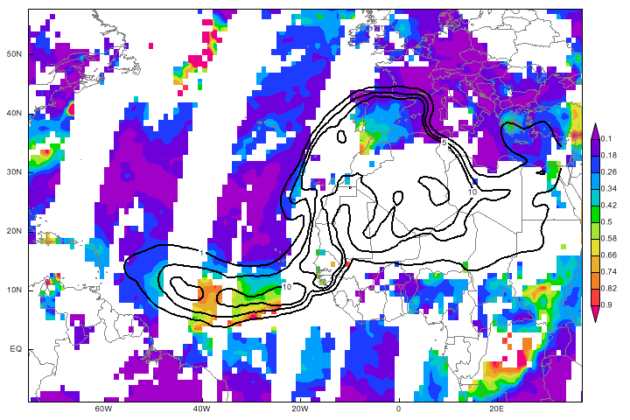
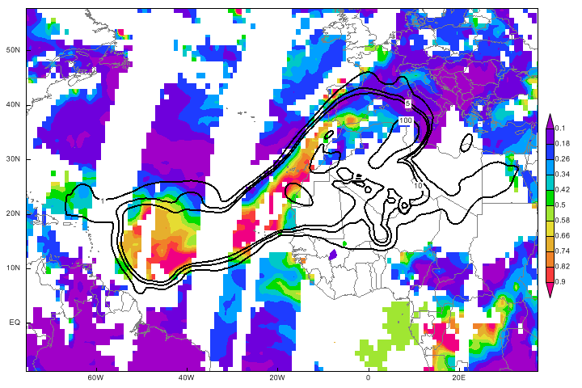
Dust from North Africa
Part of a Memorandum of Agreement with the University of Huelva, Spain
Notes:
As part of a Memorandum of Agreement between ARL and the University of Huelva, Spain.
The Hybrid Single-Particle Lagrangian Integrated Trajectories (HY-SPLIT) model has been applied to calculate the spatial and temporal distribution of dust originating from North Africa. The model has been configured to forecast hourly PM10 dust concentrations focusing on the impact over the Southern Iberian Peninsula. Two full years (2008 and 2009) have been simulated and compared against surface background measurement sites. We present a statistical analysis using discrete and categorical evaluations. The model is able to simulate the occurrence of Saharan dust episodes as observed at the measurement stations and captures the generally higher levels observed in Eastern Andalusia with respect to the Western Andalusia station. But the simulation tends to underpredict the magnitude of the dust concentration peaks. The model has also been qualitatively compared with satellite data showing generally good agreement in the spatial distribution of the dust column.

Slide 8
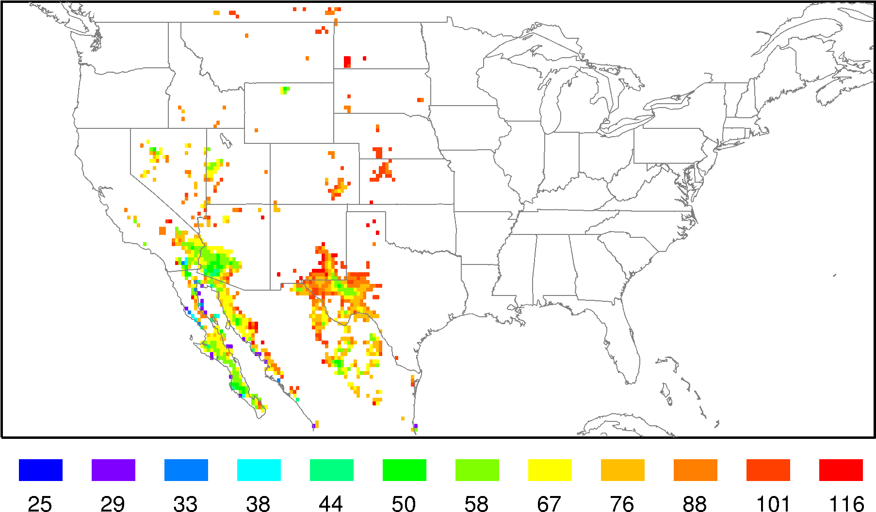
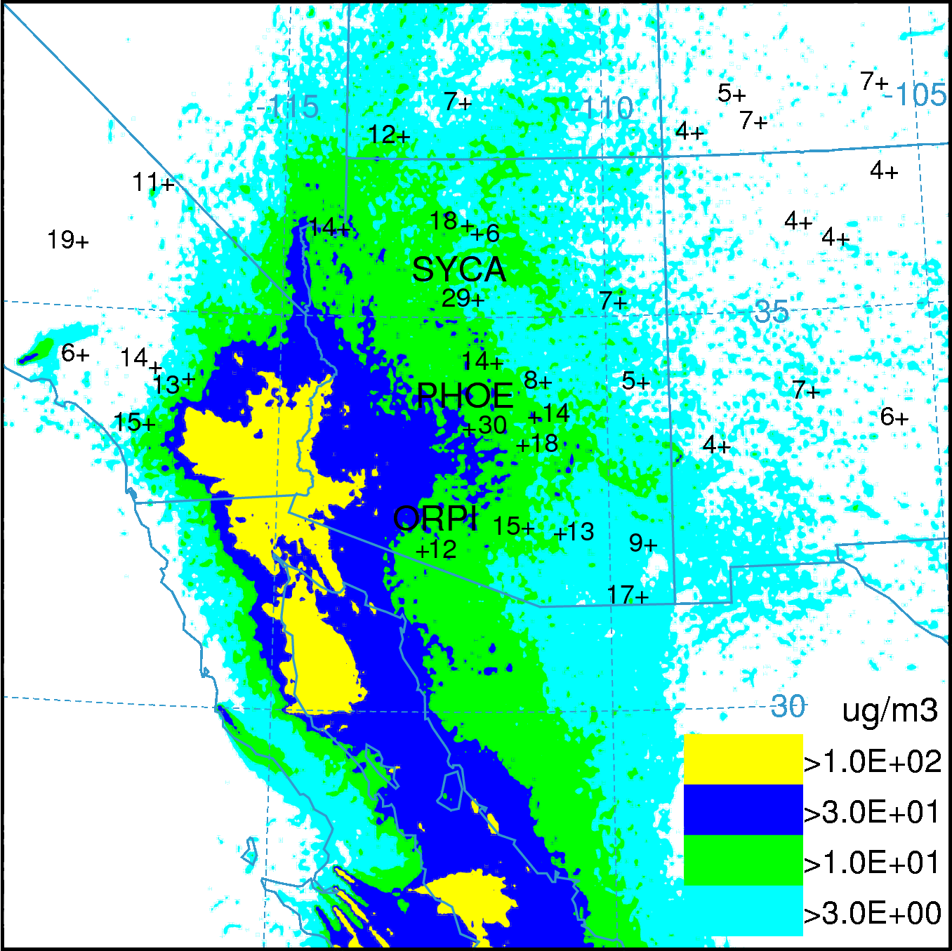
HYSPLIT Dust Storm Prediction System
Developed at ARL
Inputs
  12 km sigma level NAM meteorology
  0.25 deg monthly threshold friction velocity (u*t) and soil dust density (K)
  Grid cell dust area (Ad)
Emission Algorithm
  Q = q Ad
  q = K f(u*)
  f(u*) = u* - u*t
  particles are emitted when u* > u*t
  Emissions only occur with no rain
HYSPLIT configuration
  Time step fixed at 6 minutes
  Maximum particle duration 48 h
  Concentrations layers 0-100m and 0-5 km
  Horizontal resolution 0.10 degrees (10 km)
  Dry and wet deposition for mono-modal dust particle of 4 um diameter and 2.5 g/cc
  Domain 25N-50N and 125W-65W
  Full 3D particle mode 500,000 maximum
  About 1000 possible sources
  At least 1 particle per source per time step
Annual Average Threshold Friction Velocities
Average (μg m⁻³) for June - July 2007
Draxler et al., 2010
Notes:
This system has been developed by ARL as part of the research activities under the National Air Quality Forecast Capability
The wind blown dust emission algorithm was developed by matching the frequency of high AOD events derived from the MODIS Deep Blue algorithm with the frequency of friction velocities derived from NCEP’s NAM forecast model. The threshold friction velocity is the friction velocity that has the same frequency of occurrence as the 0.75 AOD. The AOD values are converted to an emission flux and their corresponding friction velocities are used to compute the linear regression slope of the flux to the friction velocity. The slope represents a quantity similar to a “dust density” of the soil and in combination with the friction velocity is used as a predictor for wind blown dust emissions.

Slide 9
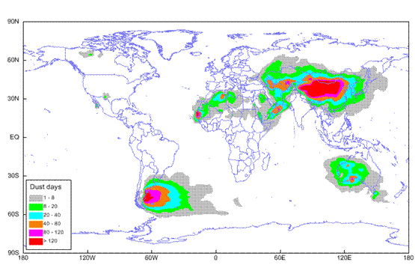
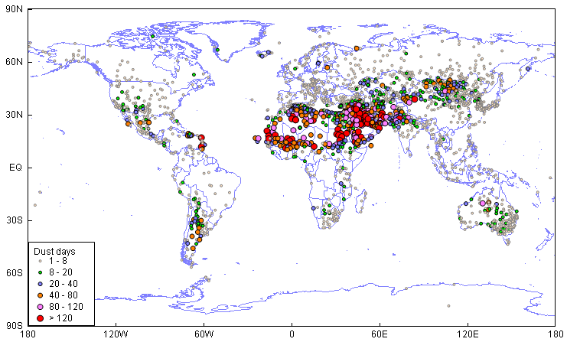
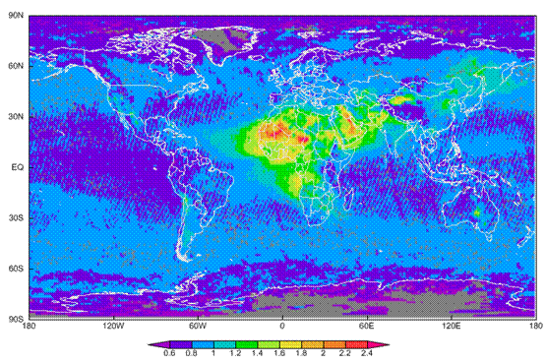
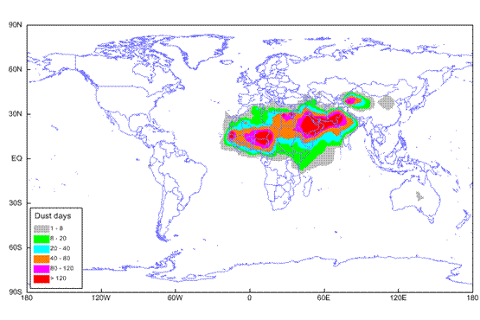
Global dust HYSPLIT
Notes:
The HYSPLIT model has been applied to simulate the global dust distribution for 2008 using two different dust emission schemes. The first one assumes that emissions could occur from any land-use grid cell defined in the model as desert. The second emission approach uses an empirically derived algorithm based on satellite observations. To investigate the dust storm features and verify the model performance, the global Integrated Surface Hourly (ISH) dataset has been analyzed to map the spatial distribution and seasonal variation of sand and dust storms. Furthermore, four stations in Northern China, two stations in Southern Spain with PM10 concentrations data, and a station in center of the Sahara Desert with AOD data have been used in this study for a quantitative comparison with the model results. The spatial distribution of observed dust storm frequency shows the known high frequency areas located in North Africa, the Middle East, Mongolia and Northwestern China. Some sand and dust storms have also been observed in Australia, Mexico, Argentina, and other sites in South America. Most of the dust events in East Asia occur in the spring, however this seasonal feature is not so evident in other dust source regions. In general, the model reproduces most of the high sand and dust storm frequency regions for the two emission approaches. Also, a good quantitative performance is achieved at the ground stations in Southern Spain and Western China when using the desert land-use based emissions, although HYSPLIT overestimates the dust concentration at downwind areas of East Asia and underestimates the column in the center of the Saharan Desert. On the other hand, the satellite-based emission approach improves the dust forecast performance in the Sahara, but underestimates the dust concentrations in East Asia

Slide 10
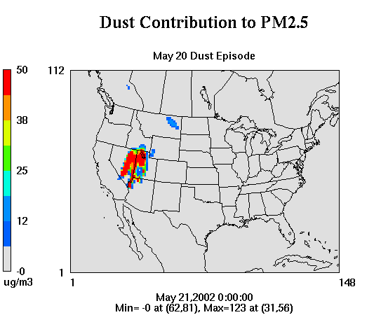
Approach:
Development of CMAQ Dust Module - FENGSHA
A physical-based model built from long-term U.S. dust observations
Initial tests show considerable improvement of air quality and climate modeling
Dust model codes have been adopted by the latest CMAQ model (v5.0) and will be released to the public by US EPA;
Notes:
While the HYSPIT dust is using a top-down approach, Daniel Tong in ARL has developed a physical-based bottom up model approach for the CMAQ model.
The CMAQ dust module, called FENGSHA, which is “windblown dust” in Mandarin, uses a modified Owen’s equation to calculate dust emission.
In this equation, M is the number of erodible land types, N is the number of soil types, K is the ratio of vertical to horizontal emission fluxes, A is a constant representing particle supply limitation, ρ is air density, g is gravitational constant (9.8 m/s²), S_{i} is dust source area for land type i, SEP is the soil erodibility factor derived from Eq. (1), u* is the friction velocity (from the meteorological model), and u_{*ti,j} is the empirically-based threshold friction velocity for soil type j and land use type i. There is generally one soil texture type for a grid cell. [Don’t need to explain them all since this is quiet long. Use it as you want]
The effect of precipitation and snow cover on dust emissions is not explicitly expressed here, but instead reflected in the soil moisture effect on the threshold velocity which will be discussed later. The threshold velocity is also controlled by the presence of non-erodible elements.
Here are some model results showing how the CMAQ dust module improve the model performance for PM2.5. During dust periods, the CMAQ underpredicts the observed PM2.5 by a factor of four. …
On the right is the similar results for CMAQ aerosol light extinction…
The CMAQ dust codes will be released ….

Slide 11
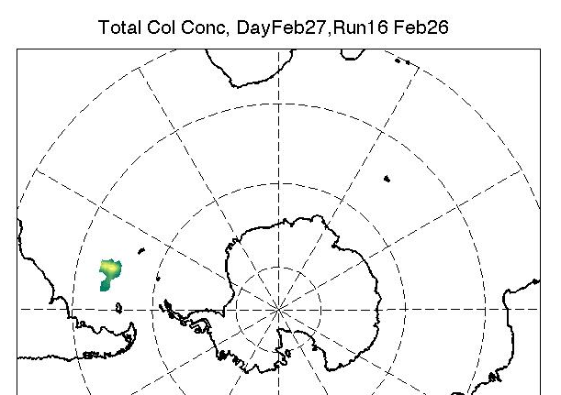
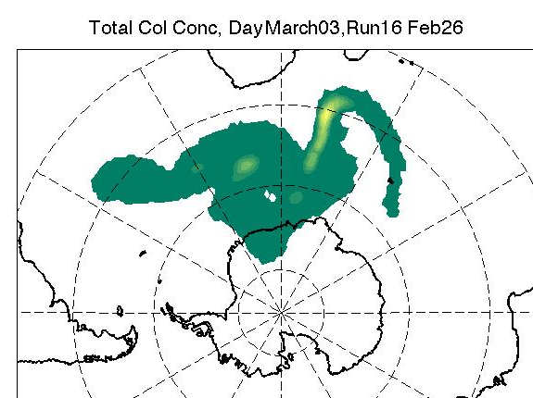
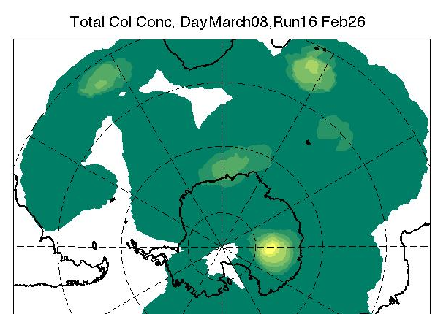
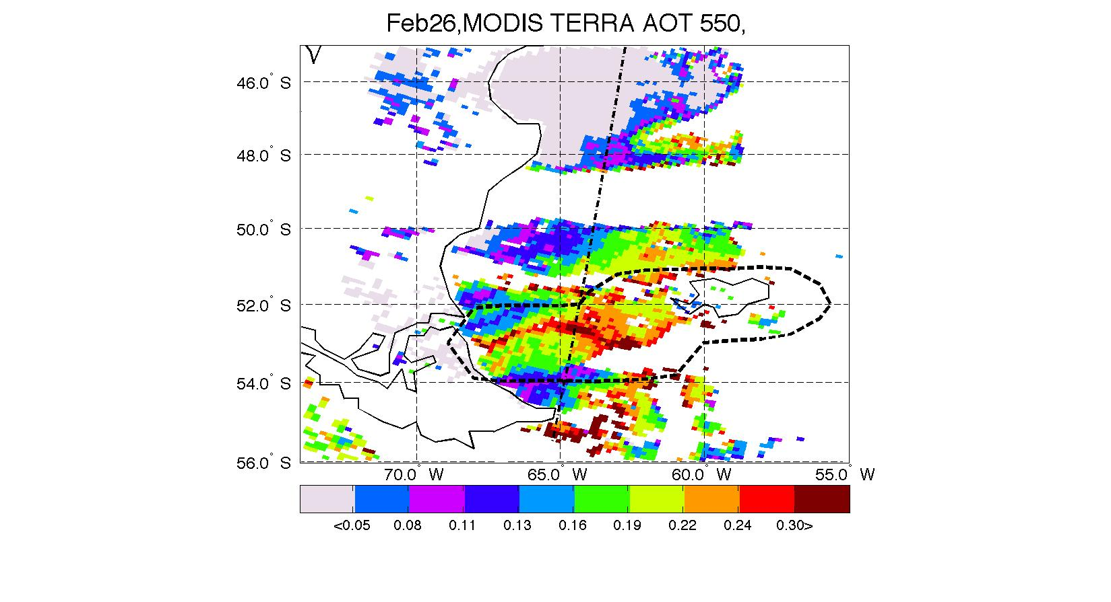
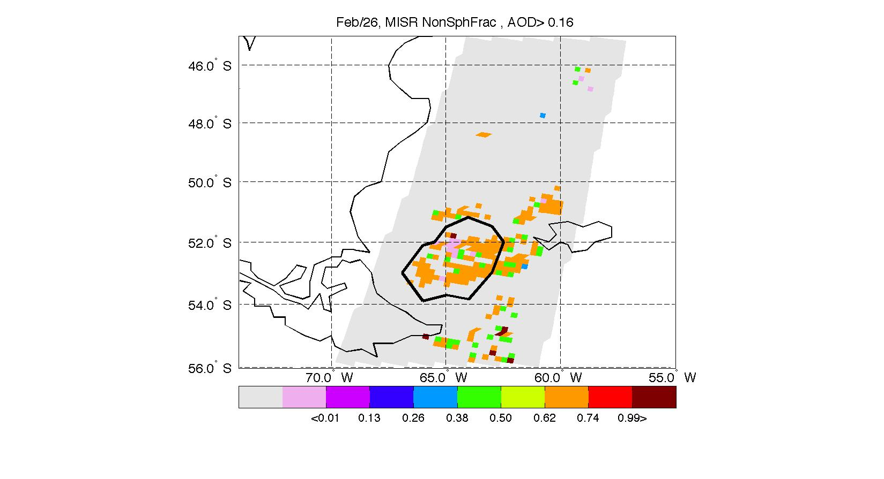
Dust transport over Antarctica
Total columnar dust concentrations modeled by HYSPLIT initialized by the active dust sources detected by MODIS on February 26 2005 and emission duration constrained by surface visibility measurements. Outputs are shown for February 27 (left), March 03 (center) and March 09 (right). Lighter colors indicate higher concentrations.
Notes:
This work was accomplished in collaboration with NASA scientists.
Although emission of dust from the Patagonia desert is shown by global aerosol models, there is conflicting observational evidence of dust activity in the region. Because dust from Patagonia into the Southern Ocean (SO) may play a role in regulating phytoplankton activity, it is necessary to confirm whether dust activity occurs and whether the dust reaches the SO. We used a combination of surface visibility, satellite measurements (MODIS and OMI) and transport model (HYSPLIT) to track and report for the first time a dust event originating in Patagonia. We show that the dust reached the free troposphere in the Sub-Antarctic Atlantic Ocean. Although the dust emission was significant, cloudiness and dilution of the plume resulted in difficult conditions to track dust in the SW Atlantic. We show that the use of any single tool (ie MODIS or OMI) is not enough to track the dust and only an integrated approach of satellite and modeling tools can achieve a consistent description. As a result, current platforms used for dust detection are probably underestimating aerosol loading in the area

Slide 12
Indicators of Success
Peer reviewed papers:
  Journal of Geophysical Research, Weather and Forecasting, Atmospheric Research, Atmospheric Chemistry and Physics, Geophysical Research Letters.
Operations:
  Smoke Forecast System; customer: NWS
  Dust Storm Prediction System; customer: NWS
  HYSPLIT emergency response system, including volcanic ash and wildfire smoke; customer: Argentinean NWS
Memorandum of Agreements:
  Argentinean National Weather Service
  University of Huelva, Spain.
Notes:
An Empirically Derived Emission Algorithm for Wind Blown Dust, Roland R. Draxler, Paul Ginoux, Ariel F. Stein. Journal of Geophysical Research, Atmospheres, 115, D16212, doi:10.1029/2009JD013167, 2010
Modeling PM10 originated from dust intrusions in the southern Iberian Peninsula using HYSPLIT. Stein A.F., Wang Y., de la Rosa J.D., Sanchez de la Campa A.M., Nuria Castell, and Draxler R.R., Weather and Forecasting, in press 2011.
Source apportionment for African dust outbreaks over the Western Mediterranean using the HYSPLIT model. Escudero, M., A. Stein, R. R. Draxler, X. Querol, A. Alastuey, S. Castillo, and A. Avila, Atmospheric Research, Volume 99, Issues 3-4, Pages 518-527, 2011.
Determination of the contribution of northern Africa dust source areas to PM10 concentrations over the central Iberian Peninsula using the Hybrid Single-Particle Lagrangian Integrated Trajectory model (HYSPLIT) model. Escudero, M., A. Stein, R. R. Draxler, X. Querol, A. Alastuey, S. Castillo, and A. Avila, Journal of Geophysical Research, 111, D06210, doi:10.1029/2005JD006395, 2006.
A combined observational and modeling approach to study modern dust transport from the Patagonia desert to East Antarctica, Santiago Gassó, Ariel Stein, Federica Marino, Emiliano Castellano, Roberto Udisti, and Jeff Ceratto, Atmospheric Chemistry and Physics, Vol.10, pp. 8287-8303,http://www.atmos-chem-phys.net/10/8287/2010/acp-10-8287-2010.html, 2010.
Does Dust from Patagonia reach the Sub-Antarctic Atlantic Ocean?. Gasso, S. and A.F. Stein. Geophys. Res. Letters. Vol 34, L01801, 2007.
Description and Verification of the NOAA Smoke Forecasting System: The 2007 Fire Season. Glenn D. Rolph, Roland R. Draxler, Ariel F. Stein, Albion Taylor, Mark G. Ruminski, Shobha Kondragunta, Jian Zeng, Ho-Chun Huang, Geoffrey Manikin, Jeffery T. McQueen, and Paula M. Davidson. Weather and Forecasting, Vol. 24, No. 2. 379–394, 2008
Verification of the NOAA Smoke Forecasting System: Model Sensitivity to the Injection Height. Ariel F. Stein, Glenn D. Rolph, Roland R. Draxler, Barbara Stunder, and Mark Ruminski. Weather and Forecasting, Vol. 24, No. 2. 379–394, 2008.

Slide 13










Collaborators

Slide 14
Future directions
Improve fire release height estimations using satellite derived emissions.
Implement and test new smoke and dust algorithms developed under lagrangian-based (HYSPLIT) paradigm into eulerian based models (CMAQ) and vice versa for future application in to the National Air Quality Forecast Capability.
Continue strengthening international collaboration.

