Slide 1
Climate - Theme Overview
Dian Seidel
Air Resources Laboratory
ARL Laboratory Review
May 3-5, 2011
Dian Seidel
Notes:
The third theme of ARL’s research program is climate.

Slide 2
Scope and Goals of ARL’s Climate Program
Climate Observing Networks
Goal: To develop in situ observational networks to meet climate needs
Climate Variability and Change Analysis
Goal: To advance understanding of upper-air climate changes
Regional Climate Modeling
Goal: To develop a NOAA modeling capability for regional climate projections, including comprehensive uncertainty analysis
See ARL’s Strategic Plan for Climate Research and Development
Observations
Modeling
Analysis
Notes:
The scope of ARL’s climate program involves the classic three areas of endeavor in Earth science – observations, modeling and analysis. However, we should recognize that these activities are each directed at somewhat different problems in contemporary climate science.
Our observational work focuses on in situ observations specifically designed and undertaking to meet the needs of climate science and monitoring. Until recently, there were hardly any observations of atmospheric state variables designed for climate purposes. Rather, climatologists relied on long-term archives of weather observations for climate studies. Research, including some studies conducted by ARL, has demonstrated the inadequacy of this approach, and ARL is leading efforts to rectify the situation, by establishing climate reference observations, both at the surface and in the free atmosphere.
Our climate variability and change analysis work attempts to identify natural and anthropogenic climate signals in observations, and since we are mainly using those imperfect weather observations, we put a very strong focus on understanding data quality and continuity and how these affect our interpretation of the observational record. This activity has deep roots within ARL, beginning in the 1960’s when Jim Angell pioneered the use of radiosonde data for climate studies. As climate science has evolved over the past 50 years, ARL has been a leader in the use of in situ global meteorological observations, particularly upper-air observations, to address a whole host of topics. We cover the globe, from the surface through the boundary layer and into the stratosphere. And we address climate variations on time scales ranges from the diurnal cycle to multi-decadal variability and trends.
In the modeling arena, ARL is endeavoring to fill a gap in NOAA’s impressive climate modeling enterprise. Specifically, decision-makers are demanding projections of climate change on regional scales. The two main approaches are downscaling results from global models and more explicit regional climate modeling. We are working to build NOAA’s regional climate modeling capabilities, including a rigorous and comprehensive analysis of uncertainty in regional projections. These efforts dovetail with modeling activities in our air quality and dispersion themes, where understanding and simulating processes operating on the regional scale has always been of importance. In addition, one of the key areas of interest in regional climate projections is understanding the interaction of climate change with air quality. So we are well positioned within ARL to make a strong and impactful contribution.

Slide 3
Driver: NOAA Next Generation Strategic Plan
Long-Term Goal: Climate Adaptation and Mitigation
An informed society anticipating and responding to climate and its impacts
Objective: Improved scientific understanding of the changing climate system and its impacts
Objective: Assessments of current and future states of the climate system that identify potential impacts and inform science, service, and stewardship decisions
Notes:
Why is ARL involved in climate research? NOAA as an agency has a leading role in Federal climate efforts. NOAA’s new “Next Generation Strategic Plan” puts this front and center, identifying climate adaptation and mitigation as one (actually the first) of four overarching agency goals. Among the objectives that underpin that goal are the two listed here, to which ARL contributes strongly. Although, as Steve mentioned yesterday, ARL’s climate program is not transitioning into the new climate service, our work falls squarely within NOAA’s climate vision.

Slide 4
Selected Other Drivers:
Provide monitoring, assessment, and analysis of the climate system through high quality observations … as well as modeling capabilities (Global Change Research Act, National Weather Service Organic Act, Coastal Zone Management Act, US Ocean Action Plan).
NOAA’s Climate Goal will focus on improving the utility of its observations by integrating climate observations … and analyzing data derived from these observing systems …(Research in NOAA: Toward Understanding and Predicting Earth’s Environment A Five‐Year Plan: FY 2008 – 2012)
  Collecting and delivering regular, systematic, and reliable climate data and information—with rigorous scientific standards and easy data access by customers—that document and describe the current and evolving state of the climate system …
  Producing reference data sets that provide improved climate information
  Conducting observational, diagnostic, and modeling research to improve understanding of physical mechanisms and processes … that will lead to improved climate models and climate predictions
Notes:
Here are a few other “drivers” that fully embrace the climate work at ARL. The first is a set of three pieces of legislation and one plan that articulate the need for climate observations, monitoring, analysis and modeling. These ideas were absorbed into, and elaborated upon, in the NOAA Research 5-yr plan that is currently in effect. Some of the terms there speak directly to ARL’s philosophy in our climate program. In a sense, you could describe us using “the 4 Rs” you see here -- reliable, rigorous, reference, research.

Slide 5
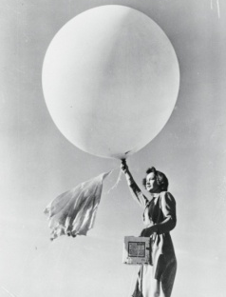
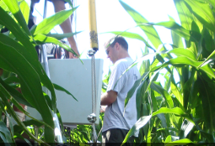
Brief History of ARL Climate Efforts:
Climate Observing Networks
Oak Ridge
Silver Spring
1950s and 1960s – Development of expertise in high-quality surface and tower observations for basic research and turbulence and dispersion applications.
1970s and 1980s - Application to contemporary air quality issues, e.g., acid deposition.
1990s to present – Application to emerging climate issues, including energy, carbon and water budgets, and reference observations.
1960s -1980s – Analysis of global radiosonde and ozone profile observations, US cloudiness and sunshine records.
1990s – ARL’s baseline observing network and sounding programs form basis of new climate lab. Recognition of inadequacies of sonde data for humidity and temperature trends.
2000s to present – Advocacy of reference upper-air observations and associated research
Notes:
A pretty comprehensive but easy to read history of ARL’s climate program, in bullet form, is in the Strategic Plan for Climate Research and Development, which is part of the lab review materials. I’d like to highlight a few key points for each of the three climate program areas, to provide a bit of perspective on how we got to where we are today, starting with our work on climate observing networks.
The activities in Oak Ridge and Silver Spring have different histories and are different in nature. Scientists in Oak Ridge have actual instrument expertise and decades of field experience. Their climate observing work grows out of this half-century of high quality atmospheric observations, which have shifted in focus over time to address the key environmental problems of the day.
In Silver Spring, we do not have this hands-on measurement expertise; rather, we focus on analysis of observations. This work, and our careful attention to data quality and homogeneity issues, has led us to be strong advocates for better observations for climate, particularly upper-air observations. But in earlier decades, the Silver Spring focus on analysis of observations was strongly coupled with ARL climate observing programs based in Boulder. You may not realize that the first somewhat sustained federal funding for Dave Keeling’s baseline CO2 measurements was from ARL, which went on to establish a series of world-class baseline observing stations for climate. These were joined with other climate activities to form a new laboratory (Climate Monitoring and Diagnostics Lab), which is now part of the Earth Systems Research Lab in Boulder.

Slide 6
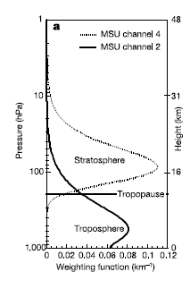
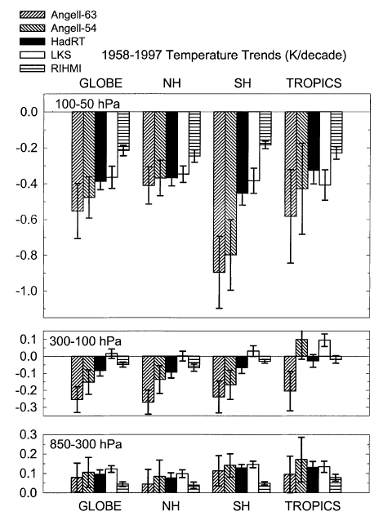
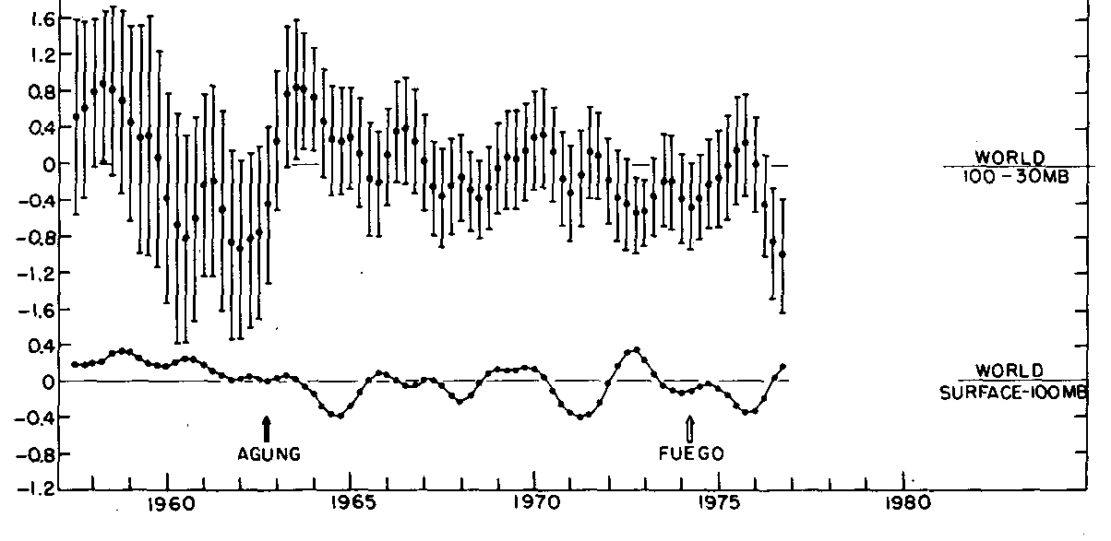
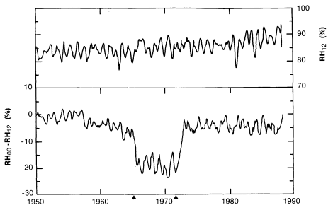
Brief History of ARL Climate Efforts:
Climate Variability and Change Analysis
Pioneering analyses of upper-air (temperature & humidity) and surface climate (1970s)
Recognition of data homogeneity and metadata issues (1990s)
Dataset intercomparisons (2000s)
Analyses of vertical profile of temperature trends (2000s)
Global Temperature Time Series
1958-1977
Angell and Korshover
(Mon. Wea. Rev. 1978)
Hilo 850 hPa RH Record
1950-1988
Elliott and Gaffen
(Bull. AMS 1991)
Upper Air Temperature Trends
Dataset Intercomparison
Seidel et al .
(J. Climate 2004)
Layers Sensed by Satellites Effect of Stratosphere
Fu et al.
(Science 2004)
Notes:
The Climate Variability and Change Analysis activity, based here in Silver Spring, has the longest heritage among ARLs climate activities. This slide is meant to illustrate a bit of the background and history of ARL’s research in understanding global temperature changes. These figures are examples from some of our earlier studies, before the period covered by this review. Pioneering research, by Jim Angell, using radiosonde data for climate studies in 1960s and 70s sowed the seeds from which the group’s upper-air research efforts over the past four decades have grown. We’ve made several major contributions to understanding vertical temperature trend profiles, which has been a high profile topic in climate science for almost 20 years. And, over time, as other groups have contributed observational analyses of upper-air temperature, we’ve been involved in all major temperature trend intercomparison studies, leading one of the first and contributing to others.
The figures show (left to right):
1. One of the first time series of global upper-air temperature (this covering ~20 yr) based on the 63-station radiosonde network used by Angell to study everything from the quasi-biennial oscillation, to El Nino, to climate trends (Angell and Korshover 1978). Note the tropospheric (bottom) cooling and stratospheric (top) warming following the two big volcanic eruptions during this period (Agung and Fuego).
2. An example of an inhomogeneous upper-air data record, showing 850 hPa humidity data from Hilo, Hawaii. The abrupt changes in the daytime relative humidity are associated with radiosonde humidity sensor changes (Elliott and Gaffen 1991)
3. First intercomparison of radiosonde and MSU representations of tropospheric and stratospheric climate signals. Plot shows large differences in trends from different datasets (Seidel et al. 2004).
4. Vertical weighting functions for two channels of the Microwave Sounding Unit (MSU). This study demonstrated that the stratospheric cooling signal diminishes the tropospheric warming signal in those satellite data and was one of the key contributions toward resolving controversies regarding vertical temperature trend profiles (Fu et al. 2004).

Slide 7
Brief History of ARL Climate Efforts:
Regional Climate Modeling
2001: ARL began regional climate model development
Collaborative partnerships
  University of Illinois at Urbana-Champaign
  Weather Research and Forecasting modeling community
  University of Maryland, College Park (2011)
Goal: Provide reliable climate information at regional-local scales, using state-of-art science and technology
Notes:
Our efforts in regional climate modeling are more recent, about a decade old, and more strongly collaborative in nature, involving partnerships with modelers around the country. Julian Wang describes details in the poster session. Essentially, the effort seeks to develop a regional climate modeling capability, based on the proven WRF (Weather Research and Forecasting) model, and including a very wide array of options that will greatly improve the characterization of uncertainty in regional simulations and projections. The team from UIUC are recently transplanted to nearby UMD/College Park, making collaboration with ARL, and with our operational partners in the National Weather Service, much easier.

Slide 8
Guiding Philosophies
Identify emerging issues where ARL can contribute significantly
Engage in evolving scientific debate
Pay attention to data quality and associated uncertainties
Collaborate with pre-eminent colleagues at relevant US and international institutions, particularly within NOAA
Communicate results through peer-reviewed publications and scientific conferences, and with the general public
Contribute to and support scientific assessment activities
Maintain strong long-term capabilities

Slide 9
Overview of ARL’s Current Climate Program
Climate Observing Networks
Surface Energy Budget Network (Tilden Meyers)
Surface Climate Reference Networks (Bruce Baker)
POSTERS:
  Utilizing land surface models for gap-filling energy and CO₂ exchange rates (Tilden Meyers)
  Automated Solid Precipitation Measurement (John Kochendorfer)
  In situ and satellite measurements of land surface skin temperature (Praveena Krishnan)
  Testing and Evaluation of the Best Aircraft Turbulence (BAT) Probe for Airborne Research (Ed Dumas)
  GCOS Reference Upper Air Network (Dian Seidel)
Notes:
In this session of the lab review, and in the poster sessions, we have tried to present the main components of ARL’s climate activities, in each of the three areas we’ve been discussing. Following this overview, Tilden Meyers will discuss work to develop a surface energy budget network, and Bruce Baker will outline ARL’s work to establish surface climate reference observing networks. Posters show other aspects of our observational work, including ground-based and aircraft mounted systems. The final poster listed here describes our advocacy for, leadership in, and research in support of a new global reference upper-air network.

Slide 10
Overview of ARL’s Current Climate Program
Climate Variability and Change Analysis
Understanding Upper-Air Climate Change
  Part I: Changes in the vertical temperature profile (Melissa Free)
  Part II. Stratospheric temperature trends and links to other climate changes (Dian Seidel)
POSTERS:
Climatology of the global planetary boundary layer (Yehui Zhang)
Changes in cloudiness in the US from surface observations (Melissa Free)
ARL contributions to national and international scientific assessments
PODCAST: What the upper atmosphere reveals about climate http://www.oar.noaa.gov/podcast/arl/arl-1.php
Notes:
Our Climate Variability and Change Analysis work will be described in two complementary talks by Melissa Free and myself, addressing upper-air climate change, and focusing on aspects of our research on global temperature variability and trends. There are three posters, each addressing other topics of study, and one podcast. The podcast is a fun, new outreach product, that describes in non-technical language why we study upper-air climate and highlights some of our findings and plans. Each of the five segments is just a few minutes long.

Slide 11
Overview of ARL’s Current Climate Program
Regional Climate Modeling
POSTER: Regional Climate Modeling (Julian Wang)
Poster describes:
  Need for climate information at regional-local scales
  Model development philosophy
  Major model improvements
  Recent research results
Notes:
The main presentation on Regional Climate Modeling is a poster by Julian Wang, covering these topics.

Slide 12
Thank You!

