Slide 1
Understanding Upper-Air Climate Change
Part II. Stratospheric temperature trends and links to other climate changes
Dian Seidel
Air Resources Laboratory
ARL Laboratory Review
May 3-5, 2011
Notes:
This presentation is the 2nd part of a 2-part perspective on Understanding Upper-Air Climate Change.

Slide 2
Focus Areas
Global stratospheric temperature trends
Tropopause studies
Tropical belt expansion
Notes:
Melissa spoke about some recent research topics in upper-air climate change. I will be addressing three more topics that have been focus areas recently and will likely continue to be of interest in the future. They are: global stratospheric temperature trends, tropopause studies, and the expansion of the tropical belt.
Stratospheric temperature trends are of interest because they are part of the fingerprint of anthropogenic climate change and changes in the stratospheric ozone layer, yet historical datasets are difficult to interpret.
Our interest in the tropopause region is motivated by two scientific issues. One is its role both in controlling stratospheric water vapor, a key greenhouse gas but one that is very difficult to measure in the stratosphere, where water vapor concentrations are just a few ppm, 2 to 3 orders of magnitude lower than in the troposphere. The second is the possibility that tropopause changes may be a sensitive indicator of anthropogenic climate change.
And our work with the tropopause has opened up a new, intriguing area of inquiry, the expansion of the width of the tropical belt, which could have important implications for global precipitation patterns, especially in subtropical regions, where water resource limitations can have significant impacts on ecosystems, agriculture, health, and geopolitics.

Slide 3
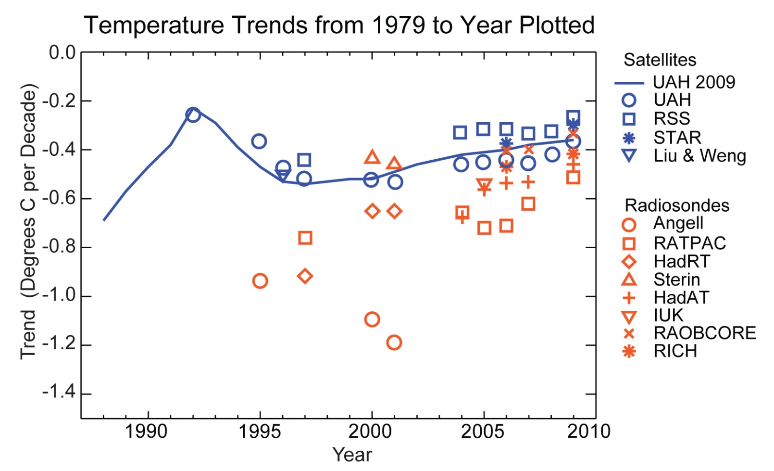
Accomplishments - Stratospheric temperature trends
Seidel , Gillett, Lanzante, Shine and Thorne
(Wiley Interdisciplinary Reviews: Climate Change, in review)
Notes:
As Melissa showed, different ways of adjusting radiosonde data can lead to different estimates of temperature change. The same is true of satellite data, such as upper-air temperature data from the Microwave Sounding Units. So it is important to systematically intercompare results from different research teams that produce different analyses. Our group has been involved in all major intercomparisons and reviews of upper-air temperature change (e.g., Ramaswamy et al., Rev. Geophys. 2001, Shine et al., QJRMS 2003, Seidel et al., J. Climate 2004, Randel et al., JGR 2009).
This plot is from a review article on stratospheric temperature trends, currently in review at Wiley Interdisciplinary Reviews: Climate Change (WIREs). That paper is a companion to a review of tropospheric temperature trends in the same journal, published last year.
The plot shows published global stratospheric trend estimates from different datasets at different times and so gives us a sense of how our understanding of trends and their uncertainties has evolved over time. The plot contains a lot of information, and we don’t have time to explain all the interesting findings. The important points are:
This is a plot of “trends in trends”. Trends are for different data periods, all beginning in 1979 but ending in different years, and from different datasets.
ARL contributed two upper-air data products: the earliest, by Angell, and RATPAC (described in Melissa’s talk, preceding this one)
All estimates show cooling (negative temperature trends) of the lower stratosphere
There is considerable spread among the cooling estimates, although the spread has decreased over time as more attention has been paid to removing inhomogeneities in both satellite and radiosonde datasets
Spread among current estimates (for 1970-2009 trends) ~0.3 K/decade, which is comparable to the trend itself and is larger than the spread in tropospheric trend estimates
Early radiosonde estimates (Angell) show much more cooling than later estimates from adjusted radiosonde data
Radiosondes still show more cooling than satellite data from the Microwave Sounding Unit (MSU), but there is also uncertainty in the MSU, as seem by the spread in the blue symbols
Univ. of Alabama in Huntsville (UAH) Microwave Sounding Unit (MSU) trends vary with data version (compare blue circles, showing published results, with blue line plot, showing trends from the current version)

Slide 4
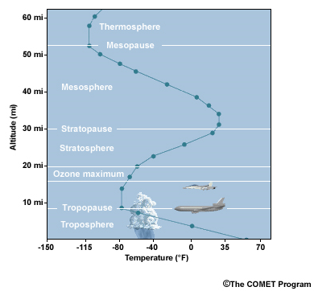
Accomplishments – Tropopause studies
Climatological analysis of tropical tropopause (Seidel, Ross, Angell and Reid, JGR, 2001)
Global tropopause variability and trends, and relation to temperature changes (Seidel and Randel, JGR, 2006)
Analysis of double tropopause climatology (Randel, Seidel, and Pan, JGR, 2007)
Notes:
ARL is also at the forefront of research in the climatology of the tropopause. We’ve contributed to three main areas: the climatology of the tropical tropopause, trends in the global tropopause, and climatology of double tropopauses. I’ll show some results from the first two of these. The figure is a simple schematic showing a standard atmosphere temperature profile, with the tropopause marked.

Slide 5
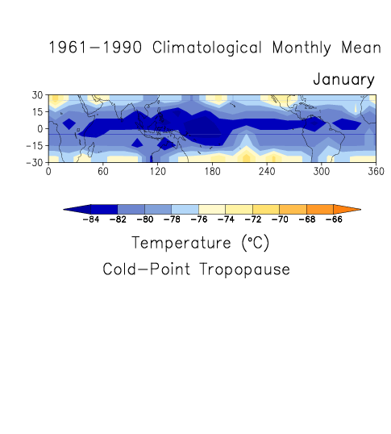
Tropical tropopause climatology
Seidel, Ross, Angell and Reid
(JGR, 2001)
Notes:
This was the first comprehensive climatological study of the tropical tropopause, based on a 30 yr radiosonde record, and it was our first study of the tropopause region. We examined different tropopause definitions (official lapse rate definition, cold point, 100 mb) and different parameters at that level, including temperature, height, pressure and saturation vapor pressure.
The latter is of interest because of the role of the tropopause in limiting water vapor entry into the stratosphere, which is extremely dry (mixing ratios of a few ppm). The animation shows that the climatologically coldest cold points are over Indonesia and the “warm pool” region, the classical “fountain region” of Newell and Gould-Stewart (1981), but other areas are about as cold in NH springtime.
This study also looked at trends in the tropical tropopause, and found that that it was rising and cooling, the opposite of what was needed to explain an increase in stratospheric water vapor, which had been reported by Oltmans and Hofmann (Nature 1995) at Boulder.

Slide 6
Global tropopause trends
1980-2004 Zonal-Mean Tropopause Trends
Global-mean 25-yr changes : 160 m rise, 4 hPa pressure decrease, 1 K cooling
Seidel and Randel (JGR, 2006)
Notes:
After looking at the tropical tropopause, we expanded our domain to an analysis of the global tropopause. The motivation here was less focused on the tropopause’s influence on stratospheric water vapor and more related to the possibility of detecting anthropogenic climate change.
Here we show trends in the global tropopause over a 25-yr period. The rise of the tropopause (~150 m or 4 hPa) was consistent with expectations from climate models forced with greenhouse gas and ozone changes. A warming troposphere and cooling stratosphere were thought to lead to a rising tropopause. But we found that tropopause height is not well correlated with tropospheric temperatures, only stratospheric ones, so this may not be a “sensitive indicator” of greenhouse gas-induced climate change. What drives tropopause changes is still an open research question.

Slide 7
Accomplishments – Tropical belt expansion
Identified tropopause height as a metric of the extent of the tropical belt (Seidel and Randel, JGR, 2007)
Integrated tropopause metric with other observations to show recent widening of the tropics (Seidel, Fu, Randel and Reichler, Nature Geoscience, 2008)
Motivated other studies on this topic
Notes:
Related to our work on the tropopause is the issue of the expansion of the tropical belt. I’ll show some work that identifies tropopause height as a metric that can be used to determine the width of the tropics. This metric, combined with other, independent observations, indicates a widening of the tropics.

Slide 8
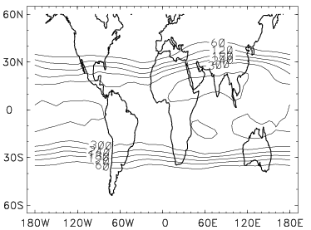
High tropopause in tropics
Days/Yr with Height > 15 km
Total widening 1979-2005: 5-8 deg. latitude
Seidel and Randel (JGR, 2007)
Notes:
Our work on tropopause height revealed a steep gradient in the subtropics, and also a steep gradient in the frequency of high tropopause days at the edges of the tropical belt. The left panel shows that between about 25 deg N and S latitude, the tropopause is almost always (more than 300 day/yr) higher than 15 km.
On the right, the mean latitude of the 300 day/yr isoline moved poleward, in both hemispheres, during 1970-2005, in reanalysis data. Radiosonde data show a similar trend going back to 1958. This suggests a widening of the tropical belt, as defined by tropopause height. Using this metric, the tropics seems to have expanded by 5-8 degrees latitude during 1970-2005.

Slide 9
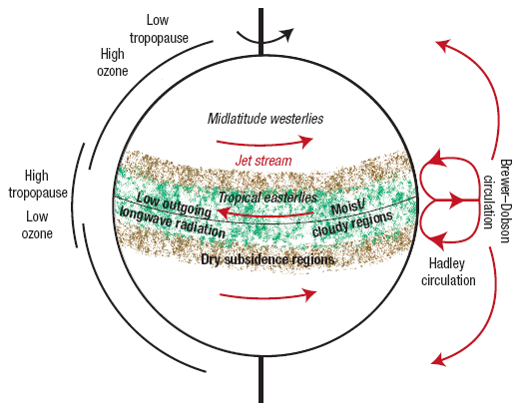
Comparison of metrics of tropical width
Seidel et al. (Nature Geosci. 2008)
Notes:
Other observations, completely independent of the tropopause observations, also suggest an expansion of the tropical belt. We reviewed a number of observational studies and compared their results. Stratospheric ozone, cloud information (from outgoing long-wave radiation observations), circulation parameters (meridional mass flux), and jet stream location all suggest a widening of the tropics.
This is a “hot topic” in climate research, and our analysis was the first to pull together the existing literature and identify unresolved questions. Interest in this issue is motivated both by the very large observed trends, which seem unsustainable, and by the serious implications for surface climate, particularly hydrology. Poleward shifts in the subtropical dry zones could imperil human settlements and ecosystems in regions of limited water resources. The 2010 Scientific Assessment of Ozone Depletion and the IPCC Fifth Assessment Report (scheduled for release in 2013) have sections on this topic (contributed by me).

Slide 10
Indicators of success
Publications; Citations in climate and ozone assessments
Community use of datasets for climate monitoring and research
Angell Symposium (November 2003)
Dept. of Commerce and NOAA medals and awards
  1995 Silver Medal (Angell/ozone and temperature studies)
  2007 Gold Medal (Seidel/vertical temperature trends)
  2007 Bronze Medal (Free, Seidel/radiosonde data products)
  NOAA Research Outstanding Scientific Paper Awards
Transformation of the scientific discussion and research
  Importance of data quality and need for reference observations
  Characterizing uncertainty in trends
  Reconciling atmospheric temperature trends
  Tropical belt expansion and outstanding questions
Notes:
Here are a few indicators of our success related to the 3 topics covered in this presentation. First, our main “product” is our scientific publications in peer-reviewed journals. A full list of our publications is on the ARL web site. Most of these are cited in major climate assessment reports. In fact, we feel that inclusion of our climate research in assessments is an excellent indicator of its relevance to the current scientific effort. Our work has been the subject of several NOAA press releases and some has been covered by popular news outlets.
Many of our publications are based on “value-added” datasets, such at RATPAC, which Melissa described in detail. As we have done with RATPAC, which is now regularly updated for climate monitoring by NOAA/NCDC, we have made many of the datasets used in our analyses available to the scientific community, either through formal data centers such as NCDC or through journals’ “auxiliary supporting material” services. This way others can try to reproduce our results and use our data for comparisons with other observations and with model simulations. Among the datasets we have made public are upper-air temperatures (RATPAC), radiosonde station history metadata, US extreme heat and humidity data, tropical tropopause climatology, radiosonde balloon drift statistics, and (most recently) Arctic and Antarctic boundary-layer inversion climatologies.
Some other indicators relate to recognition of the significance of our contributions by our peers. In November 2003, we held a symposium honoring Jim Angell on his 80th birthday; speakers reviewed Jim’s contributions to climate science (and other topics) and later documented this in an article in the Bulletin of the AMS. And we have received DOC and NOAA awards for our work on temperature trends, etc.
Finally, some of our scientific contributions could be considered “transformational”, in the sense that they influenced the direction and thinking of the climate science community.

Slide 11













Collaborators (2001-2011)
NOAA
OAR/GFDL (Klein, Lanzante, Ramaswamy)
NESDIS/NCDC (Durre, Karl, Peterson)
US Academia
NCAR (Randel)
Lawrence Livermore National Lab (Santer)
University of Washington (Fu)
University of Utah (Reichler)
University of Alabama in Huntsville (Christy, Spencer)
International
UK Met Office (Parker, Thorne)
Univ. of Reading (Shine)
Univ. of Portsmouth (Pepin)
Canadian Centre for Climate Modeling and Analysis (Gillett)
All-Russian Institute for Hydrometeorological Information (Sterin)
  Private Sector
  Remote Sensing Systems (Mears, Schabel, Wentz)
Notes:
Our group is very small, and we are only able to do what we do with a little help from our friends. This slide shows the institutions with which some of our collaborators over the past decade are affiliated. I should say, however, that in our work on upper-air temperature, the tropopause, and tropical belt expansion, we seek collaborators based on their scientific expertise, rather than their institutional affiliation. The list of our publications shows names of the folks we have worked with. Many are national and international leaders in climate science.

Slide 12
Future directions
Temperature trends – ongoing interest
Tropopause studies (James Wang, NRC Senior Associate)
  Tropical cold-point tropopause changes and relation to stratospheric water vapor
  Radiosonde and GPS Radio Occultation observations
Tropical expansion
  Contribution to IPCC 5th Assessment Report
  Analysis of robustness of tropopause-based tropical width metrics
  Update of published results (through 2005)
Notes:
What’s next in these three areas?
We don’t seem to be able to let go of temperature trend research, which we’ve been addressing for almost 40 yrs now. Since the atmosphere keeps changing, we are likely to continue work in this area.
Regarding the tropopause, this year Dr. James Wang, an NRC Senior Associate, at ARL is currently work on further analysis of the tropical tropopause, trying to answer questions regarding our ability to detect trends in the tropopause, and comparing traditional radiosonde observations with GPS radio occultation observations in that region.
As I mentioned before, we are contributing an assessment on tropical expansion to the next IPCC report and hope to examine the robustness of our earlier findings, and whether the trends we found have been continuing, in collaboration with Thomas Birner at Colorado State University.

Slide 13
Thank You!

