Slide 1
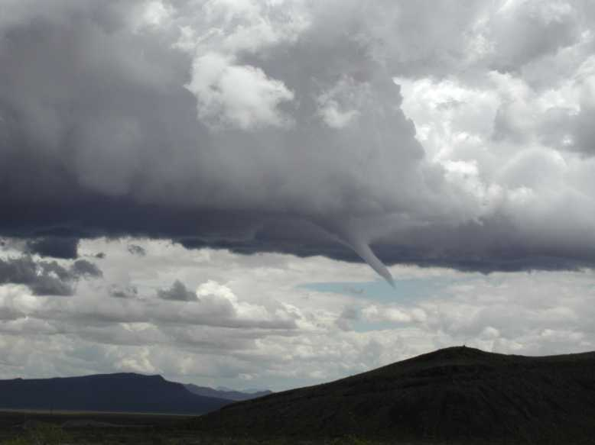
Specialized Dispersion and Meteorology Support
Walt Schalk
Air Resources Laboratory
Air Resources Laboratory Review
Tuesday, May 3 - 5, 2011
Notes:
Good Afternoon,
I am Walt Schalk from the ARL Division in Las Vegas, NV.
So far today, you have heard about specific research on dispersion topics.
My focus will be a little bit different…. I will be talking about ARL’s specialized dispersion and meteorology activities. Some of which can have immediate and life-saving impacts.

Slide 2
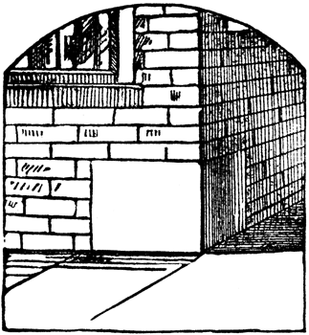
ARL’s expertise and services are sought out
Dispersion is cornerstone to services
Customer relationship pairs
Their specific & unique needs
ARL expertise and experience
ARL Benefit
Feedback to research
Dispersion
Notes:
2
In addition to ARL’s research and development, a variety of customers (for example other Fed agencies) seek out ARL dispersion and meteorology expertise and services.
With dispersion as an ARL cornerstone, we are able to provide a wide range of services to these customers, where the relationships are rooted in their specific and unique needs and matched with ARL’s expertise.
This is of great benefit to ARL because…

Slide 3
Feedback to Research
ARL Services
Expanded
applications
Increased
expertise
Lessons Learned, Data, Experience
Improved
models
Improved
tools
ARL
Dispersion
Research
Notes:
3
These partnerships and collaborations allow us to feed lessons, data, information, and needs learned from our customer relationships by providing these specialized services back into ARL’s overall research and development activities.
As a result, the research then produces improved models and tools , increased expertise and expanded application.

Slide 4
Feedback to Research
ARL Services
Expanded
applications
Increased
expertise
Lessons Learned, Data, Experience
Improved
models
Improved
tools
ARL
Dispersion
Research
Notes:
4
I will first talk about how the tools, models, and expertise developed and learned through years of research allows ARL to provide dispersion and meteorological services to other organizations

Slide 5







Customers
Primary
Others
Notes:
Other Agencies that come to ARL for dispersion and meteorology services are
Primarily the Dept of Energy and it’s related organization the National Nuclear Security Administration. Within DOE, the two primary site are the Idaho National Laboratory near Idaho Falls, ID and the Nevada National Security Site near Las Vegas, NV.
Other Agencies and Institutions include:
Department of Defense - Defense Threat Reduction Agency (DoD/DTRA)
Environmental Protection Agency (EPA)
World Meteorological Organization (WMO)
Southern Methodist University (SMU)

Slide 6
Services Provide to DOE
Meteorological Data Collection
Consequence Assessment
Meteorological Data Analysis
Mesoscale Weather Forecast modeling
Meteorological Surveillance & Forecasting
Specialized Experimental Support
Air Quality Modeling – permitting
Notes:
6
Meteorological Data Collection
- surface
- upper air
Consequence Assessment
Meteorological Data Analysis
- Climatological Analysis
- Environmental Compliance
Meteorological Surveillance & Forecasting
- routine
- on-demand
Specialized Experiment Support
Mesoscale Weather Forecast Modeling
Air Quality Modeling
- permitting
For each one of these services I will Outline
What we do…
Products developed/generated…
Importance…

Slide 7
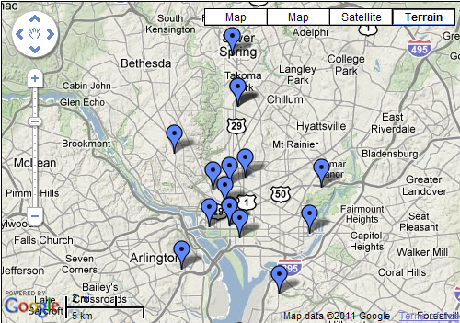
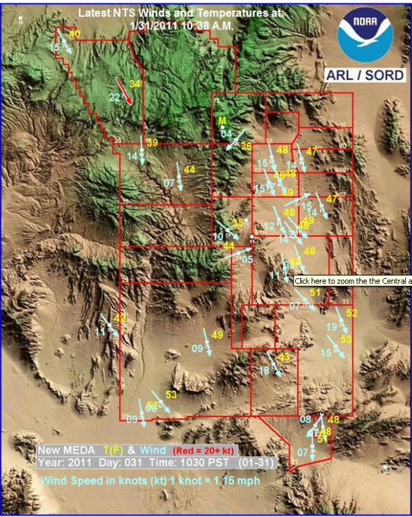
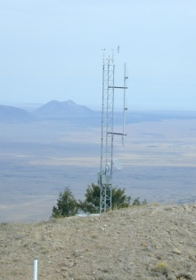
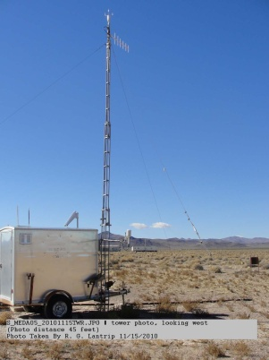
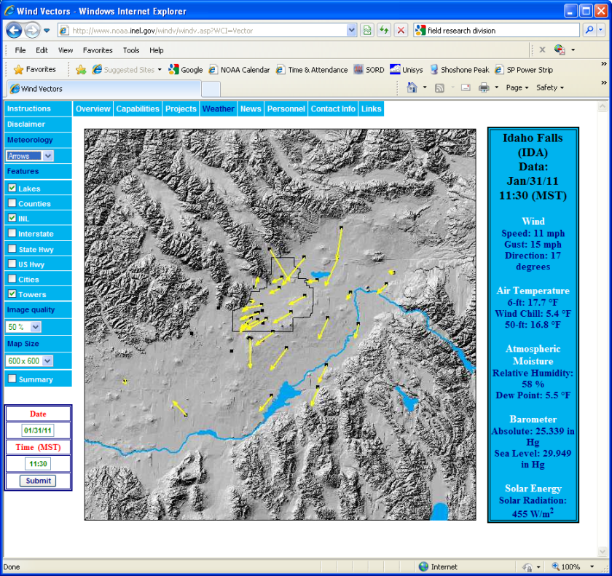
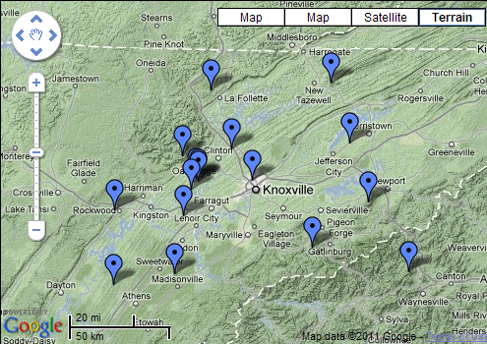
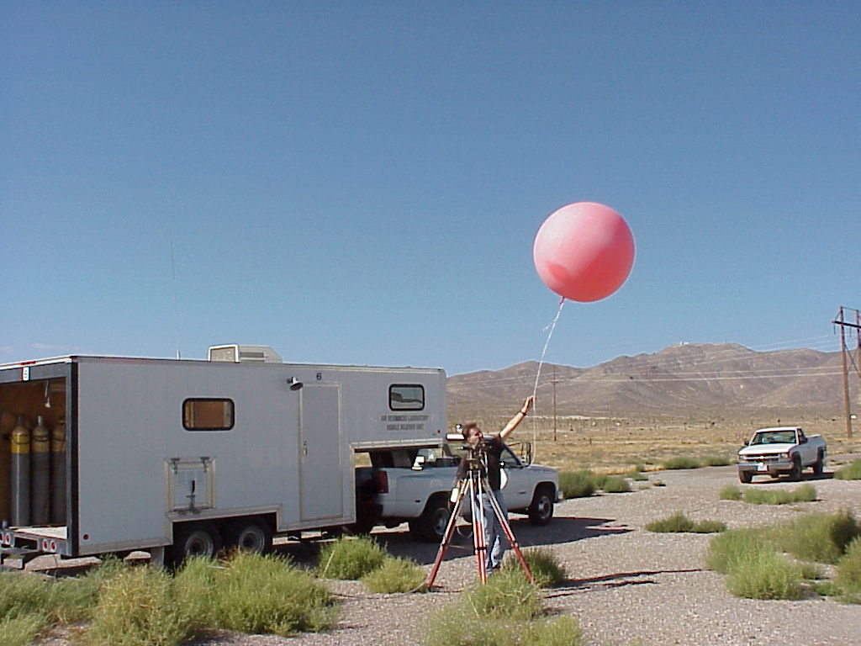
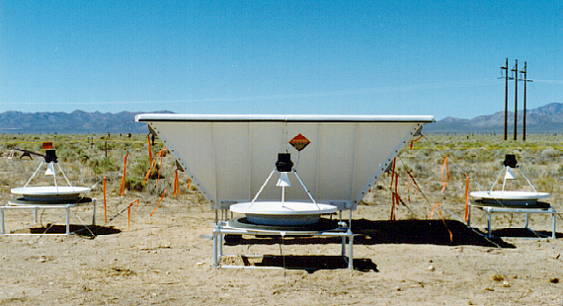
Meteorological Data Collection
Notes:
7
Examples shown here:
Field Research Division (FRD) mesonet and a weather tower, Special Operations and Research Division (SORD) mesonet and a weather tower, a wind profiler, and a radiosonde balloon release, Atmospheric Turbulence and Diffusion Division (ATDD) mesonets in Tennessee and Washington, DC.
-
What We Do…
operate and maintain weather data collection mesonets to characterize the
Atmospheric Boundary Layer of complex meteorological flows. This includes systems that measure the standard set of parameters (Temperature, Relative Humidity, Pressure, precipitation, Wind Speed, Wind Direction), but with the addition of lightning strike data in Nevada
Products…
Graphical displays of weather data; surface, upper air, precipitation
Importance…
These data a base of information for nearly all areas of services provided to DOE, such as Consequence Assessment to be discussed that are related to the health and safety of workers, populations, and property

Slide 8
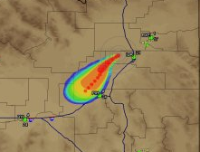
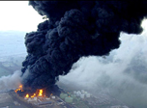
Consequence Assessment
Notes:
8
So for Consequence Assessment
BOOM, an event happens and is going to have an effect on the environment and people.
What we do…
Information is taken from the local mesonet, scenario specific information (including the material involved, how it was released to the atmosphere) is input to a dispersion model.
Product…
A plume plot is generated that shows concentration values
Expertise is applied that compares specific Emergency Action Levels that are related to Protective Actions.
Products are briefed to emergency managers, questions and discussions occur.
Expertise is provided that recommends Protective Actions based on plume concentrations .
This is then a iterative process, taking updated source term information and wind information.
FRD and SORD do this for DOE for both radiological and chemical events
Why Important…
- This information and expertise directly affects the health and safety of site workers and property, and if event is large enough, off-site people and property.

Slide 9
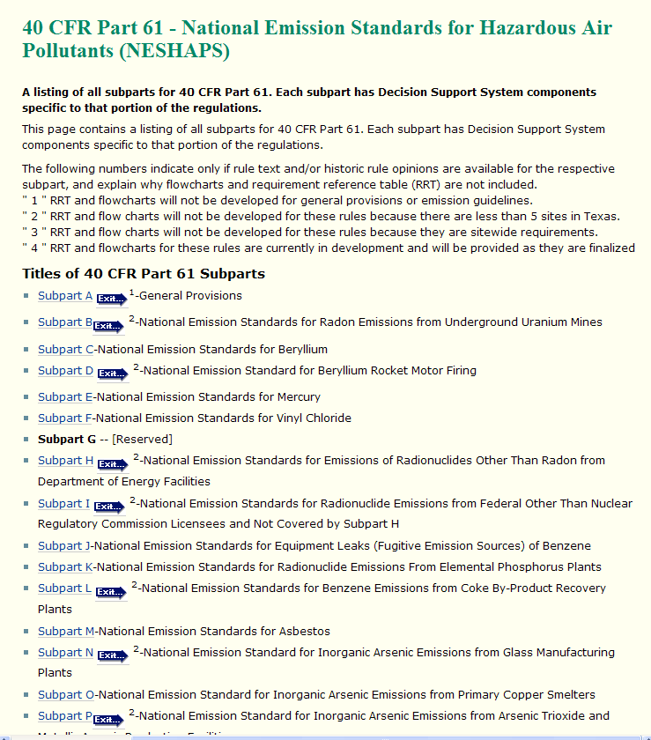
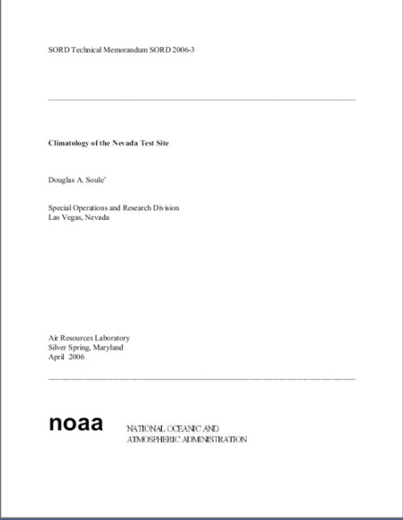
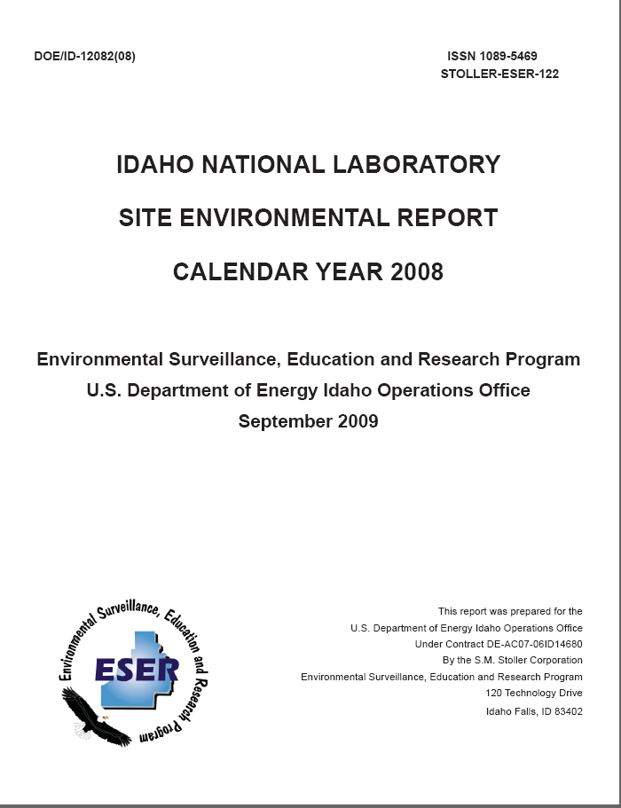
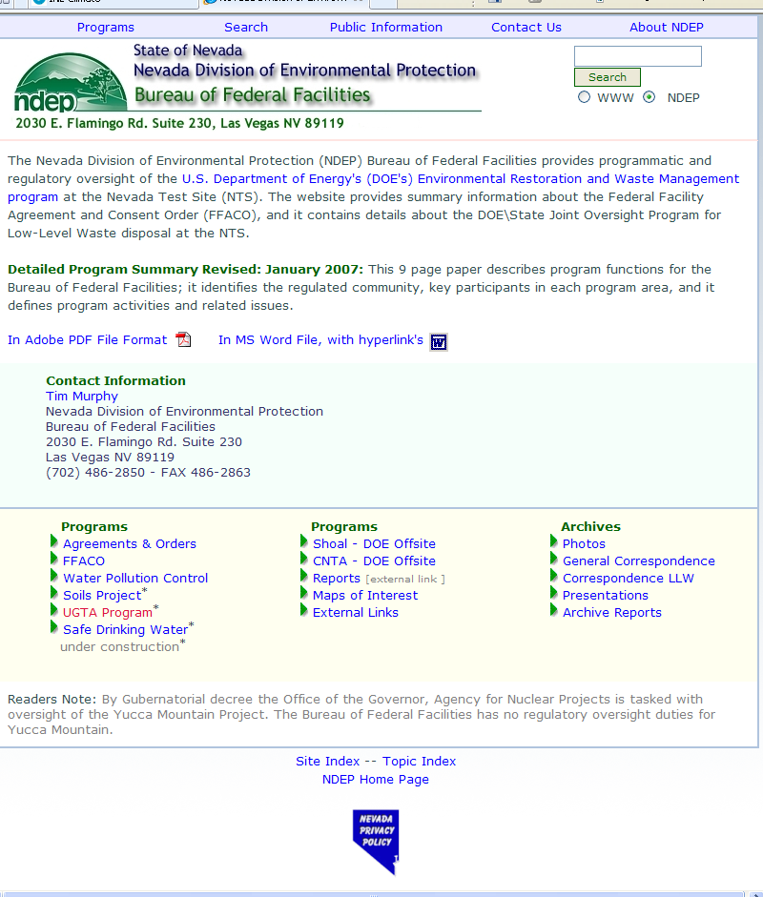
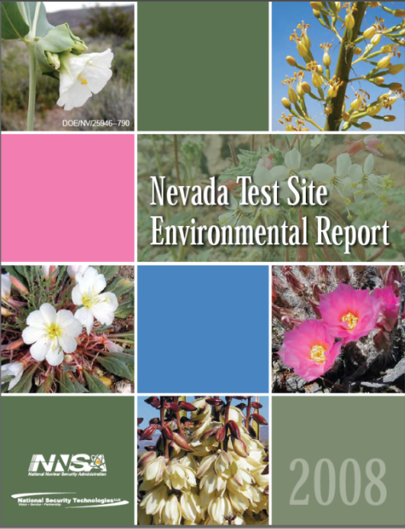
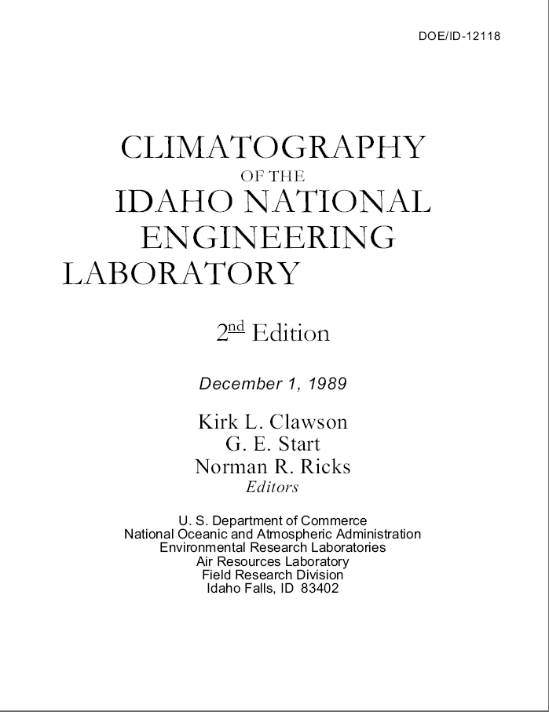
Meteorological Data Analysis
Notes:
Shown here are examples of Climatological Reports and Site Environmental Reports from FRD and SORD on the left. On the right are examples of State and Federal requirements that need meteorological data.
What We Do…
The data are processed, quality checked and assured, and archived. These data are then analyzed in many different ways depending on the customers needs. But some of the more routine
Products…
Are included in
- reports to plan activities and experiments on the sites (used for engineering design – wind loading
- Annual Site environmental Reports
- Site Environmental Impact Statements,
- Environmental Compliance requirements (Fed and State reporting) which include
- Precipitation Events (run off, ground water [wells])
- NESHAPS – National Emissions Standards for Hazardous Air Pollutants
Importance…
Maintain safe development, operation of testing and experimental facilities, and the safety of the workers, environment, and off-site populations.

Slide 10
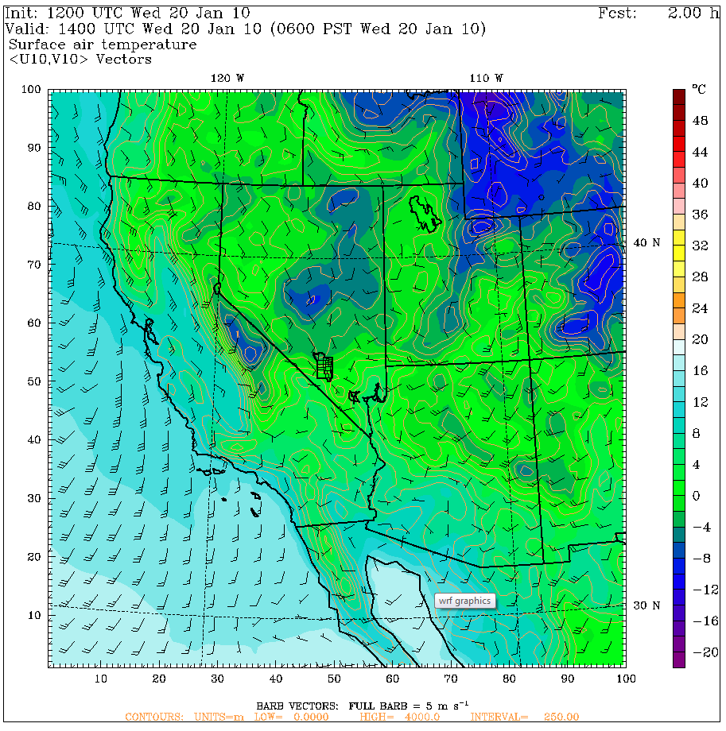
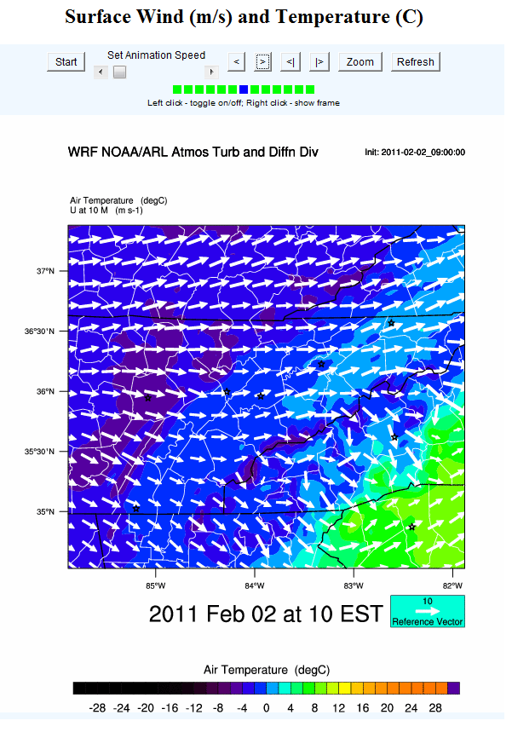
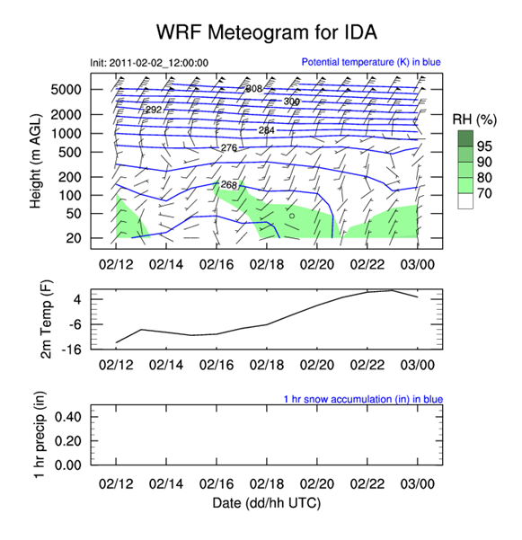
Mesoscale Weather Forecast Modeling
Notes:
10
Shown here:
(left) A forecasted meteogram (time series of weather data) from the FRD Weather Research and Forecasting (WRF) model.
(center) A southwestern US winds and temperature forecast produced by the SORD WRF model.
What We Do…
The ARL Divisions also conduct local Mesoscale modeling focusing on their particular regions and in some cases incorporate the local mesonet data.
Products…
Graphical output of weather parameters used for weather forecasting,
Importance…
The daily modeling results are used to provide products for our partners in areas such as :
Daily Forecasting
Wind fields to drive Dispersion Prediction models,
Local flight operations on the test site

Slide 11
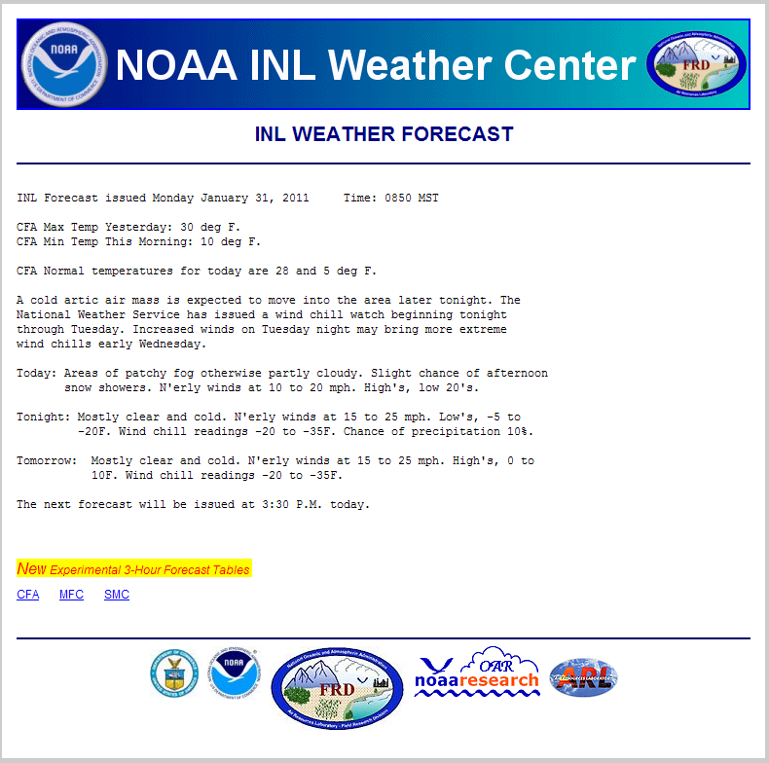
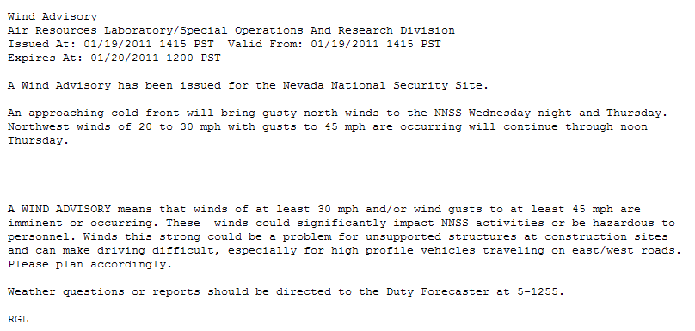
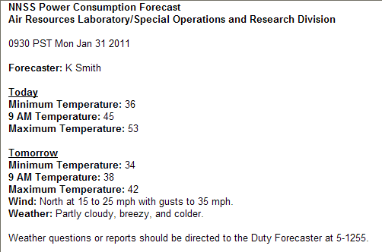
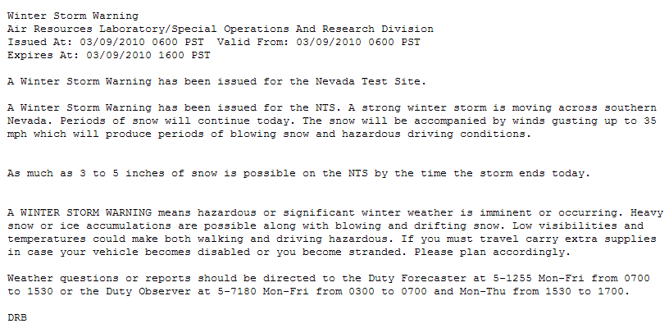
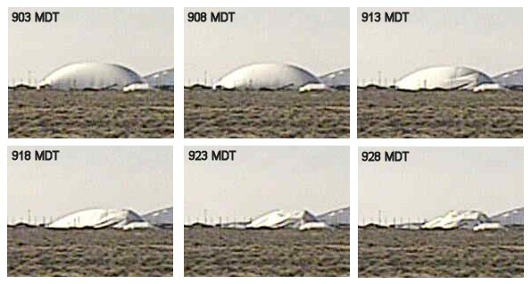
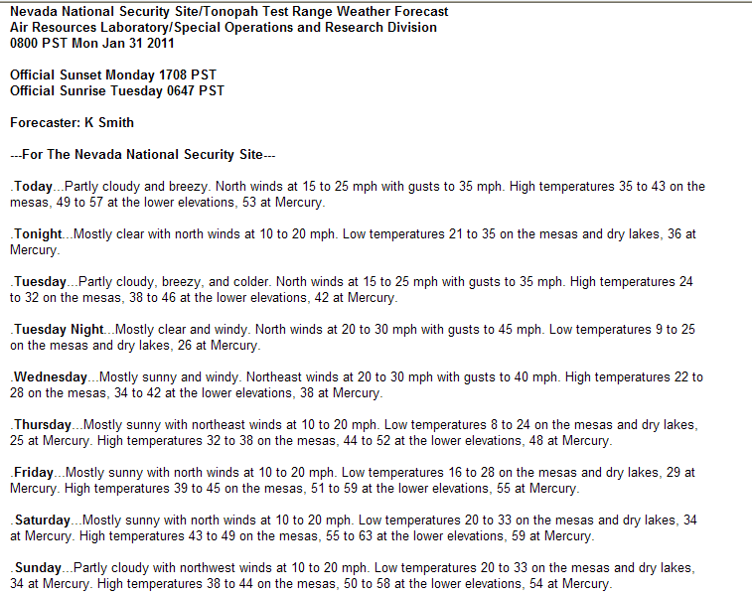
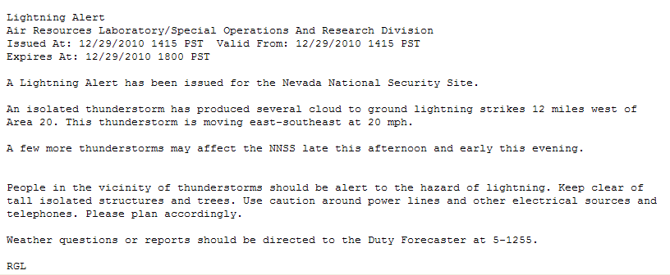
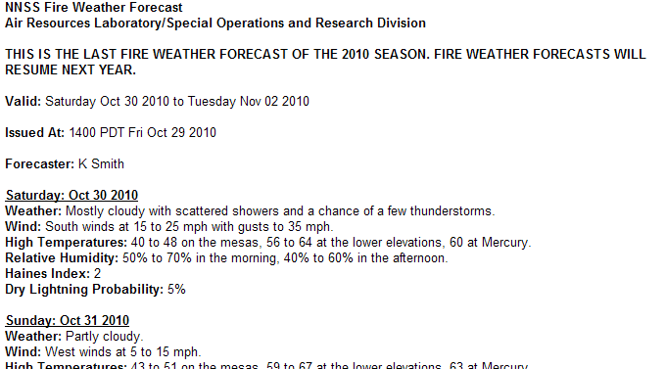
Meteorological Surveillance & Forecasting
Notes:
Shown here are examples of daily forecasts (on the left) and significant/severe weather statements (on the right) for specific DOE and NNSA facilities by FRD and SORD.
FRD wind forecasts where essential in the inflation and deflation of a large dome structure. Wind speeds were a critical component of success.
What We Do…
The mesonet data are analyzed and used in near real time for:
Products…
Site Specific Weather Forecasts for daily operational impacts
- site-wide; twice daily (M- F)
- location/event specific
- temperature forecasts for site power grid impacts, and
- Fire Weather for the site
Weather Surveillance
- Issue Site Specific Severe Weather Statements, that include
- High Winds
- Lightning
- Extreme temperatures
- Winter Weather
- Extreme Heat
- Strong Thunderstorm
Importance…
Maintain site worker and project safety, daily project planning (resources)

Slide 12
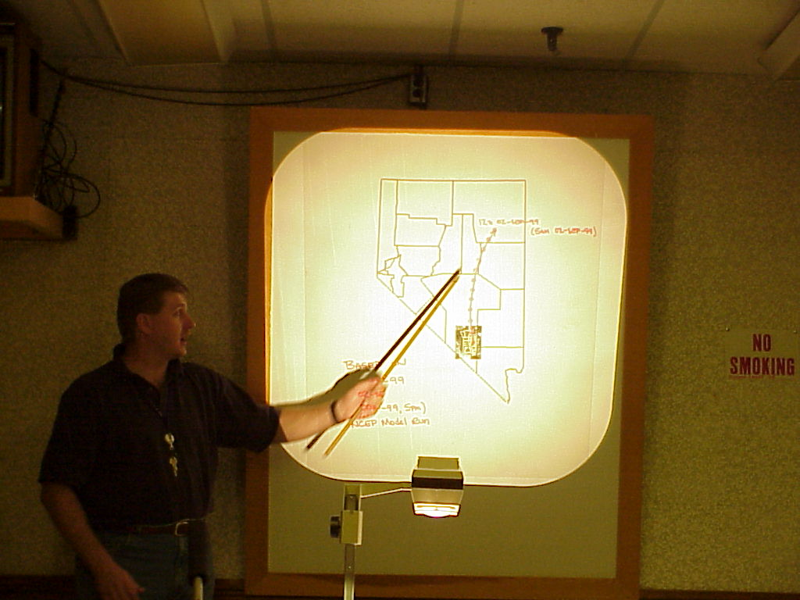
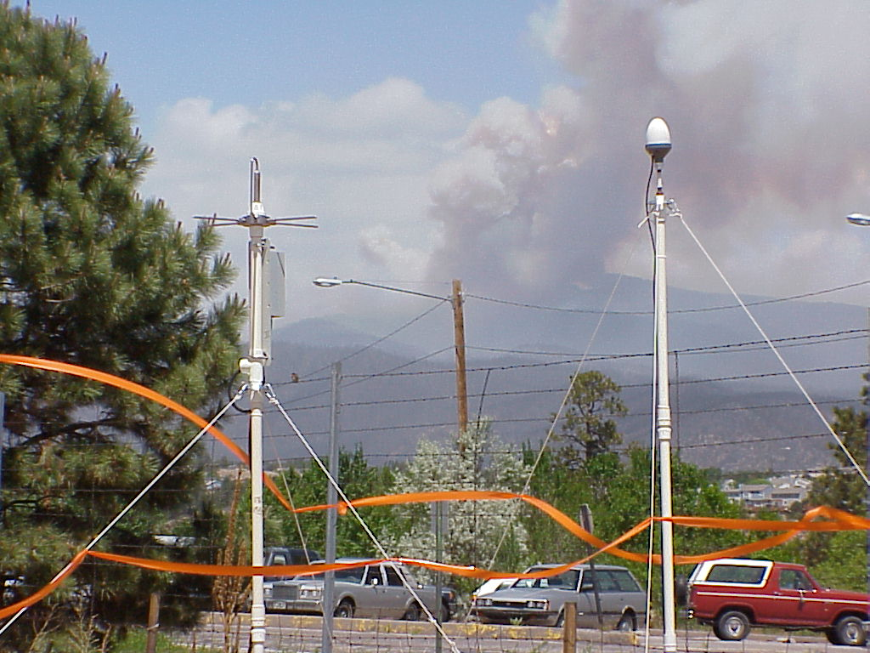
Specialized Experimental Support
Notes:
12
Many different organizations conduct experiments on the DOE sites. Some at the NNSS involve explosives of varying degree both above an below surface. The specific customer wants and needs differ as well, from where will the cloud go, to how is the atmosphere affected.
What We Do…
We work with each individual customer to determine their specific meteorological needs and tailor a package unique for their experiment;
Products…
A specific information package meeting their needs (which may have required put a weather station nearby, and a radiosonde release area; data (surface, upper-air), forecasting (very location specific), criteria for success/operations)
Importance…
Safe execution of experiment – worker and environ safety; meet or exceed experiment objectives that may have an impact on national security

Slide 13
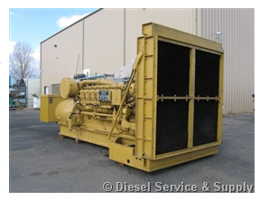
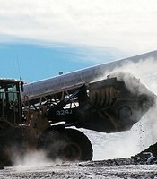
Air Quality Modeling
Permitting
AERMOD
Notes:
At the NNSS, there are many emission sources scattered all across the nearly 1400 square miles of the site. In addition, the Nevada National Security Site also has a unique capability to safely “spill” some fairly dangerous substances and study it’s dispersion, effects, etc. As such, DOE is required to obtain and maintain Air Quality permits.
What We Do…
Work with the environmental group, and take their list of sources, incorporate our mesonet data and run the AERMOD air quality model for regulatory applications
Products…
Model results document submitted to environmental group to be included as part of the permit application/renewal to the State of Nevada. Modeling is used to calculate potential off-site estimates where air quality standards are exceeded for ozone, CO2, SO2, NO2, and PM10.
Importance…
To maintain worker and site safety, to obtain and maintain permits allowing experimental and support work to continue on the site. Activities on the site should not contribute to (exceed standards) off-site air quality.

Slide 14
Specialized HYSPLIT Assessments
Notes:
14
I now want to show you some of the services provided to non-DOE
Services Provided to Others
- Specialized Hybrid Single Particle Lagrangian Integrated Trajectory (HYSPLIT) model assessments

Slide 15
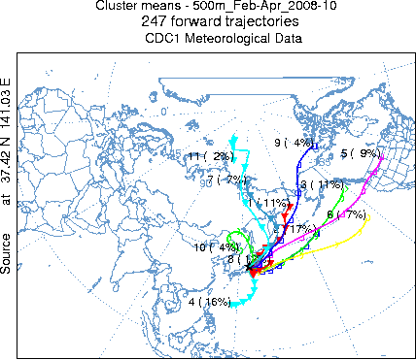
Specialized HYSPLIT assessments
Japan
- Flow Patterns
- Time of arrival
- Material spread
Notes:
15
Japan
- Flow Pattern
- Time of arrival (model and instrument related)
- Material spread
What We Do…
When contacted by a Federal organization that has specific questions relating to an accident or event, ARL applies it’s tools of meteorology data sets and models to develop an answer to the questions
Products…
Depending on what the customers needs are, results can be graphical depictions of trajectories, concentrations, dose values.
Shown here is an example of a plot of trajectories that simulate springtime (Feb-Apr) flow patterns with respect to the tragedy at the Japanese Nuclear Power Plant
Importance…
These products help in planning activities to work on the scene.

Slide 16
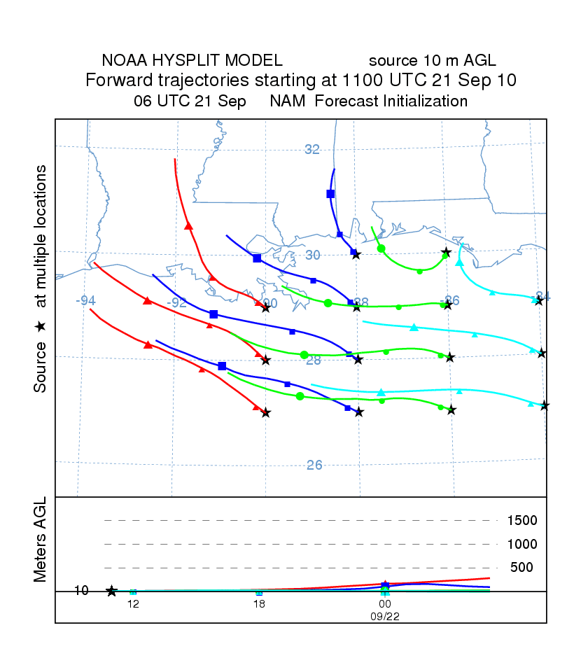
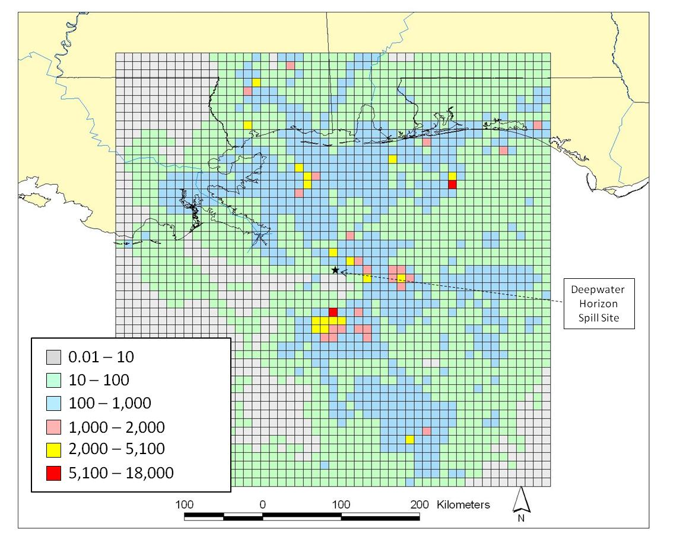
Specialized HYSPLIT assessments
Deepwater Horizon
- Odor Assessment
- Trajectories
- Dioxin
Notes:
16
Deepwater Horizon
- Odor Assessment
- Gulf Trajectories for burn planning
- Dioxin Assessment (by-products of the fires )
What We Do…
When organizations want to know where materials put into the air go, they call ARL. Based on source term information from the customer or research, and the collection of the correct meteorological data set, ARL will run the HYSPLIT model for the customers particular need.
Products…
Trajectory and concentration plots
Importance…
Health and safety of the population and wildlife, planning purposes for event mitigation and to assess different areas of concern

Slide 17
Feedback to Research
ARL Services
Expanded
applications
Increased
expertise
Lessons Learned, Data, Experience
Improved
models
Improved
tools
ARL
Dispersion
Research
Notes:
17
So far, I have talked about the services and capabilties of ARL which have been the results of years of research. Here is the second half of the picture, where what is learned in the field through the collection and application aspects of the science is feed back to the researchers so that better tools, models, methodologies can be developed for future use.

Slide 18
Feedback to ARL and NOAA R&D
HYSPLIT improvements
- improved radiological event codes
READY improvements
- Flash (web) based map interactive display
Mesoscale Modeling
- Mesonet data being used to verify WRF and HRRR model forecasts
Resources
- large areas for studies – Field Labs
Notes:
18
Here are some examples of that feedback to and successes of that research.
HYSPLIT improvements
- improved radiological event codes
To support consequence assessment better for INL, improvements to the radiological computations were necessary. HYSPLIT was upgraded with these changes.
Real-time Environmental Applications and Display System (READY) improvements
- Flash (web) based map interactive display
Work being done to improve Consequence Assessment activities to one of our customers led to the development of this product to better support them and in turn was able to be incorporated into the READY system for wider NOAA usage
Evaluation of High Resolution Rapid Refresh (HRRR) model
- Local mesonet data being used to verify
model forecasts and compare to WRF
Data already being collected for our DOE customers can be used to support another project and not have to set up a special network, this helps other OAR laboratories in their research, promotes inter-lab cooperation, and is a wise use of resources.
Resources
- large areas for studies – Field Labs
The benefit is that through these inter-agency agreements, ARL is able to take advantage of “large” field laboratories to use as test beds.

Slide 19
Future Direction
Continue current Services
- DOE
- specialized HYSPLIT assessments
Continue to take lessons learned, data, needs and feed them back into ARL and NOAA R&D
Look to new areas of research opportunities:
- NOAA/DOE Renewable Energy activities
- Fine scale wind analyses and predictions
- improve mesoscale models for the desert SW
Notes:
19
Continue current Services
- DOE
- specialized HYSPLIT assessments
Continue to take lessons learned, data, needs and feed them back into ARL and NOAA R&D
Look to new areas of research opportunities:
- NOAA/DOE Renewable Energy activities
- Fine scale wind analyses and predictions – diagnostic wind models
- the use of Unmanned Aerial Systems (UAS) - to collect atmos data
ARL finds opportunity out of events, and works with other agencies to improve dispersion and meteorological support to accomplish NOAA goals.

Slide 20
Thank you !
Notes:
20
Thank you, and I will entertain your questions.

