Slide 1
Ozone and PM_{2.5} Forecasting Research
Rick D. Saylor
Air Resources Laboratory
ARL Laboratory Review
May 3-5, 2011
Notes:
This presentation provides a brief overview of research in ARL which is focused on improving ozone and PM_{2.5} forecasting capabilities of air quality models.

Slide 2
Goal
Improve the ozone (O₃) and fine particulate matter (PM_{2.5}) forecasting capabilities of air quality models through scientifically sound improvements in model processes and model inputs.
Notes:
ARL’s air quality forecasting research directly supports the National Weather Service’s (NWS) National Air Quality Forecasting Capability (NAQFC), but also serves to advance general scientific knowledge of air quality modeling and forecasting within the atmospheric science community.

Slide 3
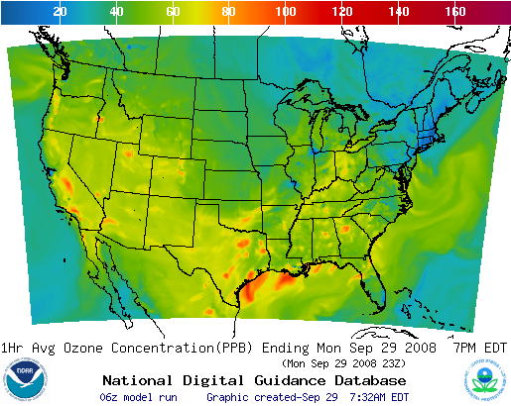
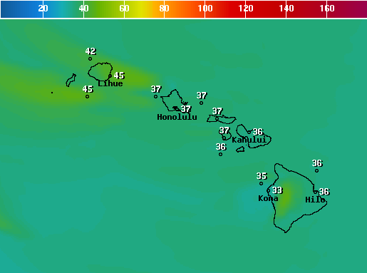
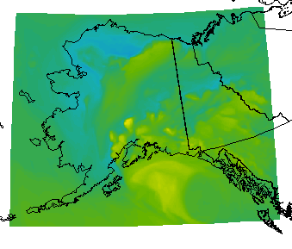
National Air Quality Forecast Capability (NAQFC) for O₃ and PM_{2.5}
Emissions
US EPA NEI anthropogenic inventories
2005 base year projected using EGU data
BEIS V3 Biogenic Emissions
Meteorological Model
North American Model (NAM) - 12 km
Air Quality Model
US EPA CMAQ v4.6 – 12 km
Operational NAQFC
48-hour O₃ forecasts available daily online
CONUS, AK and HI
Experimental/Developmental NAQFC
O₃ and PM_{2.5} for CONUS - limited availability
Operational PM_{2.5} targeted for FY2015
Tong et al. poster
Hawaii
Alaska
Notes:
The NOAA National Weather Service (NWS) National Air Quality Forecast Capability (NAQFC) is a modeling system designed to provide air quality forecast guidance for the U. S. This presentation will focus on the portion of the system (hereafter referred to as the NAQFC) which was established in 2004 to provide ground-level ozone (and eventually PM_{2.5}) forecasts for the conterminous U. S. (CONUS). The NAQFC utilizes the NWS North American Mesoscale (NAM) meteorological model run of the Non-hydrostatic Mesoscale Model (NMM) core of the Weather Research and Forecasting (WRF) system to provide forecast meteorological fields. These data drive the U. S. Environmental Protection Agency’s (USEPA) Community Multiscale Air Quality (CMAQ) version 4.6 modeling system which produces 48-hr forecast fields of ground-layer ozone mixing ratios. The CMAQ portion of the NAQFC system uses 12 km horizontal grid spacing and 22 vertical layers from the surface to 100 hPa. Emissions inputs to CMAQ use the latest available USEPA National Emissions Inventory (NEI) with electric generating units (EGUs) updated with Continuous Emission Monitoring (CEM) data and projections to the current forecast year using data from the Department of Energy’s Annual Energy Outlook. Further details of the operational NAQFC implementation and evaluations of its performance can be obtained from Eder et al. (2009), Otte et al. (2005), and Yu et al. (2010).
Eder, B., Kang, D., Mathur, R., Pleim, J., Yu, S., Otte, T., Pouliot, G.: A performance evaluation of the National Air Quality Forecast Capability for the summer of 2007, Atmospheric Environment, 43, 2312-2320, 2009.
Otte, T. L., et al.: Linking the Eta model with the Community Multiscale Air Quality (CMAQ) modeling system to build a national air quality forecasting system, Weather and Forecasting, 20, 367-384, 2005.
Yu, S., Mathur, R., Sarwar, G., Kang, D., Tong, D., Pouliot, G., Pleim, J.: Eta-CMAQ air quality forecasts for O₃ and related species using three different photochemical mechanisms (CB4, CB05, SAPRC-99): comparisons with measurements during the 2004 ICARTT study, Atmospheric Chemistry and Physics, 10, 3001-3025, 2010.

Slide 4
Approach
Daily forecast
performance evaluation
Evaluate performance of AQ model
Develop hypotheses based on performance analyses
Perform retrospective simulations
Evaluate hypotheses
Update processes or inputs to AQ model
Update as appropriate
as new CMAQ versions
are released
Long-term evaluation
Notes:
ARL has established a continuous evaluation-test-update cycle as the overall approach to guiding research efforts in air quality modeling and forecasting. NAQFC ozone and PM_{2.5} forecasting performance is monitored on a daily basis by ARL using first-cut data from the USEPA AIRNow network. A daily briefing and discussion of the modeling system’s performance allows ARL scientists to gain an initial qualitative understanding of meteorological and environmental conditions under which the model performs well or performs poorly and fosters the development of hypotheses that can be pursued by more in depth analyses. Longer-term evaluations of model performance are also carried out utilizing data from a variety of sources, including satellite measurements (e.g., MODIS, GOME, TES, etc), surface air quality measurement networks (IMPROVE, SEARCH, PAMS, etc.), and intensive field studies (ICARTT, CALNEX, etc.). Both daily and long-term evaluations of model performance generate hypotheses about model processes or inputs that may be causing model biases. Retrospective simulations are then planned and carried out by ARL to evaluate the hypotheses. These analyses then result in modifications to model processes or inputs in the NAQFC. As new versions of CMAQ are released by the USEPA, ARL performs retrospective simulations and evaluations of them to assess whether they should be incorporated into the NAQFC. Close cooperation with USEPA scientists in the Atmospheric Modeling and Analysis Division ensure that ARL research activities are complementary to their efforts and that model improvements made by ARL are available to the broader air quality modeling community.

Slide 5
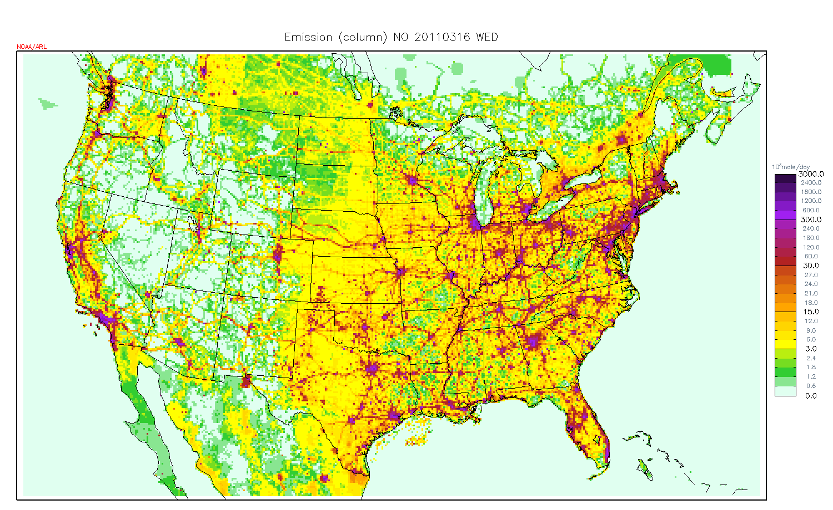
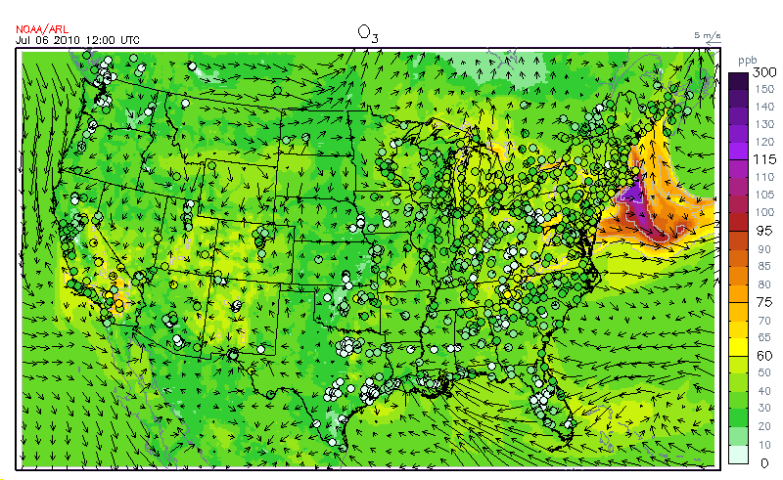
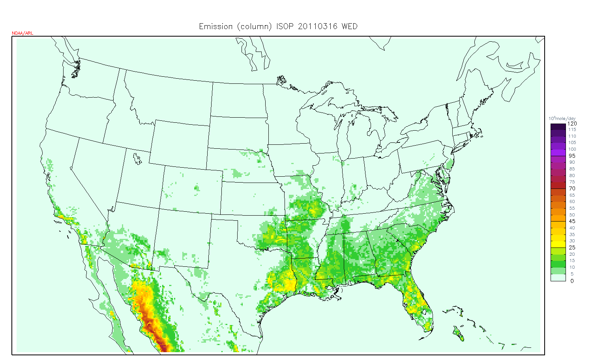
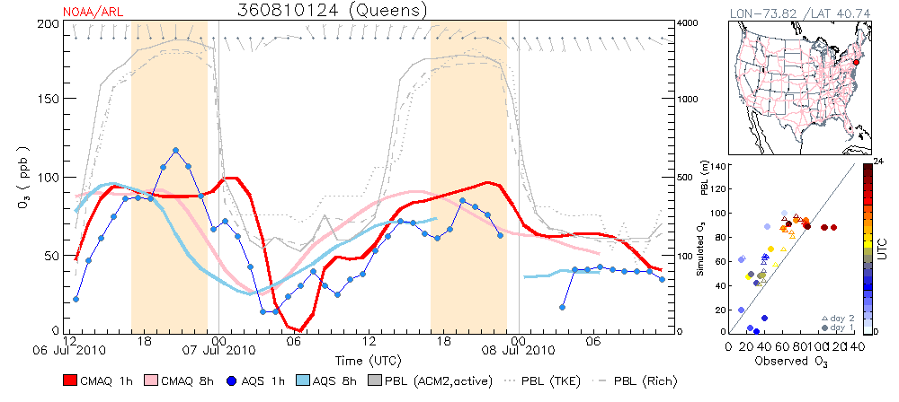
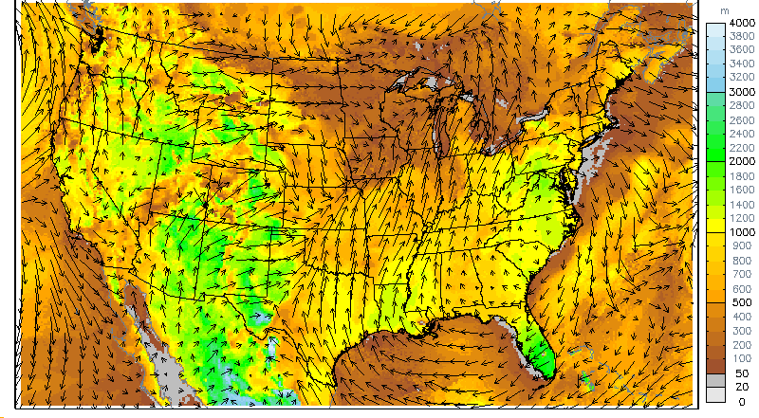
NO Emissions
Daily Forecast Discussion
Isoprene Emissions
PBL Height and Winds
Model Results vs. AIRNow Obs
Notes:
A suite of tools has been developed to facilitate ARL’s daily ozone and PM_{2.5} forecast discussion and evaluation of NAQFC, some of which are shown here. Previous-day ground-level model results are visualized and compared to first-cut AIRNow data for both ozone and PM_{2.5}. Model results can be compared to observations on an hourly basis at any operating AIRNow site, and modeled meteorological data (e.g., temperature, wind fields, or boundary layer heights) can be visualized to further understand the impact of environmental conditions on model results. These tools are all compiled on a central internal ARL website that is accessed and displayed during the daily air quality forecast briefing and discussion.

Slide 6
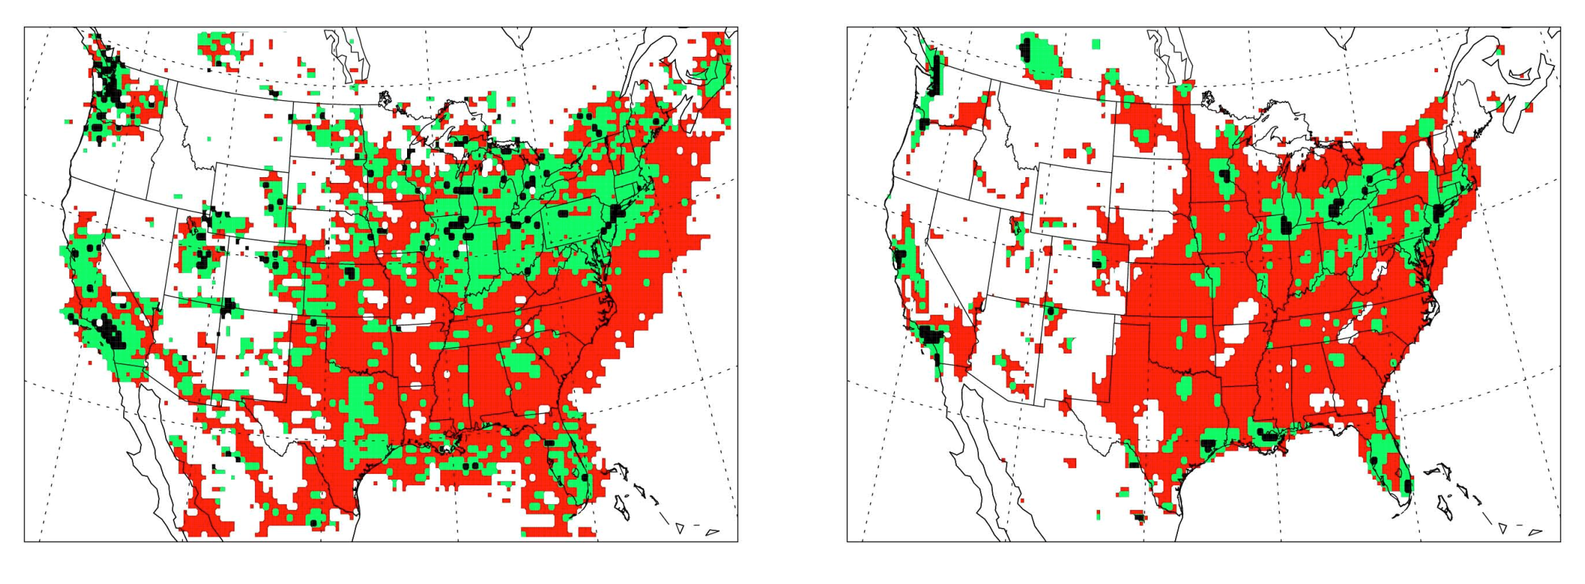

HCHO/NO₂ - August 2009
GOME-2 Satellite Data
CMAQ 4.7.1
NO_{x}-saturated
mixed
NO_{x}-sensitive
Notes:
Satellite data are also being used to evaluate NAQFC ozone simulations and help determine which model processes or inputs need to be improved. In the case shown here, GOME-2 satellite measurements of formaldehyde (HCHO) and nitrogen dioxide (NO₂) are used to test the model’s representation of ozone chemistry and differentiate NOx-sensitive vs NOx-saturated regions.

Slide 7
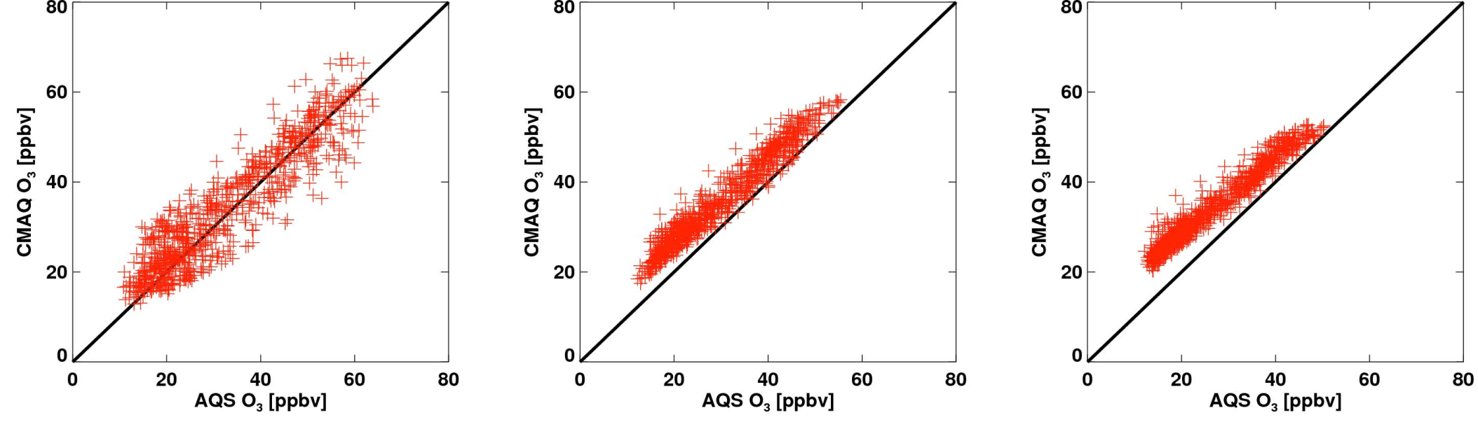
Ozone Biases by Chemical Regime
NO_{x}-saturated
mixed
NO_{x}-sensitive
Possible causes?
  Emissions
  Deposition
  Transport
  Chemistry
Choi et al. poster
Notes:
An interesting finding from this work is that the model performs well in NOx-saturated regions but has a large positive bias in highly NOx-sensitive regions. Ongoing investigations are attempting to understand these chemical-regime-dependent biases and hopefully will lead to improved overall ozone forecasts for the operational NAQFC.

Slide 8
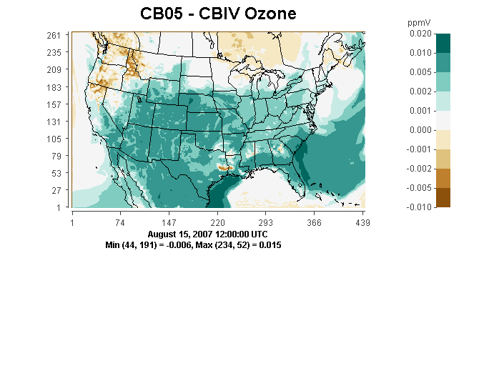
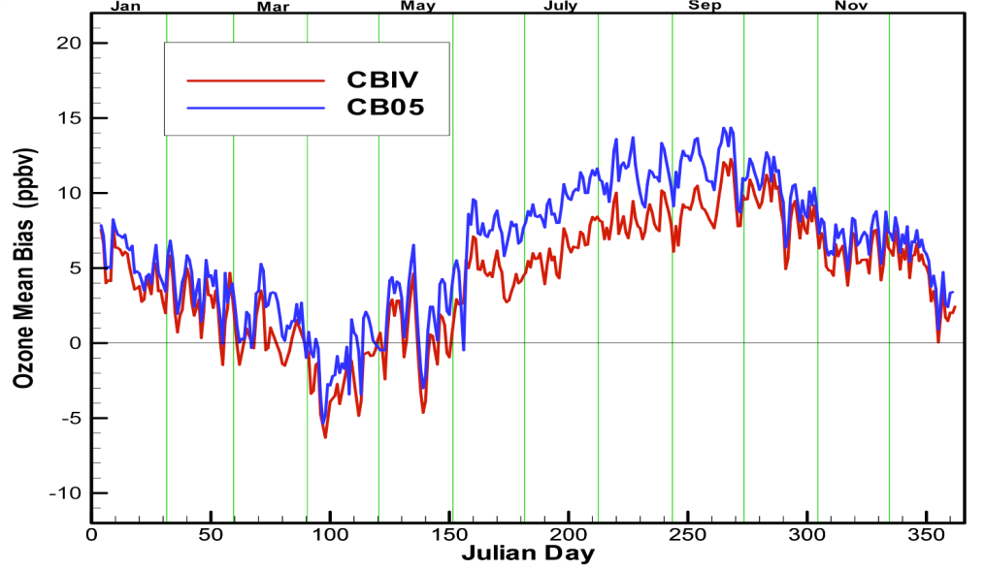
Additional NO_{x} Recycling Reactions of CB05 Produce Higher Ozone than CBMIV
NTR + OH → HNO₃ + HO₂ + 0.33 HCHO + 0.33 ALD2 + 0.33 ALDX
NTR + hν → NO₂ + HO₂ + 0.33 HCHO + 0.33 ALD2 + 0.33 ALDX
HO₂NO₂ + hν → 0.61 HO₂ + 0.61 NO₂ + 0.39 OH + 0.39 NO₃
HNO₃ + hν → OH + NO₂
N₂O₅ + hν → NO₂ + NO₃
Saylor et al. O₃ poster
Notes:
Another ARL investigation has focused on chemical mechanism differences between the operational and experimental versions of the NAQFC. The experimental NAQFC uses the Carbon Bond Mechanism version 2005 (CB05) as its gas-phase chemical mechanism, whereas the operational NAQFC uses an older version of the Carbon Bond Mechanism version IV. Even though both NAQFC versions use identical meteorological data, the same base emissions inventory, and similar boundary and initial conditions, the CB05 version of NAQFC consistently produces higher ground-level ozone concentrations. The investigation conducted by ARL scientists focused solely on mechanistic differences between the two systems and determined that the additional NO_{x} recycling reactions that were included in CB05 but are absent from CBMIV are the primary reason for the higher concentrations produced by the experimental NAQFC. The better agreement of the operational NAQFC ozone concentrations with AIRNow observations is thus likely due to unknown compensating errors that must be uncovered and corrected in future investigations.

Slide 9
Seasonal Biases of NAQFC
PM_{2.5} Forecasts
Saylor et al. PM_{2.5} poster
Comparison of Speciated PM_{2.5} Measurements with Model Forecasts
Notes:
Ground-level total PM_{2.5} concentrations from the NAQFC system exhibit seasonal biases with respect to measurements with substantial overprediction during fall, winter and spring and underprediction during the summer. Ongoing comparisons between model predictions and speciated PM_{2.5} measurements from the IMPROVE (Interagency Monitoring of Protected Visual Environments) and SEARCH (Southeastern Aerosol Research and Characterization study) networks have indicated areas where both model processes and model inputs need to be improved to lessen the seasonal biases of the NAQFC. In combination with the daily forecast evaluations, these in-depth comparisons with network data allow ARL scientists to obtain a better understanding of which model inputs and processes need to be improved to lessen the model’s seasonal biases.

Slide 10
Evaluation of the CMAQ aerosol module with smog chamber data
Stein et al. poster
Collaboration with CIEMAT (Research Center for Energy, Environment and Technology) Madrid, Spain
Notes:
Another PM research pathway being pursued in ARL is comparison of CMAQ PM module results with smog chamber data of secondary organic aerosol (SOA) formation. This work is being done in collaboration with scientists from the Research Center for Energy, Environment and Technology (CIEMAT) in Madrid, Spain, and allows the evaluation of the chemical and aerosol modules of CMAQ which are related to SOA formation. These analyses may lead to modifications of CMAQ that will improve future PM_{2.5} products from the NAQFC.

Slide 11
Future Model Improvements
Anthropogenic emissions
  New national inventories (NEI 2008), update surrogate inputs
Incorporation of near real-time fire emissions
  Remove climatological fire emissions
Improvements in fugitive dust emissions
  Seasonal variation, transportable fraction
Develop tighter linkages between NAM and CMAQ
  Grid and dynamics, input datasets (e.g., LULC)
  Tighter coupling of NAM data to CMAQ model processes
  Better linkage to surface conditions (e.g., snowcover, soil moisture)
Update CMAQ PM module
  Additional SOA precursors, nonvolatile SOA, updated thermodynamics
Chemical data assimilation
Chai et al. poster
Notes:
The research activities that the air quality forecasting group has performed over the past two years have indicated a clear path to further work that should lead to improvements in both ozone and PM_{2.5} forecasting capabilities. One overall theme is that tighter links need to be developed between the meteorological model and CMAQ, in particular with a common grid system, input datasets and better use of NAM data in CMAQ model processes. Anthropogenic emissions, of course, need to be continually updated and the upcoming 2008 version of the National Emission Inventory from EPA will be an important part of that effort, as will the continuing effort to update surrogate inputs to the emissions modeling system. The closer linkage of meteorological data from NAM with biogenic emissions algorithms should help to improve both ozone and PM_{2.5} forecasting products, in particular linking surface conditions as simulated by NAM with actual emissions introduced into the system. The developmental NAQFC will soon be updated with the latest version of the CMAQ PM module which should help to better simulate SOA formation and provide better seasonality for the organic matter component of PM_{2.5}. Proposed improvements in the algorithms for fugitive dust emissions should help to lessen wintertime PM_{2.5} biases. Also, the removal of NEI climatological fire emissions and replacement of them with near real-time fire emissions estimates based on satellite data should also help to improve the PM_{2.5} forecasting capabilities of the NAQFC. A longer term project of the air quality group is research in the area of chemical data assimilation, which in the future may provide improved forecasting products for both ozone and PM_{2.5} by assimilating near-real-time chemical and PM data into the forecast simulations.

Slide 12
Indicators of Success
Successful transition of new knowledge and data to the NAQFC
Publications
  Recent papers in peer-reviewed journals
    Atmospheric Environment, Journal of Geophysical Research, Journal of Applied Meteorology and Climatology
  Invited seminars and review articles
Analysis tools and methods
  Emissions Quality Control (mechanisms, source sectors, domains)
  Daily AQ analysis graphics (meteorology, emissions, air quality)
  Statistical and GIS-based analysis tools
Improved modeling techniques and input data
  Improved process algorithms
  More accurate model inputs (LULC, surrogates, vegetation, …)
Notes:
The primary indicator of success for the air quality forecasting research in ARL is the successful transition to the NAQFC of the new scientific knowledge, data and models that are developed as a result of the research. But also, success is defined as the dissemination of the group’s research to the general air quality modeling community in the form of journal articles, seminars, and conference presentations, as well as in the development of improved analysis tools, modeling techniques and input data sets.

Slide 13












Collaborators
Earth System Research Laboratory, NOAA
NESDIS, NOAA
Notes:
Collaborators of the air quality group include other NOAA laboratories, other federal agencies, especially the EPA’s air quality modeling group, where there is a very close working relationship, state agencies and universities. All of these collaborations are important to the success of the air quality group’s research and the dissemination of our research results to the broader community.

Slide 14
Related Posters
Emission Modeling for the National Air Quality Forecasting Capability (NAQFC),
D. Tong, et al.
Using Smog Chamber Data to Improve the Understanding of SOA Formation,
A. Stein, et al.
Improving NAQFC O₃ Predictions Over Remote Sensing Derived Chemical Regimes, Y. Choi, et al.
Identifying the Causes of Differences in Ozone Production from the CB05 and CBMIV Mechanisms, R. Saylor et al.
Comparison of NAQFC PM_{2.5} Speciation with IMPROVE and SEARCH Data: Initial Findings, R. Saylor et al.
Chemical Data Assimilation: Integrating Atmospheric Chemistry Observations into Air Quality Modeling, T. Chai et al.
Notes:
Further details about the scientific investigations briefly mentioned in this presentation can be found in six posters.

