Slide 1
Strengthening NOAA Science:
So What Does This Actually Mean For NOAA Scientists?
Paul A. Sandifer, Ph.D.
Senior Science Advisor to the NOAA Administrator & NOS Chief Science Advisor
May 3, 2011

Slide 2
Presentation Outline
Dr. Lubchenco’s commitment to strengthening NOAA science – Science underpins all that NOAA does!
Workshop on Strengthening NOAA Science (April 2010) – output, impacts, follow-on
NOAA’s scientific workforce
Scientific Integrity and Conduct Policy – in progress
Questions

Slide 3
Strengthening Science Goal
Strengthening NOAA science is a process that involves engaging NOAA’s scientists and science managers and our external partners in answering four key questions:
  What are the grand challenges for NOAA science?
  What are the best practices for encouraging, promoting, and protecting healthy science at NOAA?
  How can NOAA’s science elements be better connected and coordinated across Line Offices and with external partners to support the agency’s mission?
  How can NOAA implement a process for continual evaluation, enhancement, and celebration of its science?
Notes:
Dr. Lubchenco sees strengthening NOAA science is a process that involves engaging NOAA’s scientists and science managers and our external partners in answering four key questions:
What are the grand challenges for NOAA science?
What are the best practices for encouraging, promoting, and protecting healthy science at NOAA?
How can NOAA’s science elements be better connected and coordinated across Line Offices and with external partners to support the agency’s mission?
How can NOAA implement a process for continual evaluation, enhancement, and celebration of its science?
NOAA

Slide 4
Strengthening Science Goal
Ensure that NOAA has a world-class internal scientific workforce (with supporting infrastructure) that is recognized widely for intellectual capacity, creativity, and innovation and that partners seamlessly and routinely with the external scientific community to support NOAA’s science, service, and stewardship mission.
Notes:
Our goal for strengthening science is…

Slide 5
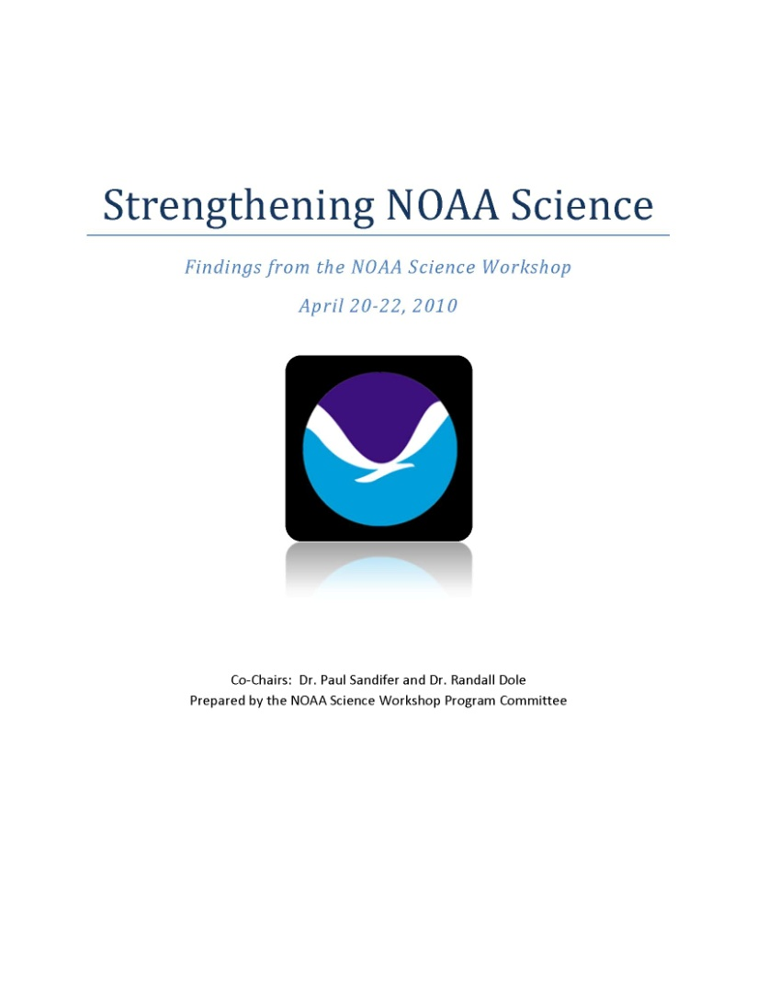
Workshop on Strengthening NOAA Science (April 2010)
  What are the most critical science challenges for NOAA over the next 5 to 20 years?
  What are opportunities and practical steps for improving how NOAA conducts science?
Notes:
We took a major step in engaging the NOAA science community last year with the first of it kind Workshop on Strengthening NOAA Science. This workshop brought together over 70 NOAA scientists and science managers to address two questions…

Slide 6
Overarching Grand Challenge: Understanding The Connections
Develop and apply holistic, integrated Earth system approaches to understand the processes that connect changes in the atmosphere, ocean, space, land surface, and cryosphere with ecosystems, organisms, and humans over different scales.
This Grand Science Challenge is central to addressing Dr. Lubchenco’s Grand Societal Challenge:
Improve Human Well-Being While Restoring The Planet’s Life Support System
Notes:
To open the workshop, Dr. Lubchenco challenged us with what she sees as society’s grand challenge. Our task was to identify NOAA’s grand science challenge. And we did. Over the course of a day, inspired by science challenge presentations by our colleagues, we came up with NOAA’s grand science challenge: “develop and apply holistic…”

Slide 7
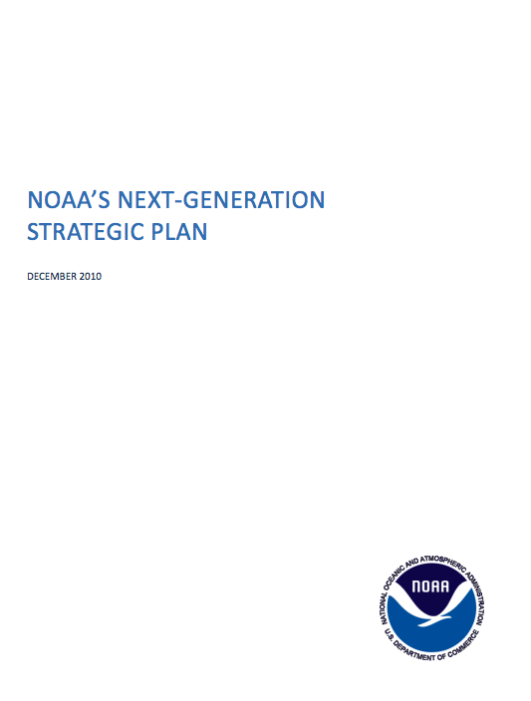
Science Workshop - Impacts
  NGSP incorporated Workshop science challenges & business practice recommendations
  Directly influenced the Administrator’s Annual Guidance Memo
  Reflected in the FY12 and onward budget planning
  Set stage for continued participation of NOAA scientists in setting agency science agenda

Slide 8
Science Workshop – Follow-Up
  Research Council planning 4 additional science workshops:
    Climate (OAR Lead)
    Water Cycle (NWS Lead)
    Ecosystems (NOS/OAR Lead)
    NOAA’s Impact on Society (Social Science Committee Lead)
Notes:
Research Council will be the “home” for continuing the Strengthening Science activities – including more workshops, drafting of science-related NOAA Administrative Orders, preparation of 5- and 20-year research plans, monitoring and evaluation of NOAA science, and celebration of NOAA science.
All of these next workshops are expected to involve representatives of the external community.

Slide 9
NOAA’s Scientific Workforce
Doubling number of ST/SL positions at NOAA
Developing science career track
Senior Level

Slide 10
Scientific Integrity & Conduct Policy - Work in Progress
The NOAA policy is designed to ensure a culture of transparency, integrity, and ethical behavior in NOAA; it will cover all employees – political, career, Federal, contract.
The NOAA policy states that our core values are transparency, traceability, and integrity.
NOAA scientists are encouraged and expected to publish their data and findings.
NOAA scientists are free to speak with the media on scientific and technical matters based on their official work, no prior approval required.
Internal “Scientific Integrity Commons” website being developed for all scientific integrity, conduct, and ethics training information, FAQs, etc.

Slide 11
So, What Does “Strengthening Science” Mean For NOAA Scientists?
NOAA’s science is the most important foundation block for the agency and all it does.
NOAA will consult and involve NOAA staff scientists at all levels in discussions of how best to accomplish the agency’s mission – opinions of scientists are highly valued!
NOAA expects and encourages scientists to communicate their results freely, without interference.
NOAA requires its scientists to meet the highest standards of ethics, scientific quality, leadership, and productivity.
NOAA is working to enhance its scientific enterprise by recruiting and retaining the best and brightest and establishing career opportunities and policies that encourage scientists to stay engaged in research, producing the science NOAA needs.
Notes:
It means that:
NOAA’s science is the most important foundation block for the agency and all it does.
NOAA will consult and involve NOAA staff scientists at all levels in discussions of how best to accomplish the agency’s mission – opinions of scientists are highly valued!
NOAA expects and encourages scientists to communicate their results freely, without interference.
NOAA requires its scientists to meet the highest standards of ethics, scientific quality, leadership, and productivity.
NOAA is working to enhance its scientific enterprise by recruiting and retaining the best and brightest and establishing career opportunities and policies that encourage scientists to stay at the bench, producing the science NOAA needs.

Slide 12
Strengthening NOAA Science:
So What Does This Actually Mean For NOAA Scientists?
Questions?

