Slide 1
Urban Meteorology
Will Pendergrass
Air Resources Laboratory
ARL Laboratory Review
May 3-5, 2011

Slide 2

“A weather-ready nation is a society that is able to prepare for and respond to environmental events that affect safety, health, the environment, economy, and homeland security. Urbanization and a growing population increasingly put people and businesses at greater risk to the impacts of weather, water, and climate-related hazards …”
NOAA’s Next-Generation Strategic Plan, 2010
Notes:
NOAA’s Next-Generation Strategic Plan, 2010 recognizes the potential for extreme weather impacts due to urbanization.

Slide 3
GOALS
Improved parameterizations to help models perform better over complex urban areas!
  Improving parameterizations means collecting representative measurements! Long term record is needed to address the many complex temporal and spatial issues related to urban meteorology
Notes:
The urban atmospheric boundary layer has a complicated three-dimensional structure with a dynamic range of spatial and temporal scales making it difficult to comprehensively describe. A valid question is whether the urban environment ever reaches the steady-state conditions assumed by meteorological and atmospheric dispersion models.
The current state-of-the-science imposes a necessarily simplistic view of the urban complex. In the horizontal, urban environments are characterized by multiple distinct changes in roughness and thermal surface properties. In the vertical, the lowest distinct layer of the urban boundary layer, that ranges from the ground to roughly the average height of the roughness elements (buildings), is referred to as the urban canopy. This layer is often associated with urban street canyons. Above the canopy layer, there is a transition layer, called the roughness sublayer, which extends to the inertial layer. It is within this initial layer that standard gradient profile techniques apply. As with vegetative canopies, the depth of the roughness sublayer can vary widely.
The lowest layers of the atmosphere are in direct contact with where people work, play, live. We need to understand atmospheric flow behavior over various topologies, especially over populated regions! Research into the micrometeorology of the urban boundary layer fits well with ARL’s historical role of extending our understanding of the PBL and atmospheric dispersion to non-uniform, non-homogeneous, non-steady state environments. Improving PBL parameterizations starts with a foundation of representative measurements (both spatially and temporally representative).
ARL’s urban research addresses the extension of micrometeorological relationship through the roughness sublayer. What are the important temporal and spatial scales within urban environments? How do these scales relate to mesoscale model parameterization schemes? Given logistical issues with conducting meteorological observations in urban environments, can representative mean and turbulence winds and temperature measurements be conducted within an urban environment? While this last question is a much debated issue, the answer is a qualified yes.

Slide 4
Approach
DCNet Urban Testbed
“Urban Test Bed: A multifunctional infrastructure that provides multi-year continuous measurements and archival of environmental data, across a metropolitan area and through the atmospheric boundary layer, supporting improvements in a range of activities from scientific research to user applications”
FCMSSR/Joint Action Group for the Joint Urban Test Beds (JAG/JUTB)
Notes:
The DCNet is a ARL research meteorological monitoring network designed as a prototype urban testbed. The urban monitoring system was proposed in 2003 in response to a data call from NOAA concerning meteorological aspects of the events of September 11th. The questions asked were simply “how many?”and “where to install?” urban meteorological monitoring stations, in order to provide first responders with accurate, timely, and appropriate transport and dispersion information. The first DCNet stations (Herbert Hoover DOC Building, National Academy of Sciences, NOAA SSMC#3, and Navy Annex) were installed in the fall of 2003. This slide contains a photograph of the first DCNet station located on the roof of the Department of Commerce (HCHB).
Coupled with the testbed questions of adequate levels of meteorological monitoring in urban environments, the DCNet system was established as a baseline NOAA system to address questions on the utility of using other meteorological observation systems to address urban dispersion issues. Beginning 2006, ARL initiated the UrbaNet program with AWS Weatherbug. Four DCNet stations were collocated AWS Weatherbug monitoring sites. The first two years of the program provided direct evaluation of AWS Weatherbug UrbaNet urban monitoring locations. Under the UrbaNet program AWS Weatherbug upgraded site instrumentation, sampling protocols, siting, and QA/QC to comply with NWS ASOS requirements.
While many want to reject non-NWS observations, the AWS UrbaNet stations have been shown to provide reasonable spatial coverage for many urban areas.

Slide 5
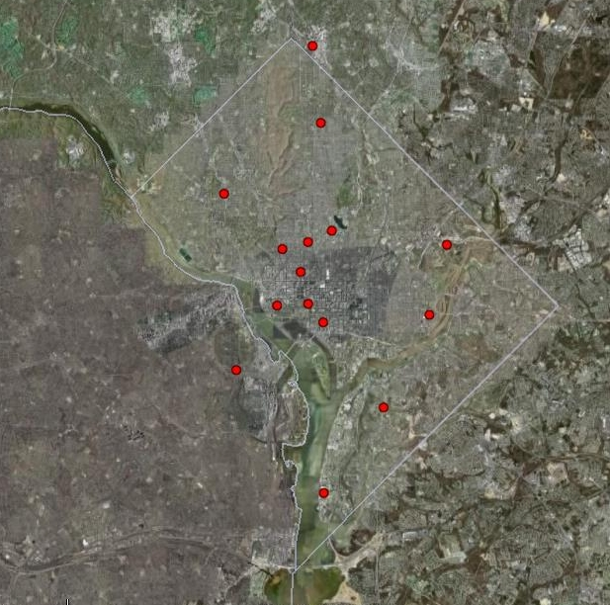
Current
DCNet Stations
2 km
5 km
Notes:
Currently there are 17 DCNet meteorological observation sites operating within the National Capital Region (NCR). If you count dots on the map, there are two sites on the Hoover building. As part of the urban testbed program, ATDD operated two DCNet style stations in New York City (Times Squares and Manhattan) for five years before transferring the New York stations to the Department of Homeland Security.
This slide also indicates a select set of partners. Before the transition to provision of DCNet data through NOAA's MADIS system, ATDD logged approximately 400 active users of the DCNet data on the ATDD data distribution system. Unfortunately, with public dissemination of DCNet data through MADIS, ATDD no longer has the ability to track users with a few notable exceptions. Perhaps our most active partner has been the Pentagon. Miss a reporting period and we get a phone call. The DCNet data is included in the meteorological driving data for the Pentagon Force Protection Agency's (PFPA) Pentagon Shield. Other examples of continued external use of the DCNet data include NRL ingestion of DCNet data within its sub-km National Capital Region (NCR) model. DCNet data is coupled with the DC Metro Protect system, NAS and the Arboretum provide local site data through a kiosk, … etc.
In the future, ATDD plans to reduce/expand the number of observations sites with a specific focus on the urban core. The modification of the DCNet network has been precipitated for a number of reasons. A number of research locations, for example the National Arboretum and NOAA SSMC#3, have seen significant urban growth (building and trees) complicating data analysis. These sites have been scheduled to be dismantled in order to re-locate the systems. In the future, ATDD intends to focus on maintaining measurements with the NCR urban-core and development of a vertical monitoring capability on the C-SPAN tower.

Slide 6
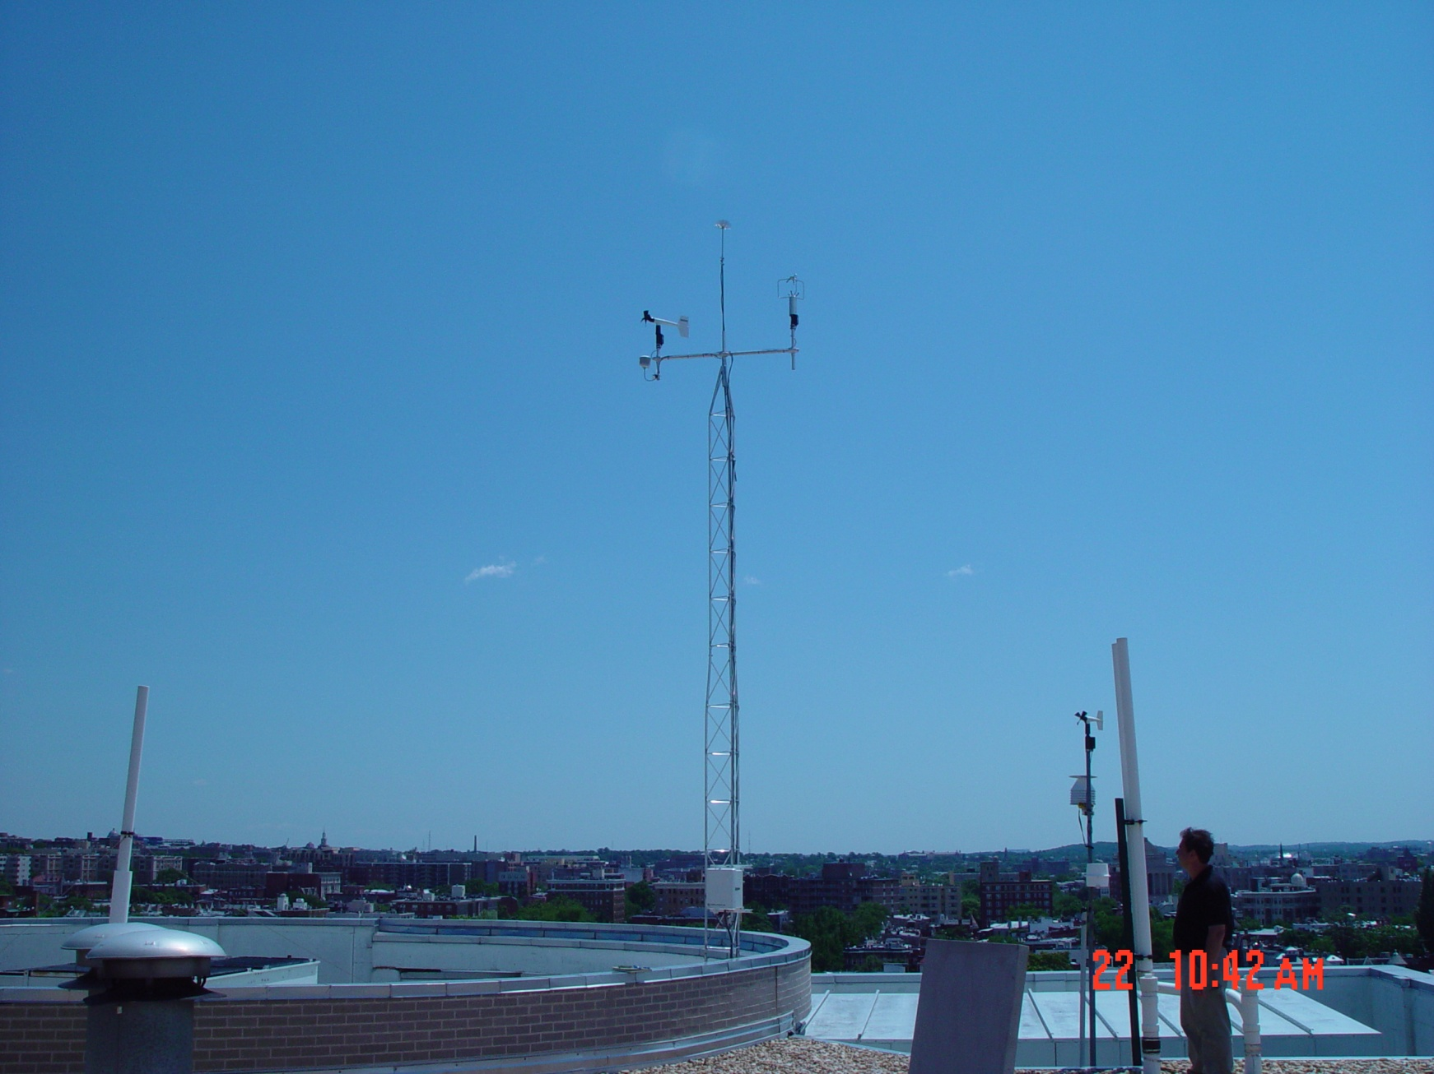
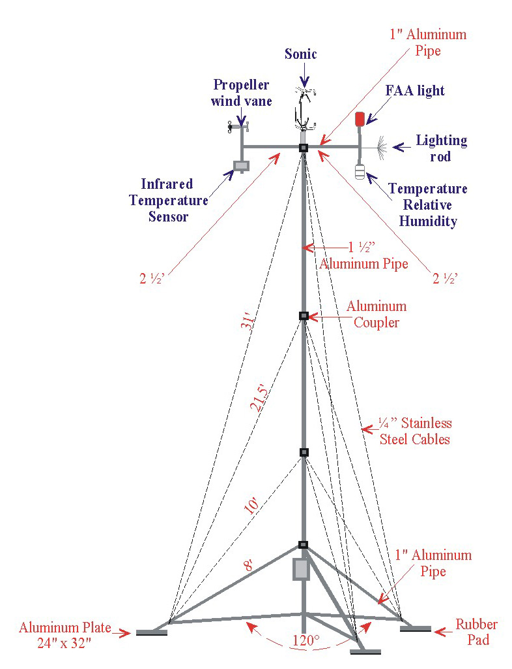
Urban Observations
Notes:
Each station is instrumented with a RM Young model 81000 sonic anemometer for retrieval of three component winds - both mean, variances as well as cross-products winds and temperature (u,v,w,t) are acquired. The sonic anemometer wind measurement is supplemented with a standard RM Young prop/vane anemometer. Ambient temperature measurements are obtain using the three aspirated PRT's measurement system designed for the Climate Research Network (CRN). Measurements are located at a nominal 10m above the local rooftop and sited to avoid local obstructions.
Campbell Scientific CR1000 dataloggers operating an ATDD developed flux program collect data at 10Hz, transmitting 15-minute averages and variances through a Verizon cellular network to the central DCNet data archives located at ATDD in Oak Ridge, TN. DCNet mean wind and temperatures are pushed to the NOAA MADIS system every 15 minutes.

Slide 7
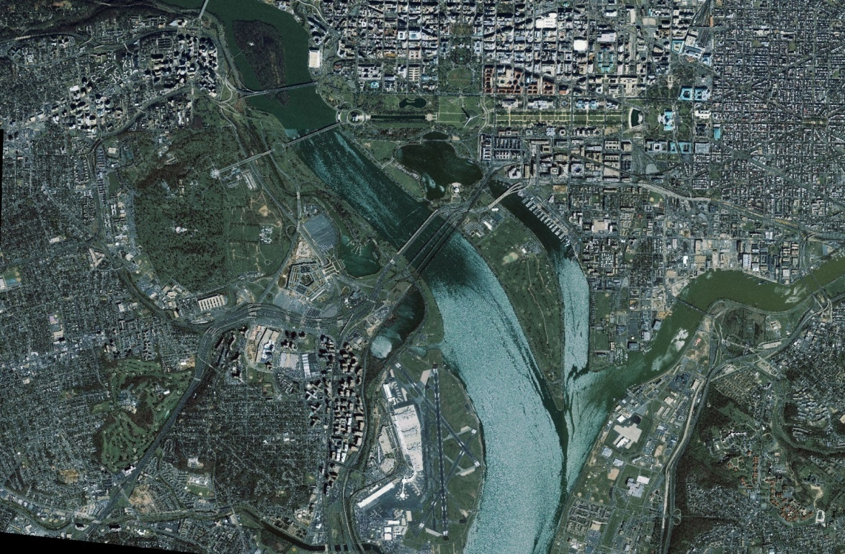
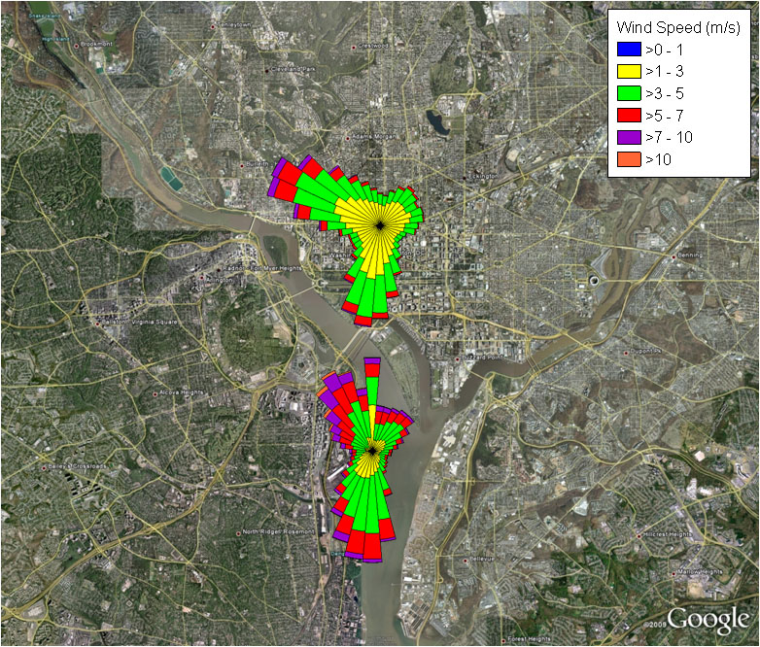
Representative
Observations
Notes:
The dispersion community has a long history of using climatology models to conduct dose and risk assessments for both chemical and radiological atmospheric releases. For example, the EPA's CAP-88 and AIRDOSE-PC are specifically approved in 40 CFR 61 for determining radiological compliance as well as developing lifetime cancer risks. The EPA's CAP88 and AIRDOSE risk assessment models are probability based, in which local NWS weather data are extracted to develop frequency based transport winds and atmospheric stability. Risk assessments are tied to how well the input meteorological data represents transport and dispersion environments.
This slide contains an update to a set of early DCNet analyzes. The upper left-hand plot has been included in NOAA Congressional briefings to illustrate the obvious difference between local airport and urban core winds and need for comprehensive urban observations and modeling. The right-hand slide confirms the early indication of directional shift between the DC urban core and that from the Reagan National Airport.
It should be noted that almost all sabotage/terrorist assessments for the NCR region have relied on the Reagan National or Dulles Airport data. Follow the 9/11 attacks, the local airport observations were the only credible available input data. Nothing is wrong with the National Airport data; it simply reports the prevailing winds which follow the channeling of the Potomac River but do not reflect the urban core.
(CAP88-PC Version 3.0 User Guide, 2007).

Slide 8
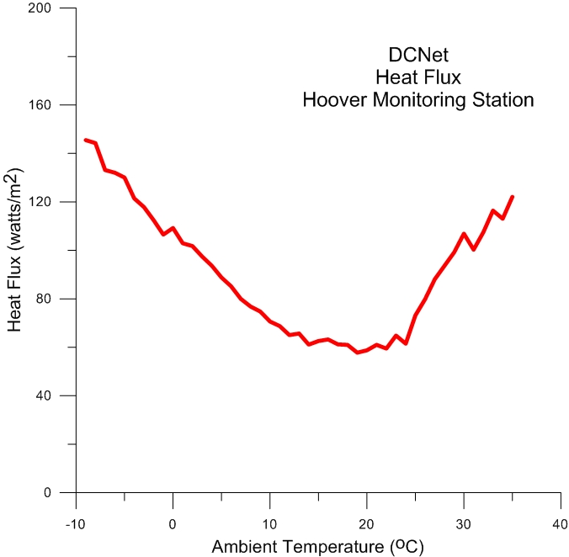
Nocturnal
Sensible
Heat
Flux
Anthropogenic
Contribution
Notes:
Urban canopy models vary from one level one way energy transfer to very complex systems in which knowledge of heat transfer is required from all building surfaces. These models require detailed information on the building structure, design materials, HVAC operating characteristics, energy conservation, etc. Grimmond et al, 2009 reviewed 33 urban canopy models ranging from simple slab models to complex system integrating local vegetation and complex building energy balance systems. Regardless of the sophistication of the urban canopy model, there are significant requirements for various energy balance components - heat flux from sun facing walls, heat flux from shadow walls, sidewalk heat flux, roadway heat flux, heat flux from building roofs, anthropogenic heat input... In most cases very limited to no data exists to support energy closure. In all cases detailed knowledge is needed simply for the suite of structures involved. In addition, the myriad of energy balance components are time varying.
This plot shows measured nighttime heat flux (w't') for the Hoover building as a function of ambient temperature. The rise of heat flux with increased ambient temperature is expected with increased daytime energy storage; however, note the significant increase in heat flux at lower temperatures. We expect that the increased heat flux is due to heat loss from the Hoover building. This trend is not shown in observations over the newer, more energy efficient DOE Forrestal building.
We are trying to obtain energy use data for the Hoover building to couple historical energy use data with the heat flux curves should allow long range forecasting of specific energy demands for Hoover. It also indicates the significant potential for energy savings.
Urban Surface Energy Balance Models: Model Characteristics and Methodology for a Comparison Study Meteorological and Air Quality Models for Urban Areas 2009, Part 4, 97-123, DOI: 10.1007/978-3-642-00298-4_11
The International Urban Energy Balance Models Comparison Project: First Results from Phase 1, C. S. B. Grimmond, M. Blackett, M. J. Best, J. Barlow, J-J. Baik, S. E. Belcher, S. I. Bohnenstengel, I. Calmet, F. Chen, A. Dandou, K. Fortuniak, M. L. Gouvea, R. Hamdi, M. Hendry, T. Kawai, Y. Kawamoto, H. Kondo, E. S. Krayenhoff, S-H. Lee, T. Loridan, A. Martilli, V. Masson, S. Miao, K. Oleson, G. Pigeon, A. Porson, Y-H. Ryu, F. Salamanca, L. Shashua-Bar, G-J. Steeneveld, M. Tombrou, J. Voogt, D. Young, N. Zhang. Journal of Applied Meteorology and Climatology,Volume 49, Issue 6 (June 2010) pp. 1268-1292, doi: 10.1175/2010JAMC2354.1

Slide 9
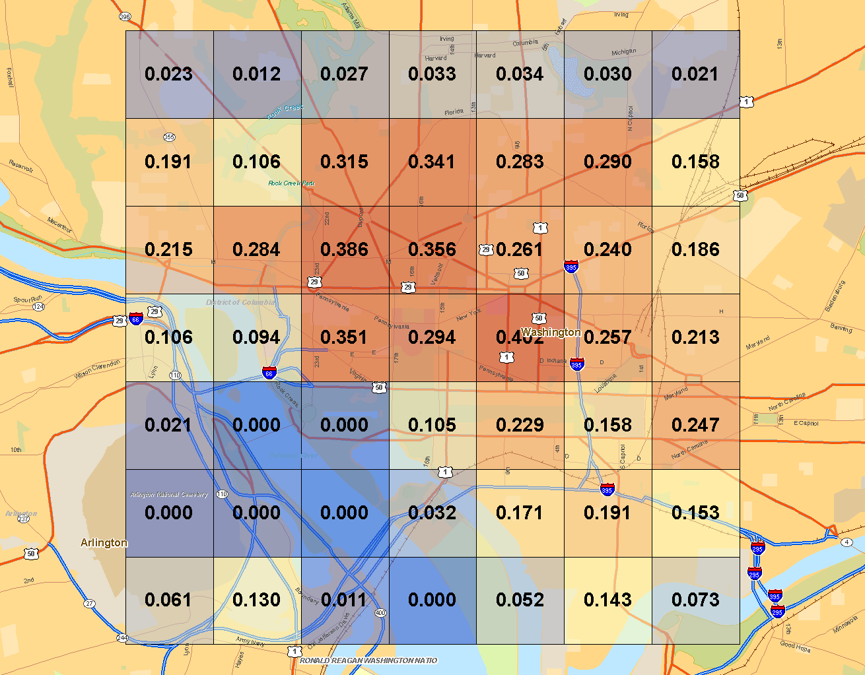
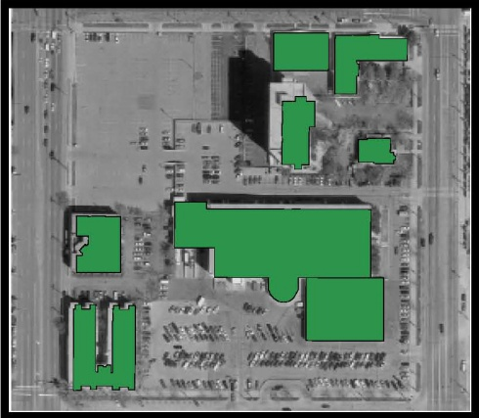
Transition to Other Urban Environments
DC Plan Area (1km²)
From NBSD2
Plan Area
 | Surface Roughness
DCNet | 0.86 m
Rule-of-Thumb | 1.6 – 2.8 m
Macdonald (1998) | 1.4 – 3.25 m
Raupach (1994) | 1.9 – 3.77 m
National Building Statistics Database Version 2 , 2008
Notes:
ATDD is addressing the transfer of the National Capital Region (NCR) experience to other urban environments through plan area and frontal area parameterization schemes which link surface roughness (z₀) and displacement height (d) to the local urban morphology. The use of plan area (lamda p) and/or frontal area (lamda f) may offer the best possibility of translating the skimming flow regime of Washington, DC to other similar urban . Lamda p is calculated, without regard to building heights, simply as the ratio of surface area covered with buildings to the total area. Lamda f is calculated as the perpendicular building frontal area to the total frontal area for a specific surface footprint; lamda f naturally has a directional dependency.
Representing urban terrain characteristics in mesoscale transport and dispersion models is critical for accurate predictions of air flow, heating and cooling, and airborne contaminant concentrations in cities. A key component of urban terrain characterization is the description of building morphology (e.g., height, plan area, frontal area) and derived properties (e.g., roughness length, skyview factor). The National Building Statistics Database (NBSD2) map provides the 1 km**2 plan area for the NCR. NBSD2 consists of a set of 13 building statistics computed at 250-m and 1-km horizontal spatial resolutions from three-dimensional digital building data for 44 metropolitan areas in the US.The NBSD work was one component of the Urban Database project that was supported initially by the Department of Energy's Chemical and Biological National Security Program and later by the Department of Homeland Security's Biological Countermeasures Office
The table provides a comparison of surface roughness as calculated from the DCNet system reflecting the urban core and that of Oke (rule-of-thumb), Macdonald, and Raupach. The DCNet values are roughly ½ that given in the NBSD. A factor of two in surface roughness translates to a 20% difference in predicted velocity and 20% difference in calculated shear stress.
Burian, S.J., Augustus, N., Jeyachandran, I., Brown, M. (2007). National Building Statistics Database, version 2. Los Alamos National Laboratory unclassified report.

Slide 10
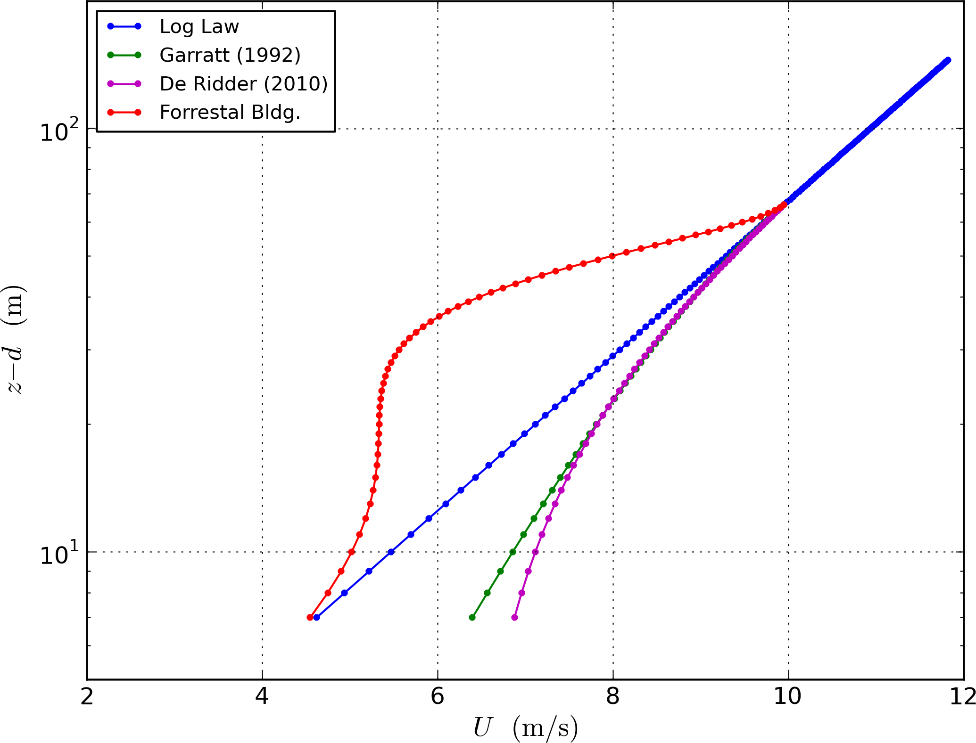
Urban
Surface
Layer
Structure
Notes:
The structure of the urban boundary layer is complex and largely unknown. Very few field observations are available. ARL conducted a series of SODAR profiles from the roof of the Department of Energy building. This plot provides a fit to the average daytime profile along with standard methodologies for addressing the flow within the surface boundary layer. It is important to note that the De Ridder and Garratt algorithms are based on wind tunnel measurements. ARL observations tend to confirm the assume skimming flow for the National Capital Region urban core showing a slowing of the surface layer winds as opposed to the speed-up indicated by Garratt and De Ritter.

Slide 11
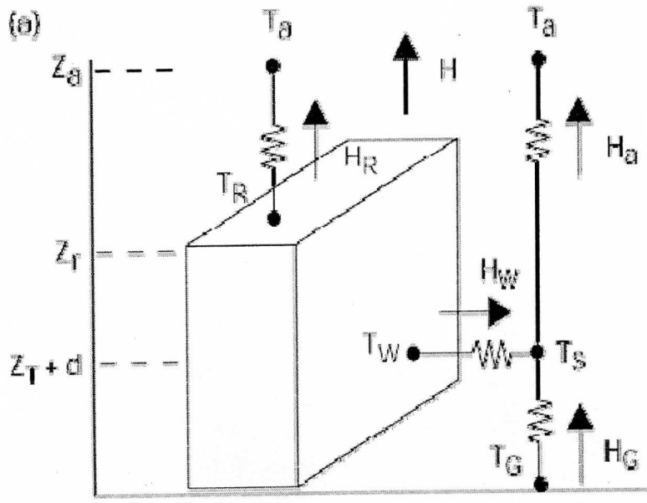
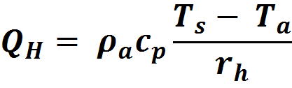

ARL Study Focus
Urban Canopy Model
Energy Balance
CalNex 2010
Interfacial Resistance (r_{b})
Aerodynamic Resistance (r_{a})
Notes:
As stated, a primary goal of ARL’s urban program is to provide representative urban parameterization algorithms and data for incorporation into mesoscale models. The initial focus of the DCNet testbed has been addressing the issue of conducting representative measurements; thus the focus on winds and temperature.
NOAA’s CalNex 2010 program provided an opportunity to conduct measurements in an alternative urban environment as well as evaluate the logistics of an urban deployment of other flux measurements such as CO₂ and water vapor within urban environments. During the CalNex study, ATDD deployed a full energy balance system at the Caltech Pasadena urban supersite. In addition to standard mean and turbulence winds, ATDD measured radiation balance components as well as water vapor and CO2 fluxes. ATDD’s goal was to address the indicated building parameterization requirements with a very narrow focus on the building rooftop.
As shown in this slide, state-of-the-art urban canopy models employ a full energy balance system to predict heat and momentum fluxes within the roughness sublayer. In this example, the list of urban state variables required in WRF urban canopy model are provided in the slide. Those parameters measured by ATDD at the Pasadena CalNex 2010 Supersite are indicated in red.

Slide 12
Indicators of Success
Data
  In use for critical operations
  Multiple users
Better understanding of the
    Urban environment
  Rules-of-thumb (Persistence)
  Surface roughness
  Phi* roughness layer correction
Collaborations

Slide 13





















Collaborators

Slide 14
Urban Meteorology
Future Directions
Develop urban observatory for in-situ vertical observations of mean and turbulent winds and temperature.
Assess changes in turbulent flow along transects from rural to urban to suburban.
Notes:
In addition to continuing with our current analysis of the both DCNet and Pasadena data, we are planning to address the gap in our understanding of the vertical structure of the National Capital Region urban core (NCR) by establishing a vertical observation system at the CSPAN tower (look for it off the red line metro). We have obtained limited vertical wind profiles obtained from SODAR measurements at both Howard University and from the DOE Forrestal building which suggest the height of the urban roughness layer to be approximately 2.8-3.0H. But as you would imagine, SODAR noise makers are not always appreciated. Instrumentation on the CSPAN tower will extend to roughly 8.0H allowing a better representation of the urban boundary layer.
In our long term plans, we would like to explore the transition in fluxes along a transect from rural-to-suburban-to-urban environments. The current concept suggest IBL’s at each roughness change – bunk!
Any questions?

