Slide 1
Atmospheric Nitrogen Research
LaToya Myles
Air Resources Laboratory
ARL Laboratory Review
May 3-5, 2011

Slide 2
Goal
Provide sound scientific information on the emission, transformation, and air-surface exchange of nitrogen compounds in the air.
Air-surface exchange measurements
Improved air and water
quality models
Effective plans to mitigate impacts on our society, economy, and environment
Notes:
In ARL, air quality programs utilize the latest technology to study key pollutants, such as nitrogen. We study the emission, transformation, and air-surface exchange of nitrogen compounds as they travel through the atmosphere. We measure reactive nitrogen fluxes in sensitive ecosystems in the US. These measurements feed into air quality models, which rely on accurate, precise data to improve estimates of how pollutants impact much larger regions of the country. In turn, model output is used in development of effective policies to maintain human and environmental health. Our measurements supply data to models which support the framework for a healthy society, economy, and environment.

Slide 3
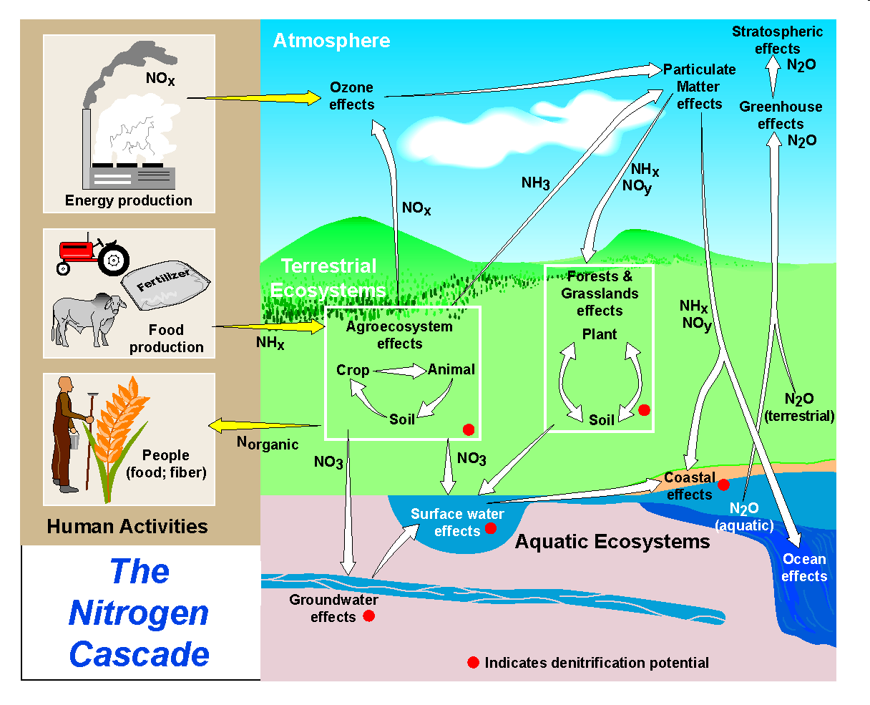
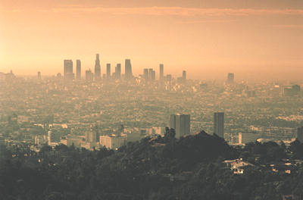
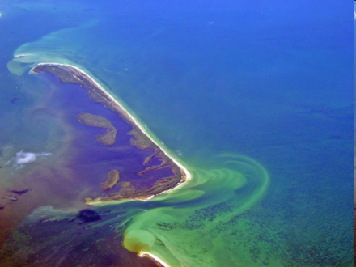
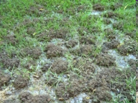
“Cascading” Effects of Nitrogen in the Environment
Tropospheric Ozone
Eutrophication
Soil acidification
(Galloway et al., 2003)
Notes:
Our research focuses on measuring atmospheric reactive nitrogen and determining its interactions with terrestrial and aquatic ecosystems. Reactive nitrogen includes all biologically, photochemically, and radiatively active nitrogen compounds in the atmosphere and biosphere. Reactive nitrogen levels have increased considerably over the past few decades due to intensive agriculture and growing fossil fuel demand. So has the ‘cascading’ effect of excess nitrogen in the environment. While there are many studies outlining the tangible effects of excess reactive nitrogen – increased tropospheric ozone production, eutrophication, soil acidification -- much less is understood about how these compounds interact in the atmosphere and the biosphere. ARL’s work provides significant new understanding that supports society’s ability to make scientifically informed decisions about reactive nitrogen in the environment.

Slide 4
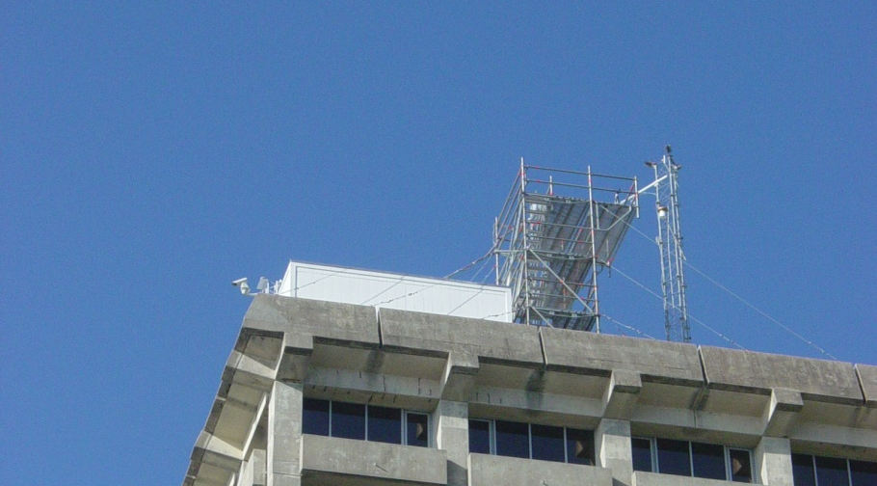
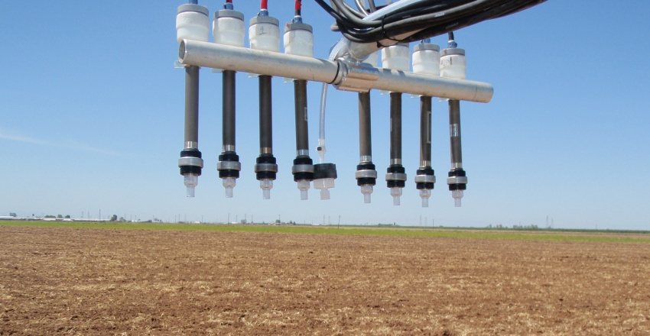
Approach
Short-term Research Intensives
  Fast-response and integrated trace gas measurements
  Extensive collaboration in major process studies to better understand the cycling of nitrogen compounds
Measurement scaffold atop the Moody Tower on the University of Houston campus.
Fast-response sensor (inlet shown center) and traditional annular denuder samplers in California.
Notes:
ARL's specialty is conducting short-term research intensives that combine our expert capabilities in measurement and modeling. We recognize that more advanced applications and techniques must be developed to reduce the vulnerability of communities and ecological systems to an overabundance of nitrogen. ARL leverages its partnerships with other government agencies, academia, and private industry to determine locations for intensive studies. For example, the State of Texas initiated recent field studies to understand the effectiveness of various pollution-control strategies in the Houston area. ARL scientists contributed to these studies by deploying a custom-built detector to measure nitrogen oxides in air masses polluted by transportation and industrial emissions from the Houston Ship Channel. Close cooperation between ARL and academic partners in this study provided datasets for air quality model development and evaluation. ARL also participated in NOAA’s most recent biennial research study, CalNex 2010. We partnered with scientists from academia and private industry to measure ammonia air-surface exchange with a new fast-response sensor. The results were used to better understand the processes associated with air quality and deposition processes that affect climate, as well as ecosystem resiliency and productivity.

Slide 5
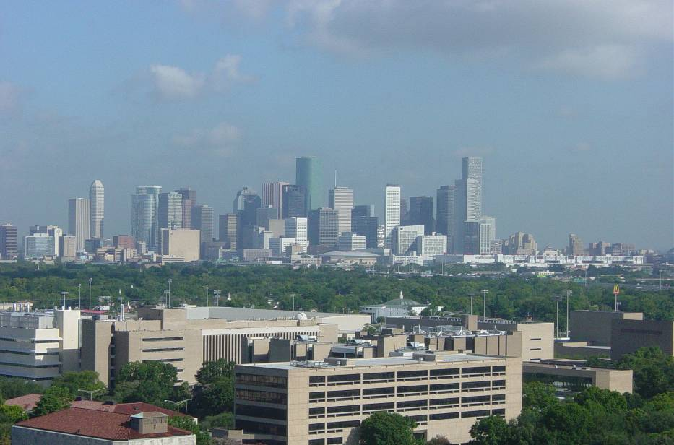
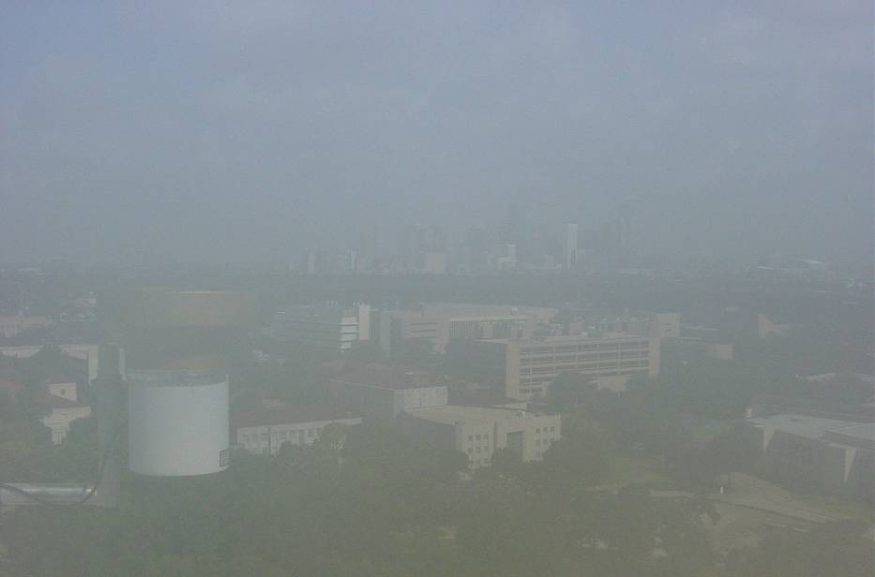
TexAQSII Radical and Atmospheric Measurement Project (TRAMP)
Summertime air quality study in Houston in 2006
Emissions from mobile sources and numerous electrical generation units, petrochemical facilities and other industrial sources
View of downtown Houston from Moody Tower under clear and polluted conditions.
Notes:
ARL scientists participated in the 2006 Texas Air Quality Study II Radical and Atmospheric Measurement Project, TRAMP. We partnered with the University of Houston and the Texas Commission on Environmental Quality to contribute critically important measurements of reactive nitrogen compounds, carbon monoxide, and sulfur dioxide from Moody Tower in downtown Houston. Moody Tower is routinely impacted by emissions from mobile sources and numerous electrical generation units, petrochemical facilities and other industrial sources. ARL’s measurements were used to derive emission source profiles, evaluate air quality models, and assess changes to air quality in southeastern Texas.

Slide 6
TRAMP Study
Luke et al., 2010
Notes:
Our measurements during the TRAMP study found that ratios of NOX oxidation products, called NOz, to total reactive nitrogen, NOy, were highest in winds from the Northeast. Midday winds from the Northeast reflected both the magnitude and reactivity of NOx and volatile organic carbon compounds in industrial emissions from sources near the Houston Ship Channel, one of the busiest waterways in the nation that is bordered by several refineries and other heavy industry. Overall our findings confirm the impact of the Houston Ship Channel as a dominant source region within the Houston Metropolitan Area.

Slide 7
Study of Houston Atmospheric Radicals Project (SHARP)
2006
2009
Notes:
In 2009, ARL participated in a follow-up study in Houston, called SHARP, to investigate the mechanisms of springtime photochemistry. We provided sensitive, high-resolution measurements of oxidized nitrogen compounds. We found that NO_{Y} concentrations were much lower in 2009 than in 2006, as shown here. This decrease was caused by a greater influence of Southerly winds and higher wind speeds in 2009. Southerly winds bring cleaner air from the Gulf of Mexico into the Houston Metropolitan Area. Higher wind speeds dilute natural and anthropogenic emissions to a greater degree.

Slide 8
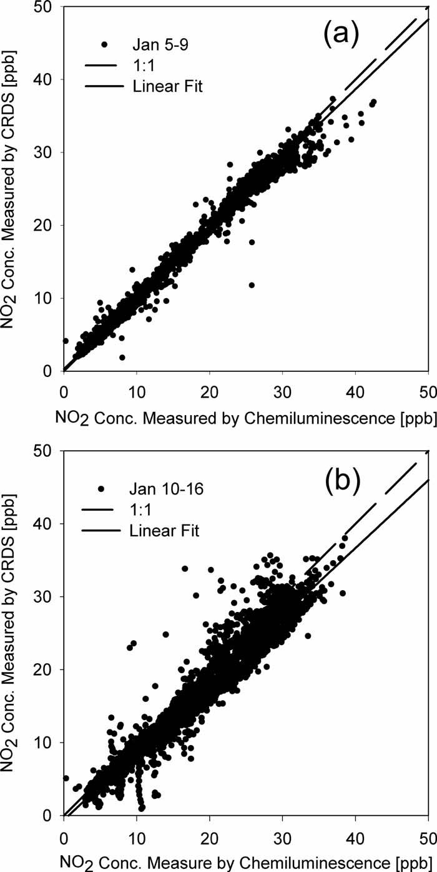

NO₂ Detection Techniques
Characterization of a commercial NO₂ detector
  University of Maryland commercial spectrometer
  ARL custom-built chemiluminescence detector
Castellanos et al., 2009
Notes:
In 2009, ARL expertise was called upon by scientists at the University of Maryland, who were interested in characterizing a commercial cavity-ring-down spectrometer for NO2. Commercial instruments with adequate response times and sensitivities may provide simpler, more cost-effective methods for NO2 detection. As I mentioned earlier, ARL operates a custom-built chemiluminescence detector that reliably measures very low concentrations of NO2, almost a part per trillion. Chemiluminescence is a more traditional technique that uses light emitted from gas phase reactions to quantify the amount of NO2 in the air. As you can see in this plot, there was good agreement between the commercial detector and ARL’s instrument. Results from this study show that commercial NO2 detectors can, with appropriate modifications, provide rapid response, specificity, and adequate sensitivity.

Slide 9
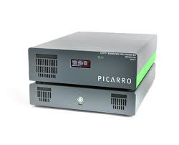
CalNex 2010 Study
Urea Fertilization
Notes:
During the CalNex 2010 study, we deployed a new fast-response ammonia analyzer developed by Picarro, one of ARL’s private industry partners. The Picarro Analyzer uses cavity ring down spectroscopy to measure ambient ammonia concentrations in real time. All instruments were deployed at a site in the northern San Joaquin Valley adjacent to a diary and surrounded by crops, which provided a strong ammonia signal. This plot shows data for June 2010 where typical days had concentration minimums of ~6-8 ppb. Urea fertilizer was applied to adjacent corn fields on the evening of June 12, which resulted in a spike in ammonia concentrations. While we expected increased concentrations from volatilization of ammonia from fertilized soils, the magnitude of the spike was larger than we have seen in previous studies but in range of similar work over fertilized vegetation in Europe.

Slide 10
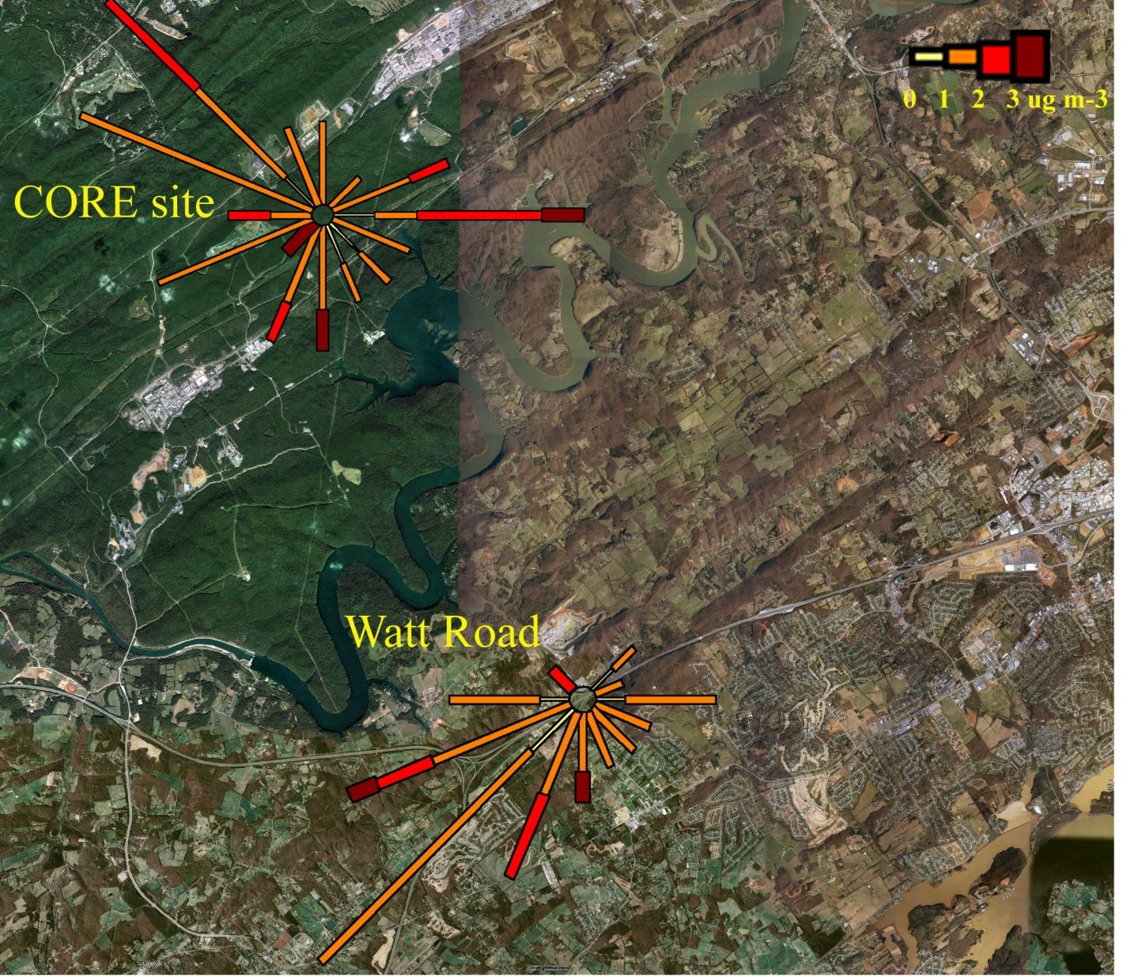
Ammonia in East Tennessee Study
Ammonia concentrations were slightly higher in winds emanating from the direction of the interstate highway.
Complex topography in the Tennessee Valley channels winds and limits influx from certain directions.
Interstate
Highway
Allen et al. 2010 (in review)
Allen et al., 2011
Notes:
In 2009, we conducted a short field experiment to measure ammonia concentrations at two local sites, one in a forest clearing and the other adjacent to a major transportation route in East Tennessee. At Watt Road, slightly higher concentrations did emanate from the general direction of the interstate highway (to the southwest), but we could not definitively identify motor vehicle emissions as significant sources. One mitigating, and intriguing, factor was the complex topography surrounding our measurement site. Winds at Watt Road are channeled from the southwest to the northeast between higher elevation ridges, which limits influx of ammonia from most other directions. These findings informed our research intensive plans for 2010...

Slide 11
Atmospheric Deposition of Ammonia Study
Notes:
ARL partnered with the University of Tennessee Knoxville to co-locate a suite of ammonia air-surface exchange instruments at their agricultural facility. Given that urea fertilizer is routinely distributed to the vegetation in that area, we were well-placed to measure ammonia fluxes with the fast-response Picarro Analyzer. With this instrument, we were able to measure ammonia concentrations on a minute-by-minute basis, a vast improvement over our previous methodology, which yielded only 4 or 6 hour accumulated concentrations. Because of the analyzer’s time resolution, we were able to decipher a diurnal cycle in ammonia concentrations. As shown in this plot, ammonia concentration tracks very well with wind speed and follows a distinct diurnal pattern with maximums occurring midday.

Slide 12
Drivers for Ammonia Air-Surface Exchange
Myles et al., 2010
Notes:
ARL’s research intensives provide information about the magnitude of nitrogen air-surface exchange and the meteorological and biological drivers that regulate air-surface exchange processes. In a 2006 collaborative study with the U.S. EPA, we found a relatively strong relationship between ammonia deposition velocity and friction velocity. Our data indicate that ammonia deposition is influenced by turbulent mixing in the layers of the atmosphere near the canopy surface. This conclusion has implications for atmospheric chemistry models that routinely utilize friction velocity parameterizations.

Slide 13
Indicators of Success
Publications
  Recent papers in peer-reviewed journals
    Atmospheric Environment, Nature Geoscience, Journal of Environmental Quality, Environmental Research Letters, Review of Scientific Instruments
  Invited commentary and review articles
Datasets
  Historic air-surface exchange measurements
    Atmospheric Integrated Research Monitoring Network (AIRMoN)
  Research intensives and collaborative projects
Improved Measurement Techniques
  Evaluation of cavity-ring down spectroscopy
  Custom-built chemiluminescence detector
Notes:
Key products from our research are peer-reviewed publications, comprehensive datasets that improve the understanding of nitrogen air-surface exchange, and improved measurement techniques. In the past few years, ARL has published results from nitrogen field studies in peer-reviewed journals, including Atmospheric Environment and Journal of Environmental Quality. Several ARL scientists have been invited to compose commentary and review articles in journals and technical reports. We have a rich history of long-term monitoring of nitrogen air-surface exchange that is documented in original, one-of-a-kind datasets from ARL programs like AIRMoN. Our current research intensives and collaborative projects continue to produce data that are used by partners in the U.S. and internationally. Some of those collaborations have resulted in ARL’s participation in world-class studies designed to refine air-surface exchange measurement techniques such as cavity-ring down spectroscopy and chemiluminescence.

Slide 14


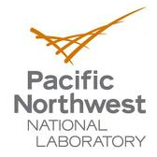











Collaborators
Notes:
Air-surface exchange research at ARL has partners in academia, national laboratories, private industry, and other federal agencies. We routinely form collaborations to conduct measurements, assess new techniques, and contribute data to modeling efforts. Collaborations help ARL leverage resources to effectively align our research with agency and stakeholder priorities.

Slide 15
Future Directions
Products
  Communication of findings to collaborators and the public
  Accessible historical datasets
Measurement studies
  Determine suitability of real-time sensors for long-term air-surface exchange research
  Conduct research intensives in coastal ecosystems
  Investigate contribution of organic nitrogen to the reactive nitrogen budget and possible effects on regional air quality
Notes:
In the near future, our efforts will concentrate on communicating results from last year’s field campaigns to research colleagues and to the general public. For example, our ammonia flux dataset from the CalNex study is being utilized by an international group for satellite validation exercises. There has been growing interest in our historical datasets, and we are working to make them accessible via the internet to our research partners in the U.S. and internationally. We are planning multi-year studies using fast-response sensors to determine suitability for long-term monitoring. Given the serious impacts of nitrogen deposition on nutrient levels in aquatic ecosystems, ARL plans to leverage partnerships with other agencies, academia, and private industry to develop a comprehensive program using new techniques to measure nitrogen air-surface exchange along the coasts. Building on our current measurement expertise, ARL also plans to investigate an emerging research concept, the role of organic nitrogen in atmospheric and biospheric processes. ARL will continue to provide valuable information on the sources and fate of reactive nitrogen that is required to mitigate impacts on the Nation’s air quality. Thank you for your time and attention. I’d be happy to entertain questions.

