Slide 1
The Surface Energy Budget
NOAA climate research for understanding
land surface processes and climate feedbacks
Tilden P. Meyers
Air Resources Laboratory
May 3-5, 2011
Notes:
Research Climate Network that focuses on the surface energy budget and it’s significance for climate change studies

Slide 2

Solar Radiation drives the climate system
Solar radiation is the
Engine of earth’s
Climate system
changes in solar output
changes in albedo
modifying outgoing longwave
Climate Change
Notes:
Climate is driven by the sun, and climate change of the earth is affected by changes the earth’s atmospheric and surface radiation budget

Slide 3
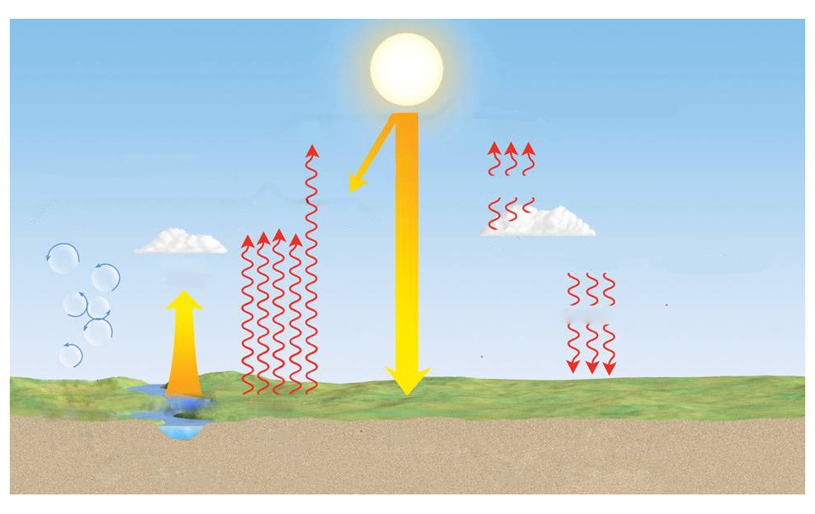
The Surface Energy Budget
H + LE + G + Ps = Net Radiation
Surface Radiation Budget
Surface heat budget
infrared
Sensible heat (H)
infrared
Evapotranspiration (LE)
net solar
infrared
Photosynthesis (Ps)
Conduction (G)
Notes:
The surface energy budget goes a step beyond by examining how the absorbed radiation (net) radiation at the surface is partitioned into sensible, latent (ET), ground and photochemical energy.

Slide 4
Research Goals
Assessment of ecosystem annual carbon and water budgets
Detection of land-surface feedbacks in response to changes in radiative forcing (albedo, Bowen ratio and changes in energy partitioning, growing season fluxes)
Improved parameterization of land surface processes for incorporation into Land Surface Model (LSM) schemes, including NOAA’s models suite.
Notes:
What are the most important factors that affect the annual budgets, plant response functions.
How might albedos be affected, length of growing season,
Land surface modeling teams in need of data for validation studies

Slide 5
Approach
Use micrometeorological measurement techniques to monitor the components of the surface energy budget (Rnet, H, LE, G, Ps) for representative ecosystems in the major climate zones of the U.S.
Rnet = Net Radiative flux
H = Sensible Heat Flux
LE = Evapotranspiration
G = Ground Heat flux
Ps = Photosynthesis
Notes:
How are we going to do this? What are the best methods?

Slide 6
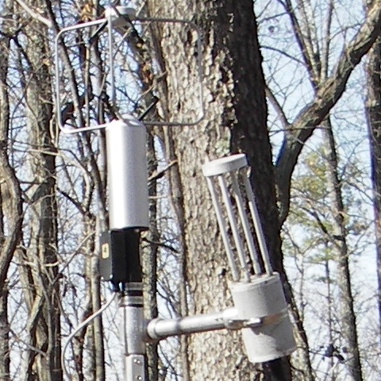
Why ARL?
Expertise in Air-surface Exchange
NAPAP
(National Acid Precipitation Assessment Program)
Measurements of dry deposition using
Micrometeorological methods
Instrumentation Development
First long term flux measurements of
the surface energy budget and CO₂ were made using open path analyzer developed by ARL scientists and engineers
Initial sponsors of this work:
GEWEX (NOAA/NASA)
DOE, Terrestrial Carbon Program
Notes:
Why ARL?, Legacy technical expertise in air-surface exchange, from the days of NAPAP to instrumentation development. Measurements from ARL scientists represent 2 of the longest period of records for energy and CO2 exchange.
Oak Ridge, and Bondville (Champaign).

Slide 7
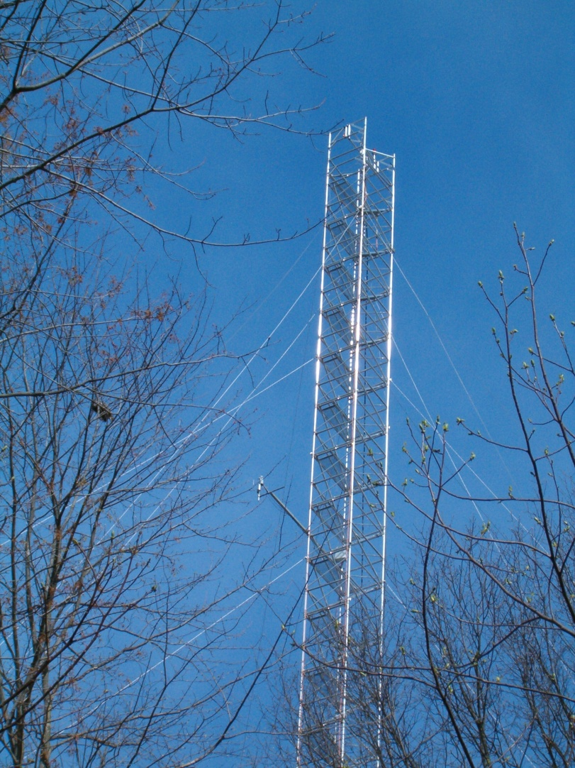
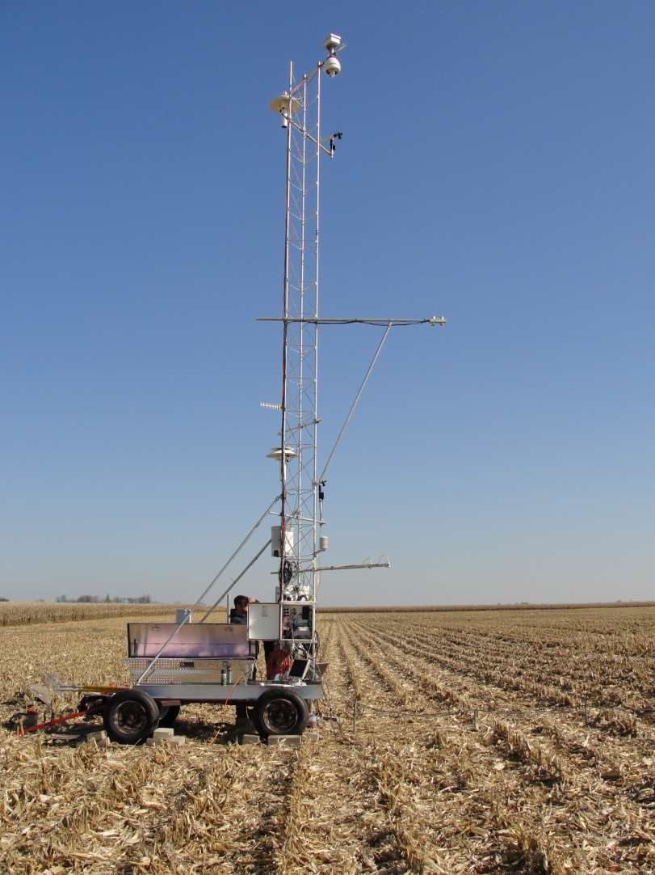
Various types of measurements and platforms
Champaign, IL- cropland
Oak Ridge, TN - forest
Notes:
With an objective of obtaining data over representative ecosystems, no two stations are quite the same, each having a unique set of challenges.

Slide 8
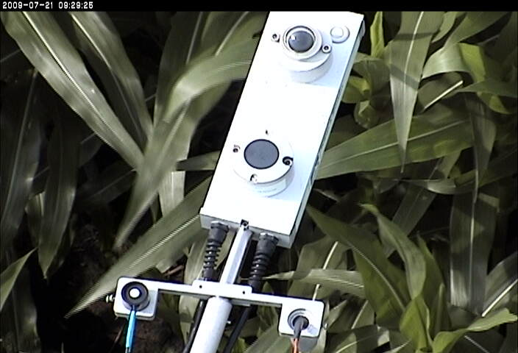
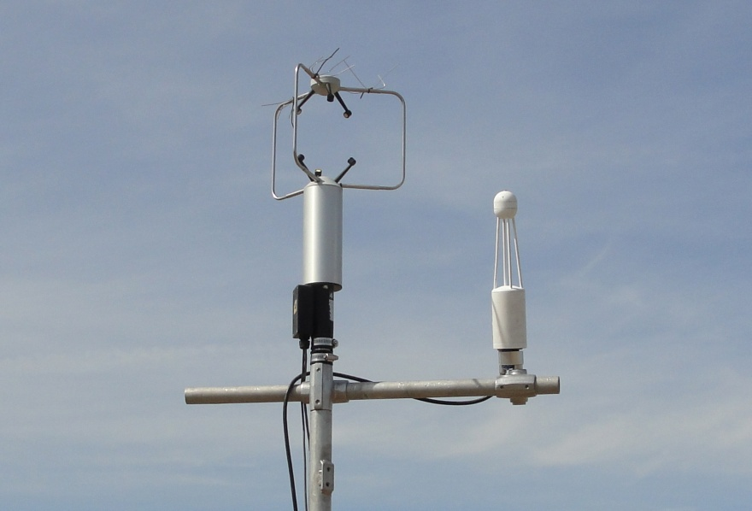
Radiation and Heat Budgets
Sioux Falls, SD
Ft Peck, MT
  Surface Radiation Budget Station
  Incoming Solar and Thermal IR
  Upwelling Solar and Thermal IR
  PAR (incoming and upwelling)
  (Photosynthetically Active Radiation)
  Surface “skin” temperature
  Surface Heat Flux Station
  Evapotranspiration
  Sensible heat flux
  Ground heat flux
  CO₂ and Momentum Flux
Notes:
Primary observations consist of measurements of the surface radiation budget, and the surface heat budget.

Slide 9
Other Supporting Observations
  Soil moisture/temperature (5,10,20,50,100 cm)
  Barometric Pressure
  Wind, Air Temperature (1.5, 5, 10 m)
  Humidity
  Surface “skin” temperature
  Litter wetness, litter temperature
  Ground heat flux
  Leaf Area Index (LAI), canopy height, biomass
  Internet camera
Derived (NDVI, albedo, roughness length)
NDVI = Normalized Difference, spectral index
Notes:
Lots of other observations are needed for interpretation of the data, inputs to land surface models, etc.

Slide 10
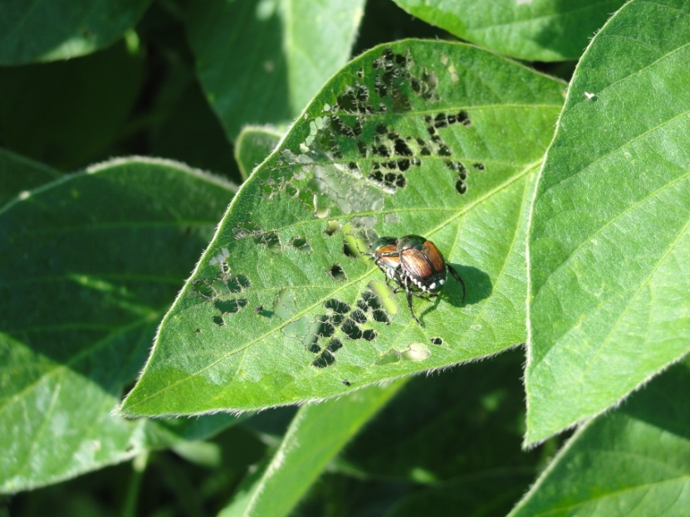
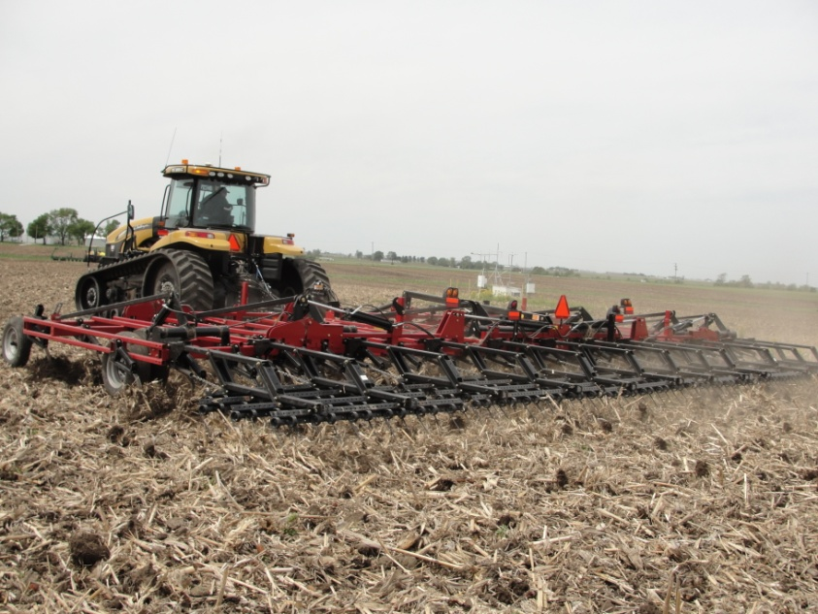
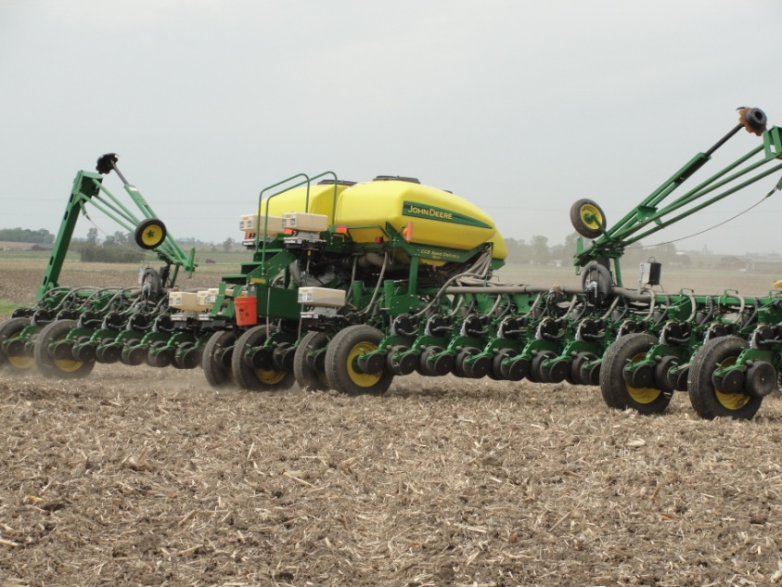
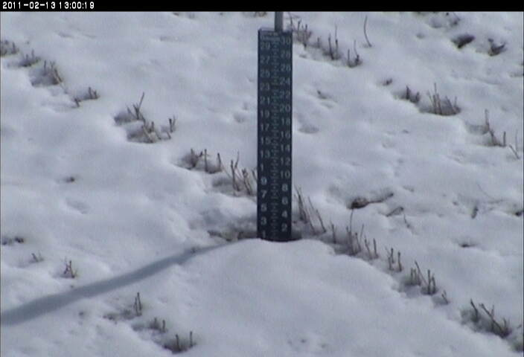
Additional observations
Notes:
Nothing like have a set of “eyes” on what is going on at the site.

Slide 11
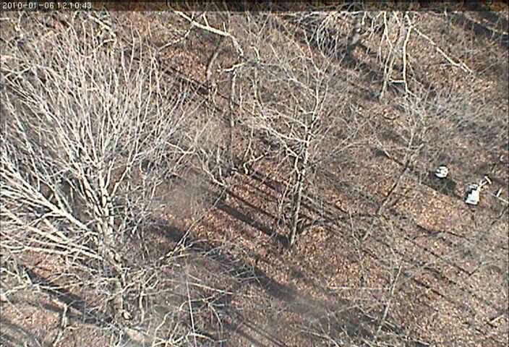
Annual cycle of forest canopy
Notes:
Time lapse measurements of canopy from Oak Ridge tower

Slide 12
Major Findings
  Droughts that occur during the growing season, leads to net annual carbon emissions (Meyers, 2001)
  Mid-western corn/soybean ecosystems small carbon sink (Bernacchi, Hollinger, Meyers, 2005)
  Significance of ecosystem storage terms in closing the surface energy budget (Meyers and Hollinger, 2004)
  Demonstrated use in-situ broad-band Normalized Difference (NDVI) to track leaf area index (Wilson and Meyers, 2007)
  Over 75% of annual evapotranspiration for semi-arid grasslands (AZ) occurs in just 3 months (Krishnan, Meyers, et al, 2011)
Notes:
Lots of other observations are needed for interpretation of the data, inputs to land surface models, etc.

Slide 13
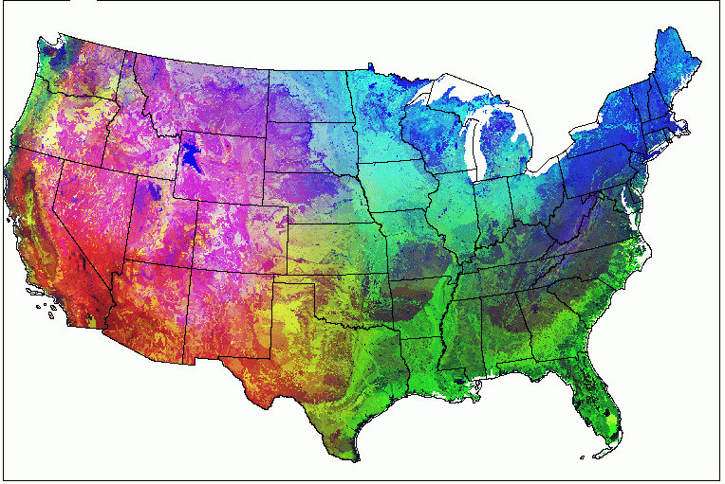
Current Distribution of Sites
Current site
Closed site
Notes:
What is the current configuration of the network?

Slide 14
Plans: A Surface Energy Budget Network (SEBN)
ARL/ATDD
ESRL/Global Monitoring Division
Surface Radiation Budget
Surface heat budget
infrared
Sensible heat
infrared
Evaporation
net solar
infrared
photosynthesis
conduction
Notes:
How could we do it better? By partnering with ESRL/GMD to handle the radiation side of the measurements which are very demanding.

Slide 15
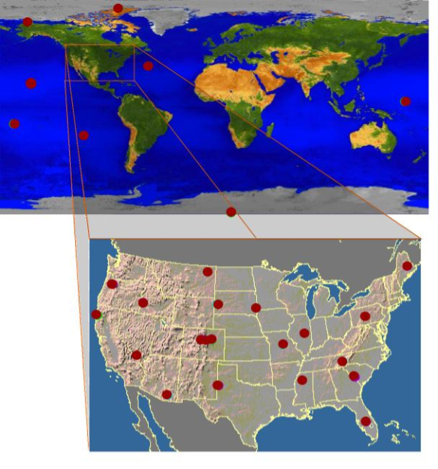
The proposed NOAA SEBN Network
Notes:
Plans in place for build out for minimum number of sites in U.S. to get observations for major land use in the major climate zones of the U.S.. They also have sites worldwide as well.

Slide 16
Benefits
Improved parameterizations of the land surface model physics that
Ultimately improves seasonal predictability of water resources
Better understanding of the critical land surface processes that control the seasonal and annual water and carbon budgets for various ecosystem types
Notes:
Measures of Success, value of observations, more reason to continue and sustain these obs.

Slide 17

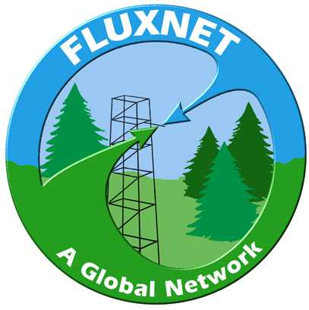





Partners and Collaborations

Slide 18
Indicators of Success
NOAA sponsored sites constitute approximately 12% of the present AmeriFlux database
Bondville, IL is one of only 6 active AmeriFlux sites with records dating to 1996 and represents the longest continuous AmeriFlux record in an agricultural system.
Over 30 authored or co-authored publications (ARL Scientists) over the last 10 years, with over 200 publications that have used this data for assessments and synthesis activities.
Serve as technical experts for the National Science Foundation’s NEON (National Ecological Observatory Network)
Notes:
Measures of Success, value of observations, more reason to continue and sustain these obs.

