Slide 1

NOAA and OAR Approaches to Research Planning
Alexander MacDonald, Ph.D.
Deputy Assistant Administrator, Laboratories and Cooperative Institutes
Office of Oceanic & Atmospheric Research (OAR)
National Oceanic & Atmospheric Administration (NOAA)

Slide 2
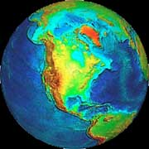
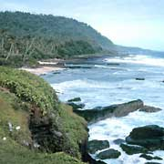

NOAA’s Research Engine
Innovation Incubation Integration
Weather and Air Quality
Climate
Office of Oceanic and Atmospheric Research
Ocean and Coastal Resources
Notes:
Introduction to OAR Research and themes - Working under the broad themes of Climate, Weather and Air Quality, and Ocean and Coastal Resources, NOAA scientists study the ocean's depths and the highest reaches of the atmosphere to better understand and predict our environment.
NOAA and the nation depend on the cutting-edge science provided by its research programs which provide the sound science necessary to help NOAA achieve her goals

Slide 3
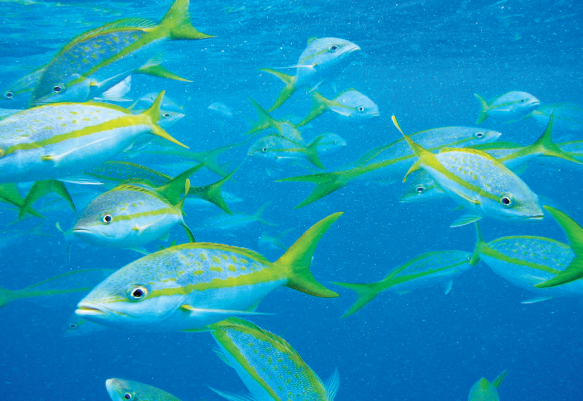
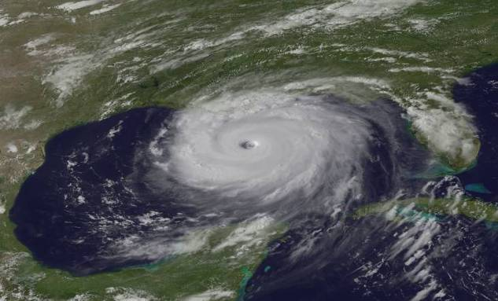
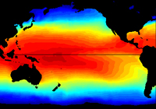
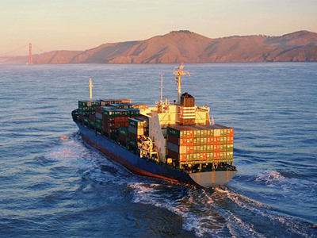
NOAA Goals
Oceans
Weather
Climate
Coastal Economies
Notes:
NOAA’s mission is to understand and predict changes in the Earth’s environment and conserve and manage coastal and marine resources to meet our Nation’s economic, social, and environmental need. NOAA Research is essential for meeting our interdisciplinary mission goals.
NOAA’s Mission Goals:
Healthy Oceans
Marine fisheries, habitats, and biodiversity that are sustained within healthy and productive ocean ecosystems
Weather Ready Nation
A society that is prepared for and responds to weather-related events
Climate Adaptation & Mitigation
An informed society anticipating and responding to climate and its impacts
Resilient Coastal Communities and Economies
Coastal and Great Lakes communities are environmentally and economically sustainable
In addition to the four thematic mission goals, NOAA also recognizes the inherent need for support. This is capture in the NOAA Enterprise Objectives: Science and technology, Engagement, and Organization and administration.
NOAA is essentially an operational ecosystem science agency with global activities on land and sea, in the air and in space. NOAA relies on science partnerships to achieve our mission. NOAA partnerships span academic and industry sectors as well as other government agencies. These critical relationships improve relations with our customers, build reliable interconnected data sources, and support NOAA’s mission.

Slide 4
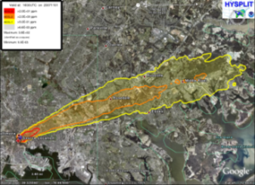
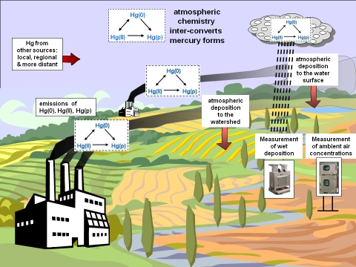
Oceanic & Atmospheric Research
Vision
A society that uses the results of our research as the scientific basis for more productive and harmonious relationships between humans and the environment.
Mission
To conduct environmental research, provide scientific information and research leadership, and transfer research into products and services to help NOAA meet the evolving economic, social, and environ-mental needs of the Nation.
Notes:
Main Message: Preeminent research is at the center of all NOAA Services.
OAR Vision: A society that uses the results of our research as the scientific basis for more productive and harmonious relationships between humans and the environment. (per OAR FY 2005 - FY 2010 Strategic Plan)
OAR Mission: To conduct environmental research, provide scientific information and research leadership, and transfer research into products and services to help NOAA meet the evolving economic, social, and environmental needs of the Nation. (per OAR FY 2005 - FY 2010 Strategic Plan)
Our role is to provide unbiased science to better manage the environment, nationally and globally. Our role within NOAA is to provide products and services that describe and predict changes in the environment.
Research results allow decision makers to make effective judgments in order to prevent the loss of human life and conserve and manage natural resources while maintaining a strong economy.

Slide 5
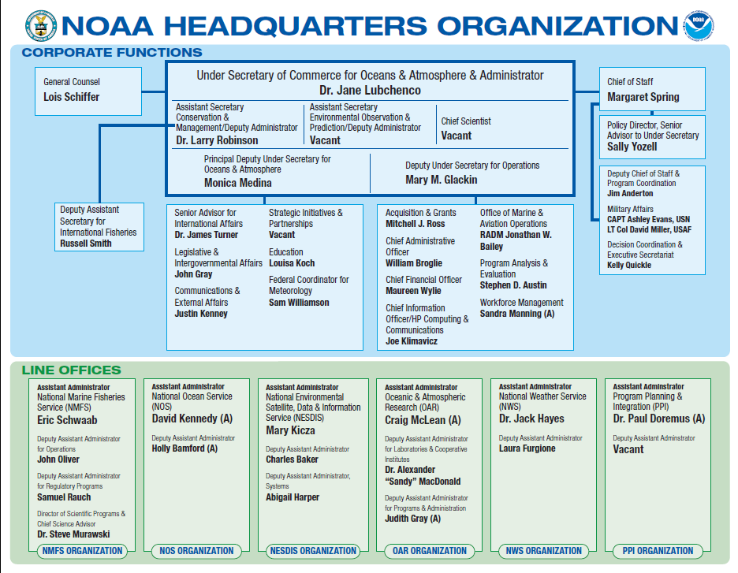
Notes:
Overall structure of NOAA.
NOAA HQ
Line Office Structure
Updates:
Doug DeMaster is the Acting Director of Scientific Programs and Chief Science Advisor for NMFS
Holly Bamford is the new Deputy Assistant Administrator of NOS – no longer acting
Steve Fine is the new Acting Deputy Assistant Administrator for Programs and Administration in OAR

Slide 6
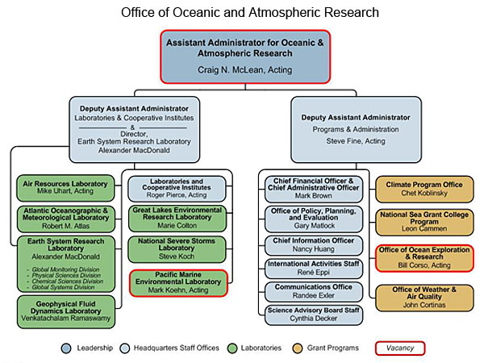
Office of Oceanic and Atmospheric Research

Slide 7

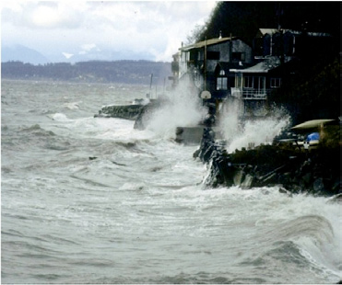
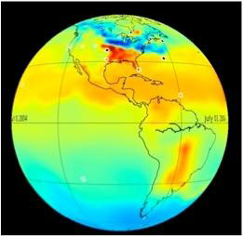
A Proposed Climate Service
The President’s FY 2012 Budget Request includes a Climate Service Line Office within NOAA
The proposed Climate Service will bring together NOAA’s existing climate research, observations, monitoring, modeling, information product development and delivery, and decision support functions
It will sustain core capabilities and improve understanding and the characterization of the nation’s vulnerability to climate change
    Arctic Watch
    Water Resources Research to Operations
    Carbon Observing and Analysis System
    Earth System Modeling
    Global Ocean Observing System
Notes:
A proposed budget neutral reorganization that establishes a climate service line office in NOAA
Strategically realigns the Office of Oceanic and Atmospheric Research (OAR), and consolidates some headquarters planning functions
The principal goal of this reorganization is to bring together NOAA’s existing widely dispersed climate capabilities under a single line office management structure to more efficiently and effectively respond to the rapidly increasing demand for climate services
The Climate Service will allow NOAA to provide a reliable and authoritative source for climate data, information, and decision-support services and to more effectively coordinate with other agencies and public and private sector partners.

Slide 8
NOAA’s Changing Strategic Directions
1998 - 2008
2008 - Future
Requirements and Drivers
Ocean Commission Blueprint
NOAA Strategic Plan
NOAA 20 Year Vision
NOAA 5 Year Research Plan
National Ocean Policy
Next Generation Strategic Plan
Proposed Climate Service
OAR Restructuring
NOAA
Actions
Creation of:
NOAA SAB
NOAA Research Council
Five Strategic Mission Goals
Matrix Program Structure
NOAA Science Workshop and Grand Challenges
Strengthening Science Mission Goals
Enterprise Objectives
Notes:
NOAA has undergone a significant period of change over the last decade.

Slide 9
NOAA Science Workshop
Strengthening NOAA Science
April 20 – 22, 2010
First–of–its–kind meeting to engage active NOAA scientists and science managers to identify grand science challenges for NOAA over the next five to twenty years
Overarching Grand Challenge
Develop and apply holistic, integrated Earth system approaches to understand the processes that connect changes in the atmosphere, ocean, space, land surface, and cryosphere with ecosystems, organisms and humans over different scales.
Also identified 7 topic specific challenges and 2 cross cutting challenges
Notes:
NOAA Science Workshop Challenges
Acquire and incorporate knowledge of human behavior to enhance our understanding of the interaction between human activities and the Earth system
Understand and quantify the interactions between atmospheric composition and climate variations and change
Understand and characterize the role of the oceans in climate change and variability and the effects of climate change on the ocean and coasts
Assess and understand the roles of ecosystem processes and biodiversity in sustaining ecosystem services
Improve understanding and predictions of the water cycle at global to local scales
Develop and evaluate approaches to substantially reduce environmental degradation
Sustain and enhance atmosphere-ocean-land-biology and human observing systems
Cross Cutting Challenges
Characterize the uncertainties associated with scientific information
Communicate scientific information and its associated uncertainties accurately and effectively to policy makers, the media, and the public at large.

Slide 10
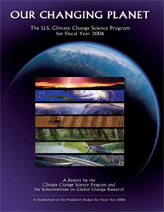
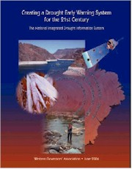
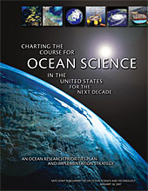
Drivers for NOAA Research
Policy Drivers
  United States Global Change Research Program (USGCRP)
  US National Ocean Policy
  NOAA Next Generation Strategic Plan
  NOAA 5-Year Research Plan
  NOAA 20-Year Research Vision
  National Response Framework
Legislative Drivers
  Clean Air Act
  National Climate Program Act
  America COMPETES Act
Notes:
Main Message: NOAA Research is responsive to a variety of external policy and legislative drivers.
Focus on NOAA OAR drivers as a whole. Steve will talk about drivers in relation to ARL. Such as:
National Response Framework - presents the guiding principles that enable all response partners to prepare for and provide a unified national response to disasters and emergencies – Will be addressed later
Clean Air Act

Slide 11
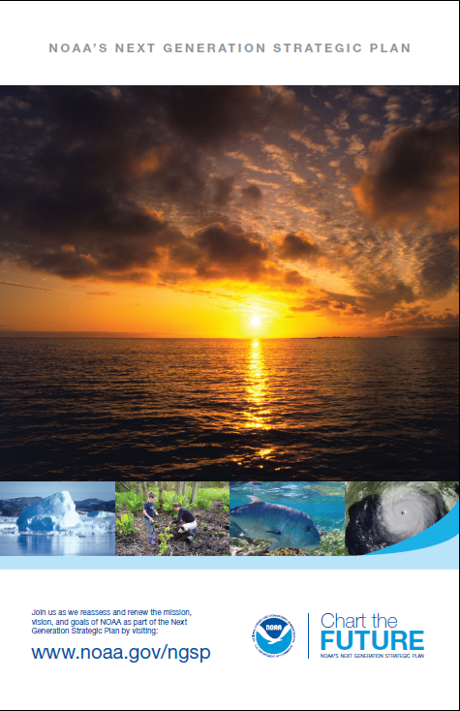
NOAA’s Next Generation Strategic Plan
NOAA's Mission:
Science, Service, and Stewardship
-To understand and predict changes in climate, weather, oceans, and coasts,
-To Share that knowledge and information with others, and
-To conserve and manage coastal and marine ecosystems and resources
NOAA’s Vision:
Resilient Ecosystems, Communities, and Economies
Healthy ecosystems, communities, and economies that are resilient in the face of change.
Notes:
Main Message: NOAA’s mission, services, and vision for the future require preeminent research that provides new insights, innovations and technological breakthroughs.

Slide 12
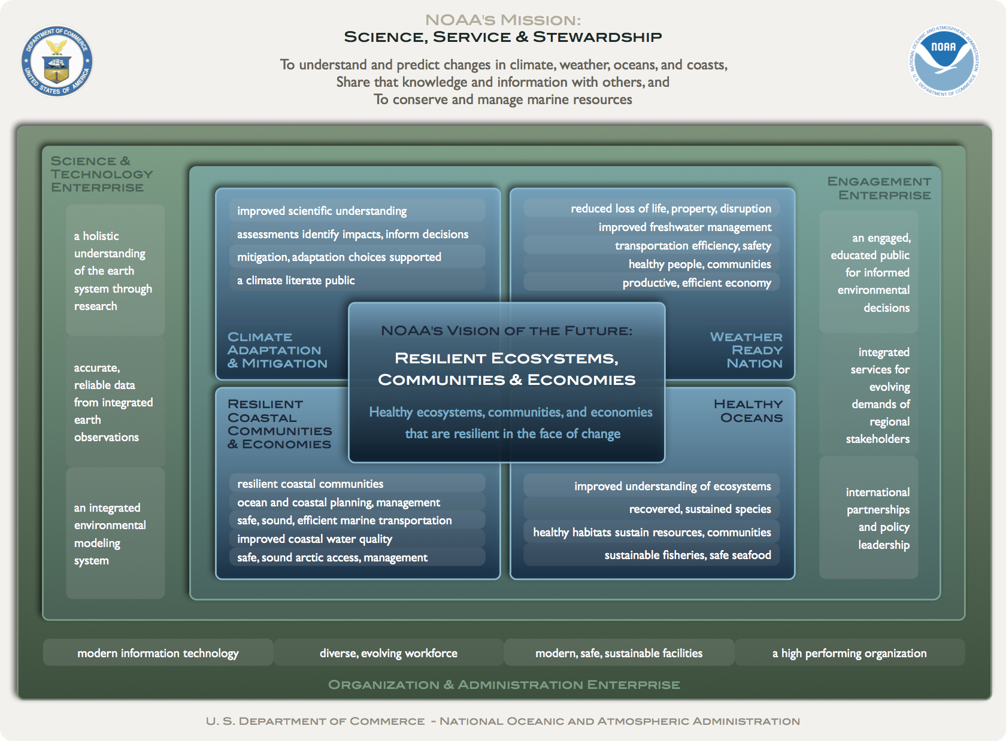
NOAA’s Next Generation Strategic Plan
Notes:
NOAA’s Next Generation Strategic Plan.
Aligning NOAA mission goals and planning structure.
NOAA’s Mission Goals:
Healthy Oceans
Marine fisheries, habitats, and biodiversity that are sustained within healthy and productive ocean ecosystems
Weather Ready Nation
A society that is prepared for and responds to weather-related events
Climate Adaptation & Mitigation
An informed society anticipating and responding to climate and its impacts
Resilient Coastal Communities and Economies
Coastal and Great Lakes communities are environmentally and economically sustainable

Slide 13
NOAA 5-Yr Research Plan
Emphasizes the integration of the observational, experimental, analytical, and modeling tools that are the core of NOAA’s research
  - Identifies specific research milestones and objectives to reach our Strategic Plan Goals and Objectives,
  - Encourages transformational research, and
  - Based on societal needs
Developed by NOAA Research Council
  - Input from NOAA line offices and mission goals, external partners, along with public commentary

Slide 14
NOAA 5-Yr Research Plan
Overarching Research Questions
What factors influence ecosystem processes and ... forecasts [of] their future state?
What is the current state of biodiversity in the oceans, and what impacts will external forces have on this diversity…?
What improvements to observing systems, analysis approaches and models will allow [lead] us to better predict[ions] …?
How are uncertainties … best estimated and communicated?
How can the … warning times for … high-impact environmental events be increased significantly?

Slide 15
The Research Funding Process
Appropriation
President’s Request
Congress
Earmarks
Request
Execution
DOC - OMB
NOAA Budget
NOAA Budget
NOAA Line Offices
SEE Process
Other Federal Agencies
ARL
Non-Federal
Notes:
Priority setting for research occurs at each phase to varying degree.
The full process ensures that only the best and most relevant priorities survive the process and are funded.
Input is given through budget narratives, associated Q&A and the Presidents Budget Request by supporting the budget rollout.

Slide 16
NOAA Research Science Reviews
Conducted every 4 years to evaluate the quality, relevance, and performance of OAR laboratory research
  - Last ARL Review: 2005 Core Capabilities Analysis
Assist labs in strategically positioning for and planning future science
Intended to ensure that research is preeminent and linked to the NOAA Strategic Plan
The Review Panel is asked to evaluate lab science areas based on specific questions within the Charge to the Review Panel
Notes:
Only the review team is allowed to ask questions during the presentation period. Observers are asked to hold their questions and ask the scientists during the breaks.
Steve Fine will address the last ARL review - 2005 Core Capabilities Analysis - recommendations and conclusions

Slide 17
NOAA Research Tenets
Preeminent Research
Value to Society
Culture of Transparency
Notes:
Main Message: We are committed to conducting and sponsoring preeminent research, providing maximum value to society, all within a culture of transparency.
With these values in mind: all of the review materials will be posted on ARL’s public webpage
Thank reviewers for participating…
Introduce Steve Fine?

