Slide 1
Understanding Upper-Air Climate Change:
Part I. Changes in the Vertical Temperature Profile
Melissa Free
Air Resources Laboratory
ARL Laboratory Review
May 3-5, 2011
Notes:
This talk is part one of a two-part discussion of ARL’s work in understanding upper-air climate change. This part covers several projects relating to changes in the vertical temperature profile.

Slide 2
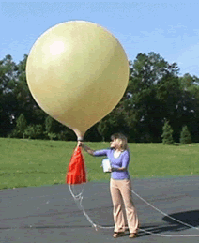
Goals
Advance understanding of changes in the vertical temperature profile by:
Improving data quality through attention to temporal homogeneity
Extracting useful climate-scale information from radiosonde records
Building on ARL’s historical leadership in using radiosonde data

Slide 3
Why?
Controversy about tropospheric temperature trends and their relation to those at the surface.
2. Stratospheric temperature changes affect the ozone layer, and possibly surface climate.
3. Changes in profile can be used for detection/attribution.
Notes:
An important motivation for studying upper-air temperature trends has been the controversy that started around 1990 with publication of work on satellite temperature trends for the troposphere. These early results showed little or no warming in the troposphere. This fueled a lengthy debate about the reality of warming at the surface, and much of our work was intended to help resolve those issues.
In the stratosphere, temperature changes are important because they affect the depletion and recovery of the ozone layer. Also, there is growing recognition that the stratosphere can affect weather and climate at the surface.
Overall, changes in the vertical temperature profile can be used in climate studies to help clarify the likely causes of climate change. For example, changes in the sun's output cool or warm the whole tropospheric/stratospheric profile, whereas changes in greenhouse gases have opposite effects in the troposphere and stratosphere.

Slide 4
Approaches
  1. Creating climate data records using radiosondes
  2. Studying climate effects of volcanic eruptions
  3. Investigating effects of ENSO on stratospheric temperatures

Slide 5
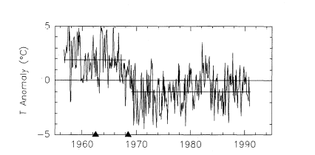
1. Creating climate data records using radiosondes
Example of the problem:
100 mb, Bet Dagan, Israel
100 mb Bet Dagan, Israel
From Gaffen, JGR (1994)
Effect of instrument change—Metox to VIZ
Notes:
We would like to use radiosonde temperature data to assess trends, because they go back much further than satellite data. Unfortunately, this is difficult because they contain many large spurious discontinuities due to changes in instruments and procedures.
The figure shows an example of such a discontinuity. These changes make it difficult to create datasets that are reliable indicators of temperature trends. This is the problem that our group has wrestled with over the past 10-15 years. The RATPAC dataset was an attempt to address this problem.

Slide 6
RATPAC = Radiosonde Atmospheric Temperature Products for Assessing Climate
NOAA Team: ARL: Melissa Free, Dian Seidel
GFDL: John Lanzante
NCDC: Imke Durre, Tom Peterson
Philosophy:
Adjust data without satellite or other reference data (to maintain independence)
“First do no harm”—Avoid overadjustment
Carefully selected set of stations
Notes:
Our effort to remove or reduce the effects of these shifts resulted in the RATPAC project, a team effort involving people from several parts of NOAA, to produce an adjusted radiosonde dataset. Previous work had adjusted data with reference to satellite temperatures, but this means the result does not give a completely independent record. We chose not to use an outside reference. Work done previously by team members indicated that adjustments, if overdone, can remove real trends. Our work tried to avoid that by taking a conservative approach. We use a limited set of stations with approximately even distribution rather than all available stations.
GFDL= NOAA Geophysical Fluid Dynamics Lab
NCDC= NOAA NESDIS National Climatic Data Center

Slide 7
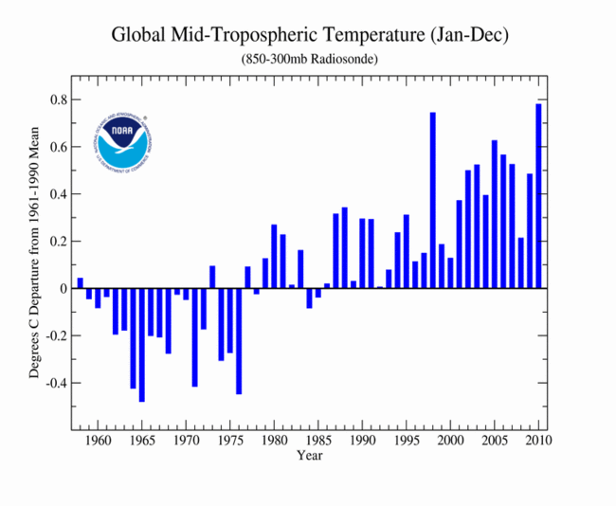
RATPAC Accomplishments:
Regional and monthly mean adjusted radiosonde temperature dataset
First radiosonde temperature dataset homogenized without the use of satellite data.
Only NOAA upper-air adjusted radiosonde dataset, transferred to NCDC for monthly operational updating.
RATPAC used by NCDC for monitoring
(Taken from NCDC website)
Notes:
RATPAC is a regional and monthly mean adjusted dataset. It was the first radiosonde temperature dataset homogenized without the use of satellite data, and is the only
NOAA upper-air adjusted radiosonde dataset. ARL transferred RATPAC to NCDC where it is updated on a monthly basis.
The figure is an example of the use of the RATPAC data updated through 2010 from NCDC’s climate monitoring web page; this was downloaded this spring, and shows that 2010 was the warmest year in the RATPAC record for the global troposphere.
[NCDC=NOAA NESDIS National Climatic Data Center]

Slide 8

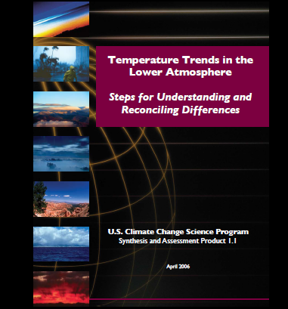
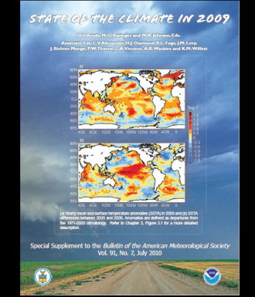
RATPAC Indicators of Success:
  Used for assessments (IPCC, BAMS State of Climate Reports)
  Used by numerous other scientists.
  NOAA Bronze Medal 2007
  RATPAC paper referenced by many others
Notes:
RATPAC has been used for climate assessments such as the IPCC AR4 report and the State of the Climate Reports published annually in the Bulletin of the American Meteorological Society (BAMS). The team won a NOAA bronze medal in 2007. Many other scientists have used RATPAC, and our paper has been referenced often in the literature.

Slide 9
Number of publications*
referencing RATPAC, by year
Total publications to date = 51
*From Web of Science
Notes:
Over 50 papers have cited our paper on the RATPAC dataset.

Slide 10
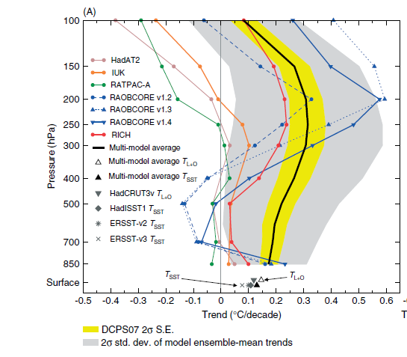
Using RATPAC: Comparing observed trends inconsistent
with models
Trends for 1979-1999 in tropics from sondes and models
Santer, Thorne, Haimberger, Taylor, Wigley, Lanzante, Solomon, Free, Gleckler, Jones, Karl, Klein, Mears, Nychka, Schmidt, Sherwood, and Wentz, Int. J. Climatol. (2008)
Notes:
RATPAC was used with other later adjusted radiosonde datasets in a paper published by Ben Santer in 2008 that showed that trends in radiosonde data in the tropical troposphere were not statistically inconsistent with those in climate models. ARL participated in this work.
The colored lines are trends for 1979-1999 in various radiosonde datasets, plotted as a function of pressure level. The black line is the mean of trends from 19 climate models. The gray area represents the uncertainty in the model trends. Because the uncertainties in the radiosonde and model trends are large, the data and models cannot be said to be inconsistent with each other. This resolves to some extent the controversy that began 20 years ago.

Slide 11
March Minimum
December Maximum
Using RATPAC: Seasonal structure of temperature trends in tropics
Mean trends for 10N-10S 1979-2009
From Free (Journal of Climate 2011)
K/decade
Notes:
This is an example of use of RATPAC by our own group. The slide shows the seasonal evolution of temperature trends in the deep tropics. The paper compared these trends in 6 radiosonde datasets and also satellite datasets. The plot shows trends for 1979-2009 for 10N-10S as a function of month (x-axis) and pressure level (y-axis).
The stratosphere shows strong cooling in early winter but little cooling in spring. The troposphere shows a weaker seasonal pattern of warming.
The strong difference in stratospheric trends in different seasons may be an indicator of changes in the stratospheric circulation, as predicted by climate models.
This work was published in Journal of Climate this spring.

Slide 12
  2. Climate effects of volcanic eruptions
Many papers on surface effects, fewer on upper air
Previous work mostly looked at layer mean temperatures or used satellite or reanalysis data.
Instead we:
Examine effects on vertical temperature profile using radiosonde data.
Carefully separate volcanic effects from other short-term variations.
Compare to results from climate models.
RATPAC
Mean of 6 climate models
from Free and Lanzante (J. Climate 2009)
Notes:
To separate long-term trends from other variability it’s necessary to study interannual-scale phenomena too, including the effects of volcanoes and ENSO.
Many papers look at the effects of volcanic eruptions on surface climate. Jim Angell of ARL was one of the first to use radiosonde data to examine effects in the upper air. More recently we have extended this work to compare observed effects to those in climate models. Most previous work of this type used layer-mean temperatures or data from satellites or reanalysis.
The figure shows a comparison of effects of Pinatubo using RATPAC data on the left and the mean of 6 climate models on the right, shown in a latitude-altitude plot. [From Free and Lanzante 2009.] You can see a similar overall pattern of warming in the stratosphere and cooling in the troposphere, with a noisier result in the observations than in the model mean.

Slide 13
Accomplishments:
Comparing volcanic signals in radiosonde data to those in climate models
K
Fig. 4b from Free and Lanzante (J. Climate 2009)
Notes:
This plot is from Free and Lanzante (J. of Climate, 2009), showing the volcanic effects on the vertical temperature profile in the tropics for three large eruptions.
To measure the effect we took the mean temperatures 2 years before minus those for 2 years after the eruption. We did this for two radiosonde datasets, RATPAC and HadAT (from the UK Met Office), shown in black, and for output from 6 climate models, shown in colors. The gray area is the 95% confidence interval around the RATPAC results.
The overall effect in both models and data is as expected, that is, cooling in the troposphere and warming in the stratosphere, but there are differences among models and between models and data.
For Chichon and Pinatubo, models show less cooling in tropical troposphere than do the data.
Models tend to show more response to Pinatubo in the stratosphere and at the tropopause than seen in data.
Other results from this paper, not shown in this plot, include a finding that the effects of eruptions on trends are probably not important for periods ending after 1998.

Slide 14
  3. Effects of ENSO on stratospheric temperatures
Previous work used single reanalysis or satellite datasets, and examined limited regions or vertical levels. Our approach differed:
Applied multiple linear regression to radiosonde data
Used several datasets to test robustness of results
Looked at whole atmosphere in zonal mean

Slide 15
Accomplishment: ENSO effect on stratospheric temperature
Tropical cooling
Polar warming
Free and Seidel (JGR 2009)
K
Notes:
Free and Seidel (Journal of Geophysical Research, 2009) shows results from regression analysis of 4 radiosonde datasets, including RATPAC and two other adjusted datasets, in the zonal mean, as a function of pressure level. The figure shows the ENSO effect in winter, with significant cooling in the tropical stratosphere and warming in the Arctic stratosphere. The blank areas are those where the effect was not statistically significant. We found significant cooling in the tropical stratosphere during El Niño winters, and warming in the Arctic stratosphere.
The warming in the Arctic stratosphere has potential implications for surface weather, especially in Europe and possibly the Eastern US, through the effects of the polar vortex on the Arctic Oscillation.

Slide 16
Summary-Accomplishments:
Greater understanding of upper-air temperature trends and their uncertainties
Clearer picture of effects of volcanoes and ENSO on vertical temperature profile

Slide 17
Collaborators:
RATPAC:
NOAA GFDL: John Lanzante
NOAA NCDC: Imke Durre, Tom Peterson
Volcanic effects on temperature:
John Lanzante, NOAA GFDL
Notes:
The RATPAC dataset was created by a team including collaborators from two other NOAA organizations: the Geophysical Fluid Dynamics Lab (GFDL) and the National Climatic Data Center (NCDC).
The work on volcanic effects was done in collaboration with John Lanzante from GFDL.

Slide 18
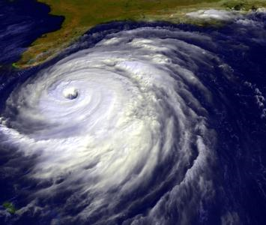
Possible Future Directions
1. Reasons for trend differences
2. Origins of biases
3. Effects on hurricane intensity
Notes:
For the future, we have more ideas than we have resources to pursue them. These are some of our thoughts.
1. We now have ~5 adjusted datasets from different institutions, showing a wide range of trends. It would be interesting to investigate the reasons for the differences in trends in these datasets.
2. One possible source of artificial cooling trends in the stratosphere is changes in the number of balloons reaching a given level due to improvements in balloon quality. It would be helpful to test whether this is an important source of problems in radiosonde records.
3. Hurricane “potential intensity” (PI) seems to be sensitive to differences in vertical temperature profiles in the tropics. We may investigate the effect of uncertainties in trends in the upper troposphere and lower stratosphere on estimates of changes in hurricane PI.

