Slide 1
Air Resources Laboratory
Summary
Steve Fine
Air Resources Laboratory
ARL Laboratory Review
May 3-5, 2011

Slide 2
Science Themes
Dispersion /
Boundary Layer
Air Quality
Climate

Slide 3
Integration Among Themes
Dispersion /
Boundary Layer
Air-land fluxes
Climatology of the boundary layer
Urban climate
Modeling for toxics, ash, smoke, dust
Flows around sound barriers
Air Quality
Climate-air quality modeling
Co-location of observing sites
Climate
Notes:
Do not expect that all activities will touch on multiple themes

Slide 4
Planning Process:
Communicate, Assess, Prioritize
Customers
ARL Staff
ARL Mgmt.
Higher-Level Mgmt.
ARL…
Priorities
Plans (Indiv. & Org.)
Proposals
Activities
Termination of activities
Community

Slide 5
Lab in Transition
Motivations
  Improve value to NOAA and other customers
  Improve critical mass
  Respond to/anticipate evolving societal needs
  Respond to recommendations from last review
Transitions
  Greater Integration with NOAA Priorities and Activities
  Establish Boundary Layer as Another Focus Area
  Greater Integration Among Divisions
  Integration of Research and Technical Services
Significant progress made

Slide 6
Major Ongoing Challenges for ARL
Continuing to implement transitions
Maintaining and improving the quality and value of R&D in current fiscal environment
Increasing investments in key areas for the Nation and NOAA
  Dispersion—integrated, enhanced NOAA capabilities
  Boundary layer—wind energy, initiation of convection, etc.
  Climate—analysis, air-land interactions, regional modeling
  Nutrients
NOAA Climate Service—ensuring that ARL climate-relevant activities are appropriately integrated

Slide 7
Highlights of Quality, Relevance, and Performance

Slide 8
ARL Publications Cited More Frequently than Average
% of Pubs in Field’s Top 1%, 10%, and 50% Most Frequently Cited
Source: Belter, NOAA Central Library
Notes:
Includes ASMD and SRRB. Details of analysis in reviewers notes. Highlights:
Analysis performed by Chris Belter from the NOAA Central Library.
“The purpose of this report is to evaluate the citations received by ARL papers published between 1999 and 2010 in order to determine if these publications received a below average, average, or above average number of citations compared to all of the articles published on the same subjects during the same years … ARL had no input or influence on the study design, methodology or results of this report.”
“For each subject category and year of publication between 2000 and 2009, a set of all papers published in that category and year was generated and ranked according to each paper’s citation count. This ranking was then used to identify four citation percentiles: 1st, 10th, 50th, and below 50th.”
“The use of percentiles allows for direct and accurate comparison of the papers under evaluation to the actual distribution of all papers in the same subject category—making interpretation of the results relatively straightforward. The results of this method are not inflated by highly cited papers and, moreover, provide a more detailed portrayal of the citations received by all articles under evaluation than any other current bibliometric indicator available.”

Slide 9
Quality: Contributions to International and National Data Sets
Dispersion
  Tracer data sets widely used by dispersion community
Air Quality
  Leadership in WMO intl. precip. chemistry efforts
  Leadership in national mercury observation network
Climate
  Implementation of reference surface observations
  Leadership in establishing international reference observations aloft
  Data sets transitioned to NCDC: RATPAC, extreme heat, …

Slide 10
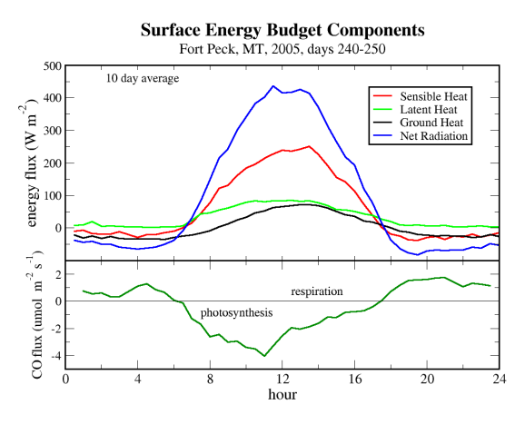
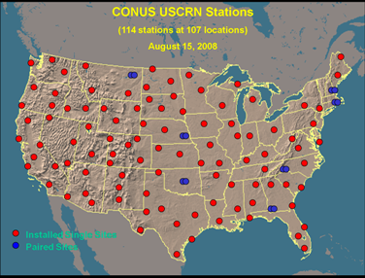
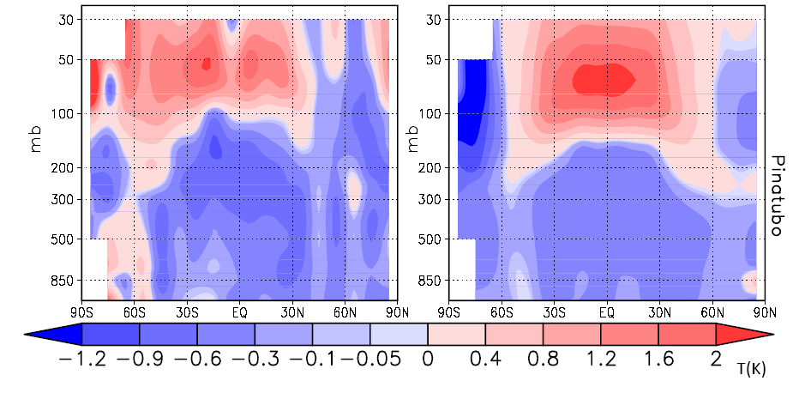
Relevance & Performance:
Selected contributions to NOAA’s Climate Goals
Objective: Improved scientific understanding of the changing climate system and its impacts
Objective: Assessments of current and future states of the climate system that identify potential impacts and inform science, service, and stewardship decisions
Response to volcanic eruptions
Obs.
Mean of 6 models
Free and Lanzante 2008
Notes:
ARL’s work contributes to these areas

Slide 11
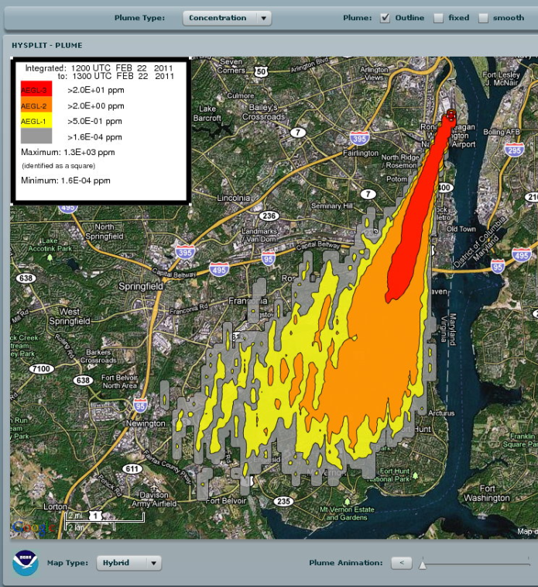
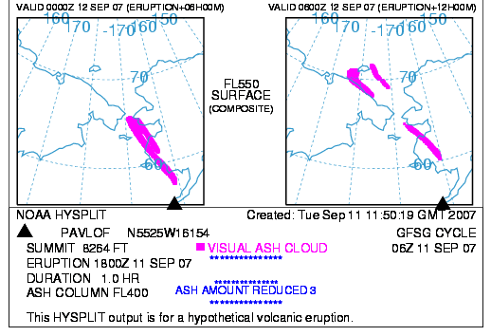
Relevance & Performance:
Selected contributions to NOAA’s Weather Goals
Objective: Reduced loss of life, property, and disruption from high-impact events
Objective: Improved transportation efficiency and safety
Notes:
ARL’s work contributes to these areas

Slide 12
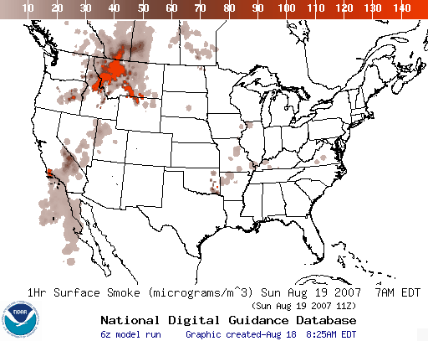

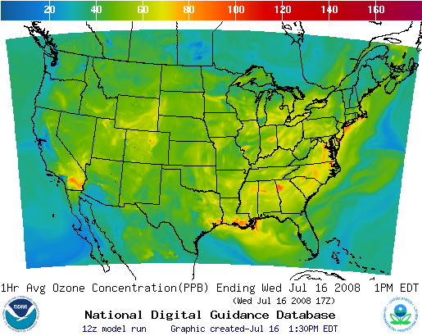
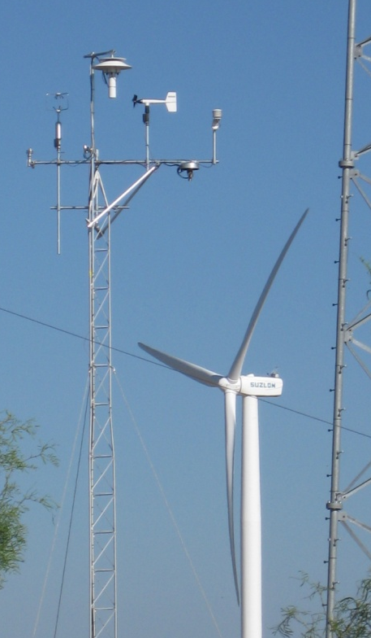
Relevance & Performance:
Selected contributions to NOAA’s Weather Goals
Objective: Healthy people and communities due to improved air and water quality services
Objective: A more productive and efficient economy through environmental information relevant to key sectors of the U.S. economy
Notes:
ARL’s work contributes to these areas

Slide 13
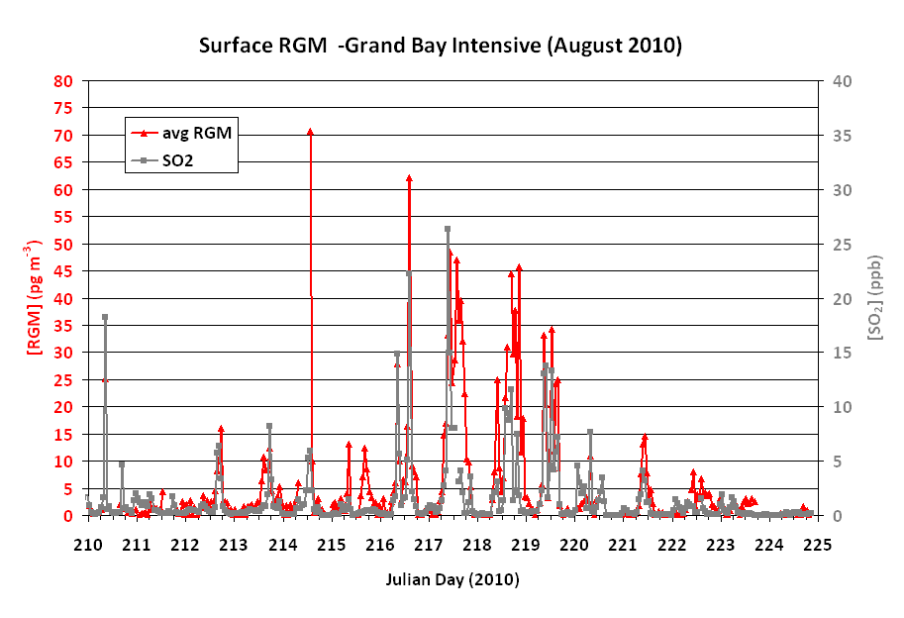
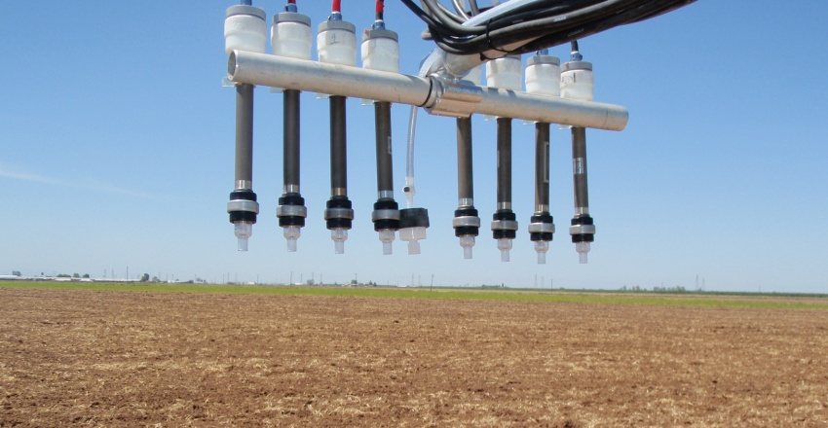
Relevance & Performance:
Selected contributions to NOAA’s Coastal Goals
Objective: Improved coastal water quality supporting human health and coastal ecosystem services
Notes:
ARL’s work contributes to these areas

Slide 14
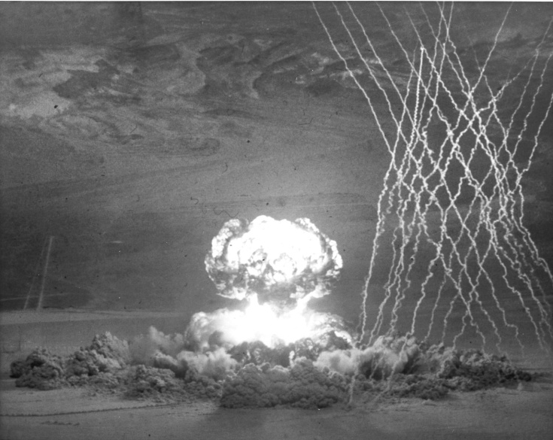
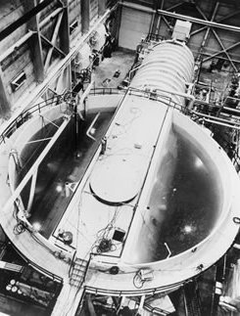
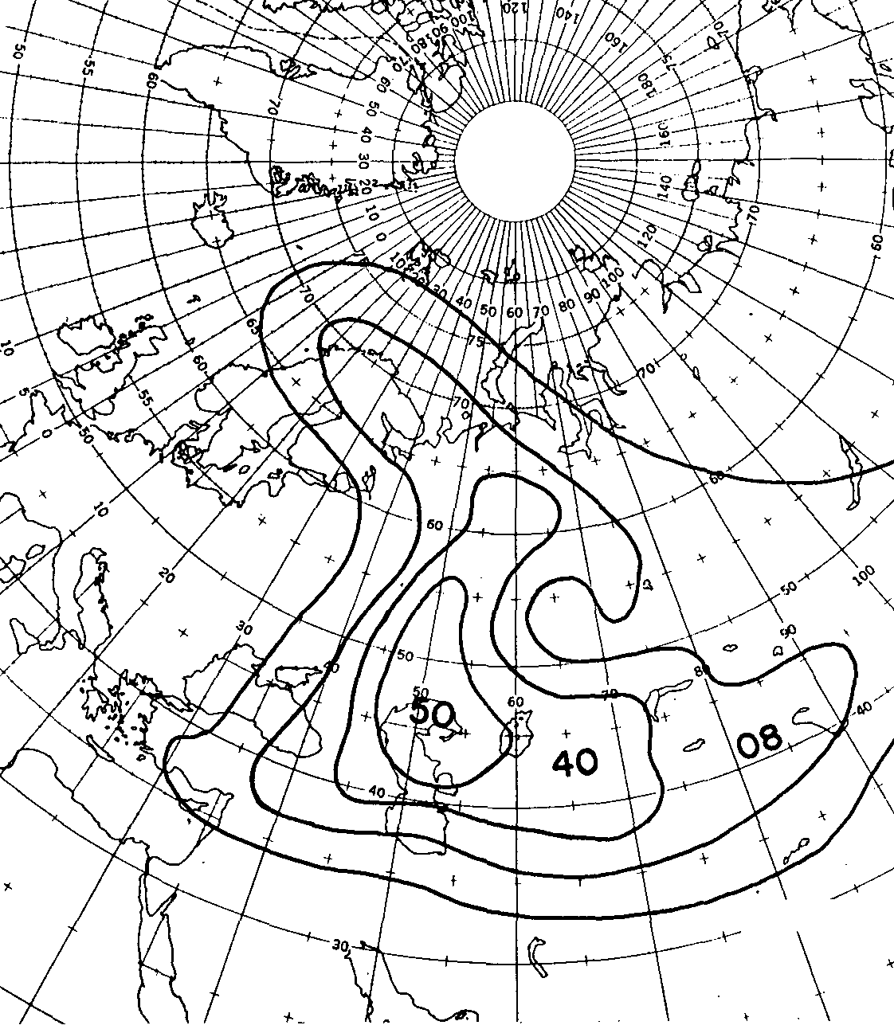
Final Thoughts
ARL founded early in the nuclear age to provide service to other agencies

Slide 15
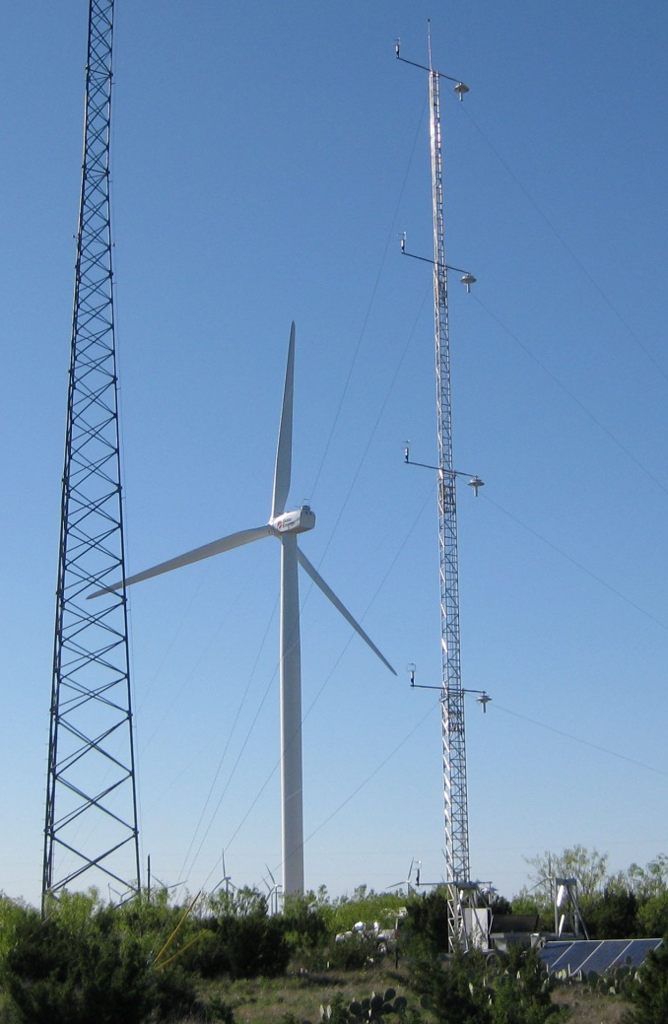
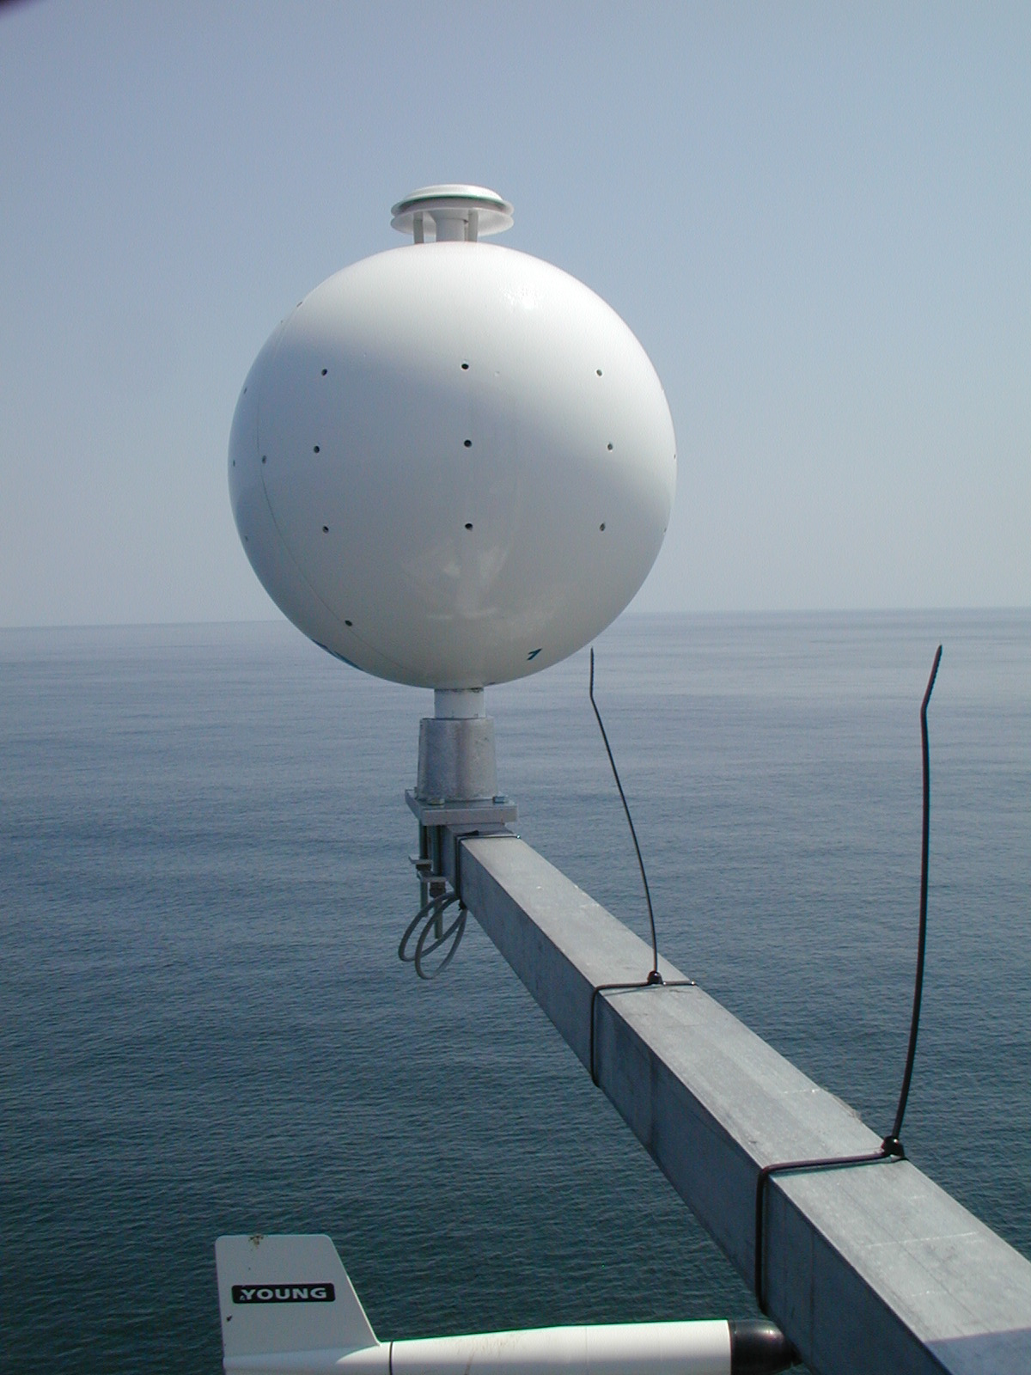
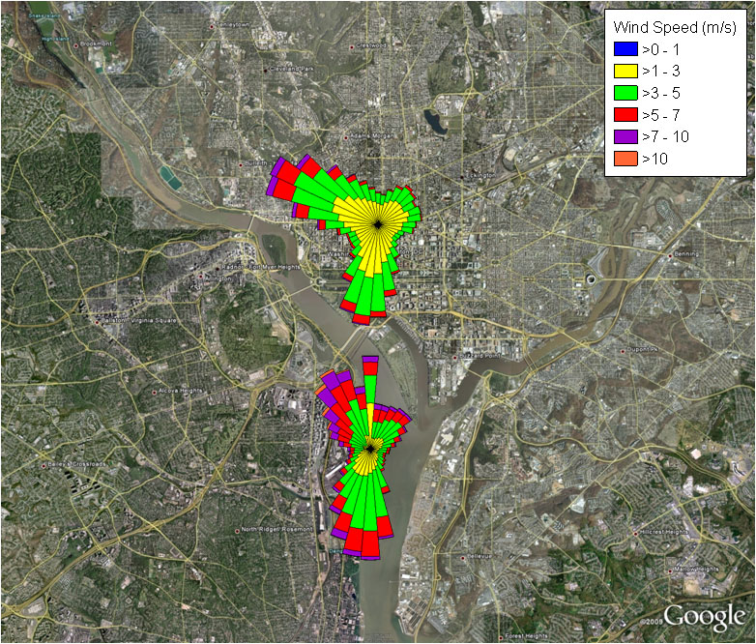
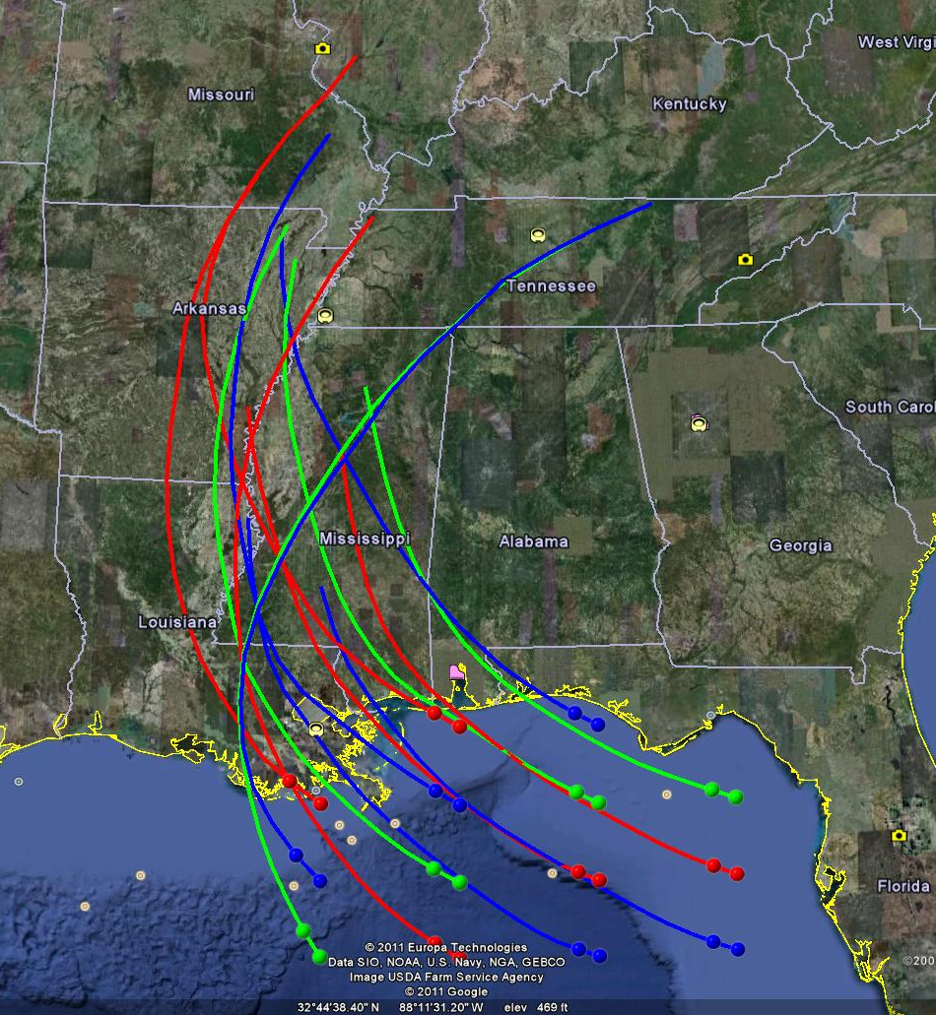
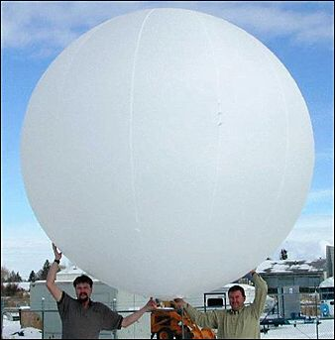
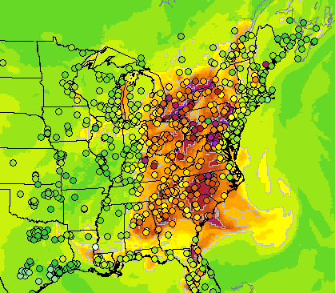
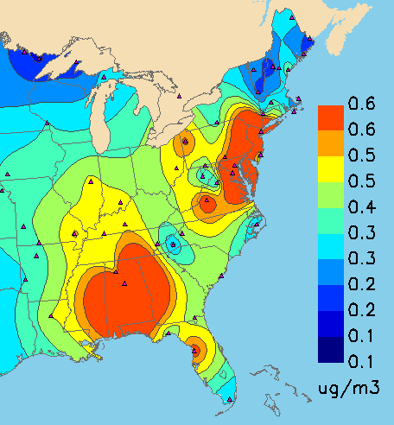
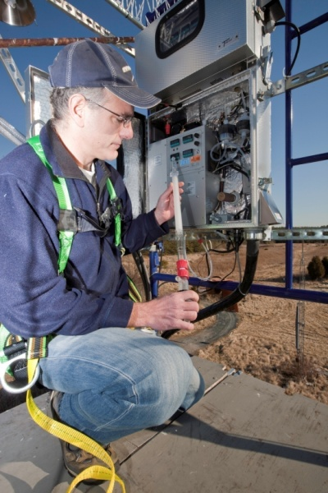
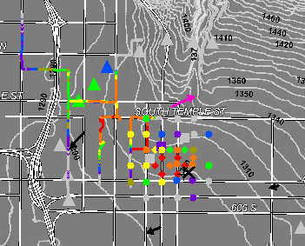
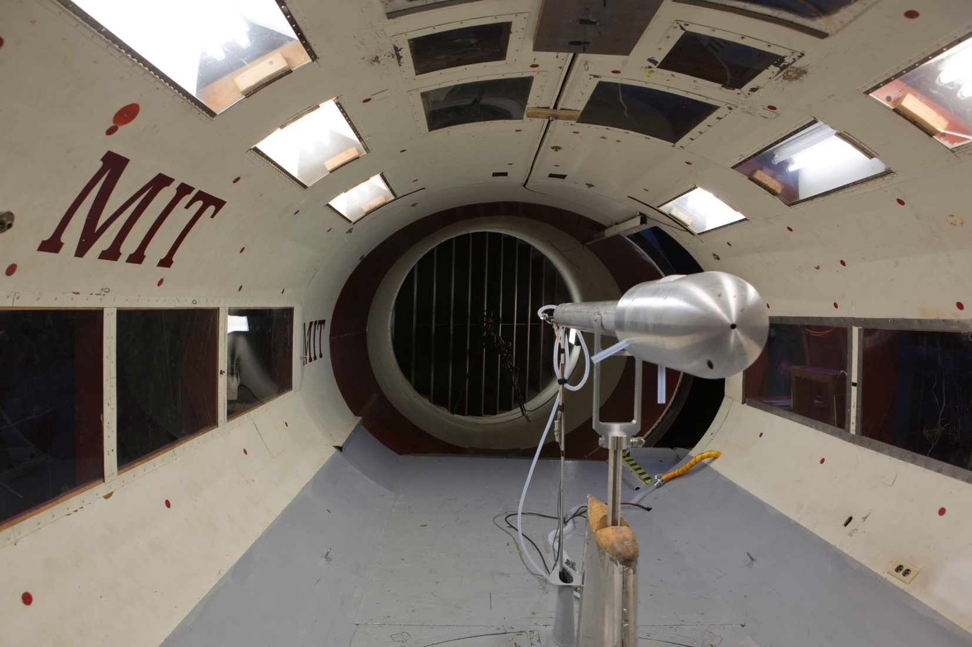
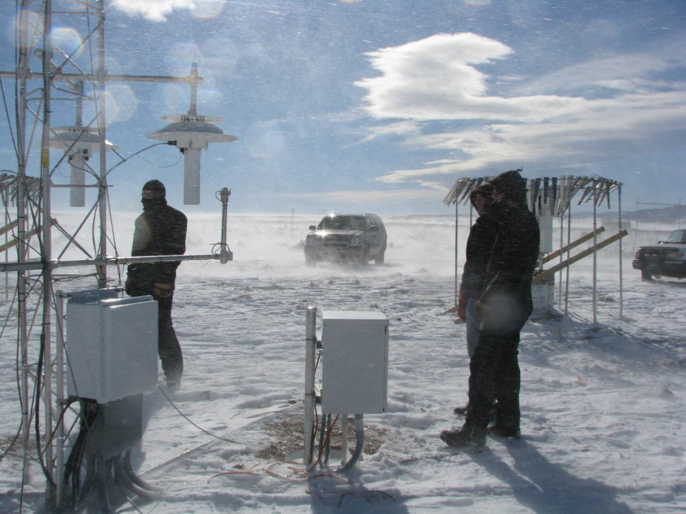
Final Thoughts
December
Maximum
March Minimum
ARL founded early in the nuclear age to provide service to other agencies
Retained
  Strong science
  Commitment to supporting applications
  Effective partnerships
while evolving to continue to meet society’s changing needs
K/decade

