Slide 1
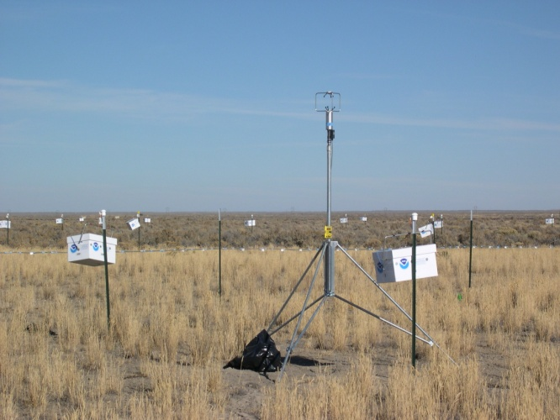
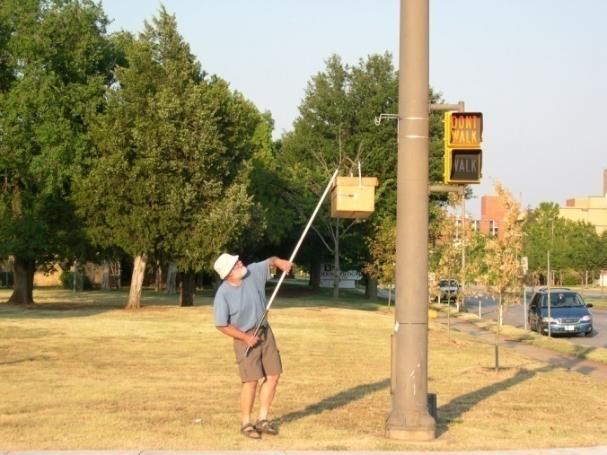
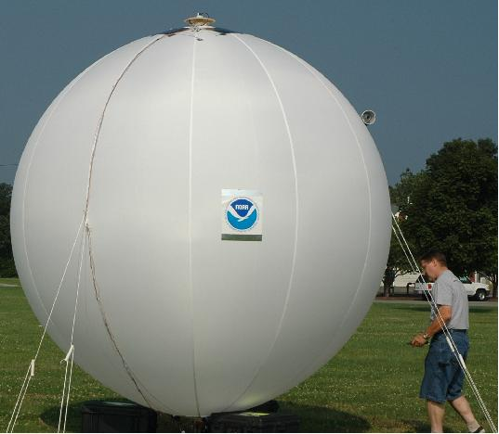
Tracer Technology and Research
Richard M. Eckman
Air Resources Laboratory
ARL Laboratory Review
May 3-5, 2011

Slide 2
Science Goals
Evaluate atmospheric dispersion models
Air quality applications (chronic exposure)
Toxic releases (acute exposure)
Improve model parameterizations
Fill knowledge gaps in complex environments―cities, complex terrain, coastal areas
Study atmospheric processes with instrumented balloons
Originally tracers for dispersion applications
Lagrangian observation platforms for air quality and hurricane boundary layer
Notes:
ARL’s dispersion activities ultimately lead to improved models for predicting the fate of hazardous materials in the atmosphere. Clearly, real-world measurements of plume concentrations are critical for evaluating model skill, developing new parameterizations of specific phenomena (e.g., stability effects), and filling knowledge gaps in challenging environments such as urban areas, coastal sites, and complex terrain. ARL has developed a world-class capability in releasing and measuring non-toxic tracer gases for dispersion research. We have the ability to measure both time-average concentrations, which are important for chronic exposures in air-quality applications, and concentration fluctuations, which are relevant for acute exposures in accident and terrorism scenarios. ARL also has expertise in the use of instrumented balloons, which can be considered a tracer. Balloons are discussed only briefly here, with details left to the poster session.

Slide 3
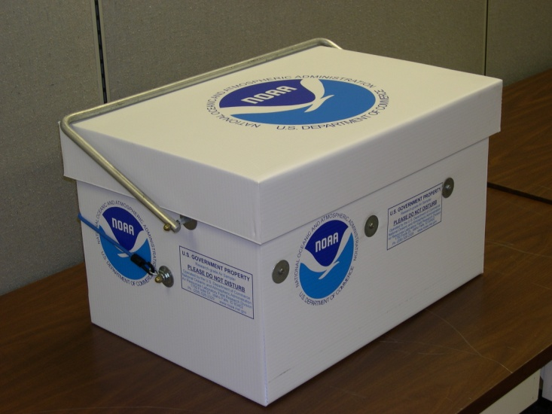
Approach: Bag Samplers
Time integrated concentrations
12 bags each
Analysis not in real time
Notes:
ARL has approximately 130 bag samplers (top left photo) that can be programmed to collect samples over periods from minutes to many hours. They provide time-average concentrations. Each sampler holds 12 bags (bottom and right photos) which are independently filled based on instructions from an on-board programmable microprocessor. Sulfur hexafluoride (SF₆) has been the workhorse tracer gas, but we can also can use perfluorocarbons. With SF₆ we can measure concentrations ranging from 5 ppt (parts per trillion) to greater than 1 ppm (parts per million). Samplers are outfitted with bar codes for maintaining chain of custody.
Note: SF₆ background level is about 5-6 ppt.

Slide 4
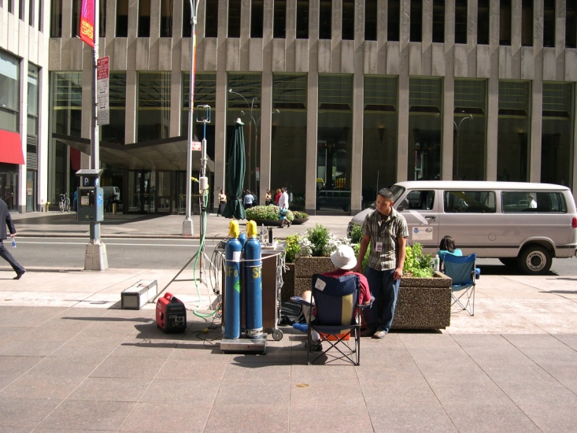
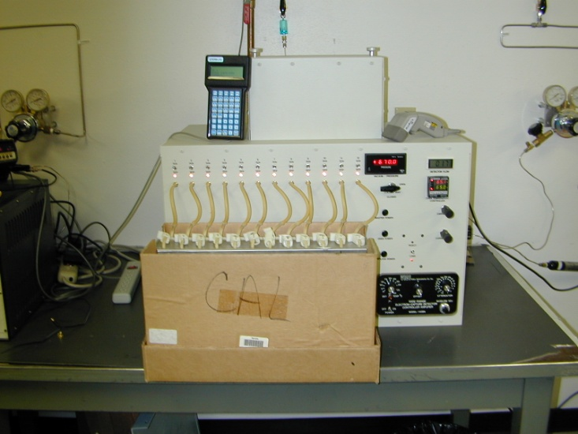
Approach: Field Deployment and Analysis
Release Mechanism
Sampler Deployment
Sample Analysis
Notes:
Bag samplers by themselves are just part of a successful tracer study. First, a tracer release mechanism (top photo) must be designed that ensures the release rate is known to high accuracy. Otherwise interpretation of the concentration data will be difficult or impossible. Second, the samplers must be deployed in a pattern to maximize the chances of a successful experiment, considering other factors such as tampering by the public (left photo). Third, the samples must be transported back to a laboratory for processing (right photo). Chain of custody is critical for quality assurance. Analysis is done with a gas chromatograph that uses an electron capture detector (ECD). ARL has expertise in all aspects of designing and undertaking tracer field studies.

Slide 5
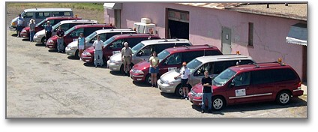
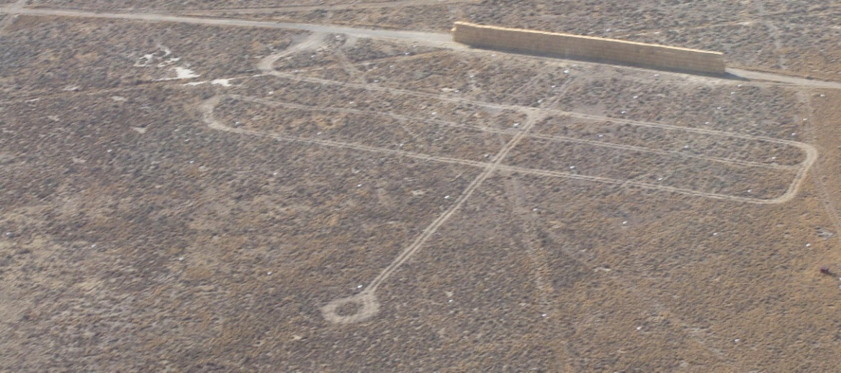
Approach: Fast Response Samplers
1 s response time
Mobile
Near real time analysis
Notes:
For measuring concentration fluctuations, ARL has developed a fast-response SF₆ sampler based on electron capture detection technology. It has a response time of about 1 second. Unlike the bag samplers, these systems analyze samples in near real time. Of course, this means there is no chance to reanalyze a sample. The fast-response samplers have a more limited dynamic range than the bag samplers: about 20 ppt to 20 parts per billion (ppb). This means they can become “saturated” if placed too close to the source.
The fast-response samplers have been scaled down in size to the point that they fit on a car seat (upper left photo). Indeed, they are often deployed in rental cars to provide mobile measurements (upper right photo). The bottom photo shows tracks made by vehicles with mobile samplers during a tracer study in Idaho. The samplers have also been used on aircraft and boats. Each sampler has a automated calibration system that uses National Institute of Standards and Technology (NIST) traceable SF₆ standards. Because of their expense, ARL has only about 10 of these samplers.

Slide 6
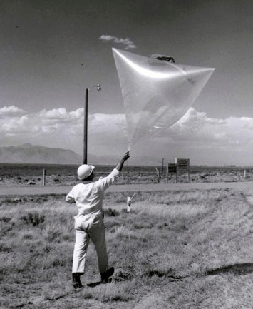
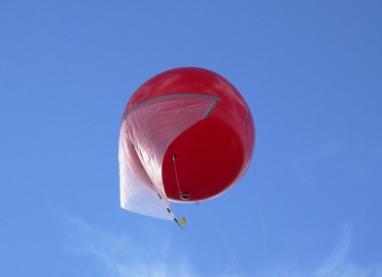
Balloon Systems
Tetroon
2006 cover Bulletin of the AMS
Hurricane balloon
Notes:
ARL balloon activities started back in the 1960s when tetroons (tetrahedral balloons, upper left photo) were used to estimate plume transport. Since then they have been adapted to a variety of air quality and hurricane-related activities. ARL’s designs are mostly constant-volume balloons that maintain an approximately constant altitude. The latest versions use GPS (Global Positioning System) receivers and two-way satellite communication, and their altitude can be remotely adjusted (right photo). They can measure pressure, temperature, humidity, solar radiation, and pollutant (ozone) concentrations. Currently, ARL is working on a balloon with a tether line and sea float that is intended to provide continuous observations near or in hurricanes (lower left photo).
Due to time limitations, details on the balloon research are provided during the poster session.

Slide 7
Major Accomplishments and Findings
Participated in all major U.S. field studies
Added ability to detect multiple perfluorocarbon tracers
Greatly expanded urban tracer datasets
Observed rapid vertical transport in high-rise areas
Observed “upwind” and “lateral” urban transport
Provided new information on the effect of roadway sound barriers on pollutant concentrations
Developed guidance for first responders in urban areas
Developed low-cost prototype detector for measuring concentration fluctuations
Notes:
ARL has been involved in tracer studies for decades. This slide shows major accomplishments and findings from 2000 to 2010. After the terrorist attacks on 11 September 2001, there was a surge in interest for urban tracer studies. As a result, many bullets are related to urban dispersion. ARL has also advanced the tracer technology by adding a capability to simultaneously measure multiple perfluorocarbon tracers and developing a simpler and less expensive detector for measuring concentration fluctuations.

Slide 8
“Upwind” Dispersion of Plume
Urban 2000 Salt Lake City
Notes:
This is an example of a significant result from the Urban 2000 study in Salt Lake City. The tracer release took place at night. When synoptic forcing is light, one would expect nocturnal drainage flow off the Wasatch Range to the east (right on map) and perhaps some drainage in the valley towards the Great Salt Lake (upper left on map). Wind measurements taken at various locations around the city (black arrows) generally confirmed this expectation. However the tracer plume (release point at black circle) actually headed northeastward, which is upslope and nearly opposite to what was expected. Urban effects apparently caused a localized area of counter flow. When dispersion models are applied to urban areas like this, wind observations from the closest airport are often taken to be representative of the whole area. This can lead to serious errors as a result of urban influences on air flow.
Paper reference: Finn et al. (2008) J. Appl. Meteorol. Climatol., 47, 2857-2878.

Slide 9
Dispersion Effects of Roadway Sound Barrier
2008 collaboration with EPA
Mock sound barrier 1 ton straw bales
Concentration ratio barrier to non-barrier neutral case
Notes:
In collaboration with the Environmental Protection Agency, ARL undertook a study to assess the effects of roadway sound barriers on the pollutant exposure of nearby residents. These barriers have been placed along many urban highways, but roadway dispersion models do not account for them. ARL constructed a mock sound barrier out of 1-ton straw bales (top photo) and performed tracer releases under various stabilities. To assess the effects of the barrier, a second no-barrier release site was constructed nearby. It was identical to the first site regarding the release and sampler configuration but lacked the mock sound barrier. This allowed us to compare the barrier and no-barrier concentrations under the same atmospheric conditions. The bottom plot shows the ratio of the SF₆ concentrations at the barrier and non-barrier sites under near-neutral conditions. There is a ~40% decrease behind the barrier but significant increases at the barrier ends.
Paper reference: Finn et al. (2010) Atmos. Environ.,44, 204-214.

Slide 10
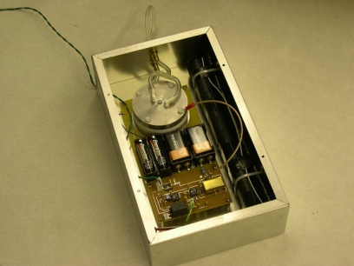
Indicators of Success
9 journal publications since 2000 (17 conference papers)
8 NOAA Technical Memorandums since 2000
Over 150 paper citations
2007 NOAA Bronze Medal
Patent for prototype fast-response detector (X-6)
Widespread media coverage
Requests for collaboration from external organizations
Notes:
ARL has been involved in nearly all the major U.S. research studies involving tracers. To our knowledge, we have the most comprehensive tracer-research capability in the U.S., extending from planning to execution and data analysis. Over 30 publications of various types have resulted from the work since 2000, excluding publications by other organizations that have used our data. Recently, a patent was awarded for a new X-6 Stepped Electric Field Detector (photo) that can provide fast-response concentration measurements with lower cost and less manual intervention than our current fast-response systems. Our capabilities are well known, and external organizations seek us out when considering a tracer study.

Slide 11
Collaborators
Federal
Department of Defense
Environmental Protection Agency
Department of Energy
Department of Homeland Security
Academia
University of Utah
Washington State University
National Center for Atmospheric Research
Desert Research Institute
Private Sector
Hanna Consultants
Northrop Grumman
Notes:
Our collaborations have mainly been with other federal agencies, in part because the resources of the federal sector are often required to mount the larger field campaigns. Joint Urban 2003 in Oklahoma City, for example, had about 150 collaborating scientists. However, these large programs also include researchers from academia and the private sector, and ARL has worked closely with them.
The Department of Defense collaborations include groups such as the Defense Advanced Research Projects Agency (DARPA) and Defense Threat Reduction Agency (DTRA).

Slide 12
Future Directions
Need for new generation of tracers with lower Global Warming Potential (GWP)
Low background, easy to detect, nontoxic
Both integrated and real-time sampling
Inexpensive to release and analyze
Lower cost fast-response measurements
Current systems cost > $30K and require constant supervision
X-6 prototype detector
Urban dispersion, chemical cartography
Notes:
Both SF₆ and perfluorocarbons have high global warming potentials (GWP). This is not purely accidental, because electron capture detection, which is the foundation of current tracer sampling, works best with fluorinated and chlorinated gases that are often good absorbers in the infrared. In addition, stable molecules with long atmospheric lifetimes are ideal as tracers, but long lifetimes also enhance the GWP. The amount of tracer released in dispersion research is a tiny contribution to total greenhouse gas emissions. However, there obviously is some concern about the continued use of such materials. ARL would like to explore a new generation of tracers that have a lower GWP. This may not be as simple as it first appears, because any new tracers must have backgrounds and detection limits in the parts-per-trillion range to be competitive with current tracers. Cavity ring down spectroscopy is one possible future method for detecting trace gases.
ARL will continue to pursue existing research directions, including the X-6 prototype detector for fast-response measurements and exploring further opportunities for understanding urban dispersion using tracers.

