Slide 1
HYSPLIT
Hybrid Single Particle Lagrangian
Integrated Trajectory Model
Roland Draxler
Air Resources Laboratory
ARL Laboratory Review
May 3-5, 2011

Slide 2
Goals
Research and Applications
Emergency Response
  Radiological releases
  Improvised nuclear devices
  Chemical releases
  Volcanic eruptions (Barbara Stunder)
Air Quality
  Kilauea plume prediction
  Fire smoke and Wind-blown dust (Ariel Stein)
  Global pollutant transport
  Source-receptor analysis (Mark Cohen)
Model Evaluation
  Data Archive of Tracer Experiments and Meteorology
  Meteorological data assimilation
Decision Support
  Dispersion model training
  Real-time Environmental Applications and Display sYstem
Notes:
The main research goal is to adapt HYSPLIT to the widest variety of simulation problems in emergency response and air quality that are optimal applications for the point-source based strengths of Lagrangian models. There is a parallel emphasis on decision support because otherwise the numeric model output fields of air concentration and deposition can not be used effectively by non-experts.

Slide 3
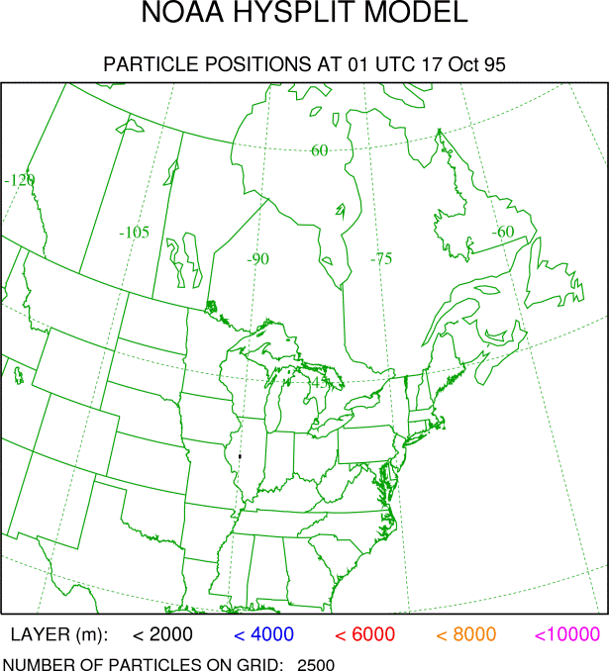
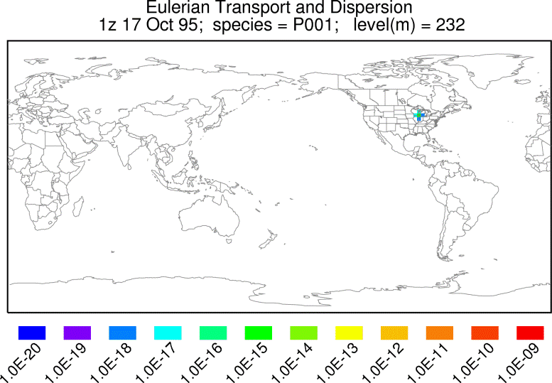
HYSPLIT Description and History
Numerical Approach
  Follows particle motion
  Off-line (easy to re-run)
  Requires meteorological fields
  Particle or puff solutions
  UNIX, PC, Mac, Web
History
  1980’s used only soundings
  1990’s switched to model fields
  2000’s incorporate 3D turbulence
Future Directions
  In-line and multi-cpu
  Shared memory optimization
Notes:
The Lagrangian solution of the advection-diffusion equation follows the mean particle motion in a changing wind field with and added turbulent component to represent the diffusion (top panel). In contrast, in the Eulerian approach, the advection-diffusion equation is solved over all grid points each time step (bottom panel). The HYSLIT calculation is performed off-line, meaning that pre-computed gridded meteorological fields are required as input to the model. In addition to the 3D particle approach, HYSPLIT can also compute the growth of the particle distribution (puff solution), rather than following the motion of each particle.
Lagrangian dispersion modeling started simply by transferring a trajectory end-point position from chart-to-chart and adding an empirical puff-growth rate to that point. Computational techniques became progressively more sophisticated, starting with the interpolation to the nearest sounding site to obtain the wind vector, to the use of numerical model output fields such as NOAA’s Nested Grid Model, to the use of the turbulent kinetic energy field (TKE), now routinely available from most numerical forecast models.
The most recent version of HYSPLIT includes a simple distributed memory message passing index (MPI) parallelization. The development of an in-line version of HYSPLIT is being considered for incorporation into the Advanced Weather Forecasting Research Model (WRF-ARW).
Draxler, R.R., and G.D. Hess, 1998, An overview of the HYSPLIT_4 modeling system for trajectories, dispersion, and deposition. Australian Meteorological Magazine, 47: 295-308.

Slide 4
Emergency Response
Radiological Releases
History
  Chernobyl accident (IAEA)
  WMO Regional Specialized Meteorological Center (RSMC)
  Support NMS in WMO Regions III and IV (Americas)
Accomplishments
  HYSPLIT installed in Australia (BoM) and China (CMA)
  Model based source-attribution applied at CTBTO
Approaches
  Web exchange of graphics and model fields
  Communicating uncertainty through multiple dispersion products
Notes:
One of the original HYSPLIT emergency response applications was in the support of accidental radionuclide releases. This was prompted by the Chernobyl accident where a lack of communication among European countries prompted the International Atomic Energy Agency (IAEA) to request the World Meteorological Organization (WMO) to establish a group of operational National Meteorological Services (NMS) that could provide dispersion forecast products to other NMS. The US Regional Specialized Meteorological Center (RSMC) is a joint effort between ARL and the National Weather Service’s (NWS) National Centers for Environmental Prediction (NCEP) to support the NMS in Central and South America (Regions III and IV). HYSPLIT is also the primary RSMC dispersion model at the Australian Bureau of Meteorology (BoM) and the China Meteorological Administration (CMA).
A relatively new HYSPLIT application is to use an above-background measurement value as a starting point for an adjoint (backward integration of the dispersion model) to identify potential source locations. This is the approach taken by the Comprehensive Test Ban Treaty Organization (CTBTO) to analyze their monitoring network data. HYSPLIT is one of the models used by the CTBTO. Many of the notification and automated model configuration scripts were developed at ARL and provided to the other RSMCs for source-attribution support to the CTBTO. NOAA does not participate in any CTBTO related activities.

Slide 5
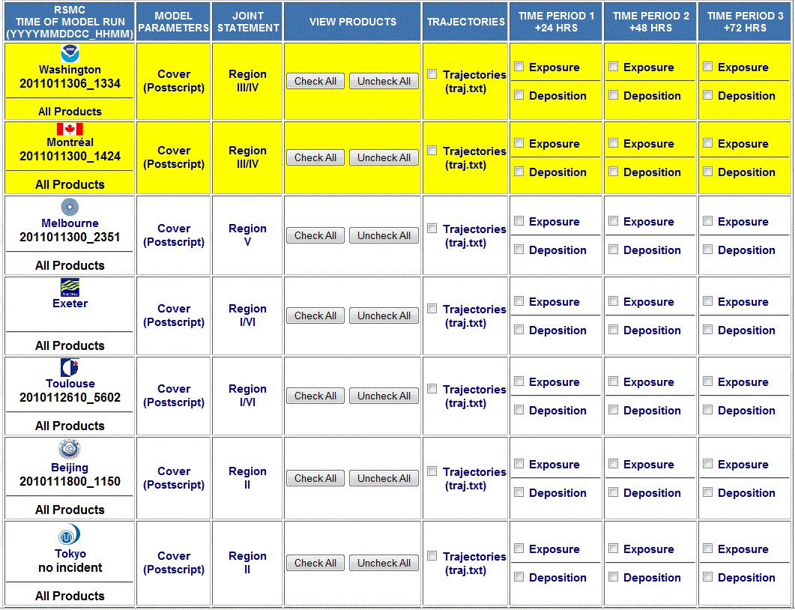
Emergency Response
Radiological Releases
Notes:
ARL RSMC information - http://www.arl.noaa.gov/rsmc.php
WMO RSMC information - http://www.wmo.int/pages/prog/www/DPFSERA/EmergencyResp.html
CTBTO application - http://fts.ctbto.org/atm/
Draxler, R.R., M. Jean, B. Hicks, and D. Randerson, 1997, Emergency preparedness -- Regional Specialized Meteorological Centers at Washington and Montreal. Radiation Protection Dosimetry, 73: 27-30.
Becker, A., Wotawa, G., De Geer, L.-E., Seibert, P., Draxler, R.R., Sloan, C., and others, 2007: Global backtracking of anthropogenic radionuclides by means of a receptor oriented ensemble dispersion modelling system in support of nuclear-test-ban treaty verification. Atmospheric Environment,41:4520-4534, doi: 10.1016/j.atmosenv.2006.12.048

Slide 6
Emergency Response
Improvised Nuclear Devices
History
  ARL participated in early atmospheric testing
Approaches
  212 species considered
  Partitioned between gas and 60 particle size bins
  Time-decayed dose post-processing
Accomplishments
  New product for NOAA’s HSPO and NWS WFOs
  Linked to research and operational NOAA forecast models
Notes:
ARL has a long history with atmospheric nuclear testing, with staff members on-site in Nevada and the Pacific providing fallout forecasts and more recently applying HYSPLIT in the re-calculation of doses resulting from some of the earlier atmospheric tests. A resurgent interest in this area resulted in our adding a nuclear detonation (<50 kT) radiological dose capability to HYSPLIT. Our approach is different from other existing models, which rely on empirical relations between elapsed time and dose. We compute the dose directly from the 212 species resulting from nuclear fission by considering the dose conversion factor for each species. The model runs with about 25,000 particles distributed over 65 different size ranges including one for noble gases. In a post-processing step, the air concentrations and deposition are decayed for each radiological species to the time of interest before computing the dose.
The radiological dose model is available to all of the National Weather Service’s (NWS) Weather Forecast Offices (WFO) and NOAA’s Homeland Security Program Office (HSPO) to support their emergency management functions. The advantage of an internal NOAA capability is that the radiological dose product is automatically linked with all of the NOAA meteorological forecast model products and therefore the normal guidance products available to the WFOs can also be used to support the interpretation of the dose prediction. The graphic shows the ground-level dose measurements from a Nevada test (Simon) in 1953.
Also see: Predictions of dispersion and deposition of fallout from nuclear testing using the NOAA-HYSPLIT meteorological model, Brian E. Moroz, Harold L. Beck, Andre´ Bouville, and Steven L. Simon, 2010 Health Physics Society, DOI: 10.1097/HP.0b013e3181b43697

Slide 7
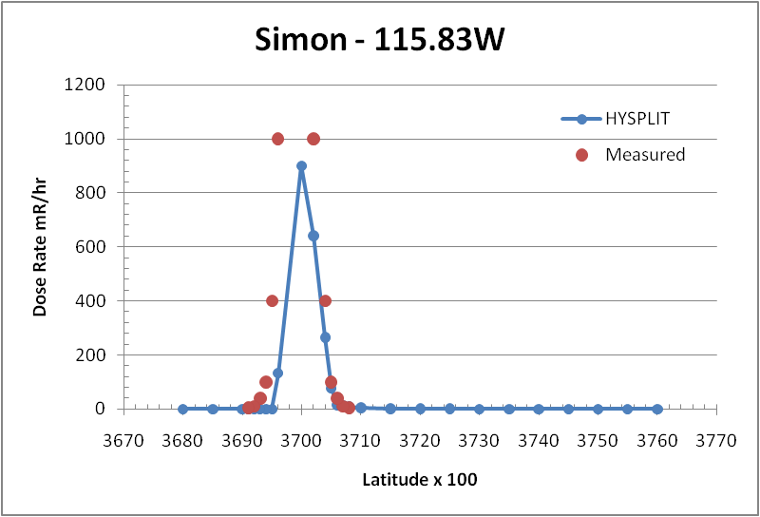
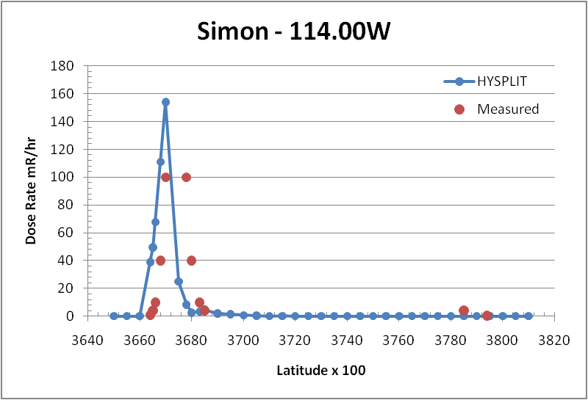
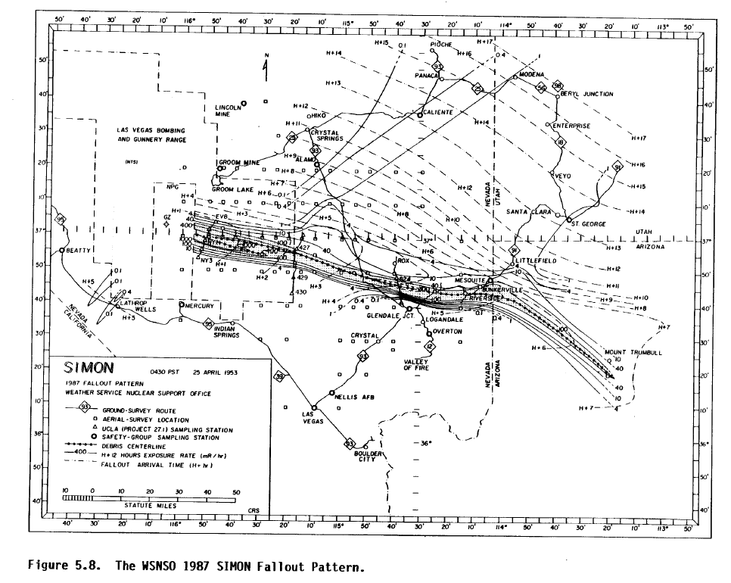
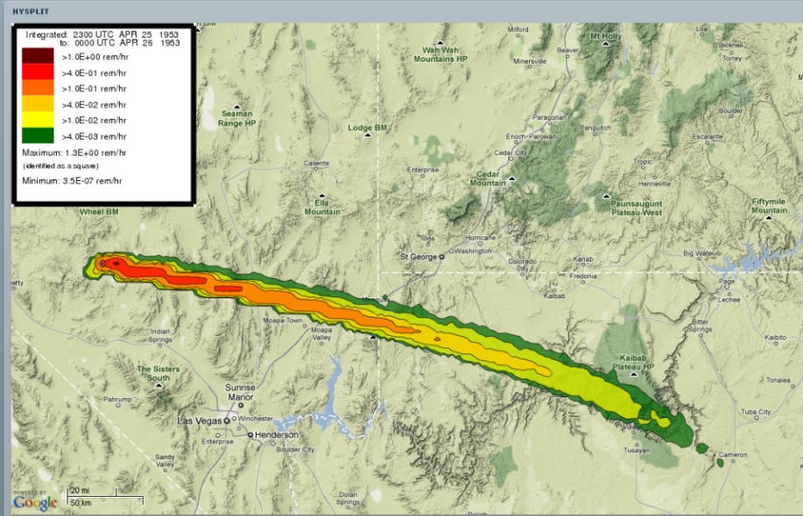
Emergency Response
Improvised Nuclear Devices
Notes:
Although it is not immediately obvious from the web interface, the radiological dose model can be used to simulate any past event rather than just computing a forecast by using the archived reanalysis data which goes back to 1948. The above illustration shows the model dose prediction from the Simon test as well as model and measured dose cross-sections at various downwind distances. Most (5 out of 6) of the events examined showed comparable performance in terms of the calculated dose magnitudes and plume sizes. Slight differences in the plume direction were observed in some of the other events not shown. There is considerable uncertainty in the particle size with height distribution. We are exploring other approaches to establishing the initial conditions.

Slide 8
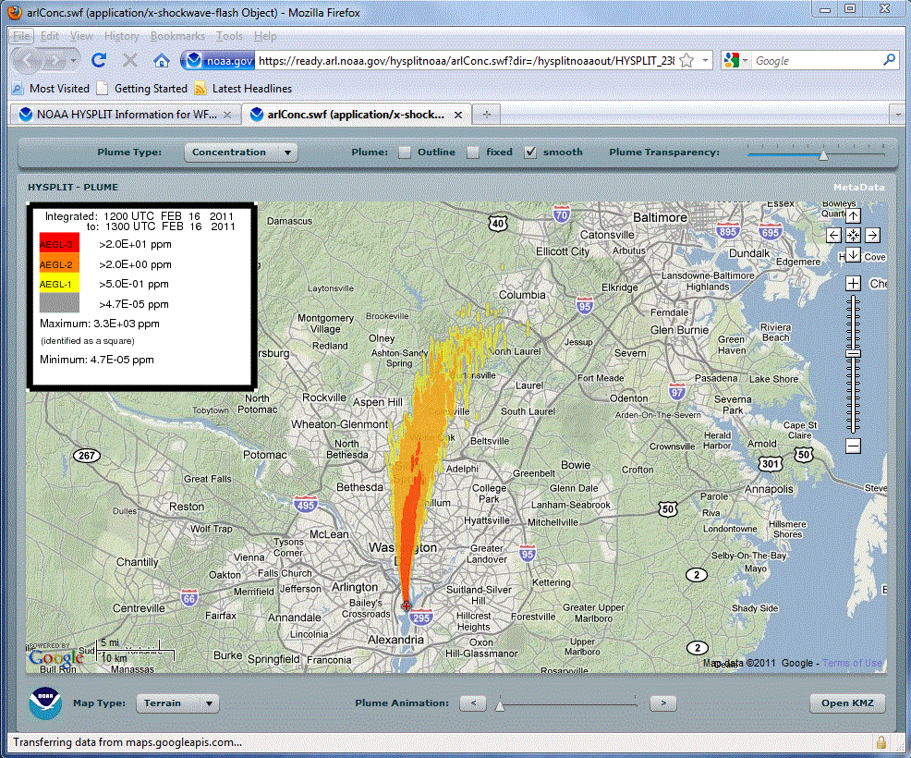
Emergency Response
Chemical Releases
History
  Simple web interface for NWS WFO plume dispersion capability
Approaches
  Link to CAMEO chemicals data
  Collaboration with OR&R to include ALOHA source model
Accomplishments
  Incorporating chemical plume modeling capability at WFO
Notes:
The interest in applying HYSPLIT to more shorter-range problems increased after 9/11 with a request to us by the National Weather Service for routine HYSPLIT forecasts at a number of fixed locations. At the same time an on-demand capability was established through the 24/7 desk of the Senior Duty Meteorologist at the National Centers for Environmental Prediction (NCEP). The response was initiated by a telephone call to the SDM, manual data entry, and the posting the results to a secure web page. The approach proved to be cumbersome and a dedicated web portal for Weather Forecast Office access was developed, initially hosted at NOAA’s 24/7 web portal, but now available only from ARL’s web server. A unique feature of this interface is that it links the Computer-Aided Management of Emergency Operations (CAMEO) chemicals data base with HYSPLIT, permitting the WFO to select a realistic emission scenario and create output graphics linked with human exposure guidelines. Currently we are collaborating with the National Ocean Service’s Office of Response and Restoration to include the source modeling features of their Areal Locations of Hazardous Atmospheres (ALOHA) model as part of the HYSPLIT chemical modeling package. We are also collaborating with the Cooperative Program for Operational Meteorology, Education, and Training (COMET) to develop modules to assist the NWS forecaster in interpretation of the plume dispersion products.
HYSPLIT - https://ready.arl.noaa.gov/hysplitnoaa/hysplit_info.html (use noaa email)
CAMEO - http://cameochemicals.noaa.gov/
ALOHA - http://www.epa.gov/emergenciescontent/cameo/aloha.htm

Slide 9
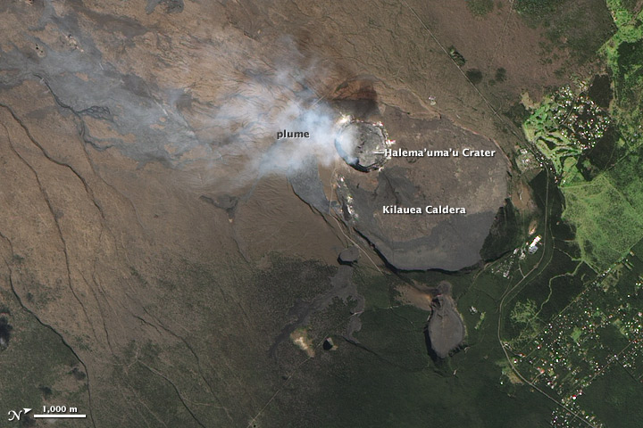
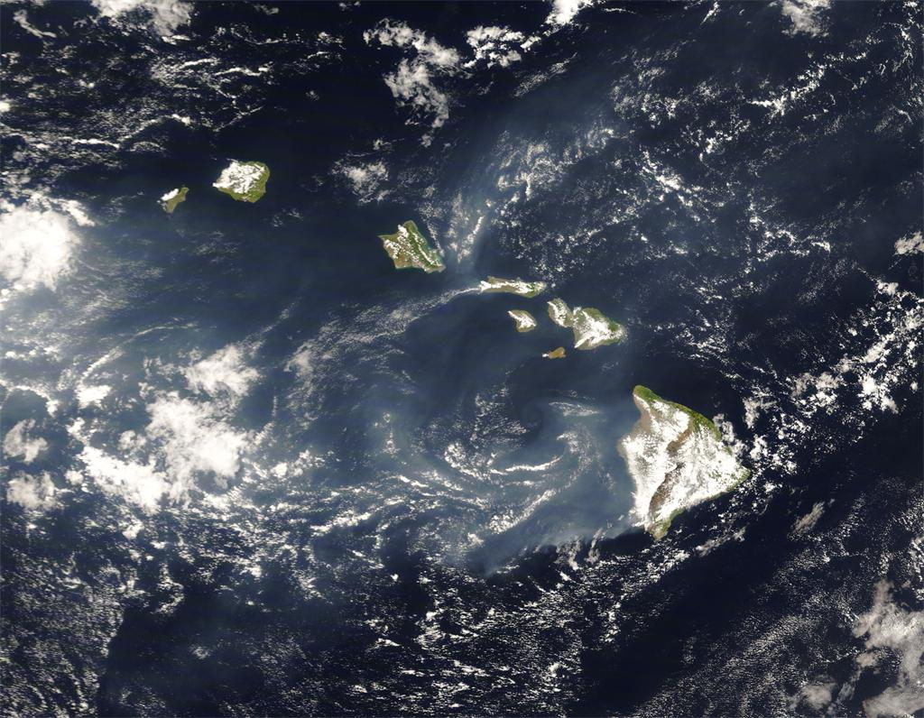
Air Quality
Notes:
Volcanoes also create air quality problems at the ground!

Slide 10
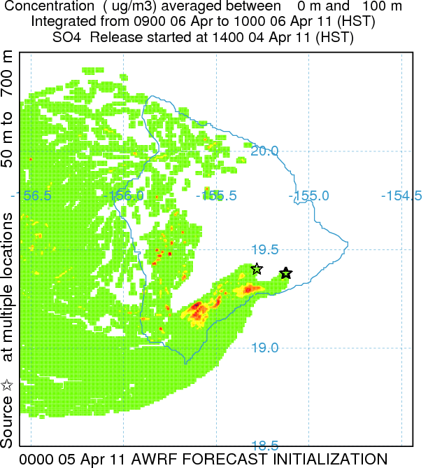
Air Quality
Pu'u'O'o and Halema'uma'u Plume Prediction
Approaches
  Model linked with locally (UH) run 1-km resolution WRF
  Real-time emissions monitoring
  Measurement data for verification
  Results available on-line
Future Directions
  Conversion of SO₂ to SO₄ in unique vent environment
Notes:
In response to increased SO2 emissions (2000 T/day) with the opening of a new SO2 vent on Kilauea (2008), the University of Hawaii (UH) in collaboration with the USPS and the US Geological Service (USGS) created an operational SO2-SO4 HYSPLIT plume forecast product using their twice-a-day WRF-ARW forecast a 15/3/1 km resolution. We helped the UH install a simple sulfate conversion module for HYSPLIT and we are currently evaluating a more complex scheme that uses the WRF liquid water content and predicted HO concentrations to modify the conversion rate. Hazardous SO2 concentrations near the national park visitor’s center may be a problem, but under the right wind conditions, restricted visibility from sulfate may impact the other islands.
The current collaborative effort builds upon a previous work funded by the National Aeronautics and Space Administration (NASA) with the University of Hawaii and the Pacific Disaster Center (PDC) in modeling the Kilauea plume and the development of the ensemble version of HYSPLIT that generates plume probability plots based upon the spatial gradients in the meteorological data fields driving the plume calculation.
In the next phase of the project, closer collaboration with the NAQFC will result in the exchange of UH predictions as well as those using NCEP models. The UH has a real-time verification system available through the web for this project which can support some of the requirements of the NAQFC program.
VOG project - http://mkwc.ifa.hawaii.edu/vmap/index.cgi
HYSPLIT forecast - http://mkwc.ifa.hawaii.edu/vmap/hysplit/
Hollingshead, A.T, Businger, S., Draxler, R., Porter, J., Stevens, D., 2003, Concentration and Dispersion Modeling of the Kilauea Plume, Boundary Layer Meteorology, 108:121-144.
Draxler, R.R., 2003, Evaluation of an ensemble dispersion calculation, J. Appl. Meteorol. 42:308-317.

Slide 11
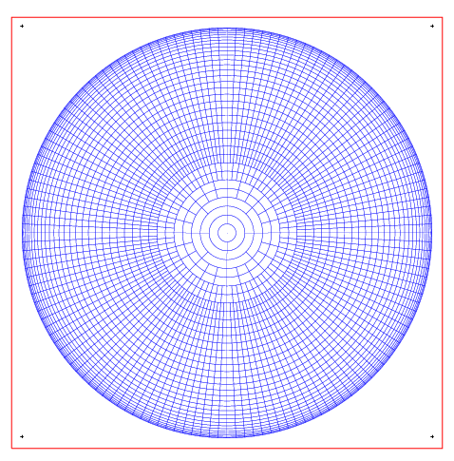
Air Quality
Global Pollutant Transport
History
  Many of the old Kr-85 experiments affected by varying background concentrations
  Lagrangian models not suitable for global predictions
Approaches
  Stand-alone Eulerian global CTM model to predict background
Accomplishments
  Fast for single species (2.5 deg 20 min/yr)
  CTM now included as a HYSPLIT subroutine
  Hg background for source-receptor analysis
Future Directions
  Parallelization needed for multiple species
  Nested grids may be required
Notes:
As will be discussed in more detail in the Decision Support section, all of the tracer experiments that involved ARL-HQ have been made available on-line as part of an interactive verification system. Prior to the development of the perfluorocarbon tracers (such as used in CAPTEX), these experiments relied upon tracers-of-opportunity, the most common was Krypton-85, a byproduct of nuclear fuel reprocessing. Unfortunately, Kr-85 has a varying background associated with air mass changes because most of the reprocessing facilities are in the upper latitudes of the northern hemisphere. When these data were first used for modeling, a seasonally varying background concentration was subtracted from the values at each measurement station. This is not an issue close to a source, which in the United States would be the Savannah River Plant (SRP), near Aiken, SC. However, at further distances the signal to noise ratio becomes small and the constant background assumption caused the loss of many useful data points. Therefore, a simple (meaning fast) Eulerian global model was designed to simulate just the background concentrations, which could then be subtracted from the measurements, leaving a data set that could be used for plume model (HYSPLIT) verification studies. The entire reprocessing history of Kr-85 (from 1948) could be simulated in one day on a PC.
Originally this was a stand-alone model. However, some of the HYSPLIT air quality modeling projects, in particular for mercury, also need to consider the contributions from sources outside of the US. At these distances, the details of the source-receptor relationships are not longer as important. Background variations may contribute to a substantial portion of the measurements in the cleaner areas of the US. Therefore , the global Eulerian model (GEM), was coded as a HYSPLIT subroutine, in a two-way nest configuration, like a grid-in-plume model. Emissions and transport start in the HYSPLIT Lagrangian framework (perhaps using high resolution meteorological data). At some user defined point in the calculation, the particle mass is transferred to the GEM module, which runs concurrently. Background values from GEM are available to HYSPLIT to modify the chemistry as needed. We believe this is a unique integration of Eulereian and Lagrangian modeling methods. There are still several areas that need more attention, such as parallelization and nested grids for the GEM module.

Slide 12
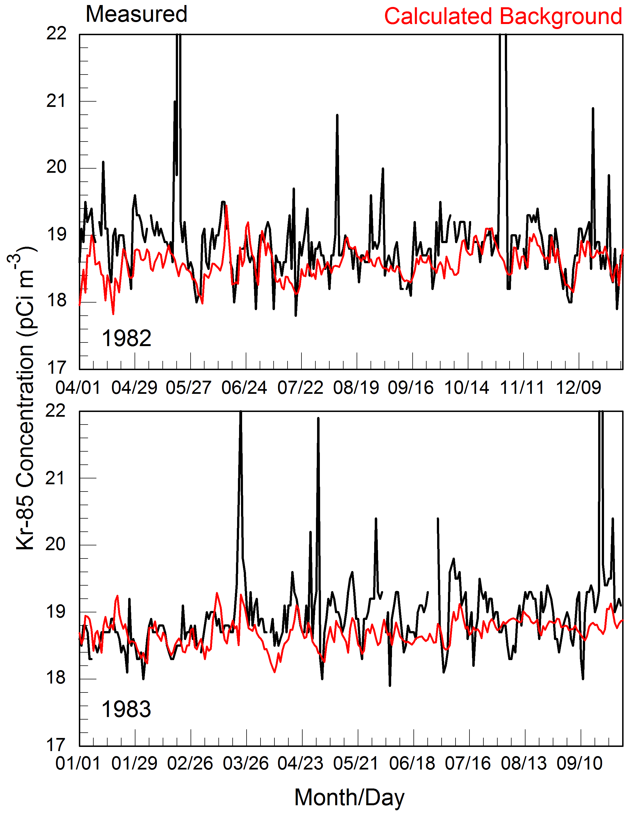
Air Quality
Global Pollutant Transport
Notes:
The 18 month time series shown here illustrates how well the GEM calculation predicts the global Kr-85 background. The measurement site is Murray Hill (MUH), NJ. The only Kr-85 source in the US continuously emitting at that time was the Savannah River Plant (SRP), about 1000 km from Murray Hill. The black line shows the measurements, the red line shows the GEM model prediction using all the global Kr-85 sources except SRP. With GEM computations on a 2.5 degree grid (reanalysis data), the SRP emissions would overwhelm the predictions at MUH and therefore cannot be included in a conventional manner. The SRP emissions were added to the calculation at a remote grid point to maintain the correct global Kr-85 mass. Subtracting the background calculation (red) from the measurements (black) results in the Kr-85 contribution from SRP. With this approach, signals as low as 0.5 pCi/m3 can be associated with the SRP. Assuming mostly westerly winds, the nearest upwind reprocessing would be the sources in the former Soviet Union.
Draxler, R.R., 2007, Demonstration of a global modeling methodology to determine the relative importance of local and long-distance sources, Atmospheric Environment, 41:776-789, doi:10.1016/j.atmosenv.2006.08.052.

Slide 13
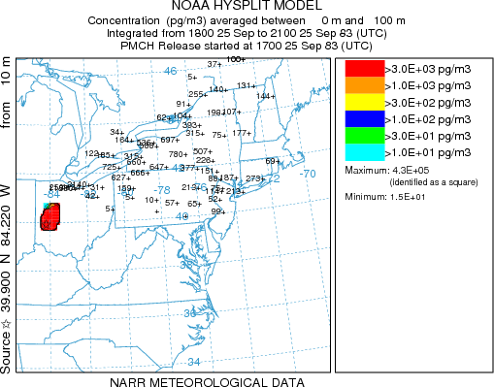
Model Evaluation
Notes:
Example animation showing tracer plume from CAPTEX release #2 and the 3-day averaged measured concentrations at each of the sampling locations.

Slide 14
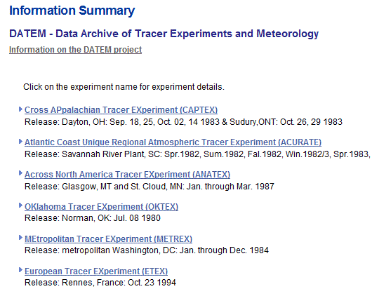
Model Evaluation
Data Archive of Tracer Experiments and Meteorology
Approach
  Creation of the NARR … data better than observations!
  Common statistical evaluation protocols
Accomplishments
  Web access to run HYSPLIT for each experiment
  Standardized model change testing in conjunction with version control
Notes:
A common theme for decision support is that individual model users need to understand the effects of changing model parameters, meteorological data, and other assumptions. The first step of this process was accomplished some time ago by standardizing the format of each of the ARL-HQ tracer experiments and providing model ready meteorological data for each experiment. This project was called Data Archive of Tracer Experiments and Meteorology (DATEM) and initially provided public anonymous FTP access to all the data files. The experiments available include a wide range of durations and distances: from the urban scale Metropolitan Tracer Experiment (METREX), to the continental scale Across North America Tracer Experiment (ANATEX).
More recently, we have updated the web interface, to permit anyone to actually run HYSPLIT against any of the experiments. With the availability of the higher resolution 32-km North American Regional Reanalysis, these simulations become more realistic than what was available previously (2.5 degree data). As part of the web evaluation, a common set of statistical analyses are performed on the results of each simulation. Users can determine the sensitivity of changing model parameters and determine the accuracy of the calculation for experiments that approximate their interests.

Slide 15
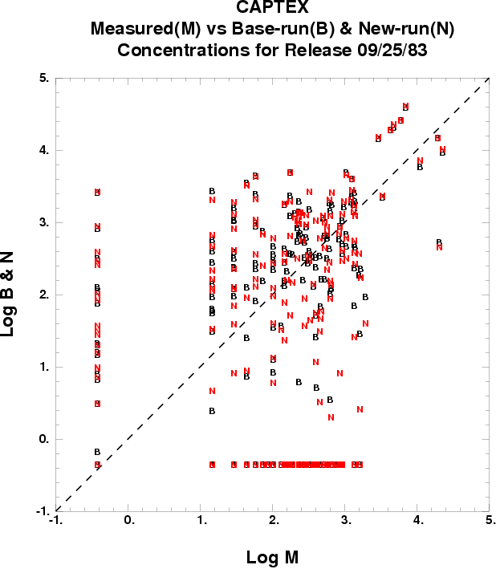
Model Evaluation
Data Archive of Tracer Experiments and Meteorology
Future Directions
  More user training on model parameters
  Include more dispersion experiments
  Add new meteorological data files …
R=0.5
Notes:
When the simulation completes, the statistical results are available, as well as a simple graphic showing how the measured-calculated scatter diagram of the current simulation compares with the base simulation. Both results shown above for CAPTEX release #2 used the NARR data. Clearly there are limits to this approach considering the computational resources we have available to make public. But it does provide a self-directed tutorial in understanding the importance of various model parameterizations and the significance of using good meteorological data. At this point there are no plans to include other dispersion models besides HYSPLIT.
An interactive DATEM-HYSPLIT demonstration is available.

Slide 16
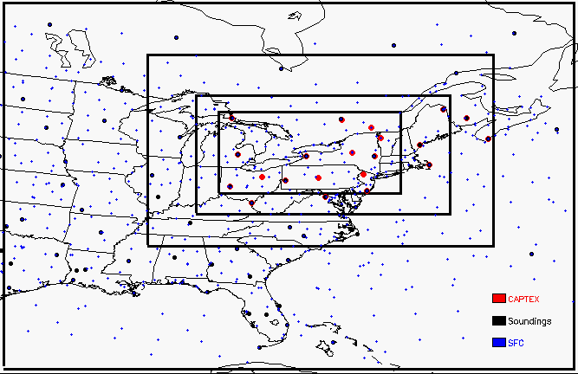
Model Evaluation
Meteorological Data Assimilation
Approaches
  Testing WRF-ARW with historical tracer measurements
  Manage data volume (1 km domain = 1.6 Gb / time)
Notes:
The fact that the accuracy of a plume dispersion prediction is primarily a function of how well the gridded meteorological data, discrete in space and time, represent the continuous fields of winds and temperature, rather than the computational details of the dispersion, is well known. As data assimilation methods have become more mature and are now available with the basic WRF-ARW system, we are evaluating the use of locally generated (versus from NCEP) high resolution fields for use in dispersion calculations. Dispersion calculations are focused on a few of the historical tracer experiments conducted by ARL-HQ. The Cross-Appalachian Tracer Experiment (CAPTEX) release number 2 is shown above. In this case, the calculation used the North American Regional Reanalysis data (NARR), which is also the data used for initial and boundary conditions for the WRF-ARW simulations.
Several issues related to WRF need to be resolved. The output data volume is huge and naturally finer spatial resolution requires finer temporal resolution to avoid introducing aliasing errors into the dispersion calculation. Typically WRF output are snapshots, valid at a specific time. However time averaged output may mitigate the need for too fine a temporal resolution. These issues are critical in determining the relative advantages of off-line versus in-line dispersion models. An in-line dispersion model does not require the output of very large meteorological data files, but at a cost of rerunning the meteorological model with each new calculation. These are all issues currently under investigation.

Slide 17
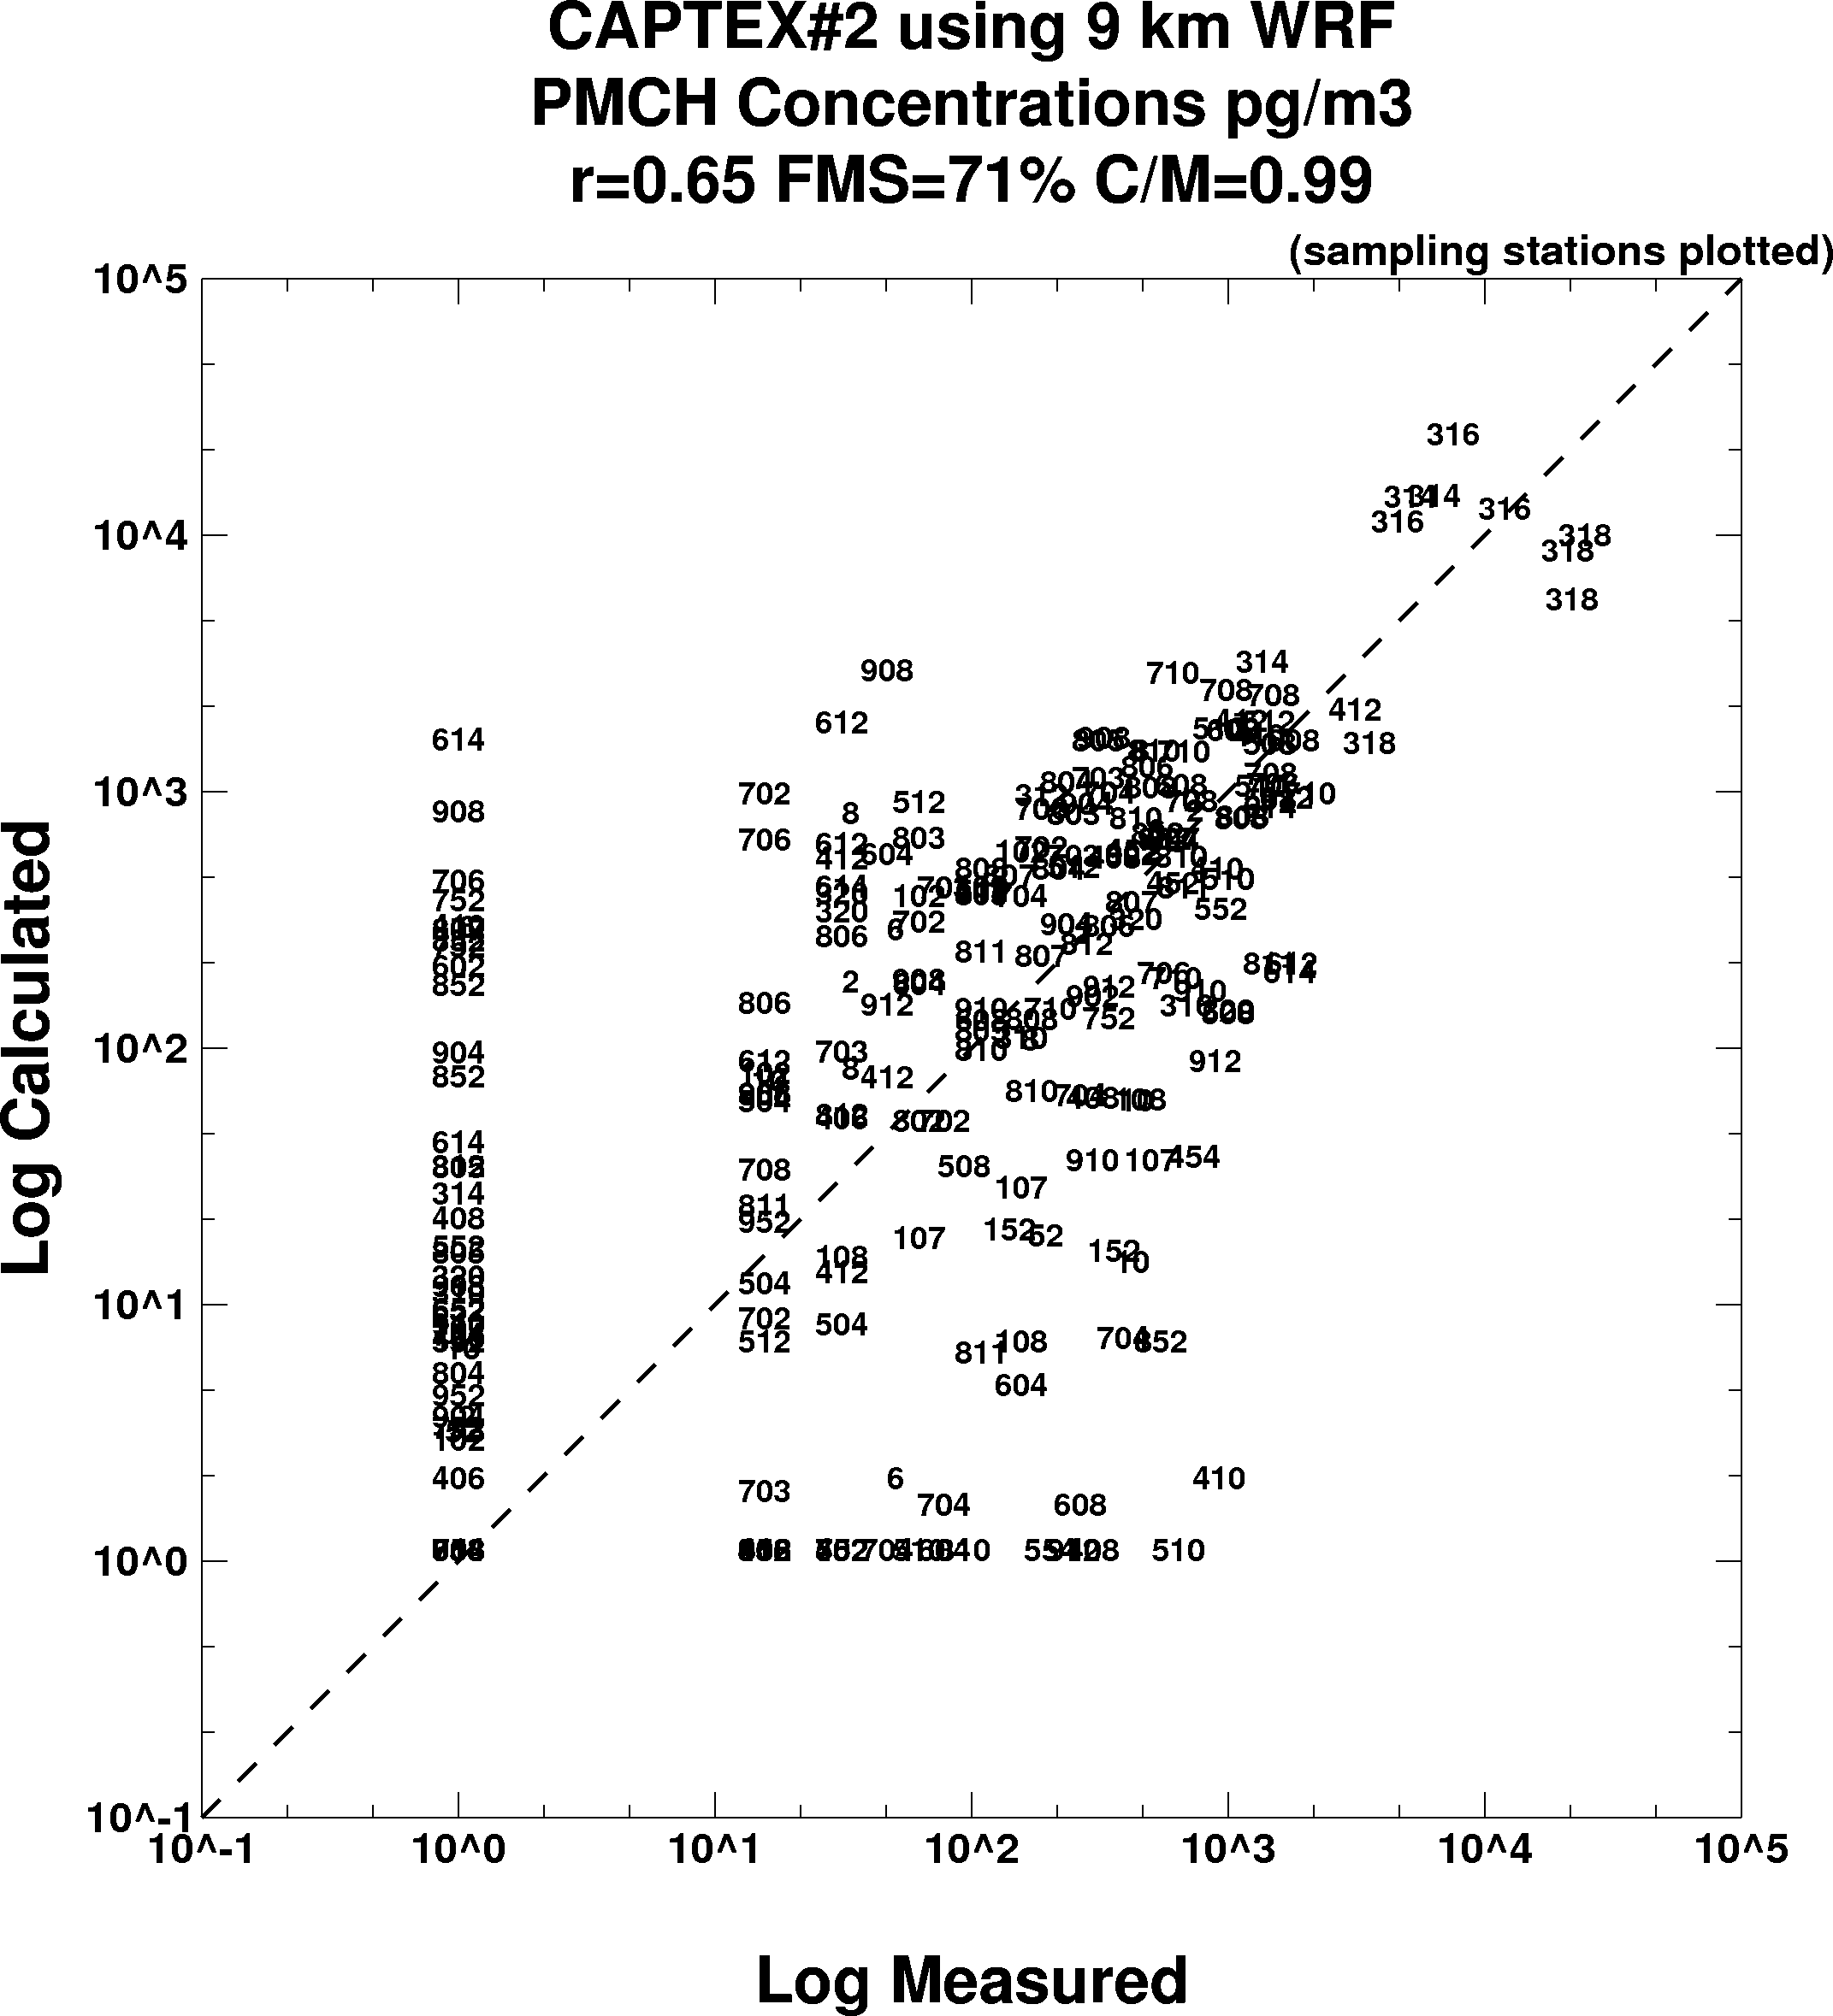
Model Evaluation
Meteorological Data Assimilation
Future Directions
  Evaluate …
    time frequency versus grid size
    Instantaneous versus time averaged fields
    In-line model versus off-line model
    Optimize model’s data I/O for large files
Notes:
A scatter diagram of the measured and the HYSPLIT calculated tracer concentrations for CAPTEX #2 using the 9-km resolution WRF-ARW fields (without data assimilation) is shown in the panel to the right. The correlation coefficient (R) was 0.65, the fractional bias (FB) was -0.01, the normalized mean square error (NMSE) was 13.42, and the figure of merit-in-space (FMS) was 71%. In contrast, the same calculation using only the NARR data, R=0.51, FB=0.21, NMSE=23.87, and FMS=63.
The results shown previously using the finer resolution WRF clearly illustrate the improvement associated with the WRF calculation. The improvement may not only be due to finer spatial and temporal resolution, but also the increased number of vertical levels within the boundary layer in the WRF results.
This result only represents the first step in a complex evaluation. There were a substantial number of additional soubding data collected during CAPTEX, especially at the off-hours (0600 and 1800 UTC). Various data assimilation trials are planned.

Slide 18
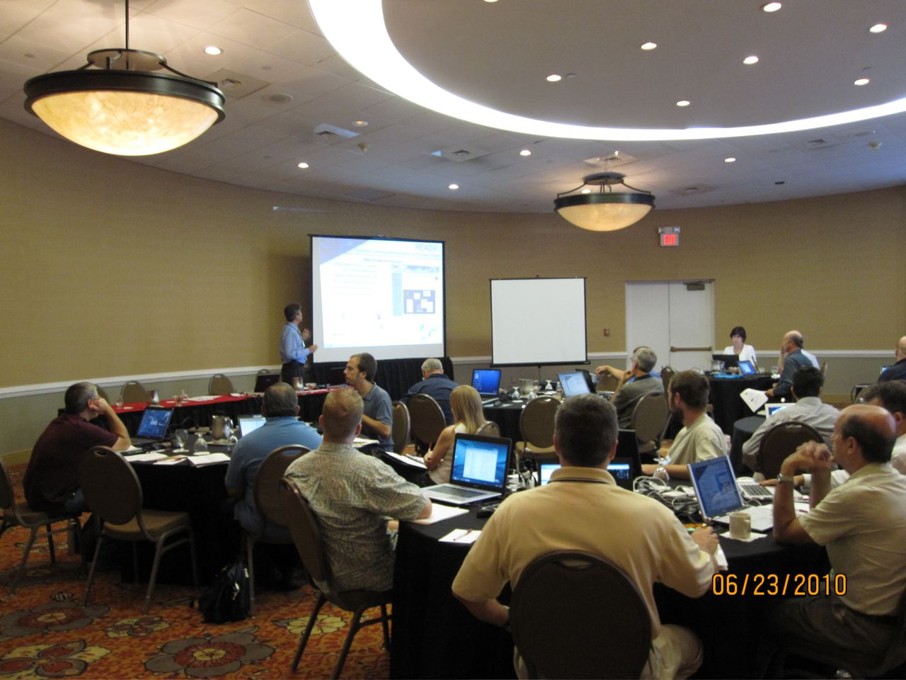
Decision Support
Notes:
June 2010 HYSPLIT workshop.

Slide 19
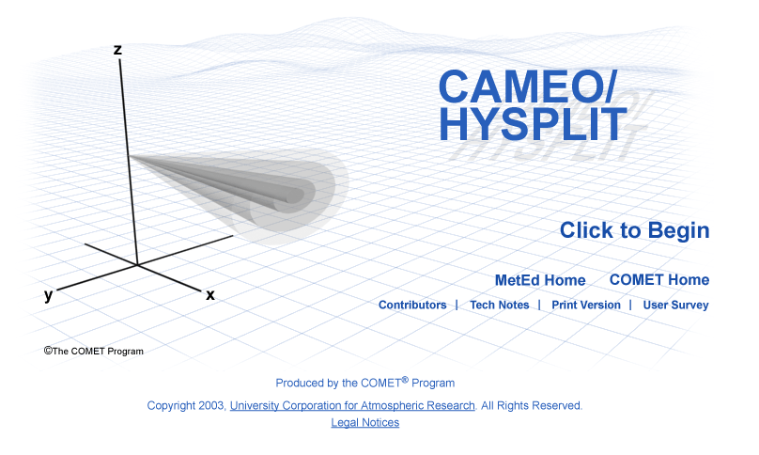
Decision Support
Dispersion Model Training
Approaches
  Annual 3-day PC training workshop (14 since 2004)
  Interact with stakeholders
Accomplishments
  New collaboration with COMET to satisfy WFO training requirement
Future Directions
  Need to develop a model front-end black-box
Notes:
As part of decision support, we have a large focus on training. In part because we permit almost anyone regardless of experience level to run simulations on the web or download the PC/MAC version of the code to run calculations on their own computers. This can lead to poor model results deriving from bad user configuration decisions that have nothing to do with the quality of the dispersion model or the underlying meteorological data. To address this issue, we have developed detailed cross-referenced help files associated with each PC menu, help buttons on the web model configuration page, and we annually conduct a training workshop focused on the PC version of HYSPLIT. We have a new collaborative effort with the Cooperative Program for Operational Meteorology, Education, and Training (COMET) program to update the HYSPLIT training materials and examples designed to support the forecasters at the Weather Forecast Offices. There are several issues we are still trying to address. In particular the range of technical capabilities of most HYSPLIT users is very diverse, which means that one set of training materials is insufficient to address all the requirements. Under consideration is the development of a front-end black box to analyze the model configuration and look for inconsistencies. Help information also becomes more difficult to maintain as model options are added.
COMET - http://meted.ucar.edu/dispersion/disp_ops/

Slide 20
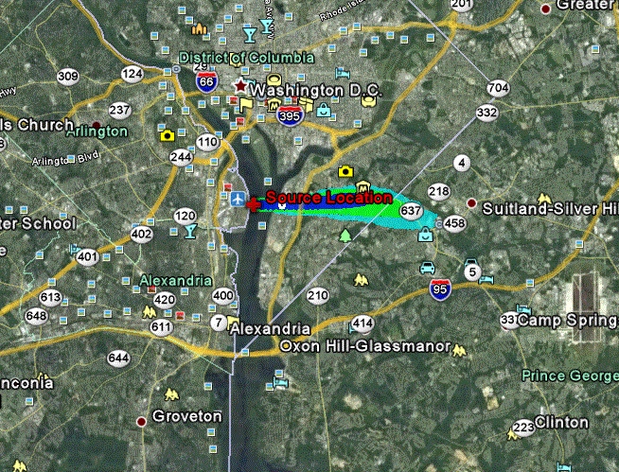
Decision Support
Real-time Environmental Applications and Display sYstem
Approaches
  WEB based interface
  Perl for input and Postscript (PS) output
  Utilities to convert PS to SVG, ESRI-SHP, KMZ
Accomplishments
  New interface using FLASH and output to Google Maps
Future Directions
  Couple with GSD’s High Resolution Rapid Refresh at ESRL
Notes:
Another aspect to decision support is to provide dispersion products in formats that are compatible with other commonly used Geographic Information Systems (GIS) so that emergency and air quality planners can overlay our dispersion products with their own data. The original HYSPLIT system used National Center for Atmospheric Research (NCAR) graphics as the base for all display applications. However, extreme latency by NCAR in updating map backgrounds, especially as international borders were rapidly changing, led to the development of an in-house graphical system that relies upon a public library to create Postscript output files. These are vector files, and again using public libraries, they can be converted to almost any other format, such as the currently popular Google Earth (.kmz), Environmental Systems Research Institute (ESRI) shapefiles (.shp), and Adobe scalable vector graphics (.svg). More recent developments are focused on improving the HYSPLIT interface with Flash and Google Maps. A continuing challenge to this approach is keeping up with rapidly changing standards and new display options and trying to maintain current up-to-date links with these externally driven changes. For example, there are rumors that both .shp and .svg formats will not be supported much longer.
Google Maps example - http://www.noaa.inel.gov/examples/hysplit.html

Slide 21
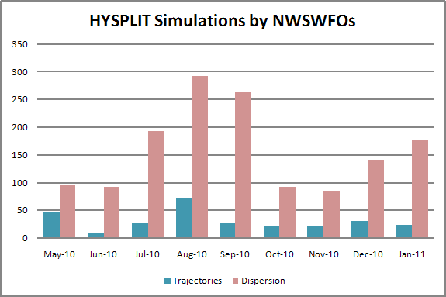
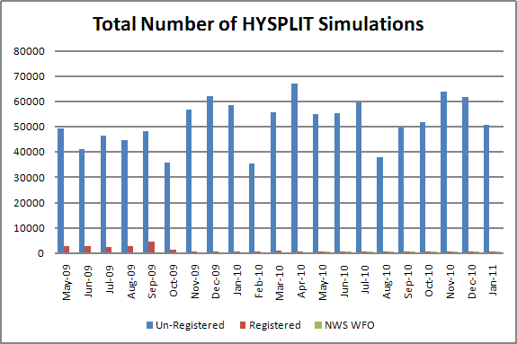
Indicators of Success
Emergency Response
  150 web simulations per month
Air Quality
  50,000 web simulations per month
  PC downloads: 4743
Decision Support
  Workshops ~ 140 persons
  Invitational ~ 100 persons
  International ~ 100 persons
Notes:
Although it is difficult to determine the exact transport and dispersion applications of our anonymous web users, the bulk of the web calculations are for trajectories using archived meteorological data, and these are almost universally applied to issues related to air quality analysis. Dispersion simulations by the NWS WFOs would be focused on emergency response applications.

Slide 22
Collaborators / Partners
Australian Bureau of Meteorology: HYSPLIT, GUI, SVG
Chinese Academy of Meteorological Sciences: MeteoInfo
National Cancer Institute: nuclear testing dose
Office of Response and Restoration: ALOHA/CAMEO
ESRL Global Systems Division: GTAS
ESRL Global Monitoring Division: STILT integration
US Forest Service: Bluesky, VSMOKE
University of Huelva: arsenic, dust, READY web
University of Hawaii: Kilauea SO2/SO4 plumes
Notes:
Australian Bureau of meteorology – helped with the development of the HYSPLIT4 turbulence schemes, the Tcl/Tk graphical user interface, and scalable vector graphics.
A researcher at the Chinese Academy of Meteorological Sciences developed a public GIS package very similar to ArcExplorer, but customized for HYSPLIT applications. See http://www.esnips.com/web/MeteoInfo
The Radiological Protection Institute of Ireland provided guidance and technical contacts that were key in constructing our fission dose computations.
Researchers at the National Cancer Institute provided valuable information in our interpretation of dose calculations from nuclear testing.
Naturally our collaboration with the Office of Response and Restoration in linking ALOHA/CAMEO with HYSPLIT will be a keystone in the future look of NOAA dispersion models.
We have started collaborating with GMD researchers to integrate some of the features of STILT (a HYSPLIT variation developed by Harvard) used for carbon tracking into HYSPLIT.
The US Forest Service integrated modified their prescribed burn modeling package with our guidance to provide the required input files to run HYSPLIT.
We are cooperating closely with the University of Huelva (Spain, near Seville) on various modeling topics. In particular they are hosting our backup server http://www.ciecem.uhu.es/hysplitweb08/HYSPLIT.php
One of the Harvard researchers that developed STILT graduated and the modeling effort has moved to the University of Waterloo (CA). We are working with them to organize a Chapman conference on Lagrangian dispersion modeling.

Slide 23
Possible Future Directions
Emergency Response
  Establishment of a Plume Prediction Center
  Web backup and redundancy
  Closer coupling of dispersion and meteorology models
Decision Support
  Dispersion model integration into AWIPS-II
  Dispersion model linked with local predictions
Notes:
Although the HYSPLIT modeling efforts are used in a variety of different applications and by many different researchers and organizations, to a large extent the development efforts are still ad-hoc.
An strong indicator of success for the emergency response program would be to have a 24/7 NOAA supported web computational facility for plume dispersion, perhaps under the aegis of a “Plume Prediction Center”. Such a center could be the focal point for stronger links with NESDIS, providing the opportunity to incorporate a data assimilation into the operational prediction.
In terms of decision support, a clear indicator of success would be for the plume dispersion modeling capability to become an integral part of the AWIPS-II program plans. A related aspect is the issue of running HYSPLIT from centrally based forecasts or local modeling at the WFO. Although resolving this issue is beyond the scope of this discussion, having the local dispersion modeling capability at the WFO, insures the link with locally run meteorological forecasts.

