Slide 1
Atmospheric Mercury Research
Mark Cohen
Air Resources Laboratory
ARL Laboratory Review
May 3-5, 2011
Notes:
People involved in ARL’s Mercury Research program include:
Winston Luke, Steve Brooks*, Paul Kelley, Jake Walker#, Xinrong Ren, Tilden Meyers, Roland Draxler, Fantine Ngan, and Richard Artz
* Oak Ridge Associated Universities, on assignment to NOAA ARL
# Grand Bay National Estuarine Research Reserve, Moss Point, MS

Slide 2

Context
Mercury exposure via fish consumption is an important public health concern
NOAA has a primary stewardship responsibility for the nation’s fisheries
Atmospheric emissions and subsequent deposition is a significant pathway through which mercury contamination enters sensitive aquatic ecosystems
Goals
Provide sound scientific information on the emission, dispersion, transformation, and air-surface exchange of atmospheric mercury compounds
Measure and understand spatial and temporal trends in air concentrations and air-surface exchange
Provide robust source-attribution information for atmospheric mercury deposition to sensitive ecosystems, to inform policies to reduce loadings
Notes:
For approximately the last 10 years, ARL has had an active research program involving mercury.
Context:
Mercury exposure via fish consumption is an important public health concern.
NOAA has a primary stewardship responsibility for the nation’s fisheries
Atmospheric emissions and subsequent deposition is a significant pathway through which mercury contamination enters sensitive aquatic ecosystems
Goals:
Provide sound scientific information on the emission, dispersion, transformation, and air-surface exchange of atmospheric mercury compounds
Measure and understand spatial and temporal trends in air concentrations and air-surface exchange
(b) Provide robust and policy-relevant source-attribution information for atmospheric mercury deposition to sensitive ecosystems

Slide 3
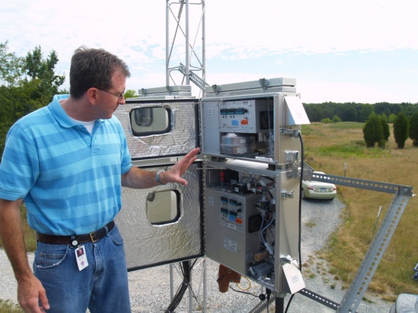
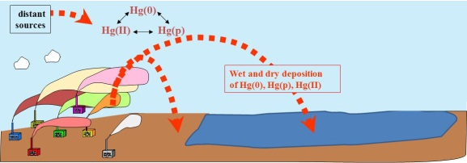
Mercury: Measurements and Modeling
MEASUREMENTS
speciated atmospheric mercury
Modeling used to aid in data interpretation and measurement planning
other air pollutants, e.g., SO₂, O₃, CO
wet deposition
air-surface exchange
MODELING
back trajectories
Measurements used for model evaluation and improvement
comprehensive fate and transport
source-attribution for deposition
Notes:
We have two basic approaches in our mercury research program at ARL – measurements and modeling. They are independent and also integrated. One key objective is to produce policy-relevant results, and to work towards reducing the uncertainties in these results. Another key objective is determining and understanding spatial and temporal trends.
The picture shows Winston Luke and the Tekran speciated mercury samplers (reactive gaseous mercury and fine particulate mercury) and the tower at Beltsville, MD, a comprehensive monitoring site representing a long-term collaboration between EPA and NOAA
One example of how the measurements are being used to aid in modeling is an ongoing model evaluation program in which the HYSPLIT-Hg model is being run for specific episodes at our Grand Bay and Beltsville sites, and the model predictions are being compared against the measurements. High resolution met data (e.g., 4 km) is being generated at ARL to support and enhance this analysis.
One example of how the modeling helps the measurements is the forecasting work done to aid in scientific mission planning. This is illustrated by the daily HYSPLIT-Hg model forecasts of anthropogenic mercury plumes to inform daily decisions about flight planning in the Grand Bay Mercury Intensive (1st phase was carried out summer 2010 and 2nd phase is going on right now (April 15-May 15).

Slide 4
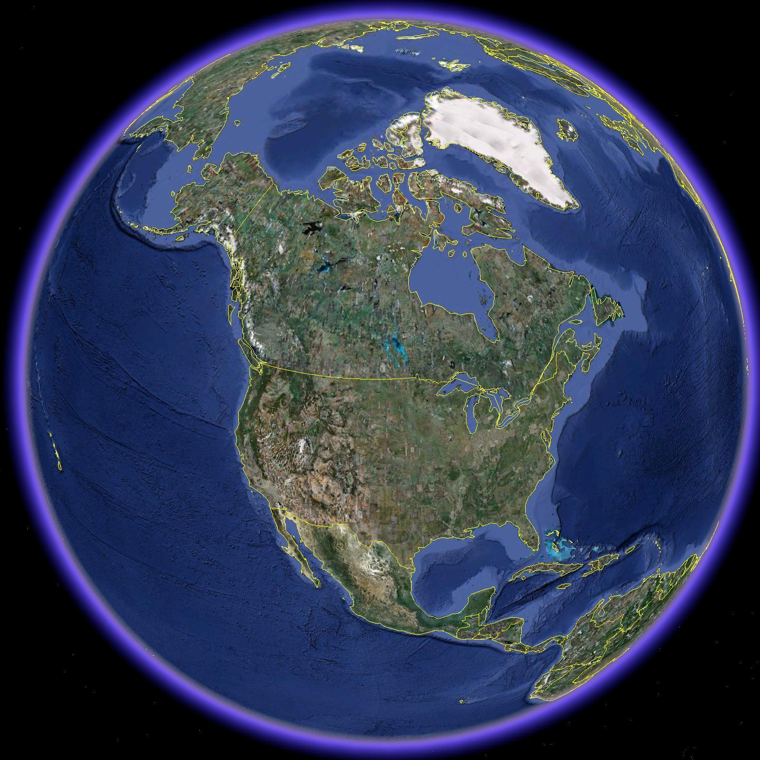


Polar-specific air-chemistry can lead to enhanced mercury deposition under some conditions
mercury
from global atmospheric pool entering
North America
mercury
that doesn’t deposit continues
its global circulation
regional and
and global sources contribute to atmospheric mercury deposition
North
American
mercury
sources
*
Atmospheric mercury deposition varies spatially and temporally, and is always a complex combination of impacts from local, regional, national, and global emissions sources.
Thousands of fish-advisories throughout North America due to mercury contamination
Notes:
Key point: atmospheric mercury impacts occur at local, regional, national, continental, and global scales…
The relative importance of the deposition contributions of local/regional sources vs. global sources to deposition is highly variable across North America and depends, e.g., on the proximity of local/regional sources

Slide 5

Different “forms” of mercury in the atmosphere
Elemental Mercury -- Hg(0)
  most of total Hg in atmosphere
  doesn’t easily dry or wet deposit
  globally distributed
Elemental Mercury -- Hg(0)
  most of total Hg in atmosphere
  doesn’t easily dry or wet deposit
  globally distributed
?
Reactive Gaseous Mercury -- RGM
  a few % of total atmos. Hg
  oxidized Hg (HgCl₂, others)
  very water soluble and “sticky”
  bioavailable
Reactive Gaseous Mercury -- RGM
  a few % of total atmos. Hg
  oxidized Hg (HgCl₂, others)
  very water soluble and “sticky”
  bioavailable
Particulate Mercury -- Hg(p)
  a few % of total atmos. Hg
  Hg in/on atmos. particles
  atmos. lifetime 1~ 2 weeks
  bioavailability?
Particulate Mercury -- Hg(p)
  a few % of total atmos. Hg
  Hg in/on atmos. particles
  atmos. lifetime 1~ 2 weeks
  bioavailability?
?
Notes:
There are three kinds of mercury in the atmosphere. They behave very differently and have different ecological and public health impacts. The forms can inter-covert… Measuring and modeling each of these forms is challenging, but is critical to understand the atmospheric behavior and impacts of mercury. There are many uncertainties in the scientific knowledge regarding atmospheric mercury, e.g., what is RGM? Have we identified all of the significant chemical reactions? Are the currently used reaction rates accurate? The importance of atmospheric methly-mercury as well as its fate and transport is uncertain.
Elemental Mercury -- Hg(0)
most of total Hg in atmosphere
not very water soluble
doesn’t easily dry or wet deposit
upward evasion vs. deposition
atmos. lifetime approx ~ 0.5-1 yr
globally distributed
Reactive Gaseous Mercury -- RGM
a few percent of total atmos Hg
oxidized Hg (HgCl2, others)
operationally defined
very water soluble and “sticky”
atmos. lifetime <= 1 week
local and regional effects
bioavailable
Particulate Mercury -- Hg(p)
a few percent of total atmos Hg
not pure particles of mercury
Hg compounds in/on atmos particles
species largely unknown (HgO?)
atmos. lifetime approx 1~ 2 weeks
local and regional effects
bioavailability?

Slide 6
Measurements – Approaches
Long-Term Monitoring
Process Studies / Field Intensives

Slide 7
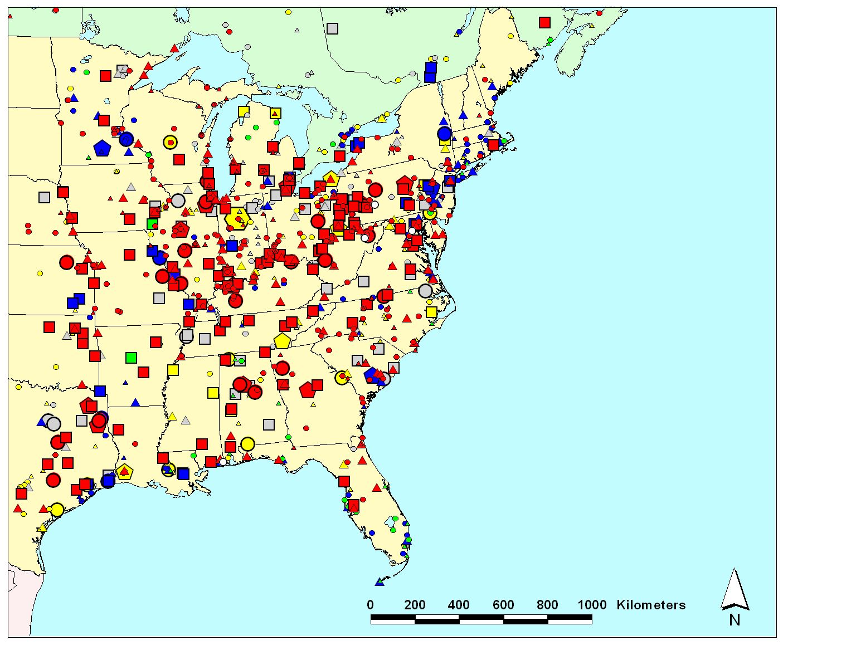
Measurement Approach – Long-Term Monitoring
Emissions
(kg/yr)
Allegheny
Portage
5-10
10-50
50-100
100–300
300–500
500–1000
1000–3500
Mauna Loa
Beltsville
Canaan Valley
Type of Emissions Source
coal-fired power plants
other fuel combustion
waste incineration
metallurgical
Grand Bay
NERR
manufacturing & other
Four ARL long-term mercury measurement sites in the continental U.S., one in Hawaii;
2002 mercury emissions sources based on data from USEPA, Envr. Canada and the CEC
Notes:
We have five total long-term measurement sites. Four of these are in the continental U.S., and one is at Mauna Loa in Hawaii.
Measurements have taken place at Grand Bay since 2006. Impetus for this site is the threat of mercury contamination in Gulf of Mexico seafood, and the role that NOAA has in protecting this fisheries resource. Located at the Grand Bay National Estuarine Research Reserve (NERR). Ongoing collaboration with Grand Bay NERR, Mississippi Department of Environmental Quality, EPA, US Fish and Wildlife Service. ARL’s site at Grand Bay was a founding station of the NADP Atmospheric Mercury Initiative, contributing data to the national network (now called the Atmospheric Mercury Monitoring Network – AMNet – see slide #16).
Measurements have taken place at the Canaan Valley Institute since 2005. The Canaan Valley Institute is in the heart of the Mid-Atlantic Highlands which generates and receives some of the highest atmospheric inputs of mercury in the nation, and is the primary source of freshwater to the Chesapeake Bay.
Twenty-two rivers and lakes within West Virginia are on the EPA 303b list of mercury impaired waters. CVI was also a founding station of AMNet. Other network site at CVI include: Climate Reference Network, Ameriflux, Global Energy and Water Cycle Experiment (GEWEX), and AIRMoN.
Measurements have taken place at Beltsville MD, in close collaboration with the USEPA, since 2006. The EPA operates a CASTNet site there, and the State of MD and the Univ of MD operates an NADP-NTN (acid rain) and MDN (mercury in rain) co-located network site.
Measurements have taken place at the Allegheny Portage site in PA since ~March 2009, in collaboration with the State of Pennsylvania, CVI, and the National Park Service. The site is in a region with very large coal-fired plants with very large emissions of mercury.
We have also made measurements at numerous other locations during short-term field-intensive, e.g., Houston, Arctic, Antarctic, Michigan, …

Slide 8
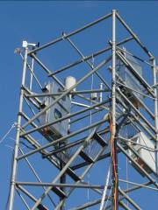
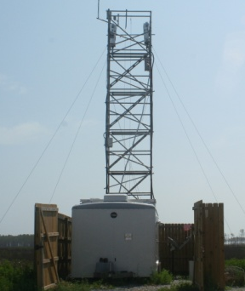
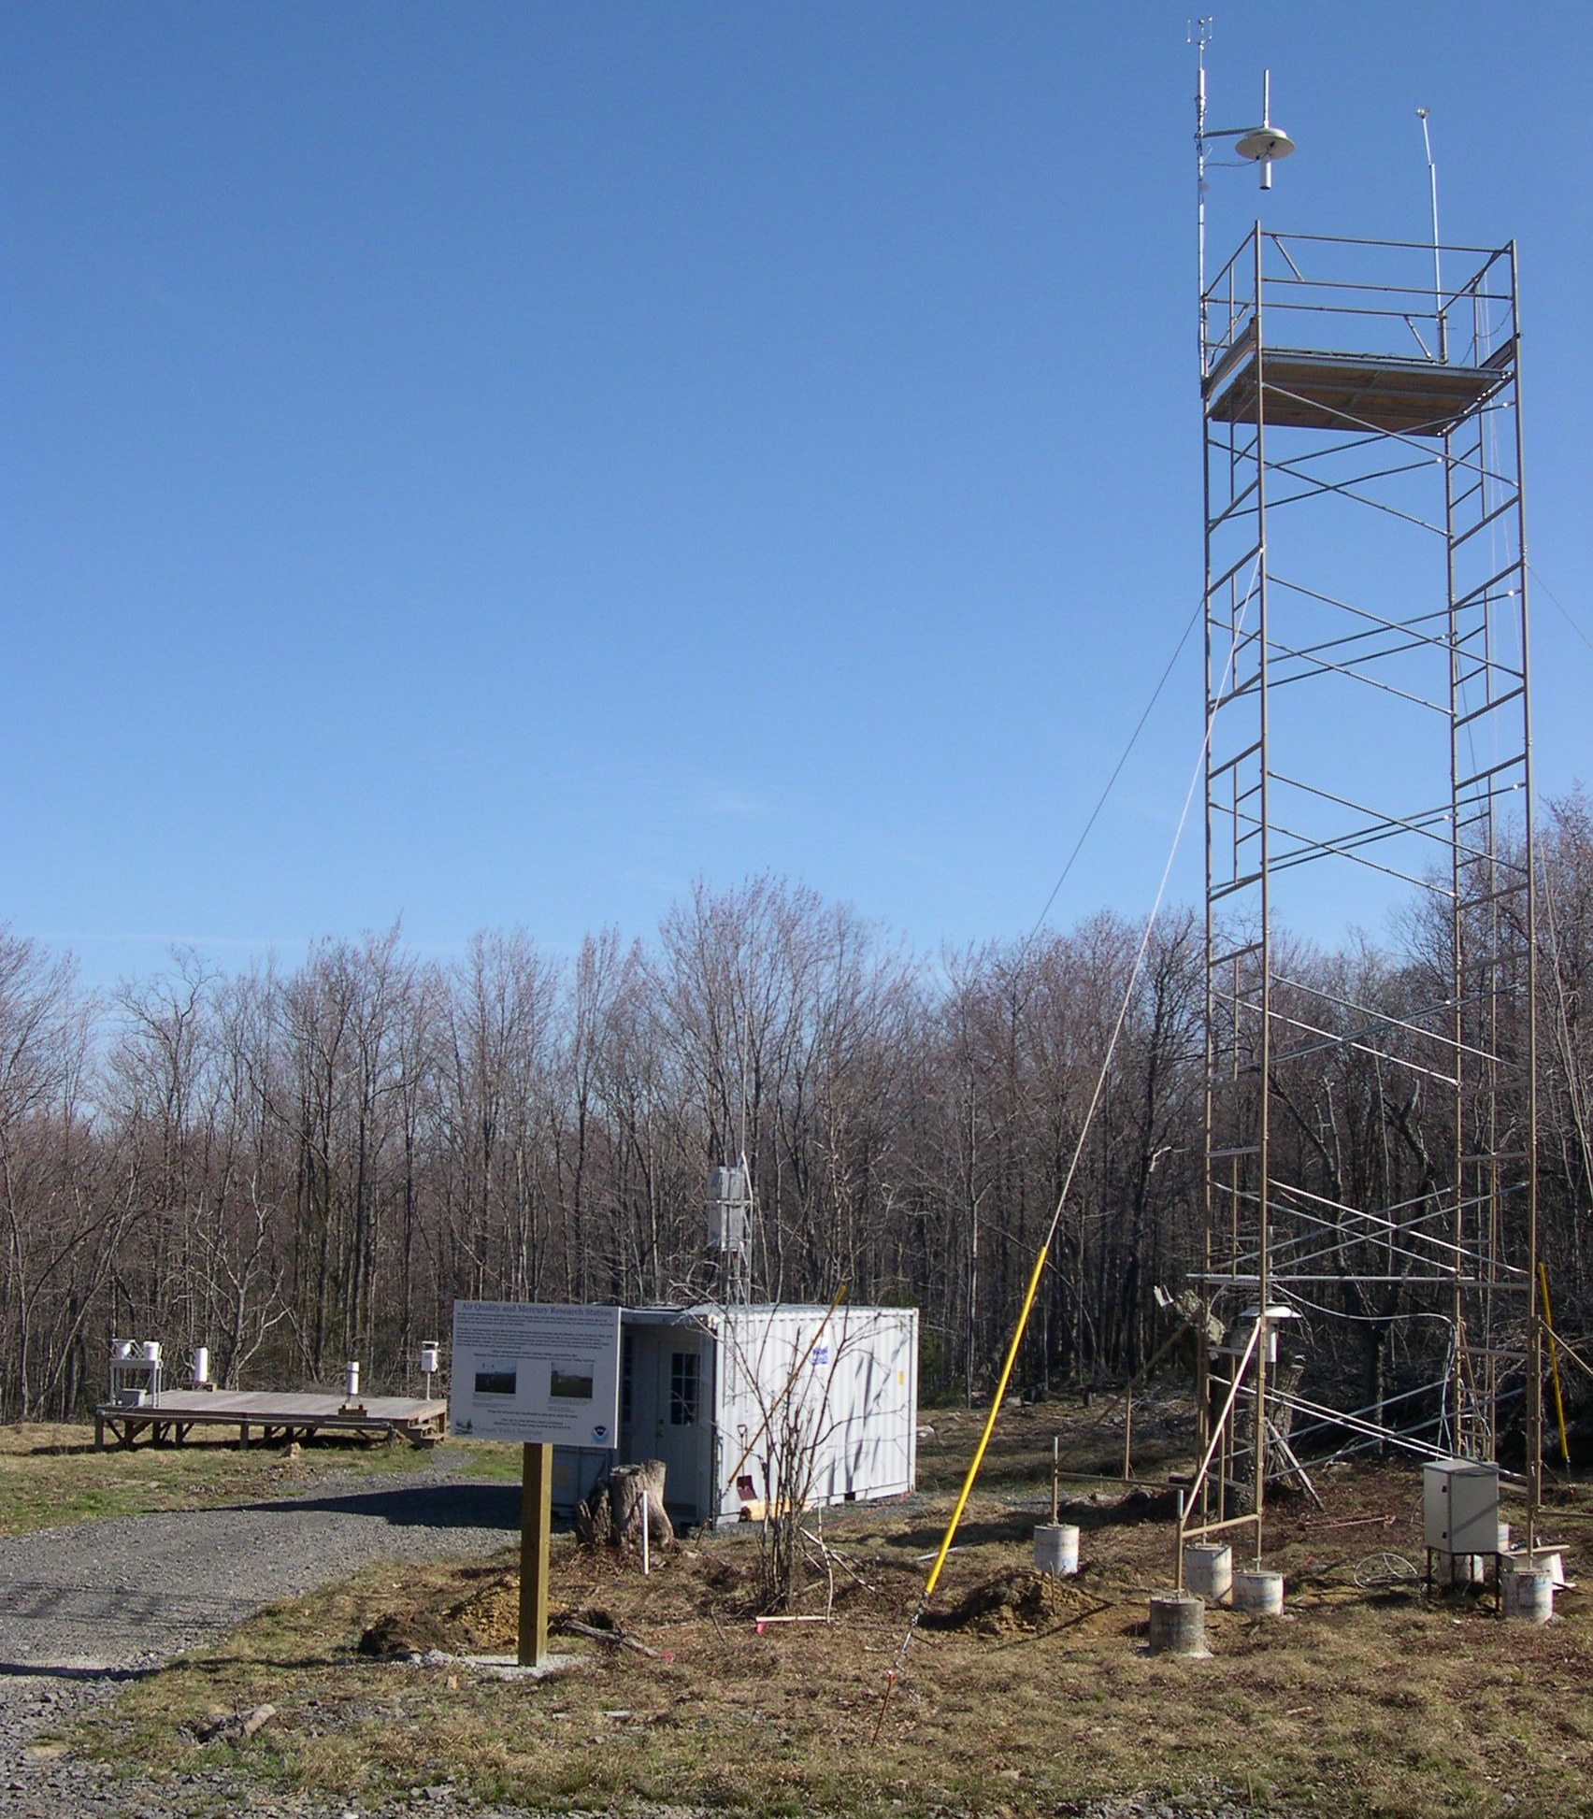

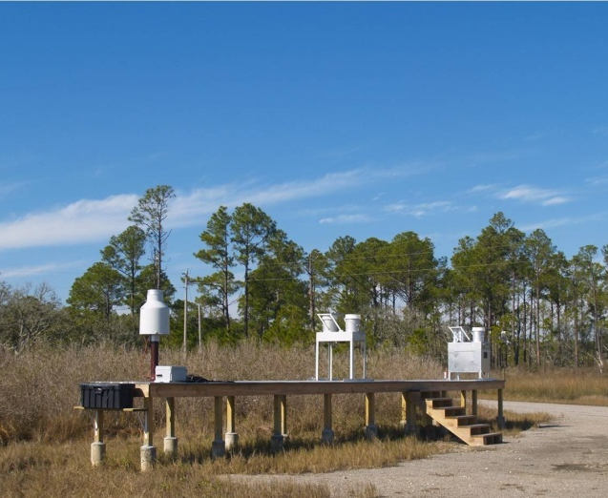
Long-Term Monitoring Examples
Grand Bay NERR
mercury & trace gas
monitoring tower
(10 meters)
Canaan Valley
ultrasonic anemometer
for wind turbulence
top of tower with two sets of RGM and Hg(p) collectors
elemental mercury sampling inlets at different heights to measure vertical gradient -- to estimate net surface exchange flux
precipitation collection
Mercury Deposition Network and heavy metals
precipitation amount
major ions
(“acid rain”)
RGM and Hg(p) collectors

Slide 9
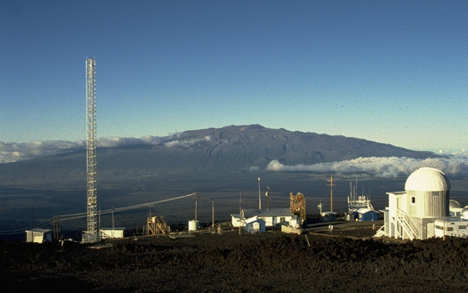
Mauna Loa Observatory, Hawaii: since January 2011
Research Question: What is the reason for the dramatically higher reactive gaseous mercury (RGM) concentrations at Mauna Loa (in the free troposphere) -- relative to typical concentrations at low elevation sites?
3,397 m ASL
down-slope flow from the free troposphere at night
ideal location to study atmospheric mercury chemistry at a high-altitude, remote location
Reactive Gaseous Mercury (pg/m3)
Notes:
Episodes of very high RGM and FPM concentrations associated with free-tropospheric air masses, measured at the Mauna Loa site, suggests that in-situ atmospheric chemistry plays a big role in global mercury cycling.
Understanding the reasons for these episodes – e.g., unraveling the full chemical mechanism, or at least reducing the uncertainties in our current knowledge of mercury’s atmospheric chemistry – is a key objective of our atmospheric mercury research.
The Mauna Loa Observatory (MLO) has a rich historical tradition, and is the site of the longest continuous record of atmospheric CO2 measurements. ARL has played a leading role throughout the history of the observatory.

Slide 10
NOAA-led measurement
Co-located measurement
Measurements – Summary
Site | Collaborators | Ambient Air Measurements |  |  |  |  |  | Precipitation |  |  | Dry Deposition |  | Other
 |  | Mercury Speciation | SO₂ | O₃ | NO/NO_{y} | CO | Carbon black | Major Ions (NTN) | Mercury (MDN) | Trace Metals | Surrogate Surface | Throughfall | Meteor-ology
Beltsville (MD) | PI = Winston Luke (NOAA) EPA Clean Air Markets Division Univ of Md; Maryland DNR MACTEC; USGS |  | • | • | • | • |  | • | • |  |  | • | •
Grand Bay (MS) | PI = Winston Luke (NOAA) Grand Bay NERR, NOAA-NCCOS MS Dept Envr Quality USEPA, US Fish & Wildlife Service |  | • | • | • | • | • | • | • | • |  |  | •
Mauna Loa (HI) | PI = Winston Luke (NOAA) NOAA ESRL Many others | • | • | • |  | • | • |  |  |  |  |  | •
Canaan Valley (WV) | PI = Steve Brooks(CVI/NOAA) Canaan Valley Institute Univ Md Frostburg Lab USGS | • |  | • |  |  |  | • | • |  | • | • | •
Allegheny Portage (PA) | PI = Steve Brooks (CVI/NOAA) Canaan Valley Institute Pennsylvania DEP National Park Service | • |  |  |  |  |  | • | •

Slide 11
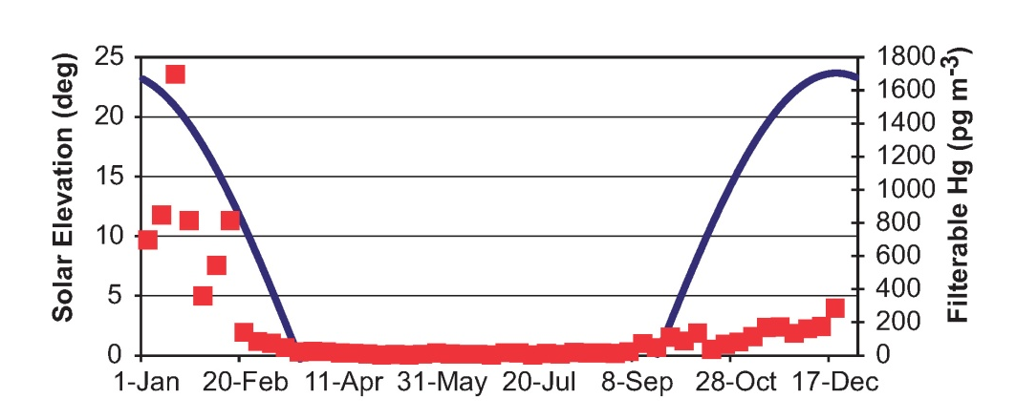
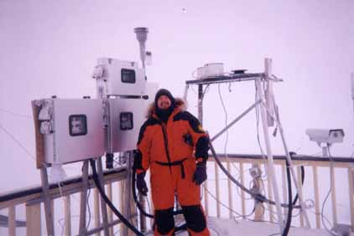
Measurement Approach – Process Studies / Field Intensives
Arctic, Antarctic, Grand Bay, Beltsville, Houston, Ann Arbor, Nevada, …
Generally large, multi-investigator studies, including method development, inter-comparision and optimization
Measurements of:
  Concentrations of different forms of mercury and other key species, at the surface and aloft, using active and passive techniques
  Surface exchange using micrometeorological and surrogate- surface techniques
…the first estimates of the mercury balance and cycling for the Antarctic polar plateau
(see Steve Brooks’ poster regarding polar mercury studies)
Weekly averages of filterable Hg (discrete points) and the solar elevation angle at South Pole Station from 2003 to 2006.
The peak annual filterable Hg lags the solar maximum by 3–4 weeks.
Steve Brooks,
NOAA – ARL,
Barrow Alaska
Notes:
Key Publications:
Brooks, S.B., C. Moore, D. Lew, B. Lefer, G. Huey, and D. Tanner (2010). Temperature and sunlight controls of mercury oxidation and deposition atop the Greenland Ice Sheet. Atmospheric Chemistry and Physics Discussions, acp-2010-1012.
Brooks, Steve, Winston Luke, Mark Cohen, Paul Kelly, Bernhard Rappenglueck, and Barry Lefer (2010). Mercury species measured atop the Moody Tower TRAMP site, Houston, Texas, Atmospheric Environment vol. 44, no. 33, 4045-4055.
Brooks, S., Arimoto, R., Lindberg, S., and Southworth, G. (2008). Antarctic polar plateau snow surface conversion of deposited oxidized mercury to gaseous elemental mercury with fractional long-term burial, Atmospheric Environment vol. 42, no. 12, 2877-2884.
Brooks, S., Lindberg, S., Southworth, G., and Arimoto, R. (2008). Springtime atmospheric mercury speciation in the McMurdo, Antarctica coastal region. Atmospheric Environment vol. 42, no. 12, 2885-2893.
Brooks, SB, Saiz-Lopez, A, Skov, H, Lindberg, SE.; Plane, JMC, and Goodsite, ME (2006). The mass balance of mercury in the springtime arctic environment, Geophysical Research Letters, Vol. 33, No. 13, 13 July 2006.
Gabriel, M, D Williamson, S Brooks (2011). Potential impact of rainfall on the air-surface exchange of total gaseous mercury from two common urban ground surfaces. Atmospheric Environment, in press.
Moore, C., M. Castro, S. Brooks (2011). A simple and accurate method to measure total gaseous mercury concentrations in unsaturated soils. Water Air and Soil Pollution, in press.

Slide 12
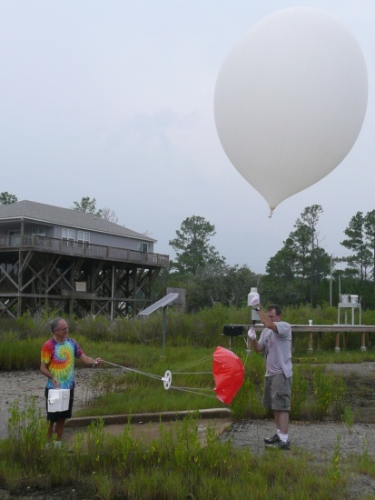
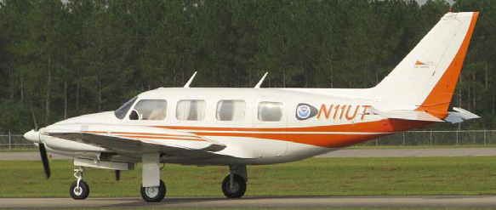
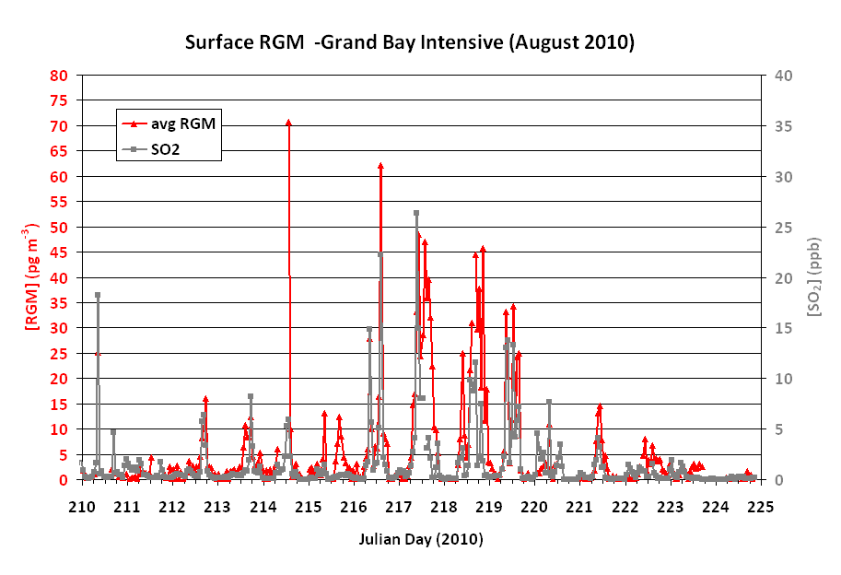
Process Studies / Field Intensives
Grand Bay (MS) Field Intensive
July-Aug 2010, April-May 2011
Launching an ozonesonde to collect ozone & meteorological data
Univ. of Tenn. Space Inst. plane for air measurements
Surface RGM and SO2 at the Grand Bay NERR site during the August 2010 intensive
Investigating the roles of:
  halogen chemistry in the marine layer and free troposphere
  transport from upper atmos.
  local/regional emissions
Measurements at surface and aloft
2nd phase ongoing now
see Winston Luke’s poster
RGM (pg/m³)
SO2 (ppb)
Julian Day 2010
Notes:
This is going on right now.
ARL is participating in an atmospheric mercury intensive field study at the Grand Bay National Estuarine Research Reserve (NERR) in Moss Point, Mississippi. Partners in the intensive include scientists from the Grand Bay NERR, Georgia Institute of Technology, Florida State University, University of Miami, University of Tennessee Space Institute (UTSI), Canaan Valley Institute, Florida A&M University, Mississippi Department of Environmental Quality, and NOAA's National Centers for Coastal Ocean Science (NCCOS). For the intensive campaign, the scientists are taking advantage of the existing ARL mercury facility at Grand Bay to collect additional atmospheric mercury measurements and other supplemental measurements using various novel techniques and methods, including a UTSI light aircraft.
Measurements of elemental mercury and reactive gaseous mercury fluxes are being collected using conventional micrometeorological techniques, as well as through the deployment of surrogate surfaces, event-based precipitation collectors, and experimental dew collectors (Canaan Valley Institute). Halogen species in the atmosphere are being measured via mass spectrometry (Georgia Institute of Technology), and mercury isotopes are being measured in particles and in precipitation samples (Florida State University). Grand Bay NERR, Florida A&M University, and NOAA NCCOS scientists are measuring mercury concentrations in biota and in water and sediment samples at various locations within the reserve. Scientists from the University of Miami are collaborating with scientists and staff from the University of Tennessee Space Institute (UTSI) to measure elemental mercury and evaluate a new system for the measurement of total reactive gaseous mercury (RGM) and individual RGM species in air samples aloft using a UTSI light aircraft. ARL is providing support measurements of sulfur dioxide, ozone, and condensation nuclei aboard the aircraft to aid in air mass identification and evaluation, and is launching ozonesondes from the NERR site to document the chemical and physical structure of the troposphere and lower stratosphere.
The Mississippi Department of Environmental Quality is continuing their ongoing precipitation sampling and analysis for total mercury, methyl mercury, major ions, and heavy metals to quantify wet deposition of these species during the intensive. Finally, ARL modelers are using a newly developed version of a HYSPLIT- based atmospheric mercury model to aid in scientific mission planning (forecasts on a daily basis) and in interpretation of measurement data. The datasets generated will also be used for an extensive post hoc model evaluation.
The study is intended to address key issues in atmospheric mercury research including, the importance of atmospheric transport from the upper troposphere in influencing mercury concentrations at the surface; the role of halogen compounds in mercury transformations; the identity of individual reactive gaseous mercury species; and the relative contributions of natural and anthropogenic emissions sources at local, regional, and global scales to the deposition of mercury in and around the Grand Bay NERR.
Background: The Grand Bay NERR is the site of an existing ARL facility devoted to the long-term monitoring of mercury species in the atmosphere. The site also hosts long-term and continuous measurements of meteorological parameters, reactive nitrogen compounds, SO2, carbon monoxide, O3, and black carbon, which are ancillary data used to interpret atmospheric mercury measurements. Samples of mercury in precipitation are also collected there on a weekly basis, as part of the National Atmospheric Deposition Program's Mercury Deposition Network (MDN). Hence, the Grand Bay site was chosen as a perfect location for the team of scientists to conduct the needed additional research. Data show that the Gulf of Mexico region is plagued by persistently high total mercury in precipitation. This study will allow the scientists to better understand what is unique about the region and to address questions, such as: Are mercury concentrations high because of halogens in the marine boundary layer? Or, are mercury concentrations high because frequent and widespread convective activity and rainfall continually scrub the middle and upper troposphere of reactive gaseous mercury, which may arise from halogen chemistry in the troposphere and the stratosphere? What role is played by local and regional anthropogenic mercury sources?

Slide 13
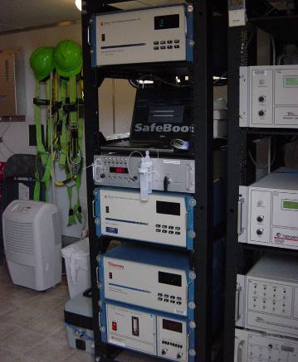
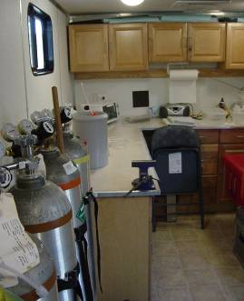
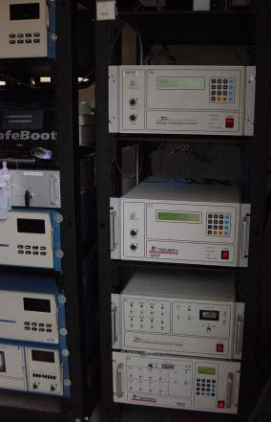
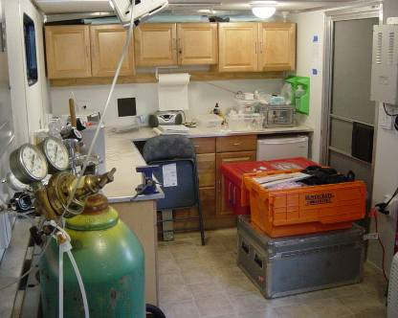
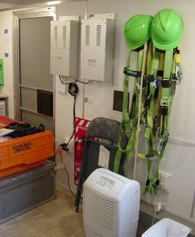
Measurements – Accomplishments
long term, high-quality data
  atmospheric chemistry
  trend analysis
  local vs. long-range transport
  source-receptor studies
  model evaluation
Inside the instrument trailer at the Grand Bay NERR long term mercury monitoring site
Notes:
Note that we have two speciated mercury instrument suites at Grand Bay (and also at Beltsville).
Close inspection of the figure shows that the both instruments “catch” the RGM peaks.

Slide 14
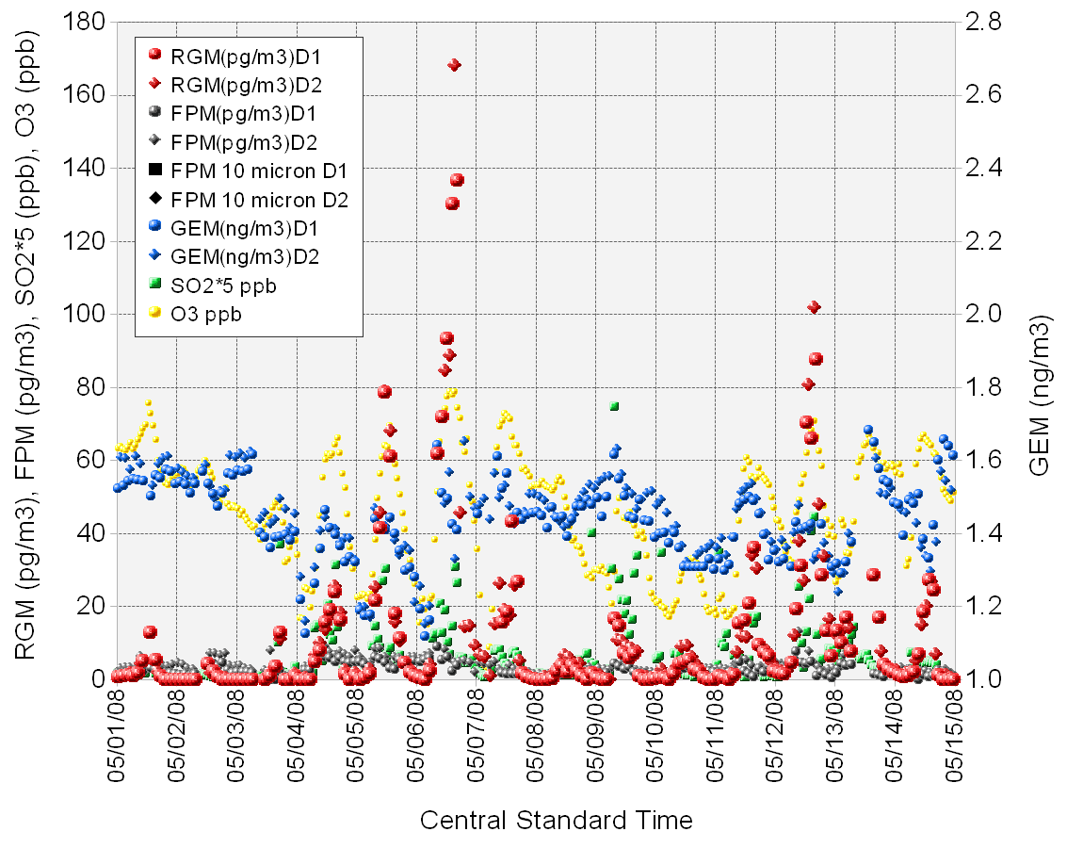
Measuring RGM (reactive gaseous mercury) is important and challenging; two co-located speciated mercury measurement instruments provide continuous “coverage” and
allow peaks to be verified
Date
Notes:
The date labels are at 12:00 AM local time; most of the peaks occur during the day.
RGM = Reactive Gaseous Mercury
FPM = Fine Particulate Mercury
GEM = Gaseous Elemental Mercury
SO2 = Sulfur Dioxide
O3 = Ozone

Slide 15
Measurements – Accomplishments
long term, high-quality data
  atmospheric chemistry
  trend analysis
  local vs. long-range transport
  source-receptor studies
  model evaluation
method development
  improved accuracy, operational robustness
  reduction of sample bias, artifact losses
advances in scientific understanding
  Polar mercury dynamics
  dry deposition
Inside the instrument trailer at the Grand Bay NERR long term mercury monitoring site
Notes:
Note that we have two instruments at Grand Bay (and also at Beltsville).
Close inspection of the figure shows that the both instruments “catch” the RGM peaks.

Slide 16
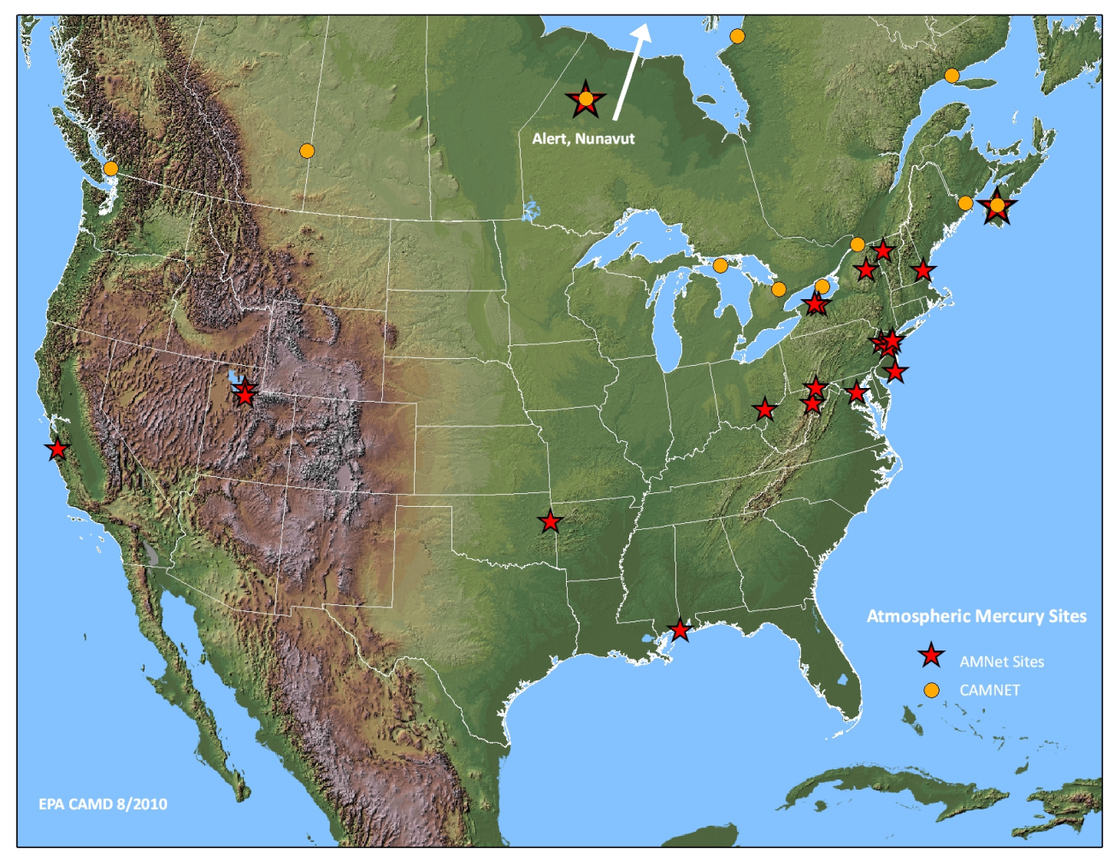
Measurements – Indicators of Success
Peer-reviewed publications (e.g., Atmos. Environ., Geophys. Res. Letters)
Funding from other agencies (e.g., EPA, NSF)
Founding member and key contributor to the Atmospheric Mercury Monitoring Network (AMNet)
  Data
  Methods
  Data analysis
Allegheny
Portage
Beltsville (2)
Canaan Valley
Mauna Loa
Grand Bay (2)
NOAA-ARL sites contributing to the Atmospheric Mercury Monitoring Network (AMNet), an emerging speciated mercury air concentration network

Slide 17
Measurements – Collaborators
NOAA
Grand Bay National Estuarine Reserve (NERR)
Nat’l Centers for Coastal & Ocean Science (NCCOS)
Earth Systems Research Laboratory (ESRL)
National Weather Service (NWS)
Sea Grant
Environmental Research Program (ERP)
Universities and Institutes
Canaan Valley Institute
Florida State University
University of Houston
University of Maryland
University of Tennessee Space Institute
University of Miami (Florida)
Georgia Tech University
Mississippi State University
Jackson State University
University of Michigan
University of Nevada
University of Illinois
Valparaiso University
Other Federal Agencies
EPA Clean Air Markets Division (CAMD)
Fish and Wildlife Service
Department of Agriculture
National Park Service
National Science Foundation
U.S. Geological Survey
Industry
TEKRAN
Electric Power Research Institute
Southern Company
State/Local Governments
Maryland, Mississippi, Pennsylvania, Texas, Alaska, Virginia, West Virginia

Slide 18
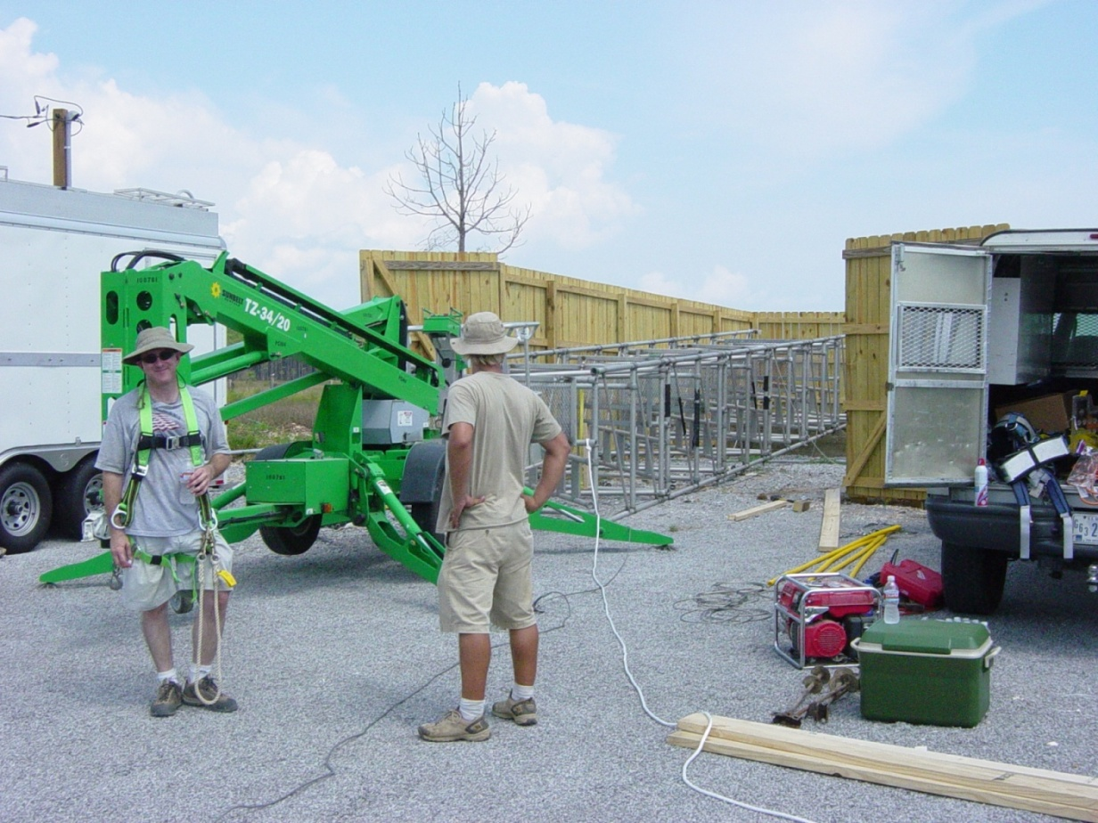
Measurements – Future Directions
Optimize existing measurement methods
Develop new methods, e.g.,
  laser-based eddy correlation system
  relaxed-eddy-accumulation (REA) system
  surrogate surfaces as low cost, simple devices for oxidized mercury concentrations and dry deposition estimates
Additional measurements at long-term sites
Publication and additional analysis of datasets
Field intensives involving process studies to address key uncertainties
Assess effects of forest fires and floods on ecosystem mercury loads
Assess the potential impacts of climate change on polar mercury oxidation, deposition, and glacial sequestration

Slide 19

Modeling – Approaches
Back-trajectory analyses with HYSPLIT
Fate and transport modeling with HYSPLIT-Hg
…focus on source-receptor relationships
Notes:
Hg(II) is Reactive Gaseous Mercury
Hg(0) is Elemental Mercury
Hg(p) is Particulate Mercury

Slide 20
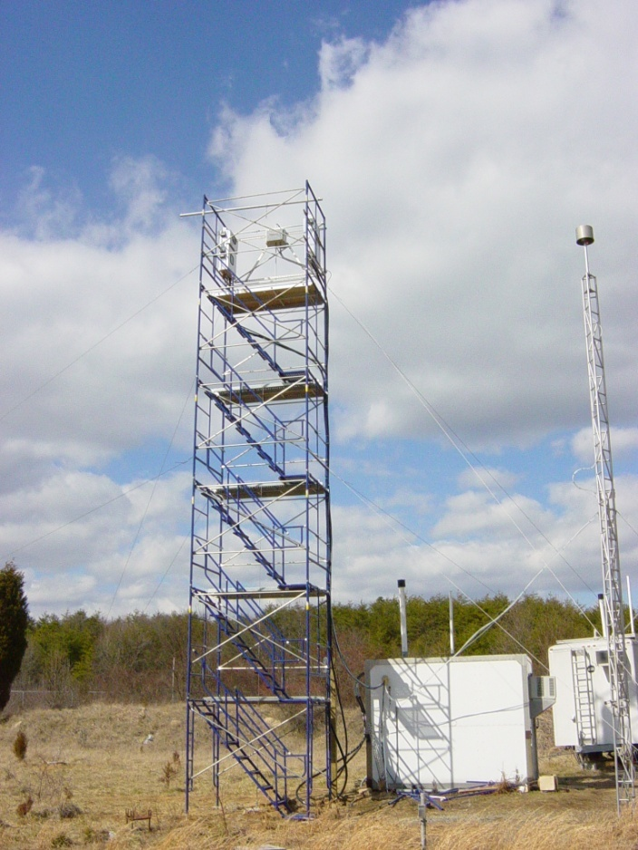
Back Trajectory Analysis – Episodes
Beltsville, Maryland
mercury site
Reactive Gaseous Mercury episode
Notes:
Sometimes we see high peaks of RGM and/or other mercury compounds.
Can we explain what is happening during these episodes? Why was the concentration so high?
Ultimately we want and need to be able to explain the continuous record of measurements at the site, but sometimes it is useful to focus on episodes.

Slide 21
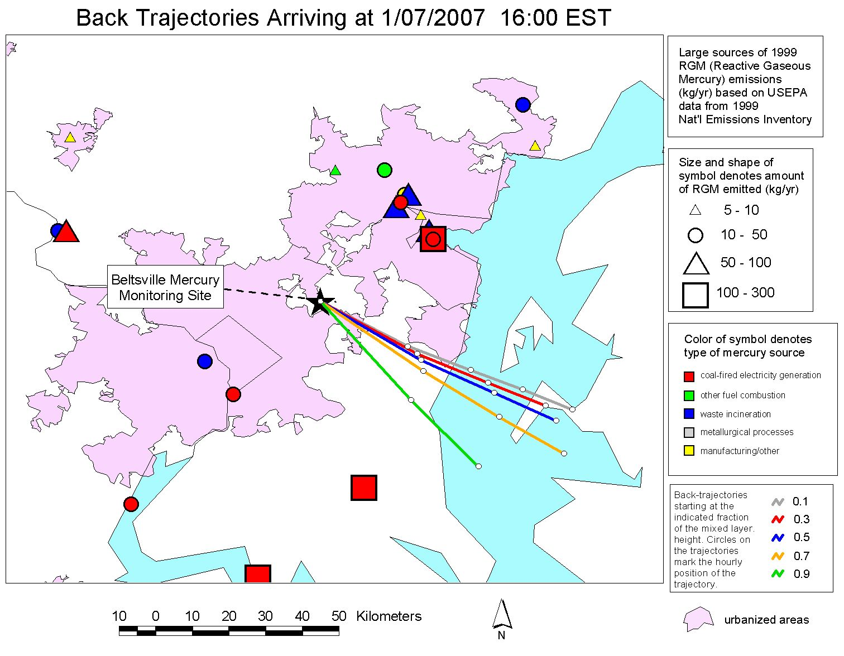
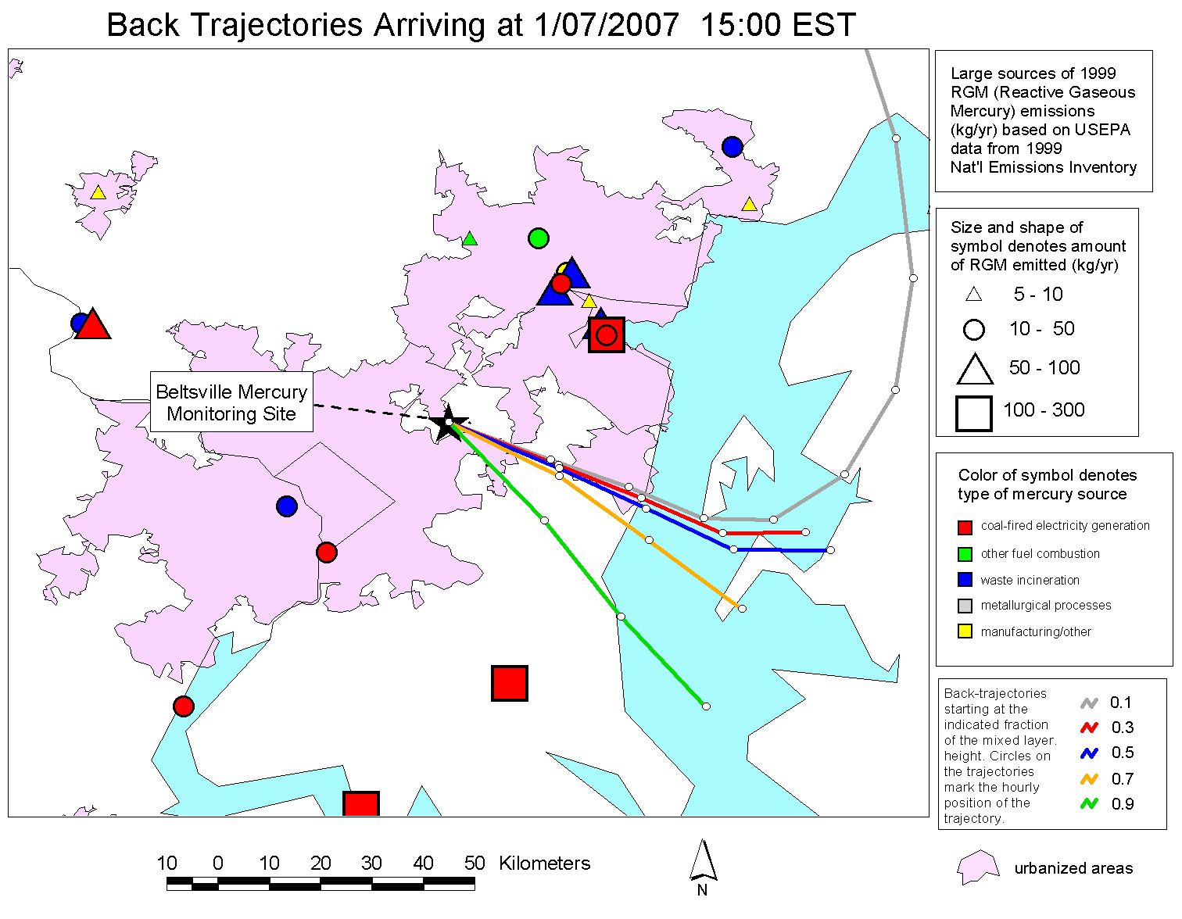
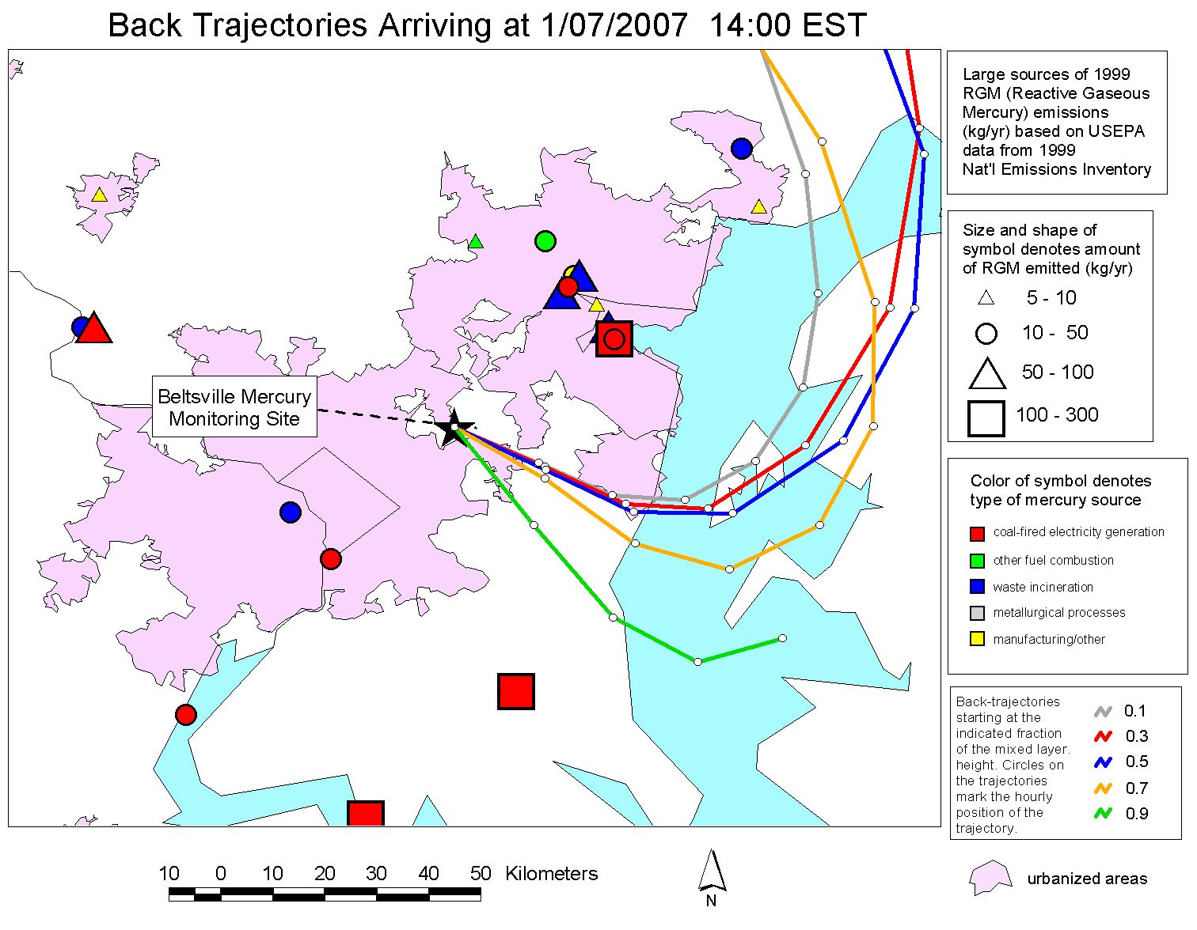
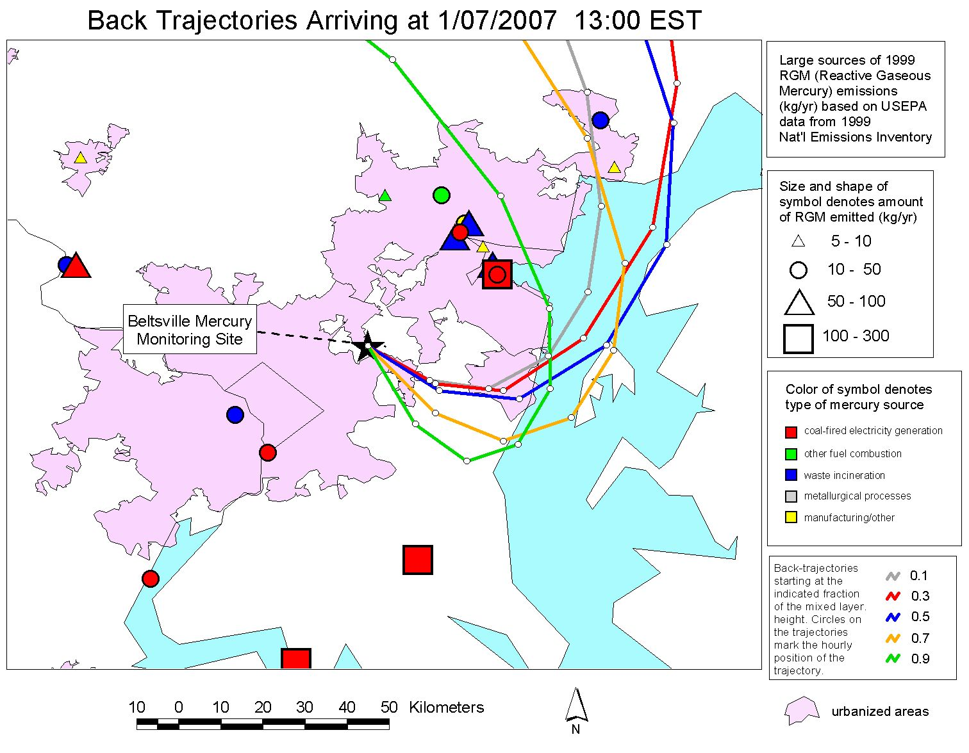
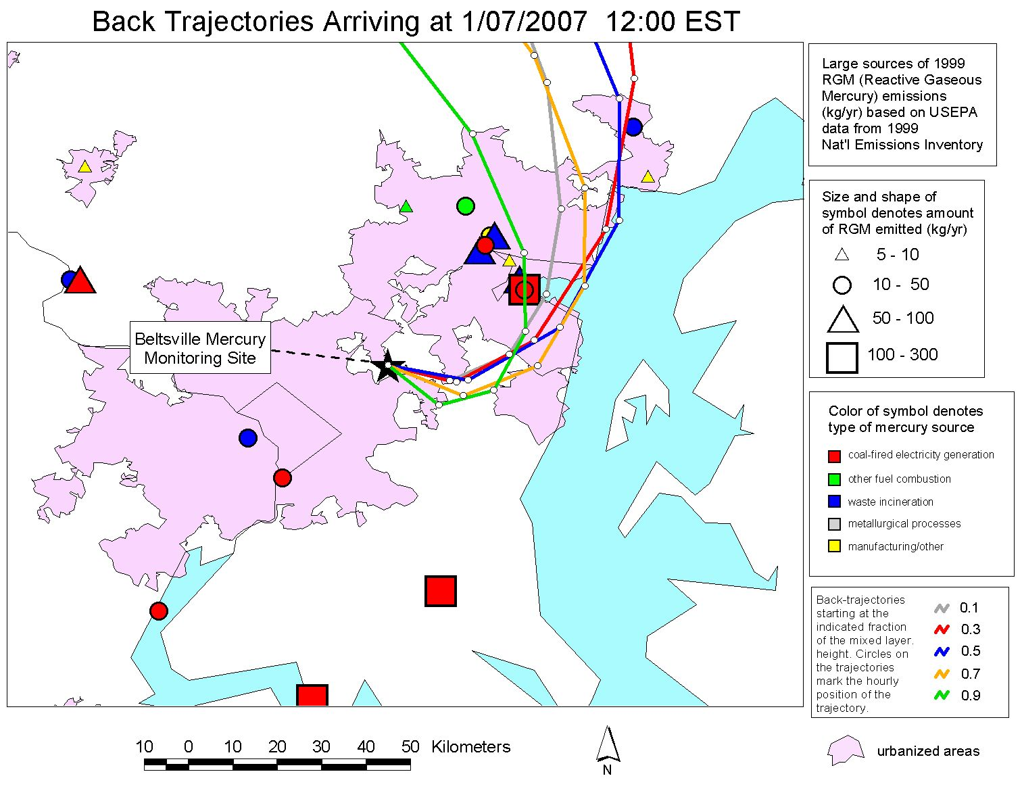
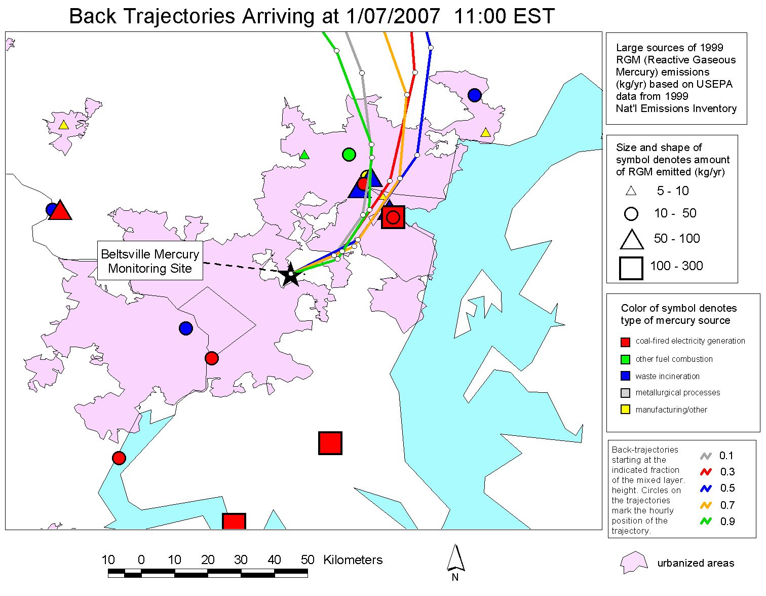

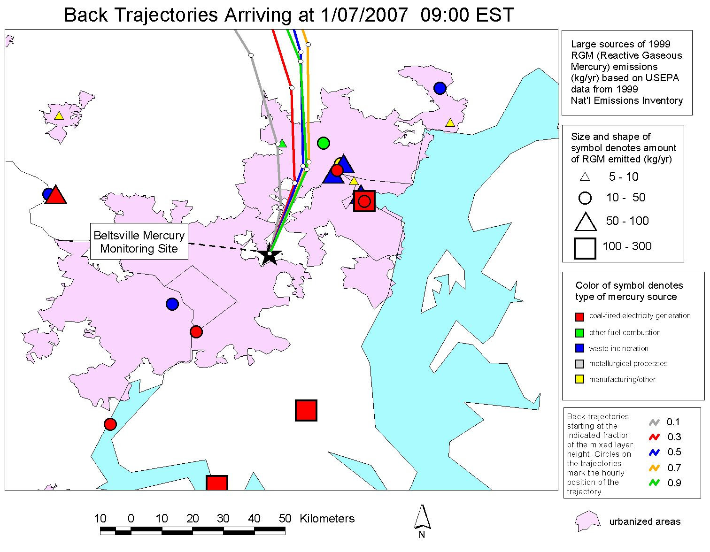
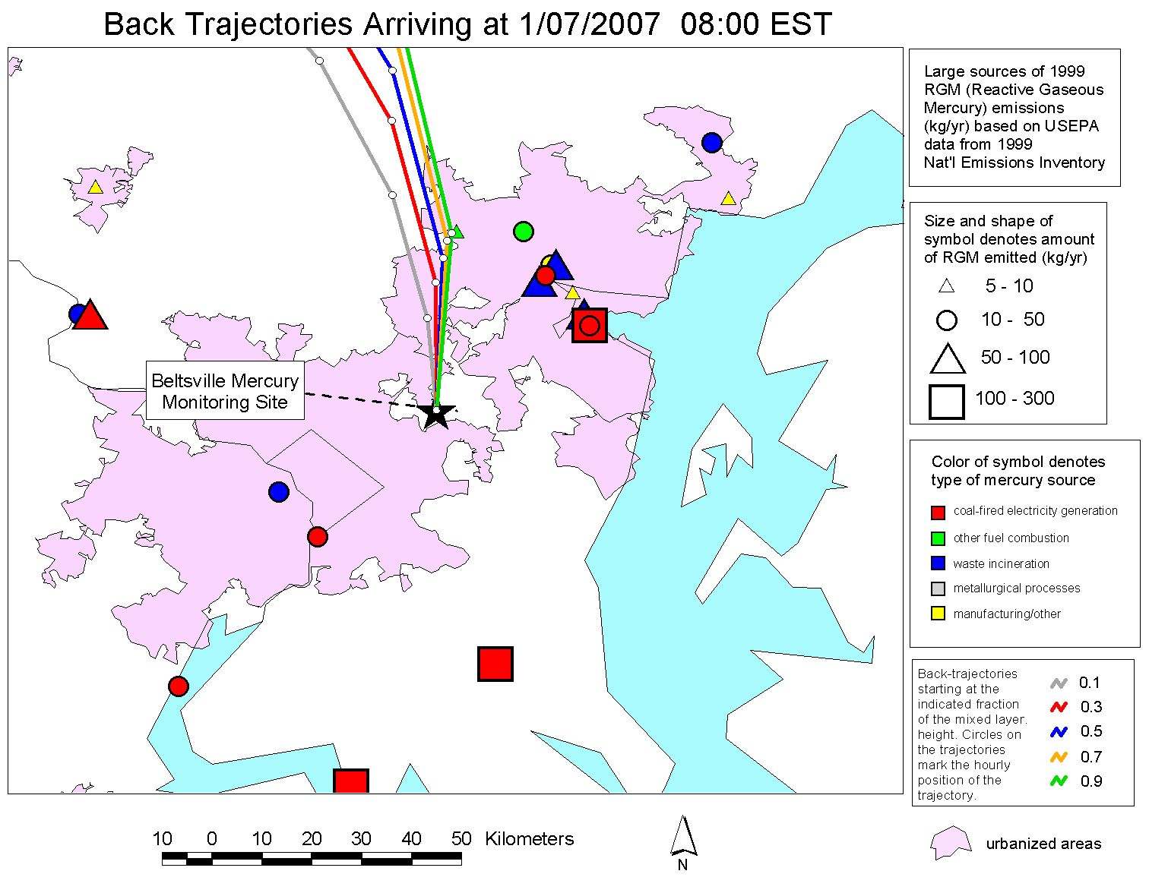
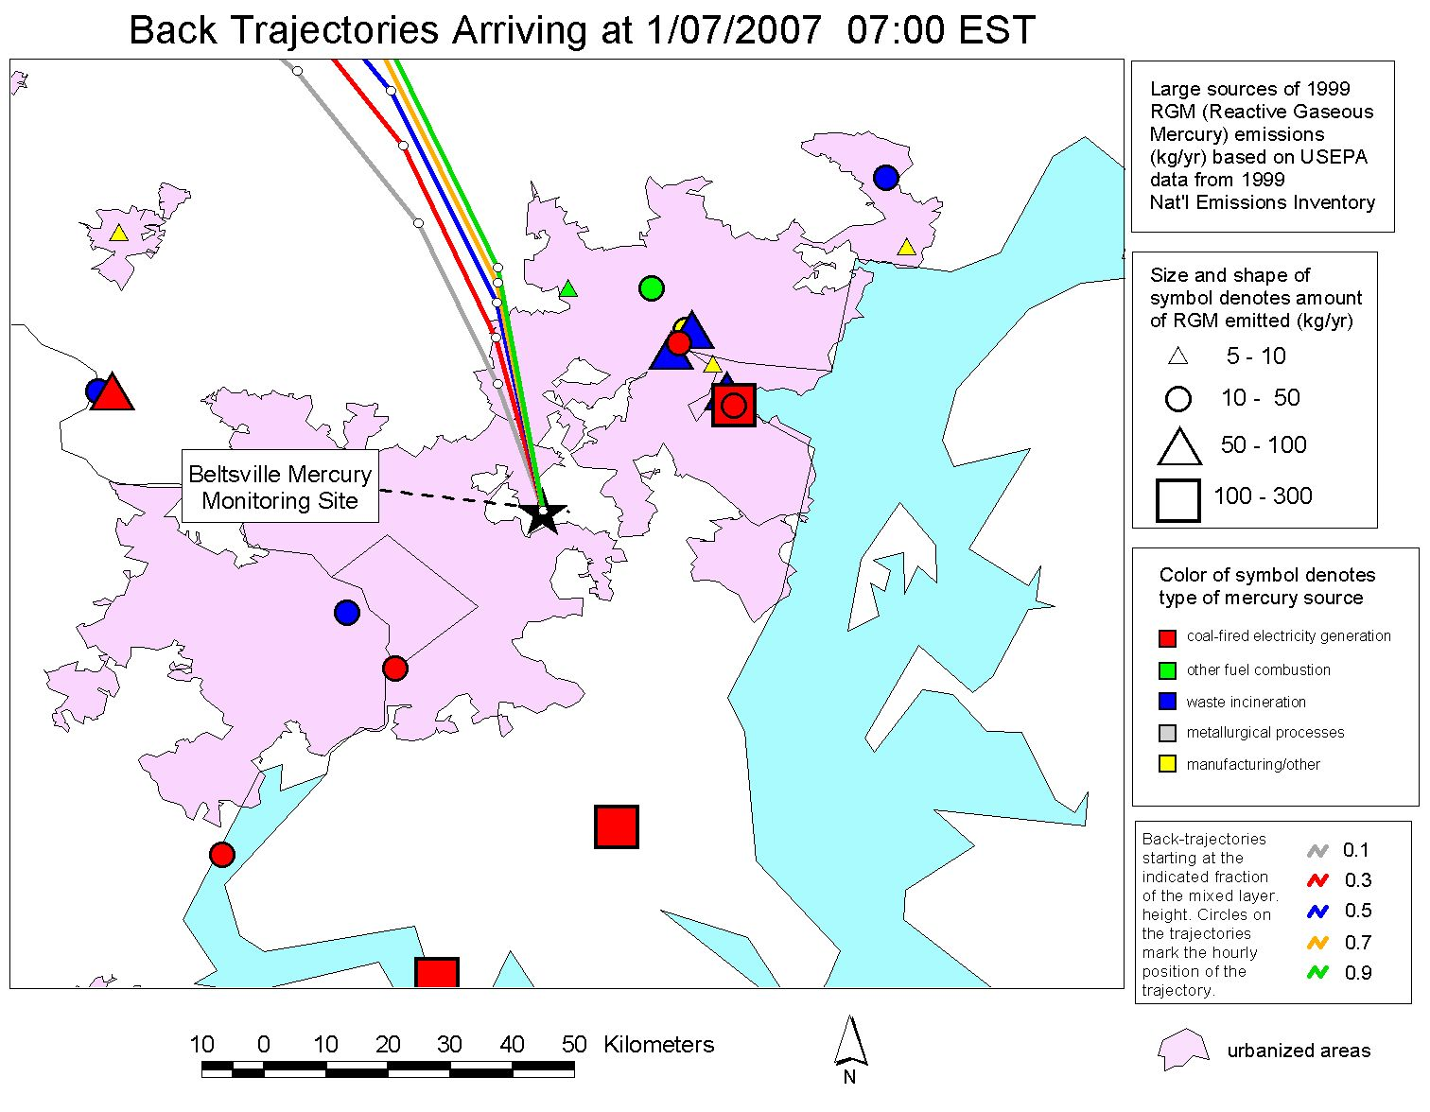
Baltimore
Chesapeake Bay
Washington D.C.
Notes:
When the concentration was high, the air masses appeared to be from a group of significant sources in the Baltimore region northeast of the site.
We have MANY examples of this kind of analysis.
This kind of analysis does not prove that the sources impacted the site and caused the episode, but it is suggestive.
Coupled with other information, this can contribute to a weight-of-evidence approach.

Slide 22
Back Trajectory Analysis – “Gridded Trajectory Frequencies”
Instead of single-event analysis,
a way to analyze a more extensive data record at a given site
When measured concentrations at a given site are relatively high (or low), where do the air masses arriving at the site tend to come from?
Are these regions related – or not – to known mercury sources?
An extension of trajectory cluster analysis
What fraction of trajectories for a given subset of measurements (e.g., top 10% of RGM measurements) pass through each grid square throughout a given domain?
How does this geographical “trajectory gridded frequency” pattern compare with locations of known mercury air emissions sources?
RGM (pg/m³)
One year of hourly reactive gaseous mercury (RGM) measurements at the Piney Reservoir site in Western Maryland, courtesy of Mark Castro, Univ. of Maryland

Slide 23
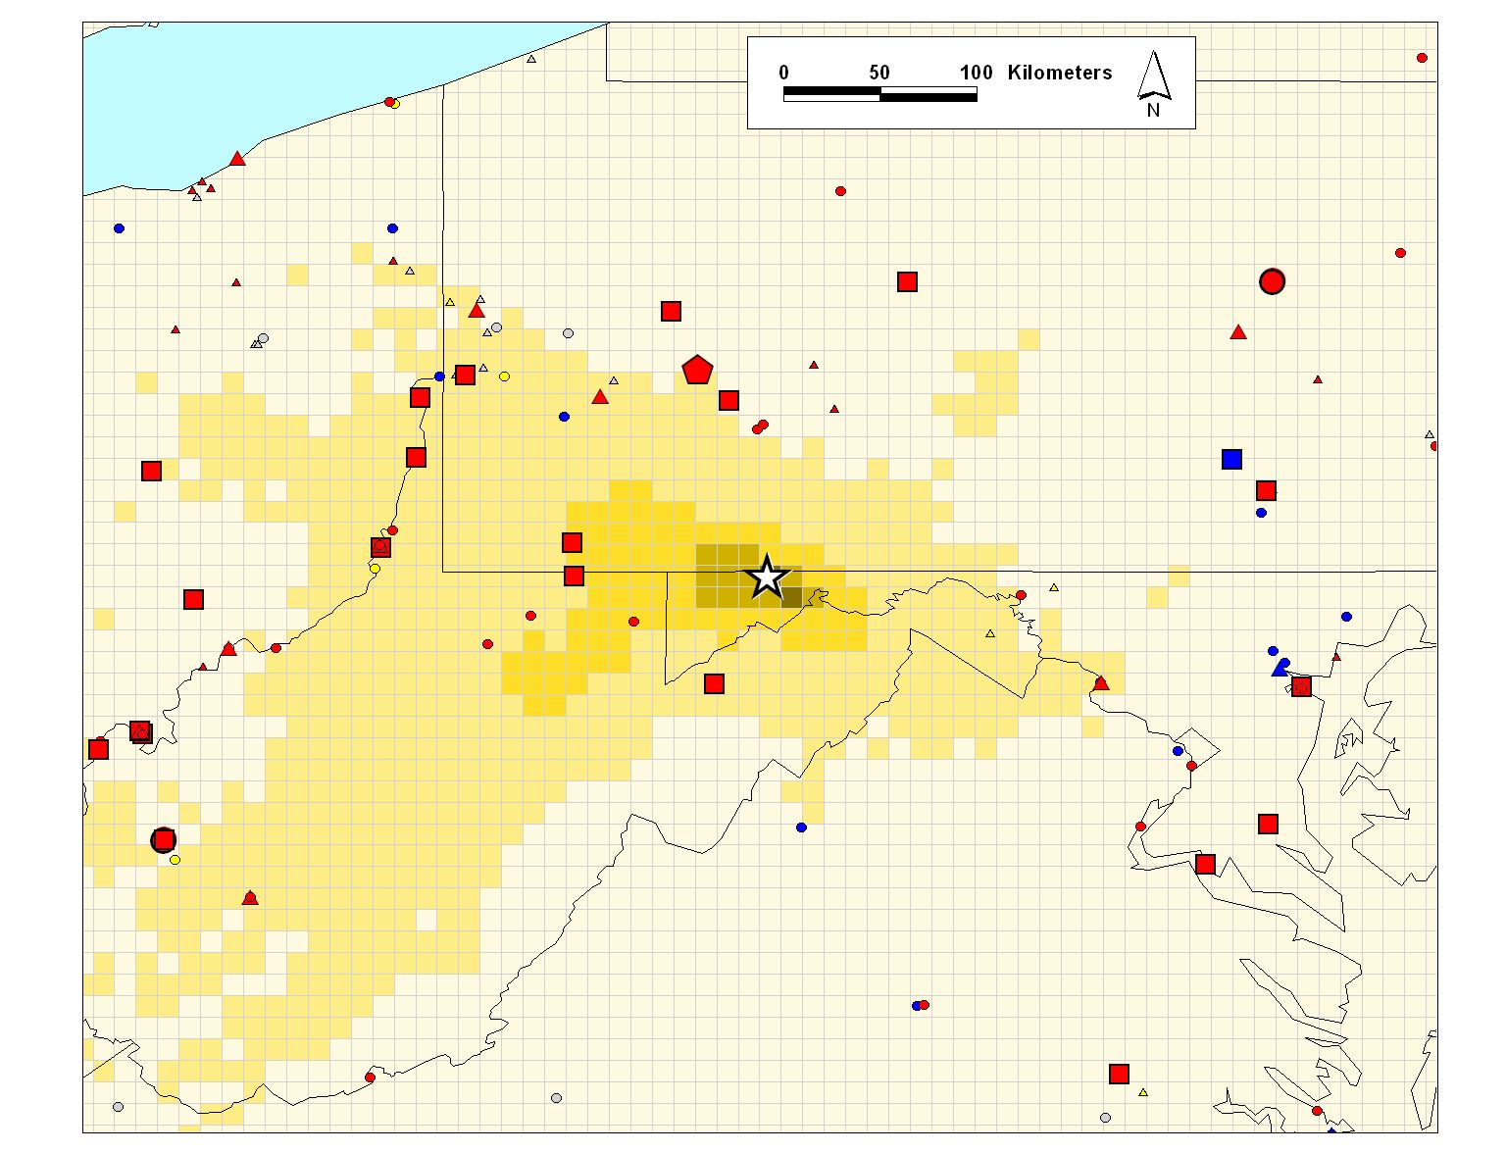
Where the air at the Piney Reservoir site tended to come from -- on average -- over the entire year
Piney Measurement Site
Percent of back-trajectories passing through grid square
0 - 1
6 – 10
1- 3
10 - 100
3 - 6
Air Emissions
size/shape of symbol denotes amount of mercury emitted (kg/yr)
5 - 10
10 - 50
50 - 100
100 – 300
300 - 500
500 - 1000
1000 - 3500
color of symbol denotes type of mercury source
coal-fired power plants
other fuel combustion
waste incineration
metallurgical
0.1 degree lat/long regional grid
manufacturing & other

Slide 24
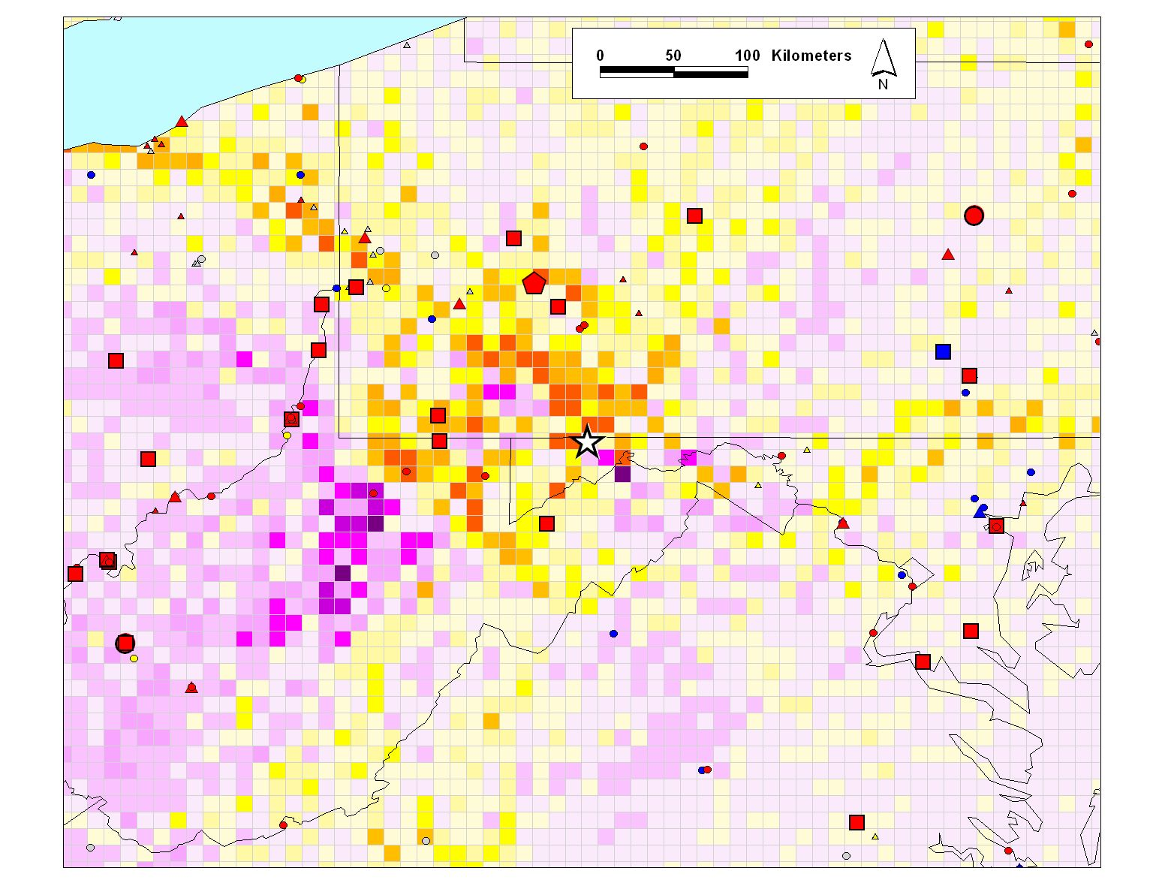
Piney Measurement Site
Where the air tended to come from when the measured RGM at the Piney Reservoir site was HIGH
Difference between selected case and total year in percent of back-trajectories passing through grid square
> 2.5
< -2.5
2 – 2.5
-2.5 to -2
1.5 - 2
-2 to -1.5
The yellow and orange grid squares are areas where the trajectories pass more often than the “average” for the entire year
The purple grid squares represent areas where the trajectories pass less often than the “average” for the entire year
1 to 1.5
-1.5 to -1
0.5 - 1
-1 to -0.5
0 to 0.5
-0.5 to 0
Air Emissions
size/shape of symbol denotes amount of mercury emitted (kg/yr)
5 - 10
10 - 50
50 - 100
100 – 300
300 - 500
500 - 1000
1000 - 3500
color of symbol denotes type of mercury source
coal-fired power plants
other fuel combustion
waste incineration
metallurgical
0.1 degree lat/long regional grid
manufacturing & other
Notes:
This was an analysis carried out in collaboration with Mark Castro who provided data from his Piney Reservoir measurement site.
“High” measurements represent the top 10% of the daytime RGM measurements, for 2005
Emissions estimates from the USEPA 2002 National Emissions Inventory (NEI) are shown
A manuscript including this analysis is in preparation.
By flipping back and forth between this slide and the next, it can be seen that higher RGM concentrations at the Piney Reservoir site seem to be associated with air masses passing through a region of sources northwest of the site.

Slide 25
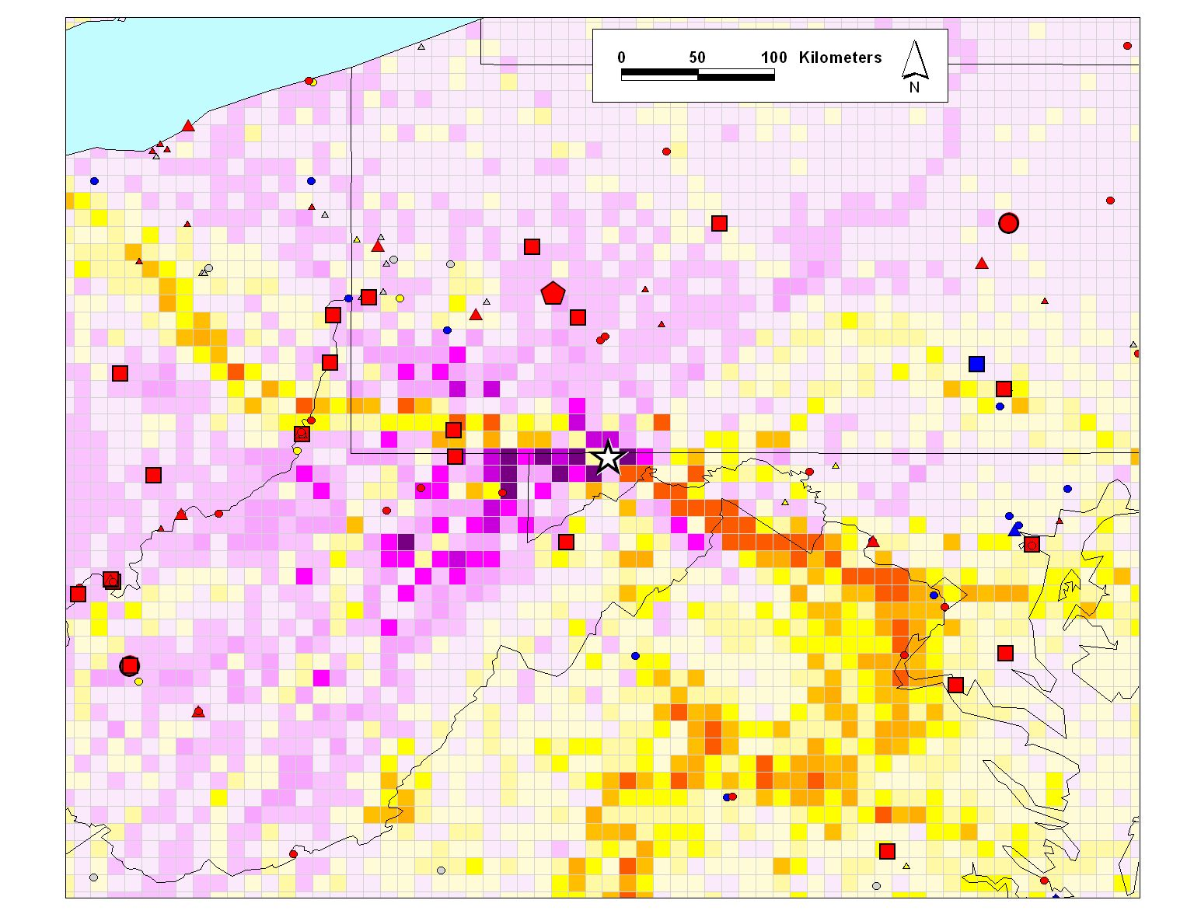
Piney Measurement Site
Where the air tended to come from when the measured RGM at the Piney Reservoir site was LOW
Difference between selected case and total year in percent of back-trajectories passing through grid square
> 2.5
< -2.5
2 – 2.5
-2.5 to -2
1.5 - 2
-2 to -1.5
The yellow and orange grid squares are areas where the trajectories pass more often than the “average” for the entire year
The purple grid squares represent areas where the trajectories pass less often than the “average” for the entire year
1 to 1.5
-1.5 to -1
0.5 - 1
-1 to -0.5
0 to 0.5
-0.5 to 0
Air Emissions
size/shape of symbol denotes amount of mercury emitted (kg/yr)
5 - 10
10 - 50
50 - 100
100 – 300
300 - 500
500 - 1000
1000 - 3500
color of symbol denotes type of mercury source
coal-fired power plants
other fuel combustion
waste incineration
metallurgical
0.1 degree lat/long regional grid
manufacturing & other
Notes:
“Low” measurements represent the bottom 10% of the daytime RGM measurements, for 2005

Slide 26

Modeling – Comprehensive Fate and Transport Simulations
Start with an emissions inventory
Use gridded meteorological data
Simulate the dispersion, chemical transformation, and wet and dry deposition of mercury emitted to the air
Source-attribution information needed at the end, so optimize modeling system and approach to allow source-receptor information to be captured
HYSPLIT-Hg developed over the last ~10 years with specialized algorithms for simulation of atmospheric mercury
Notes:
We use emissions inventories from the U.S. EPA, Environment Canada, the Commission for Environmental Cooperation, the Mexican government, the United Nations Environmental Program (UNEP), and many other sources. We also do “spot checks” on inventory records that seem suspect, by attempting to verify the location and emissions information listed in the inventory by independent means.
HYSPLIT is run using gridded meteorological data, from the output of meteorological models. The primary source of gridded met data for ARL is NOAA NCEP. The data is converted to HYSPLIT format and archived at ARL for modeling use. In some cases, we generate our “own” meteorological modeling output, for special cases, with higher resolution than would otherwise be available. We also use data from other sources (e.g., ECMWF, NCAR…).

Slide 27
Modeling – Accomplishments
Successful performance in model evaluation and model intercomparison exercises
Total Gaseous Mercury (ng/m³) at Neuglobsow, Germany, June 26 – July 6, 1995.
model inter-comparison and evaluation carried out in collaboration with numerous mercury modeling research groups around the world, under the auspices of EMEP (Europe)
Ryaboshapko et al., Intercomparison study of atmospheric mercury models: 1. Comparison of models with short-term measurements. Science of the Total Environment 376, 228-240, 2007.
Notes:
2007 Ryaboshapko et al. Intercomparison study of atmospheric mercury models: 2. Modeling results vs. long-term observations and comparison of country deposition budgets. Science of the Total Environment 377, 319-333.
Ryaboshapko et al. Intercomparison study of atmospheric mercury models: 1. Comparison of models with short-term measurements. Science of the Total Environment 376, 228-240.
EMEP = Cooperative Programme for Monitoring and Evaluation of the Long Range Transmission of Air Pollutants in Europe, established by the 1979 Convention on Long-Range Transboundary Air Pollution on Heavy Metals (LRTAP).
MSCE = model from Meteorological Sythesizing Centre – East (Russia)
CMAQ = model from U.S. EPA
GRAHM = model from Environment Canada
EMAP = model from Bulgarian National Institute of Meteorology and Hydrology
DEHM = model from Denmark National Environmental Research Institute
ADOM = model from German GKSS Research Centre
HYSPLIT = model from the NOAA Air Resources Laboratory

Slide 28
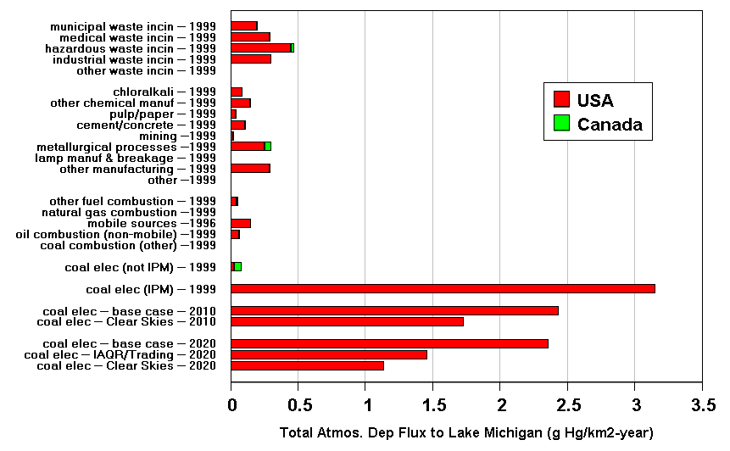
Modeling – Accomplishments
Policy-Relevant
Scenario Analysis
Atmospheric Deposition Flux to Lake Michigan from Anthropogenic
Mercury Emissions Sources in the U.S. and Canada (g Hg/km2-year)
Notes:
This was an analysis carried out for the Clean Air Markets Division in their deliberation over the proposed Clear Skies Initiative.
With models, you can examine the consequences of alternative future emissions scenarios.

Slide 29
Modeling – Accomplishments
But these “local” emissions are responsible for a large fraction of the modeled atmospheric deposition
Only a small fraction of U.S. and Canadian emissions are emitted within 100 km of Lake Michigan
Emissions and deposition to Lake Michigan arising from different distance ranges away from the lake (km)
(based on 1999 anthropogenic emissions in the U.S. and Canada)

Slide 30

Modeling – Accomplishments
When puffs grow to sizes large relative to the meteorological data grid, they split, horizontally and/or vertically
In the new version of HYSPLIT (4.9), puffs are “dumped” into an Eulerian grid after a specified time (e.g., 96 hrs), and the mercury is simulated on that grid from then on…
Ok for regional simulations,
but for global modeling,
puff splitting
overwhelms
computational
resources
Notes:
Incorporation of the mercury modeling algorithms into the new GEM-HYSPLIT code was a large scientific programming task.

Slide 31
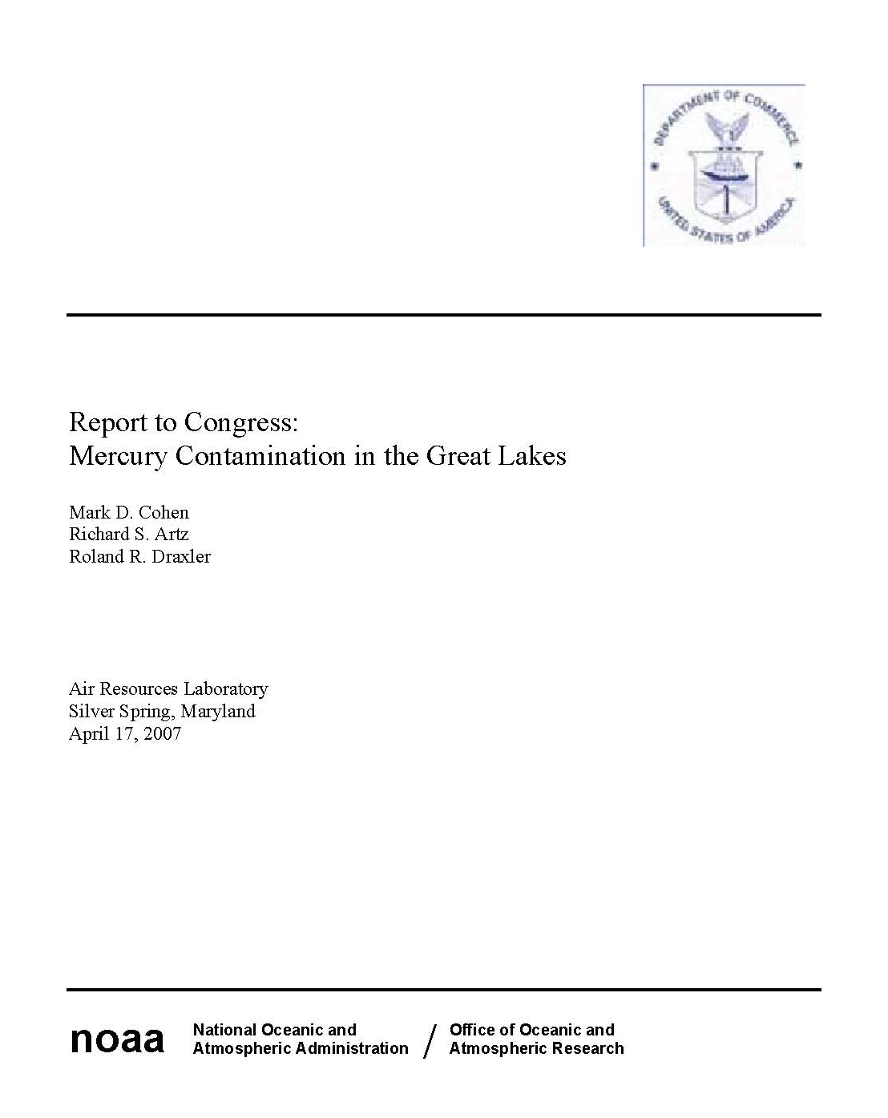
Modeling – Indicators of Success
Peer-reviewed publications, e.g., NOAA Report to Congress on Mercury Contamination in the Great Lakes
Good performance in model intercomparison and model evaluation exercises
Awarded grants to carry out modeling analysis, e.g., Great Lake Restoration Initiative
Frequent invitations to provide guidance on regulatory, legislative, and judicial issues
Examples of impact on decisions include:
  Mercury regulations enacted by Pennsylvania
  Debate over the Clean Air Mercury Rule (CAMR) related to the “hotspots” issue
Notes:
The Conference Report accompanying the consolidated Appropriations Act, 2005 (H. Rpt. 108-792) requested that NOAA, in consultation with the EPA, report to Congress on mercury contamination in the Great Lakes, with trend and source analysis.
Reviewed by NOAA, EPA, DOC, White House Office of Science and Technology Policy, and Office of Management and Budget (OMB). Review process took ~2 years. Transmitted to Congress on May 14, 2007

Slide 32
Modeling – Collaborators
NOAA
National Weather Service (NWS)
Environmental Modeling Program
Ecosystem Research Program
Universities and Institutes
University of Maryland
Jackson State University
Cornell University
Syracuse University
Clarkson University
Harvard University
Texas Christian University
University of Michigan
University of Washington
Lake Champlain Research Consortium
Other Federal Agencies and Programs
EPA Clean Air Markets Division (CAMD)
Great Lakes Restoration Initiative (GLRI)
EPA Office of Research and Development
EPA Great Lakes National Program Office
US Geological Survey
National Atmospheric Deposition Program
International Agencies and Organizations
International Joint Commission (IJC)
Commission for Environmental Cooperation (CEC)
Environment Canada
Instituto Nacional de Ecología (INE-Mexico)
Meteorological Synthesizing Centre - East (Russia)
United Nations Environmental Program (UNEP)
Arctic Monitoring & Assessment Program (AMAP)
Norwegian Institute for Air Research (NILU)
State/Local Governments
Pennsylvania, Florida, Mississippi, Maryland
Gulf of Mexico Alliance (Florida, Texas, Mississippi, Alabama, Louisiana)
Industry
Electric Power Research Institute
Southern Company
Notes:
This is just a partial list, with the main collaborators. There are numerous other modeling collaborations that have been entered into over the past five years (and of course, before then, too).

Slide 33
Modeling – Future Directions
Policy-
Relevant
Analysis
Continue/extend Great Lakes analysis (Great Lakes Restoration Initiative)
Continue/extend Gulf of Mexico analysis; link with ecosystem model
Continue/extend numerous collaborations (EPA, State TMDL’s, …)
Improve model physics & chemistry as new info. becomes available
Further development of global modeling capability
“particle-mode” dispersion simulation for HYSPLIT-Hg
Improve treatment of natural sources, surface exchange, and re-emissions
Multi-media: incorporate surface layers into model
Science
ARL’s mercury research represents a rare opportunity
to combine modeling, measurements, and meteorological data/modeling
Participate in model intercomparisons
Episode-focused model evaluation at sites
Long-term model evaluation at sites
Model
Evaluation
Notes:
We plan to work on all of the above activities, depending to a certain extent on funding levels and evolving priorities.

Slide 34
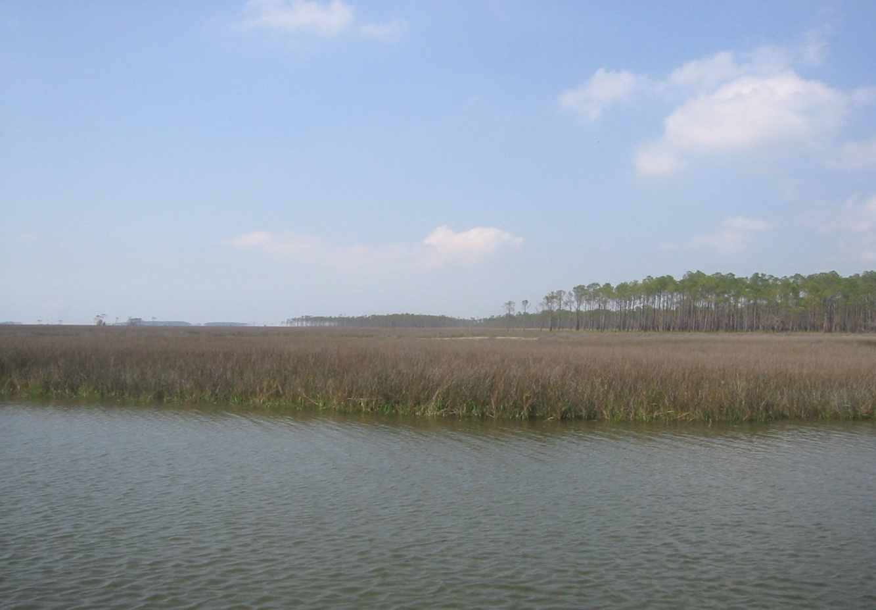
Questions?
View from the monitoring tower at the Grand Bay NERR long-term mercury monitoring site

