Slide 1
Atmospheric Dispersion and
Boundary Layer Research Summary
Kirk L. Clawson
Air Resources Laboratory
Air Resources Laboratory Review
May 3-5, 2011
Notes:
We have now come to the end of the formal presentations on our dispersion and boundary layer research programs. We have enjoyed this opportunity to share with you our rich scientific heritage, our current status, and plans for the future.

Slide 2
Atmospheric Dispersion and
Boundary Layer Posters and Demonstrations
Topic Presenter
ARL Work Supporting Wind Energy Chris Vogel
Harvard Flux Work Ed Dumas
READY & WOC Tool Glenn Rolph
HYSPLIT Decision Support Tool for INL EOC Brad Reese
Atmospheric Tracer Technologies Roger Carter
Balloon Technologies Randy Johnson
Extreme Turbulence (ET) Probe Rick Eckman
Best Aircraft Turbulence (BAT) Probe Ed Dumas
Notes:
During our time together today, we have not been able to cover all facets of our dispersion and boundary layer research. For this reason, we have prepared a number of posters, and hardware and software demonstrations that provide a more informal and hands-on view of the work we were not able to present formally. A separate session is scheduled for these presentations. The presentations are listed here together with the name of the presenter. We hope that you will take advantage of the opportunity to visit personally with these scientists during the poster session this afternoon.

Slide 3
Summary of ARL’s
Atmospheric Dispersion Research Program
Two components: modeling and measurements
Two world-class examples:
  HYSPLIT model
  Atmospheric Tracers
Many other program elements
  Decision Support Tools
  Mesonets
  Custom Instrument Development
Collaborate with and support other NOAA entities, DOE, DOD, DHS, FAA, USGS, ICAO, NASA, etc.
The program is in transition
Notes:
In reviewing the highlights of this session’s presentations, ARL’s atmospheric dispersion research program consists of two main components: modeling and measurements. Two world class examples exemplify each of these components: the HYSPLIT model and the atmospheric tracer research capability. However, there are many other program elements including such things as decision support tools, mesoscale meteorological monitoring networks (mesonets) and internally developed instruments using ARL expertise. Our dispersion research program supports other NOAA entities and collaborators include the U.S. Depts. of Energy (DOE), Defense (DOD), and Homeland Security (DHS), and other government agencies including the Federal Aviation Administration (FAA), the U.S. Geological Survey (USGS), the International Civil Aviation Organization (ICAO), and the National Aeronautics and Space Administration (NASA). The program is also in transition. It is not yet where we want it to be, but we are actively working on that. An example is the many ongoing cross-divisional efforts and planned efforts.

Slide 4
Summary of ARL’s
Boundary Layer Research Program
New field of endeavor, and outgrowth from dispersion research
ARL-developed instruments
  ET Probe
  Smart Balloon
  BAT Probe
Urban and complex terrain mesonets
Renewable wind energy forecast research
Notes:
As pointed out earlier, our formal entry into boundary layer research is an outgrowth of our dispersion research that has been going on for years. We are now formalizing that effort with the development of a strategic plan. So far we have identified a few focus areas. We are using instruments invented right here in ARL to better understand hurricane turbulence, to track and measure the evolution of pollutant plumes with constant altitude balloons, and to measure regional airborne fluxes with small aircraft. We are using urban and complex terrain mesonets to better understand dispersion in these areas. We are also conducting research to better understand and forecast the wind for renewable energy production.

Slide 5
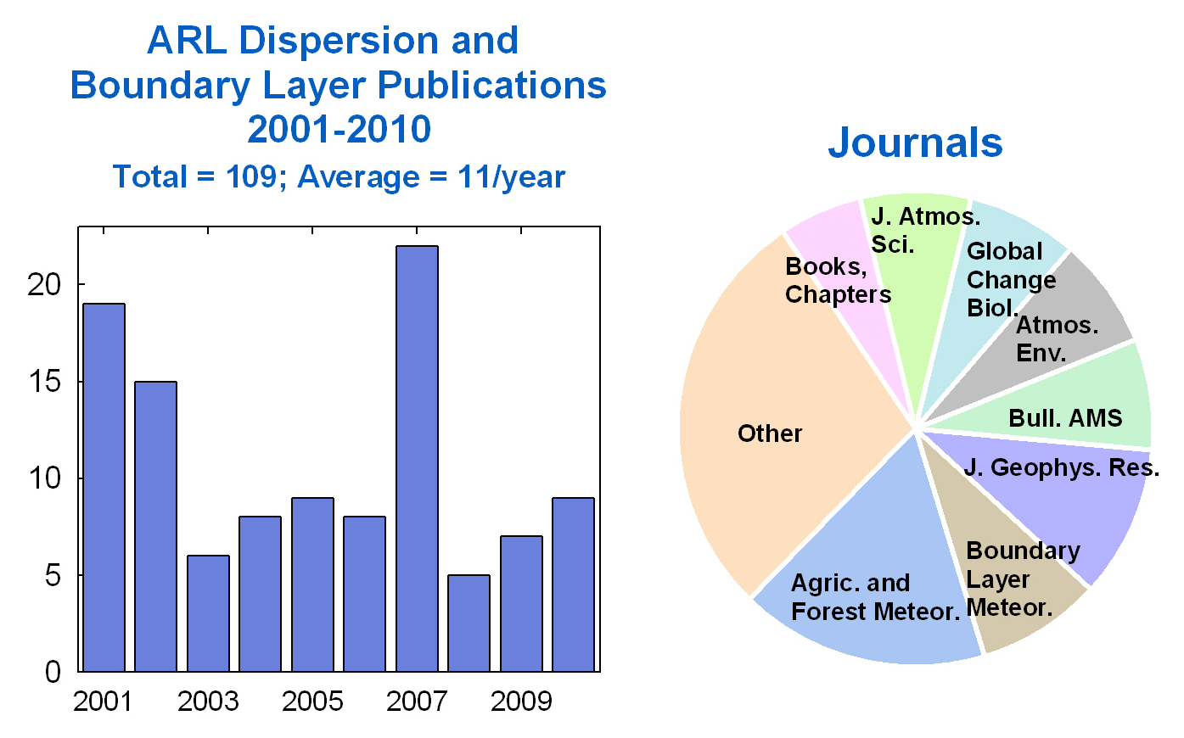
Indicators of Preeminence
Notes:
When considering a research group’s preeminence, publication counts are the usually the first type of measurement that is reviewed. ARL has published a total of 109 refereed journal articles, books, and book chapters in the past 10 years, for an average publication rate of 11 per year. The journal with the highest ARL publications is Agricultural and Forest Meteorology, where 17% of our articles have been published. The Journal of Geophysical Research is second at 10%, followed by Boundary Layer Meteorology at 8%, the Bulletin of the American Meteorological Society, Atmospheric Environment, and Global Change Biology at 7% each.

Slide 6
Indicators of Preeminence (cont.)
Department of Commerce Gold, Silver and Bronze Medals
National and international recognition, adoption and use of research, tools and data
Long-term funding relationships that have existed for more than 60 years
Requests by funding agencies for our participation in highly visible experiments and modeling efforts
Frequent mention in journal articles and scientific meetings
Widespread media coverage
Notes:
However, there are other significant indicators of our preeminence in dispersion and boundary layer research. For example, we have received the highest award the parent agency of NOAA can give: the U.S. Dept. of Commerce Gold Medal. We have received two of these in the last decade, which were awarded to Roland Draxler and Tim Crawford. Our scientific contributions are also recognized nationally and internationally and have been adopted by a number of national and international groups and organizations. The HYSPLIT model is a prime example, having been adopted or utilized by such diverse countries as Spain and China. Another example is the widespread use of our dispersion databases by national and international organizations. Some of our research funding relationships have existed for more than 60 years. This is evidence of our ability to continue to conduct relevant and useful research. Were this not so, these relationships would have been terminated years ago. Agencies and entities continue to request our expertise and assistance in field experiments and with modeling efforts. This again shows a high degree of scientific achievement and ability within ARL, and also the esteem with which the laboratory is held within the scientific community. Our work is widely cited in the professional literature and at scientific conferences. We often do not get our names included as coauthors, but our data and models are frequently cited in the literature and at conferences. Some of our work has also generated widespread media coverage. These are only a few evidences of our preeminence.

Slide 7
Future Plans
Dispersion Research & Development
  Increase integration and enhancement of a NOAA-wide plume prediction capability
  Closer coupling of dispersion and meteorology models
  Dispersion model integration into AWIPS-II
  Improved HYSPLIT initialization with observations as given in Volcanic Ash Advisory
  Develop new tracers with lower GWP
  Develop lower cost autonomous fast-response measurements
Notes:
Highlights of our future plans in dispersion research and development include the goals to increase integration and enhancement of a NOAA-wide plume prediction capability, closer coupling of dispersion and meteorology models, dispersion model integration into AWIPS-II, improved HYSPLIT initialization with observations as given in the Volcanic Ash Advisory, development of new atmospheric tracers with lower global warming potentials, and development of lower cost autonomous fast-response tracer measurements.

Slide 8
Future Plans
Boundary Layer Research & Development
  Develop urban observatory for in-situ vertical observations of mean and turbulent winds and temperature
  Continue long-term collaboration and partnerships with federal agencies
  Support renewable energy weather-related research, particularly wind energy
  Improve satellite calibration & validation algorithms for land surface temperature and soil moisture using in situ measurements
Continue and increase cross-divisional collaborations
Notes:
Highlights of our future plans in boundary layer research and development are to develop an urban observatory for in-situ vertical observations of mean and turbulent winds and temperature, and continue long-term collaborations and funding partnerships with federal agencies and support renewable energy weather-related research, particularly wind energy. And in keeping with the theme of transition, we want to continue and even increase our cross-divisional collaborations.

Slide 9
Questions?
Notes:
I now open the session to questions from our reviewers on our atmospheric dispersion and boundary layer research programs.

