Slide 1
Atmospheric Dispersion and Boundary Layer Research Programs
Kirk L. Clawson
Air Resources Laboratory
Air Resources Laboratory Review
May 3-5, 2011
Notes:
Good morning. It is an honor to have been assigned the responsibility of presenting an overview of ARL’s dispersion and boundary layer research programs. We are glad that OAR has saved the best for the last, as it were, in the laboratory review cycle. I welcome our colleagues from OAR and other NOAA offices, our stake holders, other guests, and especially our reviewers. And to our reviewers I say that we sincerely appreciate the time and effort you have given thus far and look forward to receiving your comments and suggestions for improvement.

Slide 2
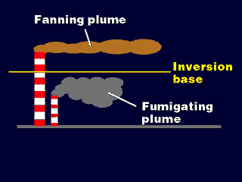
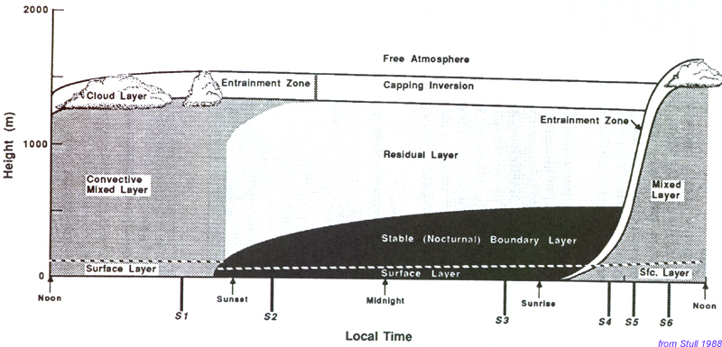
Atmospheric Dispersion and Boundary Layer Research Programs
Longest history in ARL
Established in every division
Serve to help to unify the laboratory
Exemplify theme of transition
Notes:
ARL’s dispersion and boundary layer research programs have the longest history in the laboratory and are being worked on in every division of the laboratory. These programs serve as a unifying force across the laboratory, even though the four divisions are scattered all across the country. These programs exemplify Steve Fine’s message of transition, for indeed, they are in transition. I will describe more of the history of these programs and the progress of transition later in this presentation. But first, I think it prudent to describe how these two programs (dispersion and boundary layer research) are intertwined.

Slide 3
Combination of Dispersion and Boundary Layer Research
60 years of research
Understanding of dispersion and the planetary boundary layer are intertwined
Boundary layer research is a natural outgrowth of dispersion research
Separate strategic plans are being developed for each research topic
Notes:
ARL has been involved in dispersion and boundary layer research for more than 60 years. An understanding of dispersion meteorology brings with it an understanding of boundary layer processes, for it is largely dispersion within the boundary layer that we are interested in understanding and modeling. Our recent emphasis on boundary layer meteorology is a natural outgrowth of our research in dispersion meteorology. The emphasis on boundary layer meteorological research is sufficient to warrant the creation of a strategic plan separate from that of dispersion meteorology. For the purposes of this review, we have combined the two fields of study since they are so very closely related.

Slide 4
Mission and Goals of ARL’s Atmospheric Dispersion Research & Development Program
Mission:
Provide scientific information and tools to improve the prediction of atmospheric dispersion of harmful materials to protect public health and the environment and to minimize economic impacts
Goals:
Improve the quality of atmospheric transport and diffusion predictions and assessments, including estimation of uncertainties
Improve decision-makers' understanding of predictions, assessments, and associated uncertainties
Notes:
The development of the dispersion program strategic plan is nearly complete. The plan defines the mission and goals of our research and development efforts. The mission is to provide scientific information and tools to improve the prediction of the dispersion of harmful materials into the atmosphere. We do this to protect public health and the environment, and to minimize the economic impacts to society. There are two goals associated with this mission. These are: 1) improve the quality of atmospheric transport and diffusion predictions and assessments, which includes the estimation of uncertainties, and 2) improve decision-makers’ understanding of the predictions, assessments, and associated uncertainties.

Slide 5
Mission and Goals of ARL’s Boundary Layer Research & Development Program
Goals:
Improve the understanding and prediction of boundary layer phenomena for multiple applications, including dispersion models, wind power production, and hurricanes
Improve land surface characterizations, particularly soil moisture and temperature, to assist with calibration of satellite-based measurements
Tools:
Mesonets and surface energy balance networks
Development of innovative instruments and measurements
Notes:
Because our boundary layer program is still new, a strategic plan for the program is still being formulated. Two very specific goals have been identified. Others may also be identified as the discussion continues. These goals are: 1) improve the understanding and prediction of boundary layer phenomena for multiple applications, including dispersion models, wind power production, and hurricanes, and 2) improve land surface characterizations, particularly soil moisture and temperature, to assist with calibration of satellite-based measurements. We have also identified a number of tools we will use to accomplish these goals including mesoscale meteorological monitoring networks (called mesonets), and the development of innovative new instruments and measurements.

Slide 6
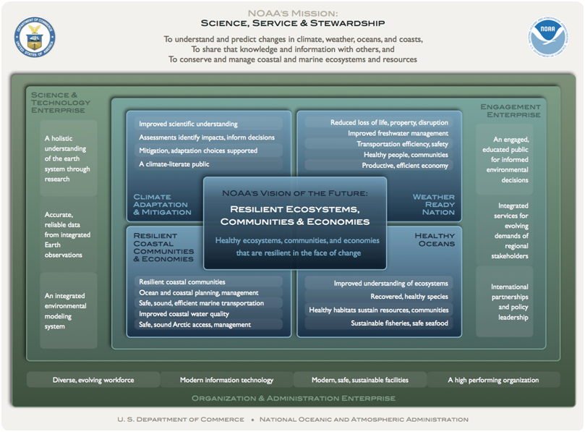
Drivers
NOAA Next Generation Strategic Plan
Weather-ready nation goal
Reduced loss of life, property, and disruption from high-impact events
Improved transportation efficiency and safety
A more productive and
efficient economy through
environmental information
relevant to key sectors of
the U.S. economy.
Notes:
There are a number of other drivers for our dispersion and boundary layer research programs besides our own strategic plans. Our programs fit neatly into NOAA’s Next Generation Strategic Plan, which became effective in December of last year. These programs help fulfill NOAA’s long-term goal of a weather-ready nation by helping our society to prepare for and respond to weather-related events. Three specific objectives of the goal are met: 1) Reduced loss of life, property, and disruption from high-impact events, 2) Improved transportation efficiency and safety, and 3) A more productive and efficient economy through environmental information relevant to key sectors of the U.S. economy.

Slide 7
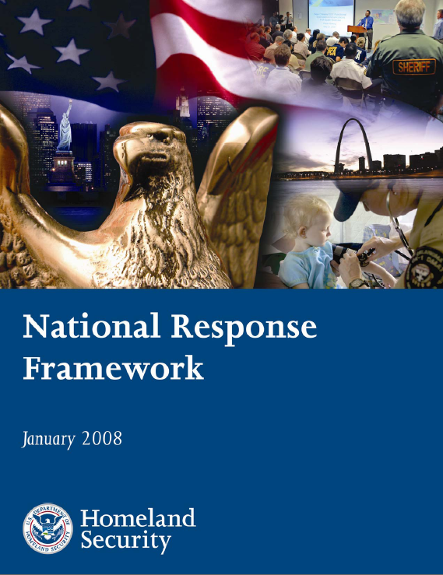
Drivers (cont.)
The National Response Framework (NRF)
Approved by the President
Emergency Support Functions in 6 areas:
Firefighting (smoke plume forecasting)
Public Health and Medical Services
Search and Rescue
Oil and Hazardous Materials Response (includes participation in the Interagency Modeling and Atmospheric Assessment Center–IMAAC)
Energy
Public Safety and Security
Notes:
Another driver is the National Response Framework (NRF), issued in 2008 by the Federal Emergency Management Agency (FEMA) of the U.S. Dept. of Homeland Security, and approved by the President himself. The NRF is a guide to how the Nation conducts all-hazards response and assigns to agencies their roles and responsibilities during such events. The term “response” as used in the NRF includes immediate actions to save lives, protect property and the environment, and meet basic human needs. Emergency Support Function Annexes of the NRF assign a number of plume-related responsibilities to NOAA. ARL’s participation is included in 6 emergency support functions that are shown on this slide. These functions are: Firefighting (smoke plume forecasting, see ESF #4-5), Public Health and Medical Services (radioactive and hazardous materials plume dispersion, see ESF #8-11), Search and Rescue (pollutant transport and dispersion, see ESF #9-6), Oil and Hazardous Materials Response (includes participation in the Interagency Modeling and Atmospheric Assessment Center–IMAAC, see ESF #10-11), Energy (dispersion model forecasts, see ESF #12-6), and Public Safety and Security (airborne plume prediction, see ESF #13-8).

Slide 8
Drivers (cont.)
Interagency agreements provide for volcanic ash plume prediction
MOU between NOAA and FAA (1988)
Letter of Agreement between NOAA and USGS (1993)
International Civil Aviation Organization (ICAO) International Airways Volcano Watch network of Volcanic Ash Advisory Centers (VAAC)
MOA between OAR and DOE-ID (2007)
Dispersion modeling and expert advice in an EOC setting
Dispersion mesonets
Notes:
Agreements with other agencies, both national and international, provide for volcanic ash plume prediction. These agencies include the Federal Aviation Administration, the US Geological Survey, and the International Civil Aviation Organization (ICAO). Still other agreements with the U.S. Department of Energy are the drivers for the sharing of dispersion expertise in emergency operation center settings and for the operation of long-term mesonets.

Slide 9
Overview of ARL’s Dispersion and Boundary Layer Research Program
Modeling Component
Hybrid Single-Particle
Lagrangian
Integrated Trajectory
Model (HYSPLIT)
Measurements Component
Tracers
Mesonets
Invented Instruments
Notes:
As previously mentioned, the history of dispersion and boundary layer research in ARL goes back more than 60 years. Much has been learned along the way. The research effort includes both modeling and measurements. The modeling component is comprised primarily of the world-class HYbrid Single-Particle Lagrangian Integrated Trajectory Model (HYSPLIT). The measurements component has many parts, such as the world-class atmospheric tracer measurement capability, mesonets for measuring complex terrain meteorological phenomena, and special in-house developed instruments.

Slide 10
Measurement and Modeling Nexus
Notes:
Our dispersion expertise that is a critical contribution to the DOE facilities in Idaho and Nevada is derived from the nexus of the measurements and modeling efforts. This symbiotic relationship has served ARL well and we plan to continue research and development in this manner. One very recent example of this synergy is the adaptation of the HYSPLIT dispersion model for use at the U.S. Dept. of Energy’s Idaho National Laboratory. The decision support tool developed for the INL assessment specialists required the calculation of radioactive total effective dose equivalents, as well as doses to the thyroid, due to inhalation, ground shine, and so forth. It also required the tracking of multiple nuclides. These were all incorporated into the INL-specific decision support tool and then further into the READY system, both of which will be demonstrated during the poster sessions.

Slide 11
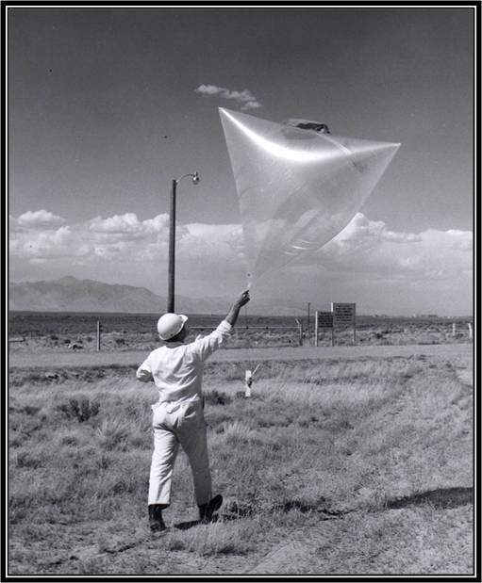
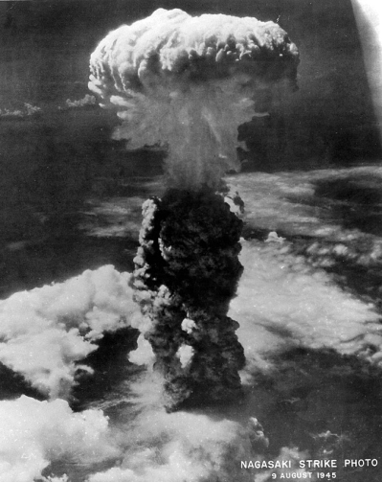
Brief History of ARL’s Dispersion and Boundary Layer Research Efforts
Models
1940’s – Estimated the location of a secret Soviet atomic bomb test site
1950’s – Development of dispersion models in support of weapons
testing
program
Measurements
1950’s – Initial development of balloon technologies for measurement of air flow and dispersion; Initial mesonets
1960’s – Development of atmospheric
tracer technology
for model
development
and evaluation
Notes:
To support this idea of intertwined modeling and measurement efforts, I have included here some key accomplishments in both areas. One of the first things accomplished by early ARL scientists in the 1940's was the estimation of the location of a secret Soviet atomic bomb test site. The decade of the 1950's was when dispersion models began to be developed in support of the nation’s weapons testing and nuclear reactor testing programs. On the measurements side, balloon technologies began to be developed for the measurement of dispersion and bulk air flow. Local mesonets began to be installed and utilized at the various DOE facilities for dispersion research and measurements. This was followed in the 1960's by the development of atmospheric tracer technologies for dispersion model development, evaluation, and improvement.

Slide 12
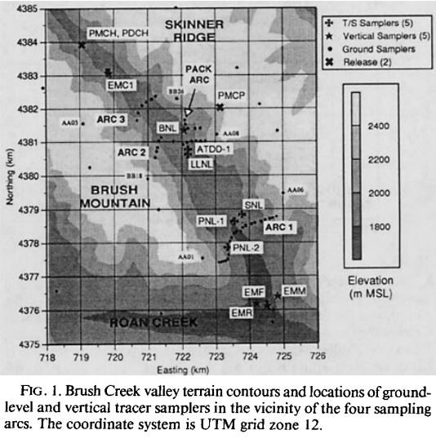
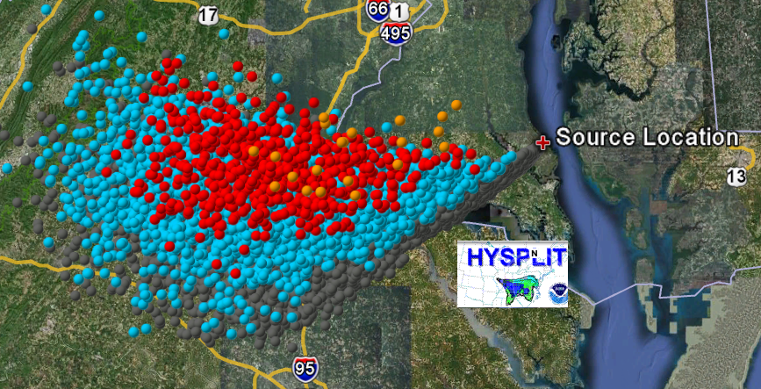
Brief History of ARL’s Dispersion and Boundary Layer Research Efforts (cont.)
Models
1970’s – Developed puff-trajectory dispersion models
1980’s – Initiated development of the HYbrid Single-Particle Lagrangian Integrated Trajectory (HYSPLIT) model
Measurements
1970’s – First major urban air quality/dispersion study in St. Louis
1980’s – Conducted major tracer studies to measure flow of materials over various
distances
and over
various
terrains
Notes:
The 1970's saw a decade of puff-trajectory dispersion model development and also participation in the first major urban air quality/dispersion study in St. Louis. Model development continued in the 1980's with the inception of the Hybrid single-particle Lagrangian integrated trajectory (HYSPLIT) model. In the same decade, many major atmospheric tracer studies were conducted in complex terrain and over distances ranging from mesoscale to hemispheric scales.

Slide 13
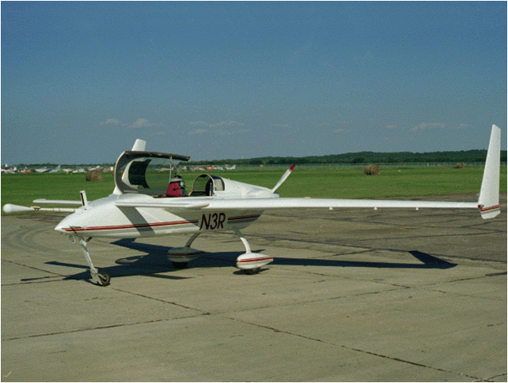
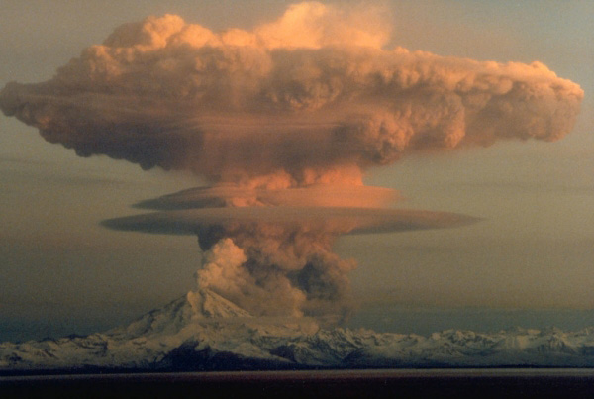
Brief History of ARL’s Dispersion and Boundary Layer Research Efforts (cont.)
Models
1990’s – Development of a web-based system to deliver dispersion products to the public
1990’s – Development of model for volcanic ash plume forecasts
2000’s – Development of dispersion forecasts of large events for weather forecasters
Measurements
1990’s – Began conducting boundary layer experiments using small aircraft
2000’s – Conducted several large urban dispersion studies
Notes:
In the 1990's, HYSPLIT was made available for on-line public access through a web-based system called READY, an acronym for Real-time Environmental Applications and Display sYstem. HYSPLIT was also adapted to provide volcanic ash plume forecasts. In the same decade, ARL began using small aircraft to complement highly-detailed surface-based measurements of surface fluxes in the boundary layer. In the decade that just ended, ARL participated in several major urban atmospheric dispersion studies that included work at the Pentagon and in New York City. Also in that same decade, HYSPLIT was adapted for use at the NOAA National Centers for Environmental Prediction (NCEP) so that National Weather Service forecasters could have access to plume dispersion forecasts for large events. There have been many more major accomplishments in these two research and development areas, but time does not permit a more complete treatise of this subject.

Slide 14
Guiding Philosophies
Customer focused, both internal and external to NOAA
Highly efficient use of limited financial resources
Concentrate on research areas where ARL can make a significant impact
Deliver products on time and within budget
Maintain high quality standards
WMO, ANSI, EPA, DOE standards
Invent measurement tools where necessary by adapting internal ARL expertise
Notes:
Which now brings us to the current state of research and development in the areas of dispersion and boundary layer meteorology within ARL. This research makes up the most extensive area of focus in the laboratory. All four divisions remain engaged in various aspects of research. We continue to use both modeling and measurements components, because neither component would be as effective without the other. In addition, the modeling and measurements components are assets that are used in the other ARL research themes, namely climate and air quality. An example of the use of these assets in air quality is the utilization of the HYSPLIT model during the intentional burning of oil slicks during the Deep Water Horizon oil spill in the Gulf of Mexico. Both the climate and air quality themes will be discussed later in separate sessions when these cross-over connections will be described in greater detail.

Slide 15
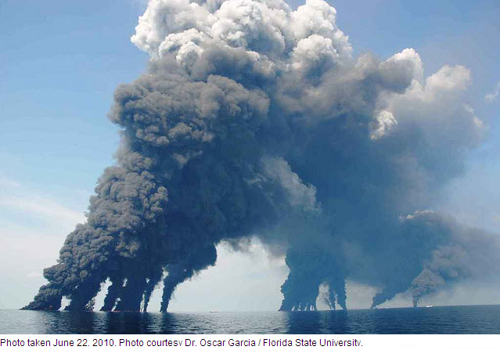
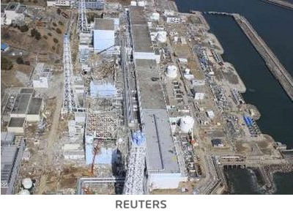
Current State of Atmospheric Dispersion and Boundary Layer Research
Major common research topic across all four divisions
Assets have relevancy in recent events
Deep Water Horizon
Iceland Volcano
Japanese Fukushima Dai-ichi nuclear reactors
Notes:
Which now brings us to the current state of research and development in the areas of dispersion and boundary layer meteorology within ARL. This major research thrust is common to all four laboratory divisions. We continue to use both modeling and measurements components, because neither component would be as effective without the other. In addition, the modeling and measurements components are assets that are used in the other ARL research themes, namely climate and air quality. Both the climate and air quality themes will be discussed later in separate sessions when these cross-over connections will be described in greater detail. These assets continually prove their relevancy as new dispersion challenges arise, such as the Deep Water Horizon, the Icelandic volcano, and the Japanese Fukushima Dai-ichi nuclear complex.

Slide 16
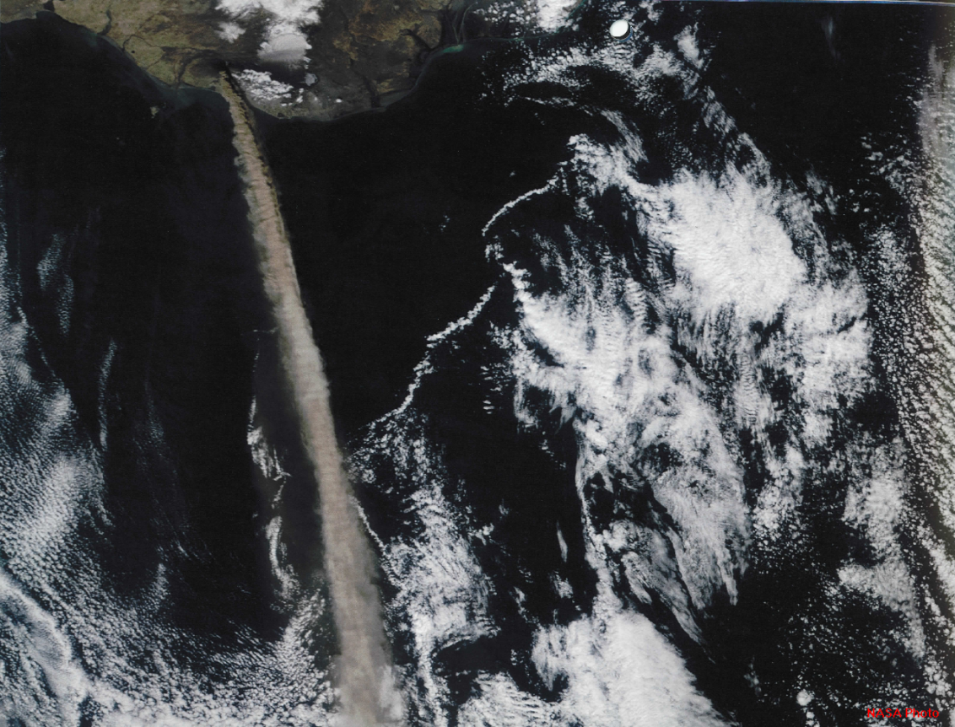
Dispersion Research Program Modeling Component
HYSPLIT
Radiological Plumes
Chemical Plumes
Volcanic Ash
(Dust)
(Fire Smoke)
Decision Support Tools
READY
Consequence Assessment
Notes:
The modeling component is principally used in the dispersion research program. It is focused on the HYbrid Single-Particle Lagrangian Integrated Trajectory or HYSPLIT model. HYSPLIT is a world-class capability that has been adopted not only nationally, but internationally, as well. It is being used for tracking radiological and chemical plumes, volcanic ash plumes, dust, and fire smoke. The topics Dust and Fire Smoke are in parentheses because these are air quality research topics that depend on the HYSPLIT model. A very recent example of the use of HYSPLIT for volcanic ash forecasting was during the Icelandic volcano eruption last year that severely impacted European air travel last year. More details on the HYSPLIT model will be presented by Roland Draxler and Barbara Stunder in later presentations in this session. The utility of the HYSPLIT model is being enhanced through the development and implementation of decision support tools. These tools provide emergency managers, for example, critical dispersion information in an easy to use format that is necessary to make quick decisions to help protect lives and property. During the poster session, Glenn Rolph and Brad Reese will demonstrate decision support tools that have been developed around the HYSPLIT model. A poster by Walt Schalk describes how models are being used in consequence assessments at the Nevada National Security Site, formerly known as the Nevada Test Site.

Slide 17
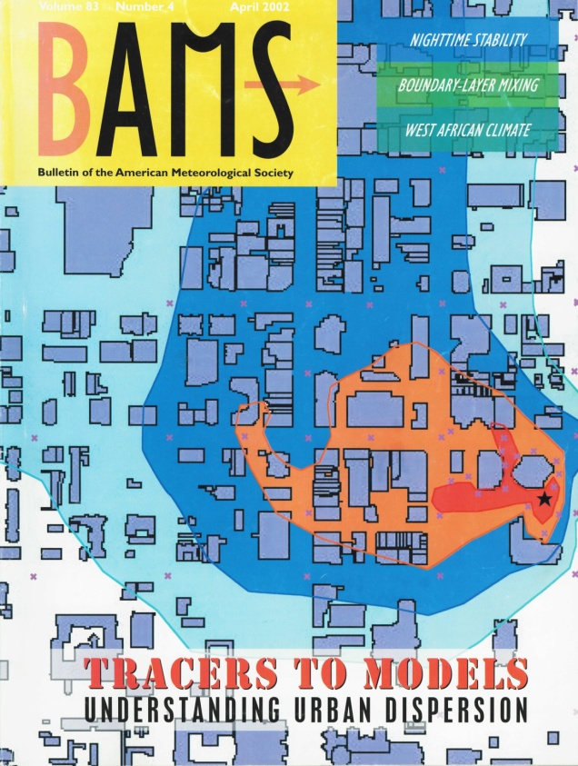
Dispersion and Boundary Layer Research Program Measurements Component
Atmospheric Dispersion Field Tests
Uses small amounts of intentionally-released atmospheric tracers
Surrogates for harmful chemicals
Major urban dispersion studies
Salt Lake City
Oklahoma City
Midtown Manhattan
Pentagon
Road-side barrier study
Notes:
The measurements component of the dispersion and boundary layer research programs consists of several parts. Perhaps the best-known piece of the dispersion measurements component is the atmospheric tracer dispersion program. An atmospheric tracer in this sense is an intentionally released gaseous tracer that serves as a surrogate for a harmful chemical. It is non-toxic, invisible, odorless, tasteless, non-depositing, inert, and is easily detectable using special equipment at parts per trillion levels in the atmosphere. It mimics the dispersion of a harmful chemical in study areas where the actual harmful chemical cannot be released. The most recent focus of this effort has been on urban dispersion, with participation in nearly every major urban tracer dispersion experiment of the past decade. These studies have been conducted in collaboration with the U.S. Dept. of Homeland Security and the U.S. Dept. of Defense. Rick Eckman will describe this research in greater detail in a presentation in this session. An exhibit by Roger Carter during the poster session will demonstrate some of the equipment used to detect the minute levels of tracer gases. It should also be noted that the capability has also been applied to air quality research in partnership with the U.S. EPA. A poster by Dennis Finn in the air quality theme describes this effort.

Slide 18
Dispersion and Boundary Layer Research Program Measurements Component
Mesonets
DCNet
Idaho National Laboratory (INL)
Mesonet
Nevada National Security Site
(NNSS) Mesonet
Eastern Tennessee Regional
Air Monitoring & Analytical
Network (RAMAN)
Notes:
Mesonets are also a part of the measurements components of the dispersion and boundary layer research programs. DCNet, a mesonet installed in the national capital area is being used to investigate urban boundary layers to help with national security efforts. Other mesonets in southern Idaho at the Idaho National Laboratory and in southern Nevada at the Nevada National Security Site are being utilized in collaboration with the U.S. Dept. of Energy. Each of these DOE sites has an atmospheric tracer release and measurement facility for dispersion research. The Regional Air Monitoring & Analytical Network (RAMAN) is operated in Eastern Tennessee. Will Pendergrass and Walt Shalk will describe these mesonets and associated research efforts in presentations that follow in this session.

Slide 19
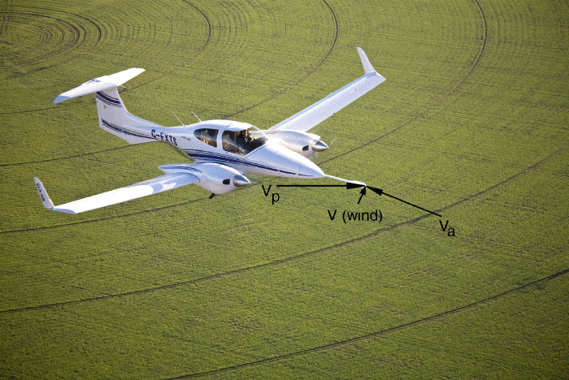
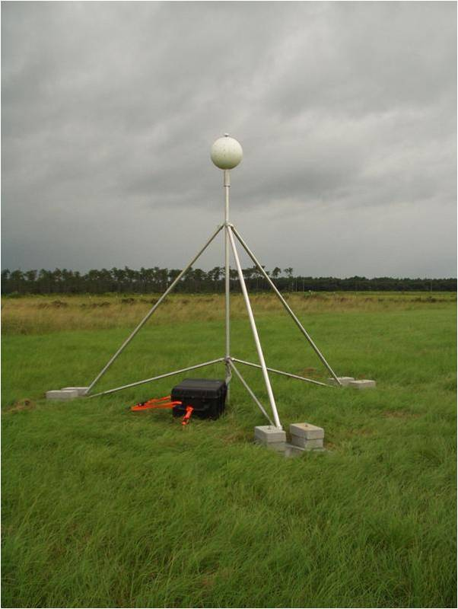
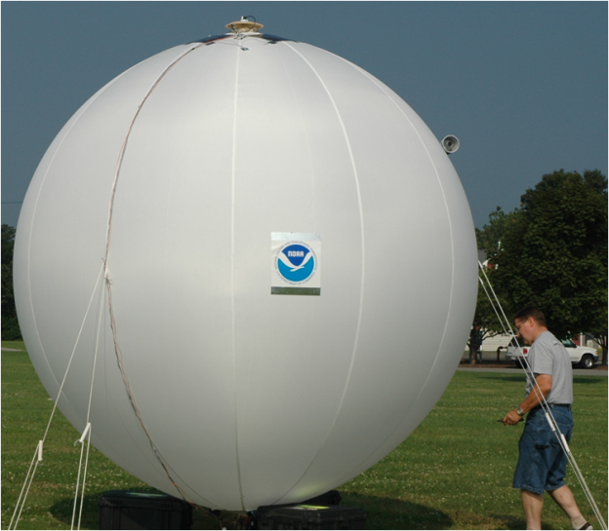
Dispersion and Boundary Layer Research Program Measurements Component
Special Instruments Development
Best Aircraft Turbulence (BAT) Probe
Extreme Turbulence (ET) Probe
Smart Balloon
Notes:
Intensive research in boundary layer meteorology requires sophisticated equipment using cutting-edge technology. If an instrument did not exist for measuring a certain governing process, ARL scientists and engineers invented the needed instrument. We have developed a number of unique tools for the measurement of boundary layer characteristics. These include the Best Aircraft Turbulence Probe (BAT Probe), developed primarily by the late Dr. Tim Crawford, the Extreme Turbulence Probe or ET Probe, also originally conceived by Tim, and various balloon technologies. Some of these instruments have international recognition and use and are being employed for a wide diversity applications. The three instruments and measurement platforms will be described in the poster and equipment demonstration session by Ed Dumas, Rick Eckman, and Randy Johnson, respectively.

Slide 20
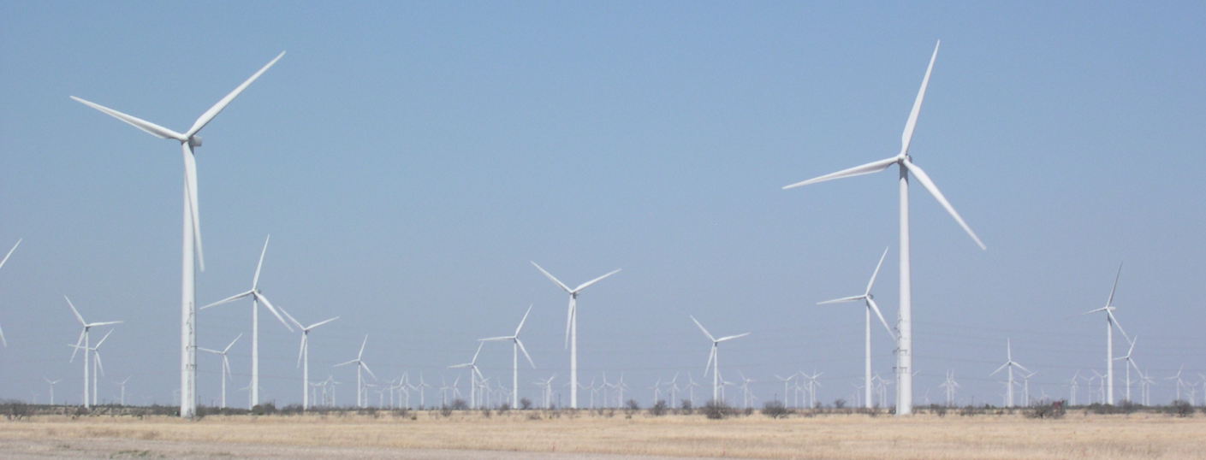
Dispersion and Boundary Layer Research Program Measurements Component
Renewable energy
Wind forecast improvement
Duke Energy Cooperative Research and Development Agreement (CRADA)
DOE/NOAA Wind Forecast Improvement Program
Notes:
ARL’s boundary layer research is also focusing on supporting renewable energy. Progress in fully developing wind-generated energy depends on accurate wind forecasts. This is a new area of growth and development for ARL. Field studies to improve wind forecasts began last year as the result of a Cooperative Research and Development Agreement (CRADA) between ARL and Duke Energy. Another field study will begin in July of this year as a collaborative effort between ARL, ESRL, DOE’s Energy Efficiency and Renewable Energy agency and two private industry partners. A poster by Chris Vogel describes ARL’s effort in this area.

Slide 21
ARL in Transition
Greater integration with NOAA priorities and activities
Establish boundary layer as another focus area
Greater integration among divisions
Integration of research and technical services
Notes:
Finally, I’d like to return to topic of transition that Steve Fine mentioned near the end of his presentation. Nowhere is the topic of transition better exemplified than in this theme of atmospheric dispersion and boundary layer research. Of the four areas of transition Steve mentioned in his presentation, all of them are being worked on in the dispersion and boundary layer programs. Specifically, we have been working to better integrate these programs with NOAA priorities. We have established boundary layer meteorology as another focus area. These programs serve as a unifying force across the laboratory, even though the four divisions are scattered all across the country. The integration of research and technical services provides a synergistic relationship for each other. Now I invite you to “sit back, relax, and enjoy the show.” Any questions?

Slide 22
QUESTIONS?

Slide 23
Atmospheric Dispersion and Boundary Layer Presentations
Topic Presenter
Urban Meteorology Will Pendergrass
HYSPLIT Roland Draxler
Volcanic Ash Dispersion Modeling Barbara Stunder
Tracer Technology and Field Studies Rick Eckman
Specialized Meteorological & Dispersion Support Walt Schalk
Notes:
Atmospheric dispersion and boundary layer presentations and the names of the presenters.
ARL will now present five talks addressing the issues identified on the slide.
In general, ARL relies on measurement and monitoring data used in tandem with research models to assess effects of pollutants on environmental quality, climate change, human and ecosystem health, and agricultural impacts.
Our focus tends to be influenced by concerns regarding food and energy security, as well as economic growth.
ARL science addresses issues of atmospheric chemistry and air-surface exchange. Our partners are responsible for using this information to assess effects in a multimedia framework.

