Slide 1
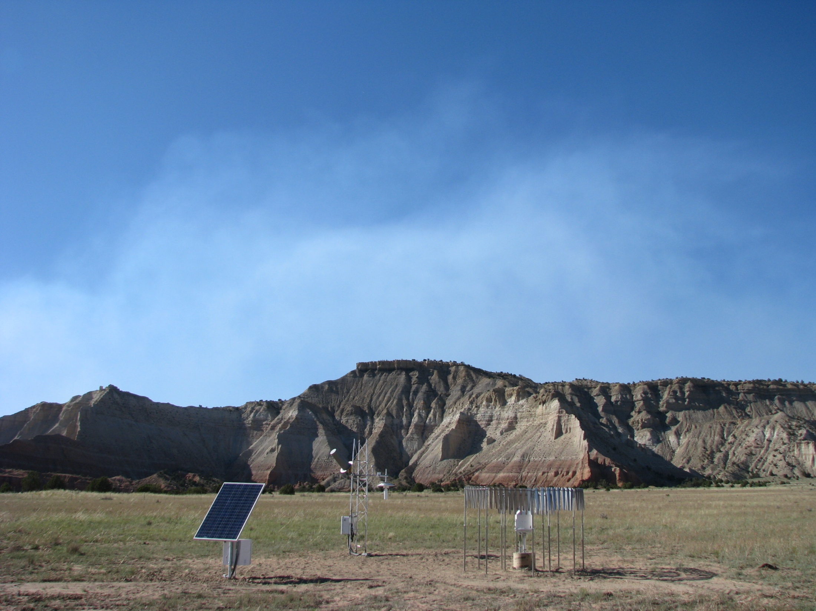
Surface Climate Reference Networks
C. Bruce Baker
ARL, Atmospheric Turbulence and Diffusion Division
ARL Laboratory Review
Silver Spring, MD
May 3-5, 2011

Slide 2
CLIMATE OBSERVING NETWORK GOALS
Answering the question at mid-century: “How has the climate of the United States changed over the last 50 years?”
Making science quality climate observations adhering to the Ten Climate Monitoring Principles of GCOS, NRC/NAS, and USGCRP
Serving as a reference standard for other networks, while evaluating new technologies
Leveraging knowledge and infrastructure to support new climate observing systems
Notes:
Primary goal of these observing systems is to minimize discontinuties and inhomogeneities in the climate signal and define standards that will enable the scientific community to better understand the mangnitude and change of long term trends of temperature and precipitation in the U.S.

Slide 3
A Scientific Approach for Climate Monitoring
This requires a state-of-the-art Climate Observing System with:
Observations that define the time series of a critically important
variable of the climate system.
Observations with an accuracy traceable to known standards such that future generations can verify the quoted accuracies.
Observations which are not compromised by interruption.
Observations that are tested for systematic error by at least two independent techniques and preferably three.
Notes:
Climate monitoring requires improved observations, data processing, measurement and siting standards. Not only will there be an improvement in the data quality for studying climate but moreover ancillary benefits will include other sectors of society.

Slide 4
Climate monitoring requires a long-term commitment to quality and stability.
Many of the climate-related signals are small, obscured by natural variability.
There must be an active program of research and analysis utilizing climate data sets to ensure the data are state-of-the-art and meet requirements.
Climate research and monitoring requires an integrated strategy of land/ocean/atmosphere observations, including both in situ and remote sensing platforms, and modeling and analysis.
Notes:
One goal is to be able to detect trends where we know the signal is small. Quality assurance/Quality control is parmount for quantifying the uncertainty and detecting regional or national trends in precipitation and temperature.

Slide 5
      Management of Network Change
      Parallel Testing
      Metadata
      Data Quality and Continuity
      Integrated Environmental Assessment
      Historical Significance
      Complementary Data
      Climate Requirements
      Continuity of Purpose
      Data and Metadata Access
Ten Climate Monitoring Principles
5

Slide 6
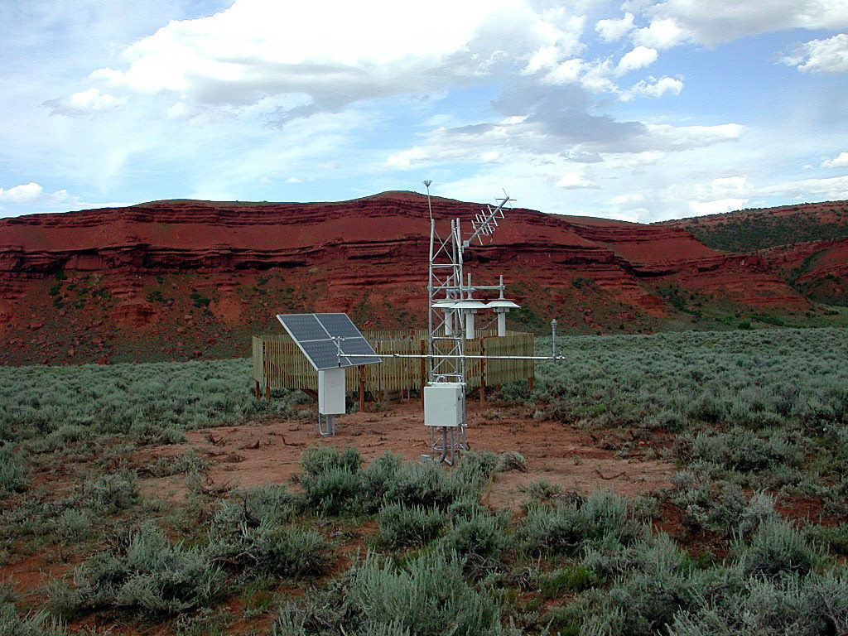
U. S. Climate Reference Network (USCRN)
FY 08 Completed Lower 48 states
(114 sites commissioned)
Lander, WY
Notes:
USCRN is finished in the lower 48 there are upgrades to the network that include soil moisture/soil temperature, relative humidity and new dataloggers that will provide additional flexibility/scalability for utilization of these sites for additional atmospheric studies.

Slide 7
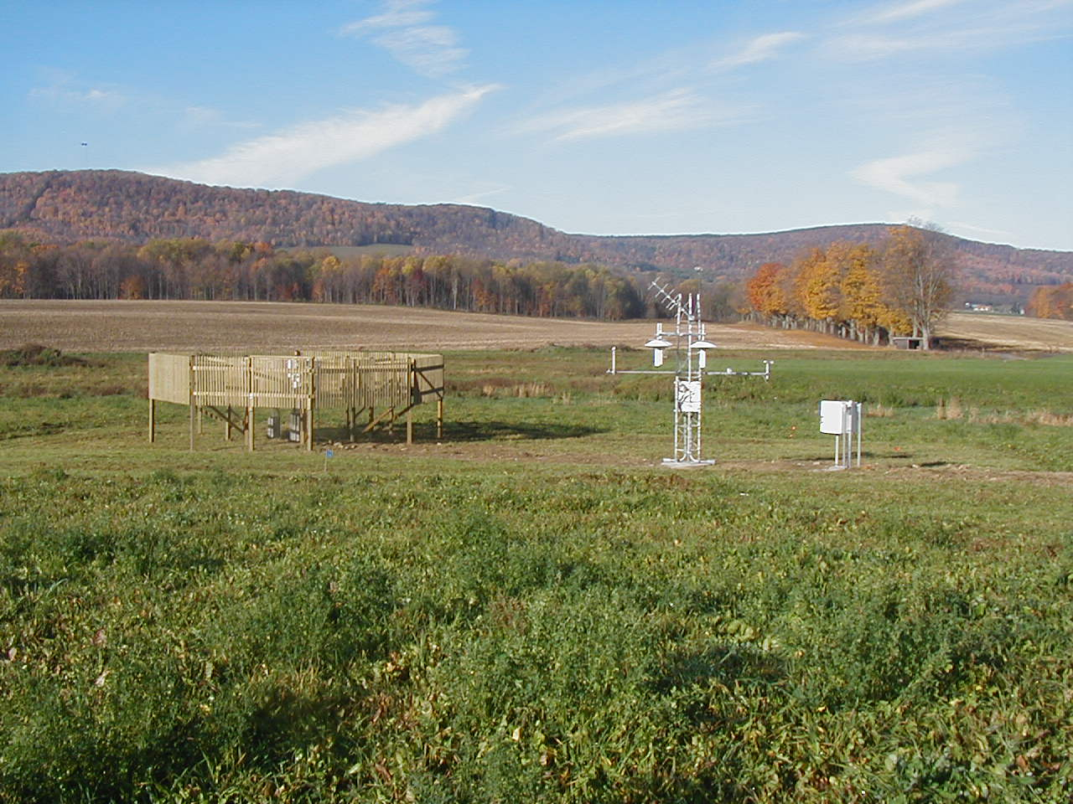
USCRN National-Level Climate Monitoring (Cornell University, Ithaca, New York)
Geonor 3-wire weighing precipitation gauge with backup gauge inside small DFIR fence and single alter.
GOES DCS Satellite
Relative Humidity in Ventilated Radiation Housing
Power Control
Solar Radiation (Pyranometer)
Ground (IR) Temperature
Anemometer
Three High-Precision Platinum Resistance Thermometers in Individual Ventilated Radiation Housings
Wetness Sensor
Datalogger
Soil Moisture & Soil Temperature (in test)
Notes:
This represents the suite of measurements on the USCRN sites in the contiguous United States.

Slide 8
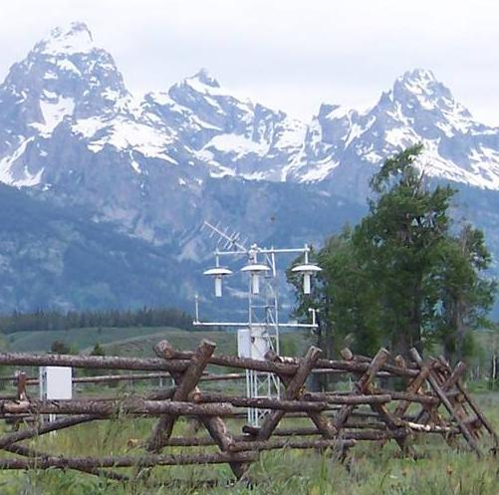
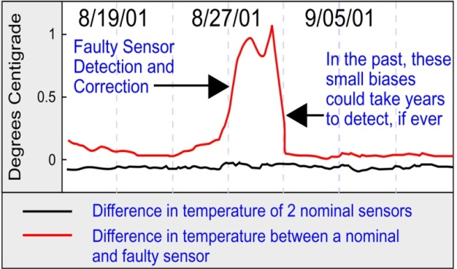
The Basics: How USCRN Works
Primary variables are measured with triplicate configurations that allow for intercomparisons:
3 PRTs measure T
3 wires measure P
Grand Teton CRN Station
Triplicate Temperature Sensors
Notes:
This illustrates the importance of having a triple configuration for Temperature measurements.

Slide 9
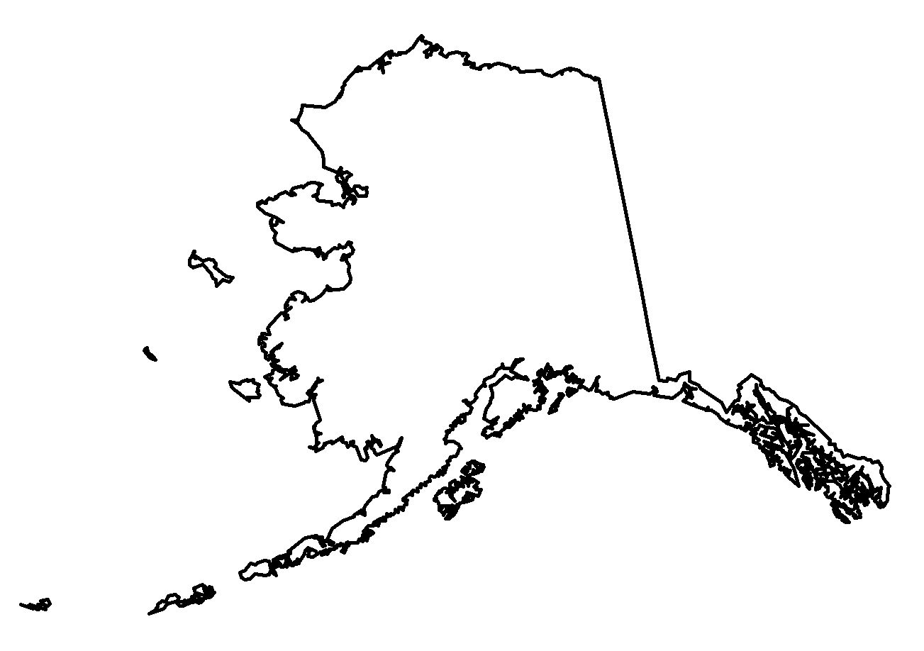
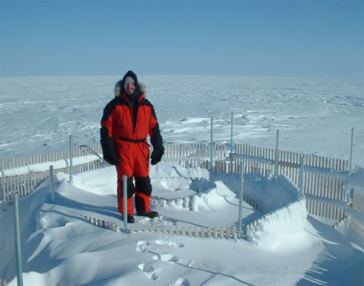
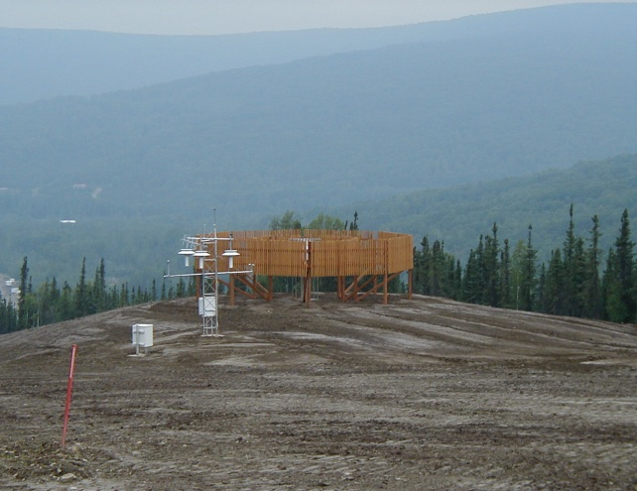
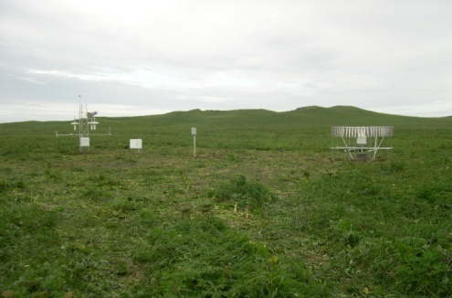
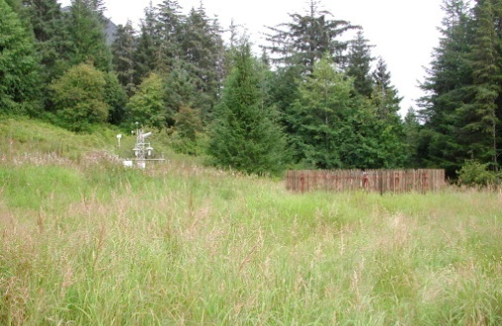
USCRN in Alaska Configuration
Barrow
Fairbanks
St Paul Island
CRN sites (current -2)
GCOS sites (current -2
GCOS sites (proposed - 29)
Sitka
Notes:
Two experimental design and testing USCRN stations were installed at fully qualified USCRN sites in Alaska in FY 2002 (Barrow and Fairbanks), and two more USCRN-design stations were installed via the U.S. GCOS Program in FY 2005 (St. Paul Island and Sitka) to provide extended experience with USCRN technology in severe Arctic environments. NCDC, along with the NWS Alaska Region Headquarters (ARH), held a workshop in Anchorage, Alaska, in May 2008 that focused on plans to expand the USCRN into all of Alaska. The initial start-up funds for USCRN in Alaska were received in FY 2008 and FY 2009, thus allowing for the installation of the first two of the 29 USCRN stations in FY 2009. Full funding began in FY 2010 and two more stations were installed bringing the total of Alaska USCRN stations to four (Figure 1), and the first two operational Alaska USCRN stations at Sand Point and Port Alsworth were commissioned in September 2010.
9

Slide 10
Future Directions for USCRN
Deploy soil moisture / temperature probes and RH instruments across the USCRN network in cooperation with the National Integrated Drought Information System (NIDIS) program
Develop new soil climate QC techniques made possible by using a triplicate configuration of probes
Cooperate with satellite remote sensing experts and soil moisture modelers with regards to using USCRN data for calibration and/or verification
Notes:
Deploy Soil moisture and soil temperature will be completed 2011. Satellite Calibration/ Validation is an ongoing effort partnering with NOAA NESDIS, NCDC, and UTSI examining
upscaling from USCRN point measurements to the satellite footprint using airplane measurements as the intermediary mesaurement.

Slide 11
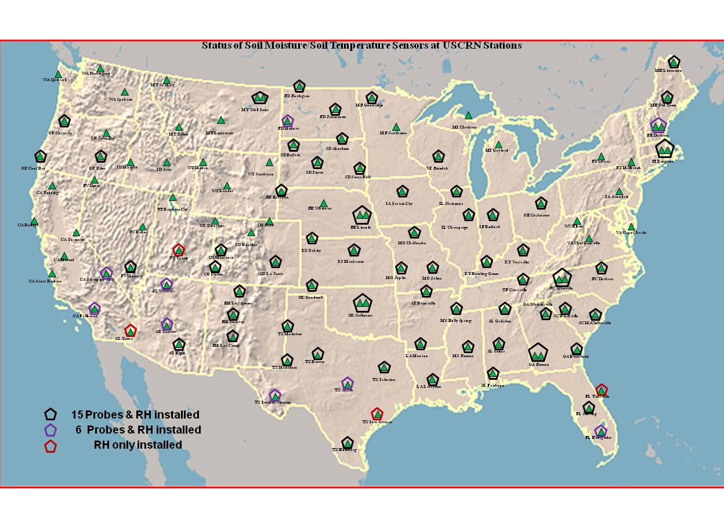
Status of Soil Moisture Temperature Sensors at USCRN Stations

Slide 12
U.S. Regional Climate Reference Network
USRCRN observing stations will provide high-quality hourly climate observations on a regional scale to all sectors of society and the economy.
Experience gained by USCRN with the Alabama USRCRN prototypes proved very useful in assisting the full national USRCRN program
A goal of ~500 stations for the U.S. is specified to provide sufficient spatial resolution to resolve regional climate trends in the continental U.S.
Notes:
While the primary mission of the USCRN is to determine national climate trends, the complementary USRCRN mission is to deploy a regional scale observing network to better characterize regional trends for temperature and precipitation.

Slide 13
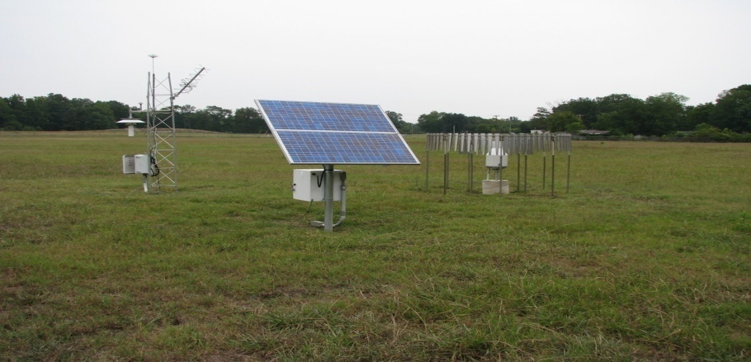
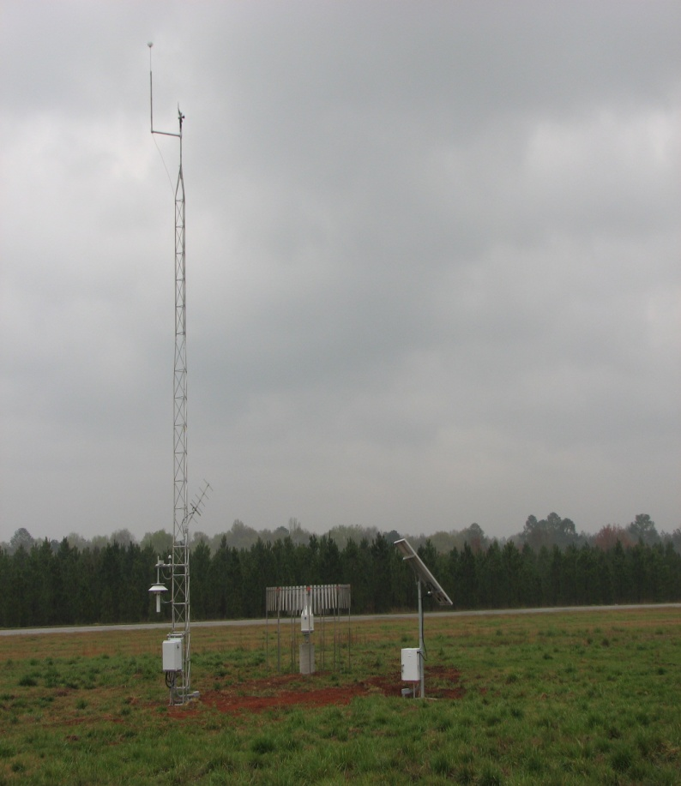
60 USRCRN Sites in Southwest, US
17 Sites in Alabama
AL USHCN-M Site – Standard Configuration
AL USHCN-M – additional sensors
Notes:
All USRCRN sites are solar powered and measure temperature and precipitation.

Slide 14
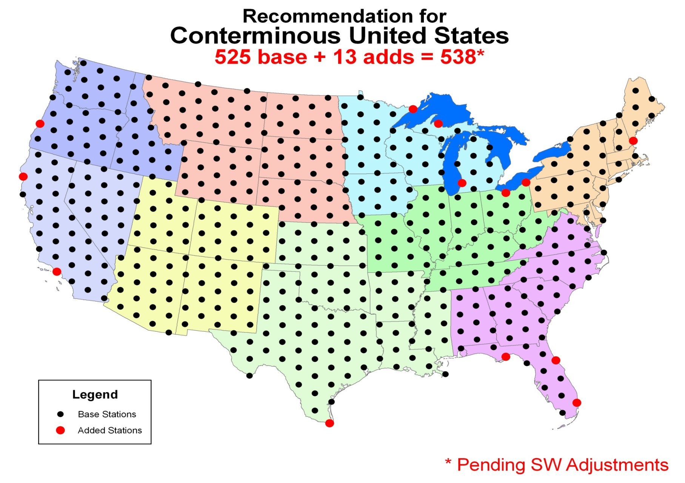
Notes:
This is the most current distribution of sites for capturing the national and regional climate signals.

Slide 15
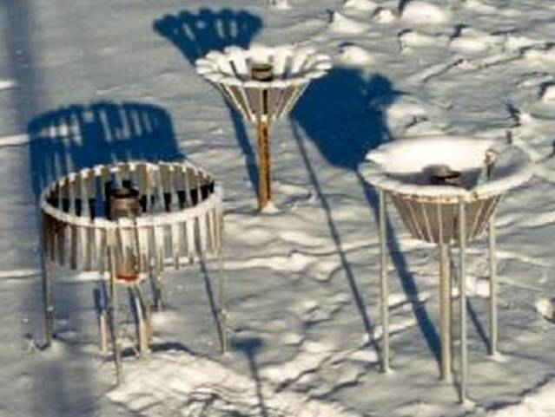
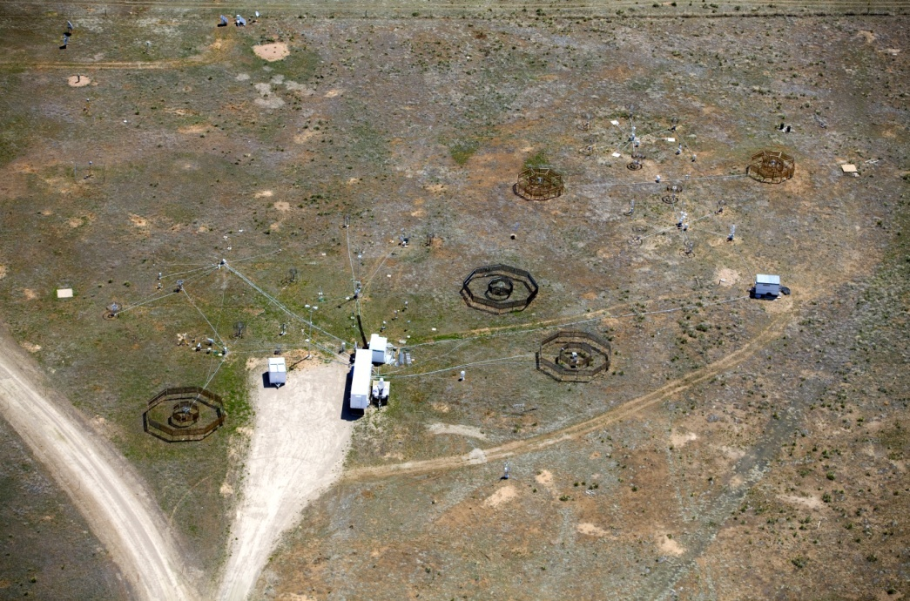
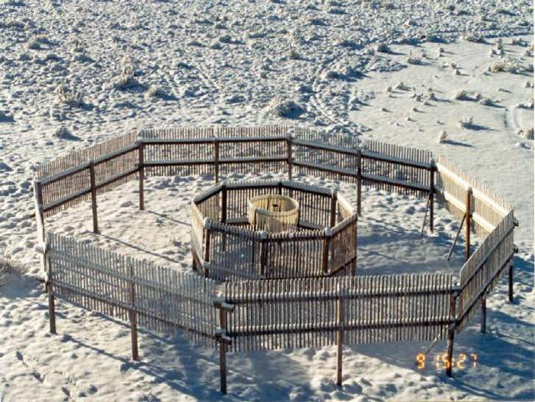
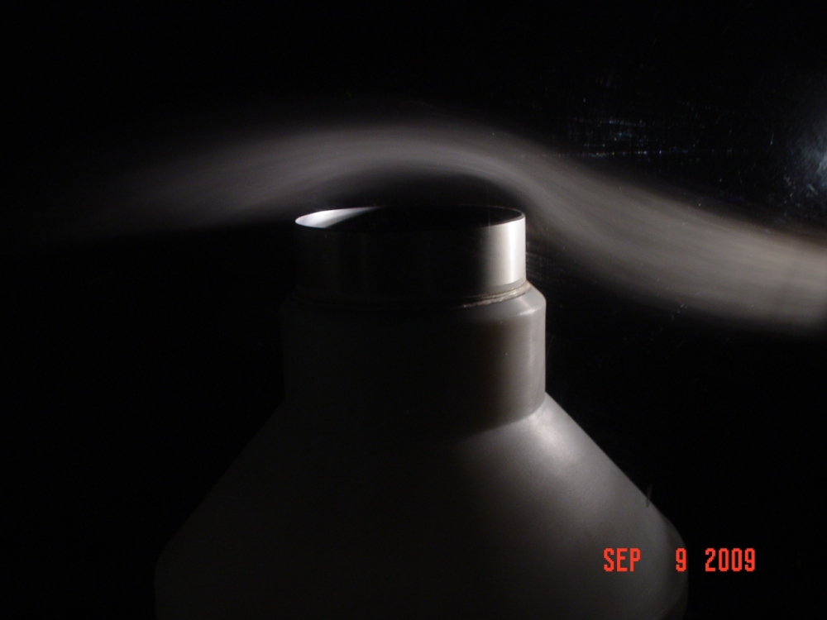
Notes:
The USCRN/USRCRN precipitation testbed in Marshal, CO. The testbed is focused on the measurement of solid precipitation, new technology for climate observing systems and the development of transfer functons between different like measuring systems.

Slide 16
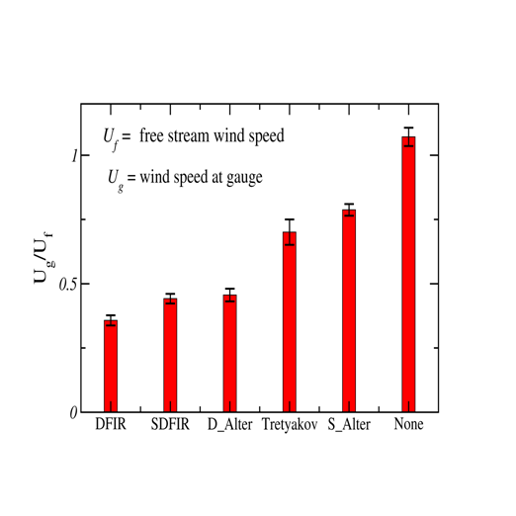
Ratio of Windspeed at the
gauge to Freestream speed
Under catch of Solid precipitation for
different shields compared to the DFIR
PERCENT
Notes:
Good example of the relative catch of solid precipitation based on the ratio the free stream horizontal flow to the measured horizontal flow at the gauge compared to cumulative measured amount for different gauge/shield combinations. The interesting thing to note is the lower the ratio of U_{G} / U_{F} the higher the catch efficiency.

Slide 17
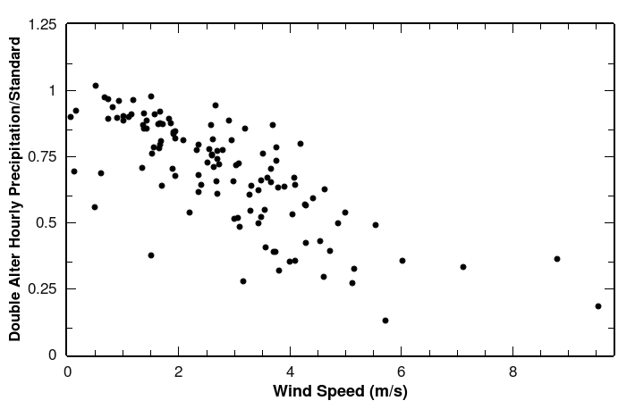
Hourly catch ratios of solid precipitation vs. 1.5 m height wind speeds

Slide 18
WMO Solid Precipitation
Inter-Comparison Experiment
2011 - 2014
To improve the understanding of the performance of various solid
precipitation gauge/shield configuration
Develop transfer functions between the various solid precipitation
gauge configurations to improve estimates of liquid water equivalent
snowfall in support of real-time applications, hydrological models and
data continuity in the climate record.
Define a field standard for automated solid precipitation gauges.

Slide 19
USCRN provides satellite daily and hourly insolation estimates to calibrate
the visible channel on GOES satellites via newly-developed techniques.
Notes:
USCRN pyranometer data are being utilized to validate satellite daily and hourly insolation estimates from the new insolation model and calibrate the visible channel on GOES satellites via newly-developed techniques. The regression formulae and correlation coefficients for satellite versus USCRN data are displayed on the charts. The results are slightly better than results with results achieved with the old insolation model.

Slide 20
Seasonal Differences between COOP and CRN
T_{max}
T_{min}
T_{max} and T_{min} differences (COOP-CRN) between co-located
stations (within 10 km). Error bars represent 95% confidence
limits of the mean bias.

Slide 21
ACCOMPLISHMENTS
Scientific Conference Papers 22
Workshops 8
Journal Articles 5
Technical Reports 10
21
Notes:
ARL scientists have either conducted or participated in 8 workshops and were either the first author or coauthor on 22 Scientific Conference papers, 5 Journal articles and 10 technical reports related to NOAA’s climate observing networks.

Slide 22
USCRN Data Receipt Rates %
FISCAL YEAR | Annual Average
2001 | 87.7
2002 | 97.0
2003 | 99.4
2004 | 99.9
2005 | 100.0
2006 | 99.3
2007 | 99.9
2008 | 99.9
2009 | 99.8
2010 | 99.8
The data receipt reflects ARL’s innovative
engineering and design of NOAA’s climate
observing systems and dedication
to maintaining these systems to the
highest degree possible to minimize
gaps in the climate record.
Notes:
The most critical performance measure for NOAA’s Climate Reference networks is ensuring a high percentage data capture rate. These numbers reflect ARL’s innovative engineering and design of NOAA’s climate observing systems and dedication to maintaining these systems to the highest degree possible to minimize gaps in the climate record.

Slide 23











COLLABORATORS

Slide 24
QUESTIONS??
24

