Slide 1
Air Quality Summary
Richard S. Artz
Air Resources Laboratory Review
Silver Spring, MD
May 3-5, 2011
Notes:
The second theme of ARL’s research program is Air Quality.

Slide 2
Scope and Goals of ARL’s Air Quality Program
Air Quality Forecasting and Air Toxics Models
Ozone and Fine Particulate Matter
Dust and Smoke
Mercury and other Air Toxics (e.g., Dioxin)
Measurement and Monitoring Programs
Mercury
Nitrogen
Precipitation Chemistry
See ARL’s Strategic Plan for Climate Research and Development
Observations
Modeling
Analysis
Notes:
To quickly summarize, the presentations you’ve heard, along with the poster presentations, present our air quality theme, which encompasses various model, measurement, and assessment programs. We’ve tried to demonstrate the nature of our contributions, which are articulated on the slides. Each of these has different historical roots and is at different levels of maturity, but together they form a contribution to NOAA’s and the nation’s overall air quality research portfolio.

Slide 3
Indicators of Preeminence
Strong publication record, including several highly-cited papers
Leadership in national and international air quality activities
Establishment of modeling products used operationally by NOAA and globally
Enduring top quality research monitoring networks
NOAA Research Outstanding Scientific Paper (Cohen, Draxler & Artz, 2003)
DOC Gold Medal for HYSPLIT model development (Draxler, 2009)
EPA 2009 Level 1 Scientific and Tech Achievement Award (Byun and Schere, 2009)
NOAA Distinguished Career Award (Dale Gillette, 2006)
Presidential Rank Award for Meritorious Senior Professionals (Bruce Hicks, 2003)
  … a myriad of applications involving a broad suite of atmospheric pollutants.
Notes:
NOAA Research Outstanding Scientific Paper
Cohen, M.D., R.R. Draxler, R. Artz, et al., (2003). Modeling the Atmospheric Transport and Deposition of PCDD/F to the Great Lakes. Environmental Science and Technology, Vol. 36, No. 22, 4831-4845, 2002.
Daewon Byun, and Kenneth L. Schere (2009) -- EPA 2009 Level I Scientific and Technological Achievement Award (STAA) “for developing a model serving as the primary tool for EPA and others to use for air quality management and forecasting.” Publication citation: Byun, D. and K.L. Schere. Review of the Governing Equations, Computational Algorithms, and Other Components of the Models-3 Community Multiscale Air Quality (CMAQ) Modeling System. Appl. Mech. Rev., Volume 59, Issue 2, 51 (27 pages) doi:10.1115/1.2128636 (2006).
ARL scientists, on assignment to the U. S. EPA National Exposure Research Laboratory in RTP, NC, and led by Dr. Daewon Byun, designed and developed the Community Multiscale Air Quality (CMAQ) modeling system. CMAQ, originally released in 1998, is currently used by numerous air quality scientists in the U. S. and around the world and its applications and continuing development are the focus of an annual conference attended by several hundred scientists each year. Working in cooperation with the NWS National Centers for Environmental Prediction, ARL scientists on assignment to the U. S. EPA National Exposure Research Laboratory, initiated the National Air Quality Forecasting Capability (NAQFC) for ground-level ozone in 2004. Using the CMAQ modeling system, the NAQFC provided 48-hr ozone forecasts for the northeastern U. S. In succeeding years, ARL and NCEP scientists have expanded coverage of the ozone forecasts to the entire conterminous U. S. (CONUS) domain, as well as Alaska and Hawaii.
Presidential Rank Award for Meritorious Senior Professionals
Bruce B. Hicks (2003) was cited for providing outstanding scientific leadership and direction of the laboratory. His visionary adaptation of Cold War-era studies of radioactive atmospheric particle and gas deposition has led to a myriad of applications involving a broad suite of atmospheric pollutants. The applications he enabled span from forecasting and assessment of air quality to a broad cross-section of scientific issues of concern. A few of Mr. Hicks’ major accomplishments at NOAA include the development of methodologies to address exposure to toxic chemicals to assess threats against our troops in Kuwait; the development of a joint initiative with the U.S. Environmental Protection Agency to begin national forecasts of ozone and small particulates; and support for the Real-Time Environmental Applications and Display System to apply ARL science to matters of homeland security.
NOAA Distinguished Career Award
Dale Gillette (2006) -- “for outstanding theoretical and empirical contributions to the field of wind-blown dust.”

Slide 4
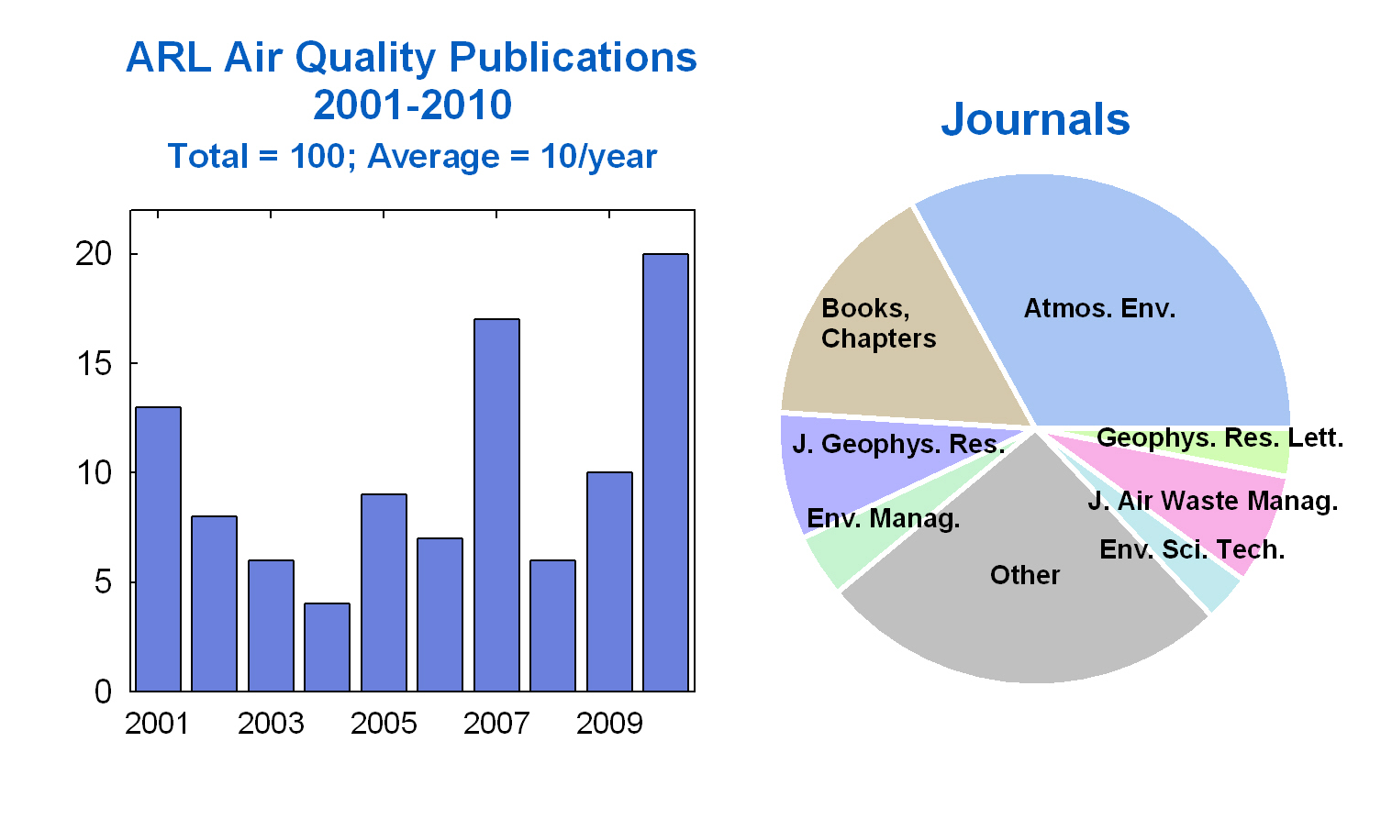

Slide 5
Future Plans
Air Quality Forecast Models
  Improve emissions estimates for fires and dust
  Develop tighter linkages with meteorological models
  Develop chemical data assimilation capability
Air Quality Toxics Models
  Improve treatment of natural sources, surface exchange, and re-emissions
  Capitalize on unique model evaluation opportunities
Mercury, Nitrogen, and Precipitation Chemistry Measurements
  Optimize existing and develop new measurement methods
  Determine suitability of real-time sensors for long-term air-surface exchange research (nitrogen)
  Develop protocols for global monitoring of mercury and dry deposition
Assessments
  Complete WMO global precipitation chemistry assessment
Notes:
Future Plans - AQ Models
Emissions improvements
Work is ongoing to include satellite-derived near-real-time fire emissions, improve fugitive dust emission estimates, include windblown dust emissions, and improve biogenic emissions estimates. Evaluation and incorporation of the 2008 National Emission Inventory will begin as soon as it becomes available from EPA.
Tighter linkages to the meteorological model
Improvements to the coupling of the meteorological model's grid and data streams to the air quality model will lessen sources of potential error. Better use of data characterizing the nature of surface conditions (snow cover, soil moisture, etc.) will improve emissions modeling and dry deposition parameterizations.
Chemical data assimilation
Longer-term research on chemical data assimilation will allow the use of ground-based or satellite observations to improve initial conditions of forecasting simulations and possibly in the future provide reanalyzed chemical fields.
Mercury Measurements:
Optimize existing measurement methods
Develop new methods, e.g.,
laser-based eddy correlation system
relaxed-eddy-accumulation (REA) system
Additional measurements at long-term sites
Publication and additional analysis of datasets
Field intensives involving process studies to address key uncertainties
Assess effects of forest fires and floods on ecosystem mercury loads
Continued development of surrogate surfaces as low-cost, simple devices for oxidized mercury concentrations and dry deposition estimates
Assess the potential impacts of climate change on polar mercury oxidation, deposition, and glacial sequestration
Mercury Modeling:
*Science:
Improve model physics & chemistry as new info. becomes available
Further development of global modeling capability
“particle-mode” dispersion simulation for HYSPLIT-Hg
Improve treatment of natural sources, surface exchange, and re-emissions
Multi-media: incorporate surface layers into model
* Evaluation:
Continue episode-focused model evaluation at multiple sites
Continue long-term model evaluation at multiple sites
Participate in model intercomparisons
* Policy-Relevant Analysis:
Continue/extend Great Lakes analysis (Great Lakes Restoration Initiative)
Continue/extend Gulf of Mexico analysis; link with ecosystem model
Continue/extend numerous collaborations (EPA, TCU, Univ. of MD, …)
Long-term priority for nitrogen:
Determine suitability of real-time sensors for long-term air-surface exchange research
Rationale: Measure diurnal cycling and seasonal trends (if any) in ammonia.
IMPROVE is planning to enhance it's analysis of optical absorption on the Teflon filters from one to three wavelength to distinguish absorption by black from brown carbon aerosol, which will provide greater utility for climate change and air quality effects assessments.
[mercury measurements]: Improve existing and develop new methods to measure atmospheric mercury concentrations and surface exchange processes
Measurement of Major ions in precipitation:
Maintain existing stations
Complete global assessment
Address WMO request to develop global program for dry deposition of major ions and mercury measurements

Slide 6
Thank You!

