Slide 1
Atmospheric Deposition Measurement and Program Management
Richard S. Artz
Air Resources Laboratory
Air Resources Laboratory Review
May 3-5, 2011

Slide 2
Goal
Provide sound scientific information on the deposition of major ions*, heavy metals, and toxic substances in precipitation to the surface of the earth.
Atmospheric deposition measurements
Trends analysis Model development Ecosystem studies
Effective plans to mitigate impacts on our society, economy, and environment
*Sulfate, Nitrate, Chloride, Phosphate, Sodium, Calcium, Magnesium, Potassium, Ammonium, pH
Notes:
As reported in previous talks, in ARL, air quality programs utilize the latest technology to study key pollutants, including compounds in precipitation. These measurements feed into air quality models, which rely on accurate, precise data to improve estimates of how pollutants are impacted by changes in emissions standards. In turn, model output is used in development of effective policies to maintain human and environmental health. Our measurements supply data to models which support the framework of a healthy society, economy, and environment.
While the previous two talks have mentioned cutting edge research, this talk will focus on a major legacy issue – deposition of major ions in precipitation. Over time, as the science has matured and as budgets have been trimmed, ARL’s role in this work has been reduced and has become more focused. It has also been expanded a bit to look at total deposition of major ions as well as at some other substances.
The current program addresses maintenance of existing network measurements – some of which have been in place since the middle 1970s -- , use of network information for regional and continental-scale studies, and management and assessment of global data with an eye toward the effects of compounds with a global footprint.

Slide 3
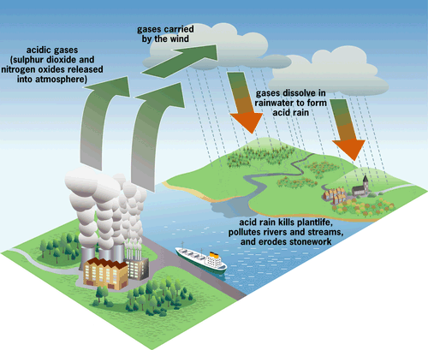
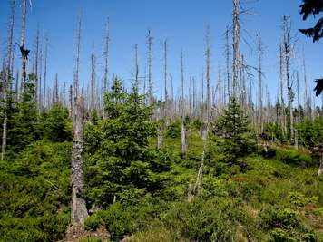
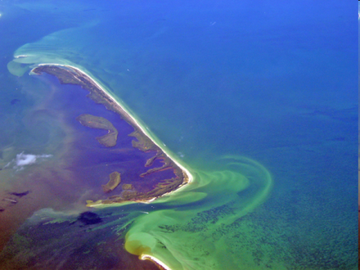
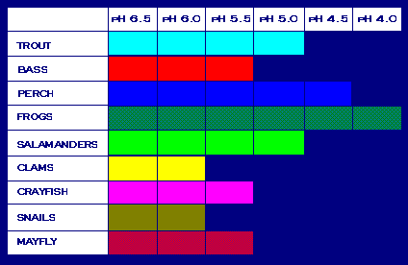
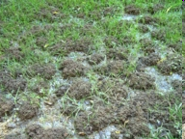
“Acid Rain”: The precursor to the “Nitrogen Cascade”
Forest Dieback
Soil
Eutrophication
Soil acidification
Aquatic Effects
Aquatic effects
Aquatic Effects
Notes:
LaToya Myles showed you a schematic of the “nitrogen cascade” as laid out by Jim Galloway and colleagues, and noted that ARL research focuses on measuring atmospheric reactive nitrogen and determining its interactions with terrestrial and aquatic ecosystems. Prior to the nitrogen focus, ARL was a leading contributor to the acid rain program, which occurred primarily in the 1970s and 1980s. Many of the contemporary issues that involve anthropogenic nitrogen evolved from the acid rain discussion. Acid rain had a strong focus on forest dieback and freshwater aquatic effects, driven to a large degree by the deposition of sulfur compounds, primarily emitted by power plants.
Key wet and dry deposition monitoring programs were put into place in North America in the 1980s to provide baseline data to address trends, study the impacts to the environment from regulatory emissions changes, build and validate models, and to address many other issues. The work described in the following slides highlights work in ARL addressing some of this monitoring and some of our collaborations outside of NOAA in North America and globally. In all of these cases, as stated previously by LaToya, the intent is to use ARL’s work to provide significant new understanding that supports society’s ability to make scientifically informed decisions.

Slide 4
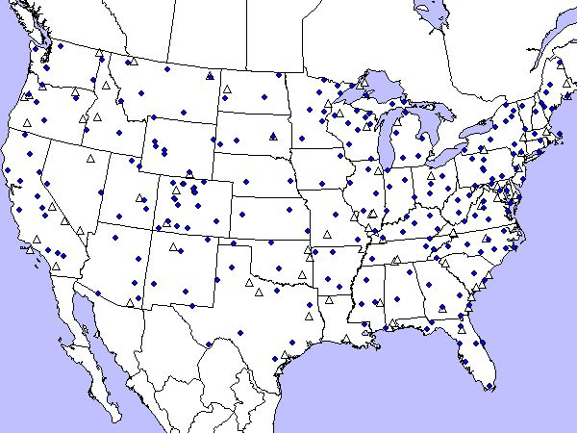
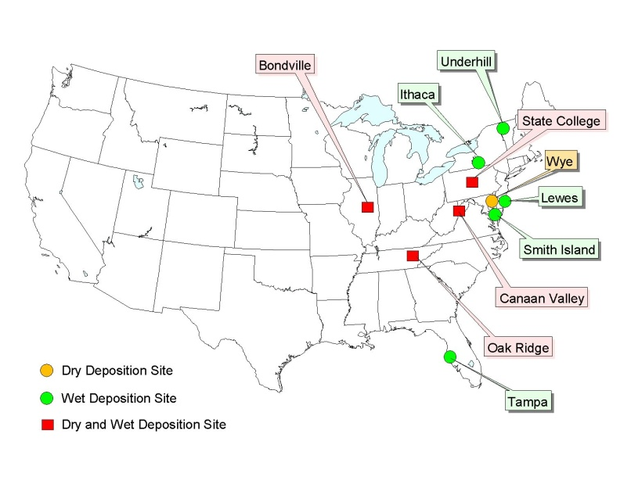
Approach: ARL Collaboration in Measurements and Data Interpretation
NTN Sites
Short-term measurements
U.S. Long Term Monitoring
NADP/NTN
NADP/AIRMoN-wet
AIRMoN-dry
NADP/AMNet
International Activities
North America: CEC, IJC
Global
WMO Global Atmosphere Watch
GAW linkages with other programs
AIRMoN Sites
Notes:
ARL is involved in several monitoring and measurement programs.
NADP = National Atmospheric Deposition Program – really a misnomer since it does not have a formal dry deposition program. NADP is the umbrella organization for several
sub-networks, including:
NTN= National Trends Network – a weekly sampling wet-only precipitation chemistry network. NTN began in 1978 has provided the bulk of the national sulfur and nitrogen trends information required for Clean Air Act and subsequent legislation. As you can see, there are many sites – approximately 230 at present.
AIRMoN = Atmospheric Integrated Research Monitoring Network, a monitoring program designed to be able to tap into ARL’s source-receptor capabilities and to provide testbed sites for new measurement and communications equipment. The AIRMoN-wet portion of the program began in 1992 with the continuation of a project begun in collaboration with the Department of Energy in 1976. Sampling follows a daily protocol Program methodologies are top quality as defined by the World Meteorological Organization Global Atmosphere Watch program guidelines. NOAA funds the AIRMoN-wet program which is also a subnetwork of NADP, ensuring strong compatibility with the weekly NTN network, a top quality assurance program, and posting of data via the NADP web page at routine intervals.
In the 1980s, filterpack measurements were developed to complement the NTN program, designed to assess the dry deposition component of atmospheric deposition – hence permitting the calculation of total deposition to the earth’s surface from the atmosphere. The ARL version of this became known as AIRMoN-dry. Unfortunately, dry deposition turned out to be a much more difficult quantity to estimate than wet deposition and subsequent progress has been in fits and starts. During the late 1980s and 1990s, both ARL and EPA operated filterpack networks, developed by a dedicated group of scientists in NOAA, EPA, and other institutions. For a variety of reasons, many driven by budgets, EPA presently maintains the routine national filterpack network (called the Clean Air Status and Trends Network – CASTNET) and ARL has focused on trying to improve the state of the science of dry deposition through the efforts mentioned in the last talk by LaToya Myles. Filterpacks have severe limitations – most importantly the inability to address ammonia deposition – but have served us well. Nevertheless, much remains to be done to improve the science at reasonable costs in a network environment for things that work that way, and through other means where they don’t. The AIRMoN-dry data from approximately 20 stations has been properly archived and made freely available via the NADP web page. The four sites in red on the AIRMoN map above were the last four to operate – and these were all collocated with AIRMoN-wet stations as well as numerous other field studies of various duration.
Mark Cohen and LaToya Myles described the NADP AMNet and the nitrogen measurement programs in previous talks. The ARL short term measurement program presently focuses on atmospheric nitrogen and mercury issues.
Findings from the programs mentioned above are used extensively in many venues. ARL collaboration takes on several forms.
ARL worked with the Commission for Environmental Cooperation (established following the passage of NAFTA in 1994 to address environmental concerns) to design and implement a Regional Action Plan designed to upgrade toxics monitoring and assessment between Canada, Mexico, and the US. While a charter was developed, governments have not provided the resources to permit real success. Meanwhile, ARL does continue to provide advise and to contribute to workshops addressing dioxin and mercury issues.
ARL has an ongoing relationship with the International Joint Commission between the US and Canada in and advisement role that primarily addresses issues associated with atmospheric emissions of sulfur, nitrogen, mercury, and other compounds that affect ecosystems and human health. IJC activities are discussed in a slide below.
ARL also serves as subject matter experts in leading the Global Atmosphere Watch Precipitation Chemistry program for the WMO. The implications of that work is discussed in following slides, and emerging links with other groups in the international community are identified.

Slide 5
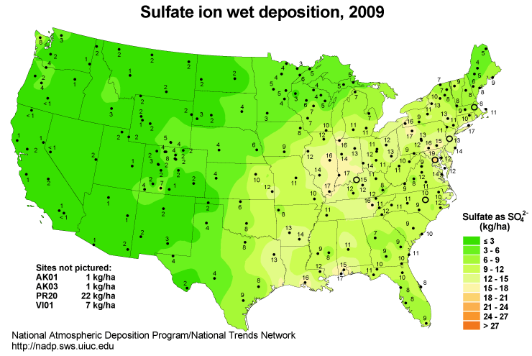
National Atmospheric Deposition Program
ARL Contributions
National Trends Network Products
Notes:
ARL has been involved with the National Atmospheric Deposition Program since 1980.
During the 1980s and 1990s, ARL operated more that 15 weekly wet-deposition stations, out of a total network that currently includes about 230 stations. A key NADP/NTN application concerns trend identification, used principally for addressing the results of cap and trade (title IV) 1990 CAAA and subsequent legislation affecting power plants, vehicles, and industry. In the early years, the task was to understand the situation. More recently, the task has been to track trends in sulfur, nitrogen, and base cation deposition and to contribute to air chemistry and ecosystem studies as appropriate. At present, the hottest application for NTN is to address critical loads, a concept used heavily in Europe, previously rejected in the US, meant to assess the capacity of an ecosystem to deal with anthropogenic loadings of nutrients and other compounds.
Within the Long Range Transport of Air Pollutants (LRTAP) convention (51 Parties – most European but includes US and Canada), the classical methods for setting critical loads of acidity have been successful in linking atmospheric deposition to ecosystem damage and contributed decisively in setting lower emission targets for acidity. For nitrogen (N) on the other hand, emissions continue to be elevated over wide parts of Europe, even exceeding in large parts the current critical loads. Conventionally, two methods are used to date for setting critical loads of nitrogen deposition for terrestrial ecosystem, namely the empirical critical loads and the dynamically modelled concentrations of nutrient nitrogen in soil solutions. The empirical critical loads are based on experimental or observed damage to plants at given nitrogen inputs, and by definition do not include other sources of reactive N nor other drivers which may alter the response to plants to N inputs. The dynamic modelling of nutrient N in soil solution measures excess N deposition by its effect on N concentrations in soil solution in excess of a vegetation type specific value defined by De Vries et al. (2007).
ARL has had two members chair the overall program: Rick Artz in 2000 and Maggie Kerchner in 2006. We have also been active in the Network Operations Subcommittee and the Ecological Response and Outreach Subcommittee. NOAA continues to have a representative on the NADP Executive and Budget Committees as well.
ARL has actively participated in NADP for many years and has contributed to network in a variety of ways:
Equipment modernization via the Small Business Innovative Research program
Various attempts to link NADP with the climate monitoring community, including the Climate Reference Network and the Historic Climate Monitoring Network Modernization.
Through the introduction of new subnetworks – in 1992 with AIRMoN and as part of a larger group of scientists in recent years through the development of network protocols for the atmospheric mercury network.
Through support of the State College, Pennsylvania station that provides a benchmark between NADP and Canadian monitoring systems.
Key products of the National Trends Network include the annual maps – two of which are shown here for sulfate deposition, and the NTN animated maps that clearly demonstrate trends in the major ions found in precipitation.

Slide 6
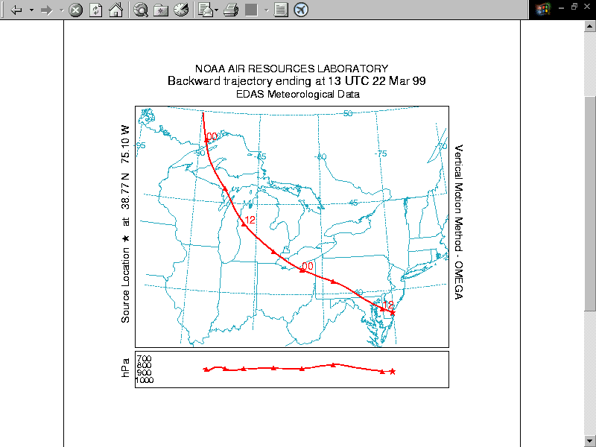
AIRMoN-wet Network
Seven stations
35 year records
Top quality
Common Applications
Comparisons of chemistry between daily and weekly samples
Trend analysis
Source-receptor relationships
Air quality model development
Atmospheric chemistry and deposition
Ecosystem studies
Coastal nitrogen deposition
Agricultural studies involving pathogens
Notes:
As mentioned previously, in 1992, ARL began the Atmospheric Integrated Research Monitoring Network – AIRMoN, building upon the MAP3S program begun in 1976 by DOE. AIRMoN was designed to address not just trends in wet and dry deposition but was also intended to improve the underlying science.
The AIRMoN-wet program was originally envisioned as a program of national scope containing about 25 daily monitoring stations. It has become a “boutique” program, composed of seven sites due to budget reality. These sites are expensive – costing about three times what is needed for an NTN station – but provide data suitable for source-receptor studies and considerably more structure to the data set useful for process understanding.
Due to their quality and longevity, AIRMoN sites are among the “crown jewels” of US monitoring and should be preserved. Quality assured daily wet-only measurements define the highest standard as identified by the World Meteorological Organization Global Watch Program, providing a benchmark for the more routine weekly or (in much of the world) bulk (open bucket) samples.
To date, AIRMoN samples have been used for
Comparison of chemistry between weekly and daily samples
Butler T.J. and G.E. Likens. 1998. Weekly and daily precipitation chemistry network comparisons in the eastern U.S. : NADP/NTN vs. MAP3S/AIRMoN. Atmos. Environ. 32(21):3749-3765.
Gilliland, A.B., T.J. Butler and G.E. Likens. 2002. Monthly and annual bias in weekly (NADP/NTN) vs daily (AIRMoN) precipitation chemistry data in the eastern USA. Atmos. Environ. 36:5197-5206.
Trend analysis
Lehmann, C.M.B. 2006. “Atmospheric Deposition Monitoring to Assess Trends in Atmospheric Species." Ph.D. Dissertation, University of Illinois at Urbana-Champaign, Urbana, IL.
Source-receptor relationships when coupled with HYSPLIT back trajectories
Butler, T. J. , G.E. Likens, F.M. Vermeylen, and B.J.B. Stunder. 2003. The relation between NOx emissions and precipitation NO3- in the eastern USA. Atmos. Environ. 37:2093-2104.
Air quality model development
Illinois State Water Survey provides preliminary data to the CMAQ modeling team about one week after received from the field. Full quality assurance takes a couple of months. ARL CMAQ modelers use these data to better understand model characteristics.
Atmospheric chemistry and deposition
Hedin, L.O., L. Granat, G.E. Likens, T.A. Buishand, J.N. Galloway, T.J. Butler, and H. Rhode. 1994. Steep declines in atmospheric base cations in regions of Europe and North America. Nature 367: 351-354.
Butler, T. J. , G.E. Likens, F.M. Vermeylen, and B.J.B. Stunder. (2005) The Impact of Changing Nitrogen Oxide Emissions on Wet and Dry Nitrogen Deposition in the Northeastern USA. Atmos. Environ. 39:4851-4862.
Ecosystem studies:
Scudlark, J.R., K.C. Rice, K.M. Conko, O.P. Bricker and T.M.Church. 2005. Transmission of Atmospherically Derived Trace Elements Through an Undeveloped, Forested Maryland Watershed. Water, Air & Soil Pollution 63:53-79.
Scudlark, J.R., J.A. Jennings, M.J. Roadman, K.B. Savidge and W.J. Ullman. 2005. Atmospheric Nitrogen Inputs to the Delaware Inland Bays: The Importance of Ammonia. Environmental Pollution 135: 4333-443.
Volk, J.A., K.B. Savidge, J.R. Scudlark, A.S. Andres and W.J. Ullman. 2006. Nitrogen Loads Through Baseflow, Stormflow and Underflow to Rehoboth Bay, Delaware. Journal of Environmental Quality 35: 1742-1755.
Driscoll C.T., G.B. Lawrence, A.J. Bulger, T.J. Butler, C.S. Cronan, C. Eagar, K.F. Lambert, G.E. Likens, J.L. Stoddard. (2001) Acidic deposition in the northeastern U.S. : sources and inputs, ecosystem effects, and management strategies. Bio Science 51 (3) 180-198.
Coastal nitrogen deposition
Mizak, C.A., S.W. Campbell, M.E. Luther, R.P. Carnahan, R.J. Murphy, and N.D. Poor. 2005. Below-cloud Ammonia Scavenging in Convective Thunderstorms at a Coastal Research Site in Tampa, FL, USA. Atmospheric Environment. 39:1575-1584.
Agricultural studies
Krupa, S., F. Booker, V. Bowersox, D. Grantz, and C. Lehmann, C. 2006. Uncertainties in the Current Knowledge of Some Atmospheric Trace Gases Associated with US Agriculture. Environmental Pollution.
Special studies:
Preservatives – potentially useful for measurements in remote locations where refrigeration is unavailable and transportation is difficult
Collocation with airborne mercury measurements for the purpose of identification of major events
Use of left over samples for soybean rust studies and various isotope studies
Artz’s wish list:
25 sites nationally
Collocated with AMNet (speciated mercury in the atmosphere) and climate sites
Collocated with filterpack and continuous gas and particle measurements
Seminal study by Gilliland et al, 2002:
Previous comparisons of the data from the National Atmospheric Deposition Program, National Trends Network (NTN) against collocated event sampled data and daily sampled data suggest a substantial bias in the concentration of ammonium [NH₄⁺] and concentrations of several base cations, while the comparability of other ion concentrations ranges among the studies. Eight years of collocated data from five NTN and Atmospheric Integrated Research and Monitoring Network (AIRMoN) sites are compared here. Unlike previous analyses, the data from these two data sets were analyzed in the same laboratory using the same analytical methods; therefore, factors that influence concentration differences can be isolated to sampling frequency and sample preservation techniques. For comparison, the relative biases for these data have been calculated using both median value and volume-weighted mean concentrations, following two different approaches in the literature. The results suggest a relative bias of about 10% in [NH₄⁺] (NTN less than AIRMoN), which is smaller than previous estimates that included the influence of inter-laboratory comparisons. The annual relative bias of [H⁺] increases over the analysis period, which results in a larger total relative bias for [H⁺] than found in a previous analysis of AIRMoN and NTN data. When comparing NTN and AIRMoN data on monthly time scales, strong seasonal variations are evident in the relative bias for [H⁺], [NH₄⁺], and [SO₄²⁻]. Large biases in [SO₄²⁻] (NTN greater than AIRMoN) on monthly times scales have not been detected in previous analyses where data for all seasons were considered together.

Slide 7
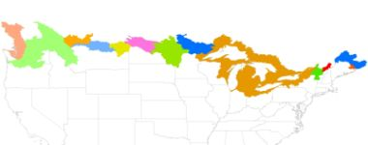
International Joint Commission -- International Air Quality Advisory Board
The IJC was established in 1909 following ratification of the Boundary Waters Treaty.
IJC Commissioners are political appointees.
IAQAB is an advisory board that reports to IJC.
ARL serves in a personal advisory capacity to IJC with nine other scientists from the US and Canada.
Contemporary issues are primarily associated with energy consumption and production
Notes:
The 1909 Boundary Waters Treaty established the Commission, which has six members. Three are appointed by the President of the United States, with the advice and approval of the Senate, and three are appointed by the Governor in Council of Canada, on the advice of the Prime Minister. The Commissioners must follow the Treaty as they try to prevent or resolve disputes. They must act impartially, in reviewing problems and deciding on issues, rather than representing the views of their respective governments.
The Commission has set up more than 20 boards, made up of experts from the United States and Canada, to help it carry out its responsibilities.
Canada and the United States created the International Joint Commission because they recognized that each country is affected by the other's actions in lake and river systems along the border. The two countries cooperate to manage these waters wisely and to protect them for the benefit of today's citizens and future generations.
In 1966 the Governments asked the International Joint Commission to observe air quality along the entire Canada and United States boundary and, as appropriate, draw air pollution problems to the attention of Governments. The Commission established the International Air Quality Advisory Board to identify and provide advice on air pollution issues with transboundary implications.
The Board includes five members from Canada and five from the United States who have expertise in various aspects of air pollution effects and control. They are appointed by the Commission and serve as advisors in their personal and professional capacities. The role of the Board is entirely advisory in nature. Information and advice is provided to the Commission by the Board through semi-annual progress reports, workshops, technical analyses and published reports on the many aspects of transboundary air pollution.
Recent IAQAB Publications
Expert Consultation Meeting on air quality issues related to the northern boundary region between the United States and Canada (March 2010)
Meeting our Electrical Energy Needs to 2030: A Review of Energy and Environmental Factors
Second Summary of Critical Air Quality Issues in the Transboundary Region (December 2007)
Summary Report: Second Clean Areas Workshop, Boulder, CO, February 2005
Consultation on Emissions from Coal-fired Electrical Utilities
Summary of the workshop on Clean Areas and Prevention of Significant Deterioration (February 2004)
2001-2003 Priorities and Progress Under the Great Lakes Water Quality Agreement
Air Quality in Selected Binational Great Lakes Urban Regions
Summary of Critical Air Quality Issues in the Transboundary Region (January 2004)
Addressing Atmospheric Mercury: Science and Policy (IAQAB and CEC, May 2003)
Report Card to the IJC by the IAQAB (April 2002)
IAQAB Chapter of the 1999-01 Priorities and Progress Under the Great lakes Water Quality Agreement (September 2001)
Protection of Great Lakes Water Quality from Atmospheric Contaminant Deposition (October 2000)
IAQAB Progress Report 25 (April 2000)
IAQAB Chapter of the 1997-99 Priorities and Progress Under the Great Lakes Water Quality Agreement (January 2000)
Central focus of IAQAB: Energy Consumption and Production.
Major Issues:
Local and regional air quality
Climate change and variability
Intercontinental transport and hemispheric air pollution
Sub-issues that occupy IAQAB time:
Regional haze
Local air toxins
Human health effects from air pollution
Climate instability
Fine particles and ozone
Mercury and other toxics
Acid rain (and more specifically of late: nitrogen pollution)
Ambient air quality
From IJC web site: www.IJC.org
The International Air Quality Advisory Board (the Board) shall advise the Commission on matters of direct relevance to transboundary aspects of air quality in the United States and Canada. Such matters may be referred to the Board by the Commission in specific requests or identified by the Board and brought to the attention of the Commission with respect to the Boards "alerting and investigative function" under the Reference.
The Board shall make suitable arrangements so that it may be currently informed regarding any air quality or deposition problems involving both the United States and Canada, including transport across the international boundary, reception by the biosphere and the development of appropriate monitoring and research strategies.
The Board shall undertake such studies as may be necessary or appropriate for the Board to carry out its work under the Reference. With respect to advising the Commission of matters appropriate to draw to the attention of Governments, the Board should first obtain the available relevant information and advise the Commission, to the extent possible of the nature and impact of the problem. With respect to special studies requested by the Commission, the Board shall prepare a study plan for Commission consideration and approval. If funds and resources beyond those available to the Board members from their agencies are needed to implement the plan, the Board shall prepare a specific budget for Commission consideration, approval and, if necessary, the seeking of the required funding.
The Board shall keep the Commission informed of the Board's plans and progress, and of any developments, actual or anticipated, which are likely to impede or otherwise affect the carrying out of the Board's responsibilities.
To the extent possible and relevant, the Board shall make maximum use of available resources, information, and technical data from the agencies of Canada and the United States, as well as from other sources.
If it appears to the Board at any time that its program should be modified, it shall so advise the Commission for its consideration.

Slide 8
World Meteorological Organization – Global Atmosphere Watch Science Advisory Group for Precipitation Chemistry
Chaired by ARL since 1998
Oversight of approximately 200 official and 400 unofficial sites globally
Implementation of WMO guidelines through:
Development of a guidance document outlining standard operating procedures
Institution of a comprehensive quality assurance program
Development of regional programs
Use of information in scientific assessments
Conducting special studies
Notes:
In 1998 Rick Artz was appointed as the chair of the World Meteorological Organization Global Atmosphere Watch Precipitation Chemistry Program Science Advisory Group. The program officially has about 200 sites recognized by participating governments, and nearly 400 “other” participating sites. Not all of them report data and not all of them should.
The roles of the GAW Precipitation Chemistry Program are stated in the GAW Strategic Plan (GAW Publication #156) . The present tasks of the Science Advisory Group are:
To promote the implementation of the new guidelines for GAW precipitation chemistry measurements through the distribution of a new Guidance Document harmonizing measurement procedures used in various regional and national programmes, and the development of a new data submission/distribution system on the World Wide Web.
To upgrade the Precipitation Chemistry QA programme by:
Implementing a comprehensive set of QA and QC activities (as specified in the Guidance Document),
Further developing and improving the QA procedures for precip chemistry measurements including the development of stringent data acceptance criteria,
Conducting the semi-annual Lab Intercomparison Studies and providing training and feedback to countries and laboratories with sub-standard performances
To continue studies on sample preservation and to make recommendations on the most appropriate preservation methods for minimizing sample degradation during collection and shipping.
To assist in developing regional programmes, to identify and attempt to increase the number of precipitation chemistry monitoring sites in data sparse areas of the world, most notably in South America, Asia, and Africa as well as in large and relatively homogeneous ecosystems such as rain forests, savannahs, and Arctic regions. More measurements may also be needed in rapidly industrializing areas to provide information required for political decisions to reduce emissions of pollutants.
To continue to assess the quality of GAW precipitation chemistry data and the success of the new SOPs.
To promote the use of GAW data in the preparation of scientific assessments of global precipitation chemistry.
To assess the need for trace metal and POPs measurements in the GAW programme. If such needs are identified, to propose a suitable measurement programme.

Slide 9
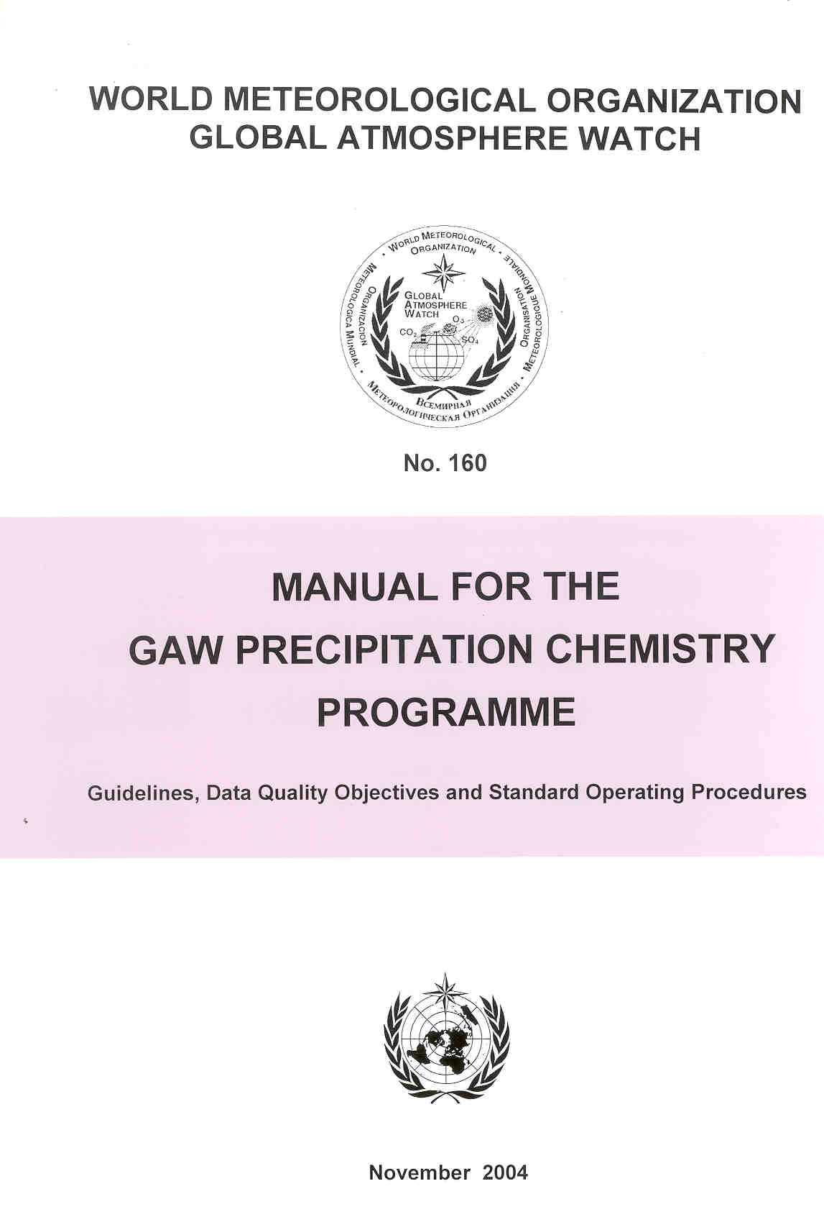
Manual for the GAW Precipitation Chemistry Programme
1. Introduction
Station Siting
Field Protocols
Laboratory Operations
Data Management
Quality Control and Quality Assurance
Notes:
Following considerable discussion, the Science Advisory Group (SAG) recognized that data quality of this network was not very good, that standard protocols had not been set, and that ongoing laboratory tests were not particularly useful in their present form. The Manual for the GAW Precipitation Chemistry Program addressed these issues and set the necessary protocols.
Both the hardcopy manual and the download of the manual have strong resonance throughout the global community. This has led to upgraded operations, improved quality, requests for audits, and within-country network upgrades. The Manual has now been in place for approximately six years and it is the goal of the SAG to begin work on an updated edition this fall.
Table of Contents
I. Introduction
GAW background
GAW Precipitation Programme objectives
2. Siting
Future Directions
Siting considerations and requirements
Global and regional sites
Site Documentation
3. Field Protocols
Sample collection and site facilities
Field instrumentation and routine checks and maintenance
Accepted sampling periods
Sample preservation, handling, and shipping
Field blanks
Sample documentation
4. Laboratory Operations
List of analytes and preferred methods
QA/QC for sample handling, chemical analyses, calibration control and verification, replicate analyses, blanks, spike recoveries, dilution checks, quality control charting and control solutions
Laboratory data validation and reporting
Analytical measurement procedures
5. Data Management
Data collection, reporting, merging, and formatting
Submission to the QA/SAC Americas, AQ/SAC Americas data quality assurance procedures
Data quality assurance
Data archiving and distribution
6. Quality Control and Quality Assurance
The objectives of QA/QC
Data Quality Objectives
Overarching aspects of QA/QC for siting, field, laboratory, and data

Slide 10
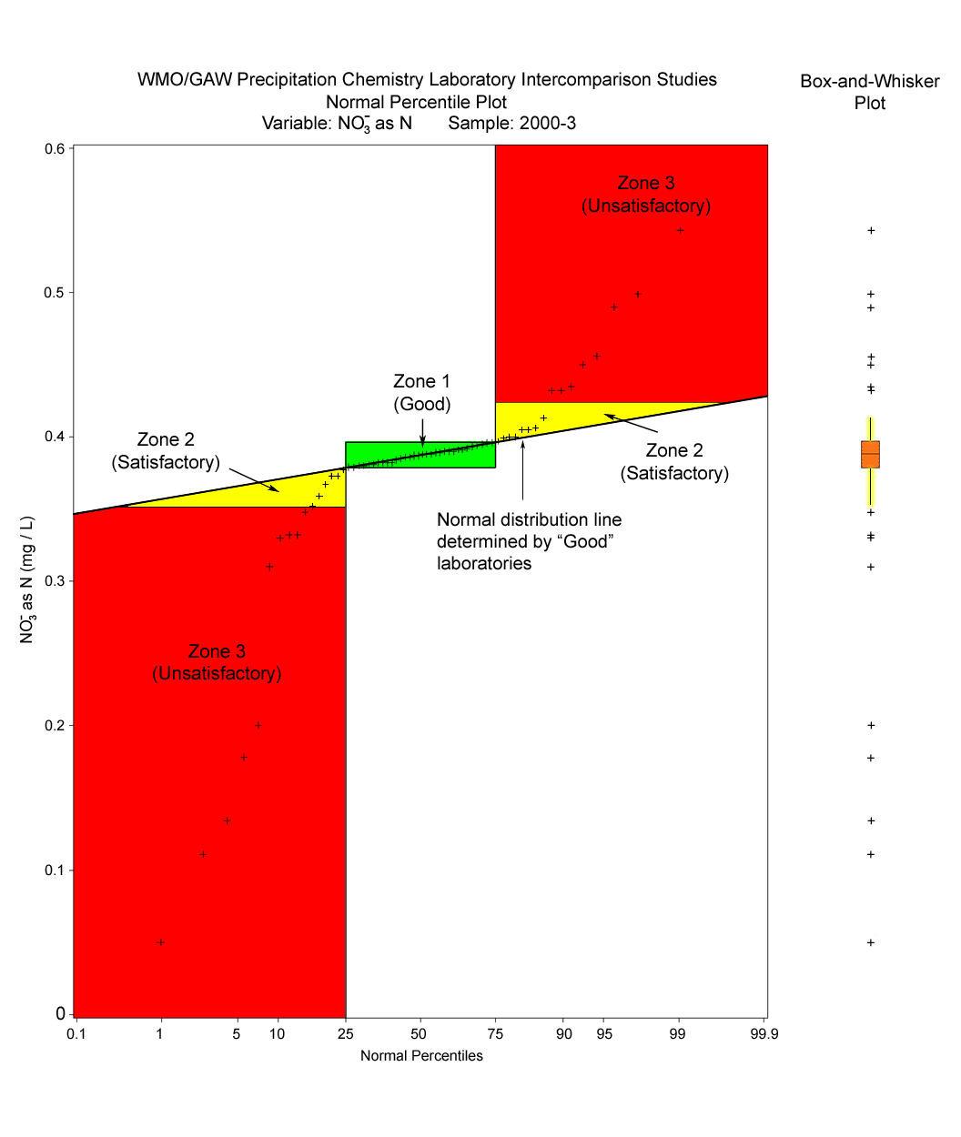
WMO/GAW Laboratory Intercomparison Studies
Normal Percentile Plot
Analyte: NO3⁻ as N (Sample 2000-3)
Box and
Whisker
Plot
0.6
Zone 3: Unsatisfactory
+
+
0.5
+
+
+
+
+
+
Zone 1:
Good
+
+
+
+
+
+
+
Zone 2:
Satisfactory
+
+
+
+
+
+
+
+
0.4
+
+
+
+
+
+
+
+
+
+
+
+
+
+
Zone 2:
Satisfactory
+
+
+
+
+
+
+
+
+
+
+
+
+
Normal distribution line determined by “Good” laboratories
+
NO₃⁻ as N (mg/L)
+
+
0.3
Zone 3: Unsatisfactory
0.2
+
+
+
+
+
+
+
+
0.1
+
+
0.0
0.1 25 75 99 99.9
Normal Percentiles
Original unpublished figure courtesy of Robert Vet and Alain Sirois
Notes:
The Lab Intercomparison Study has been conducted once annually beginning in 1978, twice annually beginning 2001 when the Science Advisory Group that I chair determined that there were good reasons to test more frequently. The 43rd comparison has just been completed.
Participation is required of every laboratory serving a GAW precipitation chemistry station.
Test samples have been made more relevant to participating laboratories.
Results are made available via the Web later this month.
The purpose of the Lab Intercomparison Study is to ensure that data in the global network are of high and known quality. Poor performance at the laboratory almost ensures that sample data are of questionable value. To address air quality, deposition, and climate issues of our day, assessment of data quality is essential.
The lab studies address performance of all of the major ions typically found in precipitation. Using the cumulative data collected for each of these studies, we define zones that indicate samples are acceptable, marginal, or unacceptable, and present them on a circular diagram as shown on the right side of the page. For each laboratory tested during each study we produce a ring diagram that serves to quickly alert both the laboratories and any data users concerning potential problems with the measurements. This was done to permit us to address emerging problems in participating laboratories (about 80 globally) and to give the user the appropriate level of confidence for datasets posted on the web site.
Ring diagrams were developed by Robert Vet, Alain Sirois, and colleagues at Environment Canada using data processed and summarized by the Illinois State Water Survey. ISWS also performs as the Central Analytical Laboratory for the US National Atmospheric Deposition Program. ARL provides financial support to the Illinois State Water Survey and key personnel associated with the program.
Ring diagrams are available on line at http://qasac-americas.org/ringdiagram
GOOD - Green Hexagon
Measurement is within the interquartile range (IQR), defined as the 25th to 75th percentile or middle half (50%) of the measurements.
SATISFACTORY - Blue Trapezoid
Measurement is within the range defined by the median + IQR/1.349. The ratio, IQR/1.349, is the non-parametric estimate of the standard deviation, sometimes called the pseudo-standard deviation.
UNSATISFACTORY - Red Triangle
Measurement is outside the range defined by the median + IQR/1.349.
DETECTION LIMIT - Open Circle
Measurement is below the detection limit of the laboratory’s analytical method.
Notes:
An outward pointing trapezoid or triangle indicates the measurement is high. An inward pointing trapezoid or triangle indicates the measurement is low.
A hexagon or trapezoid with cross-hatching indicates a measurement that meets the GOOD or SATISFACTORY definition but fails the measurement Data Quality Objective (DQO), defined in the Manual for the GAW Precipitation Chemistry Programme and listed in Table 1, below.
A straight line without a symbol indicates no measurement was reported. For example: acidity.
Table 1. Precipitation Chemistry Data Quality Objectives
Measurement DQO
pH + 0.07 units
conductivity + 7%
acidity + 25%
sulfate + 7%
nitrate + 7%
ammonium + 7%
fluoride none
chloride + 10%
sodium + 10%
potassium + 20%
calcium + 15%
magnesium + 10%

Slide 11
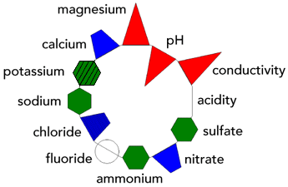
Ring Diagram Overview
GOOD - Green Hexagon
SATISFACTORY - Blue Trapezoid
UNSATISFACTORY - Red Triangle
DETECTION LIMIT - Open Circle
Lab Intercomparison Study Data
Lab 700153 India, LIS 2010 43 Ring Diagrams
Sample 1 Sample 2 Sample 3

Slide 12
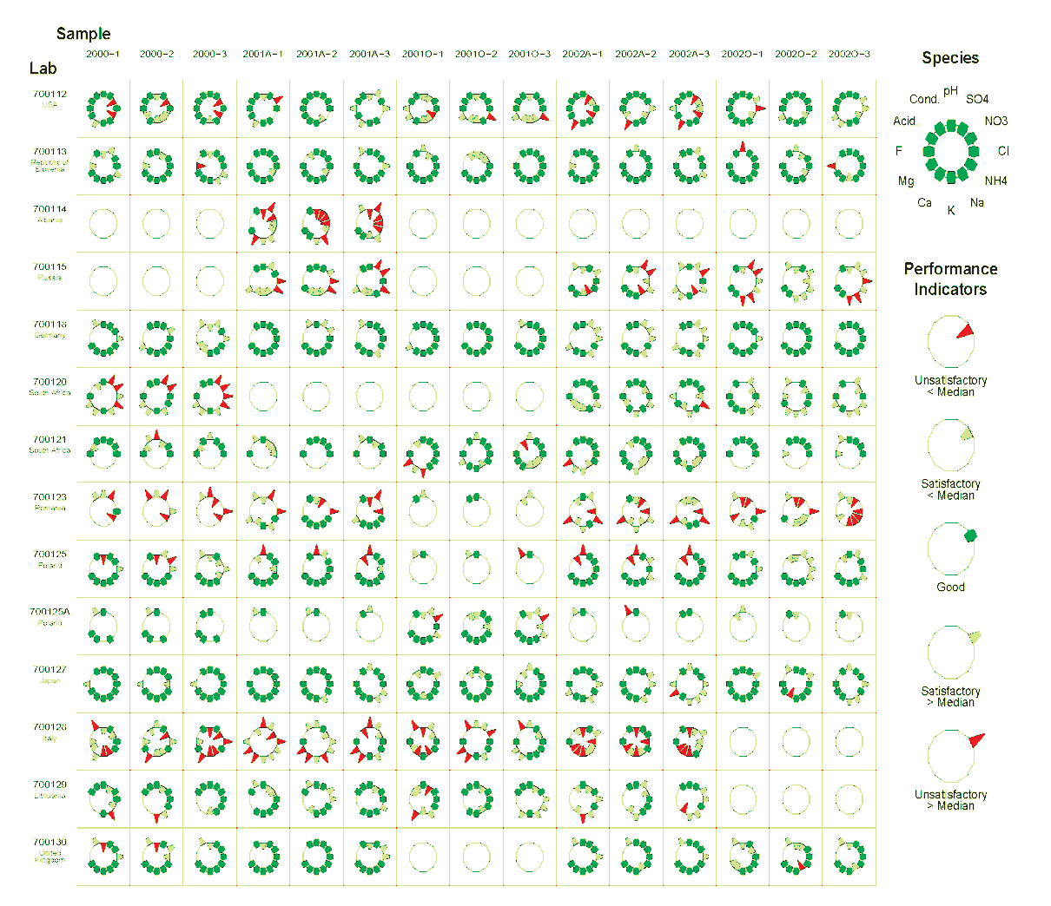
The ring diagrams are a useful way to summarize the essential lab-by-lab results of the Laboratory Intercomparison Studies, for potential users of the measurement data
Notes:
Ring Diagram excerpt courtesy of Robert Vet and Alain Sirois (Environment Canada). This is an older version, and the yellow “Satisfactory” indicators have been replaced by the blue indicators seen in the previous slide.

Slide 13
The WMO 2011 Global Precipitation Chemistry and Deposition Science Assessment
Objective: To review and synthesize the state of the science of the ion composition of precipitation and ion deposition on global and regional scales.
Key Science Questions on a Global and Regional Scale:
Spatial distribution of major ions?
Acid-base chemistry and ion composition?
Wet, dry and total deposition?
Trends?
Gaps and uncertainties?
Approach:
2000 to 2007
Global and Regional scales (Africa, Asia and Oceania, Australia, Europe, North America, South America, Polar Regions, Oceans)
Non-urban sites
Combined measurement and modeling results
To be published in Atmospheric Chemistry and Physics (ACP) in 2011
Notes:
The Global Precipitation Chemistry and Deposition Science Assessment is a project of the Global Atmosphere Watch Scientific Advisory Group for Precipitation Chemistry. Publication is expected later this calendar year, although the global data set may become available by summer.
Lead author = Robert Vet, Environment Canada
Chair of the Global Atmosphere Watch Science Advisory Group = Rick Artz
Additional report authors include: S. Carou, V. Bowersox, C.-U. Ro, M. Shaw, W. Aas, A. Baker, F. Dentener, C. Galy-Lacaux, R. Gillett, S. Gromov, H. Hara, T. Khodzher, N. Reid, K. Pienaar, S. Nickovic, and P.S.P. Rao
Considerable progress has been made:
Paper outline, draft science questions, bibliography and all chapters are in draft form
Experts are heavily involved from all continents except South America and Antarctica. Canadian scientists are serving as organizational lead
Global model results are being used to complement available data
Working with Bob Duce and the GESAMP program to estimate deposition to oceans.
Draft results were provided to the Nitrogen Deposition/Critical Loads/Biodiversity Workshop in November 2009, organized by Jim Galloway and Frank Dentener as part of the International Nitrogen Initiative.
To date, via this assessment, ARL and the Science Advisory Group has been working closely with the
- International Nitrogen Initiative – dedicated to optimizing the use of nitrogen in food production, while minimizing the negative effects of nitrogen
- GESAMP (UN Group of Experts on the Scientific Aspects of marine Environmental Protection) The Atmospheric Input of Chemicals to the Ocean
- EMEP (Co-operative programme for monitoring and evaluation of the long range transmission of air pollutants in Europe) task force on Reactive Nitrogen
- HTAP (Task Force on Hemispheric Transport of Air Pollution) primarily through Terry Keating (US EPA), Wenche Aas (NILU), and Frank Dentener (Ispra)
US Canada AQ Agreement – formally recognized the current GAW assessment as part of its mandate to address transboundary air pollution
ACCENT (Atmospheric Composition Change: the European Network of Excellence), a European project designed to improve network harmonization and data intercomparability
IPCC AR5 – to provide nitrogen sink terms for the next report.

Slide 14
N_{oxidized} + N_{reduced} wet deposition (kg N/ha/yr) – 2000-2002 annual wet deposition and 2001 modeled wet deposition
5 - 15
5 - 10
5 - >26
5 - 15
Preliminary results – not for citation, reproduction or redistribution
Notes:
The graphic above is an example of the types of materials we intend to publish as a part of the WMO assessment. Several hundred graphics will be included as an appendix to the Atmospheric Chemistry & Physics journal article, with various depictions of modeled and measured analytes. The report will will address oxidized and reduced nitrogen, sulfate, soil cations, sea salt influence, wet, dry & total deposition. This figure is courtesy of Environment Canada.

Slide 15
Indicators of Success
Publications
Atmospheric Environment, Journal Air & Waste Management Association, Journal of Geophysical Research, Environmental Science and Technology, Environmental Management, Geophysical Research Letters
Datasets
AIRMoN-dry - late 1980s - 2000
MAP3S/AIRMoN-wet 1976-2010
Air quality model applications -- CMAQ
Membership (and leadership) in national and international organizations
NADP
IJC
WMO Global Atmosphere Watch
Emerging Global Assessment Applications
International Nitrogen Initiative
GESAMP
IPCC
Sessions on NADP Web Page
2000
2001
2002
2003
2004
2005
Notes:
Recent publications are found primarily in Atmospheric Environment. ARL air quality scientists have published in over 30 peer reviewed journals since 2001.
AIRMoN dry program was discontinued in 2000.
MAP3S was the predecessor program to AIRMoN-wet.
INI: Makes use of oxidized and reduced data from NADP National Trends Network and AIRMoN-wet programs. Key contact = Jim Galloway
GESAMP: Joint Group of Experts on the Scientific Aspects of Marine Environmental Protection. Key contact = Bob Duce
IPCC: AR5 Report will make use of nitrogen data from the global assessment if we can get it completed in time. Key contact = Frank Dentener

Slide 16
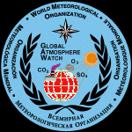
Collaborators
Notes:
Precipitation chemistry and deposition research at ARL has partners in academia, other federal agencies, with foreign governments, and international organizations. We routinely form collaborations to conduct measurements, to contribute findings to policy discussions, and to conduct national and international assessments. Collaborations help ARL leverage resources to effectively align our research with agency and stakeholder priorities.
Collaborators in this slide are shown as three distinct groups:
Under the National Atmospheric Deposition program, key collaborators include EPA, NPS, USGS, and USDA, as well as U of I, Penn State, U. Delaware, and Cary Institute.
Under the WMO Global Atmosphere Watch, collaborations are through federal organizations under foreign governments. Principal collaborators include Environment Canada, NILU, EANET, North-West University in South Africa, and the Russian Federal Service for Hydrometeorology and Environmental Monitoring.
ARL also collaborates via the International Air Quality Advisory Board of the International Joint Commission between the US and Canada and through the Commission for Environmental Cooperation Environmental Monitoring and Assessment Regional Action Plan.

Slide 17
Future Directions
Products
Continue to make available quality assured and current datasets
Manuscripts for peer-reviewed publications
Atmospheric concentration and deposition assessments
Additional data analysis
Guidance
Instruction manuals
Expert visitations
Contributions to policy-relevant issues
New analytes and the WMO
Mercury
Dry deposition
Notes:
AIRMoN is a mature program that will not expand in the absence of additional resources. Current data collection, quality assurance, and archival will continue as part of the National Atmospheric Deposition Program and will be used as appropriate in scientific studies by NOAA, close collaborators, and the general science community. Manuscripts for peer-reviewed publications have been a routine product from this program and are expected to continue.
Collaborations with the WMO will focus on:
Maintenance of the quality assurance/science activity center interlaboratory quality assurance program
Completion of the global precipitation chemistry and deposition assessment and subsequent collaboration with INI, IPCC, and other major scientific program.
Updating the guidance manual for the international precipitation chemistry program
Provision of expert visitations as requested and as resources allow.
IJC International Air Quality Advisory Board contributions will include nutrient-relevant (N, S, P) input from AIRMoN studies and other areas of ARL expertise. Because of the heavy focus of Air Board work on energy issues, there will be continued scrutiny of air issues associated with Canadian oil sand development, the biggest potential source of new emissions from the energy sector to North America presently on the horizon.
The GAW precipitation chemistry program has been approached to manage expanded roles addressing mercury and dry deposition of sulfur and nitrogen. These issues are highly resource dependent and infrastructure in most nations is behind the United States. It’s the right thing to do but quick progress is not expected here.
Working closely with our marine science colleagues in the current assessment, the GAW precipitation chemistry program has also put emphasis on getting a better handle on global phosphorus deposition. In a global context, the GAW assessment writing team found that AIRMoN data would be more useful if the unfiltered orthophosphate measurements were changed to total phosphorus measurements using acid digestion – a step that should occur this year. The AIRMoN phosphorus samples are the only routinely reported ongoing phosphorus measurements made in the United States, and perhaps globally. The 230 site NADP/NTN (filtered) orthophosphate measurements are useful for identifying contamination but typically are not reported. The writing team noted that these data would be more useful if an unfiltered aliquot were taken before filtering and analyzed for total phosphorus or, if this isn’t possible, changing the orthophosphate analysis on the filtered samples to total phosphorus analysis. Given the costs involved, this change is unlikely.
The WMO GAW precipitation program will also continue to perform expert visitations as possible, to provide standard reference materials, and to conduct special studies on sample preservation, hardware modernization, etc. as funds permit.

