Slide 1
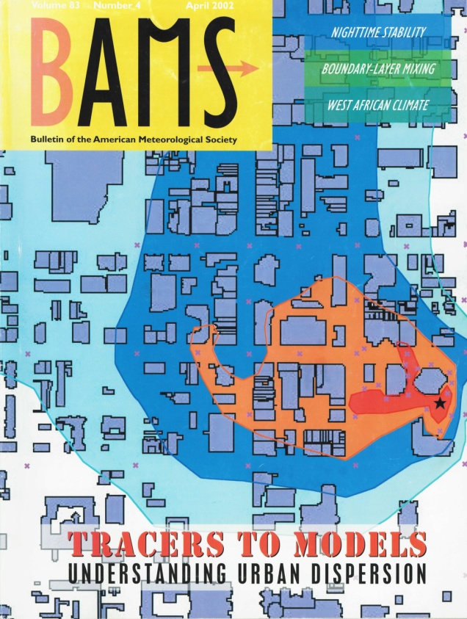
Atmospheric Tracers and Wind Energy
Kirk L. Clawson
Director, Field Research Division
June 21, 2016

Slide 2
Linkage Between Dispersion and Wind Energy Research
“An incomplete picture of the atmospheric boundary layer, where most human activity occurs, represents a major gap in our ability to diagnose and predict high-impact weather events.” (NOAA 2013-2017 Five Year Research and Development Plan)
Notes:
ARL has conducted dispersion research for many decades. As wind energy has become important, it became clear that the same issues affecting plume dispersion in the boundary layer apply to forecasting at wind turbine hub heights.

Slide 3
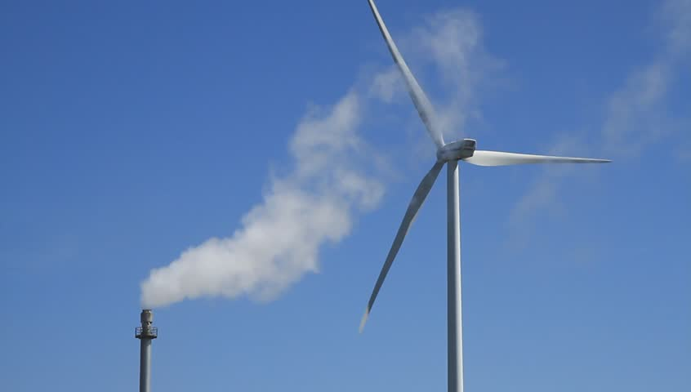
Unifying Goal
Understand Structure and Evolution of the
Planetary Boundary Layer
Atmospheric tracers: dispersion model improvement
Wind energy: wind forecast model improvement
Notes:
When wind energy started to take off, it became clear that the winds at turbine heights are affected by the same PBL forecasting issues that are important for dispersion, so the two areas overlap.

Slide 4
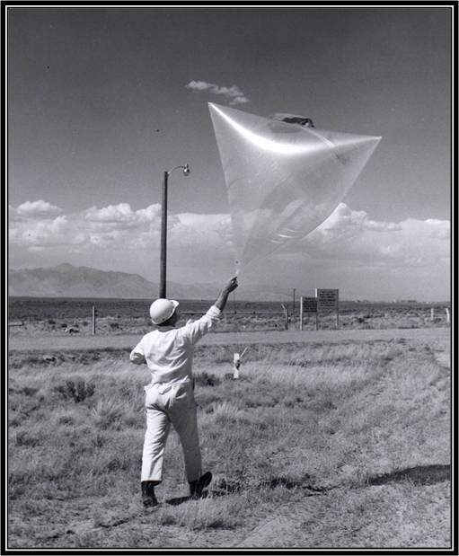
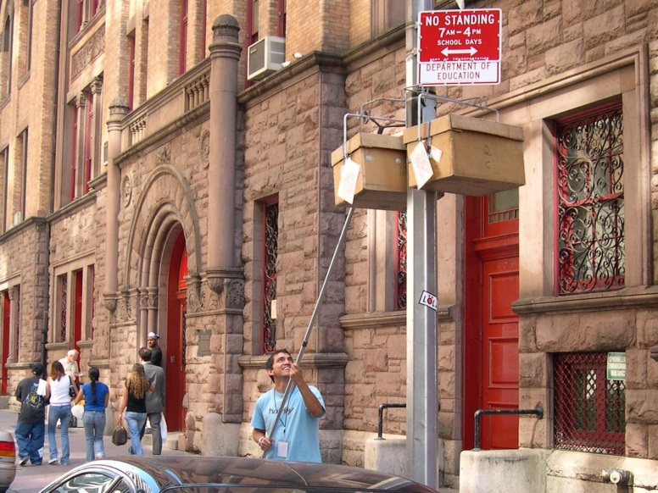
Atmospheric Tracers
Small amounts of intentionally-released atmospheric tracer (usually gaseous)
Surrogates for actual harmful chemicals
Nontoxic, odorless, tasteless, invisible
Attributable to only one source
Atmospheric dispersion field tests
Essential for dispersion model
evaluation

Slide 5
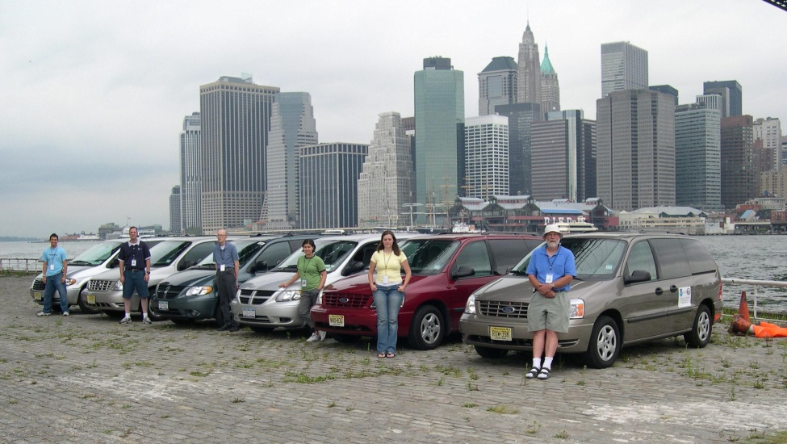
ARL’s Atmospheric Tracer History
1960s – Initial development of atmospheric tracer technology
1970s – First major urban air quality/dispersion study in St. Louis
1980s – Conducted studies in complex terrain and on continental and hemispheric scales
1990s – Continued dispersion
studies in complex terrain
2000s – Conducted several large
urban dispersion studies
2010s – Revisiting classic dispersion
studies using modern turbulence
and tracer detection equipment

Slide 6
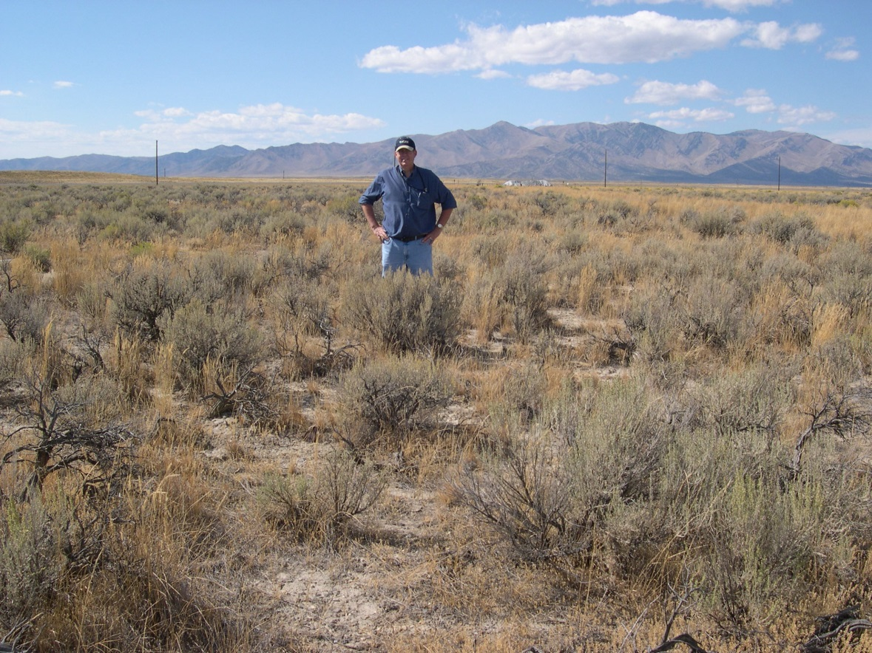
Current Approaches
Field studies
Project Sagebrush
Collaboration with other entities
Data rescue of previous field studies
Contributing to the ARL online archive
(DATEM)

Slide 7
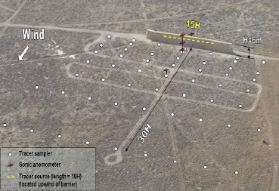
Accomplishments
EPA’s RLINE model
developed using Sound
Barrier Study data (2008)
Project Sagebrush Phase 1
completion
Tech Memo
3 journal articles in various stages
Planning for Project Sagebrush Phase 2
Rescued 10+ large-scale tracer dispersion field studies

Slide 8
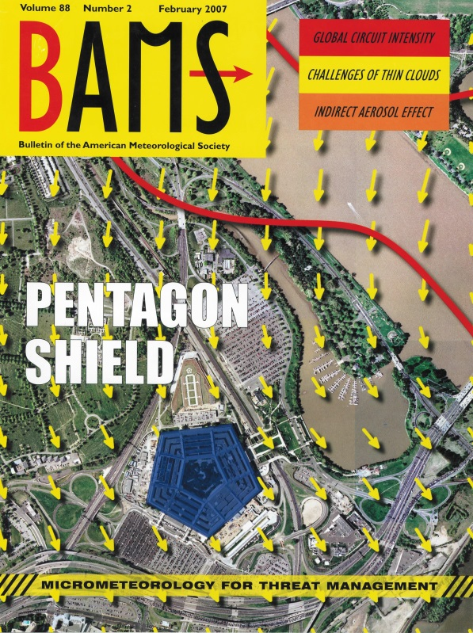
Quality, Relevance, and Performance
ARL is a go-to agency for research using tracers in field studies
Strict quality control procedures that comply with EPA standards
Pentagon Shield (DARPA)
ARL has been a key player in most
of the U.S. tracer studies of the last
few decades
Improvement of dispersion models in
open and complex terrain and
urban settings

Slide 9
Key Scientific & Technical Challenges
Significant numbers of subject matter experts have retired
Very few dispersion meteorologists are being educated
ARL has several experts who are or will be eligible to retire
Decline in U.S. funding in the last 10 years
Lack of NOAA support
Working on a shoestring budget
Principle tracer gas has very high GWP of 22,800 (100 yr)
Need to develop new tracers and likely new measurement techniques
Summary: Will funding continue to support and maintain
the large investment in personnel and infrastructure?
Notes:
US SF6 emissions estimated to be 0.3 kt (2013)
= 300 t = 300,000 kg
Estimate 10 kg for this year’s test
= 0.003% of total US emissions for 2016

Slide 10
Collaborators
US EPA
Model formulation, verification, and validation
Washington State University
Turbulence instruments and data analysis
University of Tennessee Space Institute
Twin-engine aircraft for aerial tracer sampling
University of California-Riverside
Data analysis

Slide 11
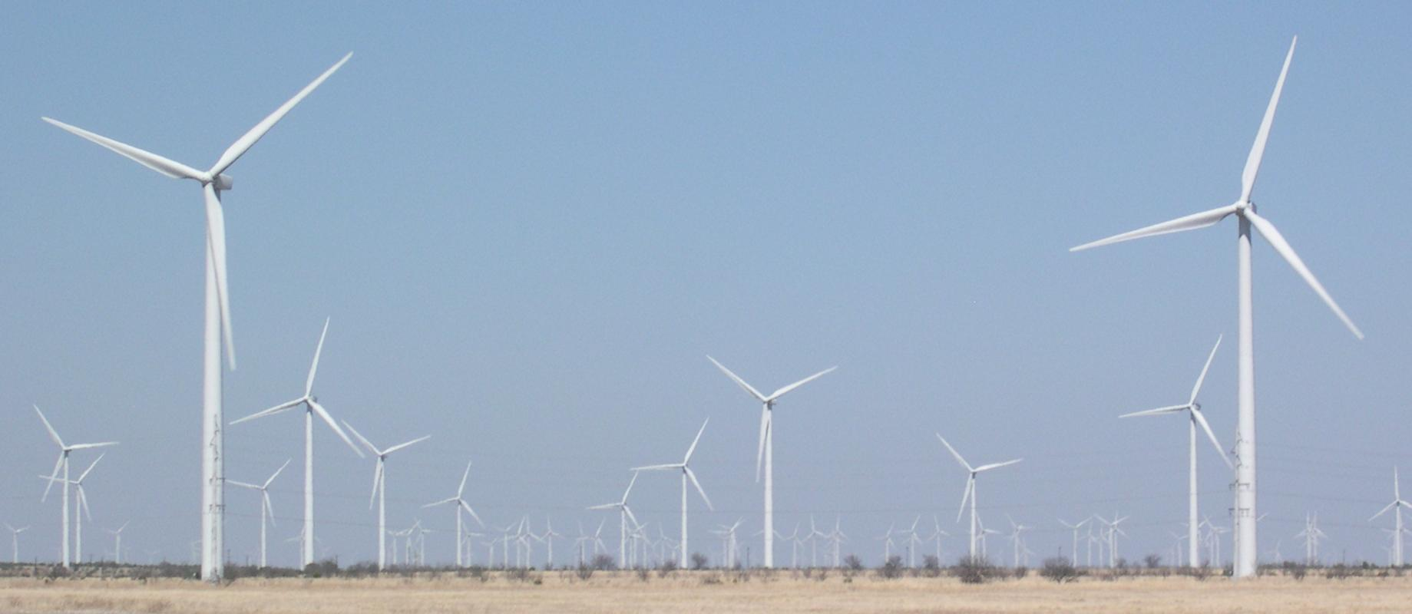
Wind Energy

Slide 12
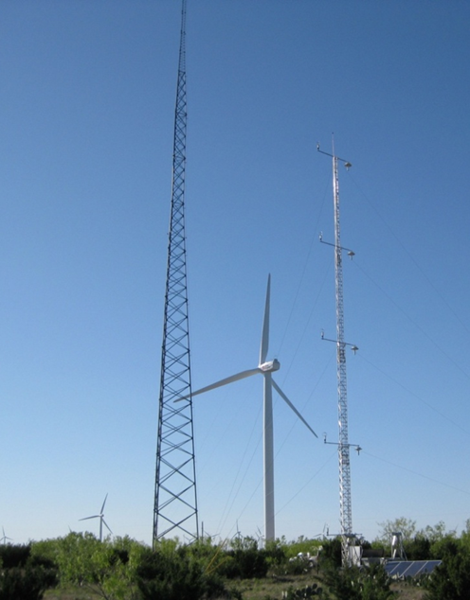
Current Approaches
Field studies
Cooperative Research and Development Agreement (CRADA) with Duke Energy Generation
Wind Forecast Improvement Project (WFIP 1 & 2)
Modeling
Flux-gradient wind profile algorithms
Surface fluxes of radiation, sensible heat, latent heat, soil heat (energy balance)
Notes:
As an outcome of discussions between Duke Energy Generation and NOAA/ATDD following the 2009 AMS Summer Community Meeting , August, 2009 in Norman Oklahoma, ARL and Duke Energy Generation (Duke) signed a Cooperative Research and Development Agreement (CRADA) which allowed ARL/ATDD to conduct atmospheric boundary layer (ABL) research using Duke Energy Generation renewable energy sites as research testbeds. The proposed ARL research was directed towards evaluation of flux-gradient wind profile algorithms based on Monin-Obkhov (M-O) similarity theory to provide a more physics based forecast of hub-height winds. Duke Energy proposed evaluation of the proposed flux gradient algorithms within the scope of Duke’s current renewable energy load management practices and provide an assessment of the economic impact of any flux-gradient enhanced forecasts. While the design of this research was direct support for the renewable energy industry, the focus is on the same fundamental ABL atmospheric processes applied to a wide range of applications and environments.
For the NOAA/Duke Energy CRADA, ARL’s PBL research is focused on improved PBL parameterizations schemes through identification of representative input parameters for PBL modeling schemes as well as defining the level of uncertainty associated with the various techniques. ARL’s research within the scope of the NOAA/Duke Energy CRADA is aimed at four basic science questions:
(1) Can the prediction of wind turbine hub-height wind speeds be improved through inclusion of near-neutral and unstable flux-gradient wind modeling techniques?
(2) What is the uncertainty associated with high resolution WRF mesoscale in both now-cast and forecast of winds at 10m and hub-height?
(3) Does assimilation of surface energy flux measurements and parameterizations (heat flux, shear stress, surface roughness, displacement height, and mixed layer height) improve mesoscale forecasts through mesoscale model land surface exchange methodology or data assimilation?
(4) What is the impact of spatial variability in surface energy-balance on predicted gradient winds at 10m and hub-height?
The field research station was installed by ARL/ATDD in support of the NOAA/Duke CRADA , located on Duke Energy’s Ocotillo Wind Farm. The Ocotillo Wind Farm is located approximately 10 miles southeast of Big Spring, Texas. ARL/ATDD’s research tower is located at the southern limits of the Ocotillo property in close proximity to the Ocotillo PMM27-28 site 80m operational meteorological tower.
The outcome of the research has been the development of a site-specific probabilistic forecast based on NCEP’s NAM12 forecast product.
On the Micrometeorology of the Southern Great Plains 1: Legacy Relationships Revisited
Author(s): Hicks, B. B.; Pendergrass, W. R., III; Vogel, C. A.; et al.
Source: Boundary-Layer Meteorology Volume: 151 Issue: 3 Pages: 389-405 Published: JUN 2014
DOI: 10.1007/s10546-013-9902-2
On the Micrometeorology of the Southern Great Plains. 2: Turbulence Statistics
Author(s): Hicks, Bruce B.; Pendergrass, W. R., III; Vogel, C. A.; et al.
Source: Boundary-Layer Meteorology Volume: 154 Issue: 3 Pages: 351-366 Published: MAR 2015
DOI: 10.1007/s10546-014-9981-8

Slide 13
Accomplishments
Duke Energy Generation CRADA field deployment May 2010-Oct. 2013
Ocotillo Wind Farm near Big Spring, TX
Two journal articles
Developing a hub-height wind forecast based on flux gradient wind profile theory
WFIP1 field deployment Sept. 2011-Sept. 2012
Upper Great Plains and Texas
Reduction (12% for forecast hour 1 to 5% for forecast hour 12) in predicted electrical power RMSE
Improvement in numerical weather prediction models
Assimilation of new observations
Data-denial experiments demonstrate up to 6% improvement came from new observations
WFIP2 field deployment Sept. 2015 to present
Columbia River Gorge wind farm area

Slide 14
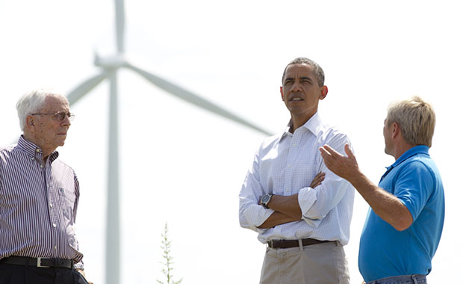
Relevance and Performance
President Obama’s goal is to double wind energy generation by 2025
Includes more predictable and efficient generation by existing installations
Duke Energy Generation
CRADA was renewed
for 3 years

Slide 15
Key Scientific & Technical Challenges
Funding is temporary
Our slice is relatively small
Supports 1 post-doc
Large and diverse body of collaborators
Managed outside of ARL
Difficult to find WRF modeler with knowledge of surface layer theory

Slide 16
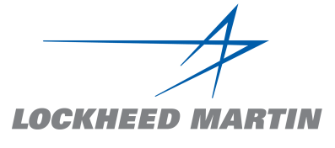
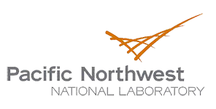
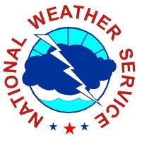
Collaborators
MetCorps

Slide 17
Poster Presentations
ARL Tracer Technology and Observational Dispersion Research
Rick Eckman
Project Sagebrush
Dennis Finn
ARLFRD’s Role in the Wind Forecast Improvement Project 2
Matt Brewer
Cooperative Research and Development Agreement with Duke Energy Generation: A Public-Private Partnership
Will Pendergrass

Slide 18
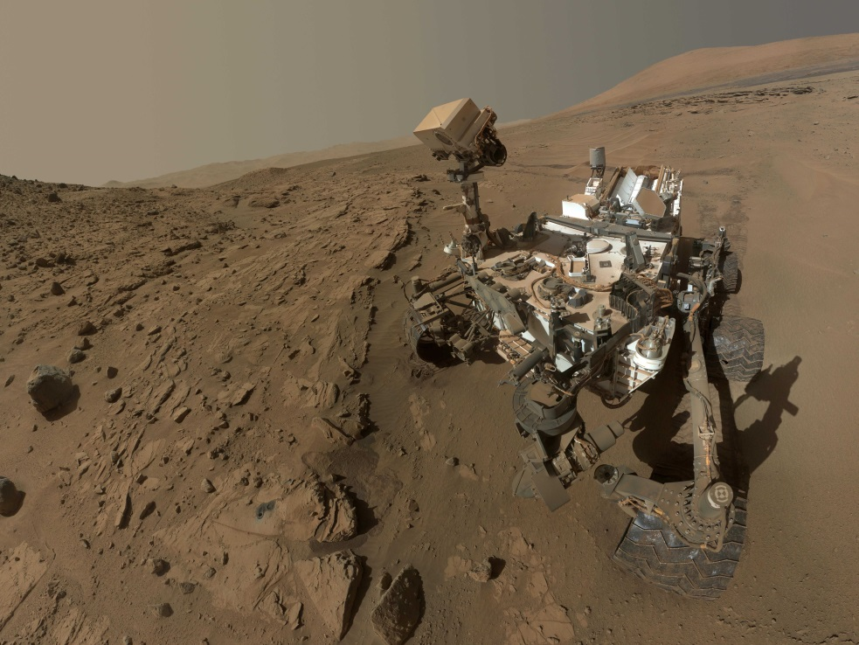
Future Directions
Continue series of Project Sagebrush experiments
Continue data rescue
Complete Duke Energy Generation CRADA
Develop flux-gradient wind profile forecast algorithm
Complete WFIP2
End of field study
Wind forecast model
improvement
Improved understanding of winds
in complex terrain
Collaborate on Mars methane
dispersion study

Slide 19
Questions?

