Slide 1
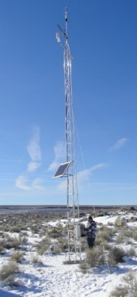
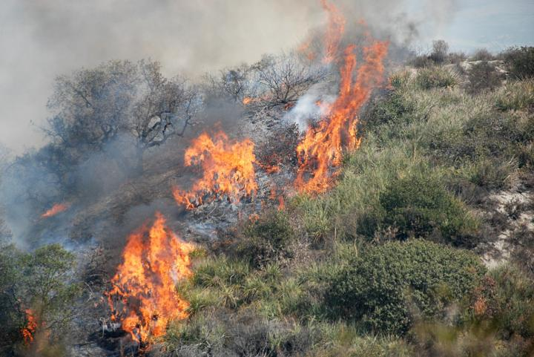
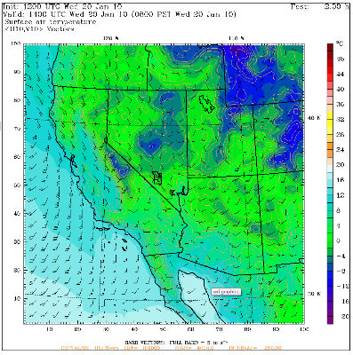
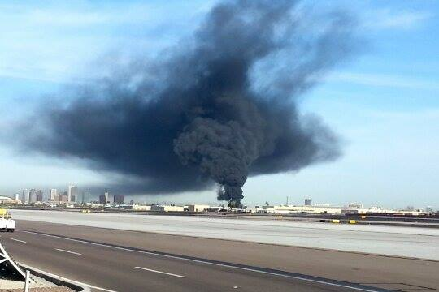
Specialized Meteorological and Dispersion Support
Walt Schalk
Air Resources Laboratory
June 21, 2016
Notes:
Good Morning,
I am Walt Schalk from the ARL Division in Las Vegas, NV.
So far, you have started to hear about several ARL research topics on dispersion. And you will hear more, later, as well.
However, my topic is a little different…. (variation on a similar theme)….
I will be talking about ARL’s specialized dispersion and meteorology activities. An interest thing is that some of these activities can have immediate and life-saving impacts.
But First, I am going to take a side step to give a little background/context…

Slide 2
The Research Flow
R2A
Research To Application
Research
Application
Notes:
During the preparation for this review, we received data calls for “Research to Application” topics and work that has been completed. While this is an important part of what we do as ARL…..

Slide 3
The Research Flow
R2A
Research To Application
Research
Application
Only half of the equation ! ! !
Notes:
It is only half of the equation, a one way street,
The other equally important half is….

Slide 4
The Research Flow
R2A
Research To Application
Research
Application
Feedback To
Research
Notes:
Feedback to Research…
You have to get information, data, and input to decide what work needs improving and research

Slide 5
Research and Application
R2A
Research To Application
Research
Application
Feedback To
Research
Notes:
A lot of the time, these two pieces, research and application, are performed in separate bubbles (or clouds here), and
It becomes difficult to get the feedback, the information, data, and input back to the research side, but a unique thing about ARL is…

Slide 6
The ARL Advantage
ARL
R2A
Research To Application
Research
Application
Feedback To
Research
Notes:
We have both parts of the equation in “one” organization.
We have developers and modelers “next to” users –
Which then allows feedback to flow from application to research and then from
Research back to application

Slide 7
The ARL Research / Feedback Loop
ARL Services
(Application)
Notes:
So, how does this work in the ARL world…..
Using the “tools” we currently have, we provide models, information, data, and expertise. This can be to other parts of ARL, OAR, NOAA, Federal Agencies, or others.
(I would like to focus on the ARL Services piece of this cycle.)

Slide 8
ARL is sought after
…for expertise and services
Notes:
So, how does this play out in the ARL world?
A variety of customers (other Federal agencies, international agencies, universities) seek out ARL dispersion and meteorology expertise and services.
These include the Department of Energy and the associated National Nuclear Security Administration. The two primary DOE sites that work with ARL are the Idaho National Laboratory near Idaho Falls, ID and the Nevada National Security Site near Las Vegas, NV
Other Agencies and Institutions include:
Department of Defense – Defense Threat Reduction Agency
Environmental Protection Agency
Department of Homeland Security
NASA
World Meteorological Organization
Duke Power
Southern Methodist University
And others that will be discussed during the next two days.

Slide 9
Services Provide to DOE
Meteorological Data Collection
Meteorological Data Analysis
Mesoscale Weather Forecast modeling
Meteorological Surveillance & Forecasting
Consequence Assessment
Experimental Support
Air Quality Modeling – permitting
Notes:
The primary ARL service provided to the DOE is to manage and operate a meteorology program for the Idaho and Nevada sites. These programs have been in existence since 1949 and 1956. These programs include:
Meteorological Data Collection
Meteorological Data Analysis
Mesoscale Weather Forecast Modeling
Meteorological Surveillance and Forecasting
Consequence Assessment
Specialized Experiment Support
Air Quality Modeling

Slide 10
Meteorological Data Collection
ARL operates and maintains mesonets (a network of weather stations designed to observe meteorological phenomena) to characterize the atmospheric boundary layer of complex meteorological flows.
Data collected are:
Wind Speed
Temperature
Pressure
Solar radiation
Lightning Strikes
Wind Direction
Humidity
Precipitation
Flux data
Upper air data
Provides the foundation for the services.
Notes:
What we do…
We operate and maintain weather data collection mesonets to characterize the atmospheric boundary layer of complex meteorological flows. This includes systems that measure the standard set of parameters (temperature, humidity, pressure, precipitation, wind speed and direction, with solar radiation and lightning strike data in some locations)
Meteorological Data Collection
Examples shown here include the Field Research Division mesonet in Idaho, the Special Operations and Research Division mesonet in Nevada, and the Atmospheric Turbulence and Diffusion Division mesonet in Washington, DC. Also shown are examples of some of the instrumentation in these networks including meteorological towers, sodar, and radiosonde balloons.
Products…
Graphical displays of weather data; surface, upper air, and precipitation
Importance…
These data are the foundation for the services provided to the DOE. They provide the input/basis for dispersion work.
There will be a poster that will go into more detail about this activity.

Slide 11
Meteorological Data Analysis
Data are:
Quality checked and assured
Archived
Analyzed
Products:
Site Climatology Reports
Site Environmental Reports (Annual and Impact Statements)
State and Federal Compliance Requirements
Project, Experiment, and Site Planning
Importance:
The use of real data for the:
Safe development and operation of testing and experimental facilities
Safety of workers, environment, populations, and property
Notes:
Meteorological Data Analysis
Shown here are examples of Climatological and Site Environmental Reports from FRD and SORD on the left. On the right are examples of State and Federal environmental compliance requirements that require meteorological data.
What we do…
After data are collected, they are processed, quality checked and assured, and archived. These data are analyzed in many different ways depending on the customer’s requirements. But some of the more routine
Products…
Include
Reports (wind, precipitation, and temperatures) to plan activities and experiments on the sites
Used in engineering designs for facilities and outdoor structures
Annual site environmental reports
Site environmental impact statements
Environmental compliance requirements both State and federal and can include
Precipitation events (run off, ground water)
NESHAPS – National Emissions Standards for Hazardous Air Pollutants
Importance
Maintain the safe development, operation of testing and experimental facilities, environmental restoration, and the safety of workers, environment, off-site populations, and property.

Slide 12
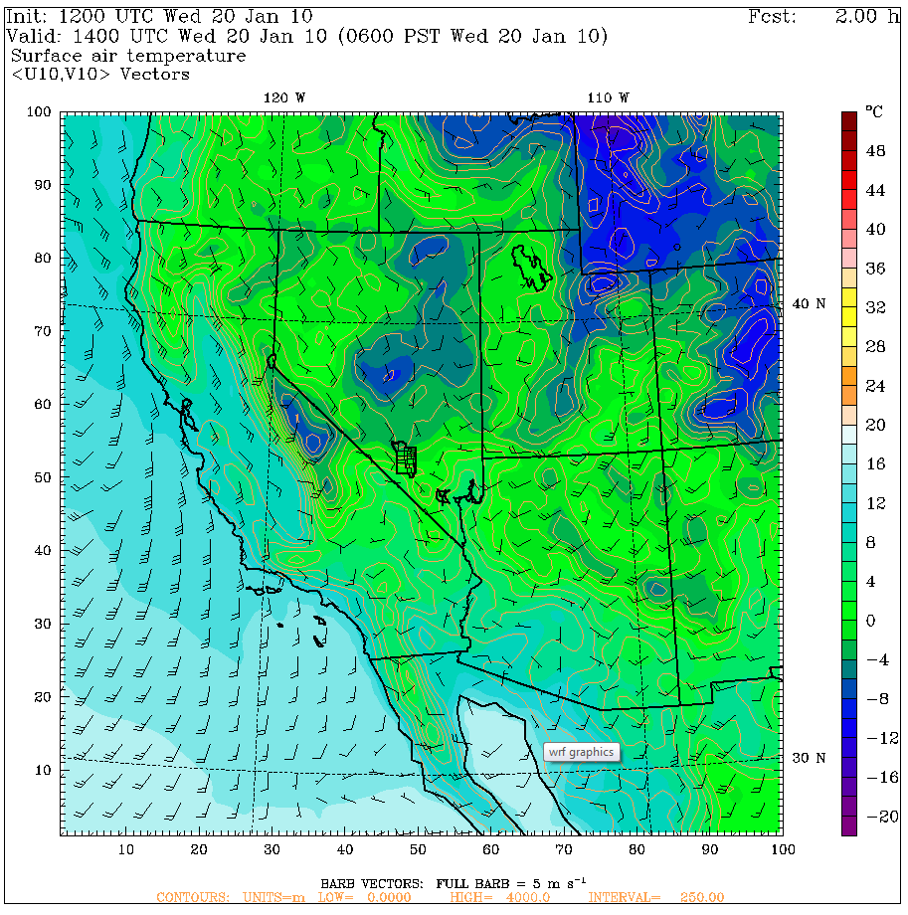
Mesoscale Weather Forecast Modeling
ARL conducts local mesoscale modeling
Results are used for:
Site forecasting for operations and planning
Crane work
Digging
Explosive handling
Site flight operations
Fire weather
Wind fields for dispersion models
Notes:
What we do…
The Divisions conduct local mesoscale weather forecast modeling work focusing on their particular regions and in some cases incorporate their local mesonet data.
Mesoscale Weather Forecast Modeling
Examples of local mesoscale weather forecast model products from across the Lab are shown here.
Products…
Graphical and text output of weather parameters
Importance…
These results and products are used to provide information for our partners for
Daily forecasting
Wind fields to drive dispersion models
Input for site flight operations
Planning of weather sensitive activities (i.e. crane work, digging, explosives handling)

Slide 13
Meteorological Surveillance & Forecasting
Mesonet data are used in near real-time for:
Site and event specific forecasts for operations
Surveillance for severe weather, including:
High winds
Lightning/Thunderstorms
Flooding
Winter storms
Important for site worker and facility safety and project planning
Notes:
Meteorological Surveillance and Forecasting
Shown here are examples of daily forecasts and significant/severe weather statements for specific DOE and NNSA sites by FRD and SORD.
What we do…
The mesonet data are analyzed and used in near real time for:
Products…
Site specific weather forecasts for daily operational impacts
Site wide twice daily
Location/event specific
Precipitation data for compliance reporting (over an ½”)
Weather surveillance
Issue site specific severe weather statements that include
High winds
Lightning
Extreme temperatures
Winter weather
Potential flooding events
Importance
For site worker and facility safety, and daily project planning
FRD wind forecasts were essential in the inflation and deflation of a large fabric dome structure. Wind speeds were a critical component of success.
Wildfire Prevention at the NNSS - During wildland fire season, we work closely with the fire department of the site. When thunderstorms are forecast, we communicate closely and fire teams are dispatched to the field and our lightning detection data are watched and when strikes occur, fire teams inspect the area to check for smoldering areas and douse them before they become an issue. This has worked well for several seasons now.

Slide 14
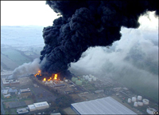
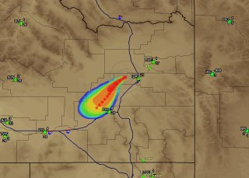
Consequence Assessment
Mesonet data are used in near real-time to run dispersion models.
ARL scientists provide dispersion expertise to Emergency
Responders and/Managers.
Critical for site worker and public safety.
June 21-23, 2016
14
Notes:
Consequence Assessment
ARL uses the data collected to run dispersion models and provide expertise to assist Emergency Responders/Managers during airborne hazardous material releases.
This slide shows the four basic steps of an event
something happens (i.e. a vehicle accident, a lightning strike, etc..)
turns into something bigger and more dangerous
information is collected about the event (i.e. weather data, source information)
dispersion models are run to calculate potential areas of contamination and provided to emergency responders.
Steps three and four are repeated as new and additional information are learned, which can be helpful to better quantify the event.
There will be a poster that will go into more detail about this activity.

Slide 15
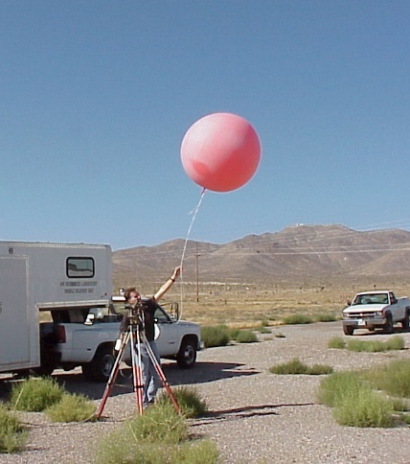
Experimental Support
DOE and NNSA conduct unique experiments.
Each experiment has different requirements:
Where will an explosive cloud travel?, or
How is the atmosphere affected?
ARL works with DOE to identify the unique meteorological requirements:
Forecasts
Go/no-go criteria (winds, lightning)
Data (surface, upper-air, both?)
Key is for safe experiment preparation, execution,
and data collection.
Notes:
Specialized Experiment Support
DOE, NNSA, other agencies, and companies conduct experiments on the DOE sites. Some at the NNSS involve explosives of varying degree both above and below ground. The specific wants and needs of a customer also differ, from where will the cloud go, to how is the atmosphere affected.
What we do..
We work with each individual customer to determine their specific meteorological needs and tailor a program unique to their experiment.
Products
The unique program may include locating a surface weather station near to the event, planning for the release of radiosonde balloons, obtaining go/no-go criteria, and detailed forecasting to the very specific area of the experiment.
At SORD, we have been working with scientists from the DOE National Laboratories on experiments at the NNSS. They have very specific needs in terms of wind speed requirements for both experiment set-up and for execution. Our forecasts are an important part of their daily operations and work plan. Other factors, such as lightning, are also a very important part of their experiments success and safety and are built in to the program developed for them.
Importance
Safe set-up of the experiment as well as the safe execution of the experiment. Worker and environmental safety. Meet or exceed experiment objectives that may have an impact on national security experiments.

Slide 16
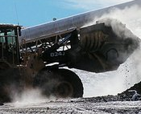
Air Quality Modeling
ARL conducts air quality modeling for DOE site activities to support State and Federal Regulatory Requirements.
Activities include:
Digging (PM10)
Emissions (NOx, SOx, COx, Ozone)
Explosions
Hazardous Chemical Spills
Notes:
Air Quality Modeling
At the NNSS, there are many emission sources scattered across the reservation. In addition, the NNSS also has a unique capability to safely “spill” some fairly dangerous substances and study it’s dispersion, effects, etc. As such, the DOE is required to obtain and maintain air quality permits.
What we do…
Work with the site environmental group, use their list of sources, incorporate our mesonet data and run the AERMOD air quality model for regulatory applications.
Products…
Model results document submitted to environmental group to be included as part of the permit application/renewal to the State of Nevada. Modeling is used to calculate potential off-site estimates where air quality standards are exceeded for ozone, for CO2, SO2, NO2, and PM10.
Importance
To maintain worker and site safety, to obtain and maintain permits allowing experimental and support work to continue on the site. Activities on the site should not contribute to (exceed standards) off-site air quality.

Slide 17
Additional Applications
Specialized HYSPLIT Assessments
Japan (March 2011) Fukushima Daiichi
Flow patterns
Time of arrival
Material spread
Deposition
Notes:
Just prior to the last program review in May 2011, the major Fukushima Daiichi event occurred in March. Quite a lot of work was done in near real time to model the initial and subsequent releases that occurred over the months that followed. Several Federal agencies requested products and information. Some of the information requested included:
flow patterns
time of arrival (to the US)
material spread
deposition on the water

Slide 18
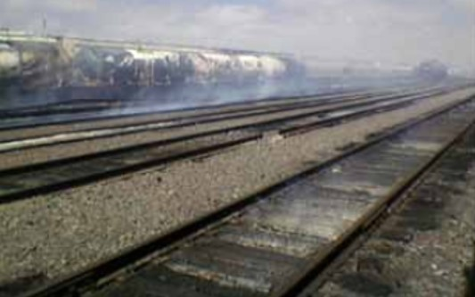
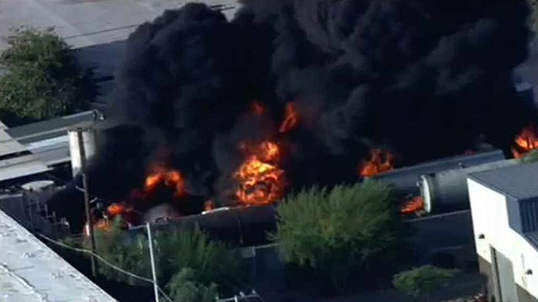
Additional Applications
Specialized HYSPLIT Assessments
Phoenix, AZ (Apr 2014)
NWS
Rail Oil Tanker Car Fire
Amarillo, TX (Oct 2011)
NWS
Isopentane and molten Sulphur
Notes:
The HYSPLIT model is accessible by the National Weather Service Weather Forecast Offices. Numerous events take place every year where HYSPLIT is used to support local city emergency responders through the NWS WFOs.
For these events, HYSPLIT is run through the Weather Service Senior Duty Meteorologist at the National Centers for Environmental Prediction (NCEP). ARL provides reach back dispersion expertise if needed.
I wanted to highlight a couple events that I came across that generated some local evacuations.
Isopentane and molten Sulphur in Amarillo, TX (October 2011)
Oil tanker railcar fire in Phoenix, AZ (April 2014)

Slide 19
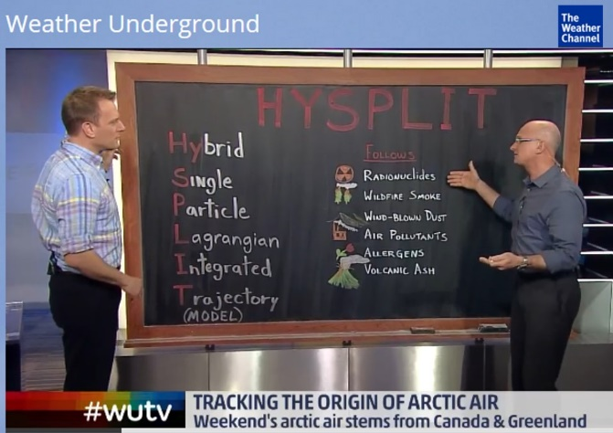
Additional Applications
Specialized HYSPLIT Assessments
Weather Channel (Feb 2016)
Back Trajectories of Cold Air push into NE storm
Other Applications
INSRP – Interagency Nuclear Safety Review Panel
ARL participates in the pre-launch preparation and the launch process of a radiologically powered spacecraft.
Notes:
Something I witnessed this past February. We will have the weather channel on in our Weather Operations Center to keep up on what is happening nationally. I happened to be in the Center and I looked up to see the Weather Channel using the HYSPLIT back trajectory capability to identify the origins of the cold air that flowed into one of the big storms in the Northeast.

Slide 20
The ARL Research / Feedback Loop
ARL Services
(Application)

Slide 21
The ARL Research / Feedback Loop
ARL Services
(Application)
Lessons Learned, Data, Experience
Notes:
From this work, we gain experience with the tools and on the information provided and develop lesson learned.

Slide 22
The ARL Research / Feedback Loop
ARL Services
(Application)
Lessons Learned, Data, Experience
ARL
Dispersion
Research
Notes:
This information is then shared with the ARL research groups.
From all the information about the services and work we do (with others), we take that information, that data, the experience gained, and the lessons learned and pass that along to the ARL researchers

Slide 23
The ARL Research / Feedback Loop
ARL Services
(Application)
Lessons Learned, Data, Experience
Improved
models
Improved
tools
ARL
Dispersion
Research
Notes:
From this, models and other tools are improved and developed.

Slide 24
The ARL Research / Feedback Loop
ARL Services
(Application)
Increased
Expertise &
Knowledge
Expanded
applications
Lessons Learned, Data, Experience
Improved
models
Improved
tools
ARL
Dispersion
Research
Notes:
These are then fed back to those providing services, which now have increased experience and have expanded application.
And this cycle continues and results in continued improvements and new tools/models.
So, this is the Research to Application Loop for ARL

Slide 25
Summary: QRP
Quality Indicator | Quality Indicator
Contributions of Data | Technical and Science Societies/ Organizations
Mesonets and sensor networks | DOE Emergency Management Issues – Special Interest Groups (EMI-SIG)
Data are made available to: NCEP Meteorological Assimilation Data Ingest System (MADIS), Western Regional Climate Center (WRCC) | DOE Meteorological Coordinating Council (DMCC) Leadership – Chairman Participating Members Subcommittee on Consequence Assessment and Protective Actions (SCAPA) - Participating Members

Slide 26
Summary: QRP
Relevance Indicator
NOAA Mission
Understand and predict changes in weather and climate | Share Knowledge and Information with Others
Services to DOE: Data Collection Data Analyses Mesoscale Modeling Surveillance and Forecasting | - Services to DOE - Collaborations:

Slide 27
Summary: QRP
Relevance Indicator
NOAA Strategic Plan
Climate Adaptation and Mitigation | Weather Ready Nation
ARL Scientists working with DOE to identify relevant areas of concern. | FRD worked with local NWS to get the Idaho National Laboratory Weather Ready. SORD working with local NWS to get the Nevada National Security Site Weather Ready.

Slide 28
Summary: QRP
Performance Indicator
Quality Indicator | Relevance Indicator
Collaborations | Customer Survey and Interviews - Stakeholders
Federal Agencies, International Agencies, Universities, Industry | Continues to be effective and critical for safe conduct of operations at DOE Sites. Over a 60 year history of inter-agency cooperation (Inter-Agency Agreements, MOUs, MOAs).

Slide 29
Summary: QRP
Quality Indicator - Technologies Transferred w/ Impact
Relevance Indicator – Products, Services, and Assessments
Performance Indicator – Transitions: R2A
Mesonets, sensor networks, data analyzes, and CA/AQ modeling | HYSPLIT | READY | HYRad
Critical to Site Ops - planning, - written into Site Plans, - Go/No-Go and Stop Work decisions, - Federal and State Environmental Compliance | Reviewed and Approved and added to the SCAPA Toolbox for DOE Dispersion/ Consequence Assessment Models. | Japan: Fukushima Numerous NWS WFO Responses Weather Channel back trajectories | Model and User Interface taken by Pacific Northwest National Laboratory to expand application to other DOE sites.

Slide 30
Future Direction
First
Continue to
Provide high quality, unique, and site specific data, expertise, and services to the DOE/NNSA
Support HYSPLIT’s use in specialized assessments
Provide lessons learned, experience, data, and needs into the ARL Research/Feedback Cycle
Improve models, applications, and services
Second
Look to new areas of research opportunities:
NOAA/DOE Renewable Energy activities
Fine scale wind analyses and predictions
Improve mesoscale models for the desert SW
Notes:
The future
Continue the services we provide to DOE and NNSA and the support for the uses of HYSPLIT
Continue to take the information, data, experience, and lessons learned and feed them back into ARL and NOAA Research and Development
Look to new areas of research opportunities in
Renewable energy activities
Fine scale wind analyses and predictions
New instrument platforms
Improve mesoscale models

Slide 31
Thank you !
Notes:
Thank you.
I would be happy to entertain any questions

