Slide 1
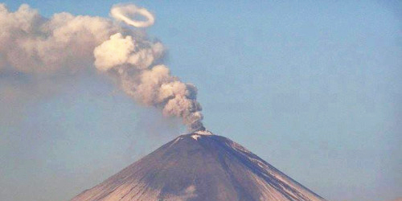
Atmospheric Dispersion and Boundary Layer Characterization
Improving prediction of the transport and fate of harmful airborne material
and understanding surface and near-surface weather and climate processes
Ariel Stein Air Resources Laboratory June 21, 2016
Notes:
It is an honor to have been assigned the responsibility of presenting an overview of ARL’s dispersion and boundary layer research programs. I would specially like to thank our acting director, Richard Artz, for his leadership and also for giving me the opportunity to give this presentation. I welcome our colleagues from OAR and other NOAA offices, our stake holders, other guests, and especially our reviewers. And to our reviewers I say that we sincerely appreciate the time and effort you have given thus far and look forward to receiving your comments and suggestions for improvement.

Slide 2
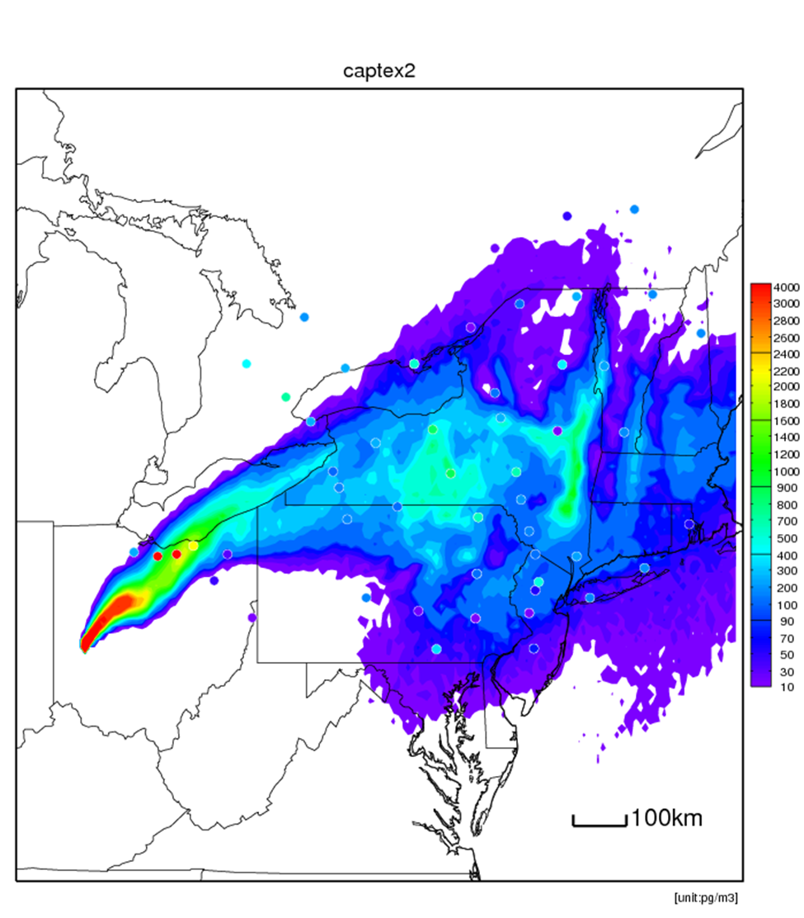
Background
65+ years of research experience
Conducted across all divisions of the Lab
Boundary Layer research is a natural outgrowth of dispersion research
Dispersion and Boundary Layer research are intertwined
Notes:
ARL’s dispersion and boundary layer research programs have the longest history in the laboratory (65+ years) and they are conducted across all the divisions of the laboratory. These programs serve as unifying themes across the laboratory. An understanding of dispersion meteorology requires a deep knowledge of boundary layer processes, since mostly we are interested in understanding and modeling dispersion within that portion of the atmosphere. Our emphasis on boundary layer meteorology is a natural outgrowth of our research in dispersion meteorology. The emphasis on boundary layer meteorological research is sufficient to warrant the creation of a strategic plan separate from that of dispersion meteorology. For the purposes of this review, we have combined the two fields of study since they are so very closely related.

Slide 3
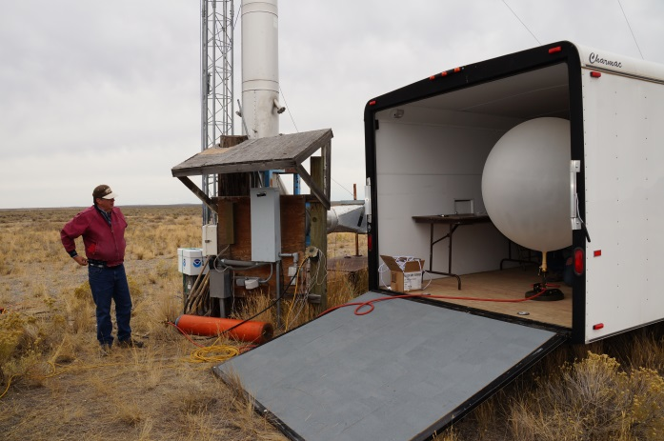
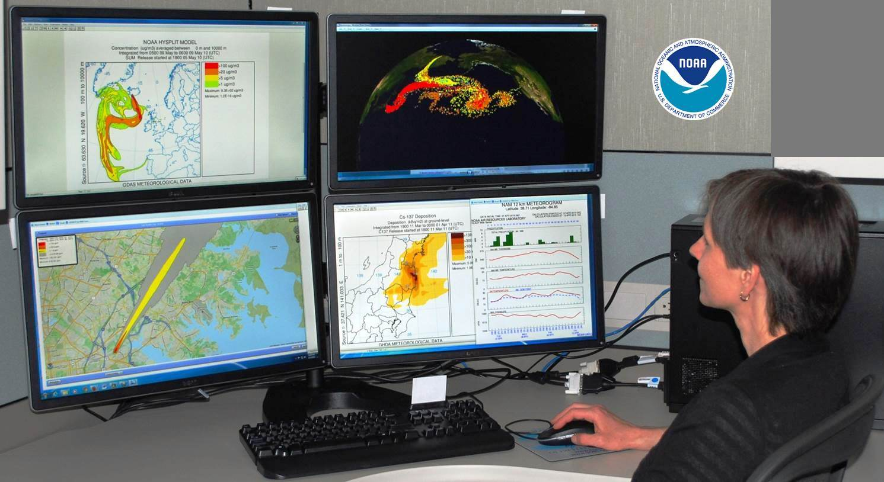
Mission
Provide the highest quality atmospheric and meteorological research and services to our partners, the research community, and society to protect human health and our environment
Goals
Improve the quality of atmospheric transport and dispersion predictions and assessments, including estimation of uncertainties
Improve our understanding and modeling of the structure of the Planetary Boundary Layer
Notes:
The dispersion program strategic plan defines the mission and goals of our research and development efforts. The mission is to provide the highest quality atmospheric and meteorological research and services to our partners, the research community, and society protecting human health and our environment. There are two goals associated with this mission. These are: 1) improve the quality of atmospheric transport and diffusion predictions and assessments, which includes the estimation of uncertainties, and 2) Improve our understanding and modeling of the structure of the Planetary Boundary Layer

Slide 4
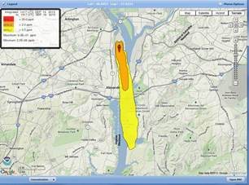
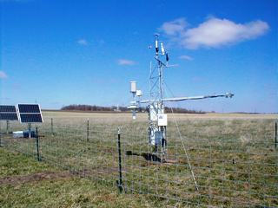
Dispersion and Boundary Layer R&D
Study the release, transport, and dispersion of harmful materials through the air.
Concentrate on acute events
Limited number of chemical transformations
Connection to emergency-type responses
Use state-of-the-art methods, techniques, and tools (and develop new ones as necessary) to better understand atmospheric boundary layer structure and processes in order to improve prediction of near-surface weather and climate conditions.
Notes:
To achieve our goals we develop research activities that focus on studying the release, transport, and dispersion of harmful materials through the air. Our emphasis is on acute events with limited number of chemical transformations connected to emergency-type responses.
In addition, we use state-of-the-art methods, techniques, and tools (and developing new ones as necessary) to better understand atmospheric boundary layer structure and processes in order to improve prediction of near-surface weather and climate conditions.

Slide 5
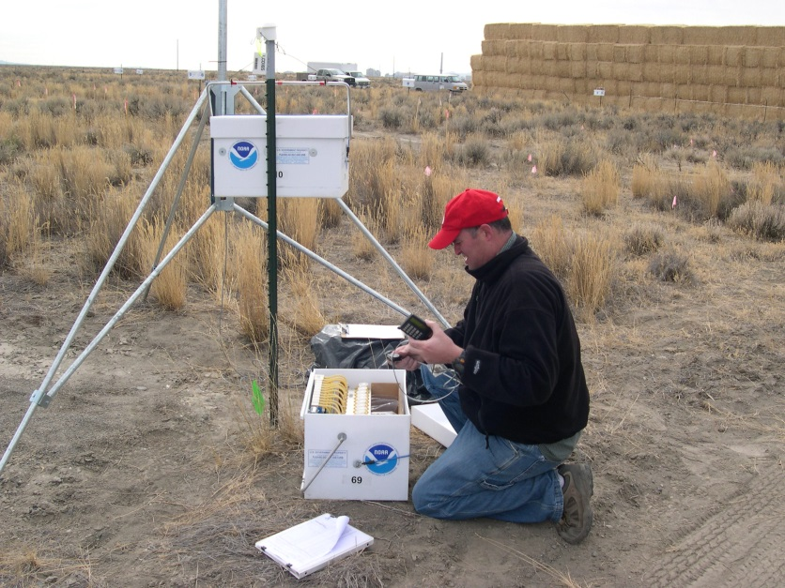
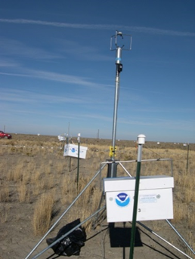
Dispersion
Research
Boundary Layer
Research
Tracer experiments
Meteorological and turbulence observations
Transport and Dispersion/Meteorological Modeling
Mesonets FRD, SORD, ATDD
Wind energy FRD
Boundary Layer Observations ATDD
Convective initiation ATDD
Wind flow in complex terrain ATDD, FRD
Dispersion/Meteorological model applications / site support
Meteorological and decision support services for DOE
SORD
Sagebrush experiment, FRD
Notes:
All the research performed under the Dispersion and Boundary Layer theme is interrelated.
One of the primary Dispersion research activities developed at ARL is Transport and Dispersion modeling: HYSPLIT model development in HQ. Used at all divisions. HYSPLIT for Radiological Applications (HyRad) from FRD.
Complementary, tracer experiments are used to understand the transport and dispersion processes in the real atmosphere and serve as ground truth for dispersion models: Sagebrush and tracer technologies FRD
On the other hand, Meteorological and Turbulence observations, such as those taken under the wind energy project at FRD, or the different mesonets at SORD, FRD, ATDD (mesonets are mesoscale meteorological monitoring networks),
Boundary layer observations ATDD, Convective Initiation ATDD, wind flow in complex terrain ATDD,FRD
are fundamental to gain insight of the meteorological phenomena that occur within the Boundary Layer and for the continuous improvement of meteorological and dispersion models.
The vast majority of the modeling and measurement research activities end up in Applications. Examples include the meteorological and decision support services that FRD and SORD provide for DOE

Slide 6
Dispersion
Research
Boundary Layer
Research
Dispersion/Meteorological model applications / site support
Notes:
In other words, our research gets readily transferred to a variety of applications. At the same time, these applications provide an opportunity to test our scientific understanding and give feedback for further improvements.

Slide 7
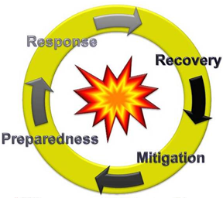
Drivers
The National Response Framework (NRF)
The Federal NRF Annexes, approved by the President in January, 2008, assigns NOAA Atmospheric Transport Dispersion prediction responsibilities for smoke and radioactive and hazardous materials.
NOAA’s Long-term goal of a “Weather-Ready Nation: Society is prepared for and responds to weather-related events” and objectives.
Reduced loss of life, property, and disruption from high-impact events
A more productive and efficient economy through environmental information relevant to key sectors of the U.S. economy.

Slide 8
Drivers
Long-term Inter-Agency Agreements between NOAA and Department of Energy (DOE)
MOU between NOAA and Federal Aviation Admin. (1988); International Civil Aviation Organization (ICAO); Letter of Agreement between NOAA and USGS (1993) network of Volcanic Ash Advisory Centers (VAAC)
MOA between U.S. Dep. of State and NOAA (2012) Comprehensive Test Ban Treaty Organization
MOU with the U.S. Nuclear Regulatory Commission (2015)
Notes:
The Long-term Inter-Agency Agreements between NOAA and DOE to provide support to the DOE’s Idaho National Laboratory and Nevada National Security Site for consequence assessments offers a unique framework that allows ARL to apply its modeling and measurement capabilities. Consequent assessment in this instance is defined as the process of identifying or evaluating the potential for or actual effects of a release of radioactive materials or harmful chemicals.
FRD: DOE Idaho Operations Office for the NOAA/INL Meteorological Research Partnership since 1949. MOA between OAR and DOE-ID (2012) Dispersion modeling and expert advice in an Emergency Operations Center setting; Dispersion mesonets
SORD: started as Weather Bureau Research Station (Department of Commerce) in 1956. MOA between OAR and DOE (2014) HYSPLIT for Radiation Applications (HYRAD); Mesoscale weather forecasting; data collection and analysis
In coordination with the International Civil Aviation Organization, we operate two of nine Volcanic Ash Advisory Centers that are responsible for coordination and dissemination of information on atmospheric volcanic ash clouds that may endanger aviation.
We coordinate with the World Meteorological Organization (WMO) to operate a Regional Specialized Meteorological Center to provide information to the International Atomic Energy Agency about expected transport of radiation and to the Comprehensive Test Ban Treaty Organization about possible source regions of clandestine nuclear and/or radiological releases. In 2012, NOAA signed an MOU with the Department of State to support operationally the CTBTO application.
We recently signed an MOU with the U.S. Nuclear Regulatory Commission (2015) to perform research related to atmospheric transport and dispersion of radiological contaminants.

Slide 9
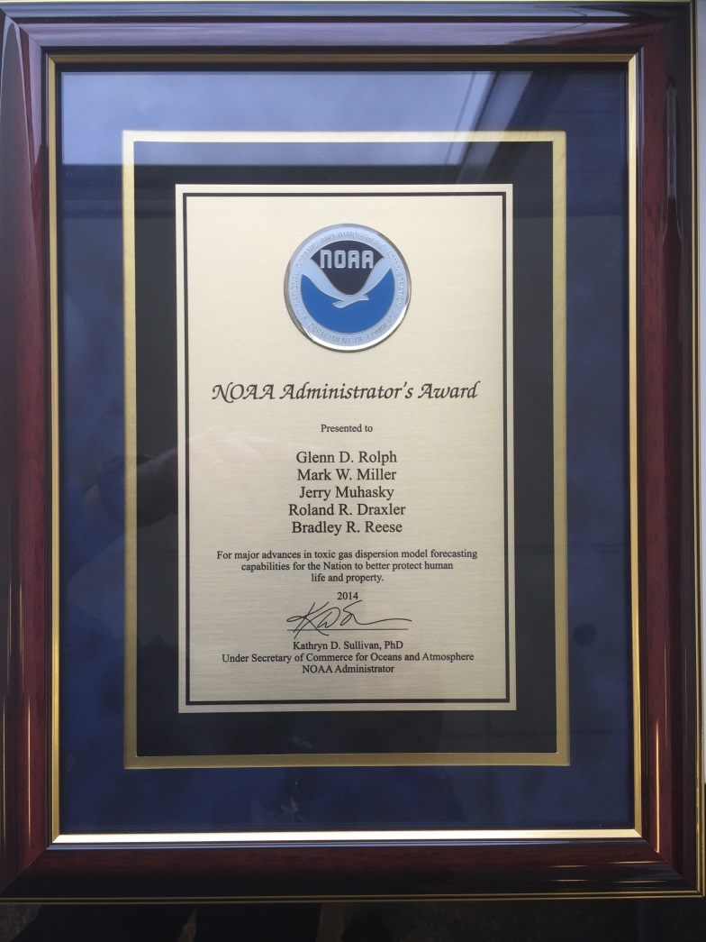
Quality: Awards
2012
NOAA Bronze medal award for work on Fukushima
2014
NOAA Administrator's Award for major advances in toxic gas dispersion model forecasting capabilities for the Nation to better protect human life and property
2016
Roland R. Draxler: Distinguished Career Award 2016. Scientific Achievement For significantly improving U.S. and international capabilities to respond to airborne hazards, including radionuclides, chemicals, and volcanic ash
Notes:
Our work has been recognized by NOAA with several awards. In this slide we show some of the most recent ones.

Slide 10
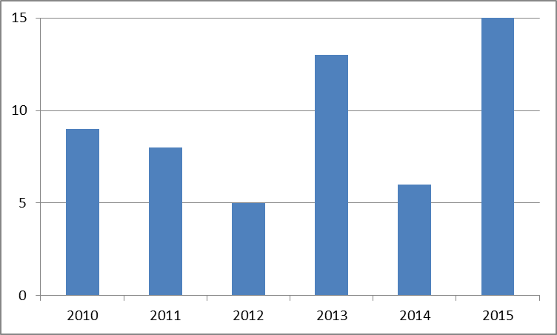
Quality: publications
Publications 2010 – 2015
Total = 56
Notes:
Our publication record reflects some of the new scientists that have joined the HYSPLIT development group over the last few years.

Slide 11
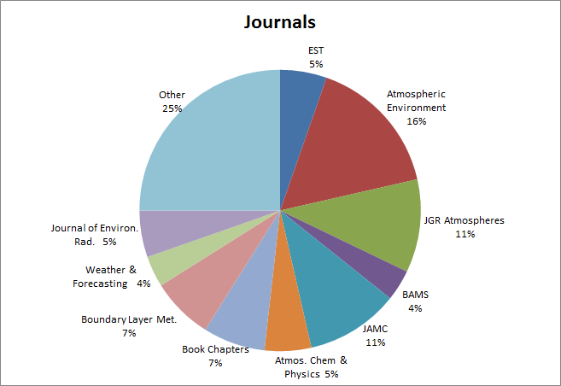
Quality: publications
Notes:
We publish in prestigious international journals such as JGR, Atmospheric Environment, etc.

Slide 12
Relevance
ARL consistently transitions dispersion model research products to NWS for operational emergency response
Thousands of HYSPLIT users in government, academia, private sector -- US and international
ARL operates one of the primary tracer experiment facilities in the nation for dispersion model development
ARL leads the World Meteorological Organization’s (WMO) international radiation modeling activities
HYSPLIT for Radiological Applications (HyRad) DOE’s Subcommittee on Consequence Assessment and Protective Actions (SCAPA)
Notes:
ARL consistently transitions dispersion model products from research to operations.
The HYSPLIT model counts with a user base of thousands of people and we are continuously expanding HYSPLIT usage in web, for PC, Mac, and linux environments.
On the other hand, ARL operates one of the primary tracer experiment facilities in the nation for dispersion model development.
ARL scientists actively participate and lead the WMO’s international radiation modeling activities within the context of the Regional Specialized Meteorological Center and the Comprehensive Test Ban Treaty Organization.
In addition, the HyRad model has been accepted as a tool for DOE’s Subcommittee on Consequence Assessment and Protective Actions (SCAPA)

Slide 13
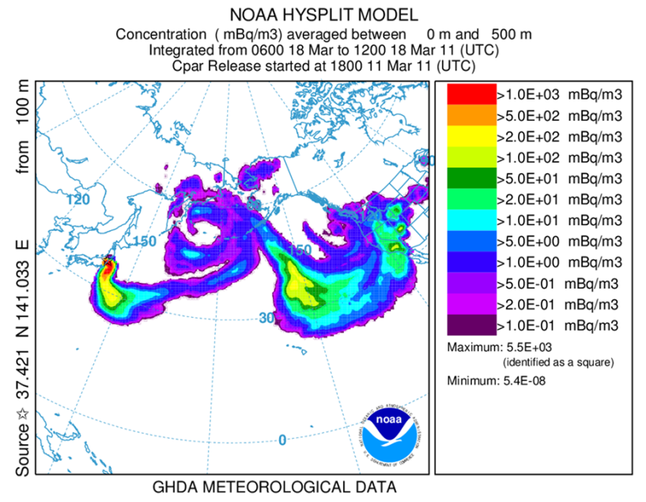
Performance
ARL is the developer of the HYSPLIT model
Produce operational and research grade dispersion products
HyRad released and being examined by Pacific Northwest National Laboratory to be converted into a version for use at DOE/Nevada Nuclear Security Administration (NNSA) sites.
Notes:
HYSPLIT, developed by ARL, is one of the most widely used models for atmospheric trajectory and dispersion calculations. HYSPLIT is a complete system for computing simple air parcel trajectories as well as complex transport, dispersion, chemical transformation, and deposition simulations. Some examples of its applications include tracking and forecasting the release of radioactive material, wildfire smoke, windblown dust , pollutants from various stationary and mobile emission sources, allergens and volcanic ash.
Our dispersion products are not only used for operational applications at the NWS but also by other US government agencies, academia, and private companies
For instance, HYSPLIT for radiation applications (HyRad) is going to be used by DOE for the Nevada Nuclear Security Administration.

Slide 14
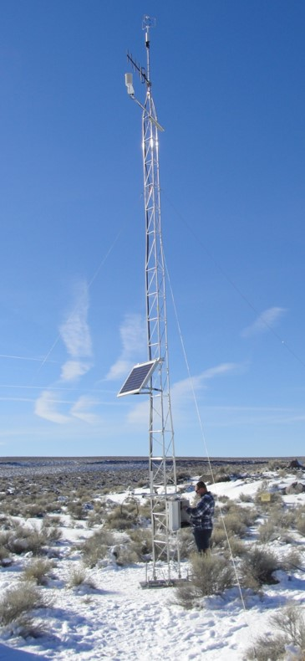
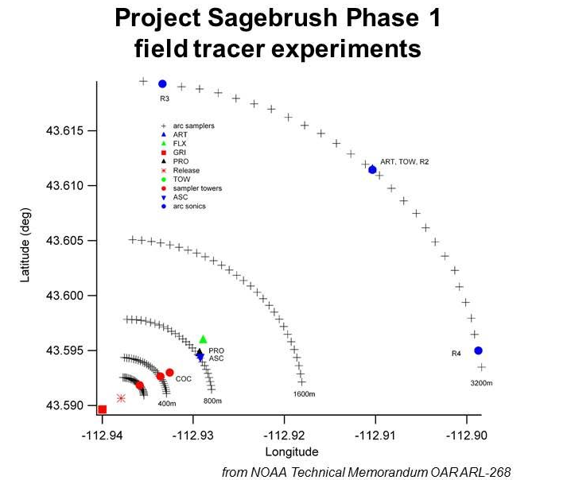
Performance
Complete replacement and upgrade of Nevada National Security Site (NNSS) mesonet
Lead Sagebrush tracer experiment
Notes:
Over the last few years SORD personnel have upgraded and completely replaced the Nevada National Security Site mesonet.
FRD lead the Sagebrush experiments, one of the most recent short-range tracer experiments.

Slide 15
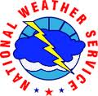
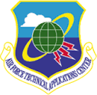
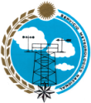
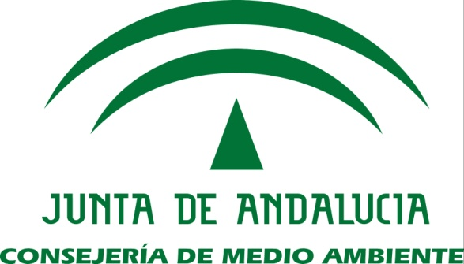
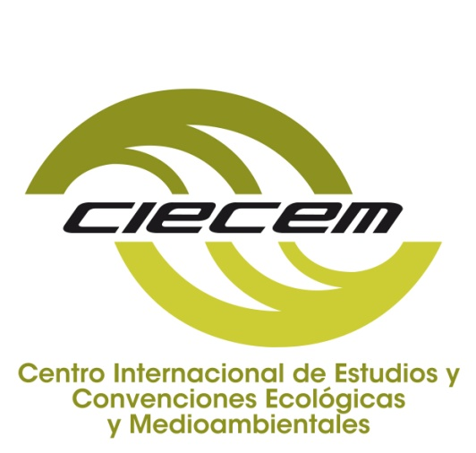
Performance: Collaborations
Notes:
To perform our work we rely on a network of collaborators. These partners help us develop our research. Many of them use our products and also give us feedback for further improvement.

Slide 16
Dispersion and Boundary Layer Research Presentations
Tracers and Wind Energy
Specialized Meteorological & Dispersion Support
Boundary Layer Measurements
Kirk Clawson
Walt Schalk
Bruce Baker
Special Convective Initiation Project
Tilden Mayer
Dispersion Modeling
Ariel Stein
HYSPLIT-ALOHA Model Demo
Glenn Rolph
10:30
10:55
11:20
11:45
12:10 Lunch
1:10
1:40
2:05 Q&A Session
Notes:
ARL will now present five talks and a demonstration that will further expand on the main topics that I just introduced.

Slide 17
D&BL E-Posters
Station # | Time | Title | Presenter
1 | 2:20 2:35 | Inverse Modeling with HYSPLIT Lagrangian Dispersion Model | Tianfeng Chai
1 | 2:50 3:05 | Gap Flows in the Birch Creek Valley, Idaho | Dennis Finn
1 | 3:20 3:35 | Project Sagebrush | Dennis Finn
2 | 2:20 2:35 | HYSPLIT research to NCEP operations | Barbara Stunder
2 | 2:50 3:05 | ARL/FRD’s Role in the Wind Forecast Improvement Project II | Matt Brewer
2 | 3:20 3:35 | Dispersion Ensembles | Ariel Stein
Notes:
In addition, ARL scientist will present 18 posters that will give you more details on the research and applications concerning Dispersion and BL. The subsequent presentations will introduce the posters that are relevant to their topics.

Slide 18
D&BL E-Posters
Station # | Time | Title | Presenter
3 | 2:20 2:35 | Inline Coupling of WRF-HYSPLIT: model development and evaluation | Fantine Ngan
3 | 2:50 3:05 | Numerical Simulations of Surface Flux Heterogeneity | Michael Buban
3 | 3:20 3:35 | Nuclear Emergency Support Applications | Glenn Rolph
4 | 2:20 2:35 | Volcanic Ash | Alice Crawford
4 | 2:50 3:05 | ARL Consequence Assessment – Emergency Response | Walt Schalk
4 | 3:20 3:35 | ARL Mesonets – Idaho and Nevada | Walt Schalk

Slide 19
D&BL E-Posters
Station # | Time | Title | Presenter
5 | 2:20 2:35 | Dispersion Modeling for Releases at Department of Energy Facilities | Rick Eckman
5 | 2:50 3:05 | ARL Tracer Technology and Observational Dispersion Research | Rick Eckman
5 | 3:20 3:35 | Using a small Unmanned Aircraft System (sUAS) for Atmospheric Research | Ed Dumas
6 | 2:20 2:35 | Cooperative Research and Development Agreement with Duke Energy Generation: a Public-Private Partnership | Will Pendergrass
6 | 2:50 3:05 | Observations of Convective Initiation over the Southeast US | Temple Lee
6 | 3:20 3:35 | Atmospheric Boundary Layer: Surface Layer Meteorology | Will Pendergrass

