Slide 1
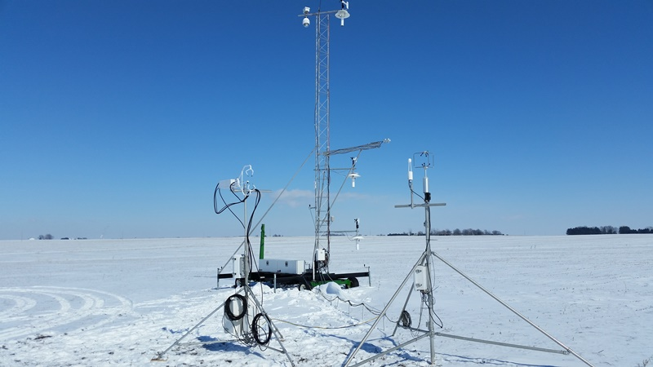
Climate Observations and Analyses
C. Bruce Baker, Director
NOAA/OAR/ARL/ATDD
June 22, 2016

Slide 2
Relevance
Goals
Improve the understanding and prediction of climate variability and change
Advance understanding and assessment of climate change through analysis and evaluation of atmospheric observations and models
Improve the quality of global climate observing system measurements of the atmosphere
Primary Activities
Reference observations
Atmosphere-land surface interactions
Climate variability and change analysis
Assessment of regional climate impacts

Slide 3
Performance: 2011-present
Led development of new international/national measurement approaches for measuring precipitation
69 Publications since last review
Widely recognized experts on soil moisture and soil temperature measurements in support of National Integrated Drought Information System (NIDIS)
Demonstrated the usefulness of using regional physics perturbations/ensembles as a better alternative for seasonal climate forecasts/outlooks
Stimulated efforts to improve/reconcile climate data records
Stimulated other investigations of stratospheric temperature change

Slide 4
Quality: Publications

Slide 5
Quality: Publications
2010-2015 ARL Climate Observations and Analyses Publications
Total = 69
Average = 12 per year

Slide 6
Understanding and Describing the Climate
requires a long-term commitment
to quality and stability
Many of the climate-related signals are small and obscured by natural variability.
There must be an active program of quality control and long term maintenance program to ensure the data are state-of-the-art and meet climate requirements.
Climate research and monitoring requires an integrated strategy of land/ocean/atmosphere observations, including both in situ and remote sensing platforms, and modeling and analysis.

Slide 7
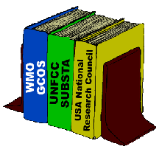
The Climate Observing System: What is needed?
Adherence to Ten Principles for surface-based observations
1. Management of Network Change 6. Historical Significance
2. Parallel Testing 7. Complementary Data
3. Metadata 8. Climate requirements
4. Data Quality and Continuity 9. Continuity of Purpose
5. Environmental Assessments 10. Data and Metadata Access
The international framework for sharing data is vital.

Slide 8
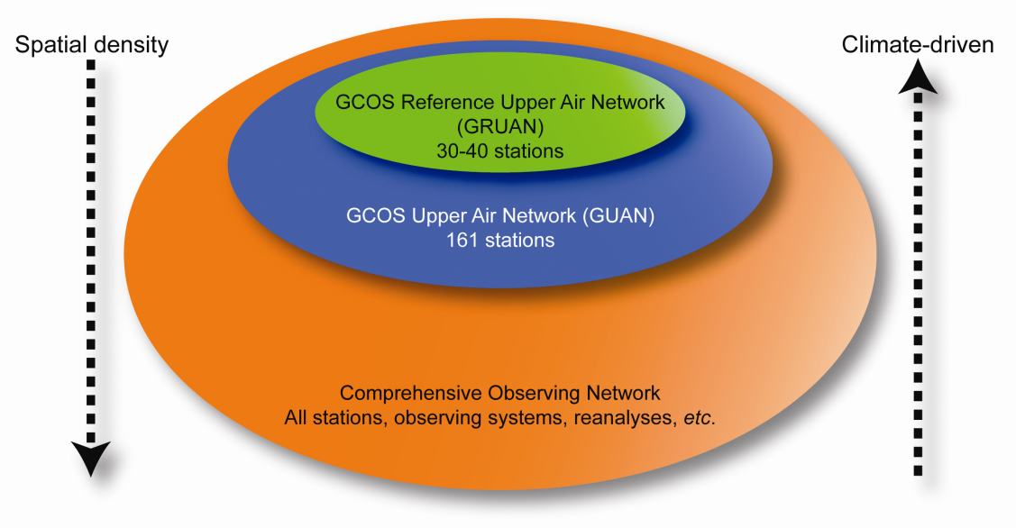
GCOS Reference Upper-Air Network (GRUAN)
Goal: Reference-quality in situ profile observations for long-term climate monitoring/ research and to support evaluation of satellites
ARL Roles
Providing scientific guidance
Development of network requirements
Future directions
Analysis of GRUAN observations
Notes:
Oversight and guidance of international Reference Upper-Air Observations from GRUAN. GRUAN has matured to become a functioning network that provides reference-quality observations to a community of users. Developed GRUAN manual, guide to operations and public availability first data product. First-ever reference upper air observations provides a basis for climate monitoring, validation of satellite observations, and climate process studies.

Slide 9
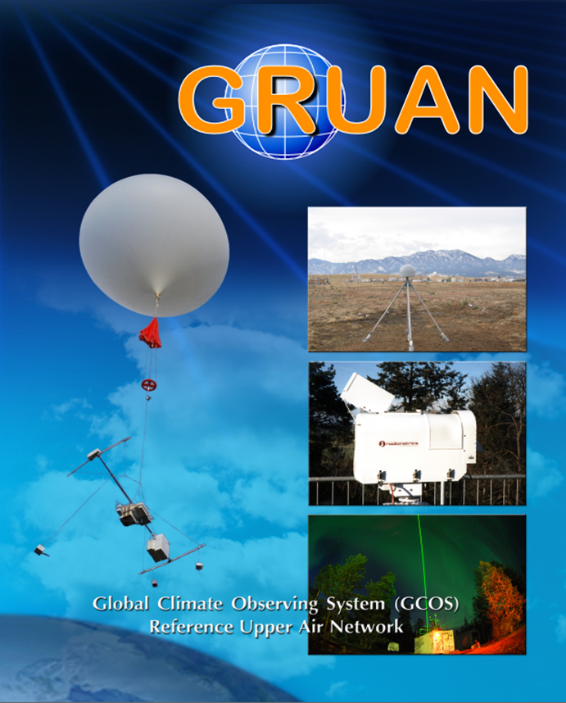
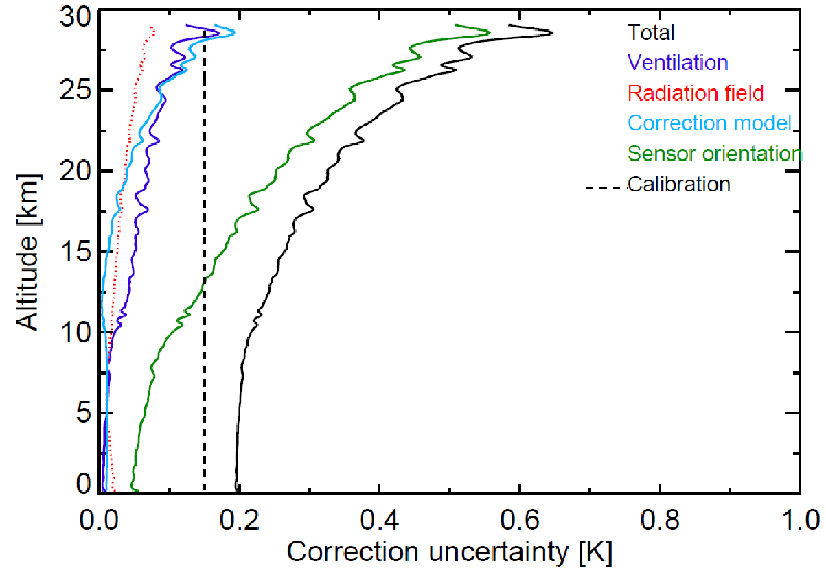
Contributions of various terms to the total uncertainty estimate of the GRUAN temperature correction for a sounding from Lindenberg on 27/09/2013. Complete characterization of uncertainty makes GRUAN data unique and reference quality.
Notes:
Part of the process to develop a high quality upper air data set included a detailed error analysis. To note here the sensor orientation is one of the largest errors.

Slide 10
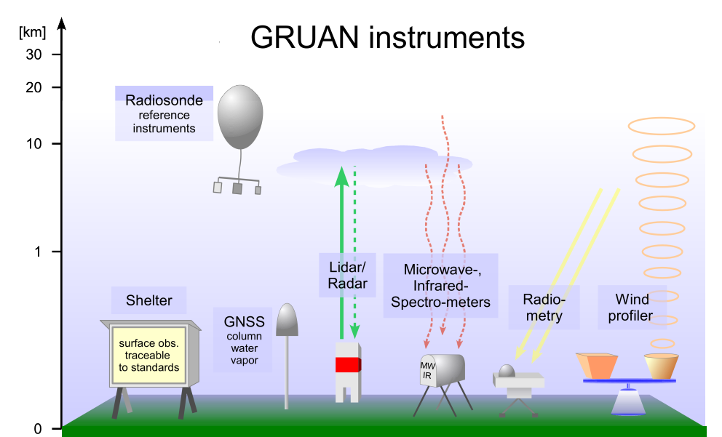
GRUAN Goals
Maintain observations over decades
Validation of satellite systems
Characterize observational uncertainties
Traceability to SI units or accepted standards
Comprehensive metadata collection and documentation
Long-term stability through managed change
Validate observations through deliberate measurement redundancy
Priority 1: Water vapor, temperature, (pressure and wind)
Priority 2: Ozone, clouds
Notes:
GRUAN is expected to provide long-term, highly accurate measurements of the atmospheric profile, complemented by ground-based state of the art instrumentation in order to fully characterize the properties of the atmospheric column and their changes.

Slide 11
Planetary Boundary Layer Changes
Major Contributions
Extension of our earlier work on PBL climatology
Analysis of 1973-2010 trends in PBL over Europe
Key Collaborators: Nanjing U, Wuhan U
Publications
Zhang, Y., D.J. Seidel, and S. Zhang, 2013: Trends in planetary boundary layer height over Europe, J. Climate, 26, 10071-10076. doi: 10.1175/JCLI-D-13-00108.1
Impact
New perspective on European climate and air quality changes

Slide 12
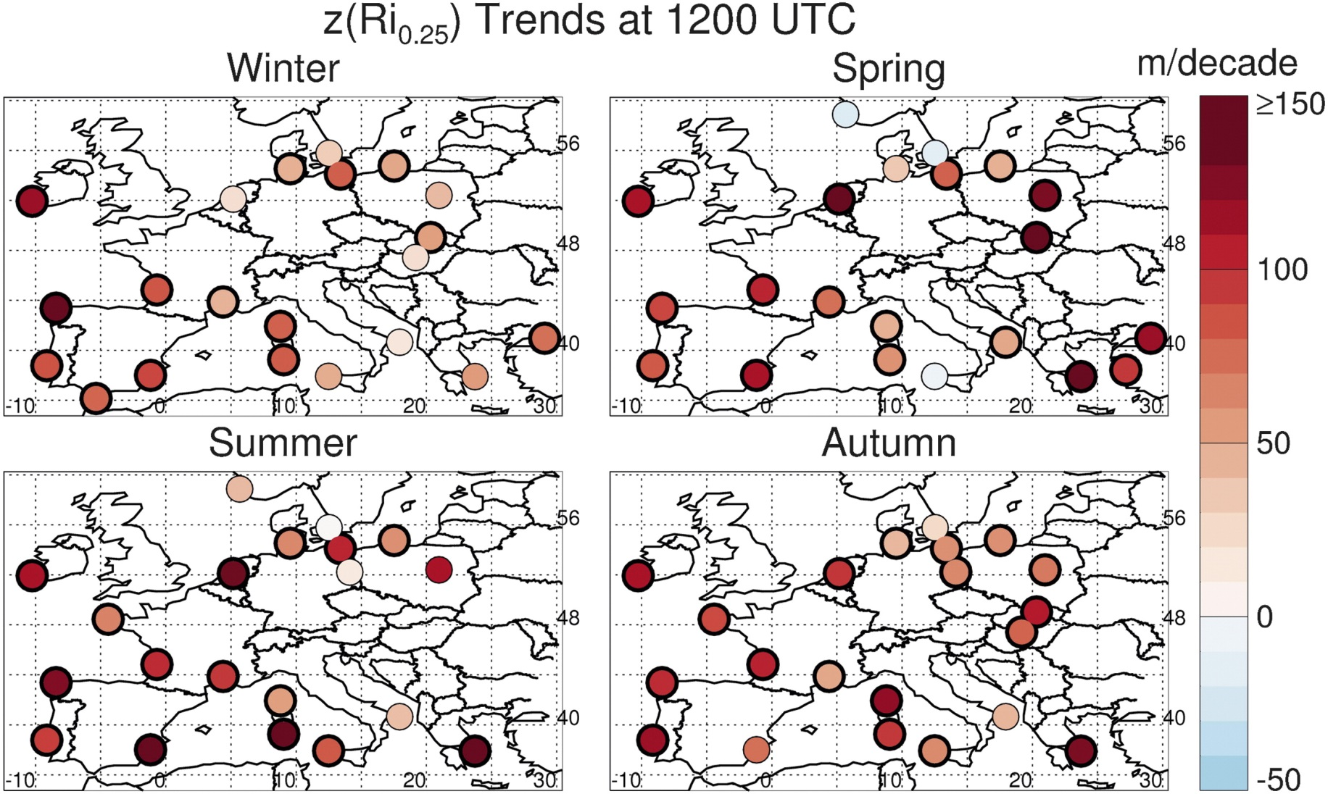
Seasonal Trends in 12 UTC PBL Height over Europe
All radiosonde stations (with >25 year record) showed daytime increases in mixing height during 1973-2010. Black circles indicate trend is statistically significant at 0.05 level. Average increase is 76 m/decade.
Notes:
The PBL height is then chosen as the lowest height at which the value of the Bulk Richardson number (RI_{0.25} ) is at a critical threshold. The literature suggests several different critical thresholds of the Richardson number, based on resolution of sondes, location, etc. In this analysis the PBL height estimates based on a critical threshold of 0.25

Slide 13
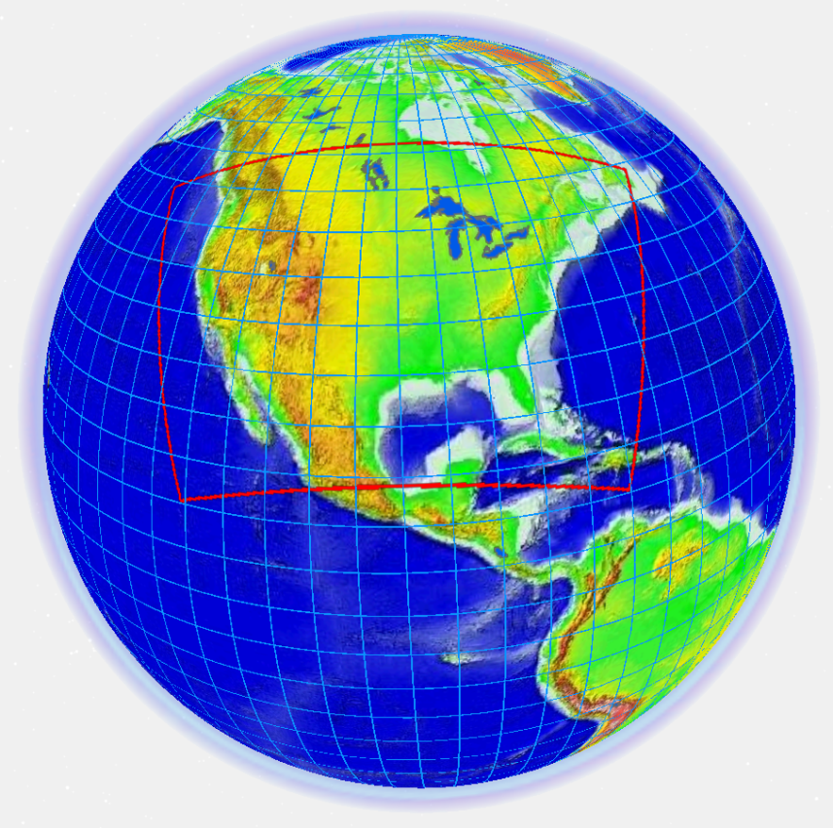
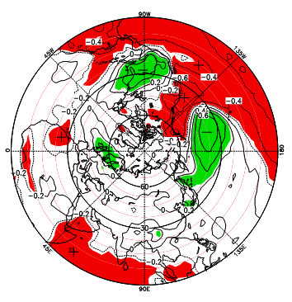
Regional Climate Modeling
Accomplishments:
5 publications
Improved NOAA sub-seasonal to seasonal forecasts
Provided a vital alternative to NMME (national multi model ensemble)
Collaborators: U. MD, Howard U, UIUC
Impact: Demonstrated that regional physics ensembles are a better alternative for seasonal climate forecasts/outlooks
Future Direction: Research activities are re-directed
CWRF
CFS
Regional Climate Analyses
Accomplishments:
4 publications (1 in press, 1 in preparation)
One PhD student graduated
Identified 2 types of hemispheric patterns for winter
Key Collaborators: NASA Goddard, GMU, Nanjing U.
Impact: Improved understanding on winter time regional climate anomalies & its effects on climate predictability
Future Direction: to publish all results
ARL Science Review, June 21-23, 2016
13

Slide 14
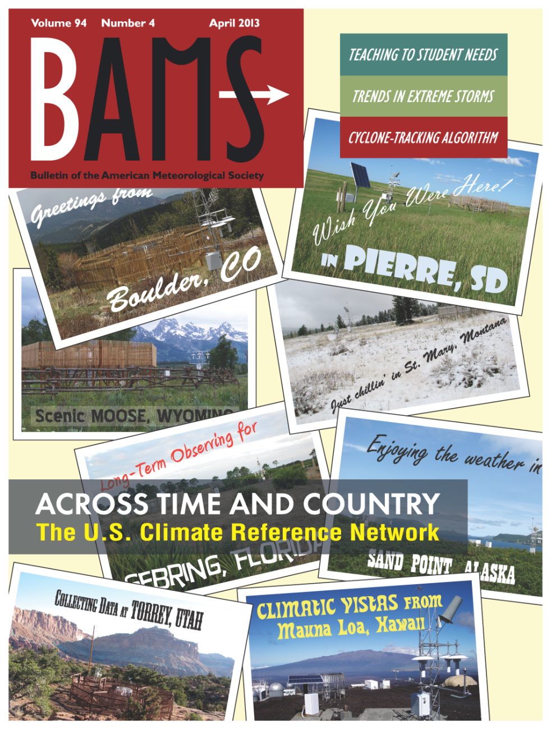
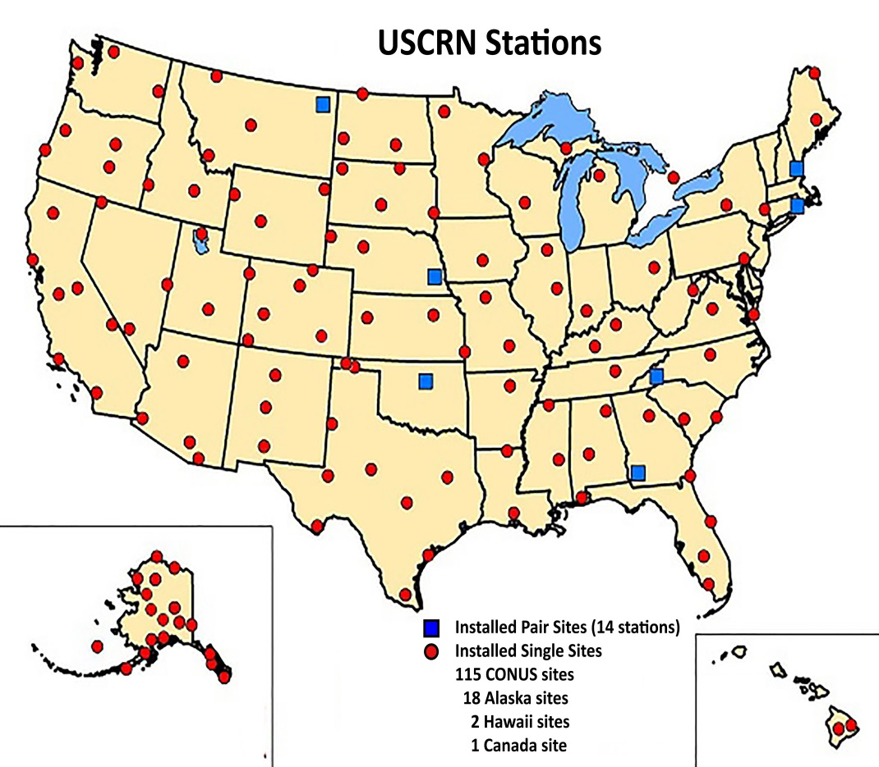
U.S. Climate Reference Network (USCRN)

Slide 15
U.S. Climate Reference Network
Answering the question at mid-century: “How has the climate of the United States changed over the last 50 years?”
Serving as a reference standard for other networks while evaluating new technology
Leveraging USCRN knowledge and infrastructure to support new missions
Sonora Desert Museum
September 18, 2002
Mauna Loa Observatory
September 26, 2005
^{[1]}
Notes:
Answering the question at mid-century: “How has the climate of the United States changed over the last 50 years?”
Serving as a reference standard for other networks, while evaluating new technology
Leveraging USCRN knowledge and infrastructure to support new missions

Slide 16
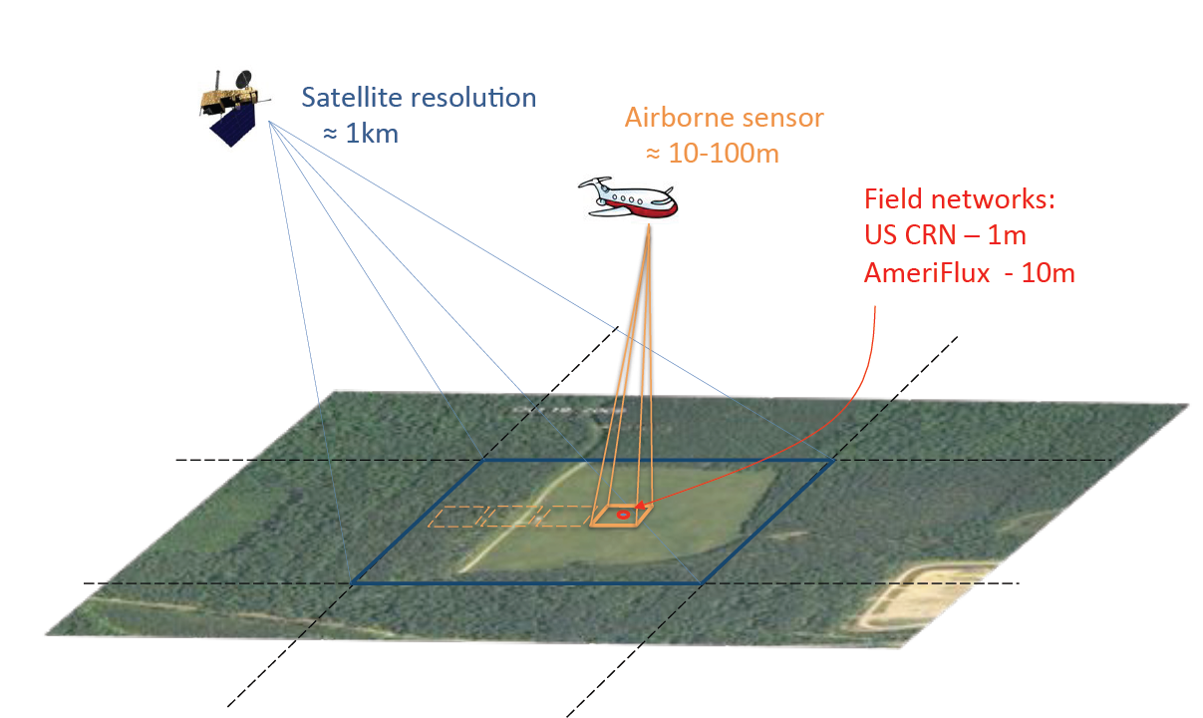
Land Surface Temperature
Measurements and Scales

Slide 17
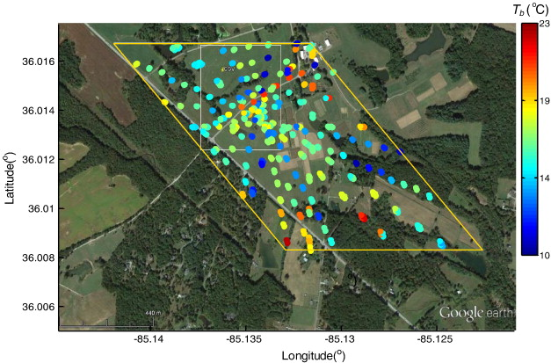
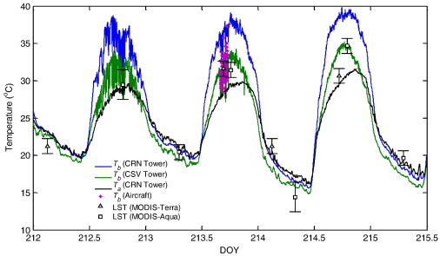

Slide 18
WMO Solid Precipitation Intercomparison Experiment (SPICE)
To improve the understanding of the performance of various solid precipitation gauge/shield configurations
Develop transfer functions between the various solid precipitation gauge configurations to improve estimates of liquid water equivalent snowfall in support of real-time applications, hydrological models and data continuity in the climate record
Define a field standard for automated solid precipitation gauges

Slide 19
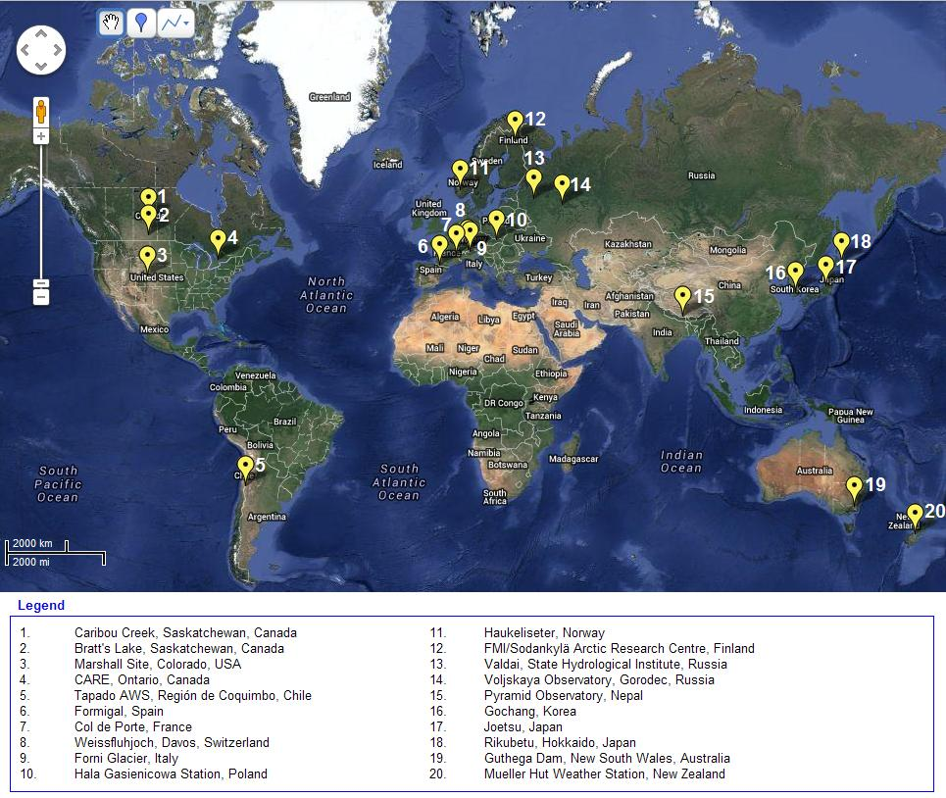

Slide 20
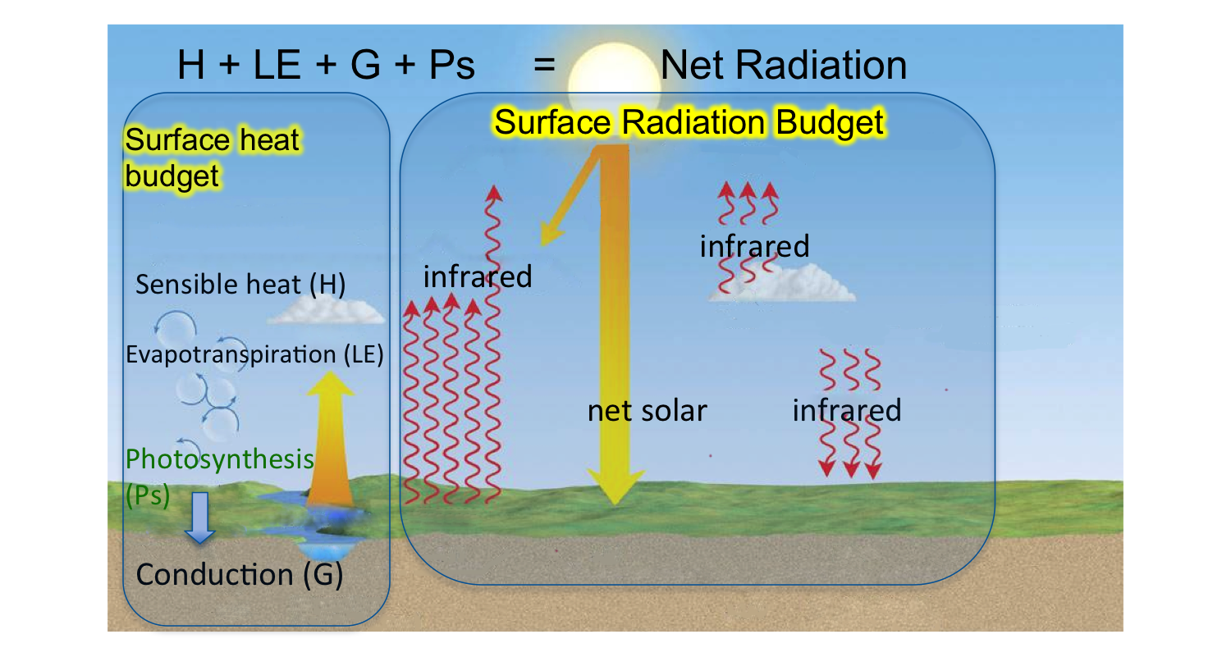
World Climate Research Programme’s
Global Energy and Water Cycle Exchanges (GEWEX)
Assessment of water and carbon budgets of major land use
Detection of land-surface feedbacks to climatic events (droughts, temperature extreme events)
Improve parameterizations of Land Surface Models (LSM)

Slide 21
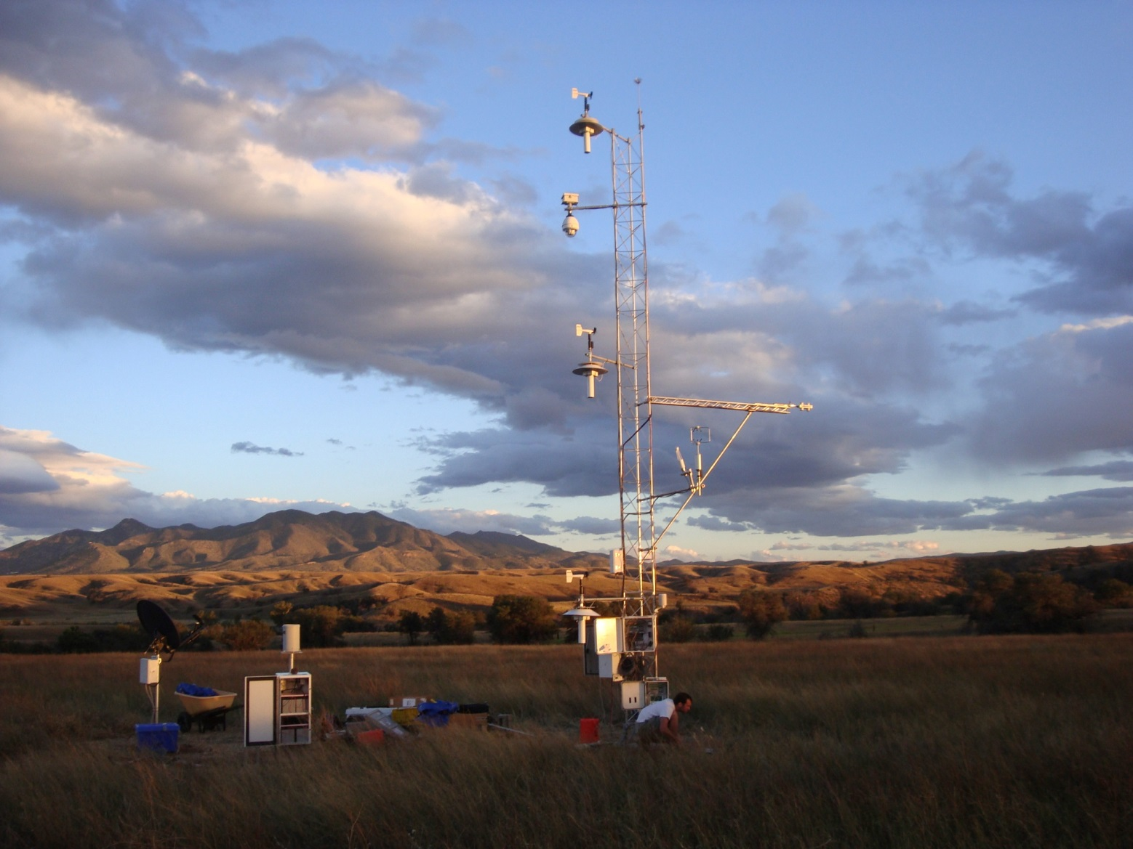
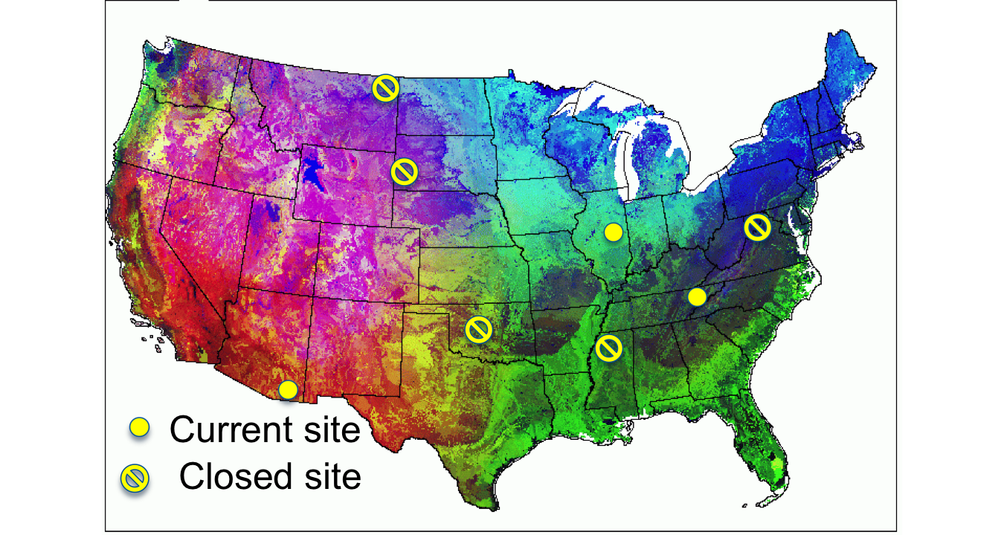
Surface Radiation Budget
SW, LW
PAR (incoming and upwelling)
Surface “skin” temperature
Surface Heat Budget
Evapotranspiration
Sensible heat flux
Ground heat flux
CO₂ and Momentum Flux

Slide 22
Major Findings
Drought in grasslands leads to net annual carbon emissions
Mid-western corn/soybean ecosystems small carbon sink
Ecosystem storage terms are significant in closing the surface energy budget
Demonstrated use of in-situ broad-band Normalized Difference (NDVI) to track leaf area index
Over 75% of annual evapotranspiration for semi-arid grasslands (AZ) occurs in just 3 months
Leaf Litter respiration plays a major role in ecosystem respiration
In 2016, 20 years of flux data from Bondville, IL, longest record in world for crops. All data records will be gap-filled for reassessment of water and carbon budgets

Slide 23
Challenges for ARL
Two key climate scientists retired in FY 16
Maintaining and improving the quality and value of R&D in current fiscal environment
In transition with retirements and want to closely align new effort in climate with OAR and NOAA
Redirect the climate of the free troposphere and the stratosphere to ARL’s climate R&D as part of this realignment
Proposed realignment would include new staff and would leverage ongoing Lab activities and expertise.

Slide 24
Future Directions
Develop a strategy to improve hydrological models and input from atmospheric models during drought and extreme events using observations ̶ Partners: NCAR & NWS
Perform studies of spatial variability around surface climate stations to improve interpretation of regional climate variability and change ̶ Partners: NESDIS USCRN
Provide evaluations of physical energy fluxes in different regions of the U.S. to improve land surface model parameterizations and to improve seasonal predictions of water resources ̶ Partners: NESDIS & NIDIS
Conduct a pilot study to determine the feasibility of developing observing systems that quantify sources and sinks of carbon dioxide and methane ̶ Partner: NOS

Slide 26
Surface Energy Budget
Tilden Meyers
WMO Solid Precipitation Intercomparison
John Kochendorfer
Climate Variations and Analyses
Julian Wang
Question and Answer Session
Bruce Baker
Break
Poster Session Atmospheric Chemistry & Deposition and Climate Observations & Analyses
Climate Observing Networks
Bruce Baker
1:25
1:50
Climate Observations and Analysis Session
2:10
2:30
2:50
3:00
3:15
26

Slide 27
Climate Observations & Analyses Posters
TV # | Time | Title | Presenter
4 | 3:15 & 3:30 | Intercomparison of Land Surface Temperatures | Tilden Meyers
6 | 3:15 & 3:30 | US Climate Reference Network Soil Properties | John Kochendorfer
6 | 3:45 & 4:00 | Sonic Anemometer Vertical Wind Speed Biases | John Kochendorfer
5 | 3:15 & 3:30 | The Spatial Distribution of Air-Surface Exchange of CH in Alaska | Ron Dobosy

Slide 28
QUESTIONS?

