Slide 1
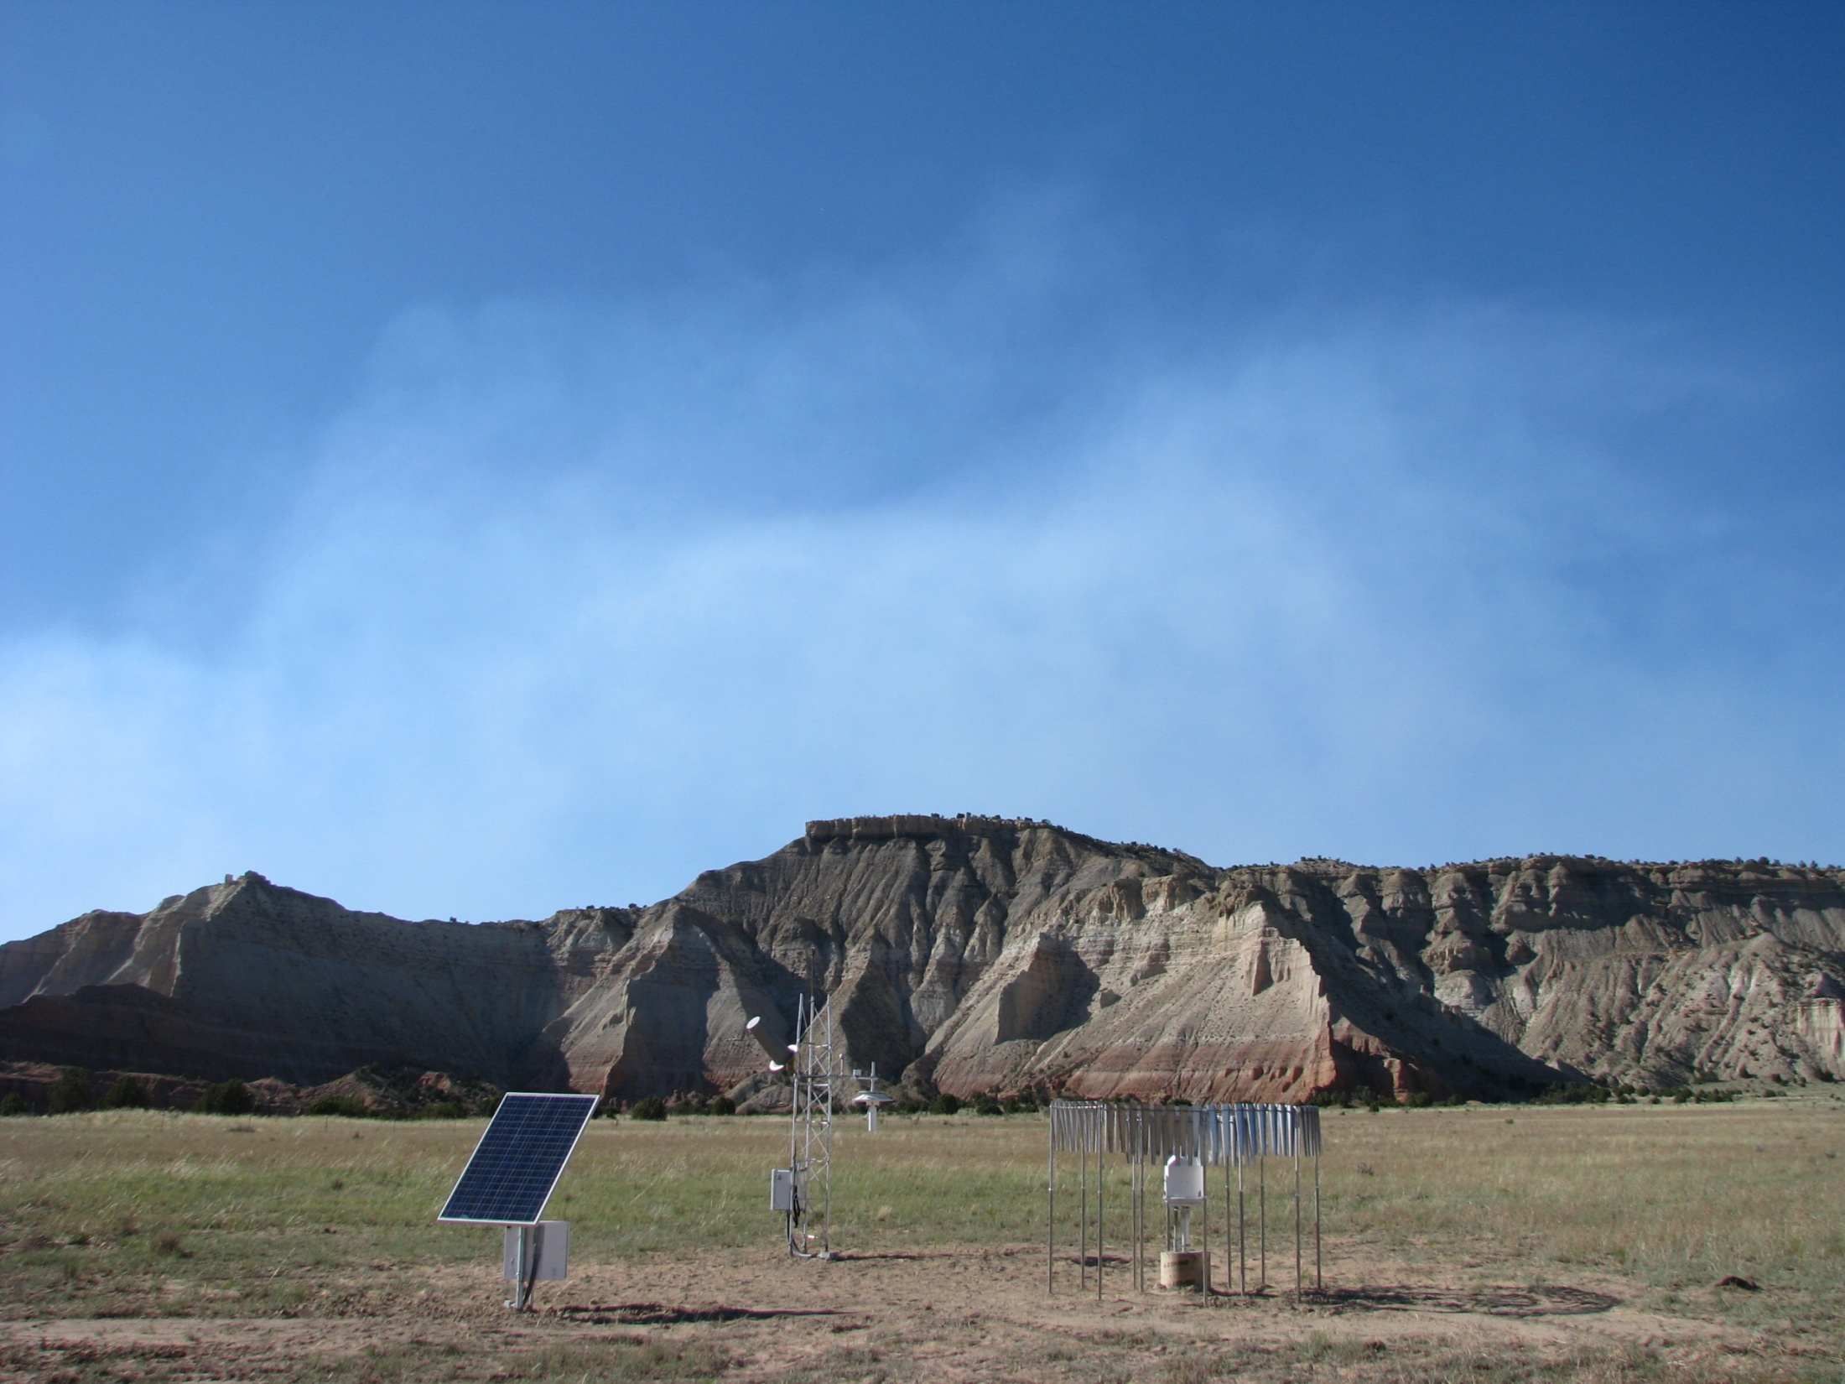
Climate Observing Networks
C. Bruce Baker, Director
NOAA/OAR/ARL/ATDD
June 22, 2016

Slide 2
Evolution of Surface Climate Observing Systems in the U.S.
Climate Reference Network
122 Stations CONUS
30 Stations Alaska
U.S. Historical Climatology Network (HCN) Subset (1218 manual stations
selected in the 1980s).
On-going
On-going
Cooperative Observer Program Network (11,000 stations) beginning
in the late 19th Century. Still ongoing with ~8,000 observers
On-going ~8,000 observers
NERON was a pilot attempt to modernize COOP (2000s till terminated in 2008)
Terminated in 2008
HCN-M/USRCRN – AL stations established with earmark and NWS initiative in
mid 2000s. 72 stations in SW; 16 Alabama
Terminated in 2014
U.S. Army Forts, U.S. Signal Corps, Smithsonian network, Diaries, logs (e.g., Jefferson, Franklin)
1700 - 1800
1900
2000
2014

Slide 3
Relevance: Contributions to NOAA Priorities
Improve the understanding and prediction of climate variability and change
Advance understanding and assessment of climate change through analysis and evaluation of atmospheric observations
Improve the network of global climate observing system measurements of the atmosphere
Primary Activities
Reference observations
Atmosphere-land surface interactions
Climate variability and change analysis

Slide 4
Key Accomplishments/Recognition (2011-present)
Led development of new international/national measurement approaches for measuring precipitation – a 5 year WMO International Intercomparison
10 Publications since last review
Widely recognized experts on soil moisture and soil temperature measurements in support of National Integrated Drought Information System (NIDIS).
Participating in a multi-agency National Soil Moisture Network with USDA and USGS
Support of NASA’s Soil Moisture Active Passive ground calibration/validation for soil moisture
25 USCRN stations are in National Parks

Slide 5
US Regional CRN (USRCRN)
Essential to monitoring regional climate change such as monitoring drought, extremes in temperature, and for hydrological forecasting
Fills gaps in observations which have resulted from reductions in other NOAA networks
Data are also used by the local WFOs for refining their local forecasts
Consists of 90 sites (73 in the Southwest and 17 in Alabama)
Budget reprogramming in FY11-FY13 reduced the amount of funding available to execute the original scope of 538 stations
USRCRN was in a sustainment mode until FY14, with no new deployments and only providing for the O&M of the 90 sites that were in place prior to reprogramming

Slide 6
USRCRN Options Overview
OPTION | DESCRIPTION
Maintain | Either sustain in NWS or transfer the system to OAR or NESDIS Ownership of USRCRN property and O&M would be transferred
Hibernate | Cease collection of data Site visits for equipment shutdown and removal of hazardous waste required. Stations left unattended for an indefinite amount of time. Seek transfer of system to outside entities such as the State Climatologists within the Four Corner States. Most stations were turned over to the state climatologists in Utah, Colorado, New Mexico, and Arizona.
Terminate | Permanent shutdown and removal of all sites. Will require additional funding..

Slide 7
NOAA’s Benchmark US Climate Observing Network (USCRN)
Designed to answer questions about National Air Temperature, Precipitation, and Soil Temperature and Moisture changes with the highest confidence
Extend the U.S. vision for building a network with our partners, on a global basis, that 50 years from now can with the highest degree of confidence answer the question: How has the climate of the Nation changed over the past 50 years?

Slide 8
Stations and Observations
Stations are sited in stable, open locations
Instruments are calibrated to National Institute of Standards and Technology standards
Triplicate sensor configuration for the primary measurements of temperature and precipitation
internal consistency assures quality
redundancy protects continuity
Ancillary measurements support the primary measurements
global solar, surface IR temperature, low-level wind, wetness
Additional measurements
soil moisture, soil temperature, relative humidity
Data are acquired, processed and re-distributed hourly

Slide 9
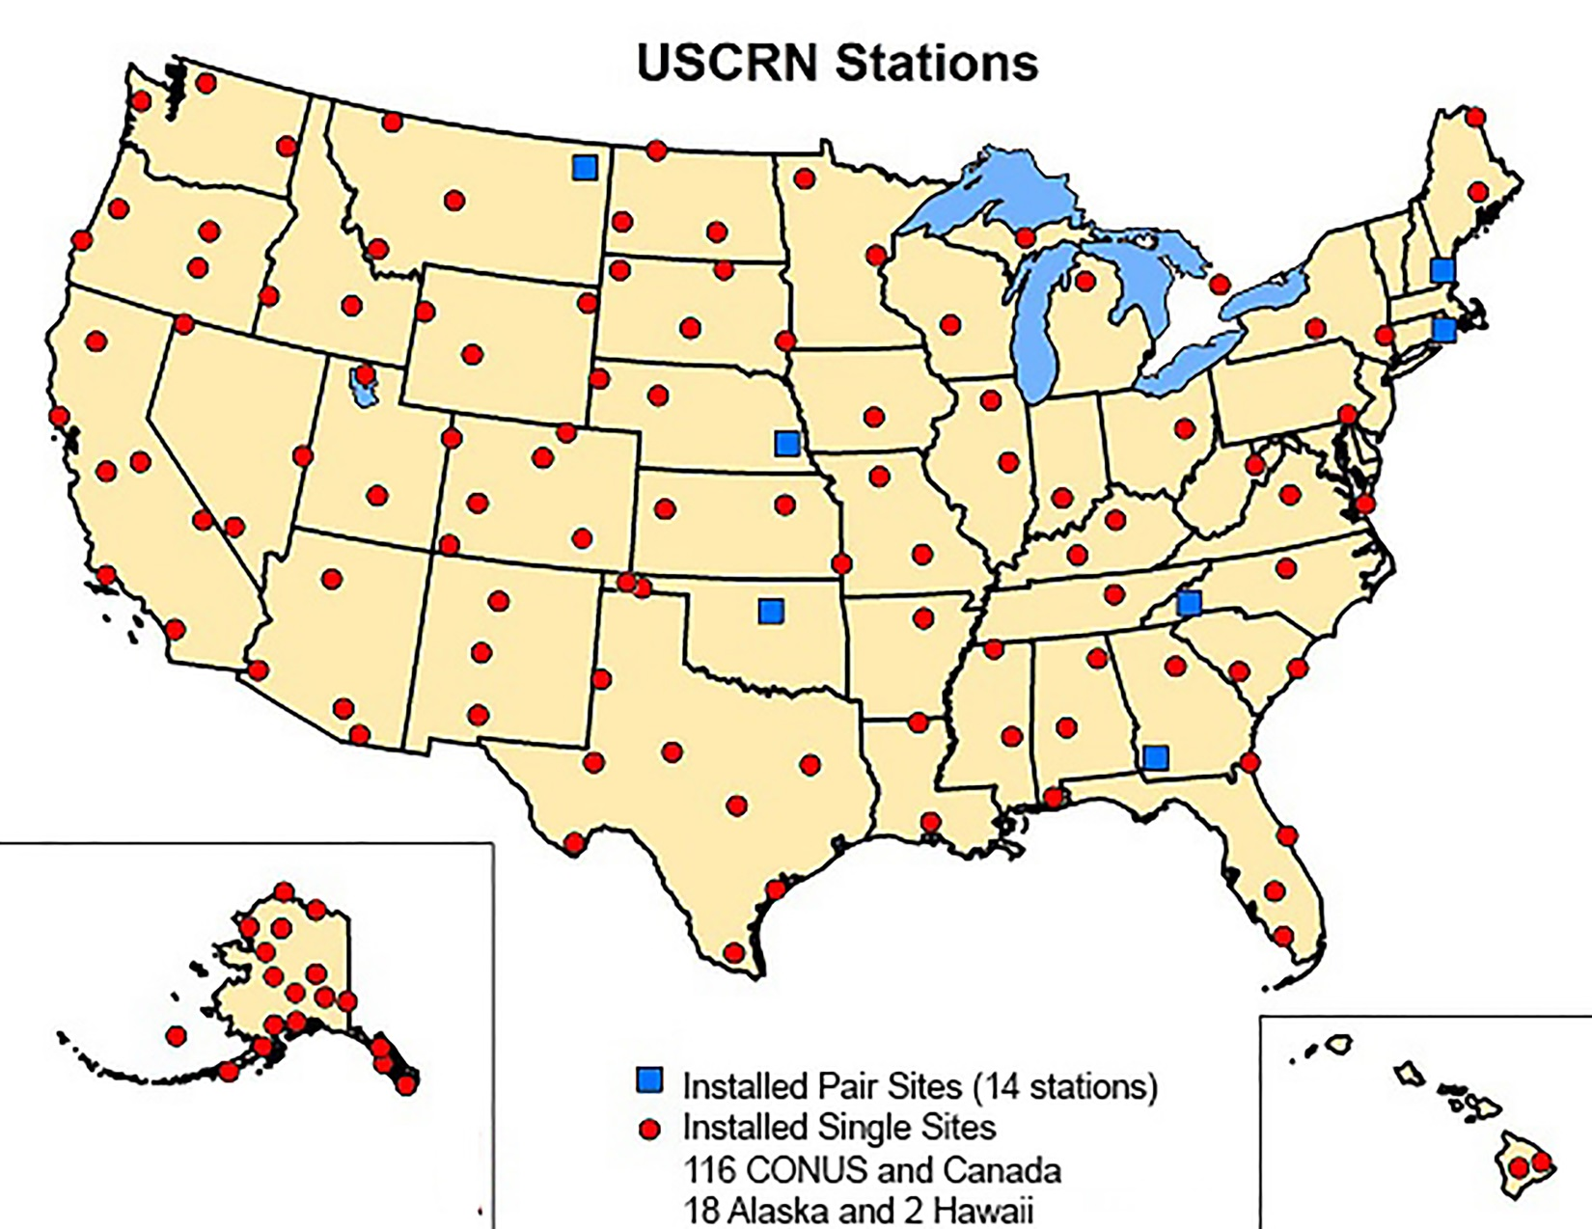

Slide 10
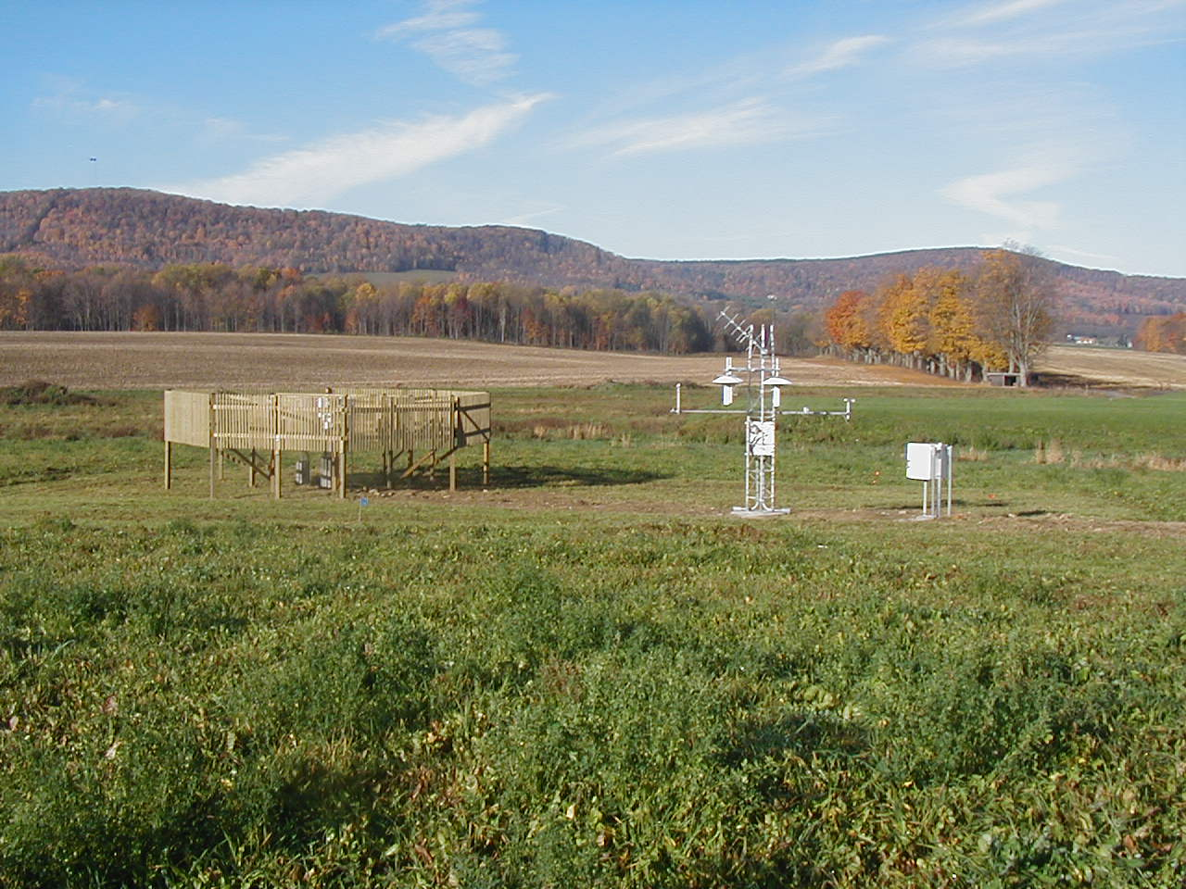
Climate Reference Network Station for National-Level
Climate Monitoring (Cornell University, Ithaca, New York)
Satellite communications
High-risk reduction precipitation gauge with backup gauge inside a large wind fence
Relative Humidity
Power Control
Solar Radiation (Pyranometer)
Anemometer
Three High-Precision Platinum Resistance Thermometers in Individual Ventilated Radiation Housings
Ground Temperature
Wetness Sensor
Soil Moisture & Soil Temperature (in test)
Datalogger
10

Slide 11
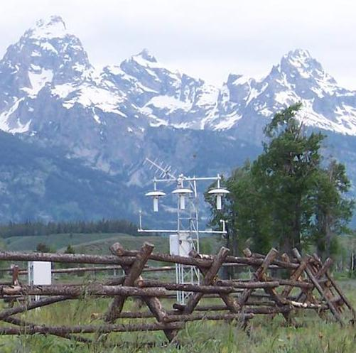
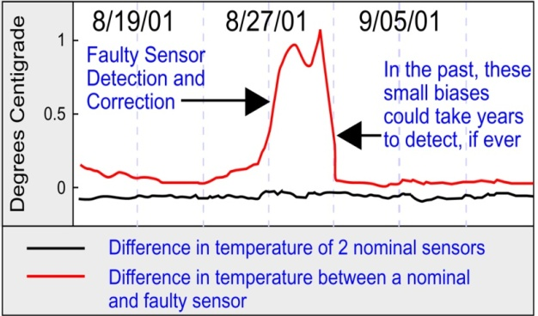
The Basics: How USCRN Works
Primary variables are measured with triplicate configurations that allow for intercomparisons:
3 PRTs measure T
3 wires measure P
Grand Teton CRN Station
Triplicate Temperature Sensors

Slide 12
Environment Canada Centre for Atmospheric Research Experiments August 8, 2008
ARL Science Review, June 21-23, 2016
Air Resources Laboratory
12
Notes:
USCRN co-located with Environment Canada Reference Climate Station (RCS) at the CARE site in Canada and a Canadian RCS is co-located with a USCRN station at the EROS data center in Sioux Falls, SD
Accomplished under the NOAA US/Canada Bi-lateral agreement.

Slide 13
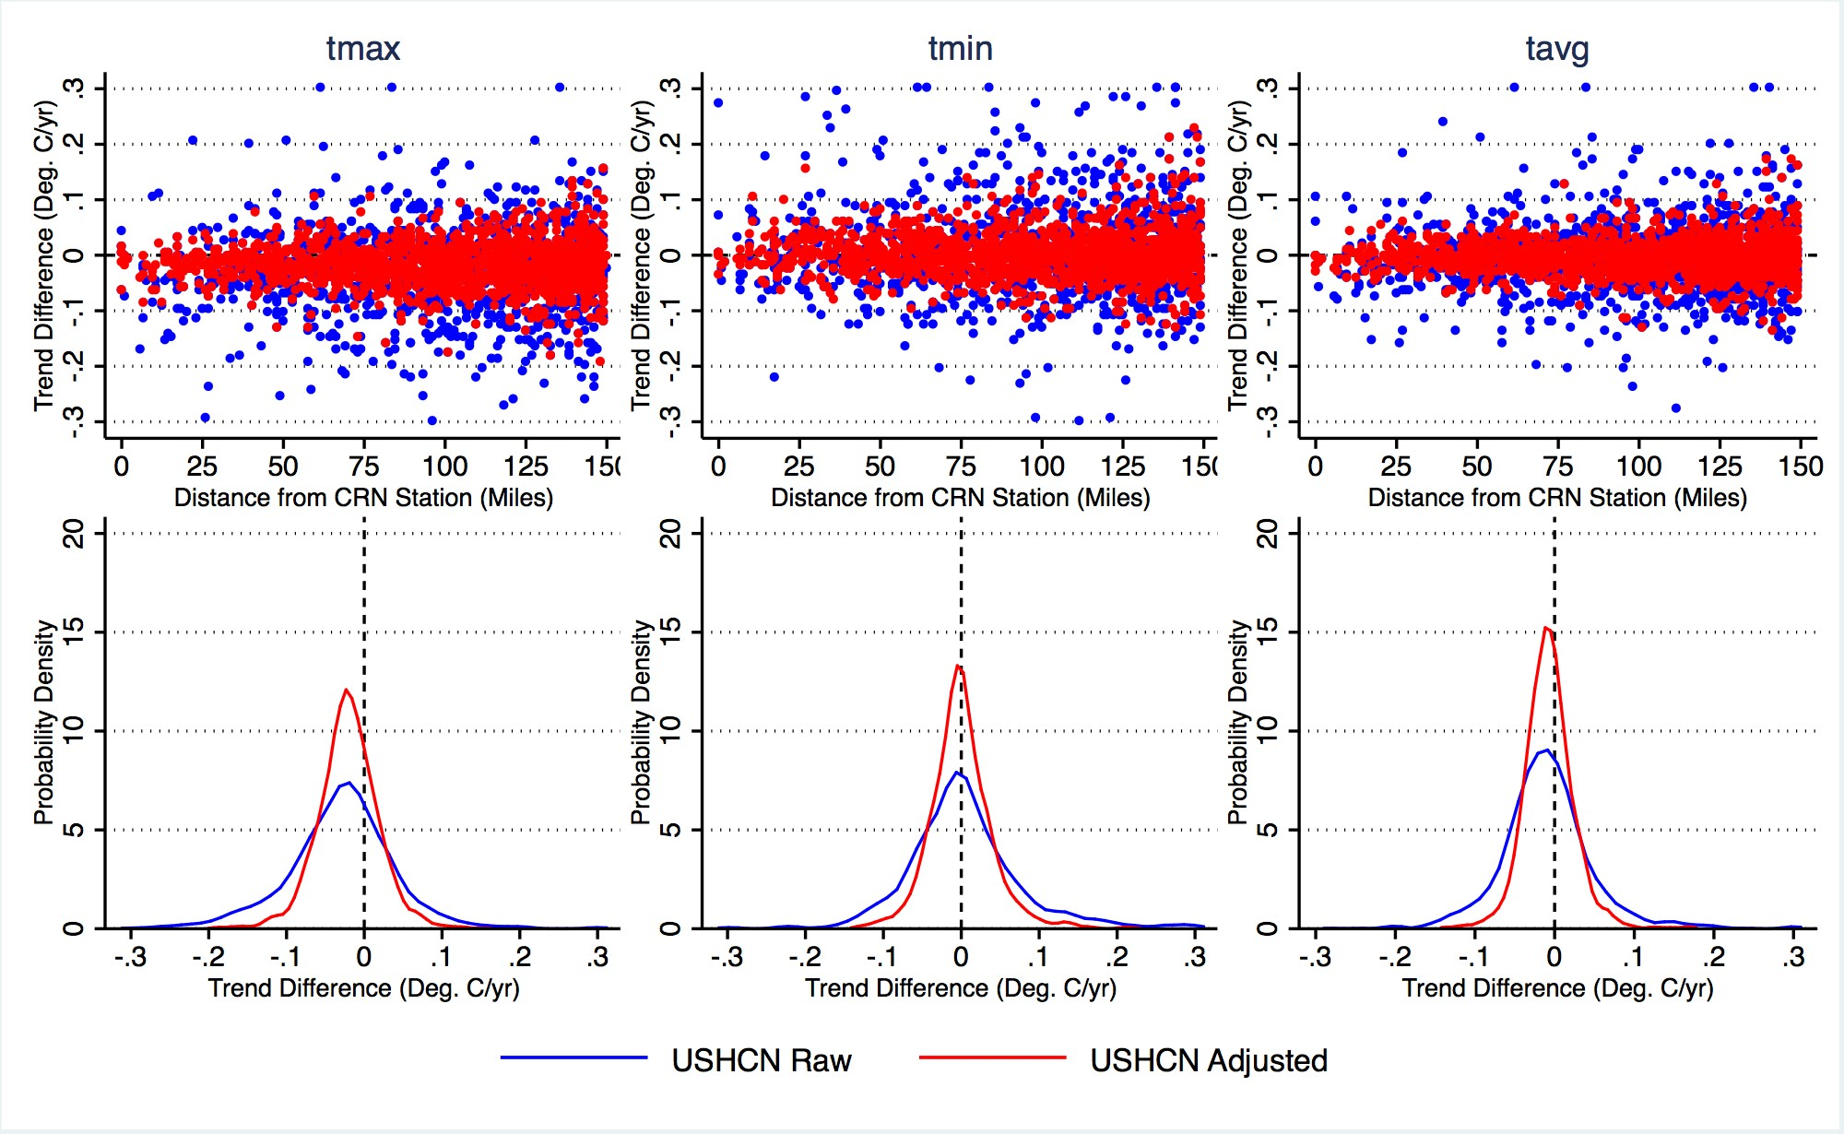
Notes:
The probability density functions in Figure 2 show a clear narrowing of the
distribution around zero trend differences, particularly for minimum and mean
temperatures. For maximum temperatures the distribution is narrower, but has a slight
negative mean. This means that adjusted (and raw) USHCN stations generally
have a lower maximum temperature trend than their nearby USCRN pairs, similar to
the results from the CONUS-wide analysis. Adjustments move the trend difference slightly
closer to zero

Slide 14
Soil Sensors Map
USDA SCAN, NWS COOP, and USCRN
(Deploy USCRN FY 08-12, 114 sites @ 107 locations)
Coop (Temp only ~263)
SCAN (Moisture & Temp ~111)
Additional 24 coop
CRN (Moisture & Temp ~114 FY 08-12)
Air Resources Laboratory
14

Slide 15
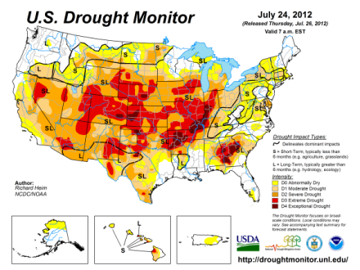
National Integrated Drought Information System (NIDIS) and USCRN Contributions
USCRN provides critical data in drought monitoring
Current: Surface temperature, precipitation, solar radiation, wind, wetness
Demonstrates versatility and expandability of USCRN design in meeting emerging requirements

Slide 16
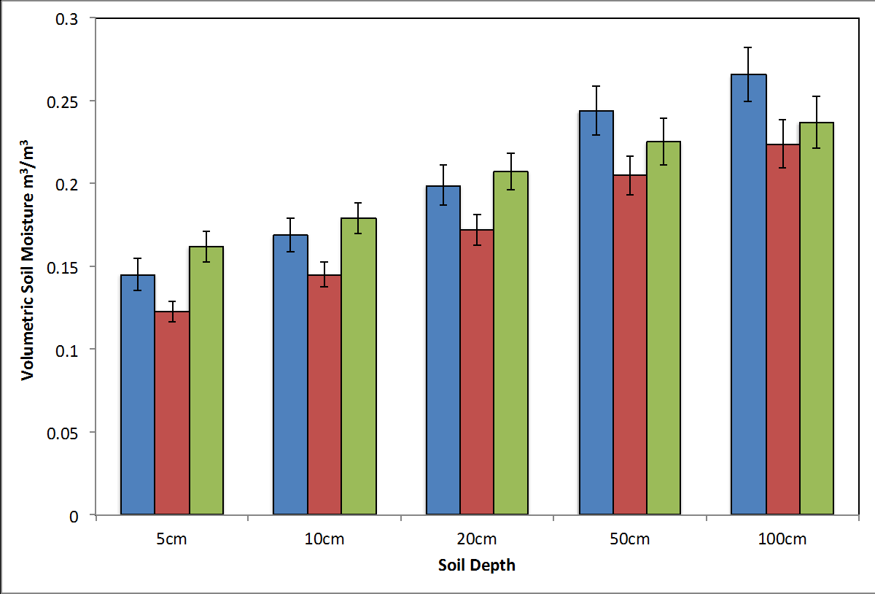
2011
2012
2013
16

Slide 17
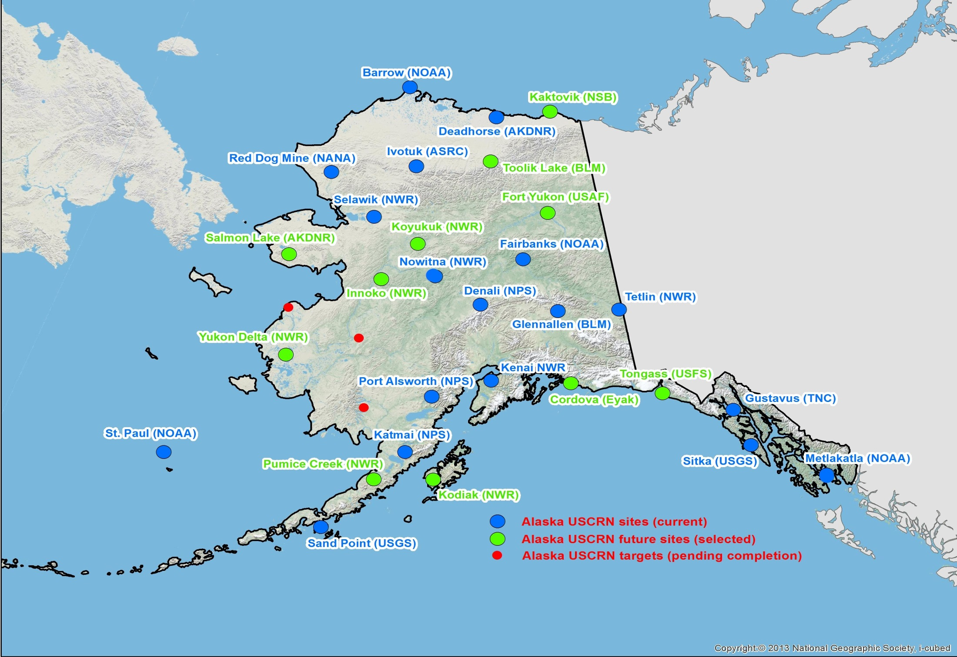

Slide 18
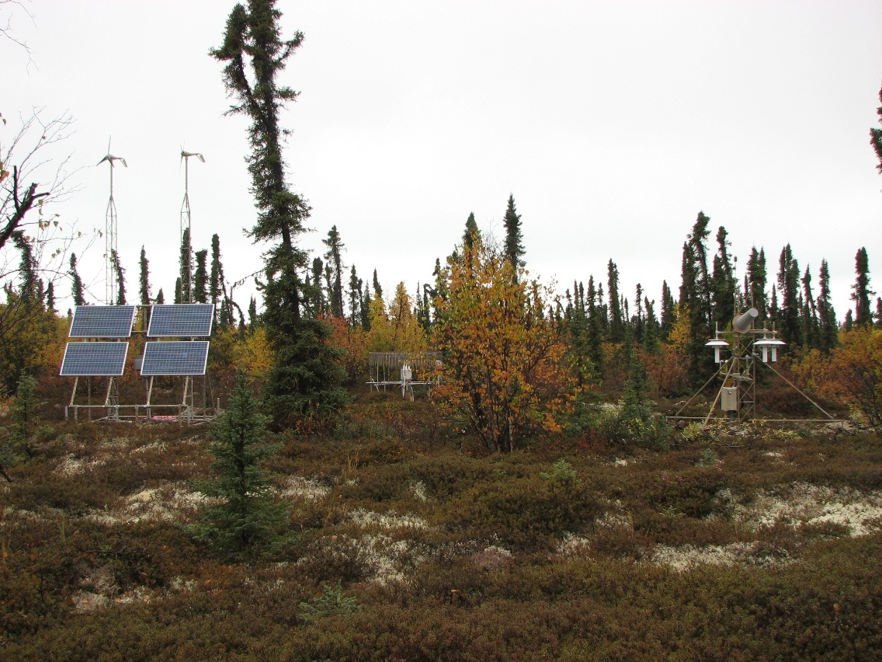

Slide 19
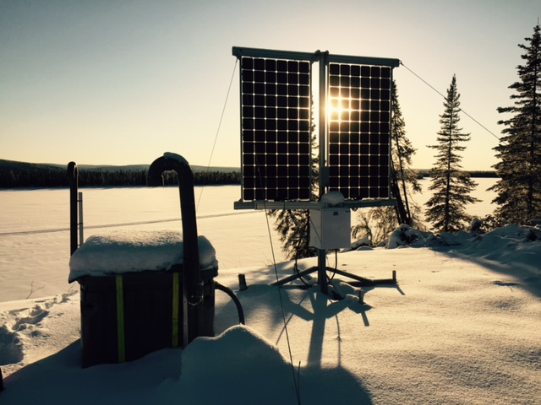

Slide 20
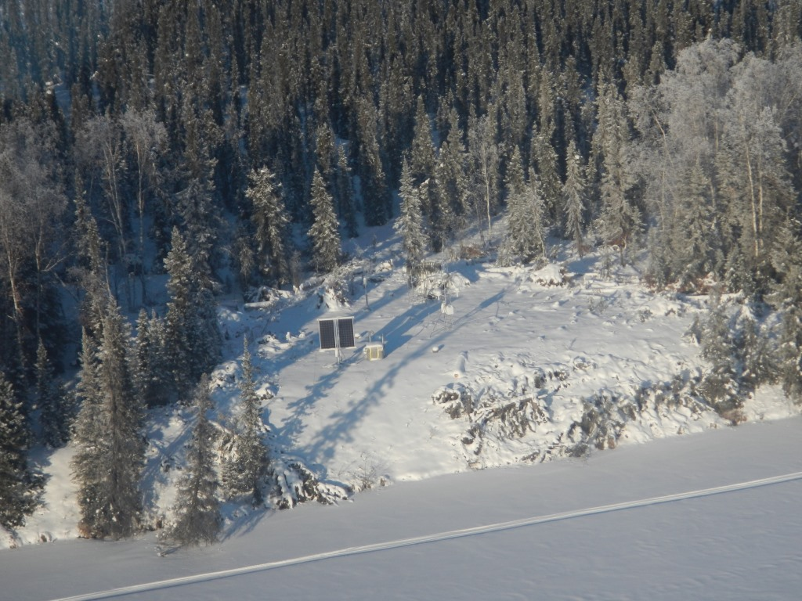

Slide 21
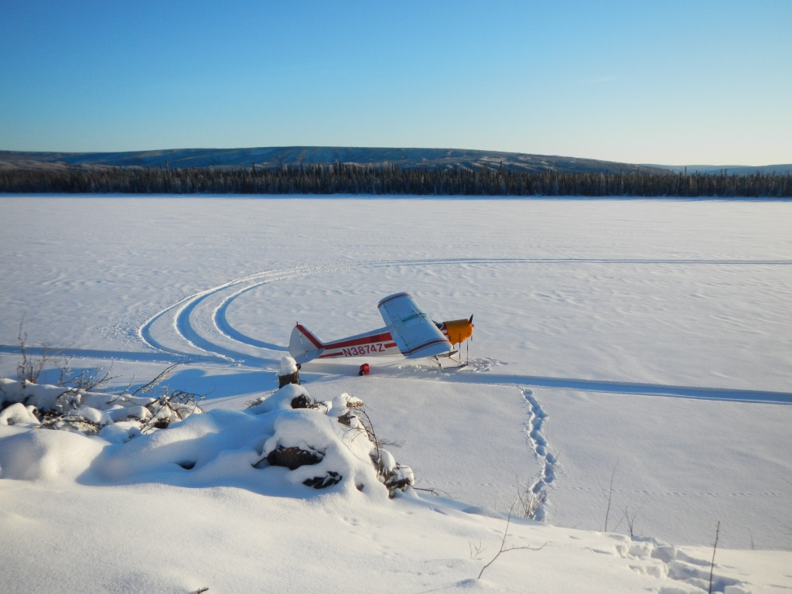

Slide 22
22

Slide 23
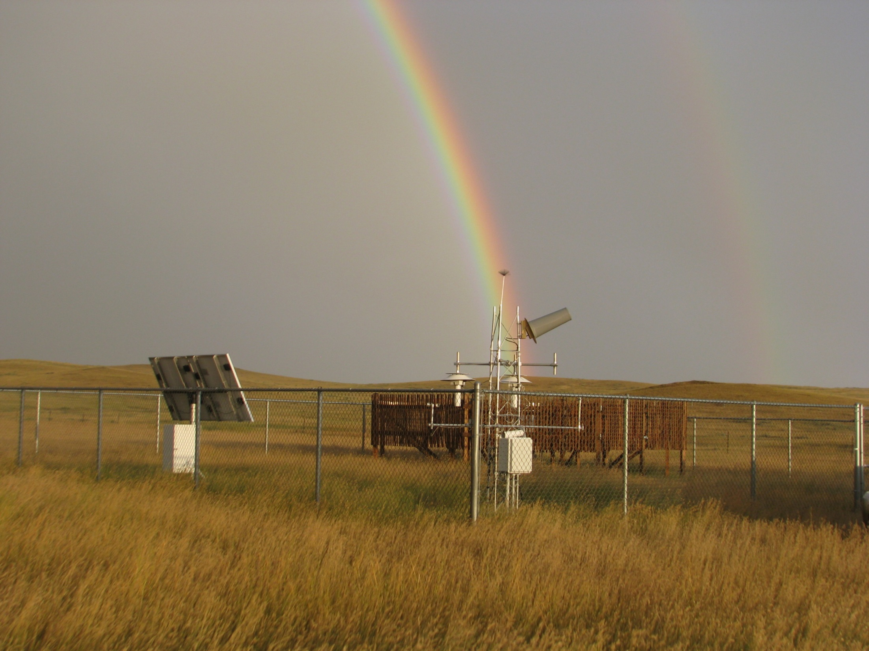
23

Slide 24
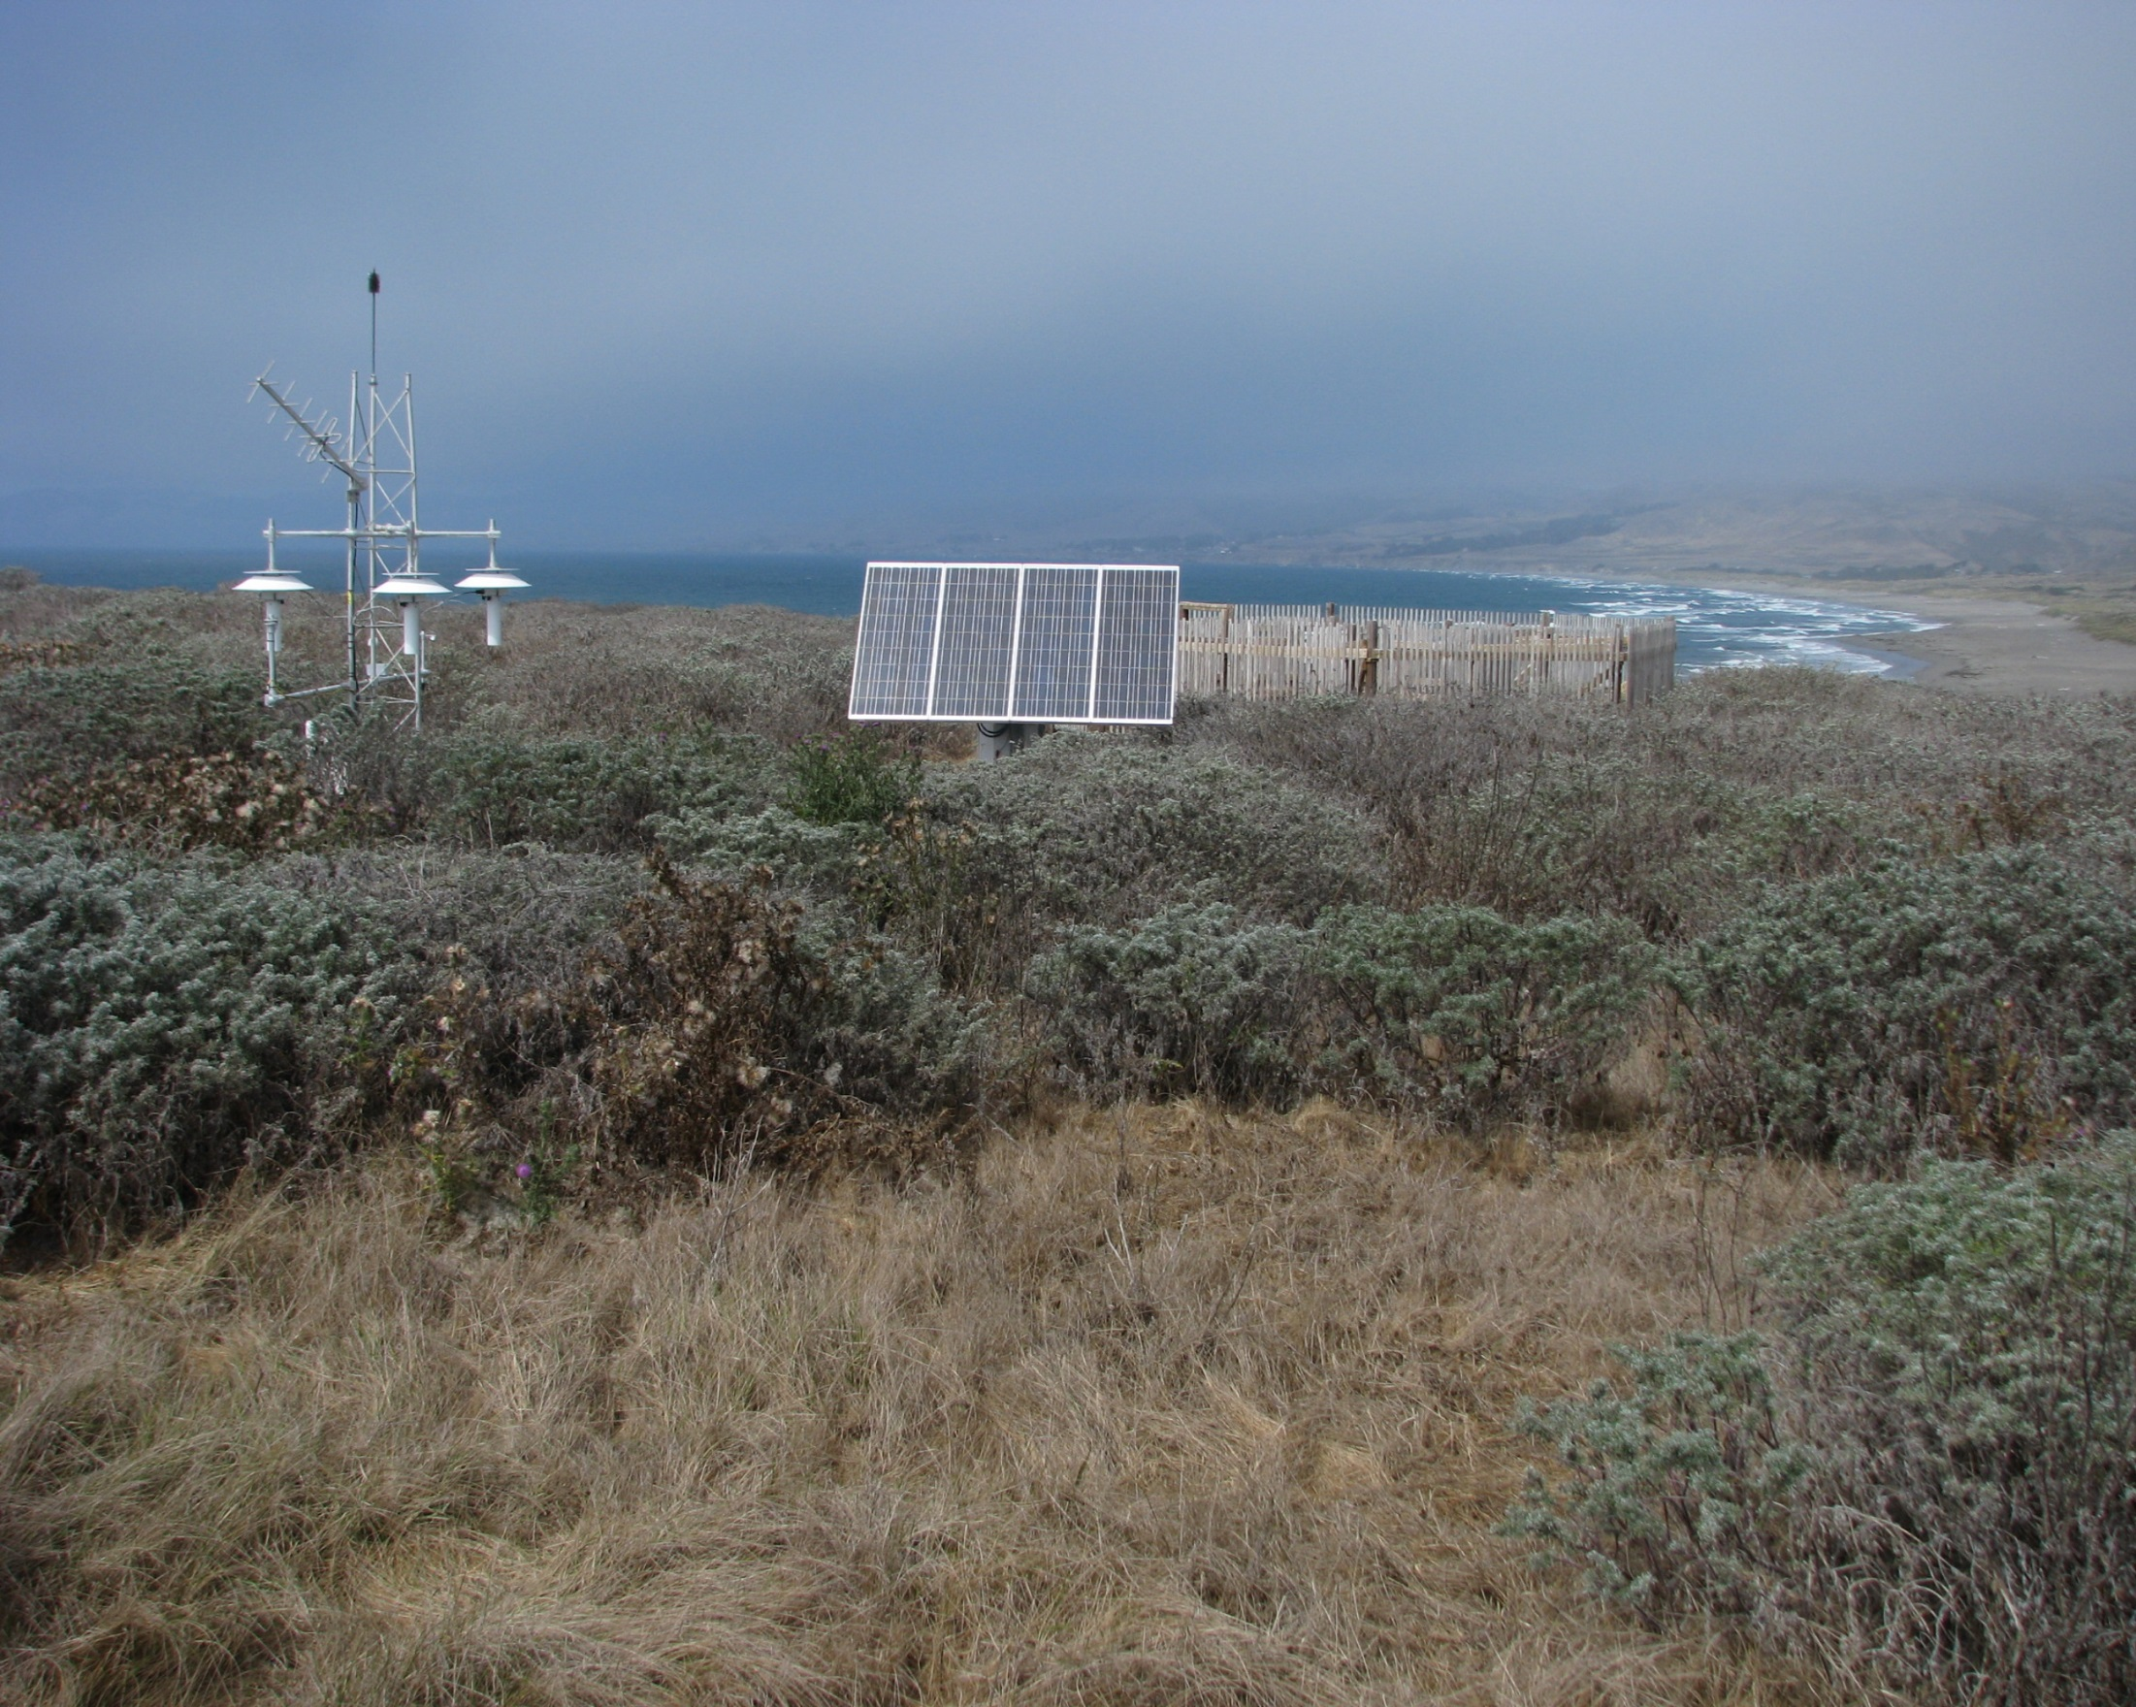
24

Slide 25
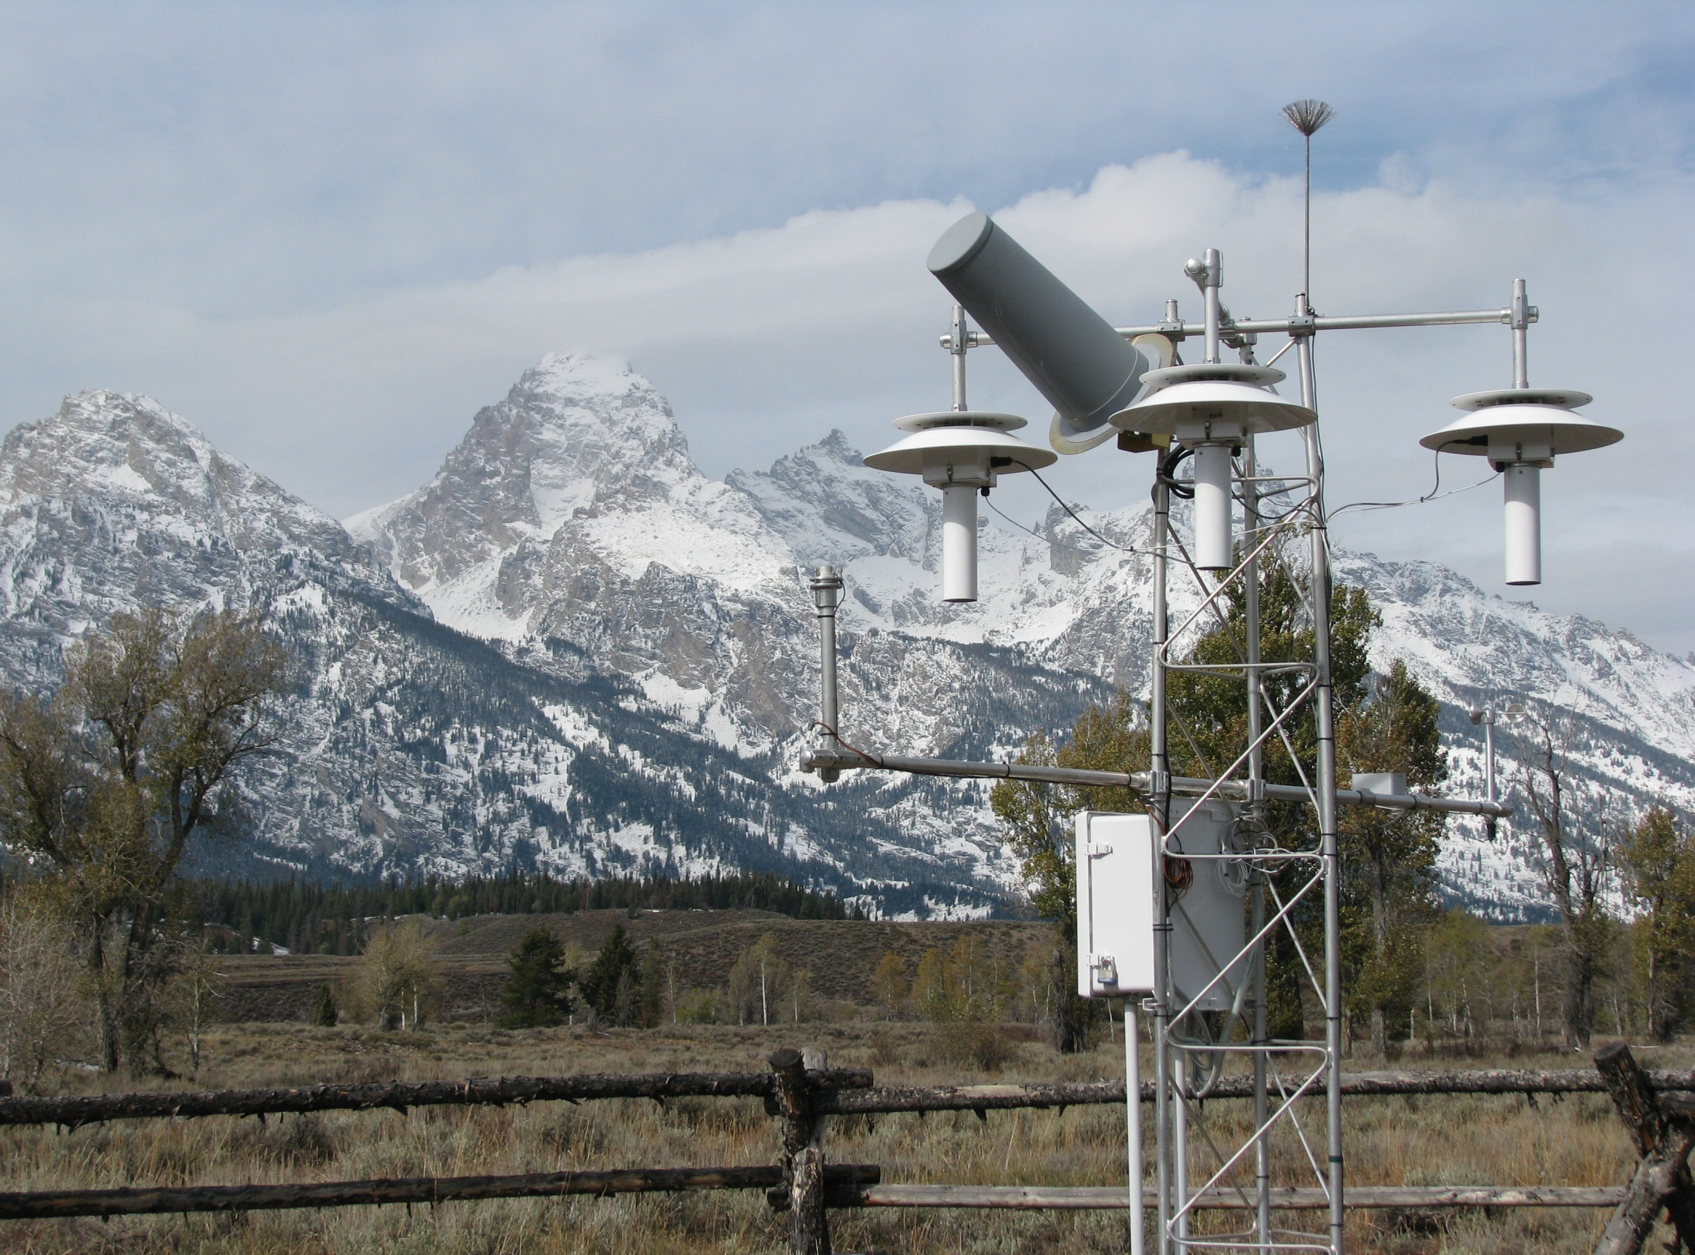
25

Slide 26
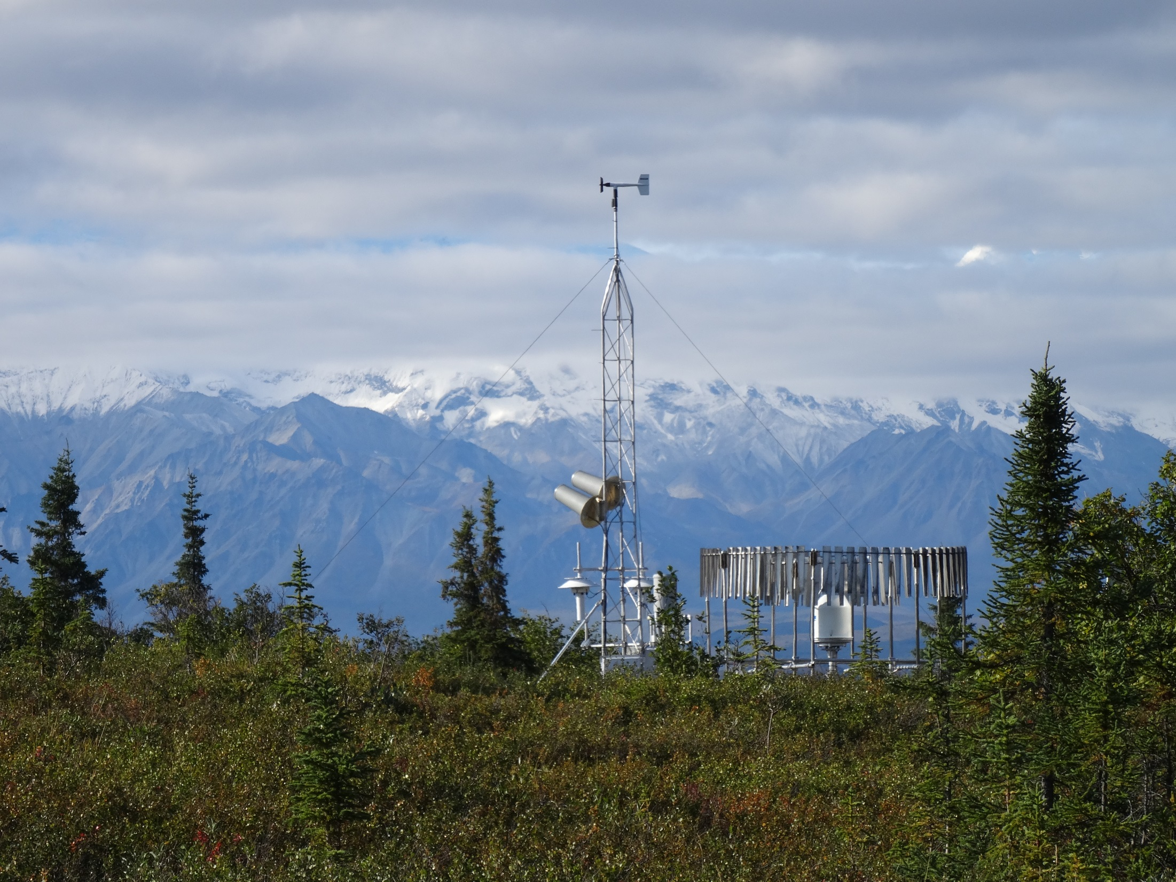
26

Slide 27
QUESTIONS?

