Slide 1
Air Resources Laboratory
Overview
Richard S. Artz
Acting Director
June 21, 2016

Slide 2
Outline
ARL Overview
Relevance
History
Organization
Research Areas
To DOC, NOAA, OAR
To Decision-makers
To Stakeholders
Tech Transfer
Staff and Funding
Performance
Workforce
Program Funding
Facilities
Strategic Accomplishments
Critical Alliances
Quality
Opportunities and Challenges
Awards
Service
Publications
Priorities
2011 Review
Program for the Next Two Days

Slide 3
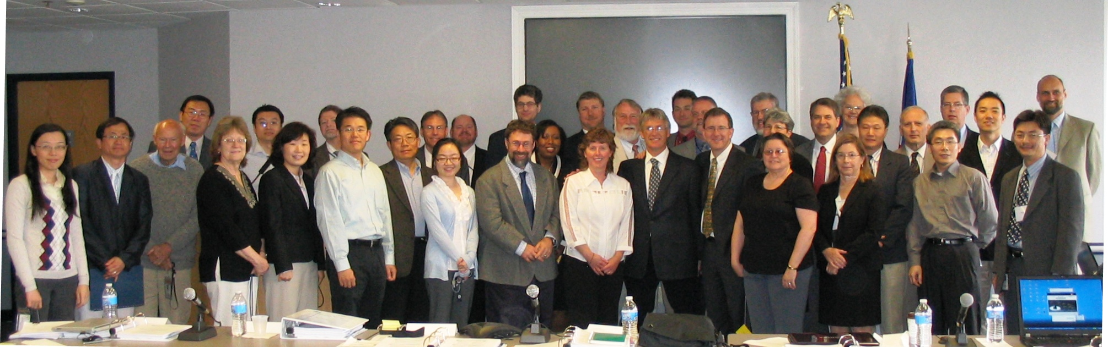
VISION
MISSION
A world-renowned research laboratory highly regarded for its scientific accomplishments in atmospheric dispersion, atmospheric chemistry, climate observations and analysis, and boundary layer science.
Provide the highest quality atmospheric and meteorological research and services to our partners, the research community, and society to protect human health and our environment.
2011 ARL Lab Review

Slide 4
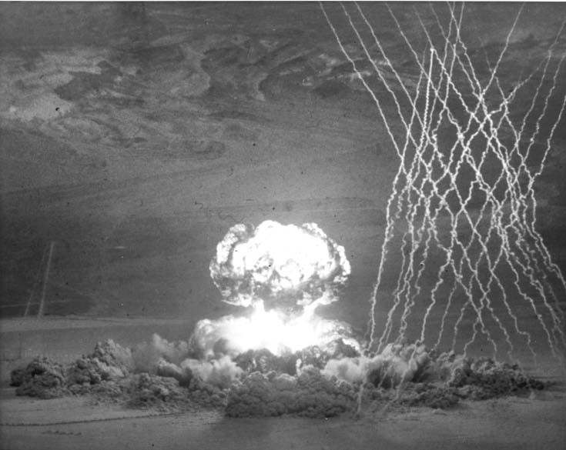
Genesis of Lab
1948: Special Projects Section of
U.S. Weather Bureau
Provide meteorological expertise to other Federal agencies
Atmospheric factors were very important to emerging issues of the 1940s, 1950s, and 1960s
  Cold War & Nuclear Arms Race
    Weapons Testing
      Detection
      Safety
  Nuclear energy: safety
  Air pollution
  Climate change
1992, Bulletin of the American Meteorological Society

Slide 5
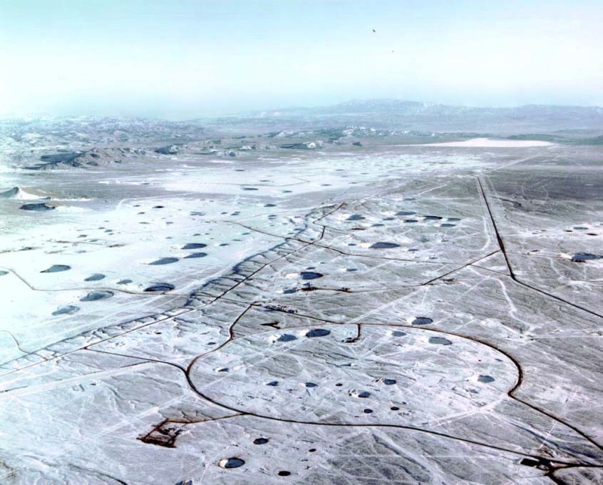
Genesis of Lab
1948: Special Projects Section of
U.S. Weather Bureau
Provide meteorological expertise to other Federal agencies
Atmospheric factors were very important to emerging issues of the 1940s, 1950s, and 1960s
  Cold War & Nuclear Arms Race
    Weapons Testing
      Detection
      Safety
  Nuclear energy: safety
  Air pollution
  Climate change

Slide 6
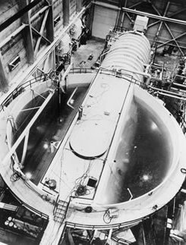
Genesis of Lab
1948: Special Projects Section of
U.S. Weather Bureau
Provide meteorological expertise to other Federal agencies
Atmospheric factors were very important to emerging issues of the 1940s, 1950s, and 1960s
  Cold War & Nuclear Arms Race
    Weapons Testing
      Safety
      Detection
  Nuclear energy: safety
  Air pollution
  Climate change

Slide 7
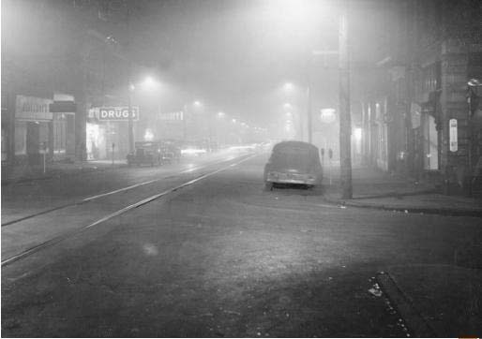
Genesis of Lab
1948: Special Projects Section of
U.S. Weather Bureau
Provide meteorological expertise to other Federal agencies
Atmospheric factors were very important to emerging issues of the 1940s, 1950s, and 1960s
  Cold War & Nuclear Arms Race
    Weapons Testing
      Safety
      Detection
  Nuclear energy: safety
  Air pollution
  Climate change
Noon Smog in Donora, PA, 1948
Notes:
Noontime smog on a street in Donora, Pennsylvania, 1948. © Pittsburgh Post-Gazette

Slide 8
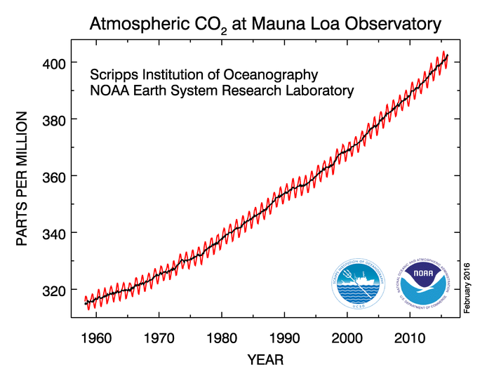
Genesis of Lab
1948: Special Projects Section of
U.S. Weather Bureau
Provide meteorological expertise to other Federal agencies
Atmospheric factors were very important to emerging issues of the 1940s, 1950s, and 1960s
  Cold War & Nuclear Arms Race
    Weapons Testing
      Safety
      Detection
  Nuclear energy: safety
  Air pollution
  Climate change
ARL/GMCC
CMDL &
ESRL/GMD
Notes:
ARL/GMCC Air Resources Laboratory/Geophysical Monitoring for Climatic Change division located in Boulder from 1957 to 1989
CMDL Climate Modeling and Diagnostics Laboratory – Boulder, CO 1990 - 2006
Earth Sciences Research Laboratory/Global Monitoring Division – Boulder, CO 2006 - Present

Slide 9
ARL’s Research Areas
Atmospheric Dispersion and Boundary Layer Characterization
Atmospheric Chemistry and Deposition
Climate Observations and Analyses

Slide 10


ARL’s Place in NOAA
National Weather Service
Headquarters
College Park, MD
National Environmental Satellite Data and Information Service
Atmospheric Turbulence & Diffusion Division
Oak Ridge, TN
Air
Resources
Laboratory
Oceanic & Atmospheric Research
National Ocean Service
Special Operations & Research Division
Las Vegas, NV
Office of Marine and Aviation Operations
Field Research Division
Idaho Falls, ID
National Marine Fisheries Service

Slide 11

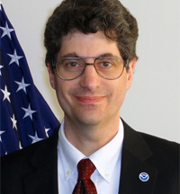
ARL’s Place in NOAA
OAR DAA L&P
ARL Director
Dr. Steven Fine
(2007 to March 2016)
National Weather Service
Headquarters
College Park, MD
National Environmental Satellite Data and Information Service
Atmospheric Turbulence & Diffusion Division
Oak Ridge, TN
Air
Resources
Laboratory
Oceanic & Atmospheric Research
National Ocean Service
Special Operations & Research Division
Las Vegas, NV
Office of Marine and Aviation Operations
Field Research Division
Idaho Falls, ID
National Marine Fisheries Service
Notes:
Dr. Steven Fine served as ARL Director beginning in 2007. Starting in 2011, he was often two-hatted, taking on various positions with OAR Headquarters while serving as ARL Director.
Early in 2011 Dr. Fine was detailed part-time to NOAA’s Office of Program Planning and Integration (PPI). From PPI he coordinated NOAA’s support of a NOAA Science Advisory Board review of NOAA’s research and development portfolio. Also in 2011, Dr. Fine served as Acting Deputy Assistant Administrator for Programs and Administration in NOAA Research. In that position, he oversaw budget, policy, planning, evaluation, IT, communications, and other administrative activities. He also oversaw research programs in the areas of climate, Sea Grant, ocean exploration and research, and weather and air quality. Additional short-term assignments included leading NOAA’s atmospheric dispersion activities in response to the Fukushima nuclear incident; leading the planning for improved hurricane and storm surge forecasting and resilience tools; assisting with the acquisition of a new radar system for NOAA’s hurricane hunter jet; and contributing to the planning for a NOAA-wide integrated mercury assessment project. In 2013 he became the Deputy Assistant Administrator for Laboratories & Cooperative Institutes as well as the ARL Director.

Slide 12
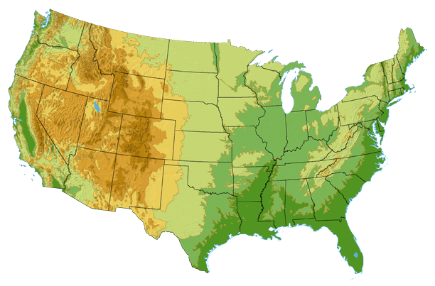
Lab Organization
  Headquarters (HQ)
    Atmospheric Dispersion and Boundary
    Layer Characterization
    Atmospheric Chemistry and Deposition
    Climate Observations and Analyses
  Atmospheric Turbulence & Diffusion Division (ATDD)
    Atmospheric Dispersion and Boundary Layer Characterization
    Atmospheric Chemistry and Deposition
    Climate Observations and Analyses
  Field Research Division (FRD)
    Atmospheric Dispersion and Boundary Layer Characterization
    Substantial site support for DOE
  Special Operations & Research Division (SORD)
    Atmospheric Dispersion and Boundary Layer Characterization
    Substantial site support for DOE
FRD
HQ
SORD
ATDD
Notes:
Why four locations?
ARL was originally formed to provide meteorological support to other agencies.
The three “field” divisions were created to support the Atomic Energy Commission (predecessor to DOE).
Divisions in Idaho and Nevada still primarily support DOE and are primarily funded by DOE
Specialized meteorological support
Consequence assessments
Why OAR?
Federal voice requested
Not a routine weather operation (e.g., national security issues)
Leveraged with other dispersion and boundary layer activities

Slide 13
Research Area 1: Atmospheric Dispersion &
Boundary Layer Characterization
Description:
Atmospheric Dispersion
R&D considers the release, transport, and dispersion of harmful materials
Primary focus is on acute events; a limited number of chemical transformations; and a connection to emergency response applications
Boundary Layer Characterization
R&D focuses on methods, techniques, and tools
Primarily to improve weather and climate models
Research Group:
Conducted across all ARL divisions
Objectives:
Improved dispersion predictions and assessments
Improved understanding and modeling of the planetary boundary layer structure
Provision of specialized services
Notes:
Description:
Dispersion R&D focuses on the release, transport, and dispersion of harmful materials through the air. Attention is typically on acute events; a limited number of chemical transformations; and a connection to emergency-type responses. Boundary Layer R&D focuses on using state-of-the-art methods, techniques, and tools (and developing new ones as necessary) to better understand atmospheric boundary layer structure and processes in order to improve prediction of near-surface weather and climate conditions.
Research Group:
Dispersion and Boundary Layer research is conducted across all ARL divisions
Objectives:
Improve the quality and understanding of dispersion predictions and assessments, including estimation of uncertainties
Improve understanding and modeling of the structure of the planetary boundary layer
Provide specialized services related to consequence assessment to DOE

Slide 14
Research Area 2:
Atmospheric Chemistry & Deposition
Description:
R&D considers the emissions, transformation, transport, and fate of important atmospheric pollutants
Primarily focus on specific pollutants that contribute to poor air quality, ecosystem decline, are associated with many emissions sources, and are significantly influenced by chemical transformations
Research Group:
Conducted in ARL Headquarters and ATDD
Objectives:
Improved predictive modeling of air pollutants and air-surface exchange
Informed policies and plans
Notes:
Description:
Atmospheric Chemistry and Deposition R&D considers the emissions, transformation, transport, and fate of important atmospheric pollutants known to have an impact on human health and/or the environment. The focus is typically on specific pollutants that contribute to poor air quality; contribute to ecosystem decline; are associated with many emissions sources; and are significantly influenced by chemical transformations.
Research Group:
Atmospheric Chemistry and Deposition research is conducted in ARL/HQ and ARL/ATDD
Objectives:
Advance scientific understanding and predictive modeling capabilities of the emission, transport, chemical transformation, and air-surface exchange (including deposition and bi-directional processes) of air pollutants that impact human and ecosystem health
From Ariel’s R20 Proposal:
The research activities described in this proposal directly support NOAA priorities as follows:
• NGSP: Weather Ready Nation/ Reduced loss of life, property, and disruption from high-impact events
• Five-Year R&D Plan: Weather Ready Nation/ Improved predictive guidance/ Determine the relative merits of different approaches to ensemble generation including multi-model, stochastic physics, and multi-physics.
• R2X Announcement of Opportunity:
o Decision Support Including Social and Behavioral Science: Introduce or improve predictive guidance and decision support tools
o Earth System Forecasting Improvement: Strengthen abilities to assess climate, weather, and non-climate/weather hazard related risks and impacts to communities and ecosystems
omplete

Slide 15
Research Area 3:
Climate Observations and Analyses
Description:
R&D focused on the development & maintenance of reference observing systems
Primary focus is analyzing and evaluating long-term observational datasets and models to understand climate change on diurnal to multi-decadal time scales
Research Group:
Conducted in ARL ATDD and Headquarters
Objectives:
Improved understanding of climate through study of observations & models
Improved network of global climate observing system measurements
Notes:
Description:
Concentrates on developing reference observing systems to meet climate requirements and analyzing long-term observational datasets and models to understand climate variability and change on diurnal to multi-decadal time scales.
Research Group:
Climate studies are conducted in ARL/HQ and ARL/ATDD
Objectives:
Advance understanding and assessment of climate change through analysis and evaluation of atmospheric observations and models
Improve the network of global climate observing system measurements

Slide 16
Integration Among Research Areas
Dispersion / Boundary Layer
- Air-land fluxes
- Climatology of the boundary layer - Urban emissions of climate gases
- Severe weather
- Modeling of toxics, ash, smoke, dust
Flows around sound barriers
Chemical tracer field experiments
Atm Chemistry and Deposition
Climate-air quality modeling Collocation of observing sites
Climate Obs
and Analyses

Slide 17
Outline
ARL Overview
Relevance
History
Organization
Research Areas
To DOC, NOAA, OAR
To Decision-makers
To Stakeholders
Tech Transfer
Staff and Funding
Performance
Workforce
Program Funding
Facilities
Strategic Accomplishments
Critical Alliances
Quality
Opportunities and Challenges
Awards
Service
Publications
Priorities
2011 Review
Program for the Next Two Days

Slide 18
Key Activities
Activity Title | Atmospheric Dispersion & Boundary Layer | Atmospheric Chemistry and Deposition | Climate Observations & Analyses
Program Project Activities | Weather Labs & CIs | Weather Labs & CIs | Climate Labs & CIs
Programmatic Theme | Modeling and associated measurement programs | Modeling and associated measurement programs | Observations
Collaborations | NOAA Line Offices Other Federal Agencies Int’l Atomic Energy Ass’n, WMO, Comprehensive Test Ban Treaty Organization, various universities | NOAA Line Offices Federal and State Agencies WMO, various foreign governmental organizations, Various universities | NOAA labs and line offices, NASA, various universities, international organizations
Products and Services used by other NOAA Offices | Modeling products | Modeling products and deposition data | Climate datasets
R&D Maturity | TRLs 1-9 | TRLs 1-9 | Research Network
FY2014 Total Funding | $5.80M | $4.15M | $5.36M
FY2015 Total Funding | $4.57M | $4.32M | $4.51M
Notes:
Key Activity: Atmospheric Transport, Dispersion, & Boundary Layer Objectives
Objectives:
Improve the quality and understanding of dispersion predictions and assessments, including estimation of uncertainties
Improve understanding and modeling of the structure of the planetary boundary layer
Provide specialized services related to consequence assessment to DOE
Ultimate beneficiaries:
National Weather Service (both central and local offices), NOS, Department of Energy, FAA, EPA, NRC, DOD, emergency managers, other forecasting and emergency management agencies around the world, aviation industry
Key Activity: Atmospheric Transport, Dispersion, & Boundary Layer Deliverables
Major milestones and deliverables:
Complete an interactive radiological interface for dispersion model results integrated with measurement data to provide more accurate plume dispersion estimates.
Key performance measures from FY2015 AOP:
Cumulative number of dispersion and air quality prediction system updates made available to NWS
Most significant finding/impact within the past two years:
Improved HYSPLIT simulation of radiation transport based on lessons learned from the response to Fukushima accident
Successfully transitioned a new web-based dispersion modeling system (ALOHA/HYSPLIT) to NOAA operations
Provided important HYSPLIT contribution to radionuclide backtracking capability for the Comprehensive Test Ban Treaty Organization
Collected new dispersion data using modern technologies that will improve dispersion modeling
FRD’s HyRad was significantly improved to assist the INL and other DOE facilities with emergency response functions
Key Activity: Atmospheric Chemistry & Deposition
Objectives:
Advance scientific understanding and predictive modeling capabilities of the emission, transport, chemical transformation, and air-surface exchange (including deposition and bi-directional processes) of air pollutants that impact human and ecosystem health
Ultimate beneficiary:
National Weather Service
EPA
State and local gov't agencies
Public
Key Activity: Atmospheric Chemistry & Deposition
Major milestones and deliverables:
Test and apply an EPA 2011 National Emission Inventory for fugitive and windblown dust within the CMAQ ozone (O3) and fine particulate matter (PM) forecasting system
Complete updated HYSPLIT-Hg simulations of the atmospheric fate and transport of mercury from global sources
Analysis of ammonia data and preparation of a manuscript describing results from field experiment in an agricultural area in IL
Deliver precipitation datasets to the National Atmospheric Deposition Program
Key Activity: Atmospheric Chemistry & Deposition
Key performance measures from FY2015 AOP:
Cumulative number of dispersion and air quality prediction system updates made available to NWS
Cumulative number of regional assessments of atmospheric mercury source-receptor relationships
Cumulative number of completed field studies of ammonia exchange between the air and land
Cumulative number of research-grade, quality-assured deposition/concentration datasets provided to the National Atmospheric Deposition Program (NADP)
Most significant finding/impact within the past two years:
Provided major chemical modeling upgrade to NOAA /NCEP for a first ever national forecast capability for fine particulate matter concentrations.
Led and published a highly valued global assessment of air pollutant deposition.
Key Activity: Climate
Objectives:
Advance understanding and assessment of climate change through analysis and evaluation of atmospheric observations and models
Improve the network of global climate observing system measurements
Ultimate beneficiary:
NOAA and national and international climate scientists and decision-makers
Key Activity: Climate Deliverables
Major milestones and deliverables:
Examine the impact of extreme events such as wildfires and droughts on the seasonal energy budgets of carbon and water in natural grasslands in the region of the North American Monsoon in Arizona
Prepare publication on ambiguities among definitions of sudden stratospheric warmings that provides a basis for a possible international, standardized definition of these extreme stratospheric climate events.
Key performance measures from FY2015 AOP:
Cumulative number of regions for which a surface flux study has been conducted
Cumulative number of analyses of climate above the surface of the earth and related observing systems.
Most significant finding/impact within the past two years:
ARL's Best Aircraft Turbulence probe was successfully used on an aircraft, along with ground-based data, to confidently characterize air-surface exchange of greenhouse gases (methane and carbon dioxide gases) in Alaska.
Led a study that addresses key questions surrounding efforts to engineer Earth's climate to increase reflection of sunlight to counteract climate warming.

Slide 19
ARL Staffing
ARL has experienced a 15% decrease in total staff since the last lab review in 2011.

Slide 20
Workforce Distribution
Contractors
34%
2006
Current

Slide 21
Workforce Demographics
Management
7%
Administrative
(2 part time)
13%
IT Support
5%
Function
Education Level

Slide 22
Air Resources Laboratory Federal Staff By Age Group
Notes:
Mean age = 53 in 2016

Slide 23


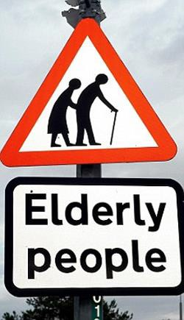








Distribution by Age Group
GSD FY15 Federal
Staff by Age Group
30
25
20
15
10
5
0
CIRES & CIRA employees
are ~ 15 years younger!

Slide 24
Workforce Diversity

Slide 25
ARL Base Funds ($K)
Notes:
Based on information from http://inflationdata.com/inflation/Inflation_Rate/HistoricalInflation.aspx, $1M in 2003 dollars = ~ $1.32M in 2015 dollars.
Adjusted ARL 2003 base funding was approximately equal to $6M in 2015 dollars.

Slide 26
FY 15 ARL Base Funding By Program

Slide 27
Notes:
FY 11 Base - Includes $600K as permanent instead of transfer
FY 13 Base - Includes $280K Health of the Atmosphere as permanent
FY 13 Other NOAA - Includes $1,876K Sandy Supplement
FY 14 Base - Includes $125K IT as permanent

Slide 28
ARL Expenditures
FY 11 Total $14M
FY 15 Total $14M

Slide 29
Financial Partnerships
ARL

Slide 30
Facilities (FY15)
Facility | Name | Location | Status | Square Footage | % of Total Owned or Rented by ARL
ATDD | Atmospheric Turbulence and Diffusion Division | Oak Ridge, TN | Owned by ARL | 16,573 | 42%
HQ | Headquarters | College Park, MD | Rented (GSA managed) | 8,937 | 23%
FRD | Field Research Division | Idaho Falls, ID | Rented (GSA managed) | 13,681 | 35%
SORD | Special Operations and Research Division | Las Vegas, NV | Owned by DOE | 2,385 | ----
Notes:
ATTD:
The main building is an old (circa 1940s) frame building.
The "Annex" is an ancient "temporary" structure.
The main building and Annex are poorly insulated and the Annex badly needs to be replaced because of a leaky roof. These issues were address in 2016 via (scheduled) demolition of the Annex and repairs & new offices in other buildings.
There are additional storage and utility buildings which are in good condition.
Local development encroaching on the formerly isolated ATDD facility is making us vulnerable to theft and vandalism.

Slide 31
Outline
ARL Overview
Relevance
History
Organization
Research Areas
To DOC, NOAA, OAR
To Decision-makers
To Stakeholders
Tech Transfer
Staff and Funding
Performance
Workforce
Program Funding
Facilities
Strategic Accomplishments
Critical Alliances
Quality
Opportunities and Challenges
Awards
Service
Publications
Priorities
2011 Review
Program for the Next Two Days

Slide 32
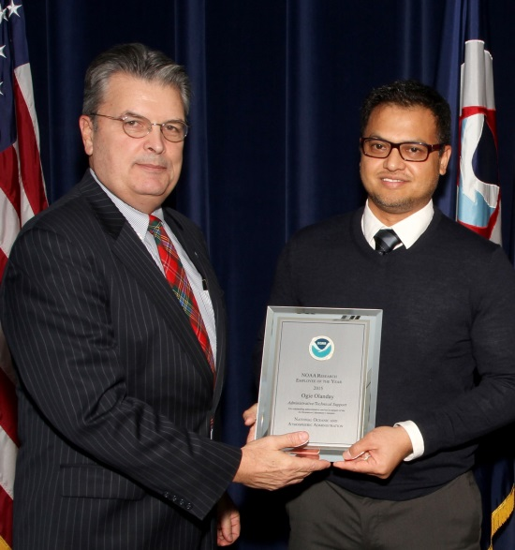
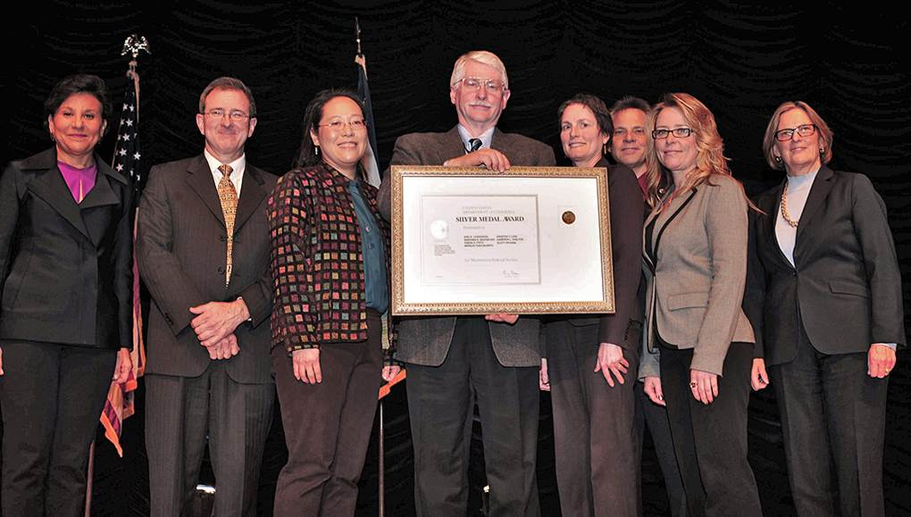
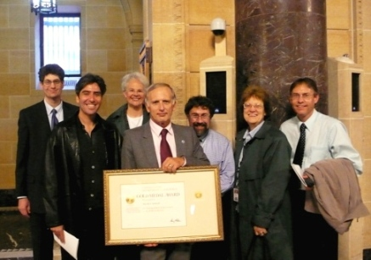
Evaluation Criterion: Quality
A measure of the novelty, soundness, accuracy, and reproducibility of a specific body of research
Refers to the merit of Research and Development (R&D) within the scientific community

Slide 33




Quality: DOC, NOAA, and Other Awards
Science
2016 NOAA/OAR Distinguished Career Award – Roland Draxler for significantly improving U.S. and international capabilities to respond to airborne hazards, including radionuclides, chemicals, and volcanic ash.
2015 American Nuclear Society Certificate of Appreciation – Kirk Clawson and Walt Schalk in recognition of their support in the development of ANSI/ANS-3.11-2015 Determining Meteorological Information at Nuclear Facilities.
2014 NOAA Administrator’s Award – Glenn Rolph, Roland Draxler, and Brad Reese for major advances in toxic gas dispersion model forecasting capabilities for the Nation to better protect human life and property.
2014 NOAA/OAR Employee of the Year Award – Pius Lee for his superior sustained performance leading ARL’s Air Quality Forecasting Team.
2013 DOC Bronze Medal – Roland Draxler, Steve Fine, Richard Eckman, Barbara Stunder, Glenn Rolph for their outstanding response to the 2011 Fukushima Nuclear Power Plant disaster.
2011 NOAA/OAR Employee of the Year Award – Roland Draxler for his outstanding scientific contributions in the NOAA responses to the Deepwater Horizon oil spill (2010), the volcanic eruption of Eyjafjallajokull in Iceland (2010), and the Fukushima nuclear incident (2011).
2011 EPA Science and Technology Achievement Award, Level II – Daniel Tong for his work on aerosol formation from volcanic emissions.
Notes:
The Department of Commerce Bronze Medal is the highest honor award that the Under Secretary of Commerce for Oceans and Atmosphere may bestow. Winners are recognized annually at a formal ceremony held in the Washington Metropolitan area. The medals are awarded to individuals, groups (or teams), and organizations.
Science
Roland Draxler received an OAR Employee of The Year Award 2011 for his outstanding scientific contributions in the NOAA responses to the Deepwater Horizon oil spill (beginning April, 2010), the volcanic eruption of Eyjafjallajokull in Iceland (in April-May, 2010), and the Fukushima-Daiichi, Japan, nuclear power plant incident (April, 2011).
Daniel Tong received a 2011 EPA Science and Technology Achievement Award (STAA), Level II.
Roland R. Draxler, Steve Fine, Richard Eckman, Barbara Stunder, and Glenn Rolph were awarded the DOC 2013 Bronze Medal for their outstanding response to the 2011 Fukushima Nuclear Power Plant disaster by providing important information about the expected spread of radiation in the air and the ocean.
Glenn Rolph, Roland Draxler, and Brad Reese received the 2014 NOAA Administrator's Award for major advances in toxic gas dispersion model forecasting capabilities for the Nation to better protect human life and property.
Pius Lee received the 2014 NOAA/OAR Employee of the Year Award for leadership.
Kirk Clawson received a Certificate of Appreciation (2015) from the American Nuclear Society, in recognition of his support in the development of ANSI/ANS-3.11-2015 'Determining Meteorological Information at Nuclear Facilities'."
Will Pendergrass received a NASA Letter of Commendation / NASA Mars Science laboratory Interagency Nuclear Safety Review Panel

Slide 34
Quality: DOC and NOAA Awards
Administrative, Outreach, and Service
2016 NOAA OAR EEO/Diversity Award – LaToya Myles for her work with the NOAA Educational Partnership Program serving as a presenter and student mentor.
2015 OAR Employee of the Year Award – Ogie Olanday for outstanding administrative service in support of the ARL mission.
2013 DOC Silver Medal – Winston Luke for Meritorious Federal Service for exceptional team achievements in creating the NOAA Center for Weather and Climate Prediction.
2012 DOC Bronze Medal Award – Dian Seidel for developing a NOAA administrative order on scientific integrity policy and accompanying handbook on scientific misconduct, as part of a NOAA-wide team award.
2010 NOAA/OAR Distinguished Career Award – Sharon Conger for long-term administrative achievement in advancing the goals and mission of NOAA.
ARL Science Review, June 21-23, 2016
34
Notes:
Administration, Outreach, and Service
Sharon Conger received the NOAA Distinguished Career Award 2010
Dian Seidel received a 2012 Department of Commerce Bronze Medal "for developing a NOAA administrative order on scientific integrity policy and accompanying handbook on scientific misconduct"
Winston Luke received the Department of Commerce 2013 Silver Medal Award for Meritorious Federal Service for exceptional team achievements in creating the NOAA Center for Weather and Climate Prediction (NCWCP), a state-of-the-art facility that enhances NOAA’s ability to meet global atmospheric challenges.
Ogie Olanday was awarded with an OAR Employee of the Year Award (2015). The award recognizes OAR employees who have made outstanding contributions to promote excellence in the operations or programs of NOAA Research. Ogie was awarded for outstanding administrative service in support of the ARL mission.
LaToya Myles received the NOAA OAR EEO/Diversity Award for Exemplary Service, 2016 for her work with the NOAA Educational Partnership Program (EPP) serving as a presenter and student mentor. She also participates in numerous outreach activities and presentations for ARL targeting women and minorities.

Slide 35
Quality: Service
NOAA Boards & Committees
  Volcanic Ash Working Group
  Council of NOAA Fellows
  Ecosystem Research Committee
  Library Advisory Council
Federal, Interagency, & State Committees
  National Atmos. Deposition Program
  DOE Monitoring & Surveillance Comm.
  Interagency Nuclear Safety Review Panel
International Research Organizations
  World Meteorological Organization
  Int’l Air Quality Forecasting Research
  US-Canada Air Quality Committee
  International Joint Commission
  Comm. for Environ. Cooperation (NAFTA)
Training courses
  HYSPLIT dispersion modeling
  Mercury modeling
Service to Professional Societies and Journals
  American Meteorological Society
  American Geophysical Union
  Reviewers for many peer reviewed journals
  Editorial Board: Boundary Layer Meteorology
  Editorial Board: Agricultural & Forest Met.
  Guest editors for various special journal issues
Service to Universities
  PhD Committees
  Personnel Management (Oak Ridge Associated Univ.)
  Mentors, e.g., NOAA Ed. Partnership Program
Notes:
(See the Science, Service, and Leadership section of the Supporting Documents section of the ARL review web page)

Slide 36
Quality: Peer-Reviewed Publications
2.4% of ARL’s publications are in the top 1% of articles in their field
(i.e., are Highly Cited Papers per Web of Science)
Notes:
2.4% as Highly Cited Papers comes from analysis of 972 ARL publications published from 1995-2015, carried out by Sarah Davis, NOAA Central Library, May 2016. The analysis used data from Thomas Reuters Web of Science (WoS), including the WoS “Highly Cited Paper” designations. Of the 972 articles analyzed, 23 were considered Highly Cited Papers (2.4%).

Slide 37
Researcher | Web of Science |  |  | Google Scholar
 | Publications | Citations | H-Index | Publications | Citations
Tilden Meyers | 132 | 12,447 | 52 | 110 | 19,316
Dian Seidel* | 111 | 5,122 | 36 | - | -
Roland Draxler* | 86 | 1,744 | 24 | - | -
Winston Luke | 49 | 1,493 | 22 | 57 | 1,884
Xinrong Ren | 50 | 1,765 | 22 | 63 | 2,482
Rick Saylor | 39 | 1,358 | 19 | 45 | 2,133
Julian Wang | 51 | 14,777 | 17 | 54 | 24,195
Praveena Krishnan | 25 | 597 | 17 | 27 | 788
Tianfeng Chai | 41 | 768 | 17 | 55 | 1,449
Rick Artz | 39 | 697 | 16 | 52 | 1,837
Melissa Free* | 30 | 942 | 15 | - | -
Steve Brooks# | 24 | 864 | 15 | - | -
Ariel Stein | 49 | 508 | 15 | 54 | 857
Barbara Stunder | 21 | 525 | 14 | 35 | 1,313
Pius Lee | 37 | 588 | 14 | 50 | 1,060
Mark Cohen | 23 | 714 | 13 | 29 | 1,106
Daniel Tong | 33 | 545 | 12 | 43 | 952
Kirk Clawson | 26 | 600 | 12 | 36 | 1,137
Dennis Finn | 20 | 326 | 10 | 19 | 577
Ron Dobosy | 24 | 315 | 10 | 36 | 453
* retired
# left ARL

Slide 38
Quality: Peer-Reviewed Publications
2010-2015

Slide 39
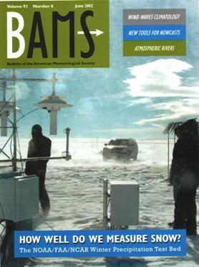
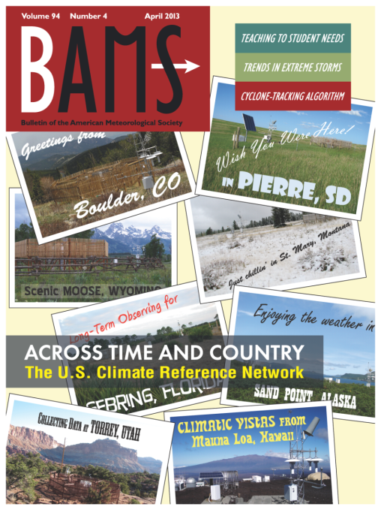
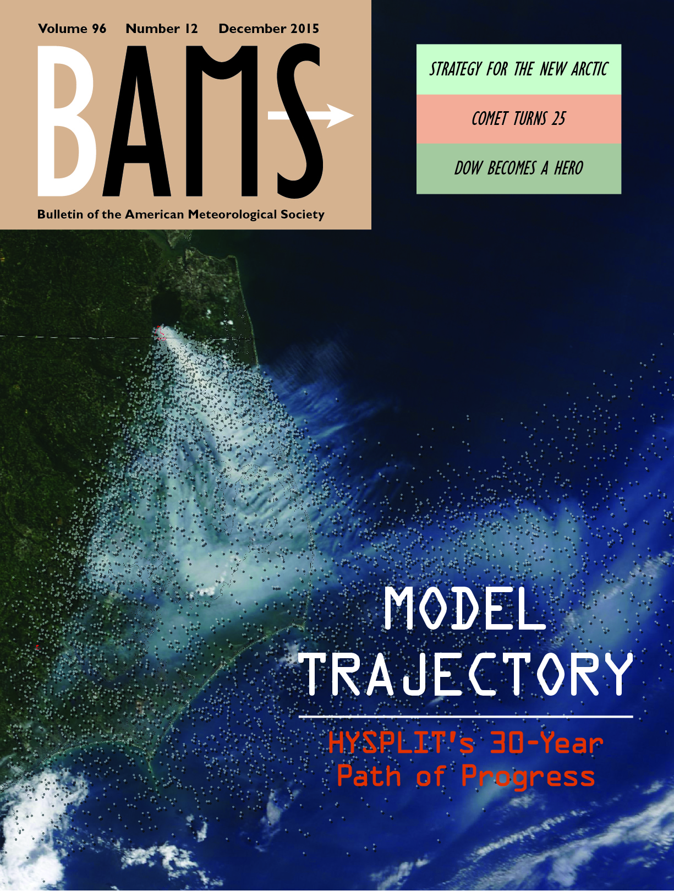
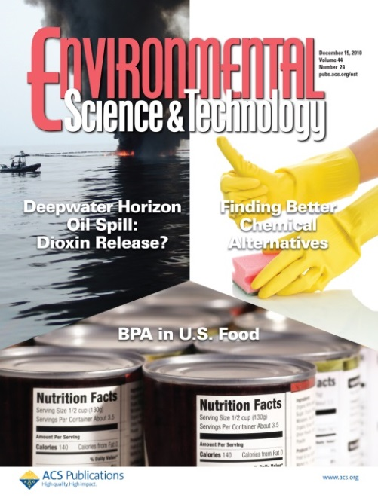
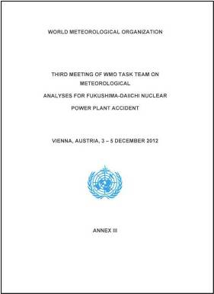
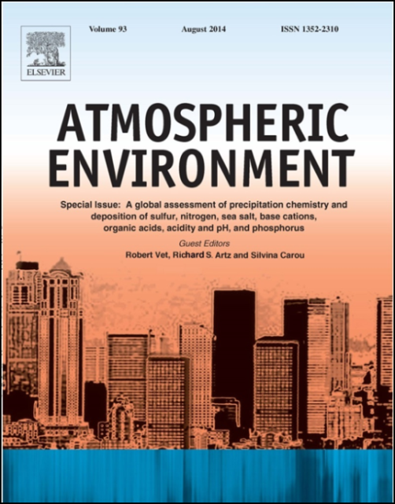

Quality: Special Publications (2010-2015)

Slide 40
Outline
ARL Overview
Relevance
History
Organization
Research Areas
To DOC, NOAA, OAR
To Decision-makers
To Stakeholders
Tech Transfer
Staff and Funding
Performance
Workforce
Program Funding
Facilities
Strategic Accomplishments
Critical Alliances
Quality
Opportunities and Challenges
Awards
Service
Publications
Priorities
2011 Review
Program for the Next Two Days

Slide 41
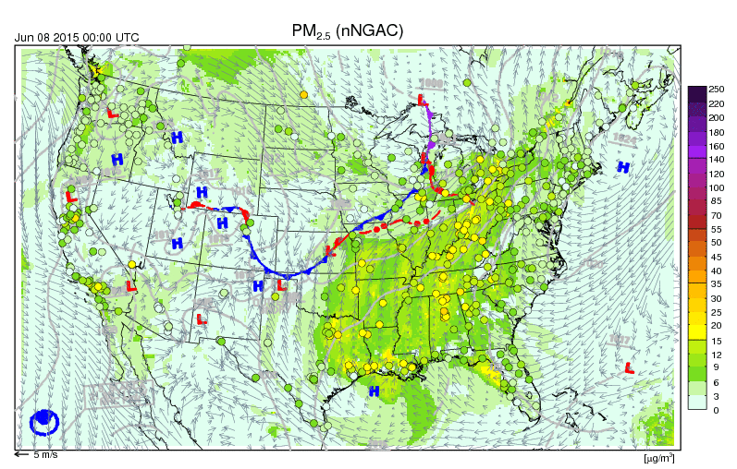
Evaluation Criterion: Relevance
A measure of how well a specific body of research supports NOAA’s mission and the needs of users and the broader society
Primarily refers to value of R&D to users beyond the scientific community
Includes not only hypothetical value, but actual impact

Slide 42
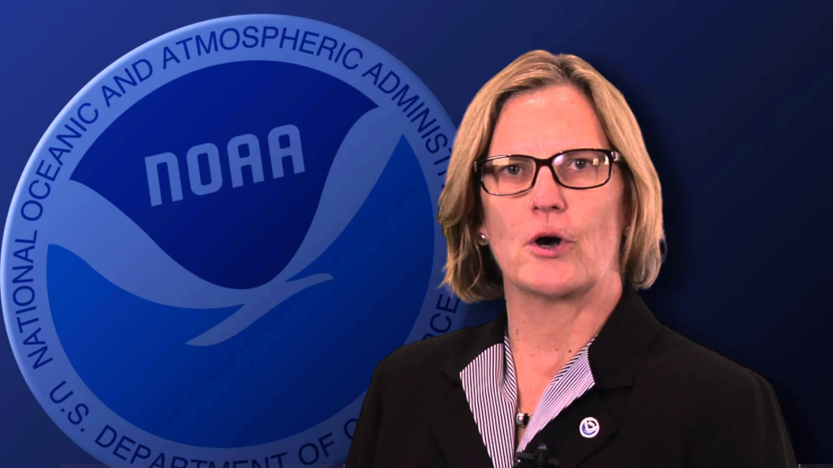
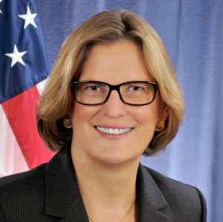
NOAA Priorities
Provide information & services to make communities more resilient
Evolve NOAA’s National Weather Service
Invest in observational infrastructure
Achieve organizational excellence
NOAA Administrator
Dr. Kathryn D. Sullivan

Slide 43
Relevance: NOAA’s Strategic Plan
1: primary partner
2: contributing partner
GOAL | OBJECTIVE
CLIMATE ADAPTATION and MITIGATION | Assessments of Current and Future States of the Climate System that Identify Potential Impacts and Inform Science, Service, and Stewardship Decisions
 | A Climate-Literate Public that Understands its Vulnerabilities to a Changing Climate and Makes Informed Decisions
WEATHER-READY NATION | Reduced Loss of Life and Disruption from High-impact Events
 | Improved Transportation Efficiency and Safety
 | Healthy People and Communities by Improving Air and Water Quality Services
 | A More Productive and Efficient Economy Through Environmental Information Relevant to Key Sectors of the U.S. Economy
SCIENCE & TECHNOLOGY ENTERPRISE | A Holistic Understanding of the Earth System Through Research
 | Accurate and Reliable Data from Sustained and Integrated Earth Observing Systems
 | An Integrated Environmental Modeling System
ENGAGEMENT ENTERPRISE | An Engaged and Educated Public with an Improved Capacity to Make Scientifically Informed Environmental Decisions
 | Integrated Services Meeting the Evolving Demands of Regional Stakeholders
 | Full and Effective Use of International Partnerships and Policy Leadership to Achieve NOAA’s Mission Objectives
ORGANIZATION & ADMINISTRATION ENTERPRISE | Diverse and Constantly Evolving Capabilities in NOAA's Workforce
 | A Modern IT Infrastructure for a Scientific Enterprise
ARL
1
2
1
2
1
1
1
1
1
1
1
1
2
2

Slide 44
OAR’s Strategic Plan
Relevant ARL Activity
WMO International Solid Precipitation Intercomparison (SPICE)
HYSPLIT-WRF inline & dispersion ensembles
Assessments (e.g., GLRI Hg Reports, WMO/GAW)
Boundary Layer Characterization Expt’s
Observations & Data
Models & Experiments
Studies & Assessments
Research
Saylor ACCESS model
Boundary Layer profiling with sUAS
Instrumenting the Coyote aircraft for hurricane research
Predictions & Projections
Emerging Technologies
Development
Extension & Outreach
Technology Transfer
READY System
Numerous HYSPLIT Products
Numerous CMAQ Products
Transitions

Slide 45
Research to Operations/Applications
Technology Readiness Level (TRL)
Broadly Relevant to NOAA Mission
Basic principles have been observed and reported
Technology concept and/or application have been formulated
Analytical and experimental critical function and/or characteristic proof-of-concept
Component/subsystem validation in laboratory environment
System/subsystem/component validation in relevant environment
System/subsystem model or prototyping demonstration in a relevant end-to-end environment
System prototyping demonstration in an operational environment
Actual system completed and "mission qualified" through test and demo in operational environment
Actual system "mission proven" through successful mission operations
Strictly speaking, there is no TRL “10,” however, data on maturity were collected this way for this exercise to mean “operational.”
1
RESEARCH
TRLs 1-2
2
3
DEVELOP
TRLs 3-5
4
5
DEMONSTRATE
TRLs 6-8
6
7
8
DEPLOY
TRL 9
9
“10”
Tailored to Requirements
Notes:
Adapted from Director’s talk for GLERL 2016 Review
How do we measure how well ARL is meeting the needs of users and broader society?
One way is by how much of our research is transitioned to operations, applications or users - R2O, R2A or R2U - for shorthand, "R2X". Further, we track the maturity of this transition process via Technical Readiness Levels, or TRLs.
A product moves through the transition funnel beginning with basic research, progressing to development, demonstration and finally deployment.
The number of projects at the various TRLs is one indication that ARL is meeting the needs of users and society.
Definitions of R2X:
R2X
“Application of the best available science and technology is essential to meeting the NOAA mission. This demands an operations enterprise that is able to quickly recognize and apply significant new research products and methods; a research and development enterprise focused on the ultimate application of emerging science and technology to user needs; and a formalized management structure that ensures that both the research and development enterprise encourage and support the transfer of research to operational status or information services to meet mission responsibilities.” (NAO 216-105: Policy on Transition of Research to Application)
Research to Operations (R2O)
R2O is the pathway by which fundamental research is developed into a useful tool or product that is run regularly and automatically. These tools and products provide routine real time and forecast guidance for application and use by the public.
Research to Application (R2A)
R2A is the pathway by which information from fundamental research is transferred to decision-makers or other end users in a non-operational framework.

Slide 46
Examples of Recent Air Chemistry and Dispersion Model Products Transitioned to NWS
TRL 9
Date | Transition
2012 – Jan | Dust predictions for CONUS using HYSPLIT
2012 – June | Mobile emission update using projections for 2012 for CMAQ ozone predictions
2014 – Sept | Comprehensive Test Ban Treaty Organization (CTBTO) system based on HYSPLIT
2015 – Jan | Updated CMAQ system with CB05 mechanism for ozone predictions, providing developmental PM 2.5 predictions from the same system
2016 – Feb | First public distribution of PM2.5 predictions using updated CMAQ system linked with global dust predictions (NGAC) at 35 levels with bias correction for PM2.5
2016 – in progress | Improving wildfire contributions and updating to CMAQ v5.0.2
Notes:
Note: Barbara Stunder’s poster lists the 12 step process to move products into NWS operations. This is not trivial!

Slide 47
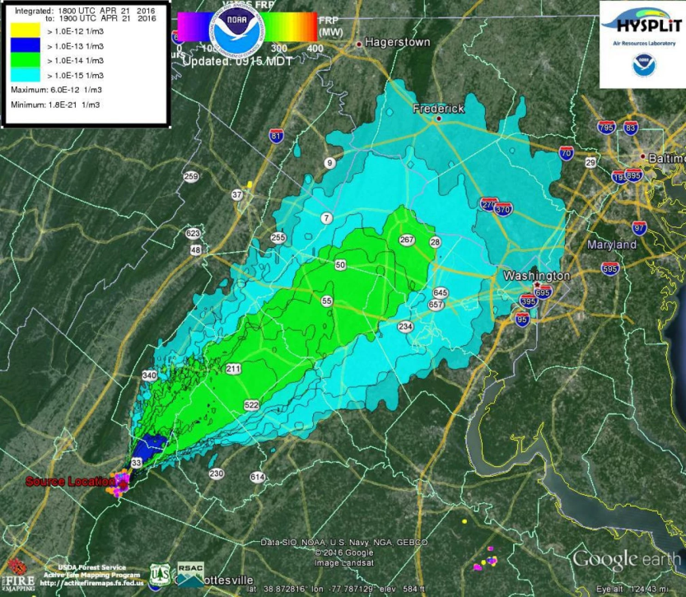
HYSPLIT Simulations
TRLs 1-9
3673 registered users (current)
Widespread “unregistered” use
Monthly On-Line HYSPLIT
Simulations on READY (1000’s)
66,000 average
per month
(May 09 – Feb 16)
Monthly HYSPLIT Simulations by NOAA Weather Forecast Offices (WFOs)

Slide 48
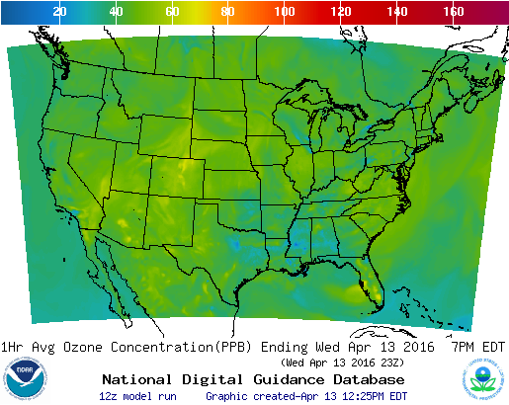
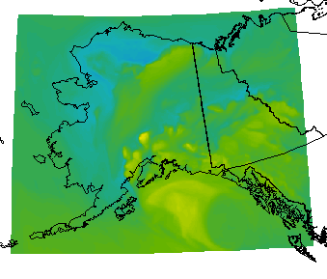
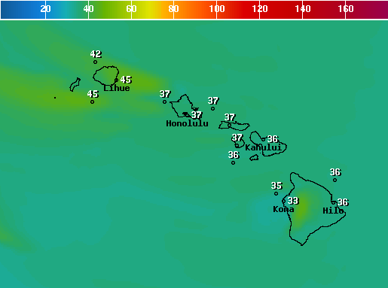
National Air Quality Forecast Capability (NAQFC) for O₃ and PM_{2.5}
TRLs 1-9
Meteorological Model
North American Model (NAM) - 12 km
Emission projection
Area sources use US EPA 2011 NEI v1
Point sources use biennial CEM and latest DoE energy consumption outlook
Mobile sources use US EPA 2012 Cross State Air Pollution Rule MOBILE6 output scaled by EPA AQS monitored trends
BEIS3 v3.14 Biogenic Emissions
Intermittent sources: dust and wildfire
Air Quality chemistry-transport Model
US EPA CMAQ v4.6 – 12 km
NAQFC 48 h forecast online
O₃ for CONUS, AK and HI
PM_{2.5} for CONUS
Surface O₃ concentration in ppb
Alaska
Hawaii
airquality.weather.gov
Notes:
The NOAA National Weather Service (NWS) National Air Quality Forecast Capability (NAQFC) is a modeling system designed to provide air quality forecast guidance for the U. S. The NAQFC was established in 2004 to provide ground-level ozone (and eventually PM_{2.5}) forecasts for the conterminous U. S. (CONUS). The NAQFC utilizes the NWS North American Mesoscale (NAM) meteorological model run of the Non-hydrostatic Mesoscale Model (NMM) core to provide forecast meteorological fields. These data drive the U. S. Environmental Protection Agency (U.S. EPA) Community Multiscale Air Quality (CMAQ) version 4.6 modeling system which produces 48-hr forecast fields of ground-layer ozone and PM2.5 mixing ratios. The CMAQ portion of the NAQFC system uses 12 km horizontal grid spacing and 35 vertical layers from the surface to 100 hPa. Emissions inputs to CMAQ use the latest available U.S. EPA National Emissions Inventory (NEI) with electric generating units (EGUs) updated with Continuous Emission Monitoring (CEM) data and projections to the current forecast year using data from the Department of Energy’s Annual Energy Outlook.

Slide 49
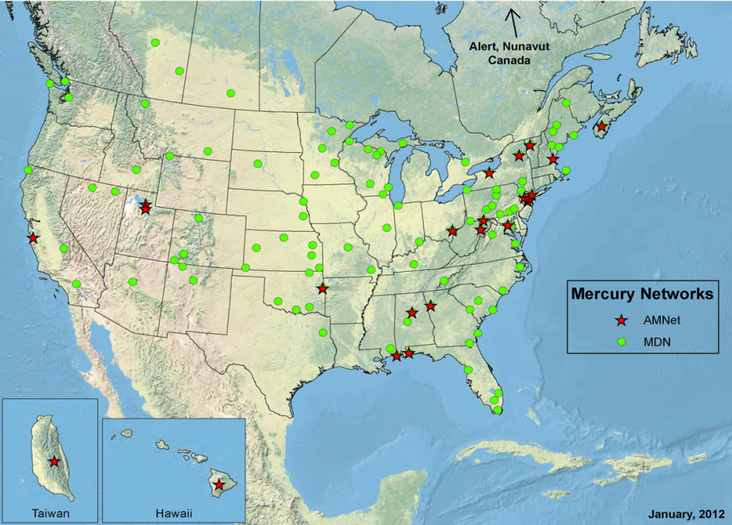
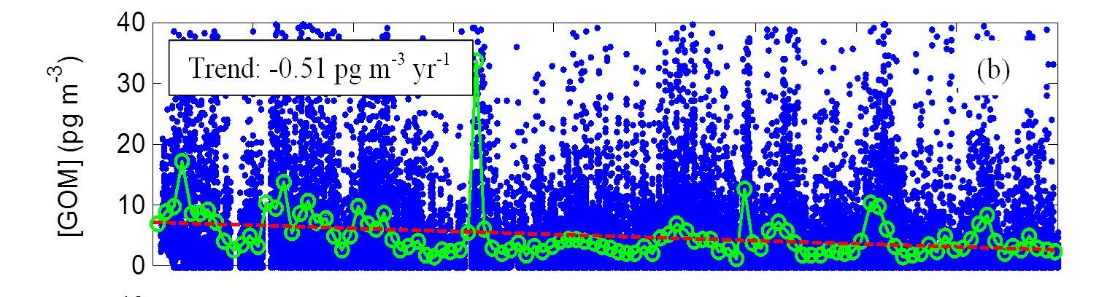
Atmospheric Mercury
TRLs 1-9
Measurements:
Three long-term AMNet sites
Method evaluation and development
Process studies and field intensives
Data for model evaluation
Modeling:
Back-trajectory based analysis
Fate/transport modeling using HYSPLIT-Hg
Policy-relevant source-attribution analysis for atmospheric Hg deposition (e.g., Great Lakes)
Atmospheric Mercury
Deposition (µg m⁻²-yr⁻¹)
Beltsville
Mauna Loa
Grand Bay
Beltsville Gaseous Oxidized Mercury
2007
2008
2009
2010
2011
2012
2013
2014
2015
2016

Slide 50
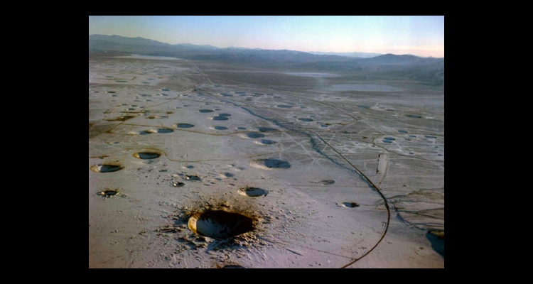
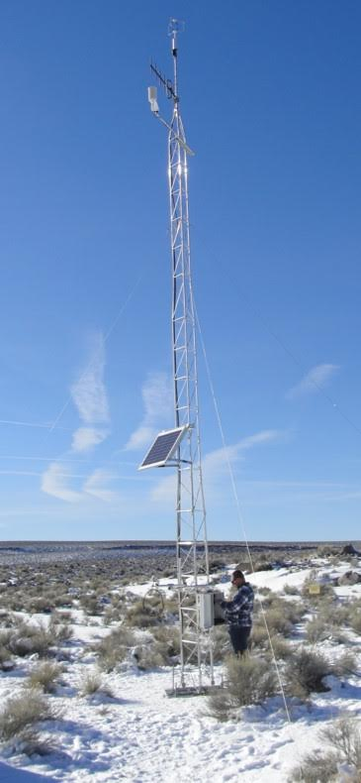
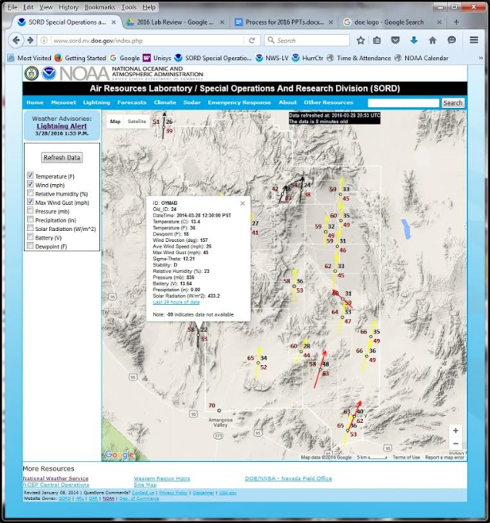
Forecasting at Department of Energy
Nuclear Facilities in Idaho and Nevada
TRL 9
Meteorological measurements
Mesoscale modeling and forecasts
Atmospheric dispersion modeling in support of chemical, radiological and other emergencies
Notes:
SORD's capabilities are in meteorology and atmospheric transport and dispersion. Its work is used by decision-makers, primarily at the Nevada National Security Site (NNSS), to protect human health, to reduce weather related injuries and fatalities, and to keep people safe during disasters. By providing key atmospheric information, necessary to protect lives and property, SORD has supported essential work at the NNSS to improve national security. Local weather observations and predictions protect NNSS staff and facilities —especially for activities dealing with radioactive, explosive, or toxic materials. SORD weather observations and modeling also support improved weather predictions and warnings for the entire region. Predictions of the atmospheric transport and dispersion of hazardous materials and air pollution provide essential information for mitigating risks for NNSS staff, first responders, and the public.
FRD was created in 1948 for the purpose of describing the meteorology and climatology surrounding the area of the National Reactor Testing Station, now known as the Department of Energy's Idaho National Laboratory (INL). In a cooperative agreement between NOAA and the U.S. Department of Energy, FRD's capabilities are used to support the INL with meteorological measurements, mesoscale modeling and forecasts, and atmospheric dispersion modeling in the event of an accidental chemical or radiological emergency at the INL.

Slide 51
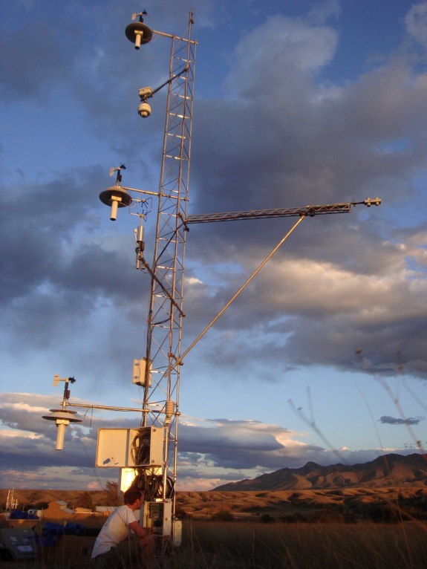
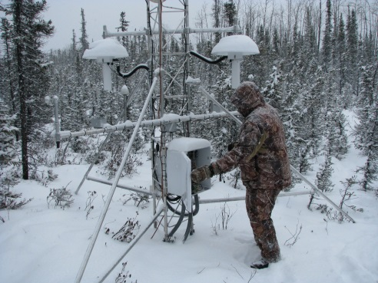
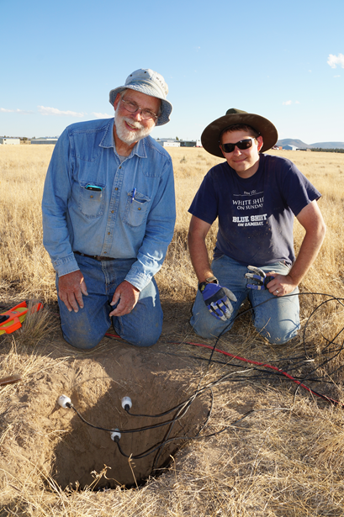
Climate Observations
Trends
Feedbacks
Improved predictions of water resources
Climate Reference Network
Observing climate trends in the US
Surface Energy Balance Network
Model evaluation & extreme climate events
National Water Center
Predictions for a water-resilient nation
TRL 8
TRL 6
TRL 3
Notes:
CRN is used to observe the climate trends for the U.S. including Alaska. The vision of the USCRN program is to provide a continuous series of climate observations for monitoring trends in the nation's climate and supporting climate-impact research.
SEBN evaluates Land Surface models and observes land surface response to extreme climate events. ARL cooperates with NOAA's Earth System Research Laboratory to measure fluxes of energy, water, and carbon dioxide at the air-land interface to improve understanding of the Earth's surface energy balance. It is this balance that drives weather, climate, and ocean circulation, and therefore must be accurately reproduced in climate models in order for decision-makers to make sound choices regarding environmental and economic policy. Accurate understanding and simulation of this balance is also important for weather prediction, including short-term and seasonal predictions of water resources.
SEBN and CRN networks being evaluated for testing products from the NOAA National Water Center (NWC) and WRF-HYDRO model. The NWC is a geographically distributed organization which includes elements in Maryland, Minnesota and Alabama. The NWC collaboratively researches, develops and delivers state-of-the-science national hydrologic analyses, forecast information, data, decision-support services and guidance to support and inform essential emergency services and water management decisions. In partnership with NWS national, regional, and local offices, the NWC coordinates, integrates and supports consistent water prediction activities from global to local levels.
The bottom photograph shows ARL staff installing soil temperature and moisture probes as part of WFIP2. Soil properties are one of the observations collected at surface energy balance stations.

Slide 52
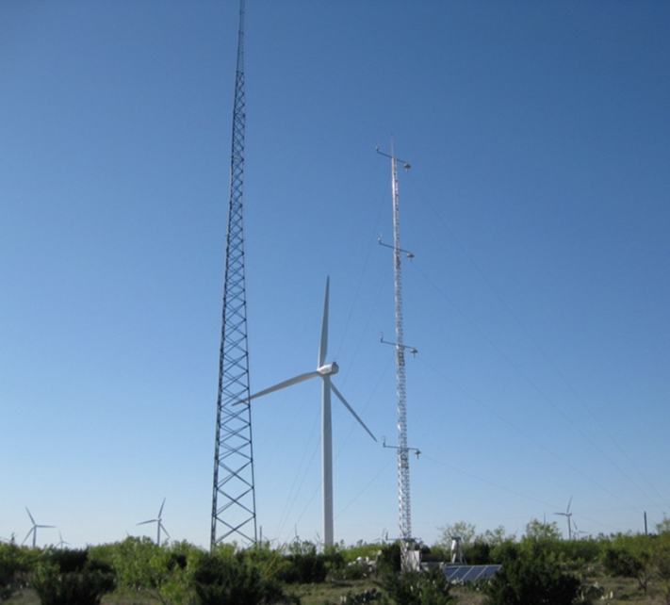
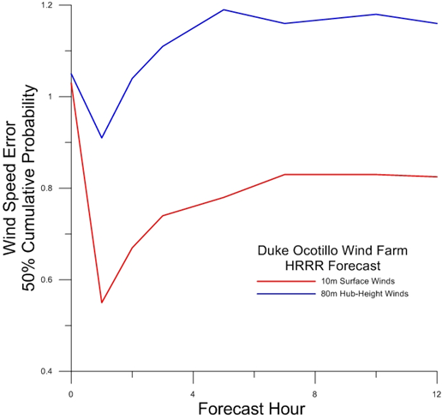
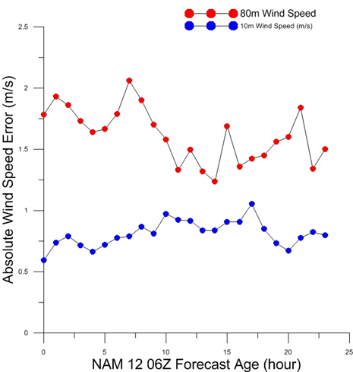
Wind Energy Research
TRL 3
Improving wind forecasts at typical turbine heights
Accurate forecasts critical for electrical load balancing & efficient wind-energy integration
Model parameterizations of air-surface exchange & boundary layer critical at hub heights
Many wind farms are located in complex terrain
Research directly benefits NOAA’s operational forecasting & ARL’s dispersion activities
Notes:
A wind farm in eastern Oregon is the primary study area for the Wind Forecast Improvement Project phase 2 (WFIP2).
------
Understanding the risks associated with wind forecasting
As an outcome of discussions between Duke Energy and NOAA/ATDD following the 2009 AMS Summer Community Meeting , August, 2009 in Norman Oklahoma, ARL and Duke Energy Generation (Duke) signed a Cooperative Research and Development Agreement (CRADA) which allowed ARL/ATDD to conduct atmospheric boundary layer (ABL) research using Duke Energy renewable energy sites as research testbeds. The proposed ARL research was directed towards evaluation of WRF and NAM model flux-gradient wind profile algorithms based on Monin-Obukhov (M-O) similarity theory to provide an understanding of the risk associated with forecasting of hub-height winds. Duke Energy has provided the evaluation of the proposed site-specific algorithms within the scope of Duke’s current renewable energy load management practices and provided an assessment of the economic impact of any modified forecasts.
What is the probability of over/under predicting hub-height winds. From our industry partner: What are the costs associated with over/under prediction? What is the risk associated with using the NAM12 forecast? with the NAM4 forecast? With the HRRR forecast?
The outcome of the cooperative research effort has been the development of a site-specific probabilistic forecast based on NCEP’s NAM12 forecast product.

Slide 53
Relevance: Commercial & Government Formal Agreements
CRADAs (Cooperative Research And Development Agreements)
  Duke Energy
  Catch the Wind
  Belfort Instruments
Memorandums of Understanding (MOUs)/Interagency Agreements (IAGs)
  Long-term IAGs between NOAA and the Department of Energy in Idaho and Nevada
  MOU between NOAA and the Federal Aviation Administration (1988)
  IAG between NOAA and the US Geological Survey (1993)
  MOA between US Department of State and NOAA in support of CTBTO(2012)
  MOU with the US Nuclear Regulatory Commissions (2015)
  Several IAGs with US Environmental Protection Agency (2002-2015; 2016?)
  Five FAA Certificates of Authorization for flying a sUAS in support of NSSL’s VORTEX-SE program
Other Major Agreements
  NOAA provision of ash forecasts to the International Civil Aviation Organization Network of Volcanic Ash Advisory Centers (VAACs)
  NOAA provision of dispersion model support to the Regional Specialized Meteorological Centers (RSMCs) coordinated by the World Meteorological Organization for nuclear incidents
Notes:
1988 MOU with FAA: ARL provides volcanic ash model forecasts. NESDIS provides satellite analysis.
1993 IAG: When a volcano erupts or threatens to erupt, brings USGS into the loop with NOAA and FAA
2012 IAG with DOS: CTBTO support. NCEP runs HYSPLIT for backtracking exercises/incidents
2015 MOU with NRC: NRC is putting HYSPLIT in their model in a research mode
2002 IAG with USEPA: Atmospheric mercury modeling (was transitioned into 2nd IAG immediately below)
2006 IAG with USEPA: Atmospheric mercury monitoring and modeling (ongoing)
IAG’s with USEPA as part of Great Lakes Restoration Initiative (GLRI): 2010, 2011, 2012, 2013, 2014, 2015
2016 IAG with USEPA: Understanding long range fate and transport issues associated with nuclear releases

Slide 54
Outline
ARL Overview
Relevance
History
Organization
Research Areas
To DOC, NOAA, OAR
To Decision-makers
To Stakeholders
Tech Transfer
Staff and Funding
Performance
Workforce
Program Funding
Facilities
Strategic Accomplishments
Critical Alliances
Quality
Opportunities and Challenges
Awards
Service
Publications
Priorities
2011 Review
Program for the Next Two Days

Slide 55
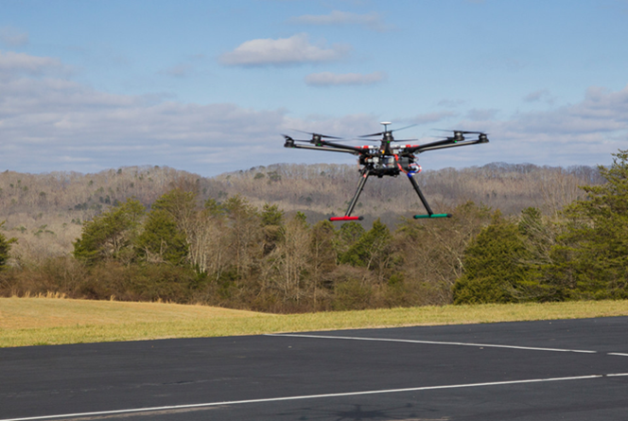
Evaluation Criterion: Performance
A measure of both effectiveness (the ability to achieve useful results) and efficiency (the ability to achieve quality, relevance, and effectiveness in timely fashion and with little waste)
Refers to the effectiveness and efficiency with which R&D activities are organized, directed, funded, and executed

Slide 56
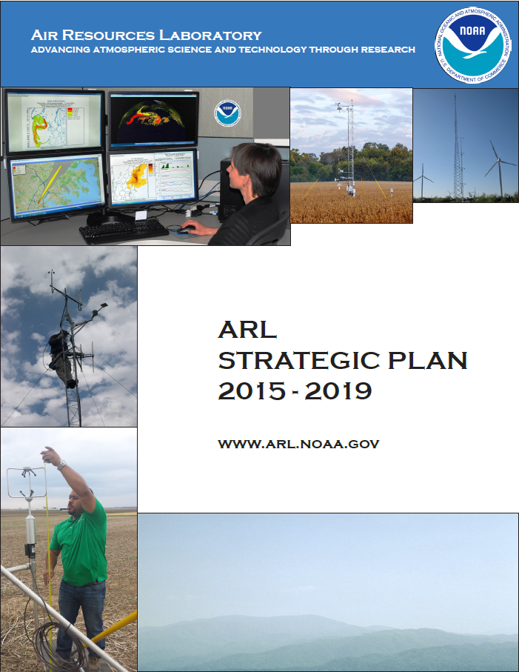
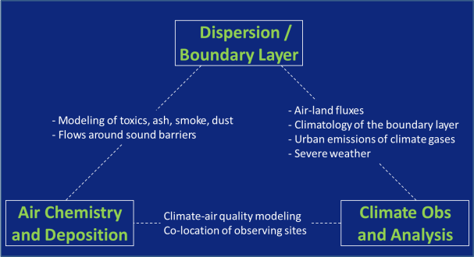
Performance: Strategic Accomplishments
Strategic Direction
  ARL’s Strategic Plan 2015-2019: a commitment to integrated fate and transport atmospheric research
Improved Program Integration
Leveraging NCWCP Opportunities
  NCEP
  NESDIS
  Cooperative Institutes

Slide 57
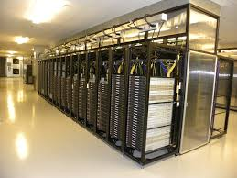
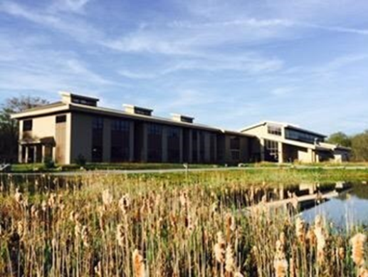

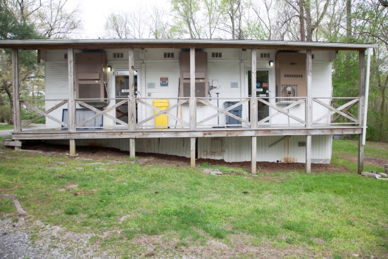
Performance: Technical Strategic Accomplishments
Research Transition Acceleration Program
  Determine the relative merits of different
  approaches to ensemble generation including
  multi-model, stochastic physics, and multi-physics
IT Transformation
  Dramatically improved cybersecurity
  Developed Common Information Technology Services Operations and Maintenance Agreement with NCEP
  Continuing need for HPCC resources
Improved Infrastructure
  Disposed of Canaan Valley Institute
  building (27,000 ft²); grounds (3000+ acres)
  Renewed IAGs with DOE and refreshed
  mesonet systems at FRD and SORD
  ATDD “Annex” scheduled for demolition
Notes:
FY17 RTAP (Research to Transition Acceleration Plans) Proposals - special funding to accelerate transition .
Of the 120, 10 were selected NOAA-wide, ARL received one.
From Ariel Stein’s RTAP Proposal:
The research activities described in this proposal directly support NOAA priorities as follows:
• NGSP: Weather Ready Nation/ Reduced loss of life, property, and disruption from high-impact events
• Five-Year R&D Plan: Weather Ready Nation/ Improved predictive guidance/ Determine the relative merits of different approaches to ensemble generation including multi-model, stochastic physics, and multi-physics.
• R2X Announcement of Opportunity:
o Decision Support Including Social and Behavioral Science: Introduce or improve predictive guidance and decision support tools
o Earth System Forecasting Improvement: Strengthen abilities to assess climate, weather, and non-climate/weather hazard related risks and impacts to communities and ecosystems
IT Transformation
Cybersecurity risk decreased as measured by annual Certification and Accreditation /Authorization and Accreditation reviews
CITS (Common IT support agreement with NCEP stabilizes costs and establishes processes for cooperation among tenants
Routinely replaced aging servers
Sought additional HPCC resources for large models

Slide 58
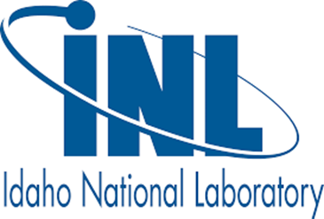













Performance: Critical Alliances
International
U.S. Federal Agencies
Other NOAA Line Offices
State Agencies
Academia
Municipalities
Tribes
Private Industry
Not-For-Profit Research

Slide 59
Outline
ARL Overview
Relevance
History
Organization
Research Areas
To DOC, NOAA, OAR
To Decision-makers
To Stakeholders
Tech Transfer
Staff and Funding
Performance
Workforce
Program Funding
Facilities
Strategic Accomplishments
Critical Alliances
Quality
Opportunities and Challenges
Awards
Service
Publications
Priorities
2011 Review
Program for the Next Two Days

Slide 60
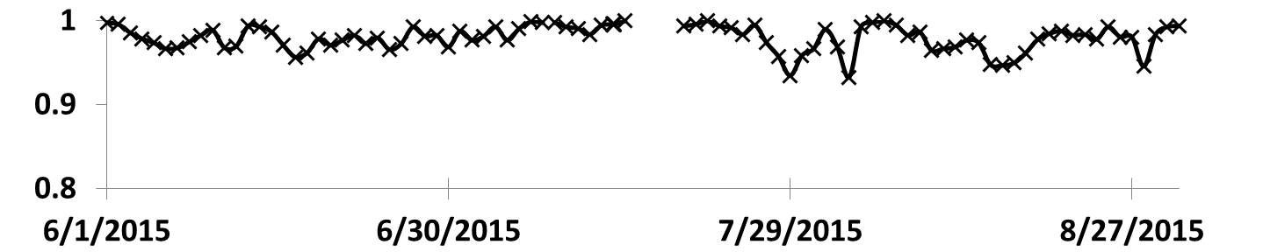
Opportunities and Challenges
ARL will be affected by various scientific, technological, social, and economic trends in the next 10 years:
Social: | Increased Federal retirements coupled with cumbersome hiring restrictions
Economic: | Flat budgets make it difficult to address emerging scientific challenges
Scientific/Technological: | Increased recognition of the importance of a holistic view of ecosystems, including the atmosphere
General: | Continued inability of base funds to keep pace with inflation will threaten long-term observations and scientific critical mass
Ozone Forecast for CONUS, Percent Correct, 2015

Slide 61
Opportunities and Challenges
Next, new high priorities:
  Continue increased focus on issues related to atmospheric boundary layer, e.g. influence of land surface on convection, low-level winds
  Develop linkages between ARL’s air quality, fate & transport, and climate models with the emerging global earth system modeling framework
Investment potential within existing base resources
  New investments will be very limited
  Current base resources are primarily applied to fixed expenses or long-term monitoring that we want to continue
Additional components needed to pursue these new priorities:
  Small unmanned aircraft systems (platforms, instrumentation, and/or flight support)
  Sufficient computer resources
Additional operations and management issues:
  Loss of ARL Director in March, 2016
  Pending retirements of key staff members
  Cumbersome hiring requirements

Slide 62
What Did the Reviewers Tell Us 2011?
Quality: The group as a whole does solid quality science and has a strong commitment to supporting other agencies and organizations with good service, application of the best methods and developing effective partnerships. The employees clearly pride themselves on doing high quality work and collecting the best data possible. The stakeholders who support NOAA research and data collection were overwhelmingly impressed with the work done for them by ARL, the professionalism of the employees, and the quality of the products.
Relevance: Overall the NOAA ARL consists of a highly competent group of researchers and support staff that perform an important role within the NOAA mission, including collecting observational data, developing data collection methods and modeling systems, and doing research on issues that are relevant to the atmosphere, ecosystems, and oceans. Their work is focused on highly relevant atmosphere-ocean issues that are important for the nation and internationally.
Preeminence: The indicators of preeminence are many including good publication track records in high quality journals (in spite of the many other obligations and deliverables) and development of widely used modeling programs and measurement methods, as well as awards, active memberships in prestigious organizations, service, and excellent collaboration with other agencies.

Slide 63
Responses to Last Review
There were several recommendations for greater ARL-wide integration of activities, and to increase in-person interaction. Changes made to address these comments include:
  Travel budgets were restricted so in-person meetings were reduced
  Communications were improved using GoToMeeting, VTC, etc
  Routine staff meetings were instituted at the division level
  All-hands meetings were routinely scheduled, principally for seminars
  Routine interaction was increased among senior staff, administrative staff, scientific staff
  Weekly updates and post quarterly reports are assembled
  Staff adjustments were made to address reduction in NAQFC support by NWS
  An ARL Strategic Plan was developed to assist planning
  Increased commitments were made to ensure that reimbursable funds support intended activities as well as NOAA priorities

Slide 64
Responses to Last Review (continued)
ARL should increase technician support
  IT support has been increased at HQ (and demands have risen as well)
  Technician support cannot be increased at field sites due to funding limitations
ARL should establish a Fellows program and provide resources to develop and lead integrated research development
  Resources present a serious constraint
  Good integration exists for most modeling programs
  Measurement programs lag for reasons associated with both funding and science requirements
ARL scientists should publish in high quality journals
  ARL limits lead author papers to high quality journals approved by senior staff
  Contributing author papers are published in the journal selected by the lead author

Slide 65
Responses to Last Review (continued)
ARL should grow its workforce with young scientists, including post docs
  ARL routinely hires young Cooperative Institute employees and strives to keep an NRC post doc in the office. Most of the new staff have been hired via CICS-MD, CICS-NC, or CIMMS.
  We continue to hire post docs and welcome visiting scientists. For 2016 we have five post docs and four visiting scientists who were not on staff in 2011.
Several recommendations concerned application of the WRF model
  ARL delivers most of its modeling products to NWS or DOE. The choice of modeling framework is rarely an option for a specific operational application. Most operational systems use the NMM core. Some research systems use ARW. We have strong capabilities with both.
  Operational applications tend to limit us to only pursue evolutionary changes in work with our operational partners using the NMM core. This can cause problems when seeking funding from NOAA Program Offices and from other federal partners because reviewers often view proposals based on operational tools as insufficiently novel and cutting edge.
  ARL is seeking increased integration with other OAR labs using both NMM and ARW cores.

Slide 66
Concluding Thoughts
ARL has successfully supported and enhanced investments for core scientific activities and associated staff since the 2011 review.
ARL activities have been pared down slightly to better focus on primary deliverables.
ARL base funding has not kept pace with inflation for more than two decades. However, reimbursable funding from other NOAA offices and other federal partners continues to provide important support for some core activities.
Loss of the ARL Director imperils future progress. Core ARL programs require protection and support.
ARL remains an applied science laboratory, transferring top quality products to its operational customers, as well as world-class science publications, data sets, and models to the public.

Slide 67
Outline
ARL Overview
Relevance
History
Organization
Research Areas
To DOC, NOAA, OAR
To Decision-makers
To Stakeholders
Tech Transfer
Staff and Funding
Performance
Workforce
Program Funding
Facilities
Strategic Accomplishments
Critical Alliances
Quality
Opportunities and Challenges
Awards
Service
Publications
Priorities
2011 Review
Program for the Next Two Days

Slide 68
Next Two Days: Overview
Tuesday
Science Presentations and Posters: Dispersion and Boundary Layer Science
Closed Reviewer Lunch with Federal Scientists: 2nd Floor NCWCP
All other attendees stay in this conference room
Stakeholder Session 1 and Reviewer Closed Session: 2nd Floor NCWCP
Wednesday
Science Presentations and Posters: Atmospheric Chemistry and Deposition, Climate
Closed Reviewer Lunch with CI/Contractor Staff: 2nd Floor NCWCP
All other attendees stay in this conference room
Stakeholder Session 2 and Reviewer Closed Session – 2nd Floor NCWCP
Thursday
Review Panel Only Meets with ARL Senior Staff
Closed Reviewer Session
Optional Tour of Lab

